Slide 1
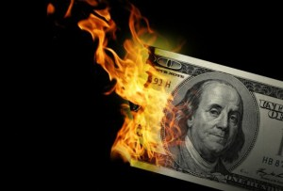
CS1951 L
Blockchains & Cryptocurrencies
Spring 2025
Lecture 18
Privacy Coins
Maurice Herlihy
Brown University

Slide 2
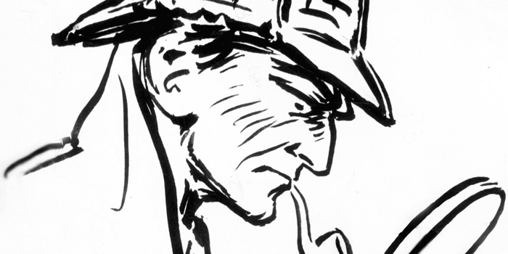
Unlinkability
It should be hard to link …
Different addresses of same party
Different transactions of same party
Payment sender to (ultimate) recipient

Slide 3
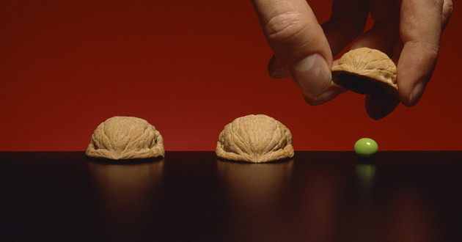
Anonymity Set
Set of transactions that …
The adversary cannot distinguish from yours

Slide 4


I can’t tell which is which!
Use intermediary to obfuscate ownership

Slide 5
What if we build a mixer into the blockchain itself?

Slide 6
Zero Knowledge Proofs
I know how to solve a puzzle …
I want to prove to you I know a solution
Without revealing that solution!

Slide 7
1
5
7
Sudoku
1
6
8
2
3
8
6
4
9 X 9 array of cards
9
4
5
6
7
Some face-up
4
7
8
3
7
3
2
6
4
Some face-down
4
8
1
9
Challenge:
Identify face-down!
1
7
2
8
5
3
7

Slide 8
1
5
7
Sudoku Rules
1
6
8
2
Each row has …
3
8
6
4
9
4
5
6
7
4
7
8
3
7
3
2
6
4
4
8
1
9
1
7
2
8
5
3
7

Slide 9
1
5
7
Sudoku Rules
1
6
8
2
Each row has …
3
7
5
8
6
2
9
4
1
9
4
5
6
7
Each digit once
4
7
8
3
7
3
2
6
4
4
8
1
9
1
7
2
8
5
3
7

Slide 10
1
5
7
Sudoku Rules
1
6
8
2
Each column
has …
3
8
6
4
9
4
5
6
7
4
7
8
3
7
3
2
6
4
4
8
1
9
1
7
2
8
5
3
7

Slide 11
2
1
5
7
Sudoku Rules
1
9
6
8
2
Each column
has …
3
7
8
6
4
9
8
4
5
6
7
6
4
7
8
3
Each digit once
7
3
2
6
4
4
8
1
9
1
7
2
8
5
3
7

Slide 12
1
5
7
Sudoku Rules
1
6
8
2
Each square
has …
3
8
6
4
9
4
5
6
7
4
7
8
3
7
3
2
6
4
4
8
1
9
1
7
2
8
5
3
7

Slide 13
1
5
9
7
Sudoku Rules
1
6
3
7
4
8
2
Each square
has …
3
8
6
2
4
9
4
5
6
7
4
7
8
3
Each digit once
7
3
2
6
4
4
8
1
9
1
7
2
8
5
3
7

Slide 14
1
5
7
Hi, I’m Victoria
(the verifier)
1
6
8
2
3
8
6
4
9
4
5
6
7
4
7
8
3
7
3
2
6
4
Hi, I’m Peter
(the prover)
4
8
1
9
1
7
2
8
5
3
7

Slide 15
I will pay you for a solution to this puzzle
1
5
7
1
6
8
2
3
8
6
4
9
4
5
6
7
4
7
8
3
7
3
2
6
4
I know a solution!
4
8
1
9
1
7
2
8
5
3
7

Slide 16
1
5
7
Show me, and I’ll pay
1
6
8
2
3
8
6
4
9
4
5
6
7
4
7
8
3
7
3
2
6
4
Pay me, and I’ll show
4
8
1
9
1
7
2
8
5
3
7

Slide 17
1
5
7
1
6
8
2
3
8
6
4
9
4
5
6
7
4
7
I will prove I know a solution without revealing anything about it !
8
3
7
3
2
6
4
4
8
1
9
1
7
2
8
5
3
7

Slide 18
Why should I believe you?
1
5
7
1
5
7
1
6
8
2
1
6
8
2
3
8
6
4
3
8
6
4
9
4
5
6
7
9
4
5
6
7
Here is my solution on a new set of cards
4
7
8
3
4
7
8
3
7
3
2
6
4
7
3
2
6
4
4
8
1
9
4
8
1
9
1
7
2
8
1
7
2
8
Challenge me!
5
3
7
5
3
7

Slide 19
I randomly challenge …
1
5
7
1
5
7
1
6
8
2
1
6
8
2
3
8
6
4
3
8
6
4
9
4
5
6
7
9
4
5
6
7
4
7
8
3
4
7
8
3
7
3
2
6
4
7
3
2
6
Pick rows, columns, or squares!
4
4
8
1
9
4
8
1
9
1
7
2
8
1
7
2
8
5
3
7
5
3
7

Slide 20
1
5
7
Rows!
1
5
7
1
6
8
2
1
6
8
2
3
8
6
4
3
8
6
4
9
4
5
6
7
9
4
5
6
7
4
7
8
3
4
7
8
3
7
3
2
6
4
Collect cards per-row
7
3
2
6
4
4
8
1
9
4
8
1
9
1
7
2
8
1
7
2
8
5
3
7
5
3
7

Slide 21
1
5
7
1
6
8
2
3
8
6
4
9
4
5
6
7
4
7
8
3
7
3
2
6
4
4
8
1
9
1
7
2
8
5
3
7

Slide 22
1
5
7
1
5
7
1
6
8
2
1
6
8
2
3
8
6
4
3
8
6
4
9
4
5
6
7
9
4
5
6
7
4
7
8
3
4
7
8
3
7
3
2
6
4
7
3
2
6
4
Shuffle each row
4
8
1
9
4
8
1
9
1
7
2
8
1
7
2
8
5
3
7
5
3
7

Slide 23
OMG! They’re all 1..9
1
5
7
6
7
8
9
1
6
8
2
6
7
8
9
3
8
6
4
6
7
8
9
9
4
5
6
7
6
7
9
But I learned nothing about the solution
8
4
7
8
3
6
7
8
9
7
3
2
6
4
6
7
8
9
Told you!
4
8
1
9
6
7
8
9
1
7
2
8
6
7
8
9
5
3
7
6
7
8
9

Slide 24
1
5
7
Rewind, Reload
1
5
7
1
6
8
2
1
6
8
2
3
8
6
4
3
8
6
4
9
4
5
6
7
9
4
5
6
7
4
7
8
3
4
I don’t actually know a solution, but I guess Victoria will challenge me on rows
7
8
3
7
3
2
6
4
7
3
2
6
4
4
8
1
9
4
8
1
9
1
7
2
8
1
7
2
8
5
3
7
5
3
7

Slide 25
1
5
7
2
3
4
1
5
6
8
7
9
1
6
8
2
1
2
6
3
4
5
8
2
7
3
8
6
4
3
1
2
8
6
5
7
4
8
9
4
5
6
7
9
1
2
4
3
8
5
6
7
4
7
Fill in rows (easy) and don’t bother with columns and squares …
8
3
1
2
4
7
5
8
3
6
9
7
3
2
6
4
7
3
2
1
5
6
8
9
4
4
8
1
9
2
4
3
4
8
1
5
6
9
1
7
2
8
3
1
7
4
5
6
2
9
8
5
3
7
1
5
2
4
3
7
6
8
9

Slide 26
1
5
7
Row!
1
5
7
1
6
8
2
1
6
8
2
3
8
6
4
3
8
6
4
9
4
5
6
7
9
4
5
6
7
4
7
8
3
4
7
8
3
7
3
2
6
4
Bingo!
7
3
2
6
4
4
8
1
9
4
8
1
9
1
7
2
8
1
7
2
8
5
3
7
5
3
7

Slide 27
OMG! They’re all 1..9
1
5
7
6
7
8
9
1
6
8
2
6
7
8
9
3
8
6
4
6
7
8
9
9
4
5
6
7
6
7
8
9
4
7
8
3
6
7
8
9
7
3
2
6
4
6
7
8
9
Heh-heh
4
8
1
9
6
7
8
9
1
7
2
8
6
7
8
9
5
3
7
6
7
8
9

Slide 28
1
5
7
1
5
7
Repeat challenge multiple times
1
6
8
2
1
6
8
2
3
8
6
4
3
8
6
4
9
4
5
6
7
9
4
5
6
7
4
7
8
3
Each time I cheat, I get away with it with probability 1/3
4
7
8
3
7
3
2
6
4
7
3
2
6
4
4
8
1
9
4
8
1
9
1
7
2
8
1
7
2
8
5
3
7
5
3
7

Slide 29
1
5
7
2
3
4
1
5
6
8
7
9
1
6
8
2
1
2
6
3
4
5
8
2
7
3
8
6
4
3
1
2
8
6
5
7
4
8
9
4
5
6
7
9
1
2
4
3
8
5
6
7
I don’t know solution,
But I guess Victoria will pick “row”
4
7
8
3
1
2
4
7
5
8
3
6
9
7
3
2
6
4
7
3
2
1
5
6
8
9
4
4
8
1
9
2
4
3
4
8
1
5
6
9
1
7
2
8
3
1
7
4
5
6
2
9
8
5
3
7
1
5
2
4
3
7
6
8
9

Slide 30
1
5
7
Column!
1
5
7
1
6
8
2
1
6
8
2
3
8
6
4
3
8
6
4
9
4
5
6
7
9
4
5
6
7
4
7
8
3
4
7
8
3
7
3
2
6
4
Busted!
7
3
2
6
4
4
8
1
9
4
8
1
9
1
7
2
8
1
7
2
8
5
3
7
5
3
7

Slide 31
1
5
7
Wait, what? These cards don’t add up!
1
6
8
2
3
8
6
4
9
4
5
6
7
4
7
8
3
7
3
2
6
4
foiled again!
4
8
1
9
1
7
2
8
5
3
7
9
8
7
8
8
9
7
9
9

Slide 32
After k successful challenges…
1
5
7
1
5
7
1
6
8
2
1
6
8
2
3
8
6
4
3
8
6
4
9
4
5
6
7
9
4
5
6
7
4
7
8
3
4
7
8
3
Probability of fooling Victoria is 1/3^{k}
7
3
2
6
4
7
3
2
6
4
4
8
1
9
4
8
1
9
1
7
2
8
1
7
2
8
5
3
7
5
3
7

Slide 33
Accumulators
A data structure that lets you …
Query whether an item is in a set
Without revealing anything else about the set!

Slide 34



Accumulators
Given a set X:
A(
) = true
Membership test A(x)
A(
) = false
A(x) easy to compute
Hard to recover X from A

Slide 35
Accumulator Example
Product of large primes: p₁^{x} p₂^{y} p₃^{z} …
Easy to check whether prime p is a factor
Hard to tell which other primes are factors

Slide 36
Commitment
I pick a value now
Later I want to prove I picked that value then

Slide 37


Commitment
Hi, I’m Alice
Bob here

Slide 38
Commitment
We have a dispute!
Let’s settle by flipping a coin

Slide 39
Commitment
I’ll call, you flip
How does that work?

Slide 40
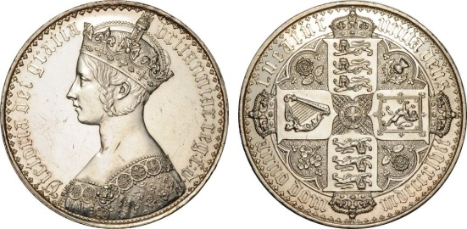
Commitment

Slide 41
Commitment
I call heads
I can’t see that call

Slide 42
Commitment
Put call in box …

Slide 43
Commitment
Lock that box …

Slide 44
Commitment
Now to perform actual flip

Slide 45
Commitment
I flipped tails

Slide 46
Commitment
He flipped tails
She called heads

Slide 47
Commitment
I won
I lost

Slide 48

Making Zerocoin
Zerocoin: mixing is “baked in”
Coins have value once on blockchain
Publishing on blockchain costs 1 BTC

Slide 49
Zerocoin
Mixing is “baked in” to protocol
Advantage: only trust crypto
Don’t need to trust other players
Less efficient than Bitcoin
But more efficient than you might think

Slide 50
Zerocoin
Zerocoin lives with BTC-like basecoin
Basecoin ≠ BTC, but OK to pretend it is
Convertible: like USD and poker chips
Conversion breaks link

Slide 51
Zerocoin
I owned a Basecoin
Then I burned it
I have a proof I burned it
That proof is redeemable for a new Basecoin

Slide 52
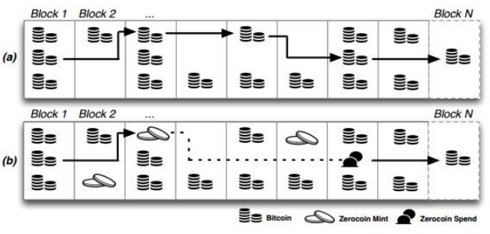
Bitcoin & Zerocoin Transaction Graphs

Slide 53
Tricky Part
How to prove I burned a Basecoin?
How to prevent double-spending proof?

Slide 54
Minting a Zerocoin
Pick random secret r (never released)
Pick long random serial # S for new zerocoin
Create commitment
C = hash(S,r)
(assume single denomination)

Slide 55
Minting a Zerocoin
Anyone can mint a zerocoin
By itself, zerocoin is worthless
Has value only if put on blockchain
That will cost you one Basecoin

Slide 56

Mint Txn
Signed by Alice
Input: 1 Basecoin Output: Hash(S,r)
BTC-like Blockchain
I just burned 1 Basecoin to create a Zerocoin

Slide 57
I want to spend my Zerocoin
Mint Txn
Signed by Alice
Input: 1 Basecoin Output: Hash(S,r)
Reveal S so no double-spending
ZK proof that
“I know some r such that H(S,r) is on the chain”
Pick any Zerocoin as input

Slide 58
Spend Txn
Serial: S
ZK-Proof
Input: 1 Basecoin Output: Alice
Mint Txn
Signed by Alice
Input: 1 Basecoin Output: Hash(S,r)
Make sure S not spent earlier

Slide 59
How is this Anonymous?
Mint Txn
Mint Txn
Mint Txn
h₁
h₂
h_{K}
…
Without r, cannot tell which h_{i}=hash(S,r)

Slide 60
Efficiency
I know r such that
Large statement
O(# coins)
H(S,r) = h₁
or
H(S,r) = h₂
or
But proof is
O(log # coins) size!
…
or
H(S,r) = h_{K}

Slide 61

Zcash
Successor to Zerocoin (2016)
Merges basecoin & zerocoin
Splits txns into public & shielded

Slide 62
Zcash
Replaces
Zero-knowledge proofs with
zk-SNARKs (more efficient)
Miners check validity, learn nothing else

Slide 63
Zcash
Bitcoin-like chain
UTXOs
Equihash PoW
ASIC-resistant
Coinbase rewards, fixed supply like BTC

Slide 64
Zcash Transactions
Transparent
Public, like Bitcoin
Shielded
Private: sender, receive, amount hidden

Slide 65
Shielded Transactions
Create shielded address
Public-private key pair
zk-SNARK: proof sender has enough money, but no other info
Private: sender, receiver, amount hidden

Slide 66
Zcash Transaction Types

Slide 67
Zcash Transaction Types
Shielded-to-shielded
Txn appears on-chain
But sender, recipient, amount hidden

Slide 68
Zcash Transaction Types
Transparent-to-transparent
Same as Bitcoin
Sender, recipient, amount visible

Slide 69
Zcash Transaction Types
unlinkable

Slide 70

Monero
All transactions private
Uses “ring signatures” for anonymity
Signatures mixed together
Can’t distinguish actual signer from decoys
“stealth addresses” disguise txn targets

Slide 71
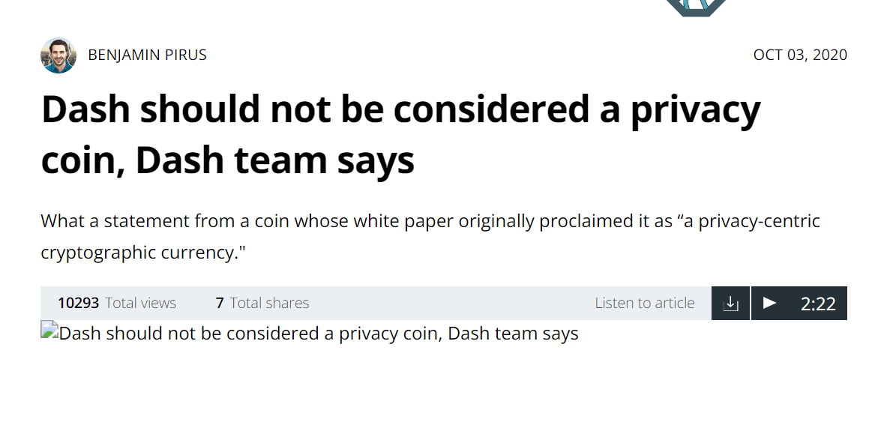
DASH
Once touted as privacy coin
Provides optional built-in CoinJoin
Much weaker than Zcash, Monero

Slide 74
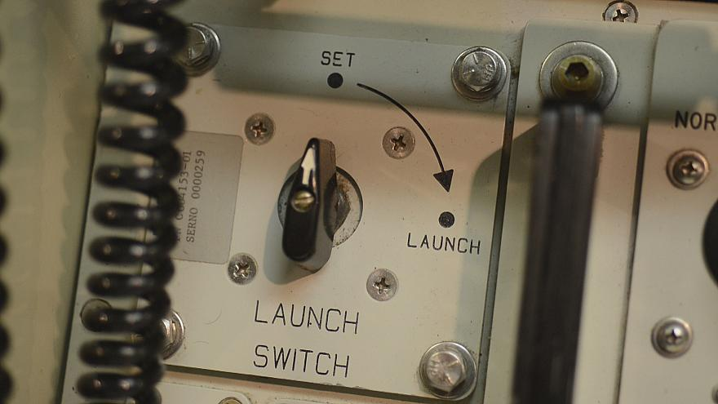
What’s the Catch?
Public parameters generated by …
Random secret inputs (gigabyte size)
Those inputs must be destroyed!
Anyone who knows inputs can counterfeit coins
Undetectably

Slide 75
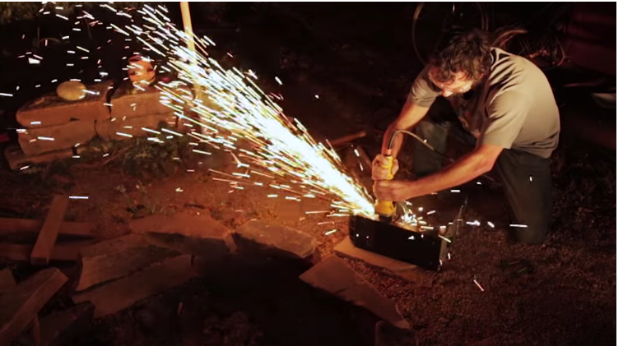
Initialization “Ceremony”
Different people create parts of parameters
Must destroy inputs without revealing
OK if even one person destroys
If all collude, undetectable counterfeiting
And maybe also privacy compromised

Slide 76
Initialization “Ceremony”
6 participants, undisclosed locations
“air gapped” computers generate pieces
Bought new, removed WIFI, Bluetooth
Input: write-once DVDs
Permanent record of inputs
Message hashes published on
Twitter, BTC blockchain
Secure Linux kernel …

Slide 77
Privacy Options
 | Type | Attacks | status
Bitcoin | Pseudonymous | Txn graph analysis | default
Single mix | Mix | Txn graph analysis, bad mixers | Available BTC
Mix chain (centralized or not) | Mix | Side channels, bad mixers | Available BTC
Zerocoin | Crypto mix | Side channels maybe | Altcoin
Zcash | Untraceable | None known | Tricky setup

Slide 78





Modern Privacy Coins

Slide 79
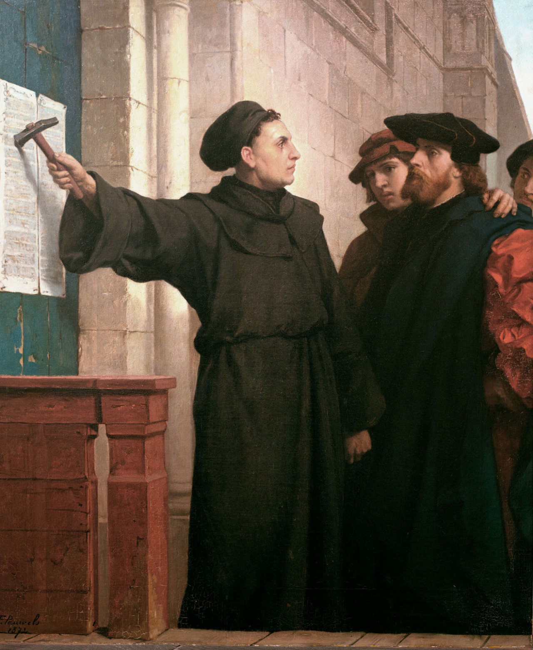
Ideas we covered in this lecture
Zero Knowledge
ZK Accumulators
ZeroCoin (+ BTC)
Zcash (no BTC)
Initialization Ceremony

Slide 80
ZCash
Zero Knowledge
ZK Accumulators
ZeroCoin (+ BTC)
Zcash (no BTC)
Initialization Ceremony

