Slide 1

CS1951 L
Blockchains & Cryptocurrencies
Spring 2025
Lecture 19
Cross-chain Swaps
Maurice Herlihy
Brown University

Slide 2
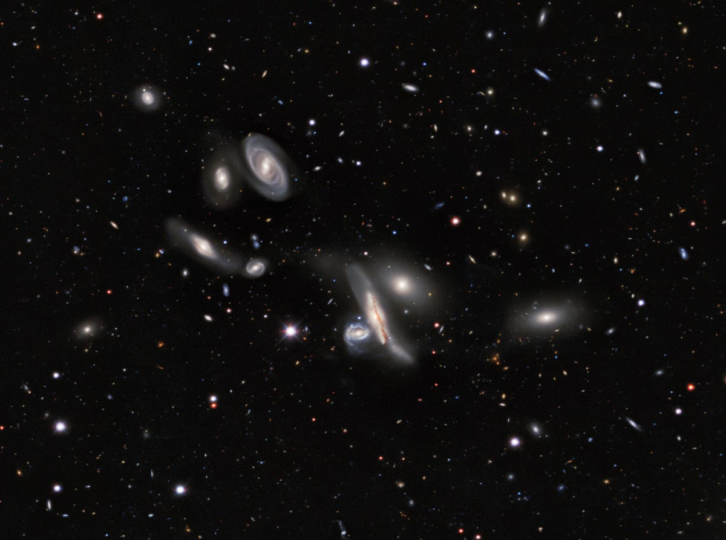
In the Future …
bitcoin
cardano
algorand
celo
ethereum
There will be many chains
Notes:
I the future, the world’s assets will be managed by multiple tamper-proof distributed ledgers, often called blockchains. There will never be one ledger to rule them all because different organizations will want to control their own blockchains.

Slide 3
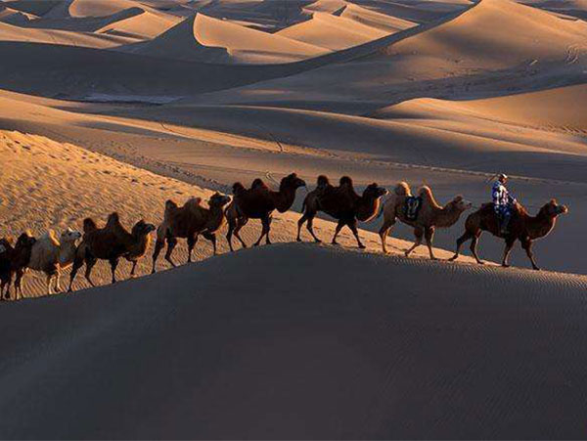
Cross-chain commerce
“Decentralized Finance”
This is a distributed computing problem
Notes:
That said, the ability for blockchains to interoperate will become crucial. The art of conducting commerce and transferring value across multiple blockchains has come to be known as decentralized finance, or DeFi for short.

Slide 4
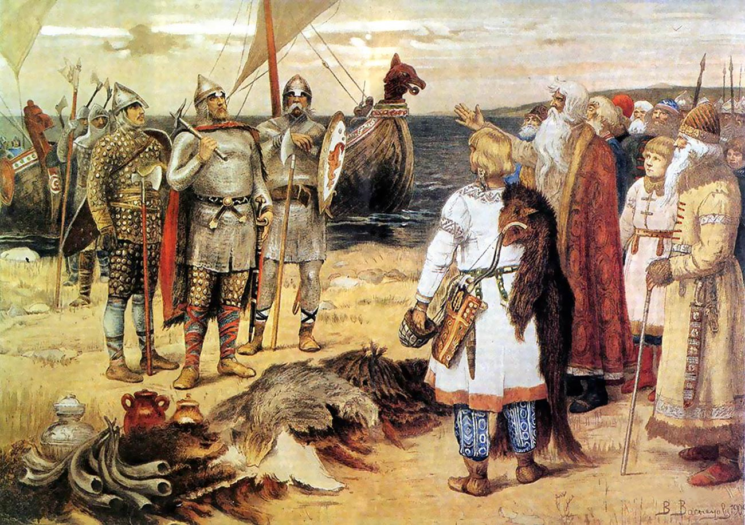
Mutual benefit if we co-operate
But we don’t trust each other
No legal system!
The oldest economic problem?
Distributed Computing’s most important problem?

Slide 5


Carol
has
wants

Slide 6

Alice
has
wants

Slide 7
Bob
has
wants

Slide 8



Slide 10
Three-Way Swap?
If all parties conform to protocol…
All swaps happen
If some parties deviate…
No conforming party ends up worse off.

Slide 11
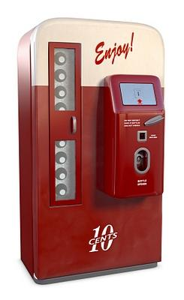
Smart Contracts
Not smart
Not contracts
Scripts on chain

Slide 12
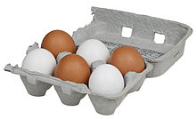
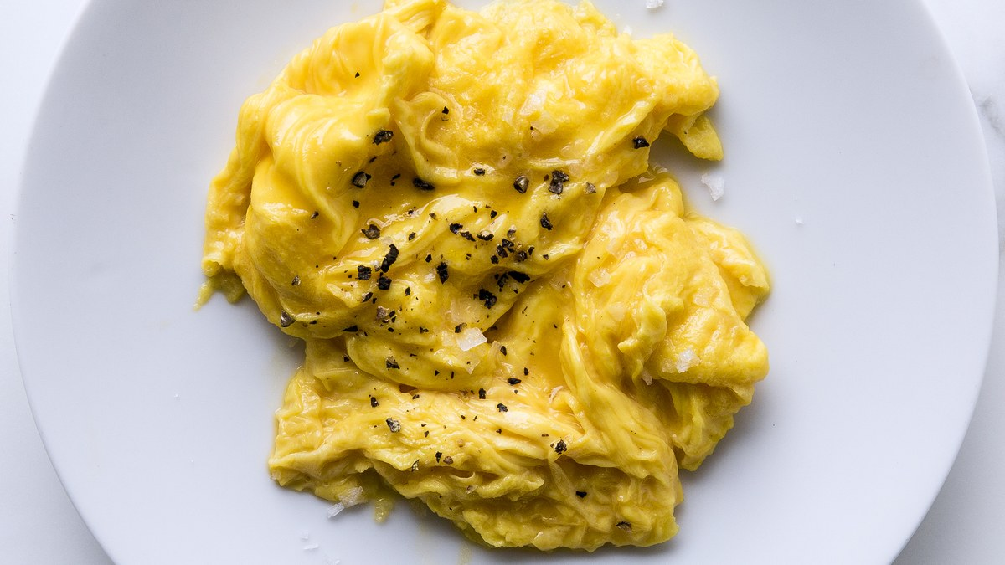
Cryptographic Hash Functions
Easy
x
Hard
H(x)

Slide 13
Two Approaches
Hashed Timelock Contracts
Token Bridges

Slide 14
Hash Locks and Time Locks

Slide 15

Hashlock
Secret s
Hashlock H(s)
Contract
I know H(s), will pay $$$ if you provide s

Slide 16
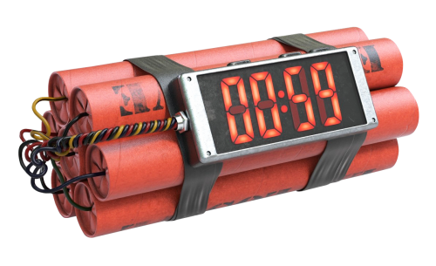
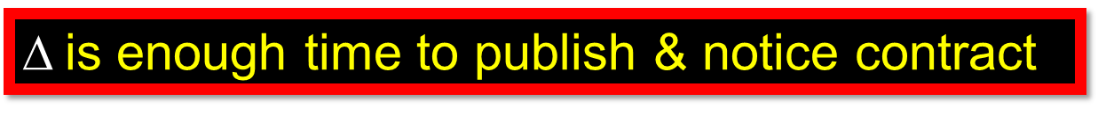
Time lock
Contract
But if secret not provided before t, refunds for everyone!
$$is enough time to publish & notice contract

Slide 17
Alice Has a Secret
s
H(s)
Time: t

Slide 18

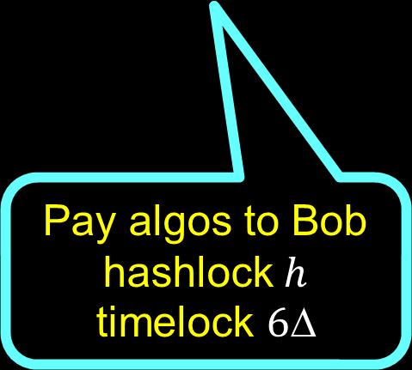
Alice Publishes Contract with Bob
Pay algos to Bob
hashlock$h$
$$\text{time}\text{lock} 6Δ$$
Time: t$+$
18

Slide 19

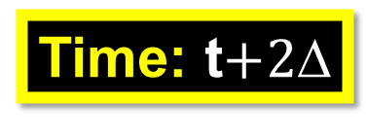


Bob Publishes Contract with Carol
$$\text{secret} s,$$
$$h=H(s)$$
Pay bitcoins to Carol
hashlock$h$
$$\text{time}\text{lock} 5Δ$$
Time: t$+2$
19

Slide 20
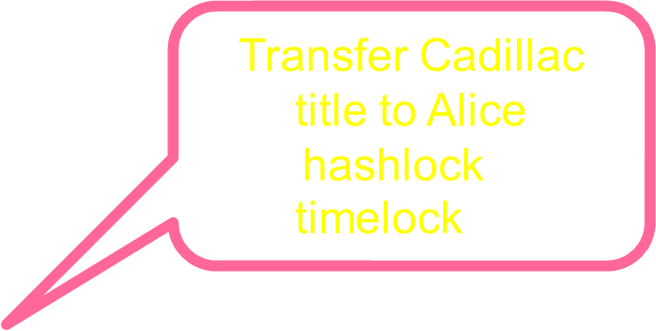
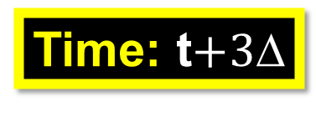
Carol Publishes Contract with Alice
$$\text{secret} s,$$
$$h=H(s)$$
Transfer Cadillac title to Alice
hashlock$h$
$$\text{time}\text{lock} 4Δ$$
Time: t$+3$

Slide 21



Alice Triggers Transfer
reveal $s$
$$\text{learn} s$$
Time: t$+4$

Slide 22
Alice Triggers Transfer
reveal $s$
$$\text{learn} s$$
Time: t$+4$

Slide 23



Carol Triggers Transfer
$$\text{learn} s$$
reveal $s$
Time: t$+5$

Slide 24
Carol Triggers Transfer
$$\text{learn} s$$
reveal $s$
Time: t$+5$

Slide 25
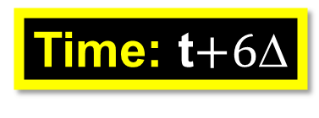

Bob Triggers Transfer
reveal $s$
Time: t$+6$

Slide 26
Bob Triggers Transfer
reveal $s$
Time: t$+6$

Slide 27
Timeouts?

Slide 28

Alice Triggers Transfer
Don’t reveal $s$
Time: t$+4$

Slide 29
Alice Triggers Transfer
Don’t reveal $s$
TIMEOUT!
Time: t$+4$

Slide 30
Refunds for All
Don’t reveal $s$
TIMEOUT!
Time: t$+5$

Slide 31
Refunds for All
Don’t reveal $s$
TIMEOUT!
Time: t$+6$

Slide 32
Refunds for All
Don’t reveal $s$
Status Quo Ante
(no one worse off)
Time: t$+6$

Slide 33
Window of Vulnerability
reveal $s$
(rewind)
$$\text{learn} s$$
Time: t$+4$

Slide 34
Window of Vulnerability
reveal $s$
$$\text{learn} s$$
Time: t$+4$

Slide 35
Window of Vulnerability
reveal $s$
Time: t$+5$

Slide 36
Bob Goes Off-Line
reveal $s$
Time: t$+5$

Slide 37
Bob Goes Off-Line
TIMEOUT!
reveal $s$
Time: t$+5$

Slide 38
Deployment Order Matters
Time: t$+$
38

Slide 39
Deployment Order Matters
39

Slide 40
Deployment Order Matters
$$\text{learn} s$$
reveal $s$
40

Slide 41
Deployment Order Matters
$$\text{learn} s$$
reveal $s$
41

Slide 42
Deployment Order Matters
Deploy clockwise,
Transfer counter-clockwise
???!!!!
42

Slide 43
Timelock Miscalculation
5Δ
5Δ

Slide 44
Timelock Miscalculation
5Δ
???!!!!
TIMEOUT!
Reveal s
5Δ

Slide 45
Timelock Miscalculation
5Δ
???!!!!
Choose timeouts wisely
5Δ

Slide 46
Irrational Behavior
I have not yet deployed my contract
Time: t$+3$
46

Slide 47

Irrational Behavior
Prematurely reveal $s$
Time: t$+3$
47

Slide 48
Irrational Behavior
Prematurely reveal $s$
No Cadillac for you!
Time: t$+3$
48

Slide 49
Atomic Swap Protocol
If all parties conform, all swaps take place
If some parties deviate, no conforming party “worse off”
No coalition has an incentive to deviate

Slide 50
Questions
When is this even possible?
How can we do this?
How much does it cost?

Slide 51
Digraphs

Slide 52
Vertex

Slide 53
Arc

Slide 54
Path

Slide 55
Cycle

Slide 56
Reachable

Slide 57
Strongly Connected
Every vertex reachable from every other

Slide 58
Feedback Vertex Set
Removal breaks all cycles

Slide 59
Blockchain
Distributed Ledger
Clients publish transactions
Smart Contracts
Which chain unimportant

Slide 60
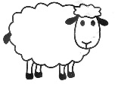






Swap Digraph
Alice
Bob
Felix
David
Carol
Ellen

Slide 61
Swap
party
Proposed asset transfer
party

Slide 62

A swap is a cooperative game
A protocol is a strategy for that game
Parties can form coalitions, committing to common strategy
Result is payoff

Slide 63
What does “worse off” mean?

Slide 64
FreeRide
Payoffs
At least one entering arc triggered
No leaving arc triggered
Something for nothing

Slide 65
Discount
Payoffs
All entering arcs triggered
Some leaving arc not triggered
Cheaper than expected

Slide 66
Deal
Payoffs
All entering arcs triggered
All leaving arcs triggered
Successful Deal

Slide 67
NoDeal
Payoffs
No entering arcs triggered
No leaving arcs triggered
Unsuccessful Deal

Slide 68
Underwater
Payoffs
Some entering arc not triggered
Some leaving arc triggered
Chaos

Slide 69

Payoffs
Payoffs
better
worse

Slide 70
Payoffs
Payoffs
better
Deal
NoDeal
worse
Otherwise, why join?

Slide 71
Payoffs
Payoffs
better
Discount
Deal
NoDeal
worse
Cheaper than expected!

Slide 72
Payoffs
Payoffs
better
Discount
FreeRide
Deal
NoDeal
worse
Something for nothing!

Slide 73
Payoffs
Payoffs
better
Discount
FreeRide
Deal
NoDeal
worse
Underwater

Slide 74
Payoffs
Payoffs
better
Discount
FreeRide
Deal
Acceptable
NoDeal
Unacceptable
worse
Underwater

Slide 75
Uniform Swap Protocol
If all parties conform, they finish with payoff Deal
If any coalition deviates, no conforming party finishes with payoff Underwater

Slide 76

Strong Nash Equilibrium
Everyone follows one strategy …
But if a coalition deviates…
It won’t improve its payoff

Slide 77
Theorem
If swap digraph is strongly connected, then parties have incentive to conform.
More precisely: conforming to any uniform swap protocol is a strong Nash Equilibrium

Slide 78
Theorem
If swap digraph is not strongly connected, then parties have no incentive to conform.
More precisely: conforming to any uniform swap protocol is never a strong Nash Equilbrium

Slide 79
Weakly Connected Swap Graph

Slide 80
Weakly Connected Swap Graph
Subgraph U

Slide 81
Weakly Connected Swap Graph
Subgraph V
Subgraph U

Slide 82
Weakly Connected Swap Graph
Arcs go from U to V, but not vice-versa
Subgraph V
Subgraph U

Slide 83
Weakly Connected Swap Graph
Arcs go from U to V, but not vice-versa
Subgraph V
Free Riders!
Subgraph U

Slide 84
Weakly Connected Swap Graph
Arcs go from U to V, but not vice-versa
Better payoff to pretend to pay parties in V
Subgraph V
Free Riders!
Subgraph U

Slide 85
Next
Let’s construct a protocol.

Slide 86
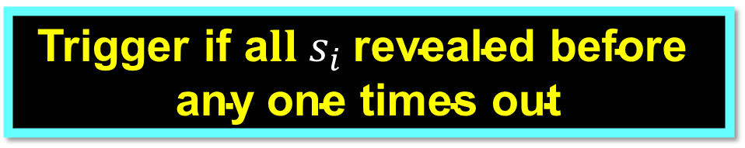
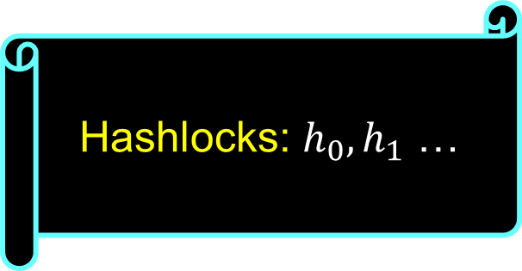
Hashlock vectors
Hashlocks: $h_{0},h_{1}$ …
Trigger if a$ll s_{i} \text{revealed} \text{before} \text{any} \text{one} \text{times} \text{out}$

Slide 87
Swap Graph

Slide 88
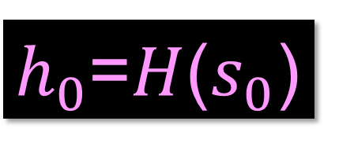
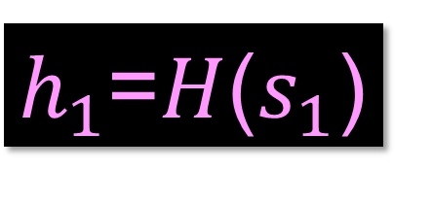
Swap Graph
$h_{0}$=$H$($s_{0}$)
$h_{1}$=$H$($s_{1}$)
Leaders know secrets

Slide 89
Swap Graph
Leaders form feedback vertex set

Slide 90
Theorem
Leaders must form a feedback vertex set

Slide 91



Swap Graph
Leader: publish contract on each outgoing arc
$h_{0}$=$H$($s_{0}$)
$h_{0}$,$h_{1}$
$h_{0}$,$h_{1}$
$h_{1}$=$H$($s_{1}$)
$h_{0}$,$h_{1}$

Slide 92
Swap Graph
Leader: publish contract on each outgoing arc
Wait for contracts on incoming arcs …
$h_{0}$=$H$($s_{0}$)
$h_{0}$,$h_{1}$
$h_{0}$,$h_{1}$
$h_{1}$=$H$($s_{1}$)
$h_{0}$,$h_{1}$

Slide 93




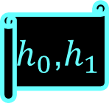
Non-Leaders
$h_{0}$,$h_{1}$
$h_{0}$,$h_{1}$
Wait for Contracts on all incoming arcs
$h_{0}$,$h_{1}$
$h_{0}$,$h_{1}$
Before publishing on outgoing arcs
$h_{0}$,$h_{1}$

Slide 94
Theorem
No other order works

Slide 95
Theorem
Every arc receives a contract in time O(diam(D))

Slide 96
We need to talk about Timeouts

Slide 97
reveal s_{i}
timeouts
A
C
B

Slide 98
reveal s_{i}
A
unlock h_{i} within Δ
C
B

Slide 99
A
C
B
reveal sig(s_{i} ,C)

Slide 100
A
unlock h_{i} within 2Δ
C
B
reveal sig(s_{i} ,C)

Slide 101
A
unlock h_{i} within 3Δ
C
B
reveal sig(s_{i} ,C,B)

Slide 102
How Timeouts Work
Secret s_{i} arrives along a path p from source
Each link is signed
Unlocks h_{i} if p is path from source, and received within time |p|Δ

Slide 103
Theorem
No compliant party ends up Underwater

Slide 104
Theorem
If all comply, swap finishes in time < O(diam D)

Slide 105
Theorem
Bits on blockchain: O(|L| × |A|), where L = set of leaders,
and A = set of arcs

Slide 106

Hedged Deals
Party who walks away pays a premium to others
How to identify who is guilty?
How to bootstrap escrow premiums?
Can hedging be automated?

Slide 107
Other Applications?
Cross-chain atomic transactions?
Off-chain transactions?
Off-chain atomic transactions?

Slide 108
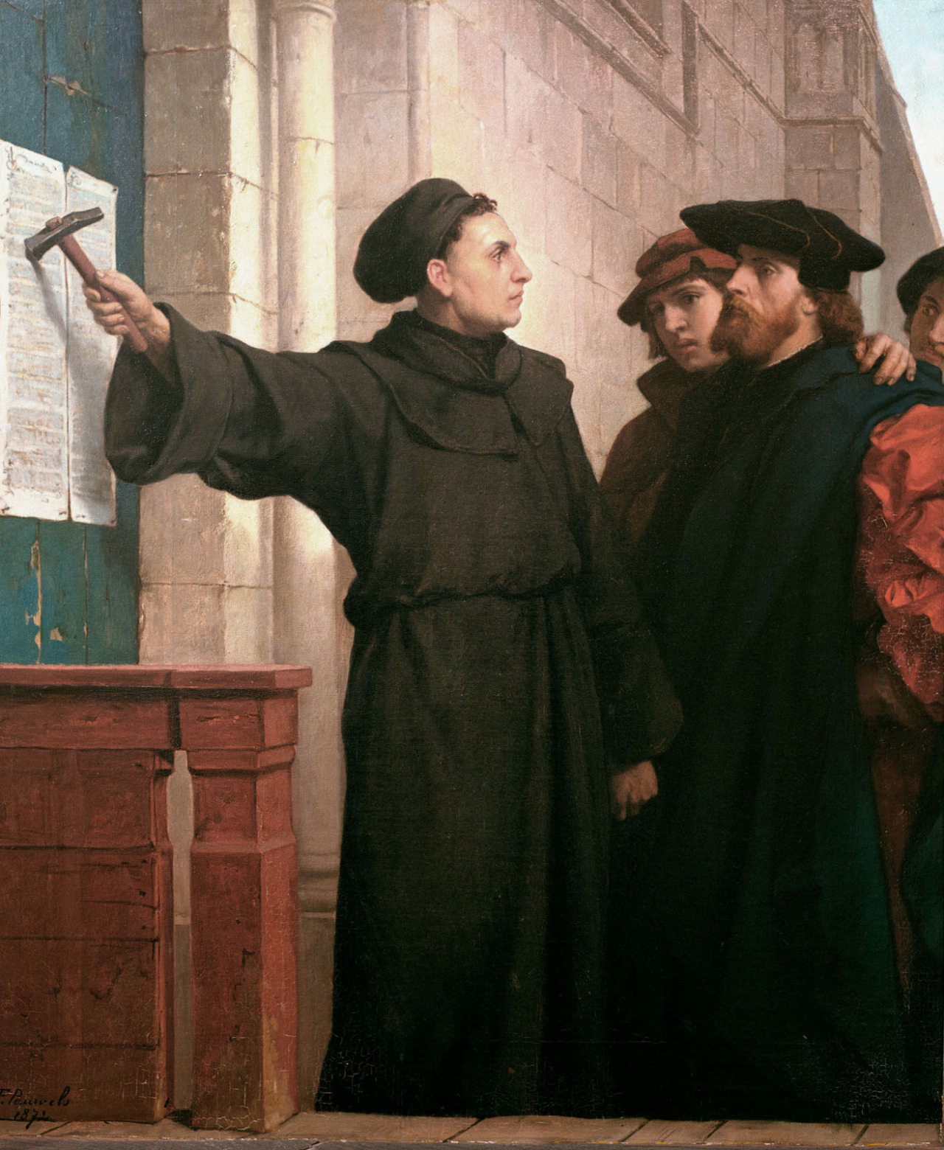
Ideas we covered in this lecture
Swaps
Hashed timelock contracts
Digraphs
Cross-chain swap protocol

