Slide 1

Hands-On Cryptography
S-AES with CFB Mode
Implementation, File Encryption, and Brute-Force Cryptanalysis
JAD ESTEPHAN 60589
RAMY ABOU NADER 60531

Slide 2






Agenda
What this project covers
01
Background
Why simplified AES exists and where it fits in a cryptography course
02
S-AES Internals
Block size, key expansion, S-box, ShiftRows, MixColumns over GF(2^4)
03
CFB Mode
How turning a block cipher into a stream cipher removes the weaknesses of raw ECB
04
Implementation
Python code, file-level encryption of text and a small image
05
Cryptanalysis
Known-plaintext and ciphertext-only brute-force attacks on the 16-bit key
06
Conclusions
Measured attack times and what changes when we move to real AES
S-AES / CFB - Cryptography Project
2 / 12

Slide 3
What is S-AES?
A teaching version of the AES standard
S-AES (Simplified AES) is a miniature cipher designed by Musa, Schaefer and Wedig in 2003 for classroom use. It mirrors every structural element of real AES but with drastically smaller parameters so students can compute rounds by hand or exhaust the entire key space in under a second.
S-AES vs Real AES
Parameter | S-AES | AES-128
Block size | 16 bits | 128 bits
Key size | 16 bits | 128 bits
Rounds | 2 | 10
S-Box size | 16 entries | 256 entries
Key space | 65,536 | 3.4 x 10^38
16 bits
16 bits
Block size
Key size
2
GF(2^4)
Rounds
Finite field used
S-AES / CFB - Cryptography Project
3 / 12

Slide 4
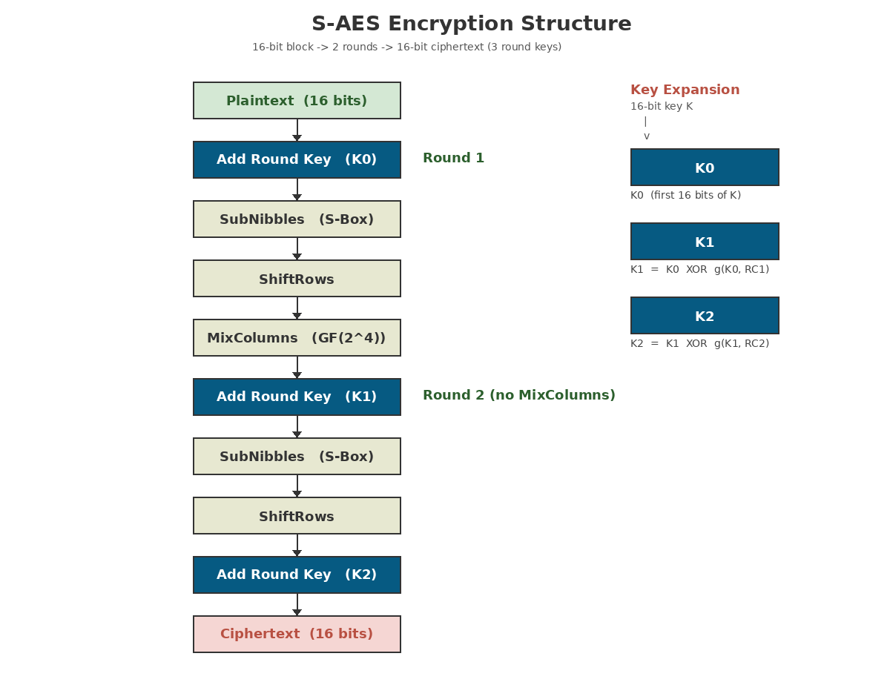

S-AES Round Structure
One Add-Round-Key followed by two rounds
SubNibbles
Each 4-bit nibble is replaced using a fixed 16-entry S-box, providing non-linear confusion.
ShiftRows
The two nibbles of the second row are swapped. On a 2x2 state this is the smallest form of diffusion.
MixColumns
Each column is multiplied by the fixed matrix [[1,4],[4,1]] in GF(2^4) under x^4+x+1.
AddRoundKey
The state is XORed with one of three 16-bit round keys produced by the key schedule.
S-AES / CFB - Cryptography Project
4 / 12

Slide 5
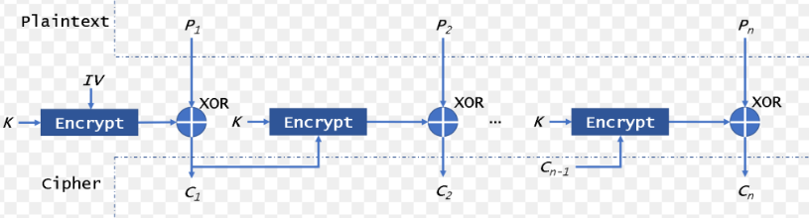
CFB Mode of Operation
Turning a block cipher into a stream cipher
Formulas
Encrypt
Ci = Pi XOR Ek (Ci−1)
C0 = IV (initialization vector)
Decrypt
Pi = Ci XOR Ek C(i-1)
Why CFB?
No padding required for bit-streams.
Converts block cipher to stream cipher.
Hides patterns effectively (like your chessboard).
S-AES / CFB - Cryptography Project
5 / 12

Slide 6


Why Chaining Matters
Visual proof that S-AES/CFB destroys plaintext patterns
Plaintext
Ciphertext
Decrypted
A 128x128 grayscale chessboard. Obvious repeating patterns and high contrast.
After S-AES/CFB, the high-contrast squares are destroyed. Each pixel depends on the one before it, creating a "snow" effect.
Using the same key and IV, the keystream is perfectly reproduced and XORed to restore the chessboard.
S-AES / CFB - Cryptography Project
6 / 12

Slide 7
Implementation in Python
Core CFB encrypt/decrypt functions from saes_cbf.py
saes_cbc.py
Implementation features
def cfb_encrypt(plaintext, key, iv):
output = bytearray()
prev_cipher_block = iv
for i in range(0, len(plaintext), 2):
p_block = (plaintext[i] << 8) | plaintext[i+1]
# CFB Logic: XOR Plaintext with Encrypted Previous Ciphertext
keystream = encrypt_block(prev_cipher_block, key)
c_block = p_block ^ keystream
output.extend([(c_block >> 8) & 0xFF, c_block & 0xFF])
prev_cipher_block = c_block
return bytes(output)
def cfb_decrypt(ciphertext, key, iv):
output = bytearray()
prev_cipher_block = iv
for i in range(0, len(ciphertext), 2):
c_block = (ciphertext[i] << 8) | ciphertext[i+1]
# DECRYPTION ALSO USES encrypt_block
keystream = encrypt_block(prev_cipher_block, key)
p_block = c_block ^ keystream
output.extend([(p_block >> 8) & 0xFF, p_block & 0xFF])
prev_cipher_block = c_block
return bytes(output)
Pure Python, no external crypto libraries
PKCS#7 padding to handle any file length
Works on text, images and binary files
Command-line interface for encrypt/decrypt
Bit-exact with the Stallings textbook example
S-AES / CFB - Cryptography Project
7 / 12

Slide 8
End-to-End Demo Output
Actual terminal output from running saes_cfb.py demo
$ python saes_cfb.py demo
======================================================================
S-AES / CFB - Demonstration
======================================================================
Single-block test (Stallings)
Plain : 0xD728
Key : 0x4AF5
Cipher : 0x24EC (OK)
CFB mode test
Key : 0xA73B
IV : 0x1234
Result : Decrypted Text Match: True
Check : Chessboard restored successfully.
S-AES / CFB - Cryptography Project
8 / 12

Slide 9

Cryptanalysis of S-AES
Brute force is trivially feasible against a 16-bit key
1
Known-Plaintext Attack
The attacker has one (plaintext, ciphertext) pair. Test every key until E_K(P) = C.
2^16
Works when any part of the message is predictable, e.g. a file header or HTTP line.
= 65,536 keys
2
Ciphertext-Only Attack
A single laptop can test every key in well under a second. S-AES is designed to be broken so students can see how attacks work end to end.
The attacker has only ciphertext but knows the message is English text.
Score each candidate decryption by letter frequency and ASCII printability, keep the best.
S-AES / CFB - Cryptography Project
9 / 12

Slide 10
Brute-Force Results
Measured on a standard laptop CPU
Attack 1: Known-Plaintext
Attack 2: Ciphertext-Only
Plaintext block
Ciphertext block
Top 5 candidates ranked by English-likeness score:
0xD728
0x8888
Rank | Key | Score | Decrypted preview
1 | 0xA73B | 101.96 | This is the confidential text for the...
2 | 0x4C51 | -312.50 | #+#`#7#&#k#9D:2h ...
3 | 0x620A | -312.50 | b>X#B#P#P:W*U#S5S ...
4 | 0xAD44 | -312.50 | &:\v#)#;#}#,#%#yD ...
5 | 0x482A | -343.75 | C##f8~^}#s#w#w#zO ...
0.47 s
0xA73B
Time to recover key
Key recovered (correct)
Only one key out of 65,536 encrypts 0xD728 to 0x8888, so the search is unambiguous.
Finished in 20.48 s. The correct key scores significantly higher than random candidates.
Attack complexity = O(2^n) trial encryptions. Linear in key space, constant memory.
S-AES / CFB - Cryptography Project
10 / 12

Slide 11
Why Real AES Is Safe
The same attack scaled up is mathematically infeasible
Our brute-force machine tests about 132,000 S-AES encryptions per second. At that same rate, the time needed to exhaust each key space grows by a factor of 2 for every extra bit. This is why cryptographers measure security in bits: every extra bit literally doubles the attacker's workload.
Time to exhaust each key space (at 132 K keys/s)
Cipher | Key bits | Key space | Time to break
S-DES | 10 | 2^10 | 0.008 s
S-AES | 16 | 2^16 | 0.5 s
DES | 56 | 2^56 | 17,322 years
AES-128 | 128 | 2^128 | 8.2 x 10^25 yrs
AES-192 | 192 | 2^192 | 1.5 x 10^45 yrs
AES-256 | 256 | 2^256 | 2.8 x 10^64 yrs
131,912
S-AES encryptions per second (measured)
-> ~0.5 seconds to break any S-AES key
Adding 112 bits (16 -> 128) makes the search 5 x 10^33 times slower. Even a billion machines running for a billion years would not scratch it.
Note: the universe is about 1.4 x 10^10 years old.
S-AES / CFB - Cryptography Project
11 / 12

Slide 12
Key Takeaways
What this project demonstrated end to end
01
02
S-AES mirrors real AES
CFB mode hides patterns
Same building blocks (SubBytes, ShiftRows, MixColumns, KeyExpansion) just with smaller parameters, making the math tractable by hand.
Chaining by XORing plaintext with the encrypted previous ciphertext turns a structured chessboard into noise.
03
04
Both attacks succeeded
Key size is everything
Known-plaintext recovered the key instantly. Ciphertext-only ranking identified the correct key 0xA73B in 20.48s.
Going from 16-bit to 128-bit keys turns a 0.5-second attack into one that takes 10^25 years. Security really is just extra bits.
Thank you

