Slide 1
Pizza Hut Sales Analysis
A Data-Driven Overview of Pizza Sales and Revenue
Prepared by: Jignesh Jadvani

Slide 2
Objective to Pizza Sales Analysis
The Pizza Hut sales analysis aims to explore sales trends, revenue generation, and customer preferences. Using SQL queries, we analyzed sales data to uncover insights about the most popular pizzas, sales distribution, and revenue contribution. This analysis can help inform strategic business decisions.

Slide 3
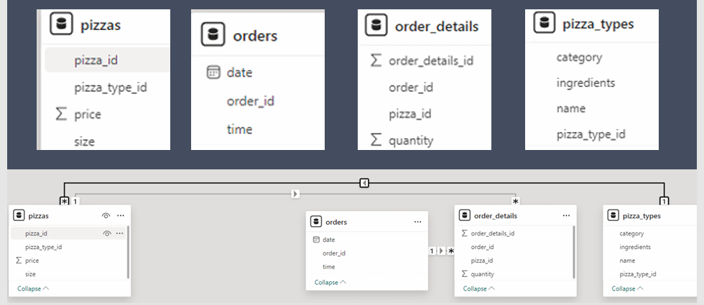
DATABASE SCHEMA

Slide 4

Retrieve the Total Number of Orders Placed
SELECT COUNT(order_id) as Total_orders FROM orders
Total Orders:

Slide 5

Calculate the Total Revenue Generated from Pizza Sales
SELECT ROUND(SUM(order_details.quantity * pizzas.price), 2) as Total_sales FROM order_details JOIN pizzas ON pizzas.pizza_id = order_details.pizza_id
Total Sales:

Slide 6
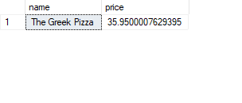
Identify the Highest-Priced Pizza
SELECT TOP 1 pizza_types.name, pizzas.price FROM pizza_types JOIN pizzas ON pizza_types.pizza_type_id = pizzas.pizza_type_id ORDER BY pizzas.price DESC
Highest Priced Pizza:

Slide 7
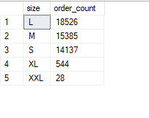
Identify the Most Common Pizza Size Ordered
SELECT pizzas.size, COUNT(order_details.order_details_id) as order_count FROM pizzas JOIN order_details ON pizzas.pizza_id=order_details.pizza_id GROUP BY pizzas.size ORDER BY order_count DESC
Most Common Pizza Size:

Slide 8
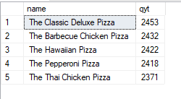
List the Top 5 Most Ordered Pizza Types with Quantities
SELECT TOP 5 pizza_types.name, SUM(order_details.quantity) AS qyt FROM pizza_types JOIN pizzas ON pizza_types.pizza_type_id = pizzas.pizza_type_id JOIN order_details ON order_details.pizza_id = pizzas.pizza_id GROUP BY pizza_types.name ORDER BY qyt DESC
Top 5 Pizza Types:

Slide 9
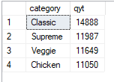
Find the Total Quantity of Each Pizza Category Ordered
SELECT pizza_types.category, SUM(order_details.quantity) AS qyt FROM pizza_types JOIN pizzas ON pizza_types.pizza_type_id=pizzas.pizza_type_id JOIN order_details ON order_details.pizza_id=pizzas.pizza_id GROUP BY pizza_types.category ORDER BY qyt DESC
Total Quantity by Category:

Slide 10
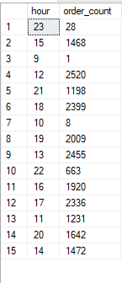
Determine the Distribution of Orders by Hour of the Day
SELECT DATEPART(HOUR,time) AS hour, COUNT(order_id) AS order_count FROM orders GROUP BY DATEPART(HOUR,time)
Order Distribution by Hour:

Slide 11
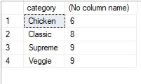
Category-Wise Distribution of Pizzas
SELECT category, COUNT(name) FROM pizza_types GROUP BY category
Pizza Category Distribution:

Slide 12

Calculate the Average Number of Pizzas Ordered Per Day
SELECT AVG(Qty) FROM (SELECT orders.date, SUM(order_details.quantity) AS Qty FROM orders JOIN order_details ON orders.order_id=order_details.order_id GROUP BY orders.date) AS order_quantity
Avg Pizzas Ordered Per Day:

Slide 13
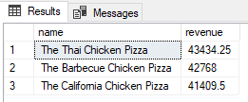
Determine the Top 3 Most Ordered Pizza Types by Revenue
SELECT TOP 3 pizza_types.name, SUM(order_details.quantity*pizzas.price) AS revenue FROM pizza_types JOIN pizzas ON pizzas.pizza_type_id= pizza_types.pizza_type_id JOIN order_details ON order_details.pizza_id=pizzas.pizza_id GROUP BY pizza_types.name ORDER BY revenue DESC
Top 3 Pizzas by Revenue:

Slide 14
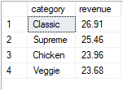
Calculate the Percentage Contribution of Each Pizza Type to Total Revenue
SELECT pizza_types.category, ROUND(SUM(order_details.quantity * pizzas.price) / (SELECT ROUND(SUM(order_details.quantity * pizzas.price),2) AS Total_sales FROM order_details JOIN pizzas ON pizzas.pizza_id = order_details.pizza_id) * 100, 2) AS revenue FROM pizza_types JOIN pizzas ON pizzas.pizza_type_id= pizza_types.pizza_type_id JOIN order_details ON order_details.pizza_id=pizzas.pizza_id GROUP BY pizza_types.category ORDER BY revenue DESC
Revenue Contribution by Pizza Type:

Slide 15
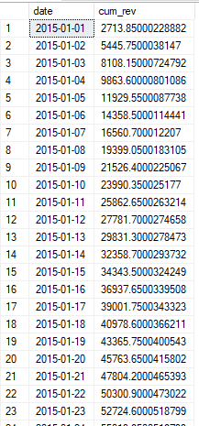
Analyze the Cumulative Revenue Generated Over Time
select top 3 pizza_types.name,
SUM(order_details.quantity*pizzas.price) as
revenue
from pizza_types join pizzas
on pizzas.pizza_type_id= pizza_types.pizza_type_id
join order_details
on order_details.pizza_id=pizzas.pizza_id
group by pizza_types.name
order by revenue desc
Cumulative Revenue:

Slide 16

Top 3 Most Ordered Pizza Types by Revenue for Each Category
SELECT name, revenue FROM (SELECT category, name, revenue, RANK() OVER (PARTITION BY category ORDER BY revenue DESC) AS RN FROM (SELECT pizza_types.category, pizza_types.name, SUM(order_details.quantity*pizzas.price) AS revenue FROM pizza_types JOIN pizzas ON pizzas.pizza_type_id= pizza_types.pizza_type_id JOIN order_details ON order_details.pizza_id=pizzas.pizza_id GROUP BY pizza_types.category, pizza_types.name) AS A) AS B WHERE RN <= 3
Top 3 Pizzas by Category:

Slide 17
Conclusion and Insights
The analysis of Pizza Hut sales reveals key insights about pizza preferences, sales distribution, and revenue generation. The most popular pizza types significantly contribute to revenue, and sales trends vary by hour and category. These insights can help optimize pricing strategies, promotions, and menu offerings.

