Slide 1

Blackjack Strategist
Ben Sun, Jadyn Wall, Matt Wilker

Slide 2

Blackjack Rules
Beat the dealer by getting a higher hand value without going over 21
Number on the card is its value
Face cards (J, Q, K) have a value of 10
Aces can count as 1 or 11
Player goes first
Dealer flip cards until they reach or exceed 17
OVERALL: player (you) finish the hand with more points (card values) than the dealer without going over 21

Slide 3
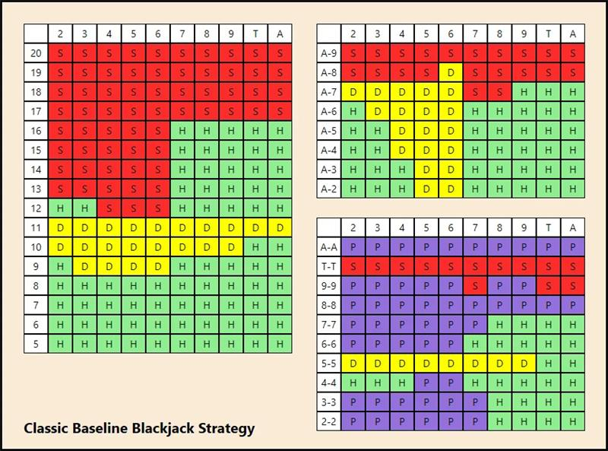
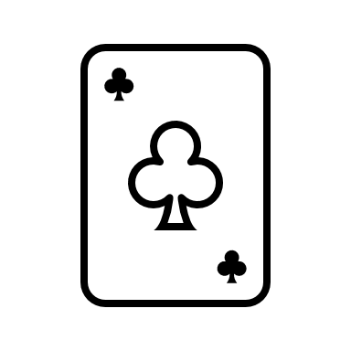

Strategy Dictating Optimal Gameplay
Possible Player Moves:
Stand (S)
Hit (H)
Double (D)
Split (P)

Slide 4

Implementation
Tools:
Python
OpenCV
EasyOCR
Image Processing Techniques:
Convert to grayscale
Gaussian blur
Canny edge detection
Contouring
Sharpen
Crop to top left corner
Threshold (Otsu’s method)
Closing
OCR

