Slide 1
STRIDE
Get the athlete paid.
Show the brand what it bought.
For semi-professional athletes in niche sports, and the local businesses near their club. Neither side is served today.
Jad Zoghaib MSc Business Plan, ESADE · Tutor: Ignacio Gallardo Albajar · October 2026
LIVE DEMO
stride-demo.onrender.com
Notes:
Good morning. I am Jad Zoghaib and this is Stride.
Two sentences. Get the athlete paid, and show the brand what it bought. Those are the two halves of the company, and most of my fifteen minutes is about why they are one company rather than two.
Be clear about who I mean on both sides. The athletes are semi-professional and amateur, in niche sports, with a real following in a real place and no agent. A professional does not need me, they already have one, and they would not use this. The brands are the businesses near that athlete's club: the physiotherapy clinic, the gym, the car dealer.
And the thesis in one sentence: athletes are creators with a second payer. OnlyFans proved direct fan monetisation beats ad share. Nobody built it for athletes, who unlike lifestyle creators also have sponsors, clubs and a competitive record that makes their audience measurable.
Everything I show you is live at that URL, and I am happy to open it in the Q&A.

Slide 2
WHY THIS, FROM ME
I am not researching this market from outside it
ATHLETE
OPERATOR
BUILDER
Capped by the Lebanese national rugby team, with international tournament experience. The athletes in my research are people I play with, which is why the conversations were candid rather than performative.
Four years in management consulting across MENA. Feasibility studies at $5 to 15M, DCF modelling, and an OpEx reorganisation that delivered SAR 650M of capital optimisation.
MSc Business Analytics at ESADE. The deployed product, the analytics engine and the financial model behind this plan are all my own work.
The plan can make claims about the technology that are checkable rather than aspirational, because I wrote it.
Notes:
Thirty seconds on why I am the person telling you this.
I am capped by the Lebanese national rugby team. The athletes I interviewed are people I play with, so I am inside the segment this plan describes, not studying it from outside.
Four years of consulting gave me the modelling. The MSc and the build gave me the product. Everything in the demo is my own code.

Slide 3
WHAT FIVE ATHLETES TOLD ME
€0
“
People are not going to spend time setting up social media and building followers purely around their sport if nothing comes back.
CURRENT INCOME FROM THEIR AUDIENCE
Not low. Not inconsistent. Nothing
Rugby league players competing in Spain and Lebanon, and top-ranked Lebanese CrossFit athletes. The founder is capped by the Lebanese national rugby team, which is how this access exists.
THE INEQUITY IS FELT
SPONSORSHIP ARRIVES DESPITE THE SPORT
SO THEY STOP BUILDING AN AUDIENCE
Influencers producing far less demanding content earn more than competing athletes do
The one athlete who has a sponsor did not get it as a rugby league player
Which suppresses the very supply the market is measured on
Primary research, five semi-structured interviews, 2026. Convenience sample, reported as one.
Notes:
I asked five athletes in my own sports what they earn from their audience.
The answer was not 'a little'. It was zero. Nothing.
And read the quote carefully, because it is the finding that matters most: they do not build an audience, because there is no return on building one. That is not a complaint about pricing. It is a market with no infrastructure in it.

Slide 4
THE BUYER'S HALF
A local brand spends on instinct, and never finds out
“What did you get back,
and how did you know?”
WHO THE BUYER IS
Physiotherapy clinics, gyms, car dealers, restaurants and regional insurers within reach of an anchor athlete's club. The segment the agencies will not serve, and the one this model is built on.
The question the sponsor discovery programme is built around. It is the one the whole analytics engine exists to answer, and today nobody below the professional tier owns an instrument that can.
CHOOSE
PRICE
VERIFY
Two athletes, and nothing to compare them on but follower count, which is the one number that can be bought.
No rate card and no benchmark anywhere in the segment. The fee is whatever was asked for.
The campaign ends, and nothing is known that was not known before it started.
THE ASSUMPTION I TEST FIRST
Twenty sponsor conversations before the pre-seed gate, and the answer that kills it is written down in advance: if brands say they already know what they get, the analytics engine is not a differentiator.
Sponsor discovery programme, section 4.6: four buyer groups, seven questions, each one aimed at an assumption the model depends on.
Notes:
Now the other side, and this is the half of the company I care most about.
The brand paying for this is not Nike. It is a physiotherapy clinic or a regional insurer near the athlete's club. They have a budget. What they do not have is any instrument at all: they cannot compare two athletes except on follower count, they have no benchmark to price against, and when the campaign ends they know nothing they did not know before.
I want to be straight about status. I have interviewed athletes, not sponsors. This is the biggest hole in my research, so it is the first thing I build and the first thing I test, and I have written down in advance which answer would kill it. If brands tell me they already know what they get, my differentiator is gone.

Slide 5
THE MECHANISM
One missing layer explains both halves
IN A POPULAR SPORT
IN A NICHE SPORT
An agent introduces the athlete and vouches for the audience. Ten to twenty per cent, and the brand gets a number it can defend.
There is no agent. The athlete's alternative is not a worse deal, it is no deal. The brand's alternative is a guess.
AND THAT ABSENCE FEEDS ITSELF
01
No route from audience to income
›
02
So no reason to build an audience
›
03
So the market measures smaller than it is
An agent introduces, and an agent vouches. Below the professional tier neither function exists: no route to income on one side, no basis for a decision on the other. So the market is sized under the incentives that suppress it, and the honest error direction is understatement.
Notes:
So why does this happen, on both sides at once? Because one layer is missing, and it used to do two jobs.
An agent introduces the athlete to the brand, and an agent vouches for what the brand is getting. In football that costs 10 to 20 per cent and it exists. In trail running or rugby league there is no agent at all, so the athlete has no route to income and the brand has no basis for a decision. One absence, two victims.
And it compounds: no route to income, so no reason to build an audience, so the market counts smaller than it really is. Every number I am about to show you is therefore the conservative reading.

Slide 6
THE PRODUCT
Two engines, and each one is the other's reason to exist
ENGINE ONE
ENGINE TWO
Monetisation
Analytics
ATHLETE AND FAN
SPONSOR
The athlete's own page, with paid fan tiers they price themselves. They keep 85% and pay nothing to be there. Self serve, with no sales touch per subscriber.
A campaign brief matched to athletes on measured audience evidence, every score decomposed into the arithmetic behind it, and delivery measured against what was projected.
15% of fan revenue · 48% of Y7
10% of deal value, plus €99 to €999 a month · 52% of Y7
THE ATHLETE PAYS NOTHING
No monthly fee, ever, on either engine. The athlete earning €200 a month pays the same rate as the one earning €5,000, which a subscription would not have done. They are the supply, and supply is the constraint.
Stride financial model: Y7 net revenue of €3.01M, 48% from fans and 52% from the two sponsor streams.
Notes:
So what is Stride. Two engines, and I want to be precise that they are peers rather than a product and a feature.
Engine one is monetisation. The athlete gets their own page with paid fan tiers they price themselves, they keep 85 per cent, and they pay nothing to be there. That is 48 per cent of year seven revenue.
Engine two is analytics. A sponsor briefs a campaign, gets athletes matched on measured audience evidence with every score decomposed, and then gets delivery measured against what was projected. Ten per cent of the deal plus a subscription, and that is the other 52 per cent.
One deliberate choice: the flat take with no athlete fee. The athlete earning 200 euros a month pays the same rate as the one earning 5,000. A subscription would have been regressive against exactly the athlete we are built for.

Slide 7
WHY THEY ARE ONE COMPANY
Each engine produces the input the other cannot buy
01
02
03
04
Fans pay
the athlete
The athlete connects
their platforms
The sponsor
sees evidence
Deals raise
athlete income
›
›
›
Subscriptions give the athlete a reason to build an audience, and give us revenue from the first month.
Monetising requires the connectors. Those same connectors are the measurement instrument.
Measured reach, engagement and cost per thousand, per athlete, in place of a follower count.
Which brings the next athlete, and arrives with an audience that can now be measured.
AND FOUR RETURNS TO ONE
WHY NEITHER HALF STANDS ALONE
A creator platform has no reason to measure an audience. A sponsorship data company has no relationship with the athlete, so it cannot get the measurements. Both halves are required, and that is the architecture rather than a roadmap.
Fan revenue funds the years in which the data accrues. By the time the analytics are worth selling, someone else has already paid to build them.
Notes:
This is the slide I would most like you to remember.
Follow the loop. Fans pay the athlete, so the athlete has a reason to build an audience. To take that money they connect their platforms, and those connectors are the same instrument that measures the audience. That measurement is what the sponsor is shown instead of a follower count. The deal raises the athlete's income, which brings the next athlete, who arrives with another audience to measure.
Now the part that matters commercially. A creator platform has no reason to measure an audience, so it never builds this. A sponsorship data company has no relationship with the athlete, so it cannot get the data at all. You need both sides, and almost nobody has both.
And the financing consequence: fan revenue pays for the years in which the data is accumulating. By the time the analytics are worth selling, somebody else has already funded building them.

Slide 8
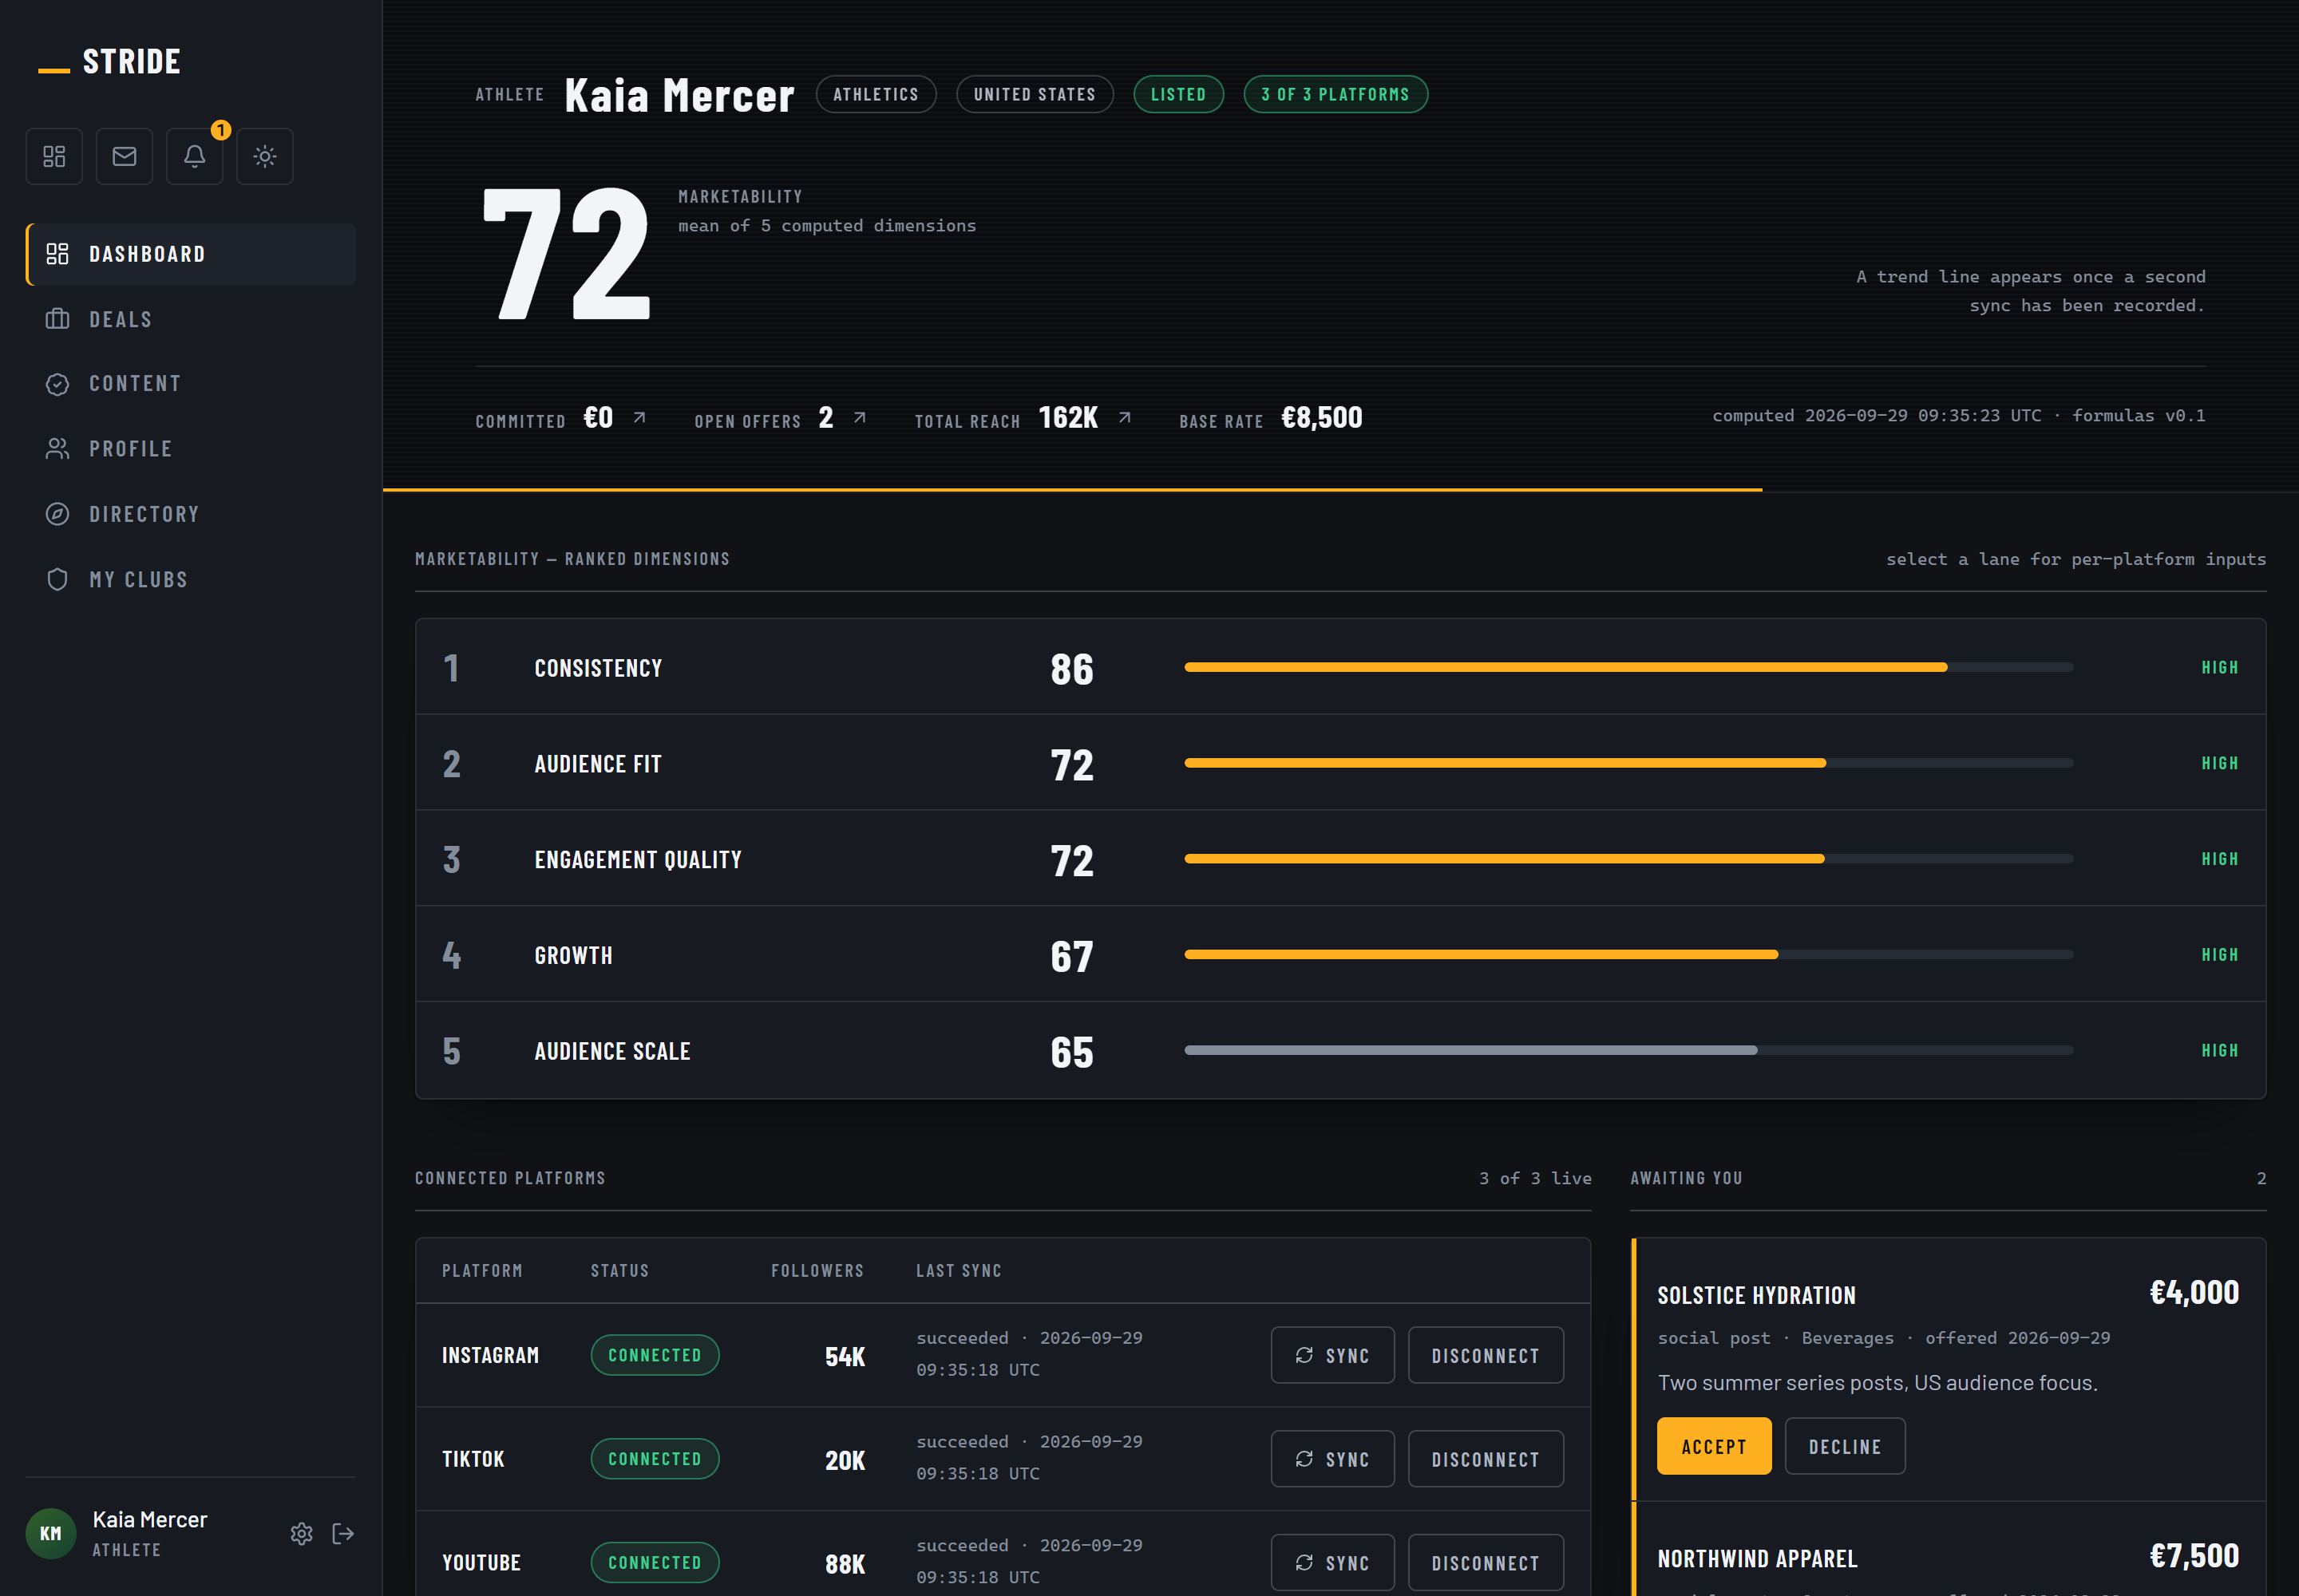
NOT A MOCKUP
It is built, deployed,
and you can open it now
Admission gate with human review
Versioned marketability scoring
Explainable campaign matching
Offers, deals, delivery measurement
Audit log and a resilience drill
Tests on two databases in CI
stride-demo.onrender.com
Fourteen demo accounts. Registration is open.
Athlete dashboard, captured from the running application.
Notes:
This is the part most business plans cannot show you.
It is not a mockup and not a prototype. It is deployed, and the URL is on the slide. Fourteen demo accounts, registration open, you can sign in during the questions if you want to.
What you are looking at is an athlete's marketability score, 72, decomposed into the five dimensions that produced it, with the connected platforms and the live offers underneath. Every number on that screen traces back to a platform sync.

Slide 9
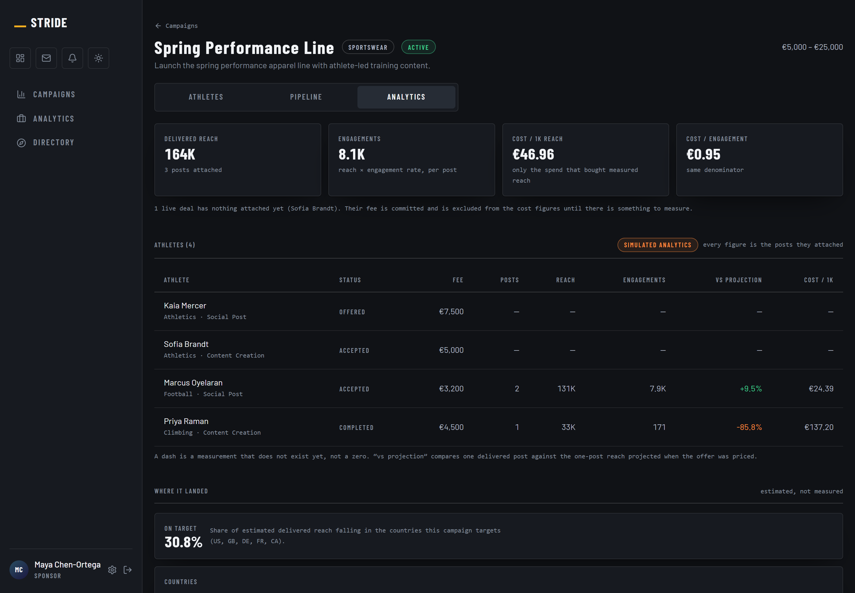
THE SECOND ENGINE, RUNNING
And this is what
replaces the instinct
Delivered reach and engagements, per athlete
Cost per thousand reached, cost per engagement
Delivered against what was projected when priced
Share of reach landing in the targeted countries
Every match score decomposed to its arithmetic
A dash where nothing is measured. Never a zero
The arithmetic is shown because a brand that cannot audit the number will not spend against it a second time. The red figure on that screen is a deal that underdelivered, and the product says so.
Campaign result view, captured from the running application. The demo's engagement figures are seeded, and the product labels them simulated on the screen itself.
Notes:
And the same proof for the second engine.
This is the screen a sponsor shows their own management. Delivered reach, engagements, cost per thousand reached, cost per engagement. Underneath, every athlete on the campaign with what they actually delivered against what was projected when the offer was priced.
I want to point at one number. The red one, minus 85.8 per cent. That is a deal that underdelivered, and the platform is telling the sponsor so. Every incentive in this industry runs the other way. That is the number that makes the rest of the screen believable.
And look at the dashes. A deal with nothing attached yet reads as unmeasured, never as zero. Zero would be a lie that flatters us.
One honesty note, and say it before anyone asks: the engagement figures in the demo are seeded, and the product labels them simulated on the screen. The arithmetic is real, the data is a fixture.

Slide 10
PRIMARY RESEARCH
The research changed the product, which is the point of doing it
“
WHAT IT CHANGED
I had pitched it to him as a product for the IOC, open only to Olympic athletes. He rejected that framing outright.
Open registration to everyone, but build a filtering mechanism so that not anyone can register as an athlete.
The admission gate exists because of that conversation. It is not a feature that was designed and then justified.
Íñigo Cristóbal Losada, AI Lead at olympics.com, after eleven years at Olympic Broadcasting Services, where he was Broadcaster Services Manager through Tokyo 2020 and Beijing 2022.
It also settled market entry. An IOC-only product inherits the IOC's athletes: elite, represented, already monetised. The segment with the actual problem sits below that tier.
Notes:
I interviewed an expert with eleven years inside Olympic broadcasting.
I pitched him a product for the IOC, Olympic athletes only. He rejected it and told me to open registration to everyone but filter who gets in.
The admission gate you just saw exists because of that sentence. I want to be precise about this: the research changed the product, it did not decorate it. And it settled where we enter the market, because the IOC's athletes are already represented and already monetised.

Slide 11
HOW BIG, BOTTOM UP
A segment nobody measures is a segment nobody has sized a product for
520M
EU-27 and UK population
EUROPEAN SPORT SPONSORSHIP
8.3M
Compete at club level or above
€24.79bn
138,000
TAM: niche sports, 5,000+ followers
Growing 5.9% a year
55,000
SPAIN, THE FASTEST MAJOR MARKET
SAM: six launch markets
+14%
6,300
Our Y7 target, 11% of SAM
Ahead of the UK and France
None of that top-down figure breaks below the professional tier. There is no published number for sponsorship of individual athletes, so the plan does not divide it by anything. The bottom-up funnel exists because the measured market stops exactly where ours starts.
European Sponsorship Association, 2025, via Statista. Funnel: Eurostat, Eurobarometer 525, and the plan's own Sport Opportunity Index.
Notes:
Market, bottom up, because top down does not work here.
European sport sponsorship is 24.8 billion euros and Spain is the fastest growing major market at plus 14 per cent. But none of that breaks below the professional tier, so I refuse to divide it by a number and call it my market.
Instead: 138,000 niche-sport athletes in Europe with over 5,000 followers. 55,000 in the six markets we would enter. We target 6,300 by year seven, which is 11 per cent of the serviceable market. That is deliberately modest.

Slide 12
THE WEDGE
We start where there is no incumbent, because that is also where the economics are best
NICHE SPORTS
POPULAR SPORTS
€16
48%
€40
30%
To acquire one athlete in Y1
Of them monetise by Y7
To acquire one athlete in Y1
Of them monetise by Y7
Cheaper to acquire, and a larger share of them earn. A professional already has an agent and would not use this, so nobody is fighting us for a trail runner with 25,000 followers and an inbox of unanswered brand DMs. What we learn there generalises upward. Football does not generalise downward.
WHY THE TWO SIDES FIT
A niche athlete's audience is concentrated where they train and compete. That concentration is worth little to a national advertiser, and it is exactly what the clinic two streets from the club is trying to buy and has no other way of buying. The same choice makes supply cheap and demand local.
Stride financial model, segment assumptions. Acquisition cost rises over the plan as the mix shifts toward popular sports.
Notes:
Why niche sports first, and this is the strategic heart of the plan. There are two reasons and the second one is the better one.
The first is cost. A niche athlete costs 16 euros to acquire against 40 for a popular one, and by year seven 48 per cent of them monetise against 30 per cent. Cheaper, and more of them earn, because nobody is competing for them. A professional already has an agent and would not use this.
The second reason is the one I would argue for. A niche athlete's audience is concentrated in a place, around the club and the circuit they compete on. To a national advertiser that is close to worthless, which is why nobody bids for it. To the physiotherapy clinic two streets from the club it is the only thing worth buying, and there is currently no way to buy it. So the same decision that makes my supply cheap is what makes my demand side exist at all.
And what we learn here generalises upward into bigger sports. Starting in football and working down does not work, because in football we would be the fifth option.

Slide 13
FOUR COMPANIES TRIED THIS BEFORE US
Two built the marketplace, two built the data. Nobody built both
COMPANY
WHAT IT IS
AGE
PEOPLE
RAISED
WHERE IT GOT TO
Sponsoo
Marketplace, same model
11 yrs
13
€2.17M
Total equity zero
OpenSponsorship
Marketplace, same model
12 yrs
23
€7.6M
Still private
Hookit
Sponsorship data
18 yrs
47
€21.5M
Sold
SponsorUnited
Sponsorship data, enterprise
9 yrs
355
€38.8M
A different business
The one that got large sells data to agencies and rights holders, and never executes a deal. 355 people is what enterprise sales costs, and it is the reason nobody runs this motion down at a €2,000 sponsorship.
THE SECOND PAYER
Fan subscriptions are 48% of our Y7 revenue, and none of these four has that stream at all. If it works, the economics are not Sponsoo's. If it does not, they are, and this is Sponsoo with eleven fewer years of relationships. The plan prices both cases.
PitchBook company profiles, retrieved 1 October 2026, reported in euros.
Notes:
I want to be straight with you about the comparables, because they are not flattering.
Four companies have built in this space. The two doing exactly what we do are small after more than a decade. Sponsoo has thirteen people after eleven years and its total equity is zero, which means accumulated losses have eaten everything shareholders put in. PitchBook models it at a 94 per cent probability of no exit.
But look at how the four split, because it is the slide about the flywheel again. Sponsoo and OpenSponsorship built the marketplace and no analytics worth the name. Hookit and SponsorUnited built the data and never had the athlete relationship, so they sell enterprise dashboards to brands that already spend. Two halves, four companies, nobody with both.
If you want the long answer on SponsorUnited I have a backup slide for it, but the short one is this. They sell what the market did. We measure what one brand's money did, and we can only do that because the projection is written onto the deal at the moment the offer is made. A company that was not in the transaction never saw the promise. I am not beating them, to be clear. I am serving a customer their cost structure will not let them near.
And none of the four has the fan. For us that is 48 per cent of year seven revenue: a second payer none of them has, and it is the whole thesis. If it works we are not Sponsoo. If it does not, we are.

Slide 14
REVENUE MODEL
The business changes shape as it grows
Y2
75%
of revenue is fan subscriptions, the year the thesis is tested
Y7
48%
still fan, with sponsorship and SaaS compounding behind it
€3.01M total at Y7
Stride financial model. Y1 to Y7, net revenue after the athlete's share.
Notes:
The revenue model in one picture. Three streams.
Fan subscriptions in amber lead and fund the early years. Sponsorship commission and the sponsor SaaS tier compound behind them.
The shape is the point: this starts as a subscription business and becomes a two-sided one. Three million euros of net revenue at year seven.

Slide 15
GO TO MARKET
Year one, concretely
250
20
1
€113k
ATHLETES
SPONSOR CONVERSATIONS
SALARY
OF CASH
recruited from 1,250 applications, in two or three niche Spanish sports
which are the first sales as much as the research, closing about 15 deals
mine, plus a named athlete partner on 5% equity rather than cash
two thirds of it available as a non-dilutive ENISA loan
THE SEQUENCE IS THE OPPOSITE OF THE OBVIOUS ONE
Build the payment rail and sponsorship billing first, and the fan tier last. Commission is invoiced against a signed deal: it needs no content moderation, no minors safeguarding and no media egress, so it is the cheapest of the three to build and the only one that earns inside the first year.
Notes:
Year one, concretely, because a plan that cannot say what happens first is not a plan.
250 athletes from 1,250 applications in two or three niche Spanish sports. Twenty sponsor conversations that are the first sales as much as they are research, closing about fifteen deals. One salary, mine, plus an anchor athlete on equity rather than cash. 113,000 euros.
And note the build order, because it is counter-intuitive. We build the sponsorship rail first and the fan product last, even though the fan product is the thesis. Commission earns inside year one. The fan tier cannot, because it needs moderation and safeguarding built first.

Slide 16
OPERATIONS AND PEOPLE
One human step in the chain, and a team sized to what I can actually run
WHAT IS SUBCONTRACTED
HEADCOUNT
Stripe Connect
Payments, KYC and payouts in 30+ countries
AWS
Compute, database and media processing
Zero-egress CDN
Media delivery, the cost that decides viability
1
2
10
16
Y1
Y4
Y7
Y10
The only human step in the value chain is admission review, and it scales with applications rather than with transactions. That is why sixteen people can run this. Sponsoo took eleven years to reach thirteen, so the comparison is deliberate rather than optimistic.
THE ASSUMPTION I AM MOST EXPOSED ON
€301k of revenue per employee at Y7, against a private B2B SaaS median of €135k. If I am wrong, the first thing to give is headcount, which means slower growth rather than a cash crisis.
Notes:
Operations and people, briefly, because the exam asks for both.
Payments, compute and media are all subcontracted. The only human step in the whole chain is admission review, and it scales with applications, not with transactions. That is why sixteen people can run this at five million of revenue.
And I will name the weak point before you do: 301,000 euros of revenue per employee is above the top quartile for B2B SaaS. If that is wrong, headcount is what gives, and the consequence is slower growth, not insolvency.

Slide 17
FINANCIAL PLAN
Loss-making for four years, and the losses are small
EBITDA POSITIVE
Y4
CASH POSITIVE
Y5
Y7 EBITDA MARGIN
24.7%
Y10 NET REVENUE
€5.25M
Gross margin climbs from 63% to 70%, not the SaaS 80%, because the payment rail is real.
Stride financial model, base case. Three scenarios are modelled; the pessimistic case still breaks even in Y5.
Notes:
The financials. Revenue in grey, EBITDA the amber line.
We are loss-making for four years and the losses are small: the worst year is 142,000 euros. EBITDA turns positive in year four, cash in year five, and year seven is three million of revenue at a 24.7 per cent margin.
One honest note on margin. We climb to 70 per cent, not the 80 a SaaS business would claim, because we move real money and Stripe takes its cut. I would rather show you 70 that survives diligence.

Slide 18
THE ASK
€150k at €1.8M pre-money
The first of two tranches, and the round that clears the worst point in the cash curve
TOTAL REQUIREMENT
€414k
the €296k trough plus a 40% buffer
NOW
€150k
equity, which also unlocks €75k of non-dilutive ENISA debt
IN Y2
TROUGH €296k IN Y3
€250k
priced against three months of real subscription revenue, not a promise
Staging it costs about two points of equity and buys the right to price the second tranche on evidence. A plan whose survival does not depend on the next round arriving on schedule is a stronger one to raise against.
Notes:
The ask. 150,000 euros at 1.8 million pre-money, and it is the first of two.
Look at the curve. The worst point is 296,000 euros in year three. Total requirement with a 40 per cent buffer is 414,000. But I do not need it now.
150 now, which also unlocks a 75,000 ENISA loan at no equity cost. Then 250 in year two, priced against three months of real subscription revenue instead of against the same promise I am making today. That staging costs me about two points of equity and it is worth it.
The important property: the pre-seed clears the trough on its own. Every round after it is a growth option, not a rescue.

Slide 19
ONE ASSUMPTION CARRIES THIS PLAN
Will fans of a semi-professional
athlete actually pay?
No interview answers it and no amount of further market sizing can. Only three months of real subscription revenue from one anchor athlete settles it, and that is exactly what the pre-seed buys.
TESTED FOR
IF IT FAILS
EVERYTHING ELSE
€80k and one year
A smaller marketplace
Already done
rather than €2.6M and four
viable, but a different company
built, deployed and demonstrable
STRIDE
stride-demo.onrender.com
Notes:
I will finish where the plan is weakest, because you are going to ask anyway.
One assumption carries this: will fans of a semi-professional athlete actually pay? No interview I did answers that. No market sizing answers it. Only real subscription revenue does.
So the plan is arranged so that question costs 80,000 euros and one year to answer, instead of 2.6 million and four. If the answer is no, what is left is a smaller sponsorship marketplace: viable, but a less interesting company, and I would tell you that rather than find out quietly.
Everything else is already built. Thank you, and I am happy to open the demo.

Slide 20
BACKUP
Held for questions
The four steps, the matching arithmetic, how we differ from the data companies, pricing, scenarios, risk, valuation and the admission gate.

Slide 21
BACKUP, MECHANICS
Four steps, and a rule that holds all four together
How an athlete gets in, gets scored, gets matched and gets paid.
01
02
03
04
APPLY
SCORE
MATCH
DEAL
The athlete connects their platforms and applies. Proof is checked automatically, then a person decides. A club can nominate a whole roster as a second route.
Marketability is the mean of five computed dimensions, each traceable to the posts behind it, and every score version is kept.
A sponsor briefs a campaign, and the match is scored on eight weighted components, each one decomposed: audience fit 72 × 32% = 23.1.
Offer, acceptance, delivery measured against what was projected. An unmeasured campaign reads as unmeasured, never as zero.
NOTHING SELF-VERIFIES
A club scoring above the verification bar still waits for a human. A rejected proof cannot be cleared by re-submitting the form. That is what a sponsor is actually buying.
Notes:
Four steps. Apply, score, match, deal.
I will not go through the arithmetic now, it is in appendix I and I am happy to take it in questions. The one thing worth your attention is the rule at the bottom.
Nothing self-verifies. Every other platform in this space lets supply assert its own numbers. Ours cannot. That is precisely what the sponsor is paying for, and it is why the admission gate is the product rather than a feature of it.

Slide 22
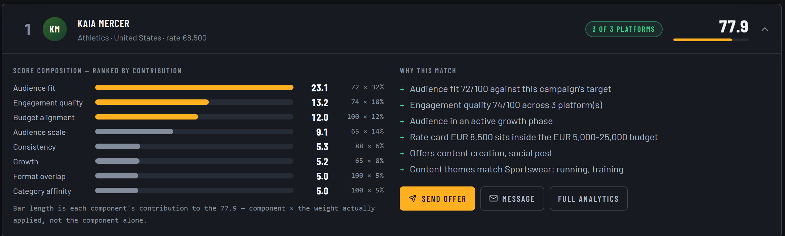
BACKUP, THE MATCHING ENGINE
A ranked athlete, opened on the arithmetic that ranked them
Eight weighted components. Bar length is the contribution to the total, not the component alone.
THE WEIGHTS ARE HAND SET
COVERAGE TRAVELS WITH THE SCORE
IT READS IN PLAIN LANGUAGE TOO
A transparent weighted sum. Learned weights come once there are outcomes, and must beat this.
Three of three platforms, or one of three. A thin score is marked thin, not quietly averaged.
Because the person approving the spend is rarely the person running the campaign.
Ranked matches for a live campaign, captured from the running application.

Slide 23
BACKUP, THE COMPARABLE THAT GOT LARGE
They sell what the market did. We measure what your money did
Slide 13 split the set two and two. This is what the split means to a brand with €2,000 to spend.
Sponsoo,
OpenSponsorship
Hookit,
SponsorUnited
Stride
THE MARKETPLACES
THE DATA COMPANIES
BOTH HALVES, ONE LOOP
CHOOSE
Browse a roster. Follower counts, self reported
Market intelligence: who sponsors whom, at scale
Ranked against your brief, every score decomposed
PRICE
You negotiate. No benchmark
A media value estimate for a property
A reach projection attached to the offer itself
VERIFY
Screenshots from the athlete
What the market did, from public posts
Delivered against that projection, per athlete
THE DATA
The athlete's own claim
Scraped, public, third party
The connector the athlete linked to get paid
THE BUYER
Brands of any size, thin support
Rights holders, agencies, enterprise seats
The clinic, the gym, the dealer
WHY THEY CANNOT FOLLOW
Delivery is measured against a projection written onto the deal at the moment the offer is made. A company that was not in the transaction never saw the promise, so it has nothing to reconcile against. That is a position, not a feature.
Plan section 3.2.2 on the competitive set and section 4.6 on the buyer. Neither data company executes a deal.
Notes:
This is the question I would ask, so let me answer it directly. SponsorUnited has 355 people and has raised nearly 39 million euros. What is left for me.
They sell a database. It tells a large brand or an agency what the sponsorship market is doing: who sponsors whom, what the activations look like, what a property is worth. It is genuinely good, and it is bought on enterprise seats by organisations with a sponsorship department.
What it cannot tell you is whether your own deal delivered what was promised, and the reason is structural rather than technical. We write the projected reach onto the deal row at the moment the offer is made, before the athlete has even accepted. The variance you saw on slide nine is that projection against what actually landed. A company that was not in the transaction never saw the promise, so there is nothing for it to reconcile against. They can tell you what the market did. Only the platform that brokered the deal can tell you what your money did.
And their data is scraped from public posts. Ours comes through the connector the athlete linked in order to get paid by their fans, which is the flywheel slide again: consented, first party, and free to acquire because the athlete came for a different reason.
One honest point. I am not beating SponsorUnited. If a brand is big enough to buy them, we are not in that conversation. Their 355 people are the cost of an enterprise sales motion, and that motion cannot be run at a two thousand euro deal. Their size is the reason the bottom of this market is still empty.

Slide 24
BACKUP, PRICING
15% sits between the only two published rates in the market
Both ends of the corridor are real competitor economics, derived from filed accounts.
PATREON
STRIDE
ONLYFANS
10%
15%
20%
all-in, on filed accounts
flat, and no monthly athlete fee
and agencies take 20 to 50% on top
At 15% we undercut the nearest comparable for any athlete earning under €1,380 a month, which is the entire long tail we are built for. The decision forfeits €0.5M of Y7 revenue against a 20% take, and buys a pricing argument that survives contact with the exact athlete we target.
Patreon and OnlyFans published terms and filed accounts; agency rates from published commission guides.

Slide 25
BACKUP, SCENARIOS
The plan survives its own pessimistic case
Each case re-runs the whole model on changed drivers rather than adjusting the base result.
CASE
WHAT CHANGES
Y7 REVENUE
Y7 EBITDA
CAPITAL NEED
PROFIT FROM
Pessimistic
Fans/athlete −25%, monetise −20%
€2.34M
€399k
€541k
Y5
Base
As modelled
€3.01M
€743k
€414k
Y4
Optimistic
Fans/athlete +25%, monetise +20%
€3.59M
€1.04M
€347k
Y4
Even the pessimistic case breaks even, one year later and on €541k instead of €414k. The downside here is a slower, smaller company rather than a failed one, and that is the property the staged raise is designed to protect.
Stride financial model, scenario table.

Slide 26
BACKUP, RISK
Eleven risks scored, and one of them is the thesis
Probability × impact, both on a 1 to 5 scale. Nothing is rated more likely than 3.
R1
Fans do not pay for niche-athlete content
3 × 5 = 15
Three months of real revenue from one anchor athlete, before the second tranche
R4
A funded entrant copies the model
3 × 4 = 12
The defence is scoring history and athlete relationships, which take time nobody can buy
R5
Regulatory: DAC7, age assurance, startup law
3 × 4 = 12
Compliance built in rather than retrofitted; reporting is a product feature
A risk map that is evenly scattered has not identified which risk is the real one. R1 is the thesis, and the entire financing structure exists to buy it down cheaply.

Slide 27
BACKUP, VALUATION
Where the €1.8M pre-money comes from
Two methods that disagree, and the disagreement is the honest part.
DCF ENTERPRISE VALUE
COMPARABLE SET
FOUNDER AND TEAM HOLD
€1.23M
€1.8M
65.2%
25% WACC, 3% terminal growth. Below the pre-money, which is normal for a pre-revenue venture.
Benchmarked against Sponsoo and OpenSponsorship, the two companies running the same model.
After both tranches, the optional growth round and a fully topped 10% ESOP.
PRE-SEED
EXTENSION
GROWTH, OPTIONAL
AFTER ESOP
€150k at €1.8M
€250k at €3.5M
€1.5M at €12M
10% pool
87.3%
81.5%
72.4%
65.2%
Founder stake retained through each round
Stride financial model: DCF, comparable transactions from PitchBook, and the dilution waterfall.

Slide 28
BACKUP, THE GATE
What the admission gate actually costs to run
The one human step in the chain, priced from the policy itself rather than assumed.
30.5%
4 min
0.64 FTE
< 48 h
ADMISSION RATE BY Y7
MEDIAN MANUAL REVIEW
REVIEWER LOAD AT Y10
SERVICE LEVEL
rising from 20% in Y1 as the funnel improves, which makes it a filter rather than a formality
priced at the same loaded salary the people line uses
at 8,500 athletes. Verification is not a money problem at this scale
the reason to automate is latency, not cost: a queued athlete is not earning
A club nomination brings a roster of 20 to 40 athletes with the verification problem already solved, and club-nominated applicants are admitted at 45% against 20% direct. That is the channel the growth plan opens at Y3.

