Slide 1
From C/C++ beyond embbedded systems to python in a Pynq board
Prime Number calculation project to stress test time execution
on FPGA, compared to pure Python and copiled C++

Slide 2
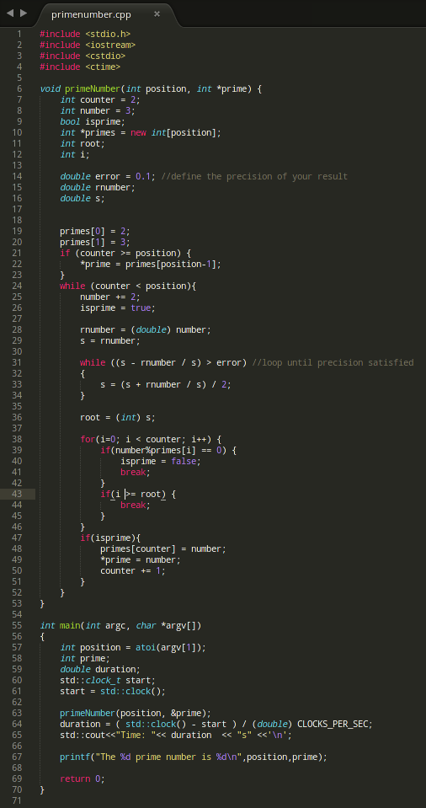
First thing you have to do is to make your code and test it in c/c++

Slide 3
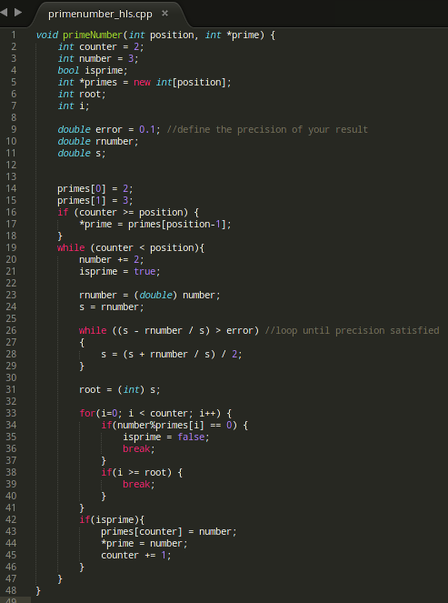
The function() will be the source for your HLS code.

Slide 4
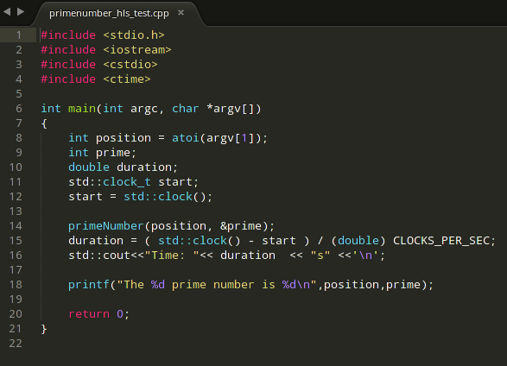
The main() of your code will be the HLS test bench.

Slide 5
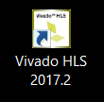
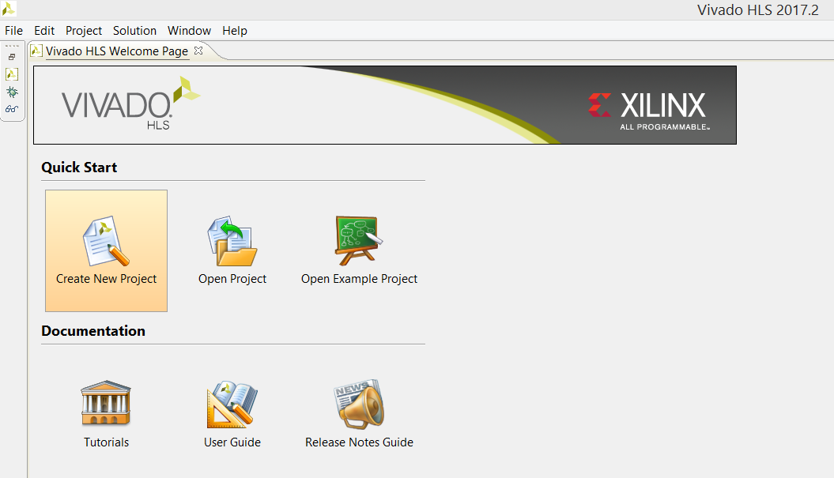
Let’s Open Vivado HLS Application and
Create a New Project

Slide 6
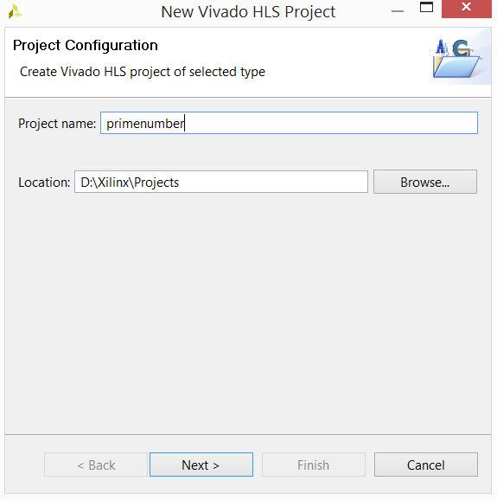
Name your project and choose project location

Slide 7
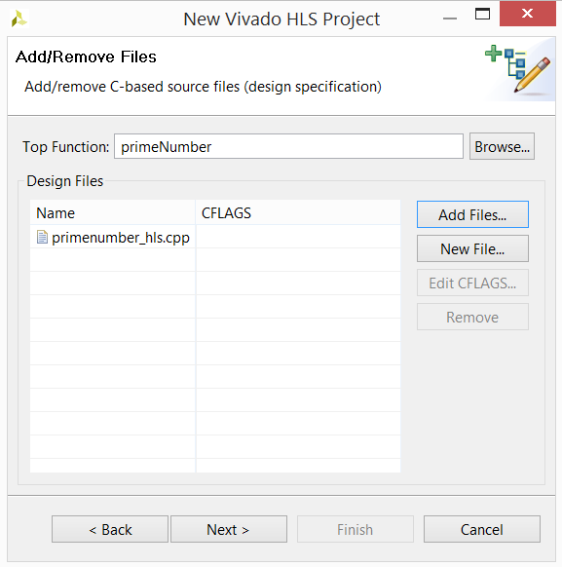
The Top Function will be the function developted earlier,
in this stage you can add your code file

Slide 8
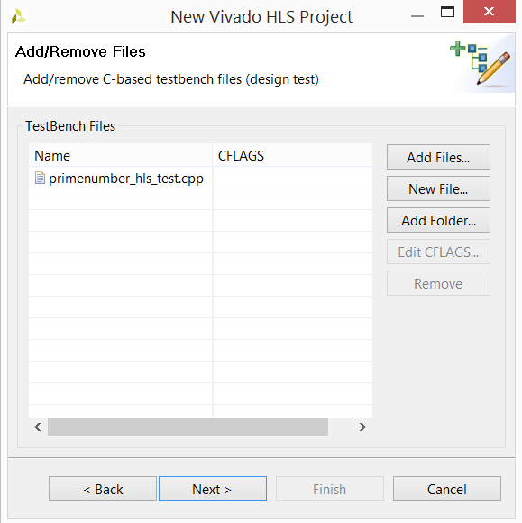
Next window add your test code

Slide 9
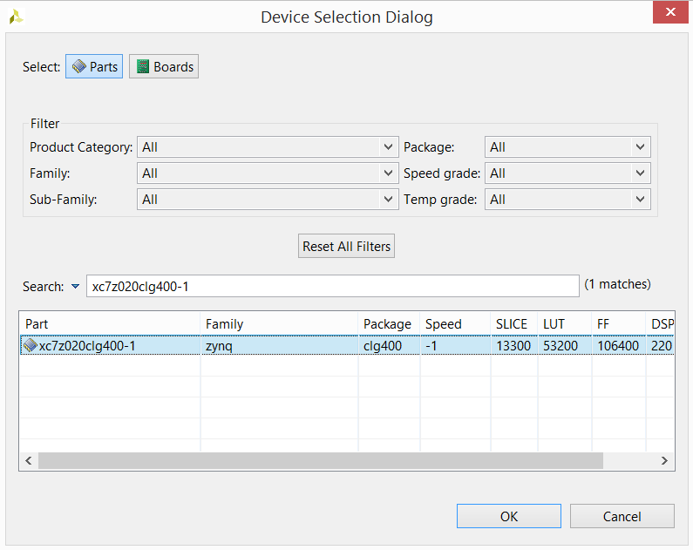
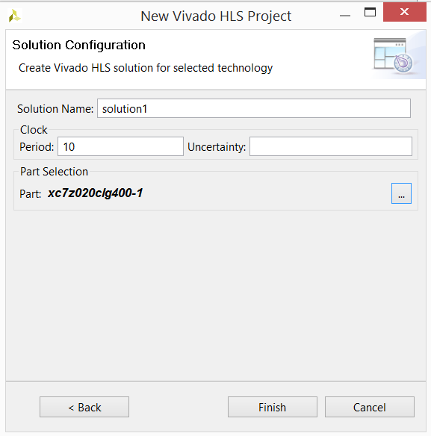
Select the part related to the Pynq board, search for
xc7z020clg400-1

Slide 10

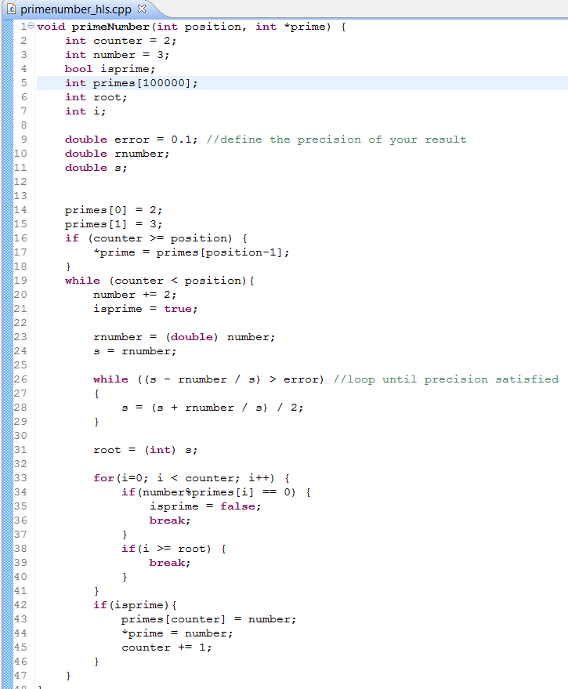

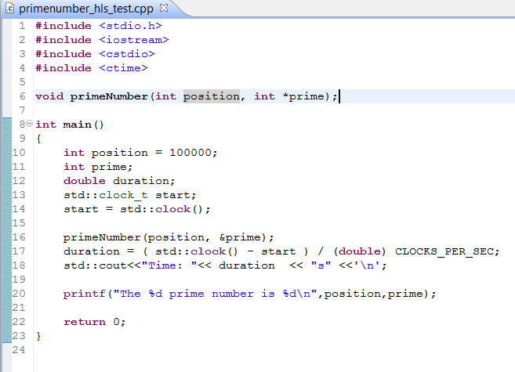
Some adjustments in your code should be necessary
to properly run in Vivado HLS

Slide 11
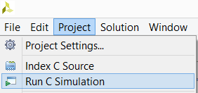
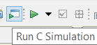
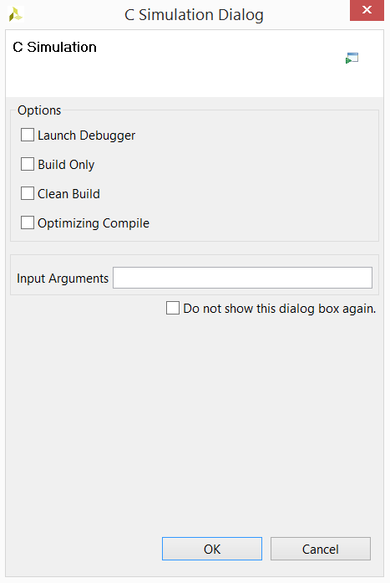
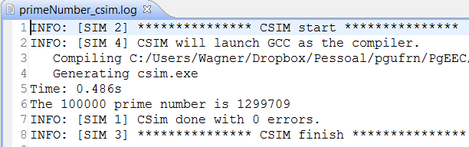
Now we need to Run C Simulation to test if code is
working in desired way
or
Afterward this window is showed
Finally the log window with the result.

Slide 12

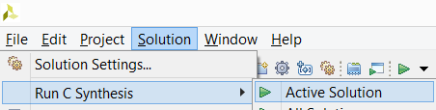
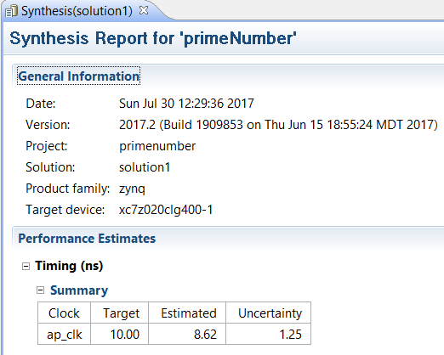
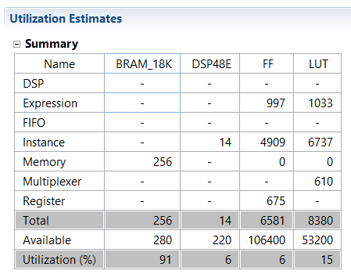
Next step is run C Synthesis that step reports about resorces
used, timing per cycle, project estimated latency, etc
or

Slide 13



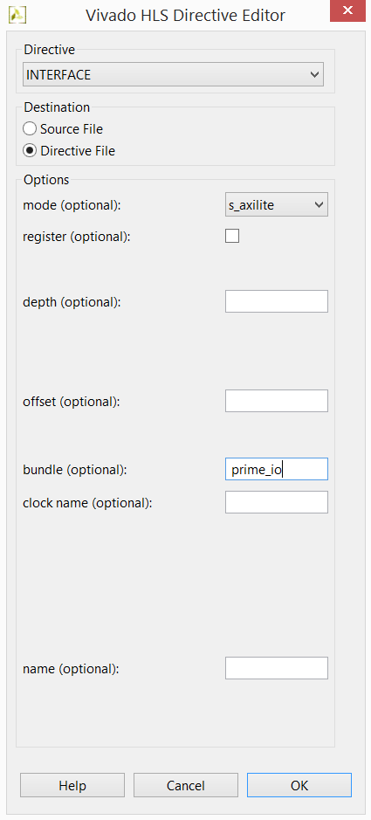
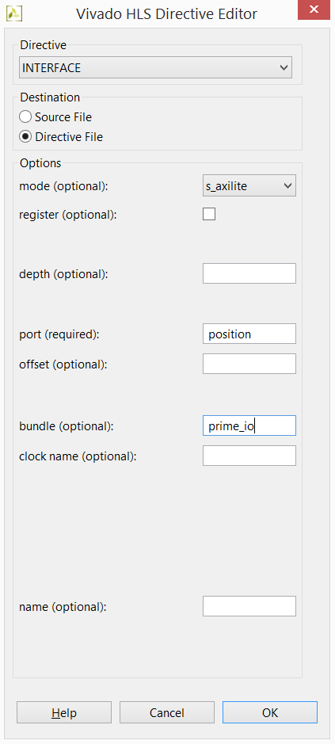
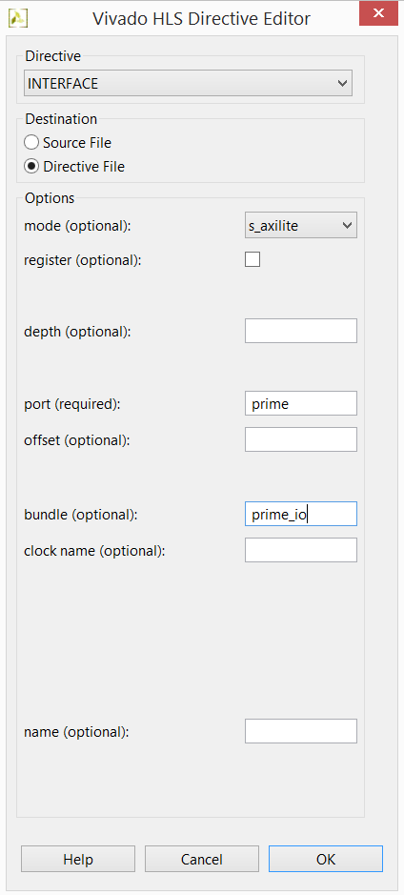
Now we have to define the IO ports to access our function from
FPGA to our final Python code, using INTERFACE Directives
ap_start, ap_done, ap_idle, ap_ready
position
prime

Slide 14
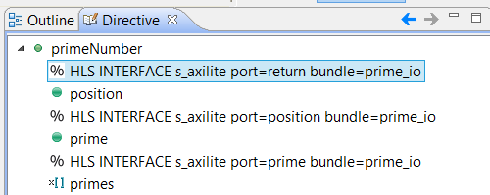
After inserting directives will be like this

Slide 15
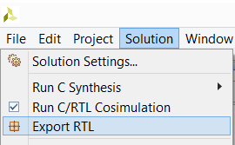
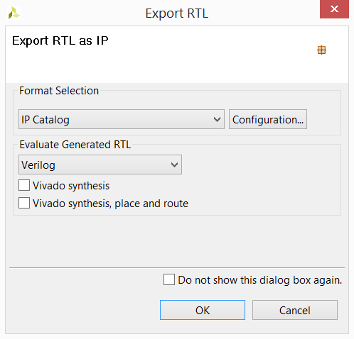
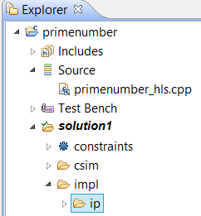
Everything is done, but we have to Synthesise again and
then we can export IP to be usedin Vivado 2017.2

Slide 16
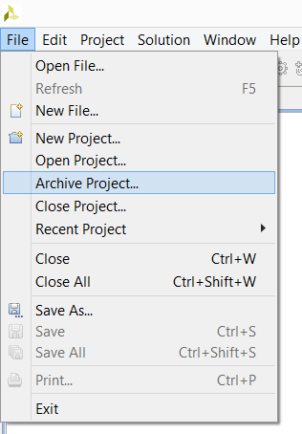
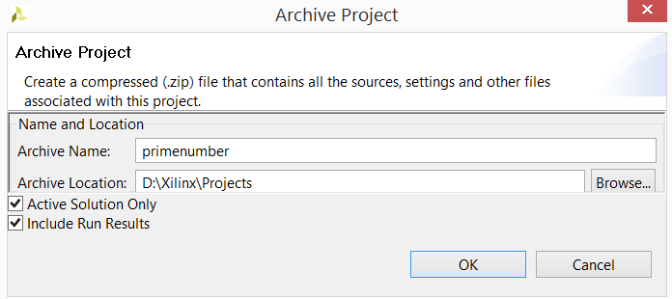
We can also backup our work to distribute to other machines

Slide 17

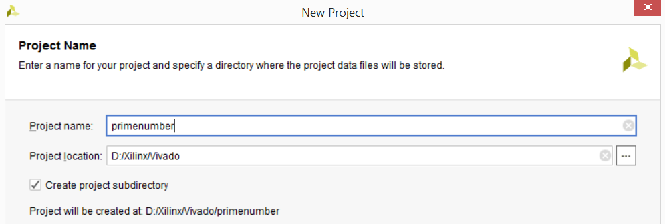
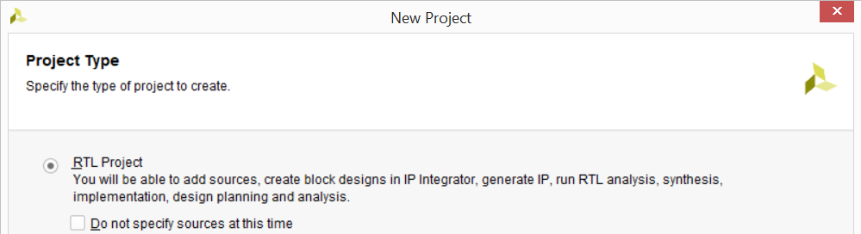
Now let’s create a Vivado 217.2 project to interface with Pynq board

Slide 18
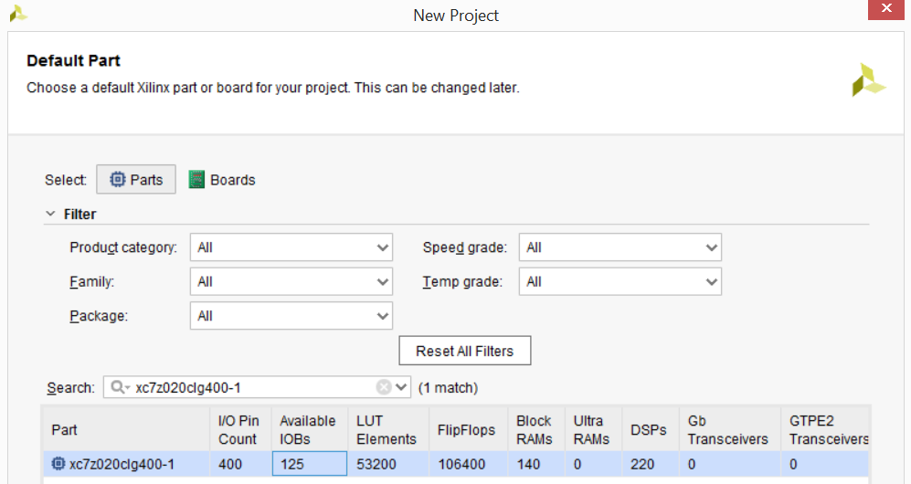
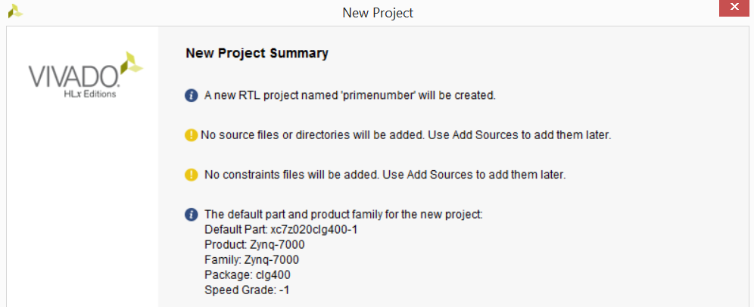
Still in the Vivado project creation wizard select parts for the board

Slide 19
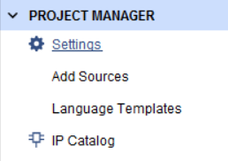
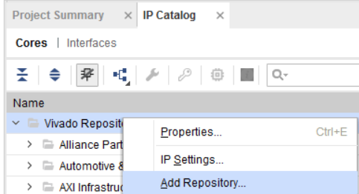
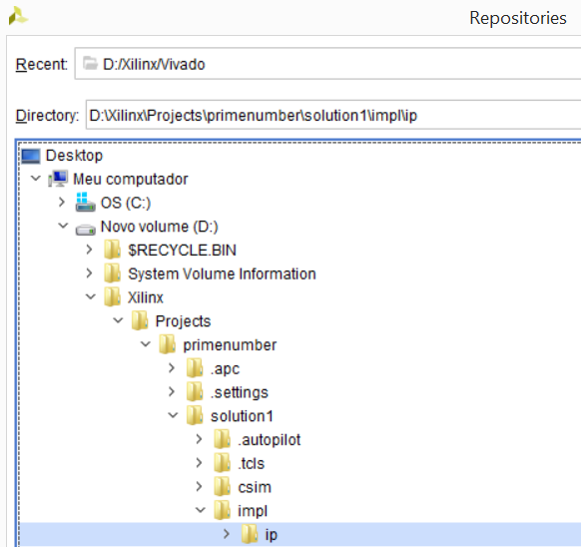
Click on IP Catalog to add IP created in Vivado HLS
Right Click on Vivado Repository and select the folder of your IP

Slide 20
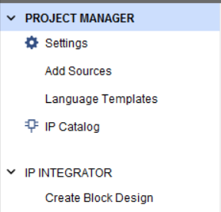
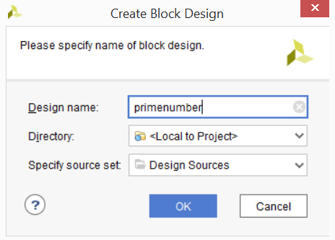
Now we need to Create Block Design by click in it

Slide 21



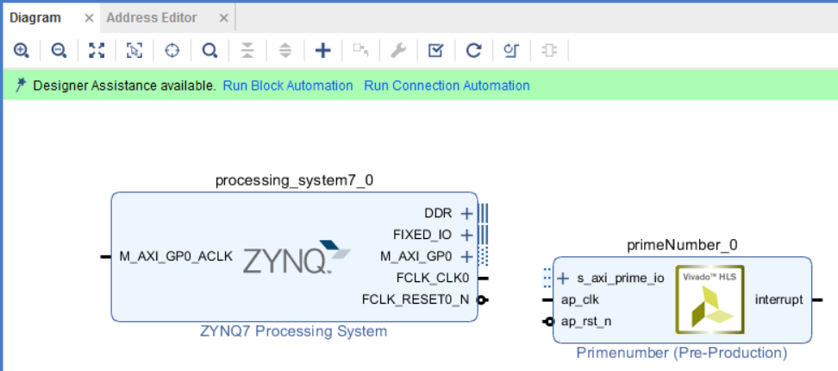
Add your custom IP and ZYNQ7 Processing System to the Diagram

Slide 22
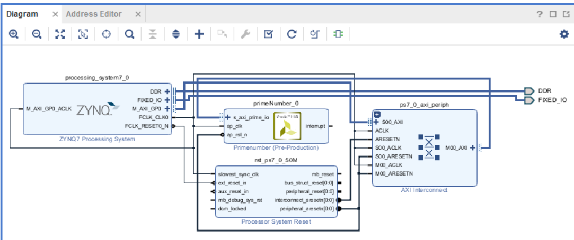
Make Run Block Automation and Run Connection Automation

Slide 23

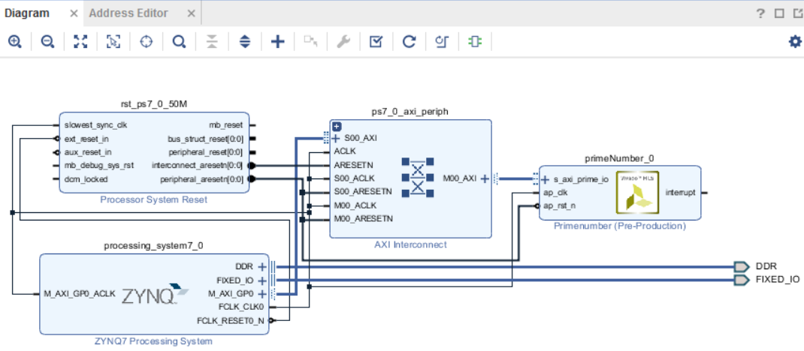
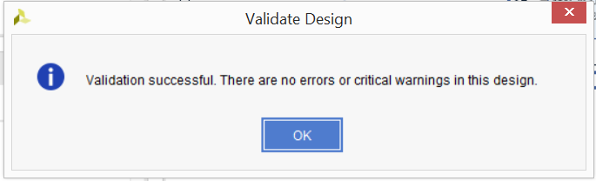

Click on Regenerate Layout to rearrange the diagram and in Validate Design to check it

Slide 24

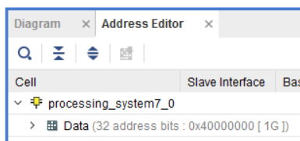
Check on Address Editor the memory address to be passed to MMIO in Python code

Slide 25
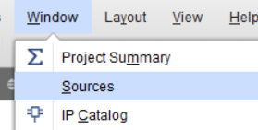
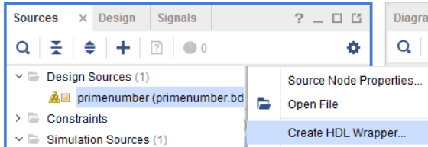
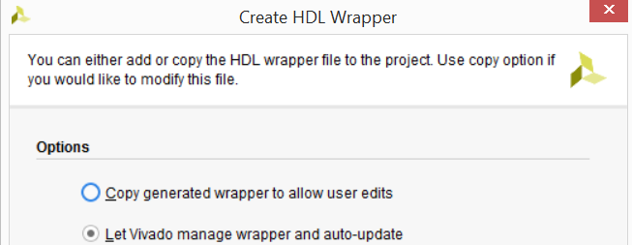
Show sources and right click on the Design project to create a Create HDL Wrapper

Slide 26
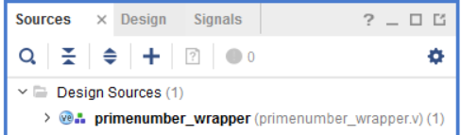
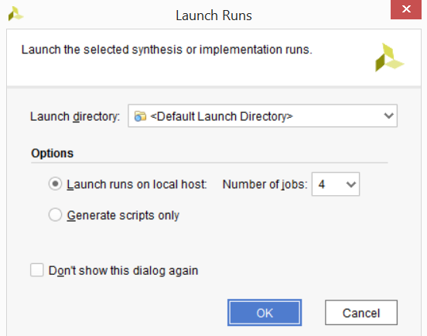

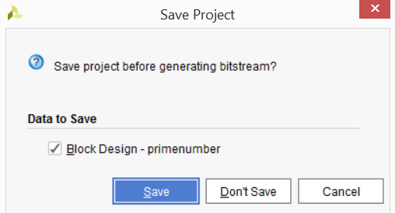

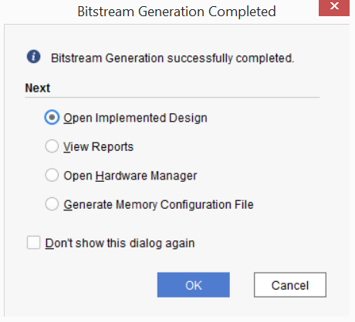
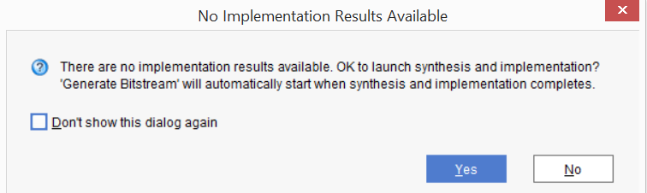
Now we can generate the bitstream wich will be used on Python Overlay
Generate Bitstream

Slide 27



In sources tab expand wrapper until we can find primeNumber_io_s_axi

Slide 28

Check the usefull addresses related to ap_start, ap_ready, data signal of position and prime

Slide 29



Now we can write the .tcl file that will be companion to the bitstream file located in same folder
On Tcl Console type the command write_bd_tcl [filename]
Locate bitstream primenumber_wrapper.bit and copy and rename it to primenumber.bit

Slide 30


Locate and conect to your Pynq board on the network
With a browser access Jupyter interface located at port 9090

Slide 31





Create a folder, rename it and upload your project files to that folder

Slide 32


Write your Python code on the Jupyter Notebook interface to test your HLS on the Pynq board

Slide 33

Run pure Python and copiled C++ to compare with HLS

