Slide 1
PYNQ Overlay implementation flow
based on Vivado HLx Tools

Slide 2
Summary
Introduction
Vivado HLS
Vivado
PYNQ Overlay call
Demo
Conclusion

Slide 3
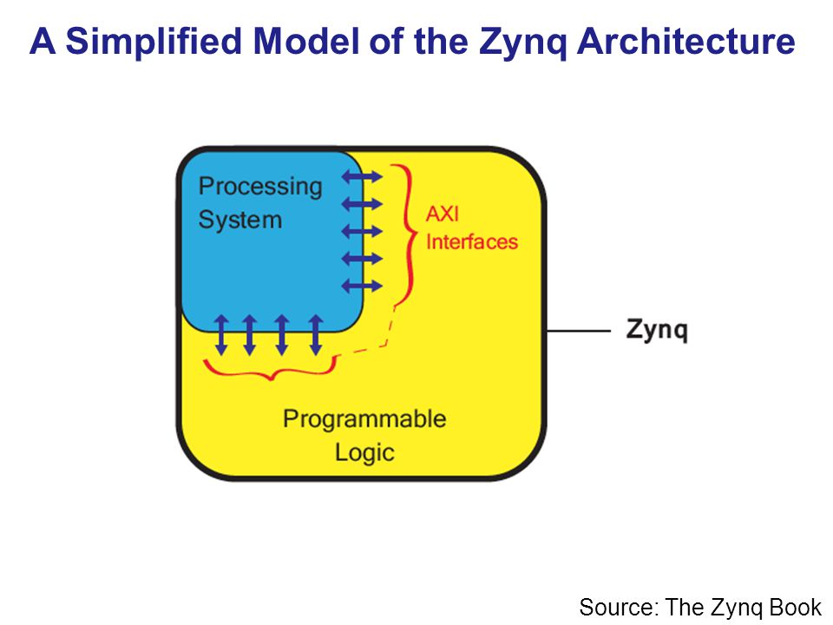

Slide 4
The routine applyed to the project is:
C/C++
Vivado HLS
Constrains /Directives
Vivado
Constrains
PYNQ

Slide 5
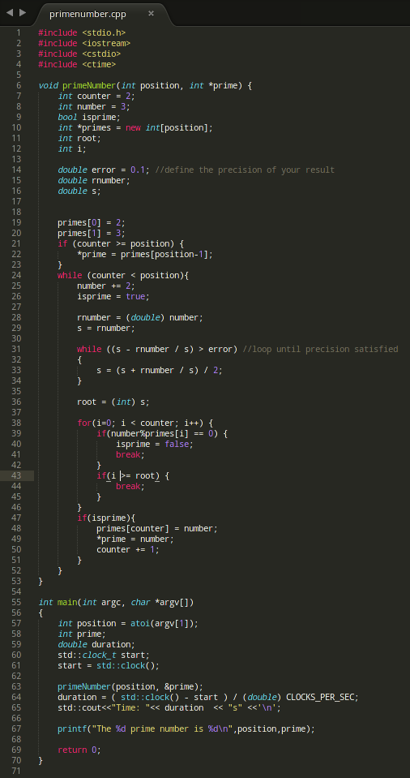
C/C++
Create C/C++ code

Slide 6
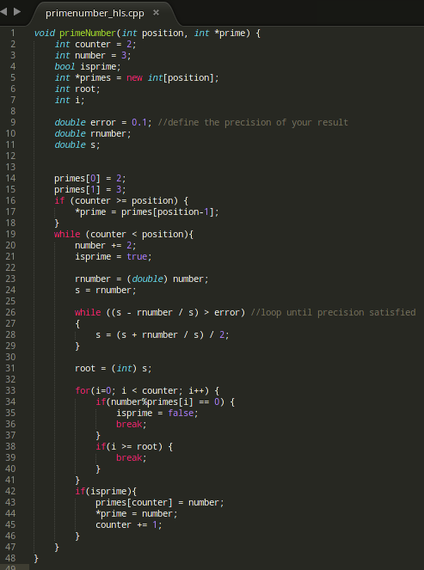
C/C++
This is the function() code for calculating the Prime Number

Slide 7
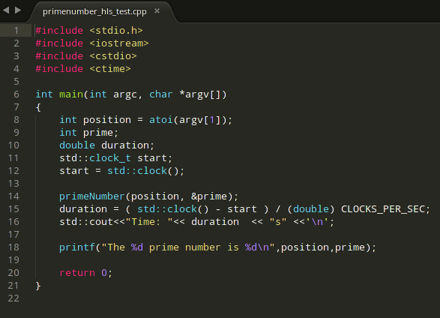
C/C++
The main() of your code will be used for time comparison

Slide 8
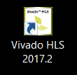
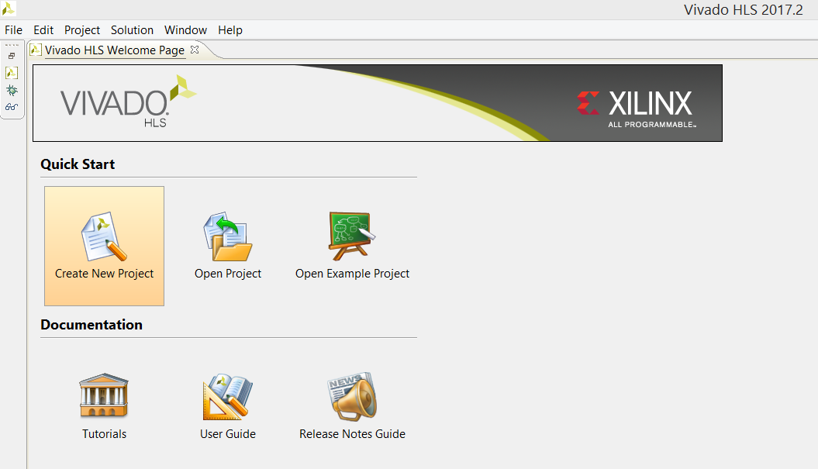
Vivado HLS
Let’s Open Vivado HLS Application and
Create a New Project

Slide 9
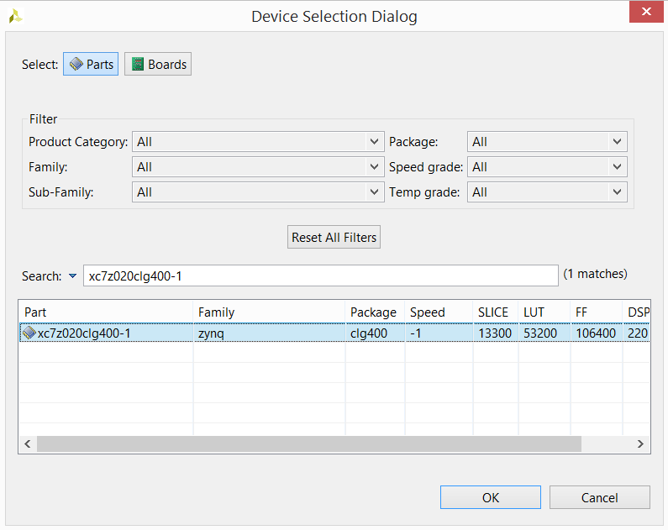
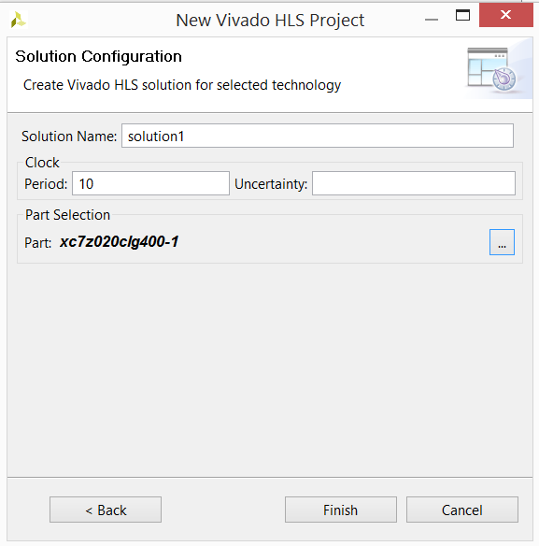
Vivado HLS
Create a new project on Vivado HLS with part
xc7z020clg400-1

Slide 10


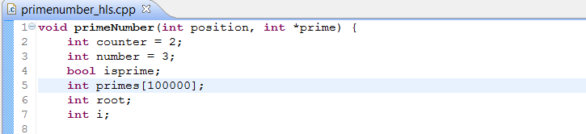
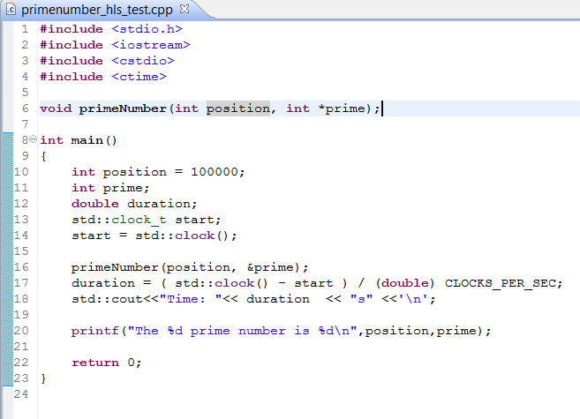
Vivado HLS
HLS code standards

Slide 11
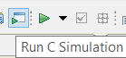
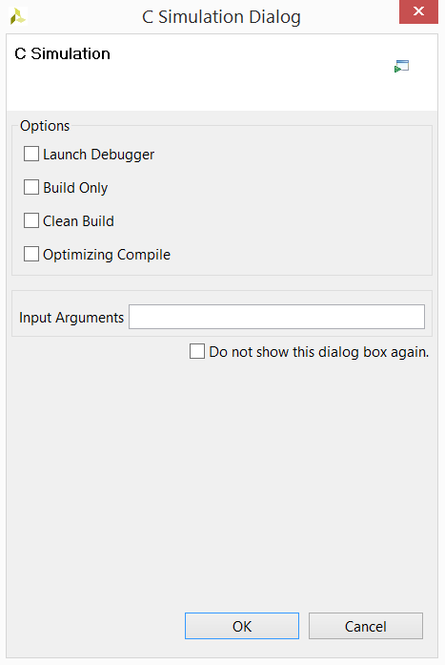
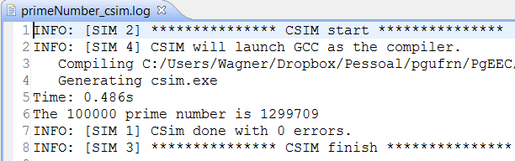
Vivado HLS
C Simulation is performed to validate the code
Afterward this window is showed
Finally the log window with the result

Slide 12
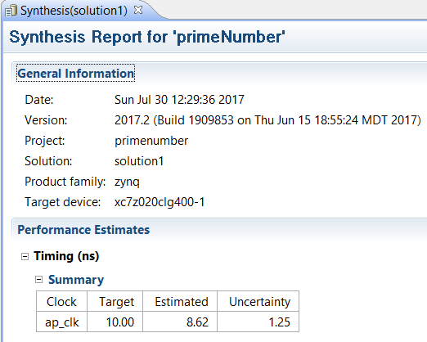
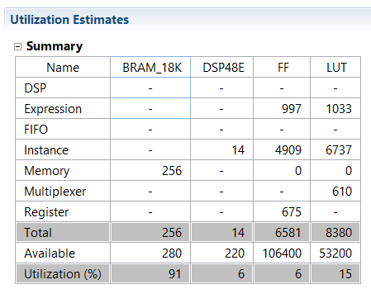
Vivado HLS
C Synthesis

Slide 13
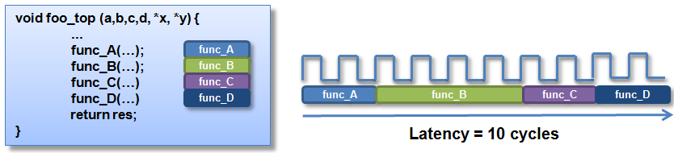
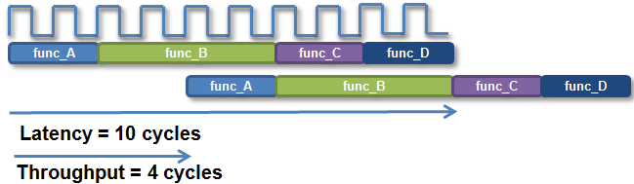
Vivado HLS
Design Latency
The latency of the design is the number of cycle it takes to output the result
Design Throughput
The throughput of the design is the number of cycles between new inputs

Slide 14
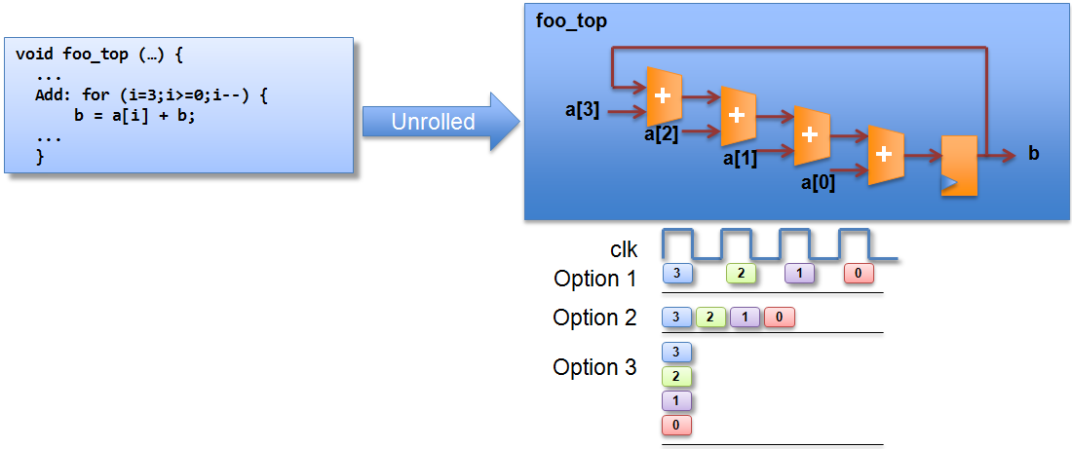
Vivado HLS
Unrolling
Reduces latency
foo_top
+
b
a[N]

Slide 15
Vivado HLS
Pipelining
Reduces throughput

Slide 16
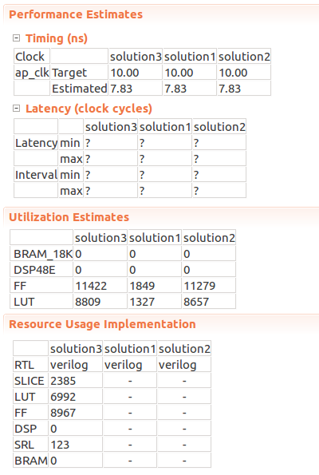
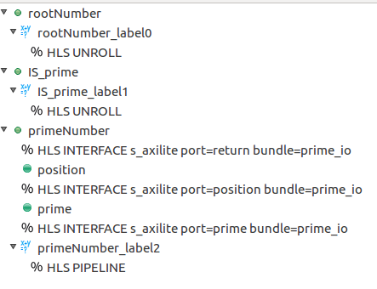
Vivado HLS
Solutions comparison
Vivado needs fixed loop for latency estimation

Slide 17
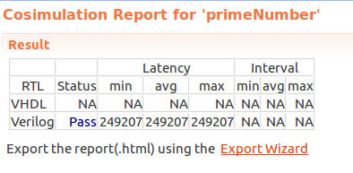
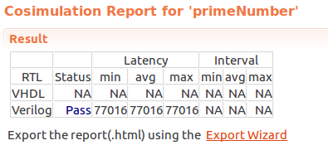
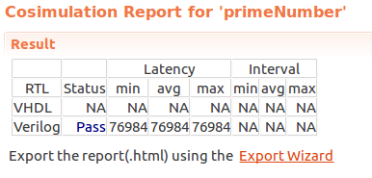
Vivado HLS
Cosimulation
Shows overall latency
-Latency for different solutions

Slide 18
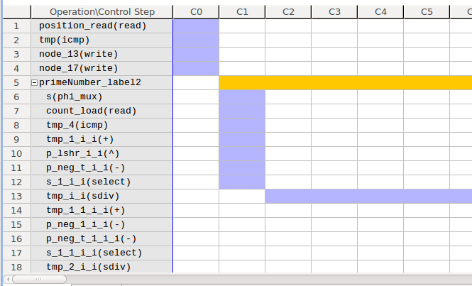
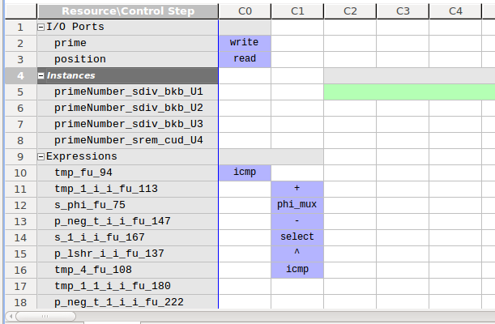
Vivado HLS
System analysis

Slide 19
Vivado HLS
AXI protocol
Advanced eXtensible Interface
Is part of the ARM Advanced Microcontroller Bus Architecture (AMBA) specification
Interface between the processing system and programmable logic sections of the chip.

Slide 20



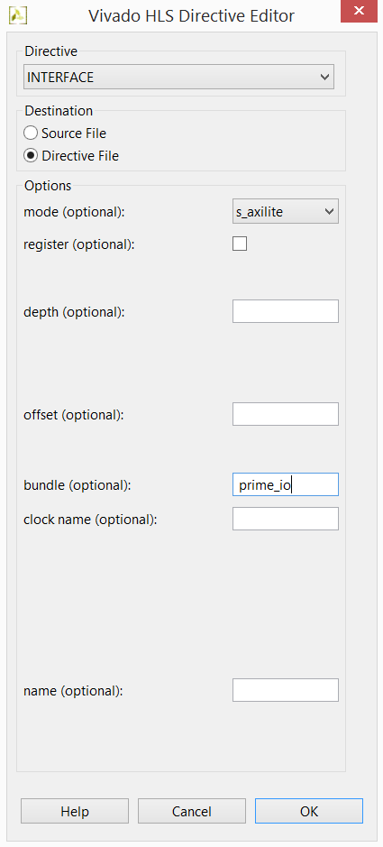
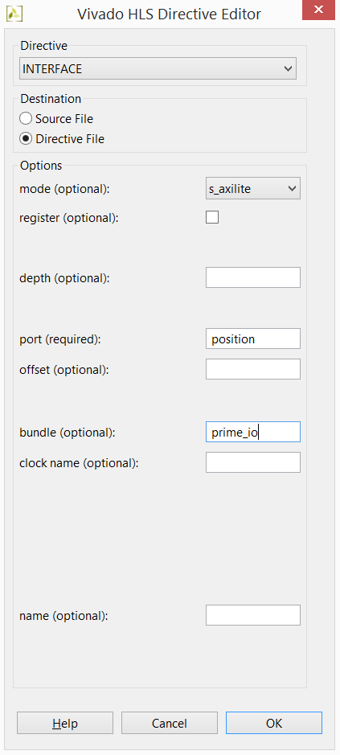
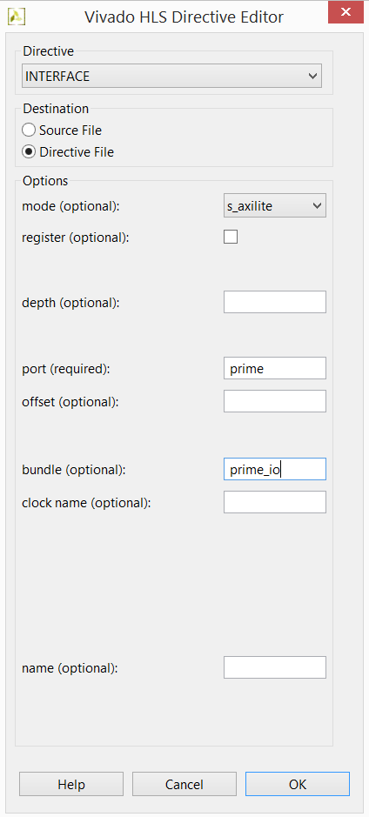
Vivado HLS
Now we have to define the IO ports to access our function from
FPGA to our final Python code, using INTERFACE Directives
ap_start, ap_done, ap_idle, ap_ready
position
prime

Slide 21
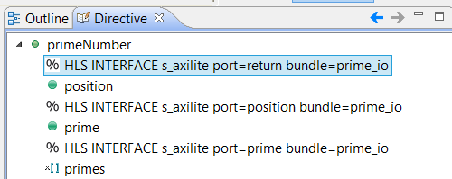
Vivado HLS
After inserting directives will be like this

Slide 22
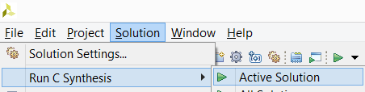
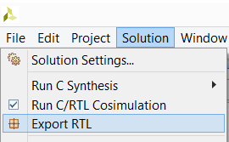
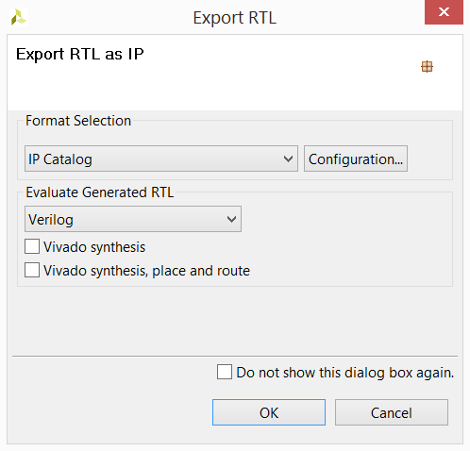
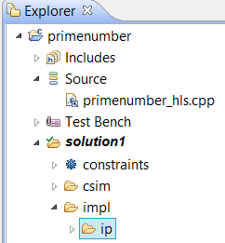
Vivado HLS
Everything is done, but we have to Synthesize again and
then we can export IP to be used in Vivado 2017.2

Slide 23
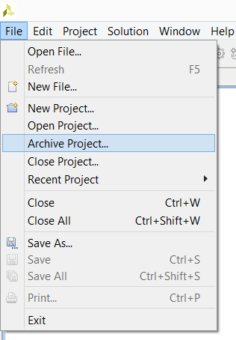
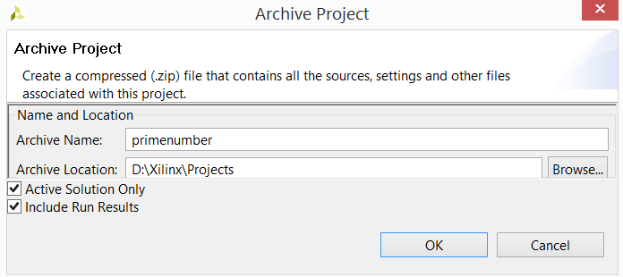
Vivado HLS
We can also backup our work to distribute to other machines

Slide 24

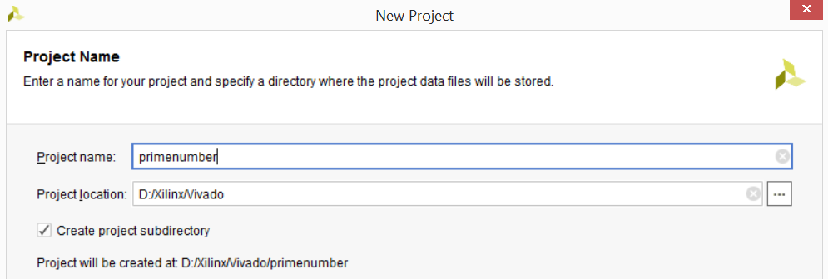
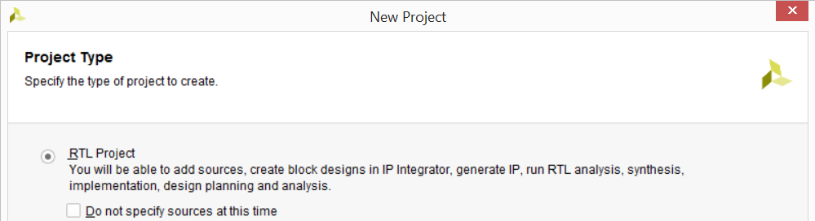
Vivado
Now let’s create a Vivado 2017.2 project to interface with PYNQ board

Slide 25
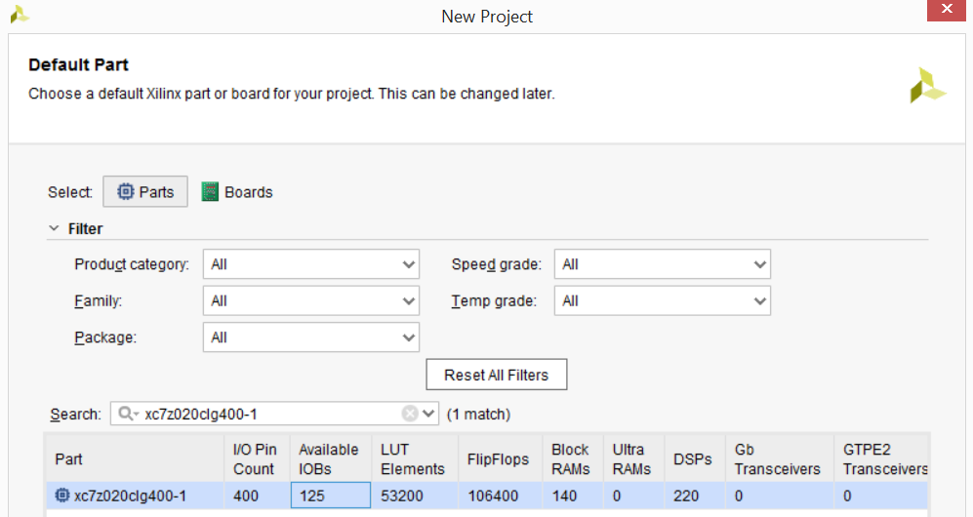
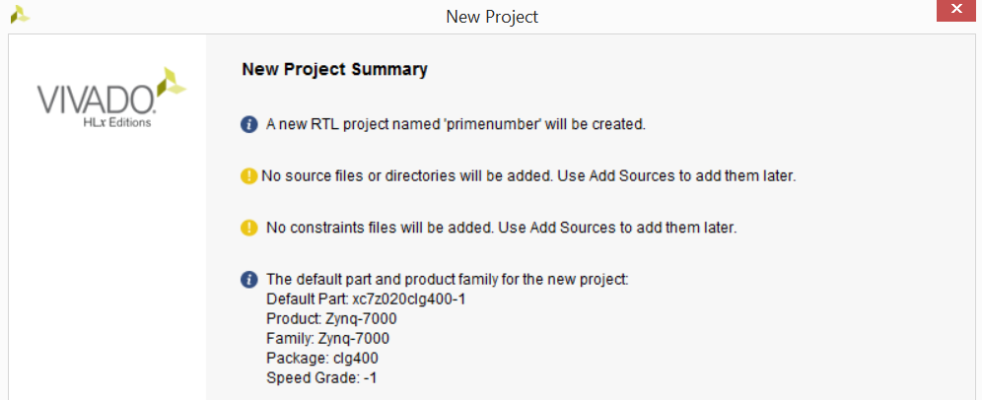
Vivado
Still in the Vivado project creation wizard select parts for the board

Slide 26
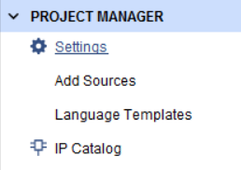
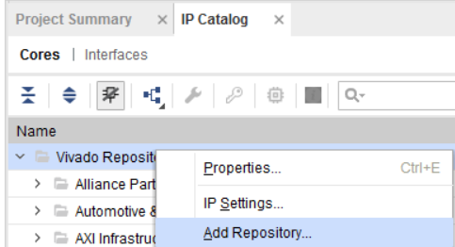
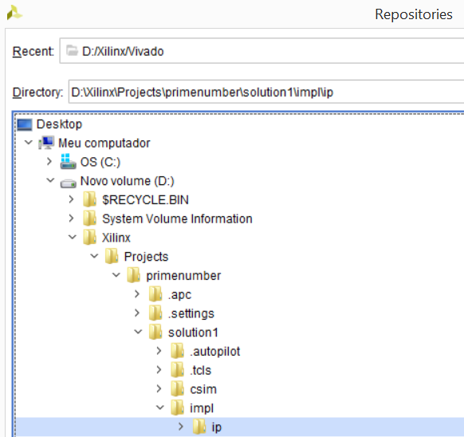
Vivado
Click on IP Catalog to add IP created in Vivado HLS
Right Click on Vivado Repository and select the folder of your IP

Slide 27



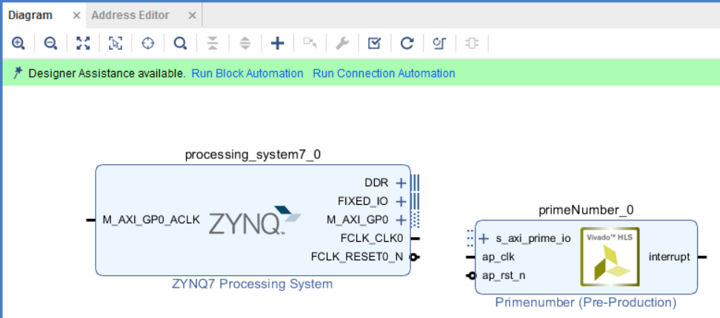
Vivado
Add your custom IP and ZYNQ7 Processing System to the Diagram

Slide 28
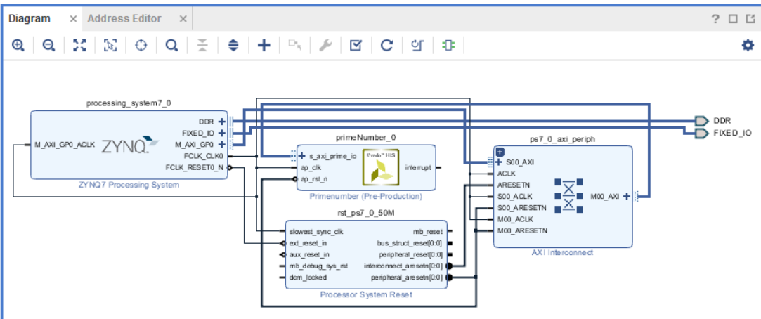
Vivado
Make Run Block Automation and Run Connection Automation

Slide 29

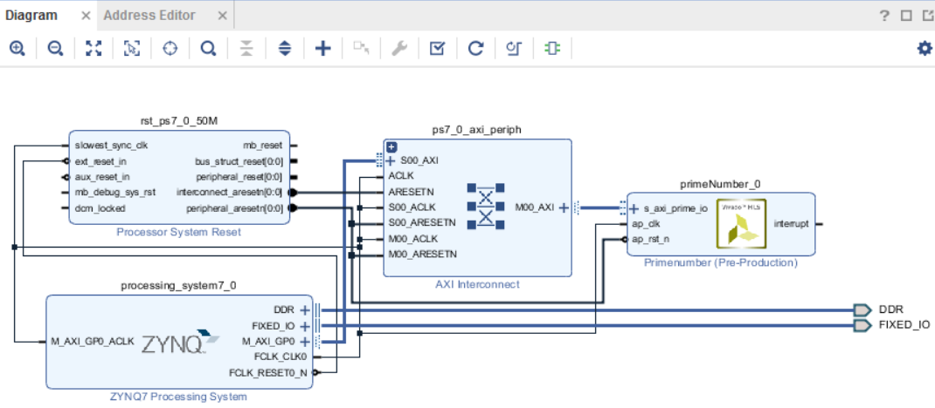
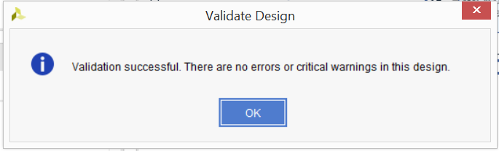

Vivado
Click on Regenerate Layout to rearrange the diagram and in Validate Design to check it

Slide 30
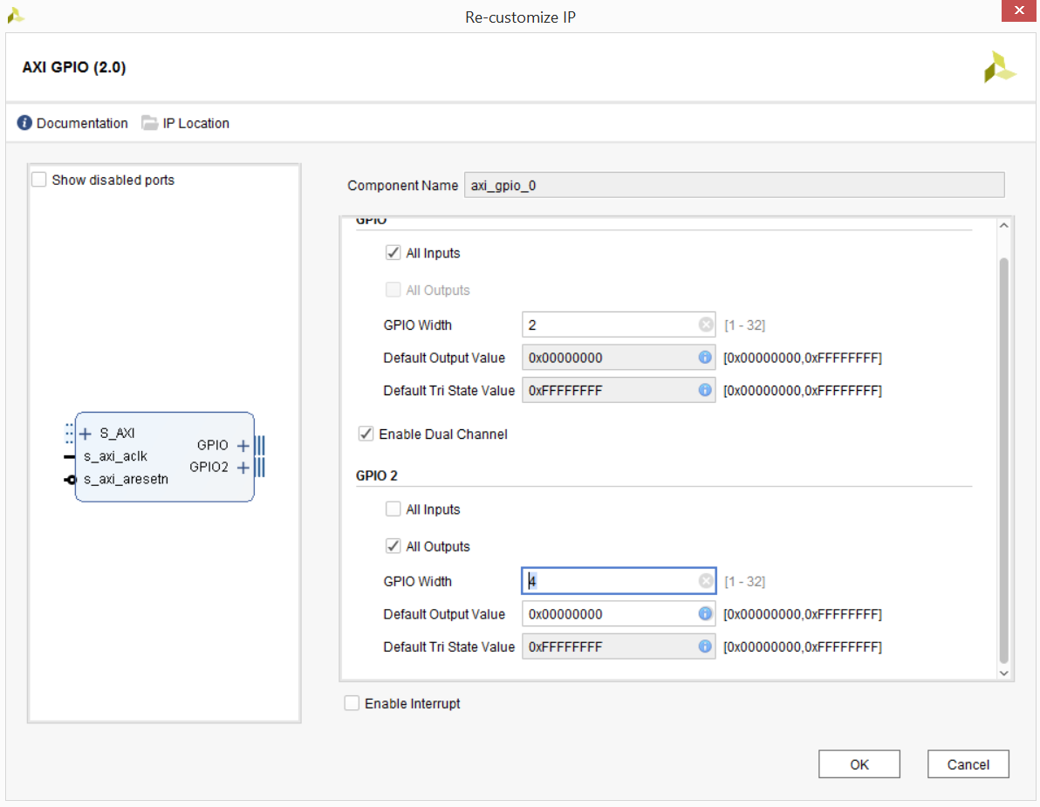
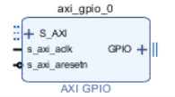
Vivado
LEDs and Switches Interface

Slide 31
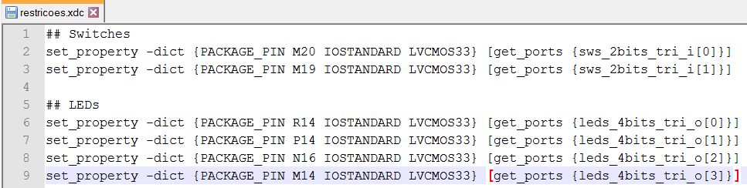
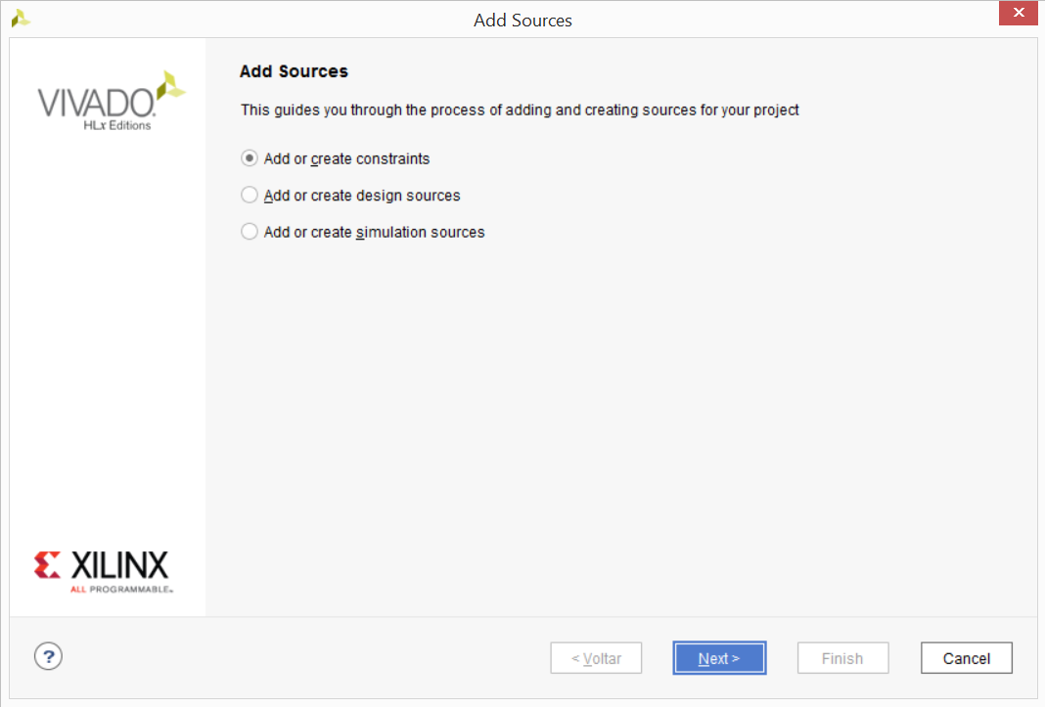

Vivado

Slide 32

Vivado

Slide 33


Vivado
Check on Address Editor the memory address to be passed to MMIO in Python code

Slide 34




Vivado
Show sources and right click on the Design project to create a Create HDL Wrapper

Slide 35


Vivado
Now we can generate the bitstream wich will be used on Python Overlay
Generate Bitstream

Slide 36

Vivado
In sources tab, expand wrapper until we can find primeNumber_io_s_axi

Slide 37

Vivado
Check the usefull addresses related to ap_start, ap_ready, data signal of position and prime

Slide 38



Vivado
Now we can write the .tcl file that will be companion to the bitstream file located in same folder
On Tcl Console type the command write_bd_tcl [filename]
Locate bitstream primenumber_wrapper.bit and copy and rename it to primenumber.bit

Slide 39


PYNQ
Locate and conect to your Pynq board on the network
With a browser access Jupyter interface located at port 9090

Slide 40





PYNQ
Create a folder, rename it and upload your project files to that folder

Slide 41

PYNQ
MMIO
PYNQ includes the MMIO Python class to simplify communication between the Zynq PS and PL.
The MMIO class can access an area of memory in the PL by specifying the start address, and the range

Slide 42


PYNQ
Write your Python code on the Jupyter Notebook interface to test your HLS on the Pynq board

Slide 43

PYNQ
Run pure Python and copiled C++ to compare with HLS

Slide 44
PYNQ
Time execution results
Runtimes:
Python
Overlay
C++

Slide 45
Demo!

Slide 46
Conclusion
Implementation time can be extensive with a common computer
Not all projects can be enhanced in performance
PYNQ is very handy to work with Processing System (PS) and Programmable Logic (PL) at the same time
Vivado has many options to improve the project specifications
For future work, improve the Vivado HLS code to beat the c++ compiled code.

Slide 47
All files used on this project are distributed on
Files
github.com/wagnerrn/pynq-primenumber
yangtavares.com/
2017/07/31/creating-a-simple-overlay-for-pynq-z1-board-from-vivado-hlx
Many Thanks
References
Xilinx Labs Tutorials
pynq.readthedocs.io
github.com/Xilinx/PYNQ

