Slide 1
A PYNQ Overlay Implementation based on Vivado HLx Tools

Slide 2
Introduction

Slide 3
The routine applyed to the project is:
C/C++
Vivado HLS
Vivado 2017.2
PYNQ

Slide 4
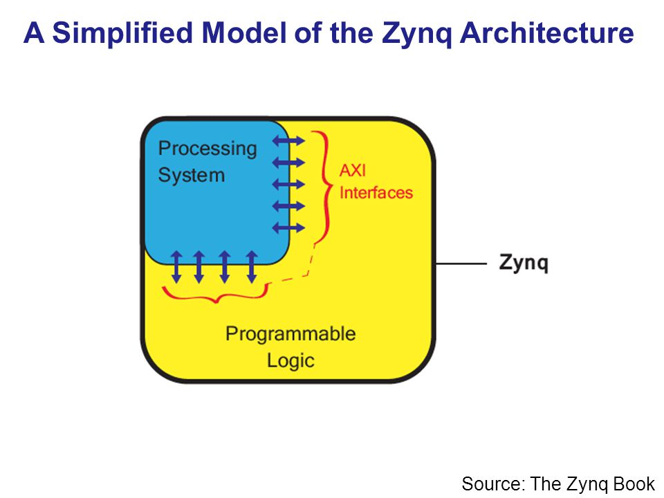

Slide 5
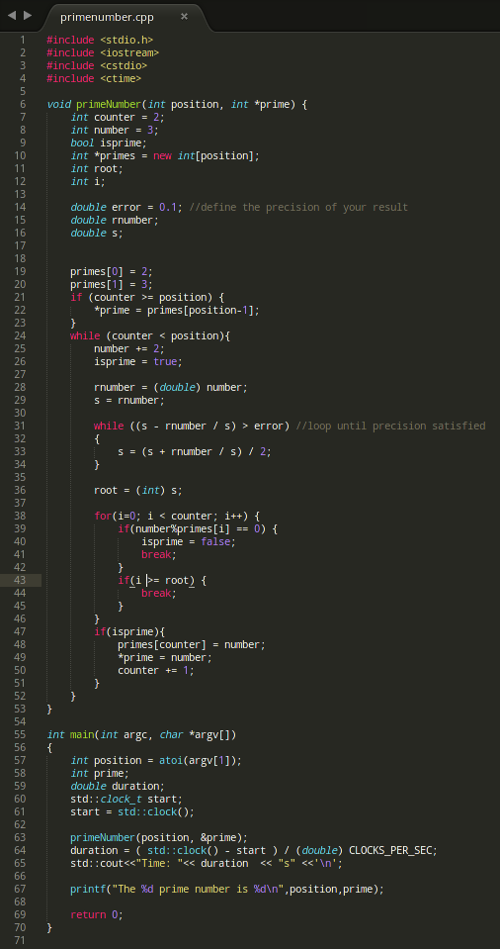
C/C++
First thing you have to do is to make your code and test it in c/c++

Slide 6
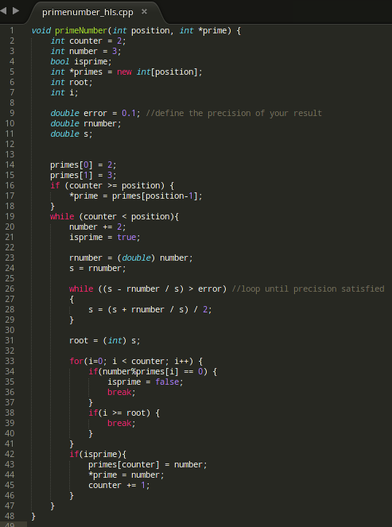
C/C++
The function() will be the source for your HLS code

Slide 7
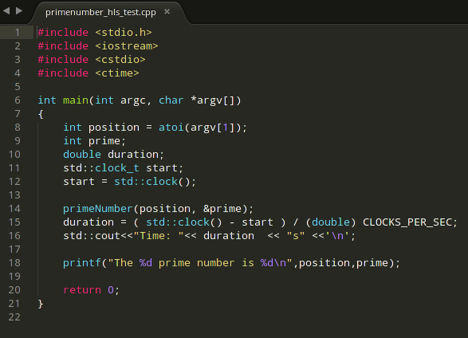
C/C++
The main() of your code will be the HLS test bench

Slide 8
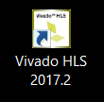
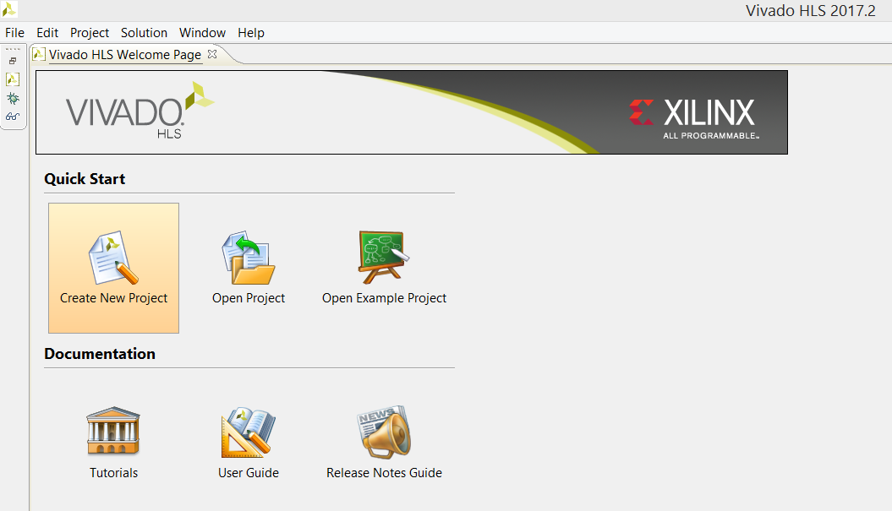
Vivado HLS
Let’s Open Vivado HLS Application and
Create a New Project

Slide 9
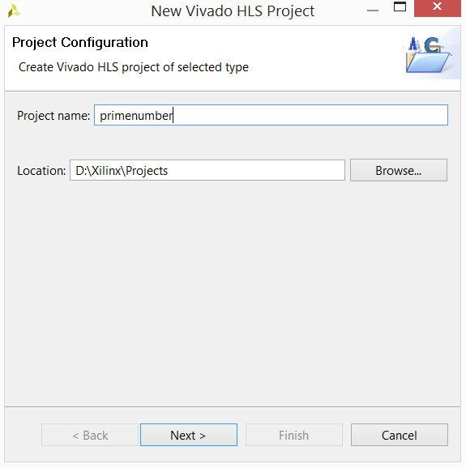
Vivado HLS
Name your project and choose project location

Slide 10
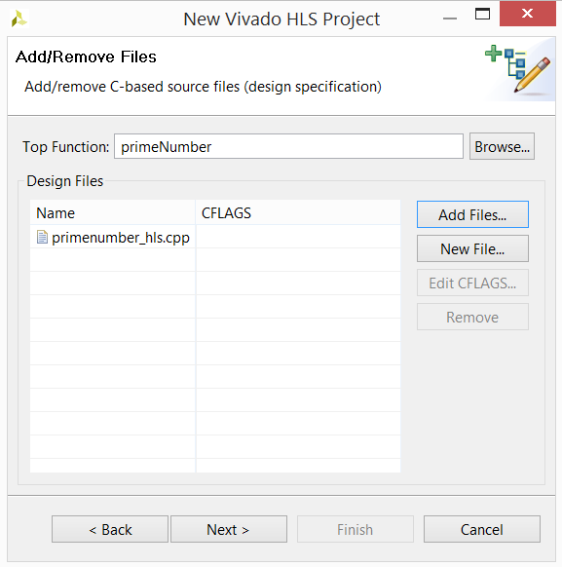
Vivado HLS
The Top Function will be the function developted earlier,
in this stage you can add your code file

Slide 11
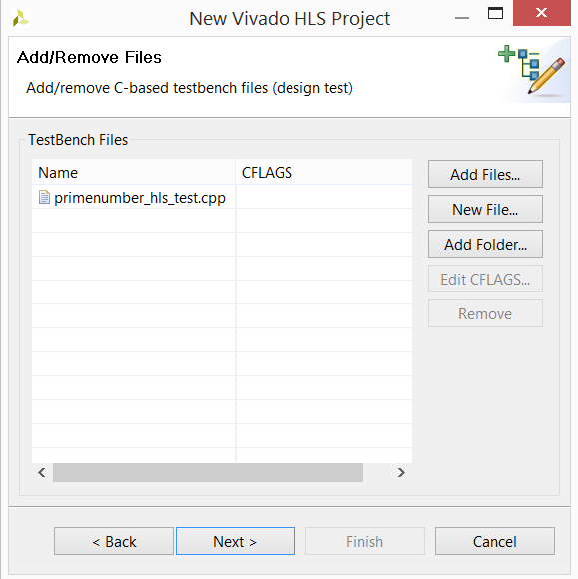
Vivado HLS
Next window add your test code

Slide 12
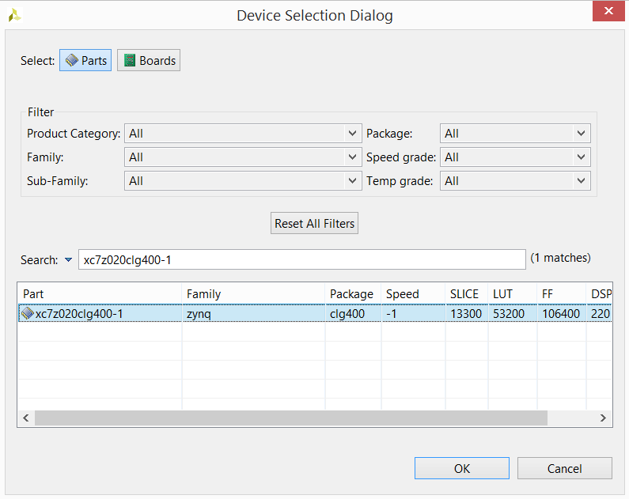
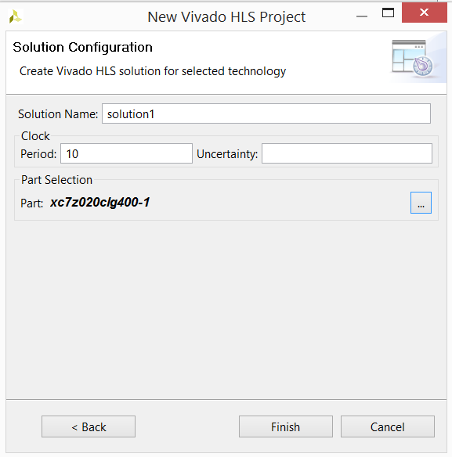
Vivado HLS
Select the part related to the Pynq board, search for
xc7z020clg400-1

Slide 13

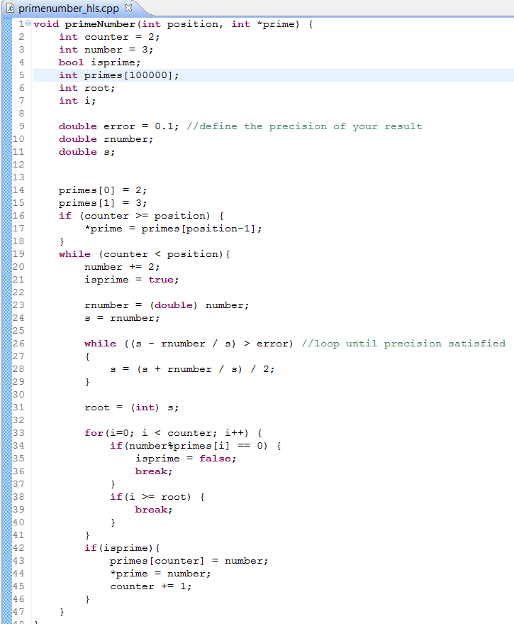

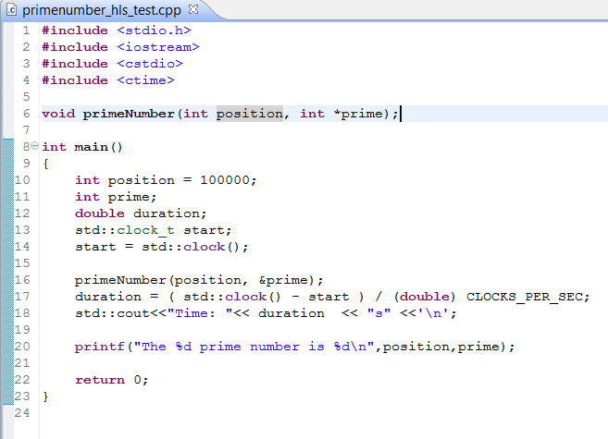
Vivado HLS
Some adjustments in your code should be necessary
to properly run in Vivado HLS

Slide 14
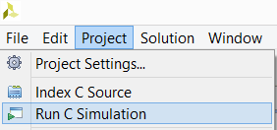
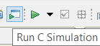
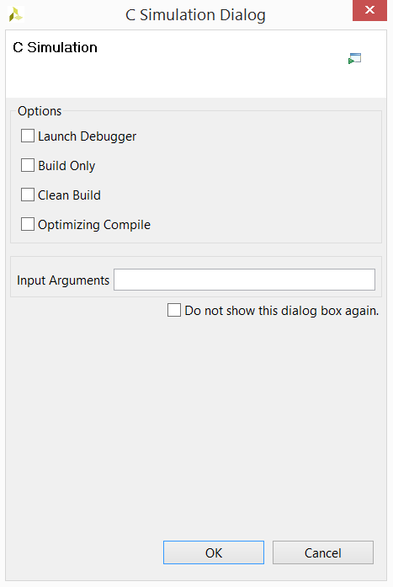
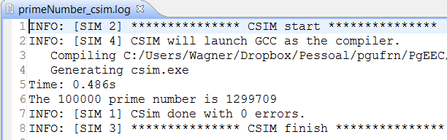
Vivado HLS
Now we need to Run C Simulation to test if code is
working in desired way
or
Afterward this window is showed
Finally the log window with the result.

Slide 15

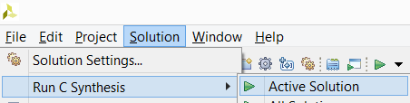
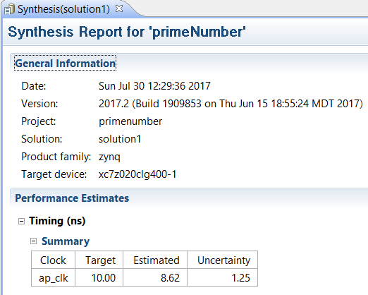
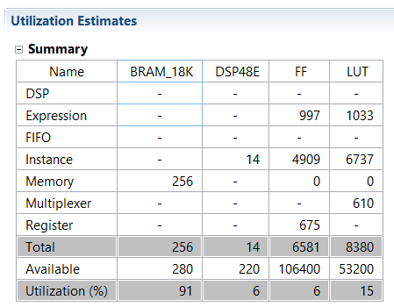
Vivado HLS
Next step is run C Synthesis that step reports about resorces
used, timing per cycle, project estimated latency, etc
or

Slide 16



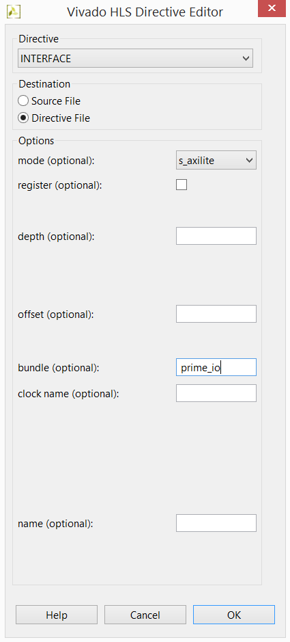
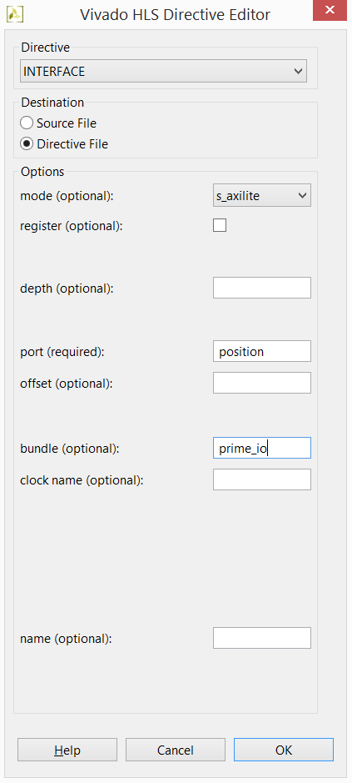
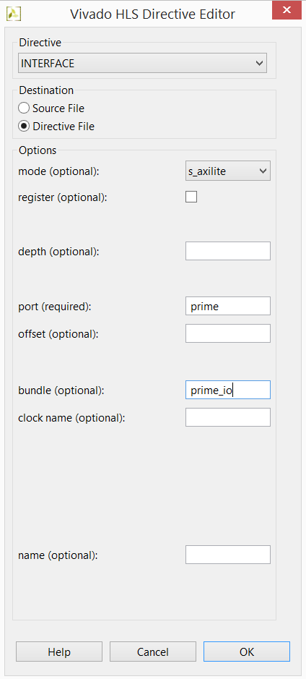
Vivado HLS
Now we have to define the IO ports to access our function from
FPGA to our final Python code, using INTERFACE Directives
ap_start, ap_done, ap_idle, ap_ready
position
prime

Slide 17
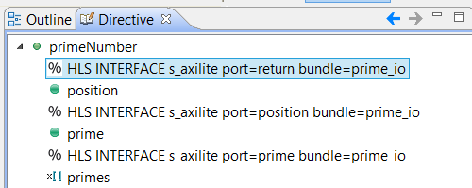
Vivado HLS
After inserting directives will be like this

Slide 18
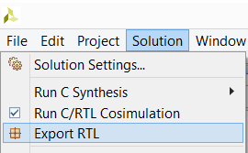
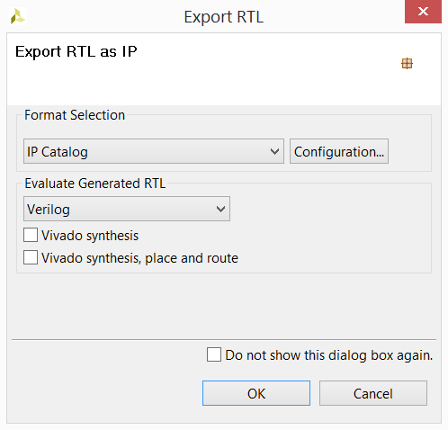
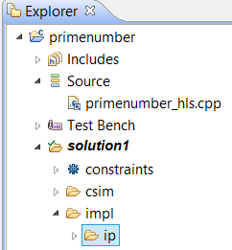
Vivado HLS
Everything is done, but we have to Synthesize again and
then we can export IP to be used in Vivado 2017.2

Slide 19
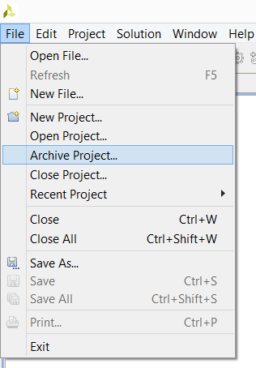
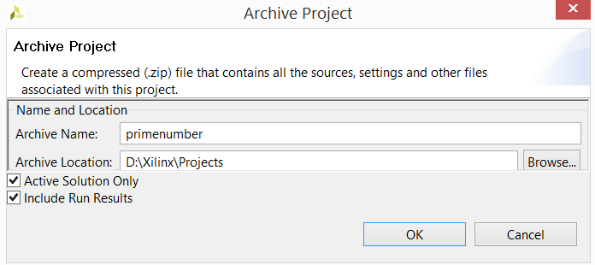
Vivado HLS
We can also backup our work to distribute to other machines

Slide 20

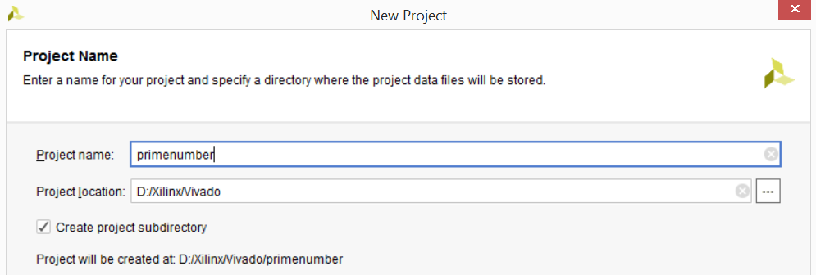
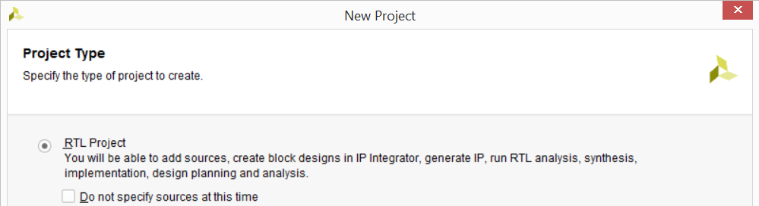
Vivado 2017.2
Now let’s create a Vivado 217.2 project to interface with Pynq board

Slide 21
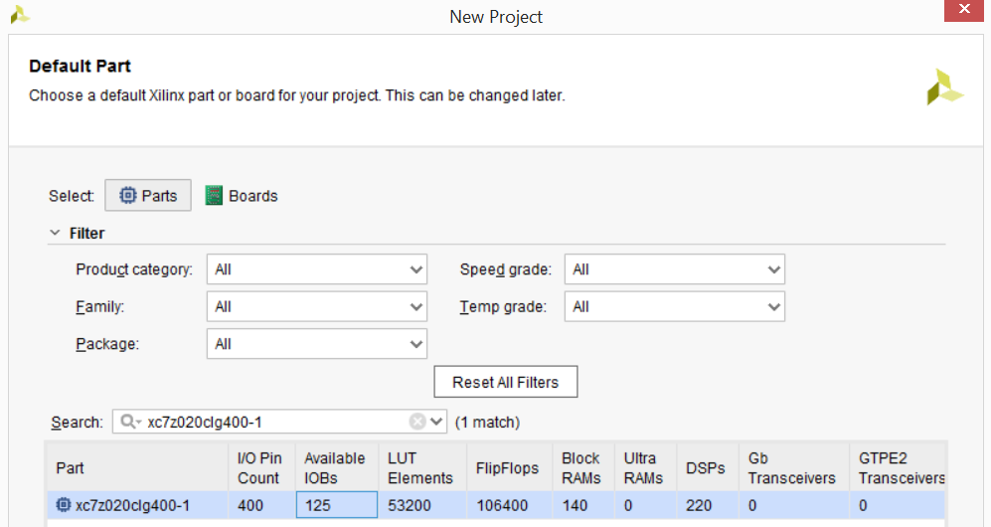
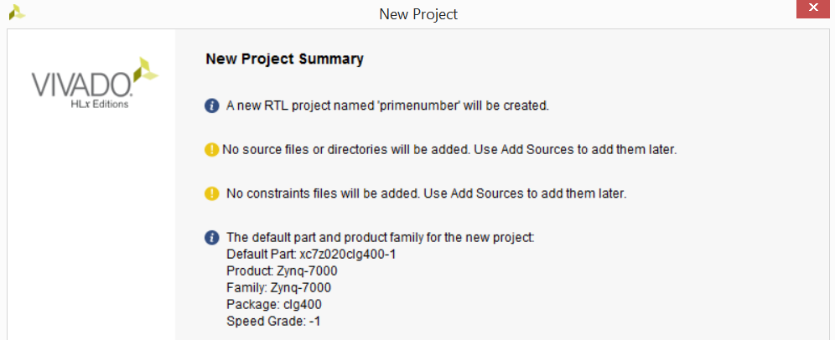
Vivado 2017.2
Still in the Vivado project creation wizard select parts for the board

Slide 22
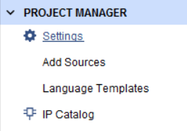
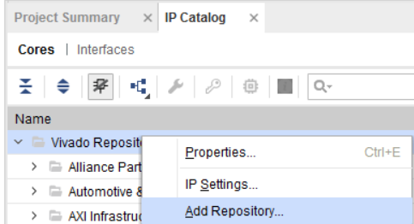
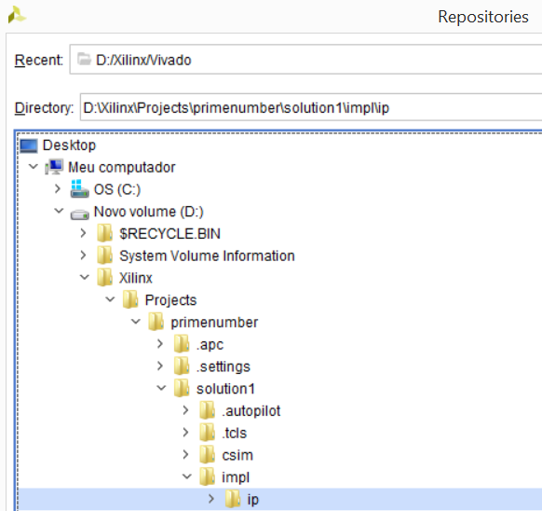
Vivado 2017.2
Click on IP Catalog to add IP created in Vivado HLS
Right Click on Vivado Repository and select the folder of your IP

Slide 23
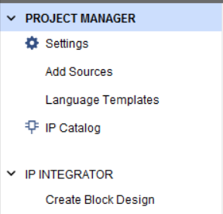
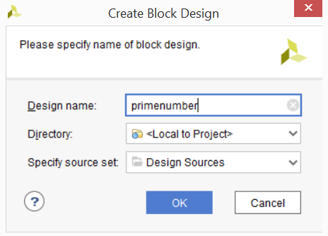
Vivado 2017.2
Now we need to Create Block Design by click in it

Slide 24



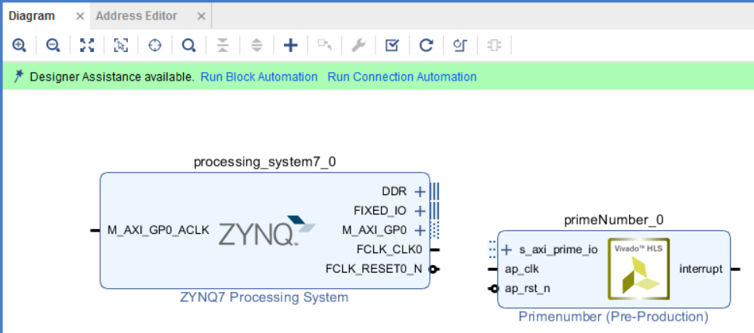
Vivado 2017.2
Add your custom IP and ZYNQ7 Processing System to the Diagram

Slide 25
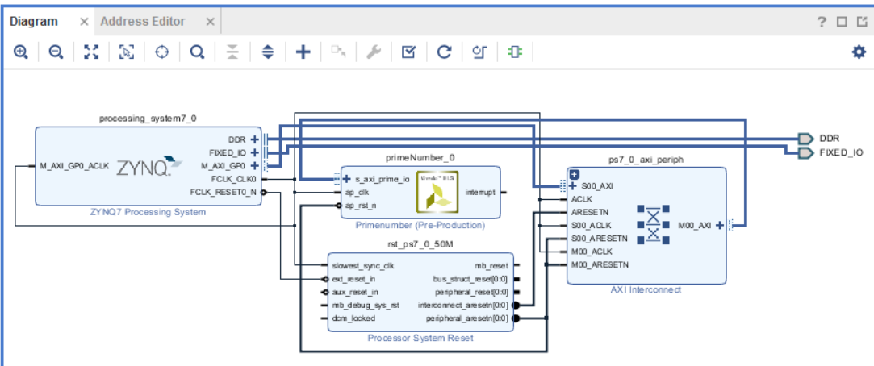
Vivado 2017.2
Make Run Block Automation and Run Connection Automation

Slide 26

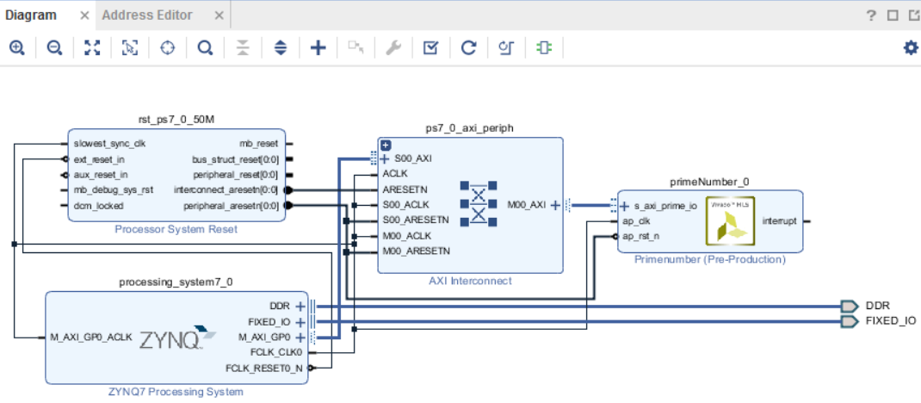
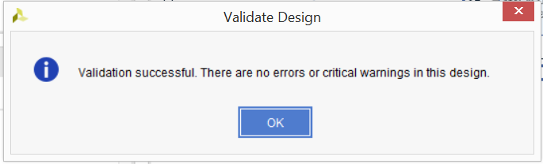

Vivado 2017.2
Click on Regenerate Layout to rearrange the diagram and in Validate Design to check it

Slide 27

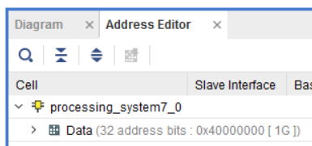
Vivado 2017.2
Check on Address Editor the memory address to be passed to MMIO in Python code

Slide 28
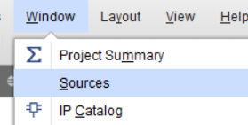
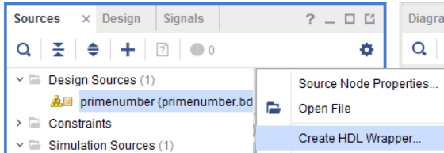
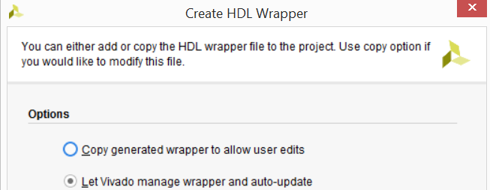

Vivado 2017.2
Show sources and right click on the Design project to create a Create HDL Wrapper

Slide 29
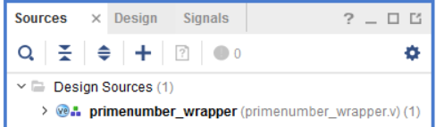
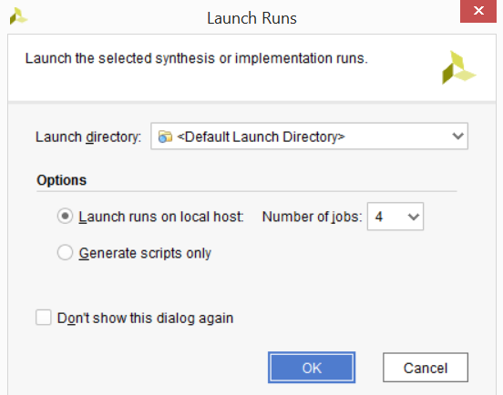

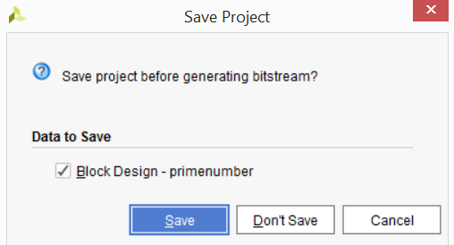

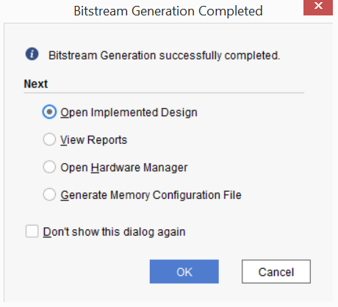

Vivado 2017.2
Now we can generate the bitstream wich will be used on Python Overlay
Generate Bitstream

Slide 30



Vivado 2017.2
In sources tab expand wrapper until we can find primeNumber_io_s_axi

Slide 31

Vivado 2017.2
Check the usefull addresses related to ap_start, ap_ready, data signal of position and prime

Slide 32



Vivado 2017.2
Now we can write the .tcl file that will be companion to the bitstream file located in same folder
On Tcl Console type the command write_bd_tcl [filename]
Locate bitstream primenumber_wrapper.bit and copy and rename it to primenumber.bit

Slide 33


Pynq
Locate and conect to your Pynq board on the network
With a browser access Jupyter interface located at port 9090

Slide 34





Pynq
Create a folder, rename it and upload your project files to that folder

Slide 35


Pynq
Write your Python code on the Jupyter Notebook interface to test your HLS on the Pynq board

Slide 36

Pynq
Run pure Python and copiled C++ to compare with HLS

Slide 37
All files used on this project are distributed on
https://github.com/wagnerrn/pynq-primenumber
Many Thanks

