Slide 1
Accessibility4md
CESP590 2023Winter
Jae Dong Hwang

Slide 2
Motivation and Promise
Homework #2 Website/App Accessibility Assessment
There are many tools available that checks the accessibility in website.
Noticed the separation pattern between publisher and validator.
Long feedback loop or development cost, i.e., re-deployment and validation.
Develop a toolset that improves the accessibility during the document publication. Demonstrate the extensibility of the tool for future adaptability.
Baseline workflow: markdown -> HTML (i.e., blog posting).

Slide 3
MD -> HTML Workflow
Use the python-markdown library
Baseline workflow
root
*.md file
Tokenizer
Parser
Post-Processor
HTML
Deploy/
Publish
h1
h1
p
p
No-Ops
alt
img
Editing

Slide 4
Three Experiment Streams
Accessibility Check in markdown file
Add a new syntax that allows the authors to decorate to HTML attribute.
Extending the accessibility check on non-text content

Slide 5


Accessibility Check
Simple format check; Title
Implemented visitor class
root
h1
h1
p
p
img
img

Slide 6

Additional Syntax for Attributes
: Registered Visitor
root
*.md file
Tokenizer
Parser
Visitor
Post-Processor
HTML
Deploy/
Publish
h1
h1
p
p
No-Ops
img
img
Editing

Slide 7
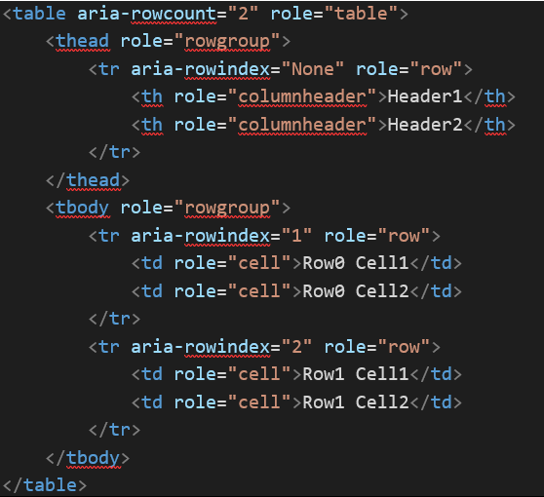
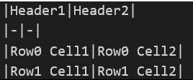
Decorating Attributes – Chain of Responsibility
root
*.md file
Tokenizer
Parser
Visitor
Visitor
Post-Processor
HTML
Deploy/
Publish
h1
h1
p
p
No-Ops
img
img
Editing
Convert Table
Role and Row-Count
Row and aria-rowindex

Slide 8
Check non-text media - Incomplete
Image Processing
Detect text and measure the contrast.
Permission issue – Need to extend the parser.
root
h1
h1
p
p
img
img

Slide 9
Lessons Learned
Balancing the freedom in markdown schemaless

Slide 10
Future Work

