Slide 1
Accessibility4md
CESP590 2023Winter
Jae Dong Hwang

Slide 2
Motivation and Promise
Homework #2 Website/App Accessibility Assessment
There are many tools available that check the accessibility in HTML website.
Noticed the separation pattern between publisher and validator.
Long feedback loop or development cost, i.e., re-deployment and validation.
Can we improve the feedback loop so that more accessibility addressed in early stage of content development?
Develop a toolset that improves the accessibility during the document publication. Demonstrate the extensibility of the tool for future adaptability.
Baseline workflow: markdown -> HTML (i.e., blog posting).

Slide 3
Standard Guidelines Highlight
Authoring Tool Accessibility Guidelines (ATAG) 2.0 (w3.org)
Guideline B.2.2: Guide authors to produce accessible content
Guideline B.2.3: Assist authors with managing alternative content for non-text content.
Guideline B.2.5: Assist authors with accessible pre-authored content.
Guideline B.3.1: Assist authors in checking for accessibility problems.
B.3.1.1 Checking Assistance (WCAG)
B.3.1.2 Help Authors Decide
B.3.1.3 Help Authors Locate

Slide 4
Three Experiment Streams
Accessibility Check in markdown file
Give the feedback and let the author to choose the adaptation.
Add a new syntax that allows the authors to decorate to HTML attribute.
Help the author to improve the accessibility.
Extending the accessibility check on non-text content

Slide 5
Markdown -> HTML Workflow
Use the python-markdown library
Baseline workflow
root
*.md file
Tokenizer
Parser
Post-Processors
HTML
Deploy/
Publish
h1
h1
p
p
No-Ops
alt
img
Editing

Slide 6


Accessibility Check
Simple format check; Title and alternative text
Implemented visitor class
root
h1
h1
p
p
img
img

Slide 7

Additional Syntax for Attributes
: Registered Visitor
root
*.md file
Tokenizer
Parser
Visitor
Post-Processor
HTML
Deploy/
Publish
h1
h1
p
p
No-Ops
img
img
Editing

Slide 8
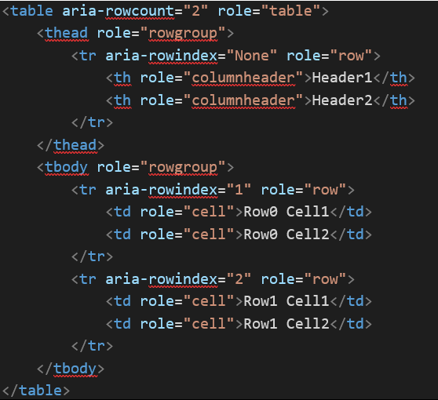
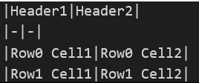
Decorating Attributes – Chain of Responsibility
root
*.md file
Tokenizer
Parser
Visitor
Visitor
Post-Processor
HTML
Deploy/
Publish
h1
h1
p
p
No-Ops
img
img
Editing
Convert Table
Role and Row-Count
Row and aria-rowindex

Slide 9
Check non-text media - Incomplete
Image Processing
Detect text and measure the contrast.
Permission issue – Need to extend the parser.
root
h1
h1
p
p
img
img

Slide 10
Lessons Learned
Standard Guideline for Authoring Tools Development
Accessibility can be improved during content development
There are many authoring apps/plugins are extensible and can contains the accessibility check mechanism.
Visual Studio Code Plugin
Markdown Stand-alone editor
Disability Justice Perspective - Leadership of Those Most Impacted.
Highly recommend this course to be any (pre-) CS program and make it mandatory.

Slide 11
Future Works
Merge the library into the python-markdown library for visibility of the work.
Solution for accessing and checking non-text content
Image in local machine.
Any other pre-authored content
Visual Studio Code markdown preview plugin.
Real-time feedback in the console.

