Slide 1
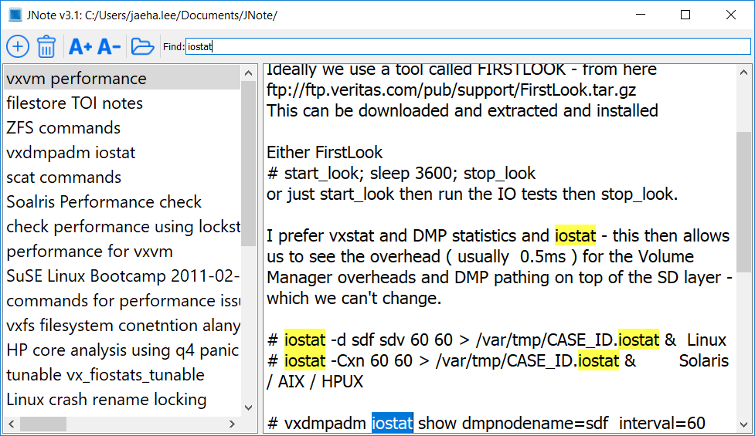
Delete Note
Resize Font Size
Open Other JNote file
Find Words
Add New Note
Current JNote Path

