Slide 1

Maximizing House Purchases (for KCHA)
Jae Heon Kim
Notes:
Hi Im Jae
Thank you KCHA
I respect your service of providing AFFORDABLE HOUSING for low-income families and now very happy to be part of it.

Slide 2
Business Problems
Home Prices up
Need for Affordable Housing up
Potential Budget down
Notes:
MENTION Rich v Poor

Slide 3
Business Goals
Want to buy as many homes as possible.
Avoid zipcodes with extreme high crime rates
Spend less than $1 Million
Optimal Strategy: Provide for as many people as possible.
Notes:
Saved money from overpaying can help even more families

Slide 4
Data Used / Exploratory Analysis
King County Accessor: Home Sales Price data (May_2014 to May_2015)
King County Accessor: Reported Offenses (2020~)
Kings County Accessor: Reported Incidents (~2019)
Notes:
FIRST
21 COLUMNS.
CREATED age, yrs since renovation
Some numerical such as sqft_living space, number of bathrooms
Some were based on rankings, such as house conditions.
turned them into CORRESPONDING Numerical values
Some were QUESTION OF YES OR NO, such as having waterfront OR NOT. Turned them into 1 for YEs, 0 for NO to include in my model

Slide 5
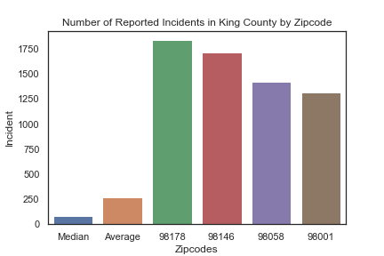
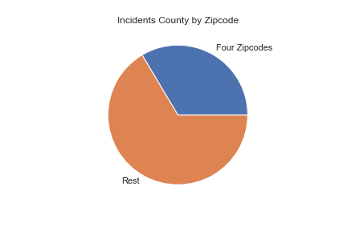
Exploratory Data Analysis (Cont.)
Notes:
We are avoding them

Slide 6
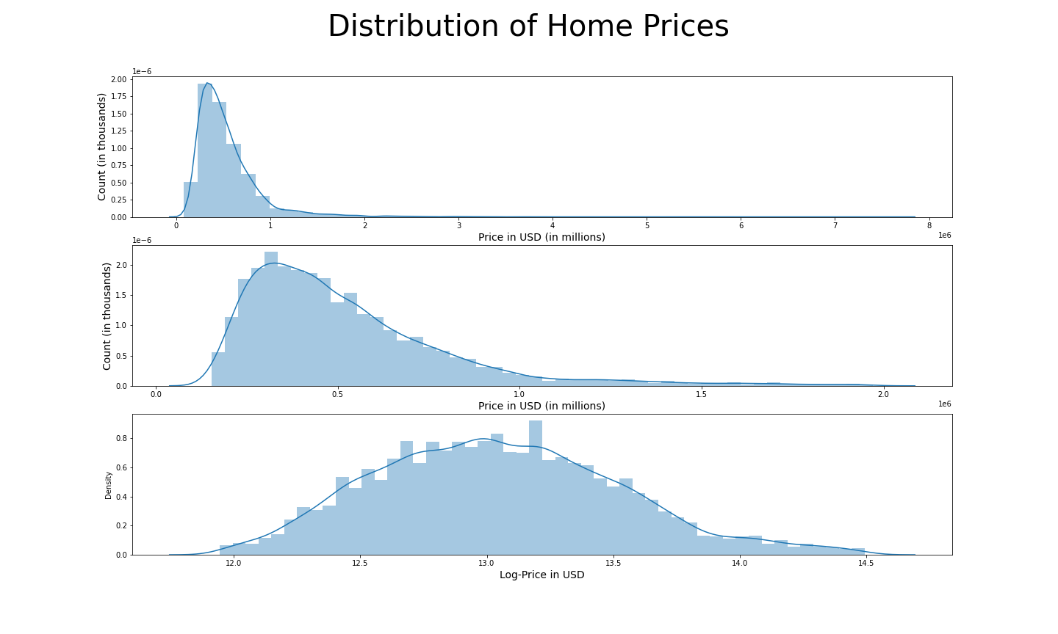
Exploratory Data Analysis (cont.)
Notes:
There we OUTLIERES
High-priced luxurious mansions are not our interest.
Dropped them because this information is never needed.

Slide 7
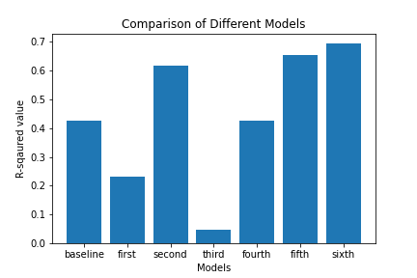
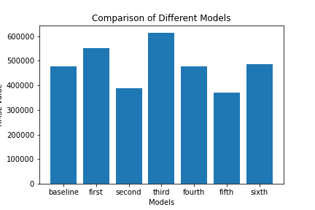
Prediction Model

Slide 8
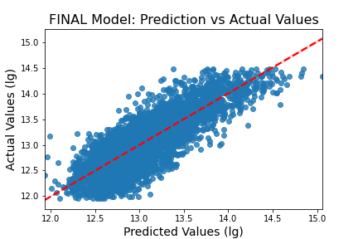
Exploratory Data Analysis (cont.)

Slide 9
Takeaways
YOUNG-BAD vs old-good
# Bedrooms NOT THAT IMPORTANT

Slide 10
NEXT STEP
Look at only homes that the takeaways apply.

Slide 11
Recommendations
Small Families: 2 Bedroom vs 1 bedroom
Large Families: 3 Bedroom vs 4 bedroom
Buy from zipcodes: 98118, 98168, 98126, 98106
Don’t Buy from zipcodes: 98040, 98109, 98074, 98006, 98075, 98077, 98005, 98102
Notes:
4 Bedroom is slightly more-effective,
BUT overall cost is more expensive
much more 3 bedroom options to look at
not enough 4 bedrooms
Zipcodes that have lots of houses that fit your preferences.

Slide 12
NEXT STEPS
Get more academic data
Get more traffic data
Get more location data
Get more up-to-date data

Slide 13

Questions ??

Slide 14
Thank you!
Jae Heon Kim
Linked in – https://www.linkedin.com/in/jae-heon-kim-5a9b88148/
Github - https://github.com/jaeheonk817

