Slide 1

Predicting Reservation Cancellations for Marriott’s Resorts
Jae Heon Kim
Notes:
Hi. Thank you Marriot for reaching out to me.

Slide 2
Outline
- Introduce and understand problem
- Explore data
Modeling
- Build different models
Evaluation
- Select the final model
- Evaluate the final model in depths
Decision
- Make meaningful suggestions
Data
Problem
- Optimize data
- Further tune models that work well
Notes:
This project aims to:
1. Study the problem
2. Collect and work with data
3. to build machine learning models
4. Tailor them for use
5. to make business decisions OR
help make business decisions

Slide 3

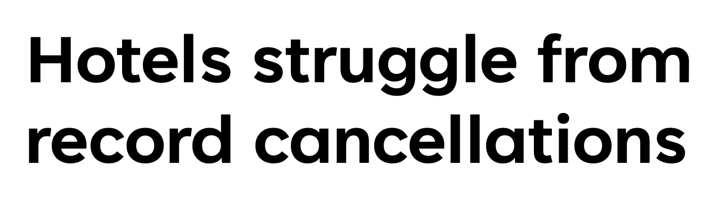
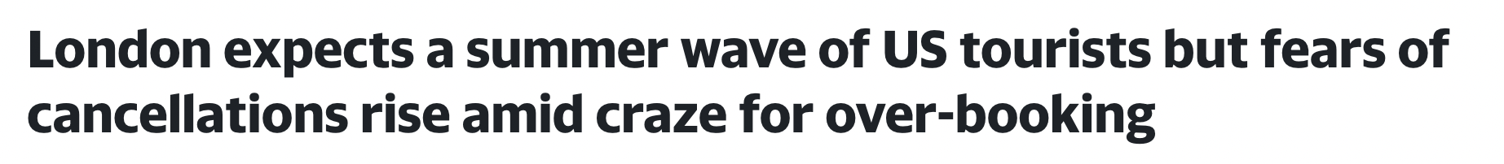
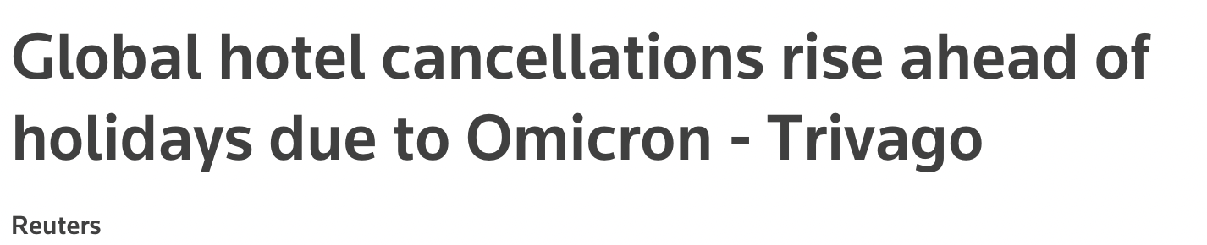

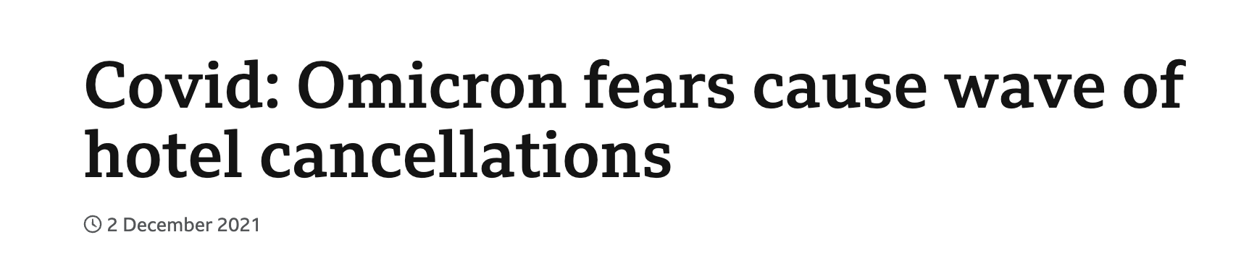
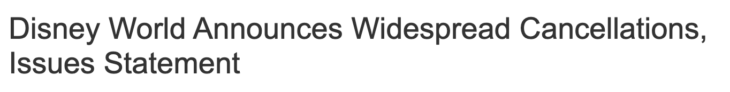
Business Problem
Notes:
Cancellations of Hotel Reservations have increased
in recent years due to the pandemic and easy
mobile accessibility.

Slide 4
Two Types of Wrong Predictions
Model Wrong:
Customer comes
Model Wrong:
Customer Cancels
Notes:
There are two major problems associated with cancellations.
1. When we predict it will be cancelled, but it's not cancelled.
- Hotel makes money
- No additional staffing costs
Problem:
2. When we predict it will not be cancelled, but it's cancelled.
- Hotel loses business
- Additional staffing Costs
While accuracy of prediction is very important, we give greater weights to accurately predicting second type of wrong prediction.

Slide 5
Definition: Precision
HIGH Precision
Low Error
Model Wrong:
Customer Cancels
Notes:
There are two major problems associated with cancellations.
1. When we predict it will be cancelled, but it's not cancelled.
- Hotel makes money
- No additional staffing costs
Problem:
2. When we predict it will not be cancelled, but it's cancelled.
- Hotel loses business
- Additional staffing Costs
While accuracy of prediction is very important, we give greater weights to accurately predicting second type of wrong prediction.

Slide 6
Data Introduction
Source
Features
Size
Kaggle Data Sets
A resort hotel in Algarve, Portugal
Booking information in 2017 and 2018
19 features
Information on :
lead time
meal plan type
repeated visits
room type
number of adults
number of children, etc..
36,275 observations
Very little missing values!

Slide 7
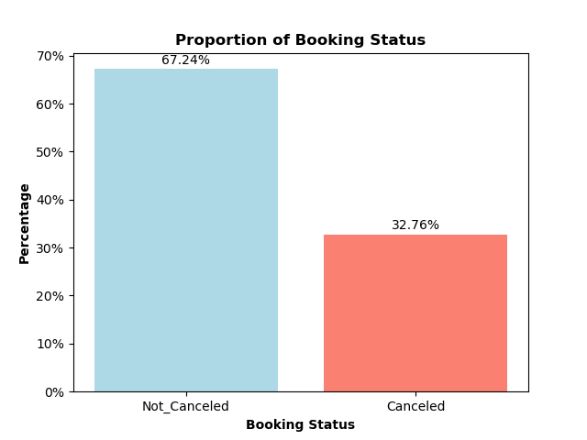
Working with Data
Preparing the Data
How many bookings are cancelled?
Studied each of 19 features
Target feature: Booking Cancellation Status
Excluded irrelevant and redundant predictor features
Tailored each feature to be fed into the machine learning models

Slide 8
Modeling Process
Step 1
Try Different Models
Step 2
Choose Good Models
Step 3
Combine Good Models to Make Better Models
Step 4
Compare Better Models and Choose the BEST MODEL

Slide 9
Modeling Process – Step 1
New Model
Evaluate
Make Changes

Slide 10
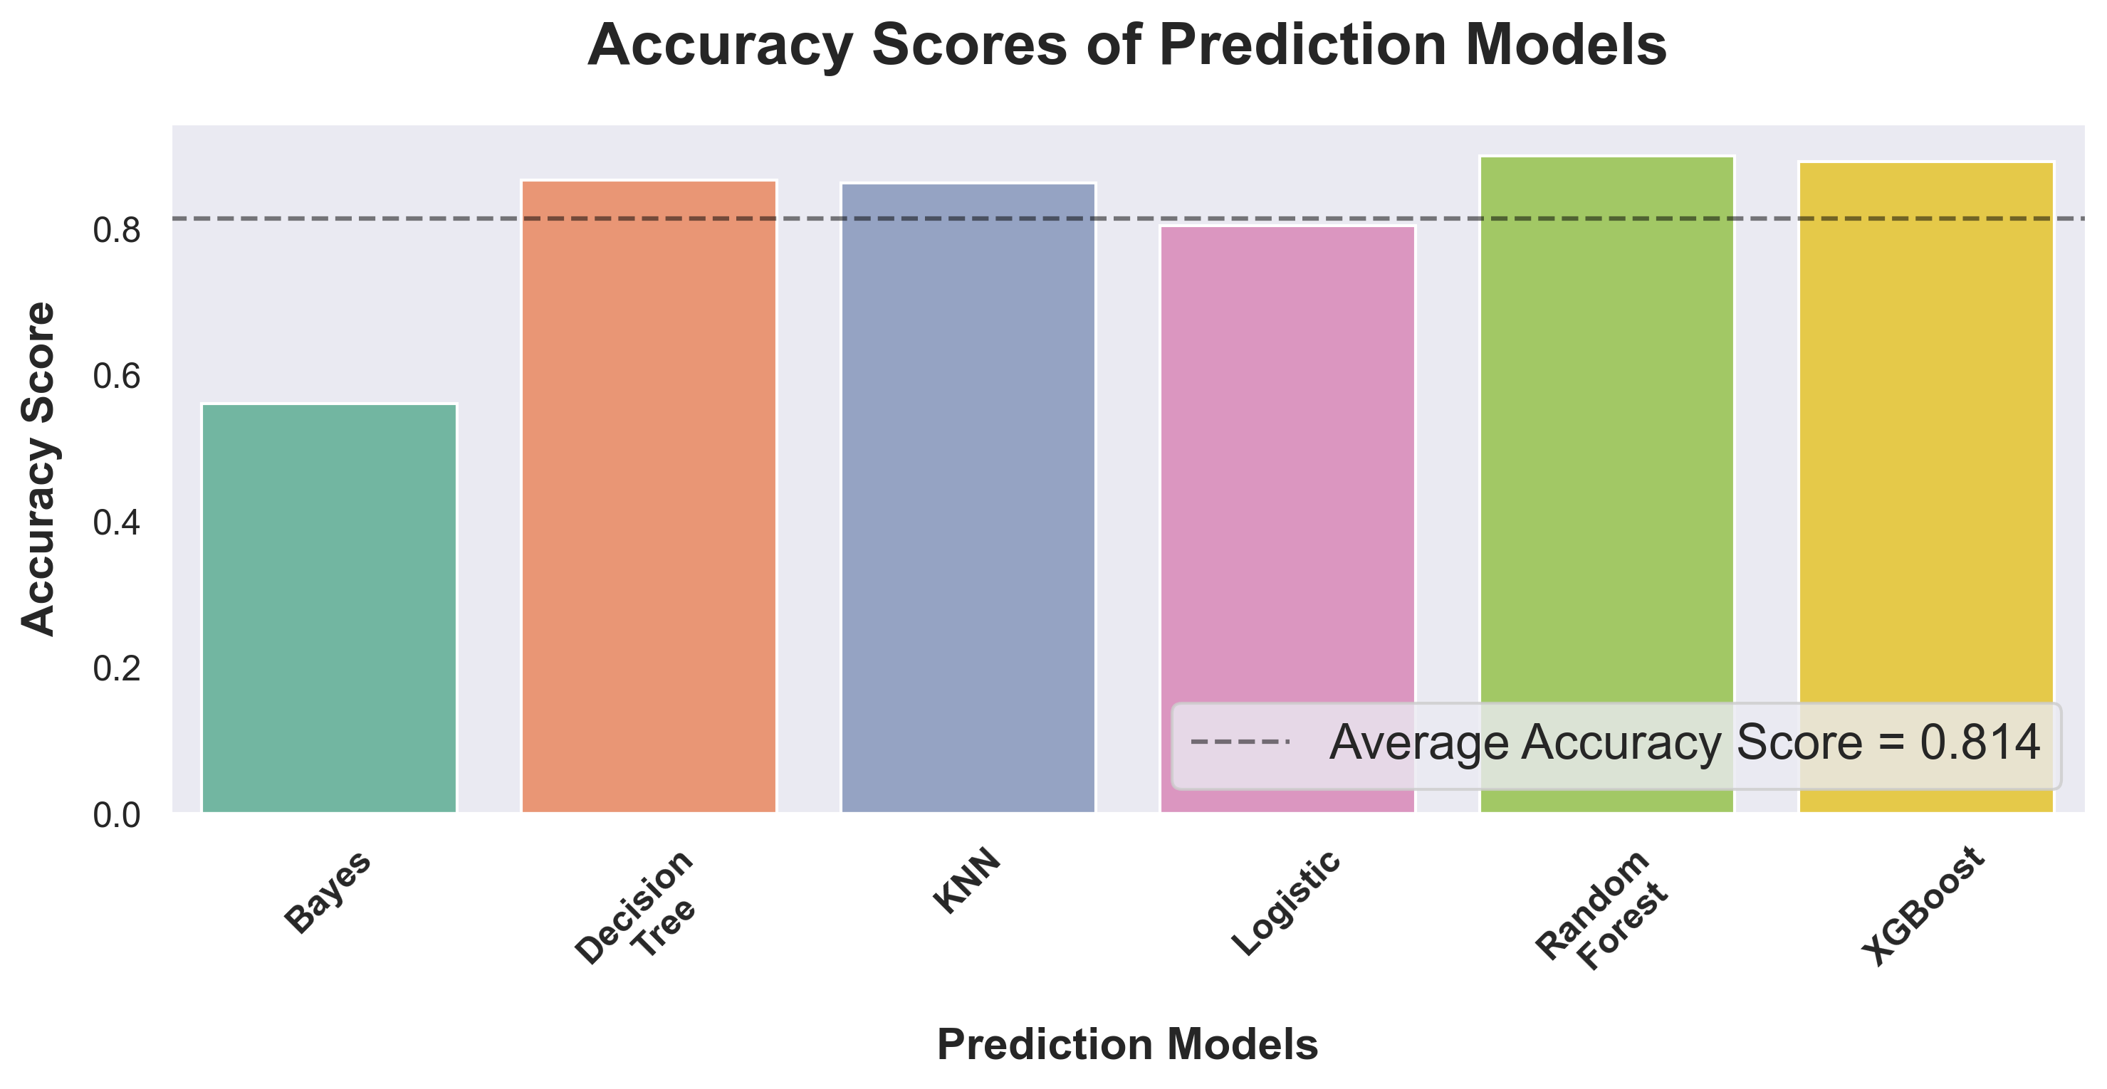
Comparing Models – Accuracy

Slide 11
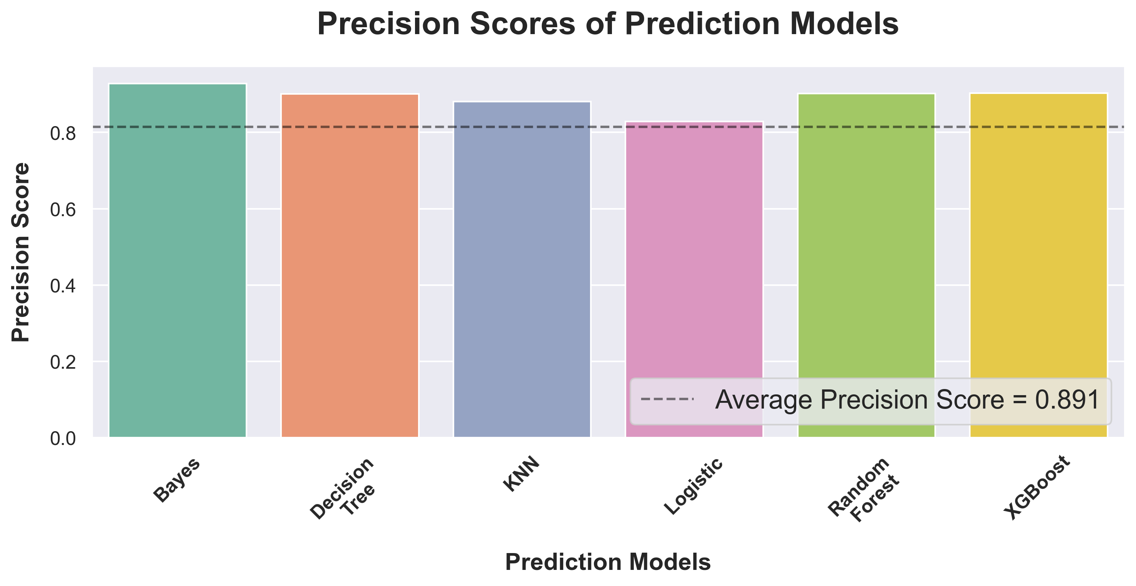
Comparing Models – Precision

Slide 12
Modeling Process – Step 2
Good Models
Bad Models
Random Forest
Logistic Reg.
Decision Tree
KNN
Gradient Boost
Bayes

Slide 13
Modeling Process – Step 3
Voting
Good Models
Better Models
Stacking
Random Forest
Decision Tree
Gradient Boost
Gradient Boost

Slide 14
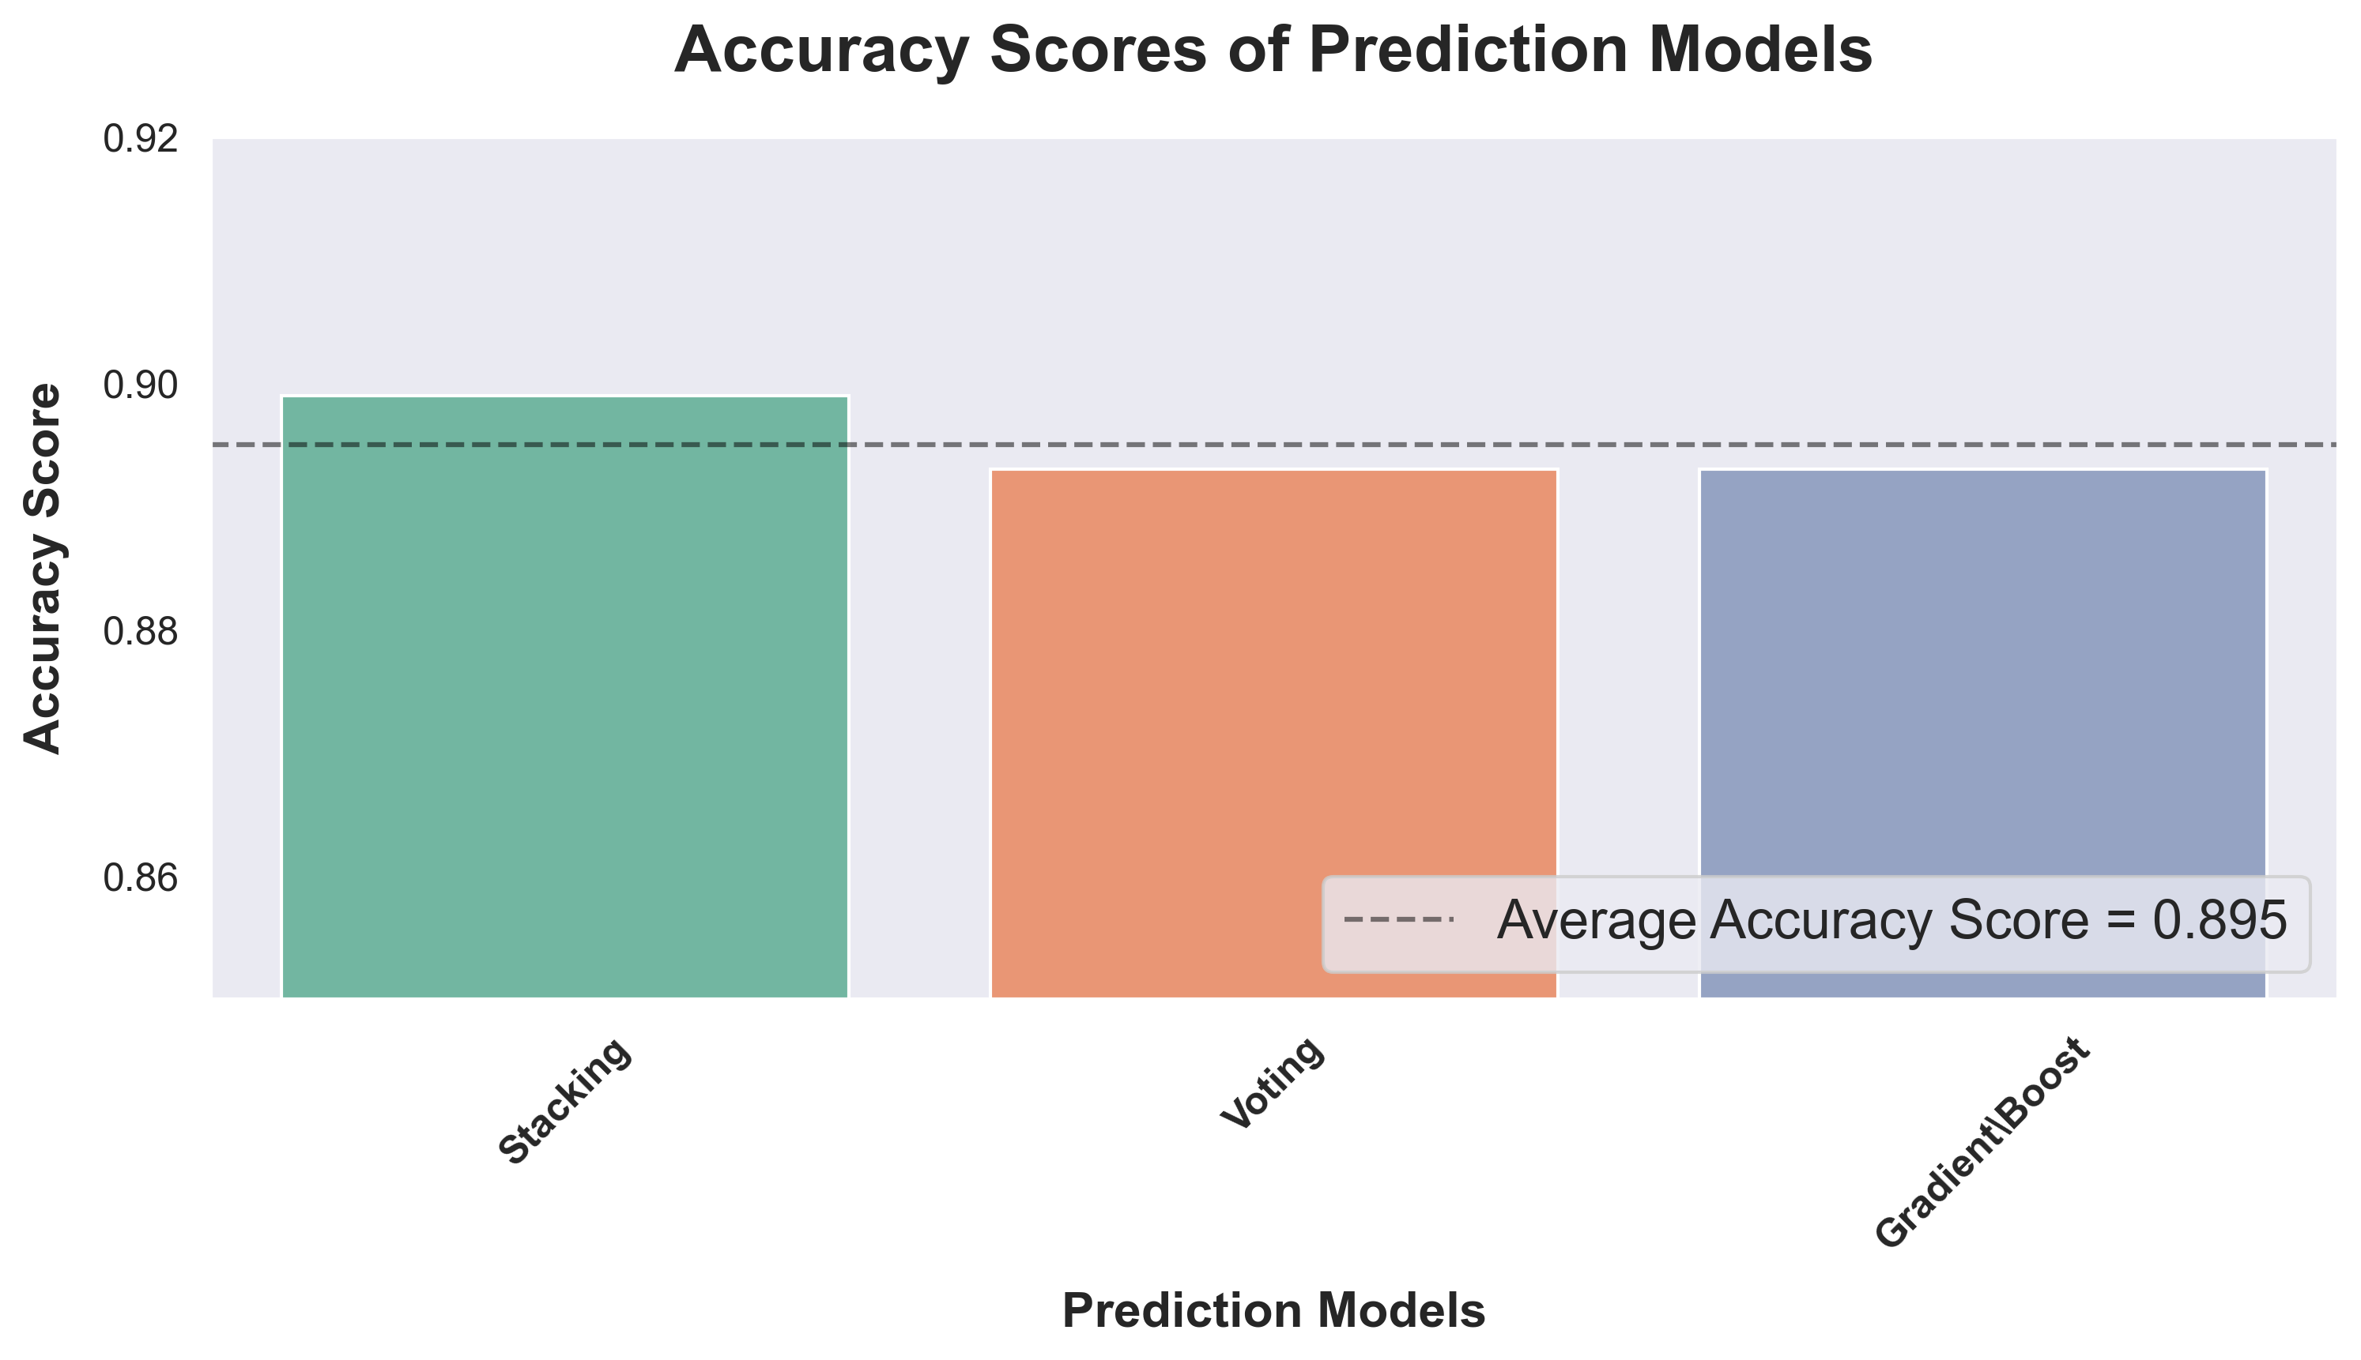
Comparing Models

Slide 15
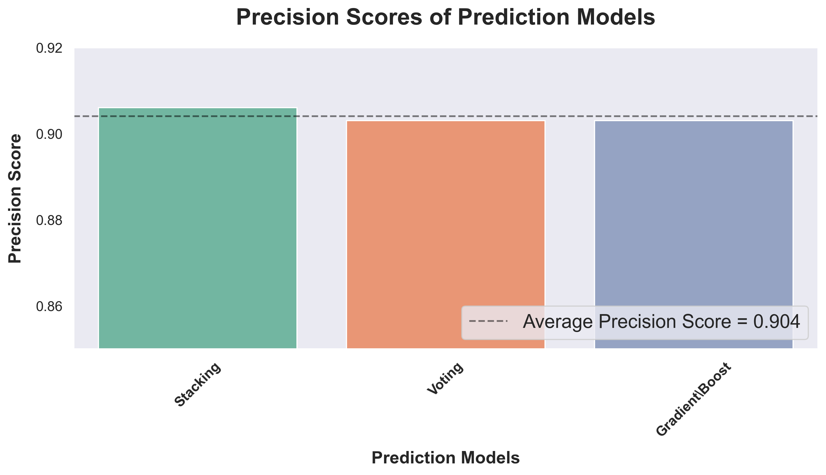
Comparing Models

Slide 16
Modeling Process – Step 4
Stacking Classifier is the Final Model
90% Accuracy
91% Prediction
When the model predicts that customer will honor the reservation, it’s correct 91% of the time
Voting Classifier – Quickest / Second-Best

Slide 17
Evaluation of the Final Model
Most Important Features
Least Important Features

Slide 18
Next Steps
For More Correctness
For More Usefulness
Collect more personal information
Demographic
Loyalty Program
Collect more appointment info.
Location of Appointment
Time it took for appointment
Gather data from other hotels

Slide 19

Questions?

Slide 20




Thank you!
Please check out my other data science projects!

