Slide 1
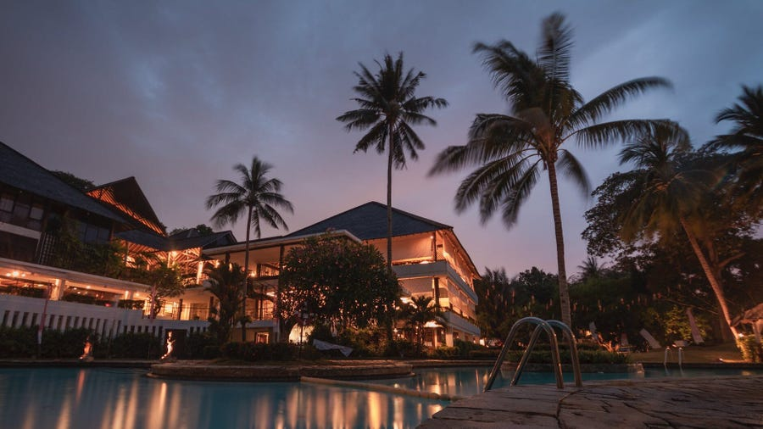
Predicting Reservation Cancellations for Hilton’s Resorts
Jae Heon Kim
Notes:
Hi. Thank you Marriot for reaching out to me.

Slide 2
Outline
- Introduce and understand problem
- Explore data
Modeling
- Build different models
Evaluation
- Select the final model
- Evaluate the final model in depths
Conclusion
- Make meaningful suggestions
Data
Problem
- Optimize data
- Further tune models that work well
Notes:
This project aims to:
1. Study the problem
2. Collect and work with data
3. to build different machine learning models
4. and pick one, Study the best model
5. to make business decisions OR
help make business decisions

Slide 3


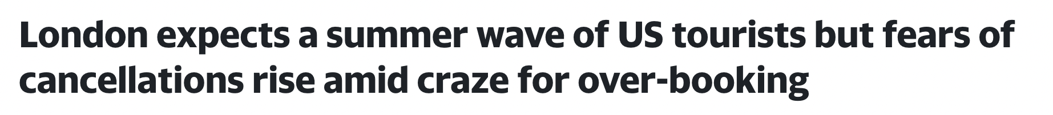
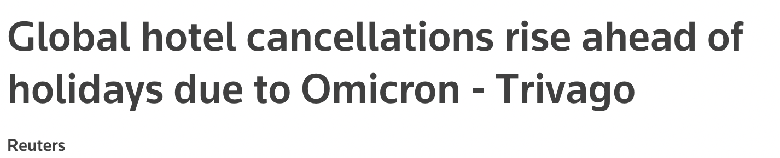

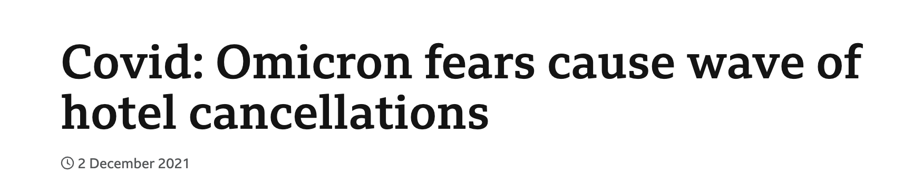
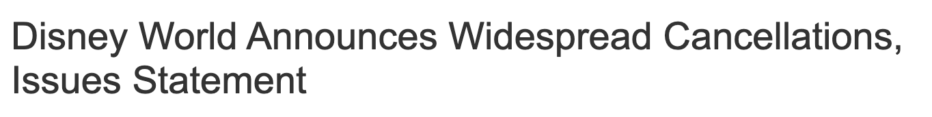
Business Problem

Slide 4
Two Types of Wrong Predictions
Model Wrong:
Customer comes
Model Wrong:
Customer Cancels
Notes:
My model can make two different mistakes in predction
FIRST
It says customers will not come but they come.
NO PROBLEM
we still make money
SECOND
It says customers will come, but they dont.
BIG Problem
lost revenue, increased spending on additional staffing.
We get stabbed twice

Slide 5
Definition: Precision
Want:
HIGH Precision
Lower Mistake
Model Wrong:
Customer Cancels
Notes:
WHEN WE WANT TO LOWER THIS
WE NEED HIGH PRECISION OF MODEL

Slide 6
Data Introduction
Source
Features
Size
Kaggle Data Sets
A resort hotel in Algarve, Portugal
Booking information in 2017 and 2018
19 features
Information on :
lead time
meal plan type
repeated visits
room type
number of adults
number of children, etc..
36,275 observations
Very little missing values!

Slide 7
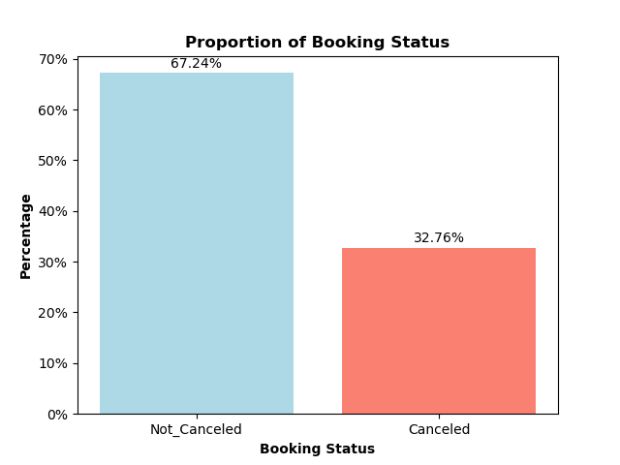
Working with Data
Preparing the Data
How many bookings are cancelled?
Studied each of 19 features
Target feature: Booking Cancellation Status
Excluded irrelevant and redundant predictor features
Tailored each feature to be fed into the machine learning models

Slide 8
Modeling Process
Step 1
Try Different Models
Step 2
Choose Good Models
Step 3
Combine Good Models to Make Better Models
Step 4
Compare Better Models and Choose the BEST MODEL

Slide 9
Modeling Process – Step 1
New Model
Evaluate
Make Changes

Slide 10
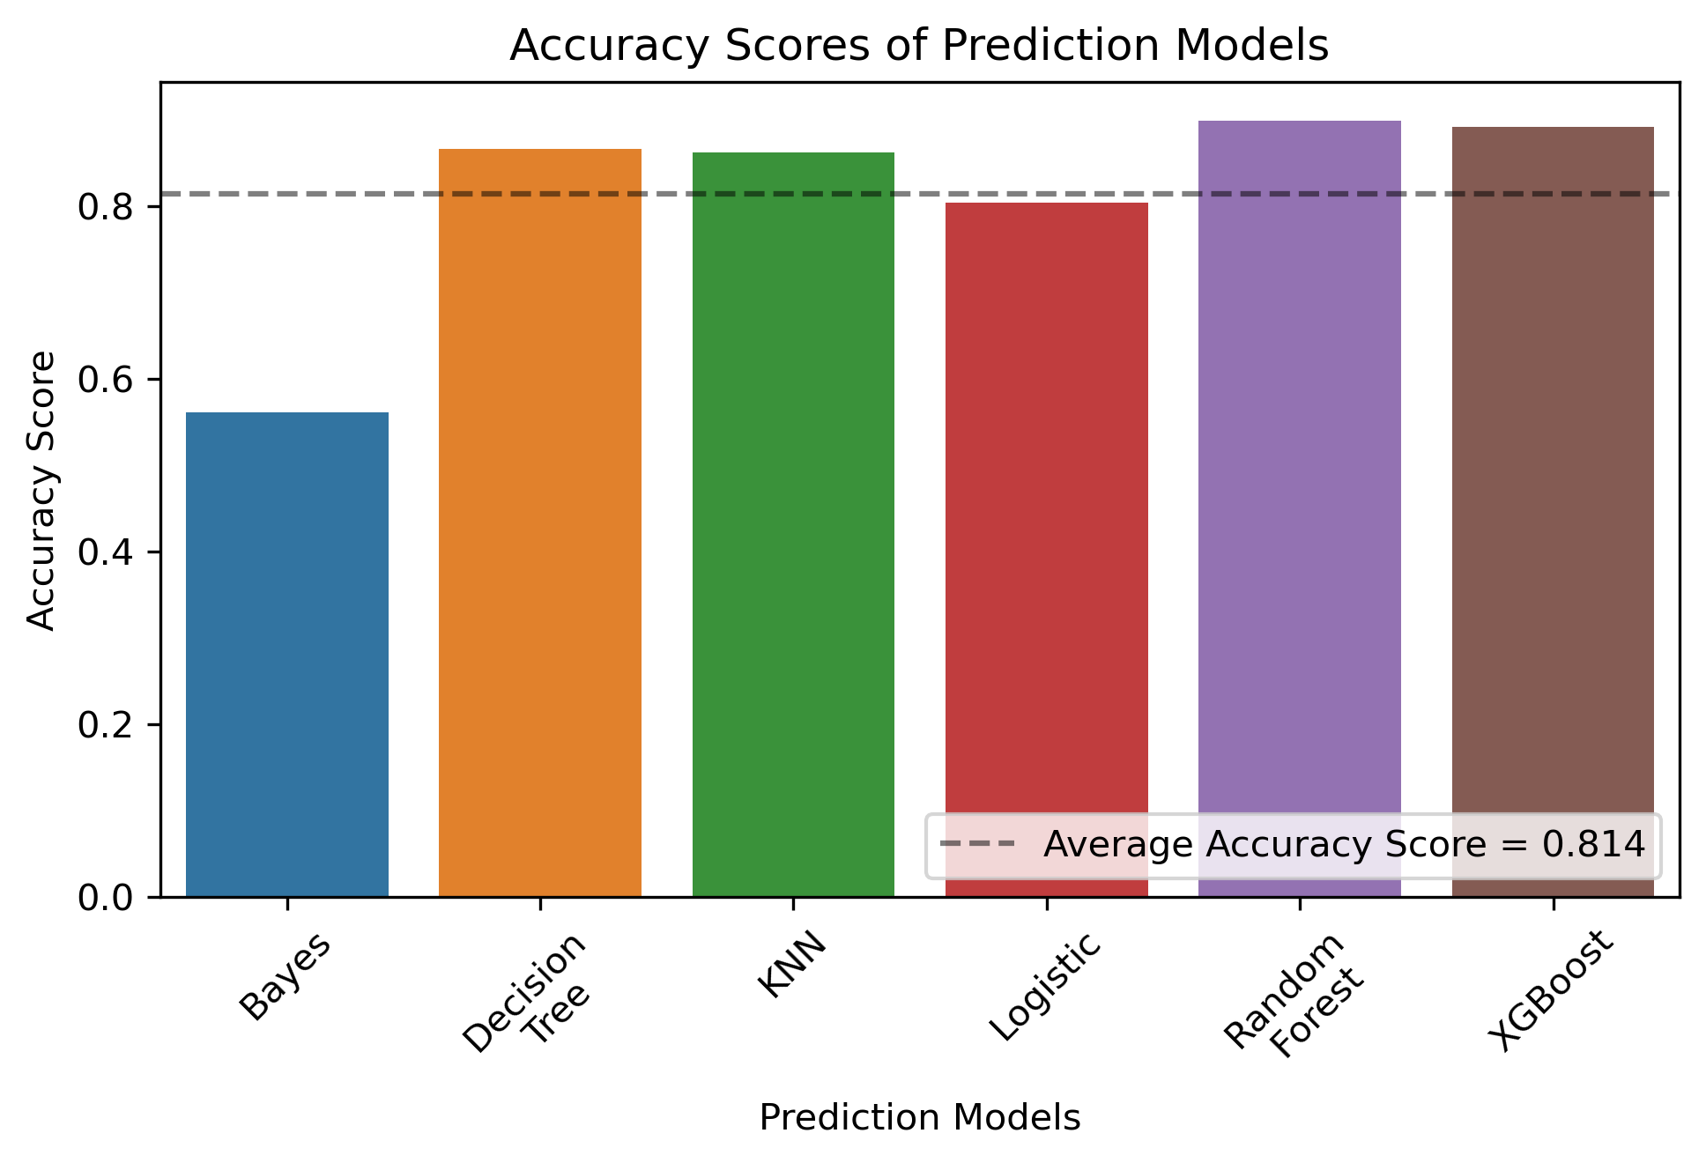
Comparing Models – Accuracy

Slide 11
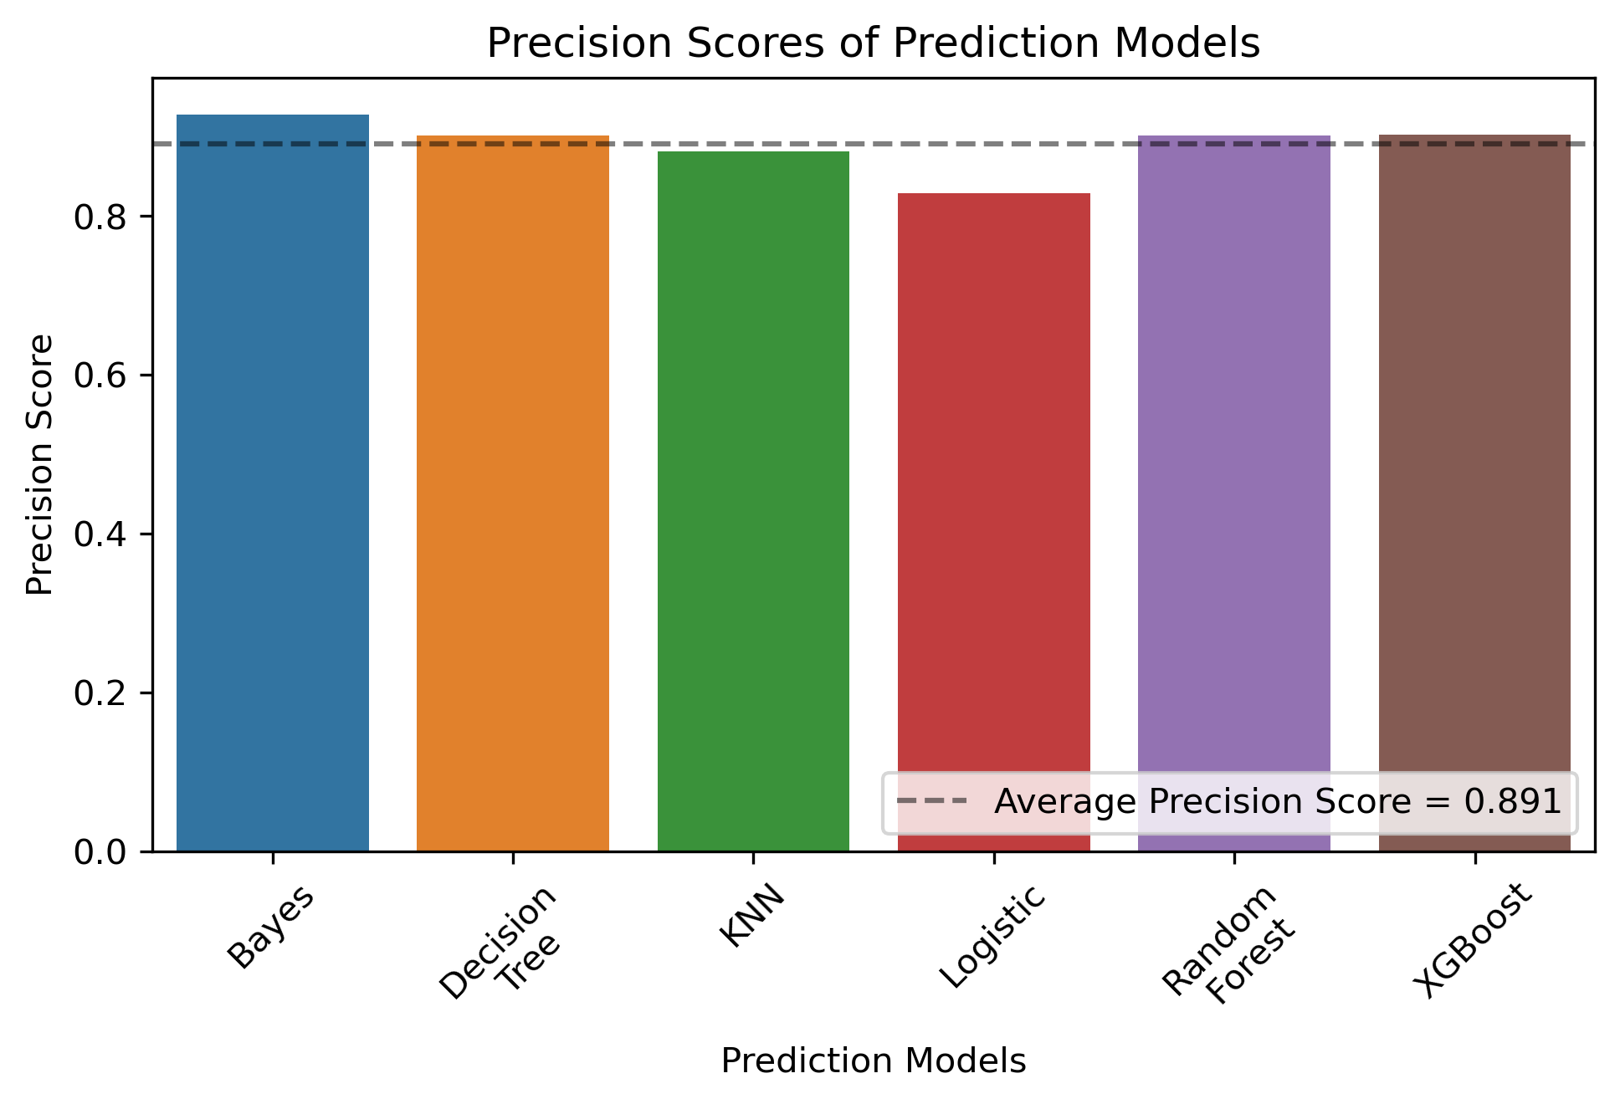
Comparing Models – Precision

Slide 12
Modeling Process – Step 2
Good Models
Bad Models
Random Forest
Logistic Reg.
Decision Tree
KNN
Gradient Boost
Bayes

Slide 13
Modeling Process – Step 3
Voting
Good Models
Better Models
Stacking
Random Forest
Decision Tree
Gradient Boost
Gradient Boost

Slide 14
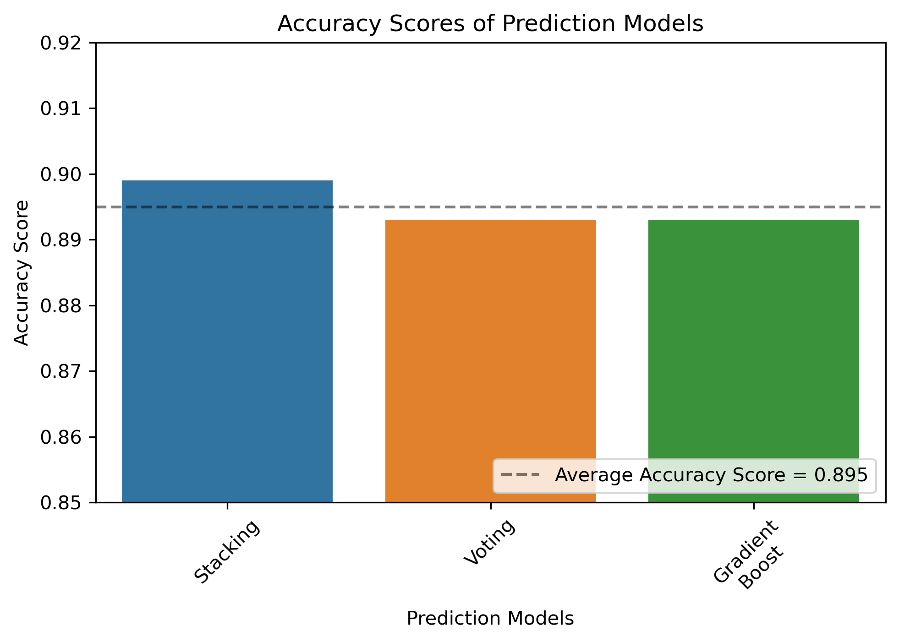
Comparing Models

Slide 15
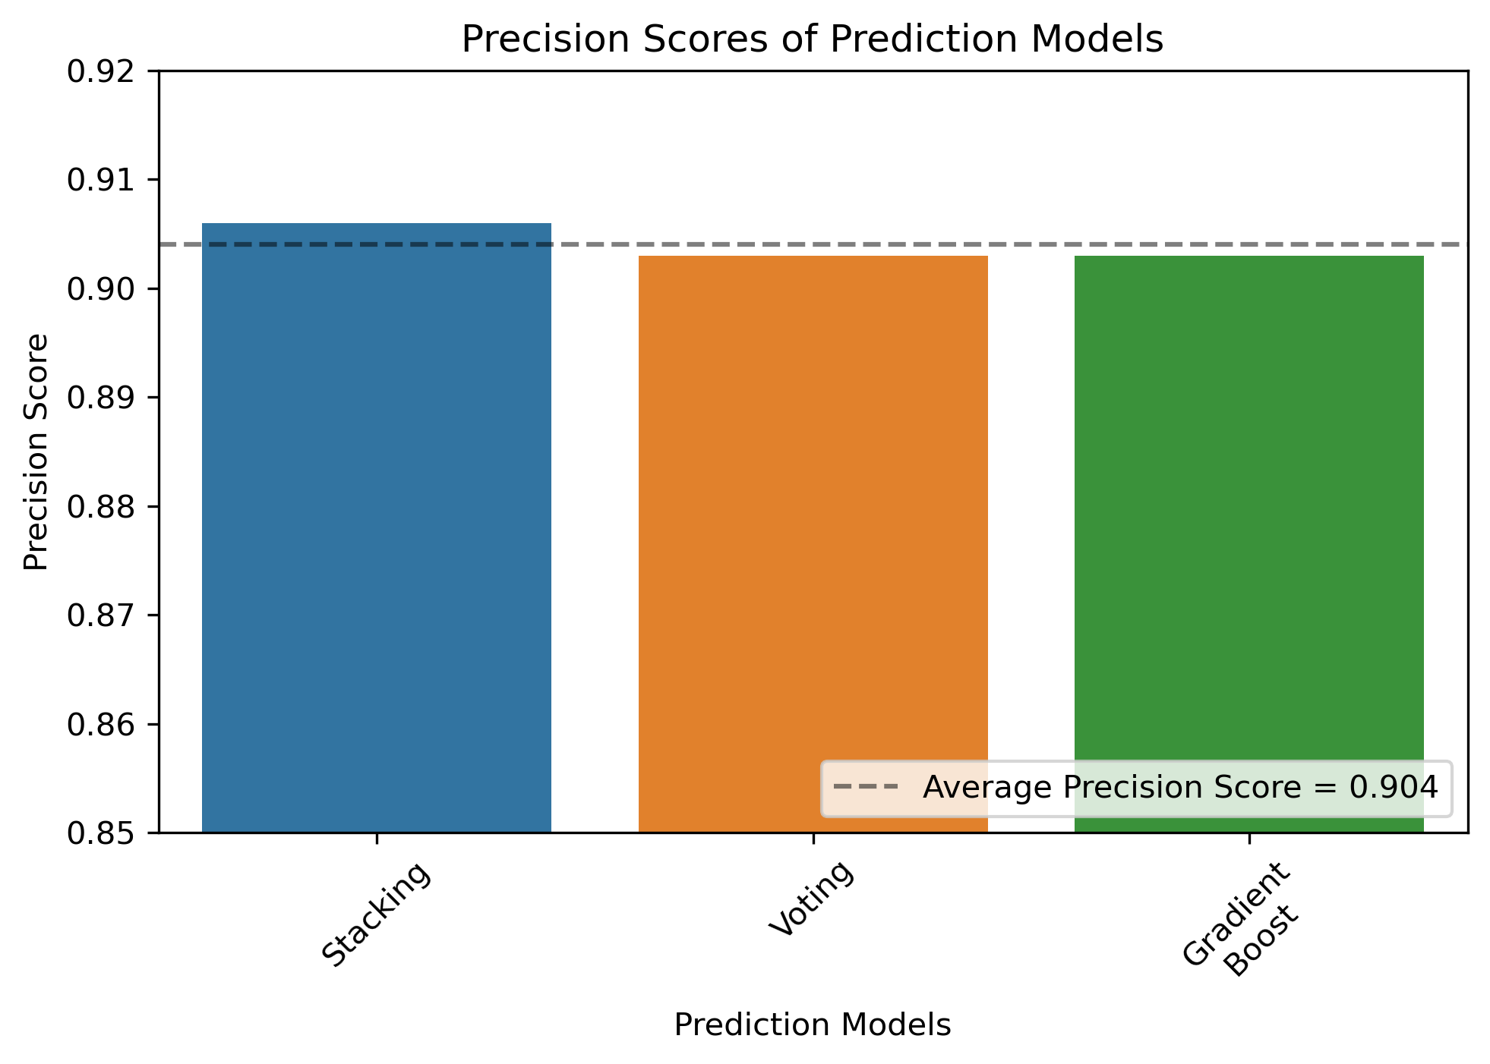
Comparing Models

Slide 16
Modeling Process – Step 4
Stacking Classifier is the Final Model
90% Accuracy
91% Prediction
When the model predicts that customer will honor the reservation, it’s correct 91% of the time
Voting Classifier – Quickest / Second-Best

Slide 17
Evaluation of the Final Model
Most Important Features
Least Important Features
Month of Arrival
Reservation Segment Type
Lead Time
Average Price Per Night
Number of Special Requests
Meal Plan Types
Number of Previous Cancellations
Room Types

Slide 18
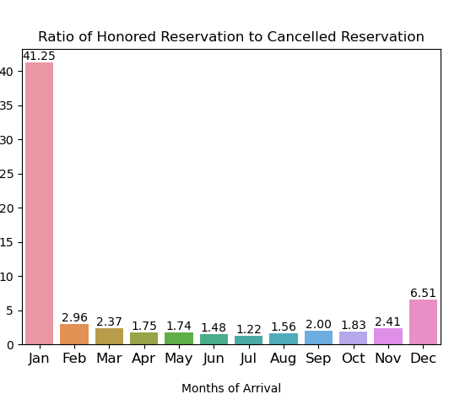
Recommendation 1
Make strategies for dealing with Summer Reservations.
Most Important Features

Slide 19
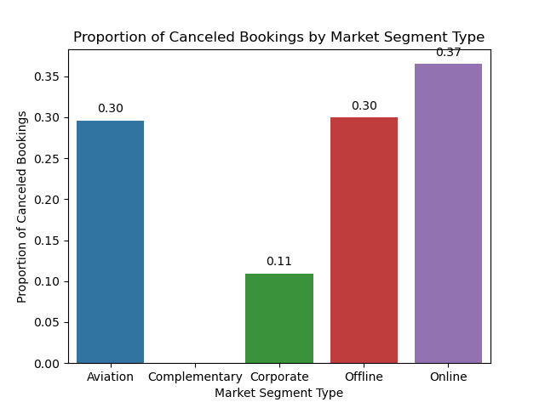
Recommendation 2
Make Business People Come.
Enhance their experience.
Most Important Features

Slide 20
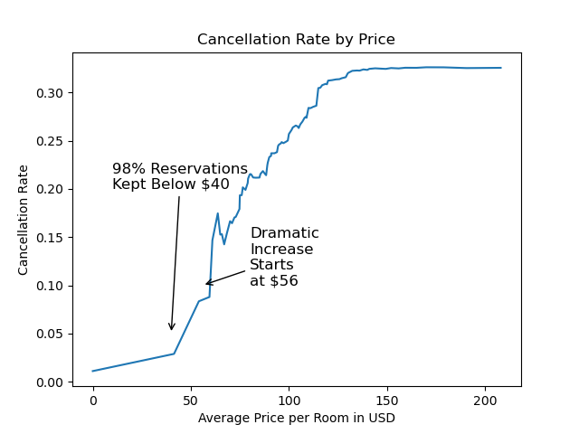
Recommendation 3
Price Your Rooms Just Before Steep Slope Increases.
dist_leadtime_cancel2.png

Slide 21
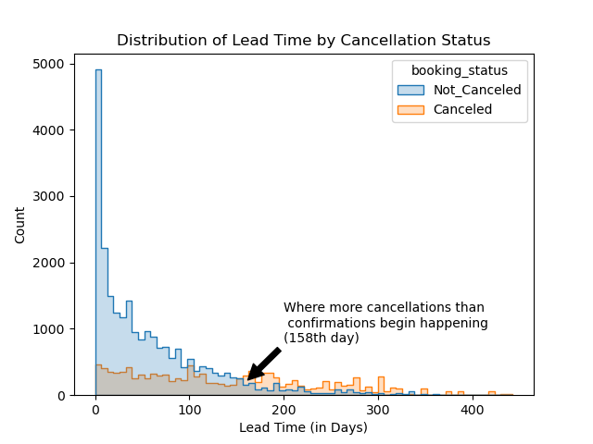
Discovery 1
Reservation made 5 months prior are recipe for cancellation.

Slide 22
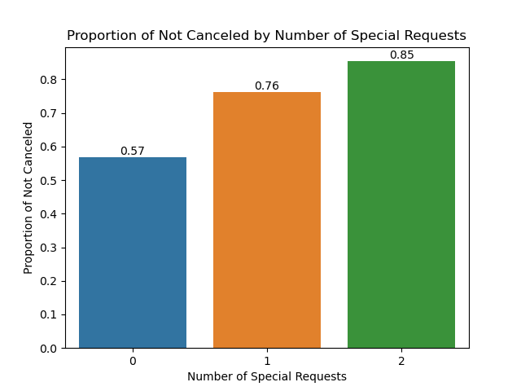
Discovery 2
More Special Requests are better.
dist_leadtime_cancel2.png

Slide 23
Next Steps
For More Correctness
For More Usefulness
Collect more personal information
Demographic
Loyalty Program
Collect more geographic info.
Location at the time of making appointment
Time it took for reservation. (for online reservations)
Gather data from other hotels

Slide 24

Questions?
Who took my laser toy?

Slide 25




Thank you!
Please check out my other data science projects!
Please click below for hyperlinks

