Slide 1

Predicting Pneumonia for Mt. Sinai Hospital: Deep Learning Approach
Jae Heon Kim

Slide 2
Overview
Business Problem
Data
Modeling / Evaluation
Conclusion

Slide 3

Business Problem Problem
Pneumonia detection is easy
Problem is false positive
Mt. Sinai needs a new detection method to decrease false positive pneumonia detections

Slide 4
Data
5863 Lung X-Rays
1381 Normal Lungs
4482 Pneumonic Lungs
Guangzhou Hospital for Women and Children
Kaggle
Different Processing Techniques applied

Slide 5
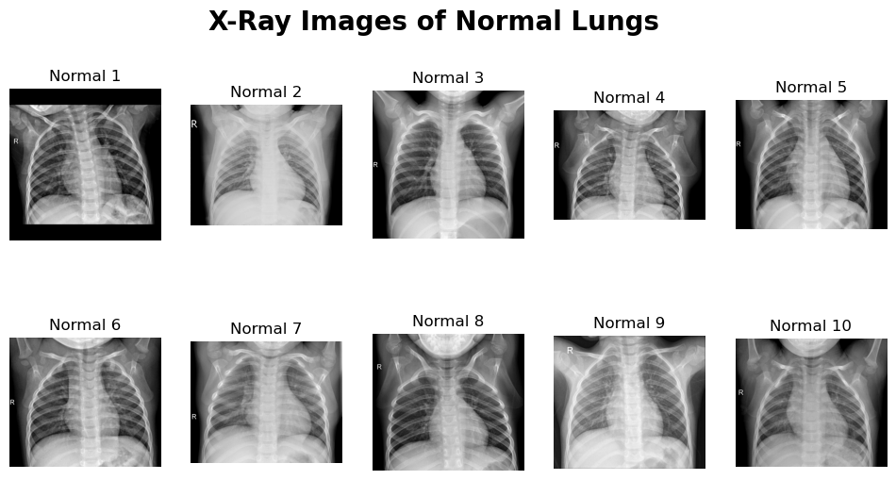

Slide 6
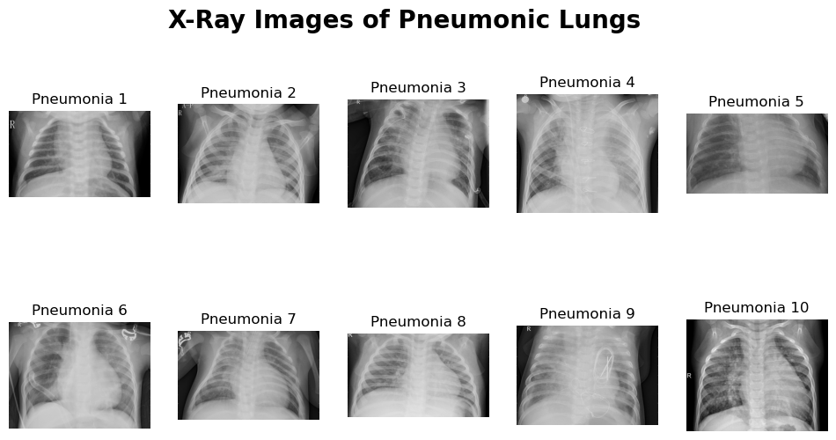
rotations

Slide 7
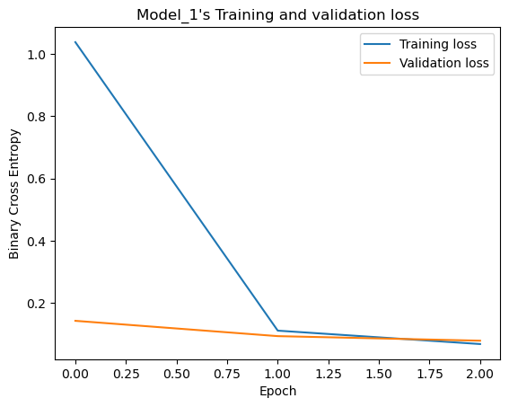
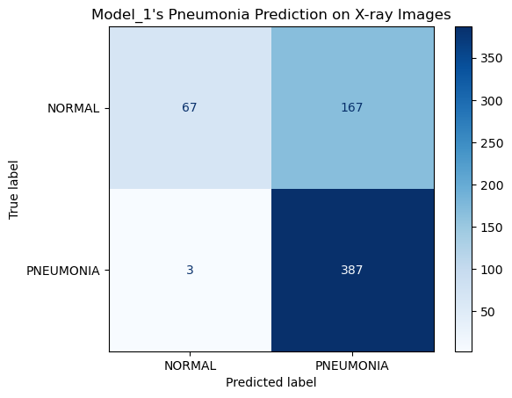
Modeling - Baseline

Slide 8
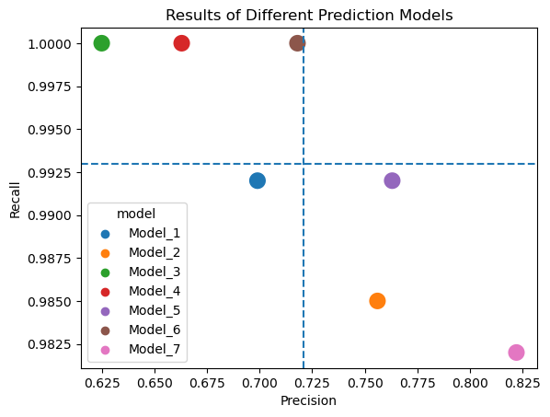
Model Performances

Slide 9
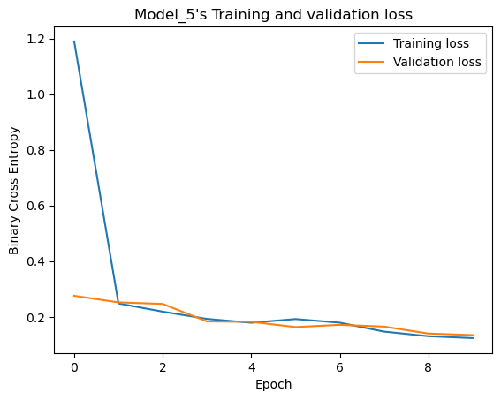
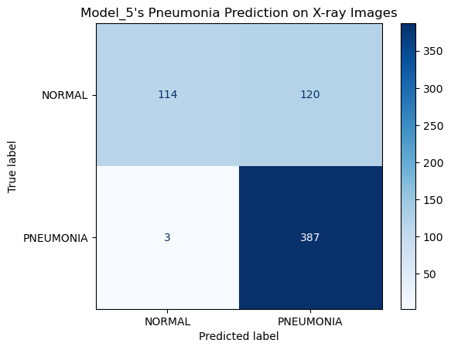
Modeling – Final Model (Fifth)

Slide 10
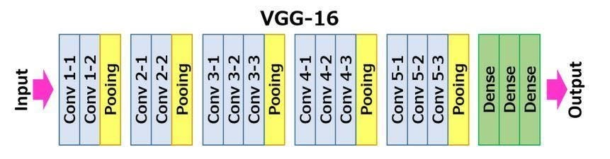
Modeling – Final Model (Fifth)
VGG-16
Flatten
Dense (512)
Dropout(0.5)
Sigmoid

Slide 11
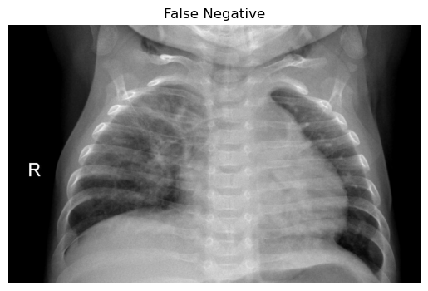
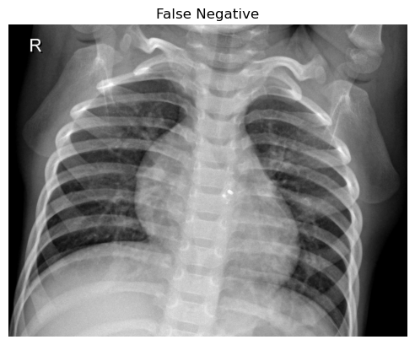
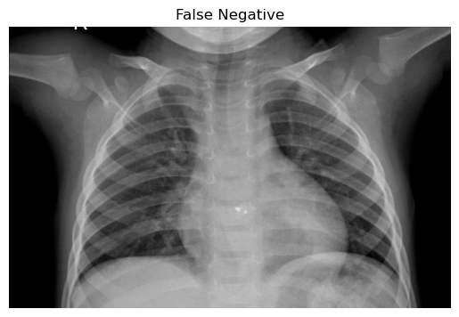
Evaluation – False Negatives

Slide 12
Conclusion
Retained the Recall
Improved the Precision by 0.075

Slide 13
Recommendation
Roll out subscription services to smaller hospitals
Apply this model to other lung infection dieseases

Slide 14
Next Steps
Gather more data
More data on men’s lung x-ray images
More data on races other than Asian
Try different Fine-Tuning

Slide 15

Thank you!
linkedin.com/in/jaeheonk817
https://github.com/jaeheonk817

