Slide 1

Deep Learning for Safer NYC Buildings
Jae Heon Kim

Slide 2

Outline
Business Understanding
Data
Modeling
Evaluation
Conclusion

Slide 3

Business Problem
NYC Buildings are OLD
Inspection Methods are OLDER

Slide 4
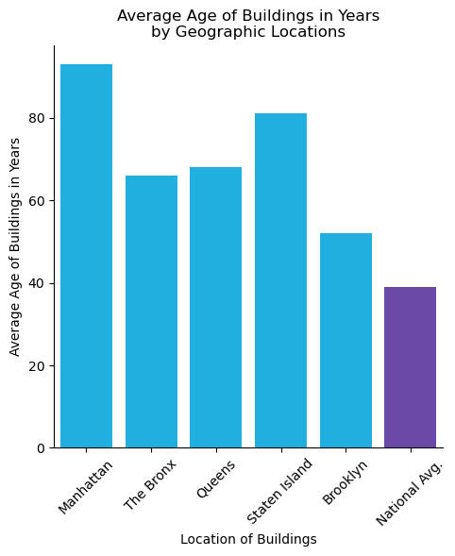
Age of NYC Buildings

Slide 5

Current Inspection Techniques
Relies heavily on human labor
Very infrequently done
Not Reliable, Time-consuming, Costly

Slide 6


Data – Description
40,000 Wall Images
20,000 Cracked
20,000 Un-Cracked
Perfect Balance
Hyperlink:
Contributor: Dr. Özgenel
Dr. Çağlar Fırat Özgenel 🙏

Slide 7
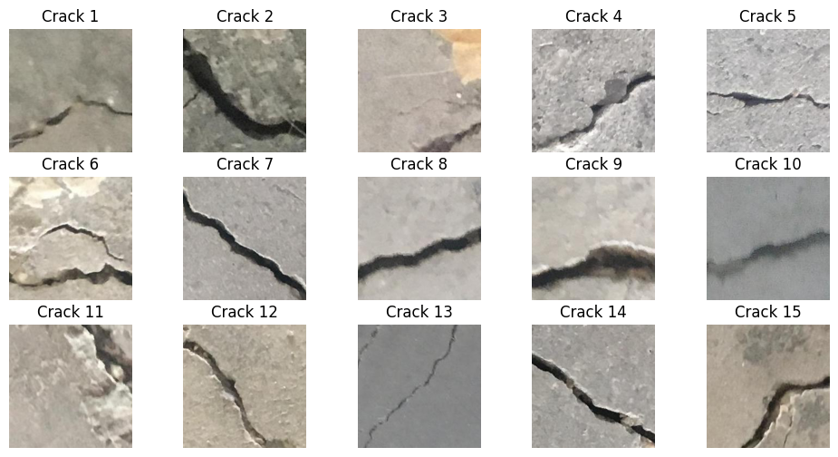
Data – Cracked Wall Images

Slide 8
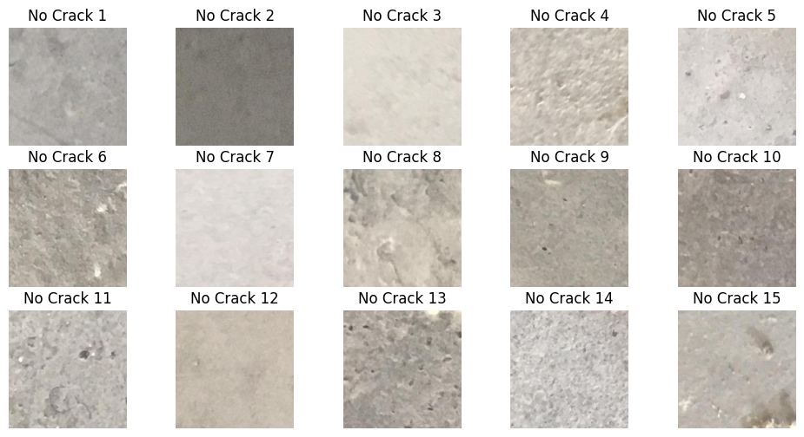
Data – Uncracked Wall Images

Slide 9
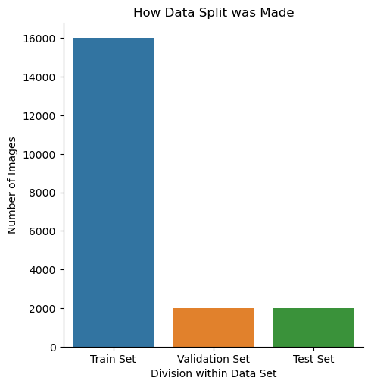
Data – Splitting
Large Data Size
Train 80%
Validation 10%
Test 10%

Slide 10
Data – Processing

Slide 11
Modeling – Baseline Model

Slide 12
Modeling – Subsequent Models

Slide 13
Modeling – Metrics Comparison

Slide 14
Modeling – Choosing the Final Model

Slide 15
Evaluation – How much Improvement?

Slide 16
Evaluation – Final Model’s Strength

Slide 17
Evaluation – Final Model’s Weakness

Slide 18
Recommendations

Slide 19
Discoveries

Slide 20
Discoveries

Slide 21
Next Steps

Slide 22
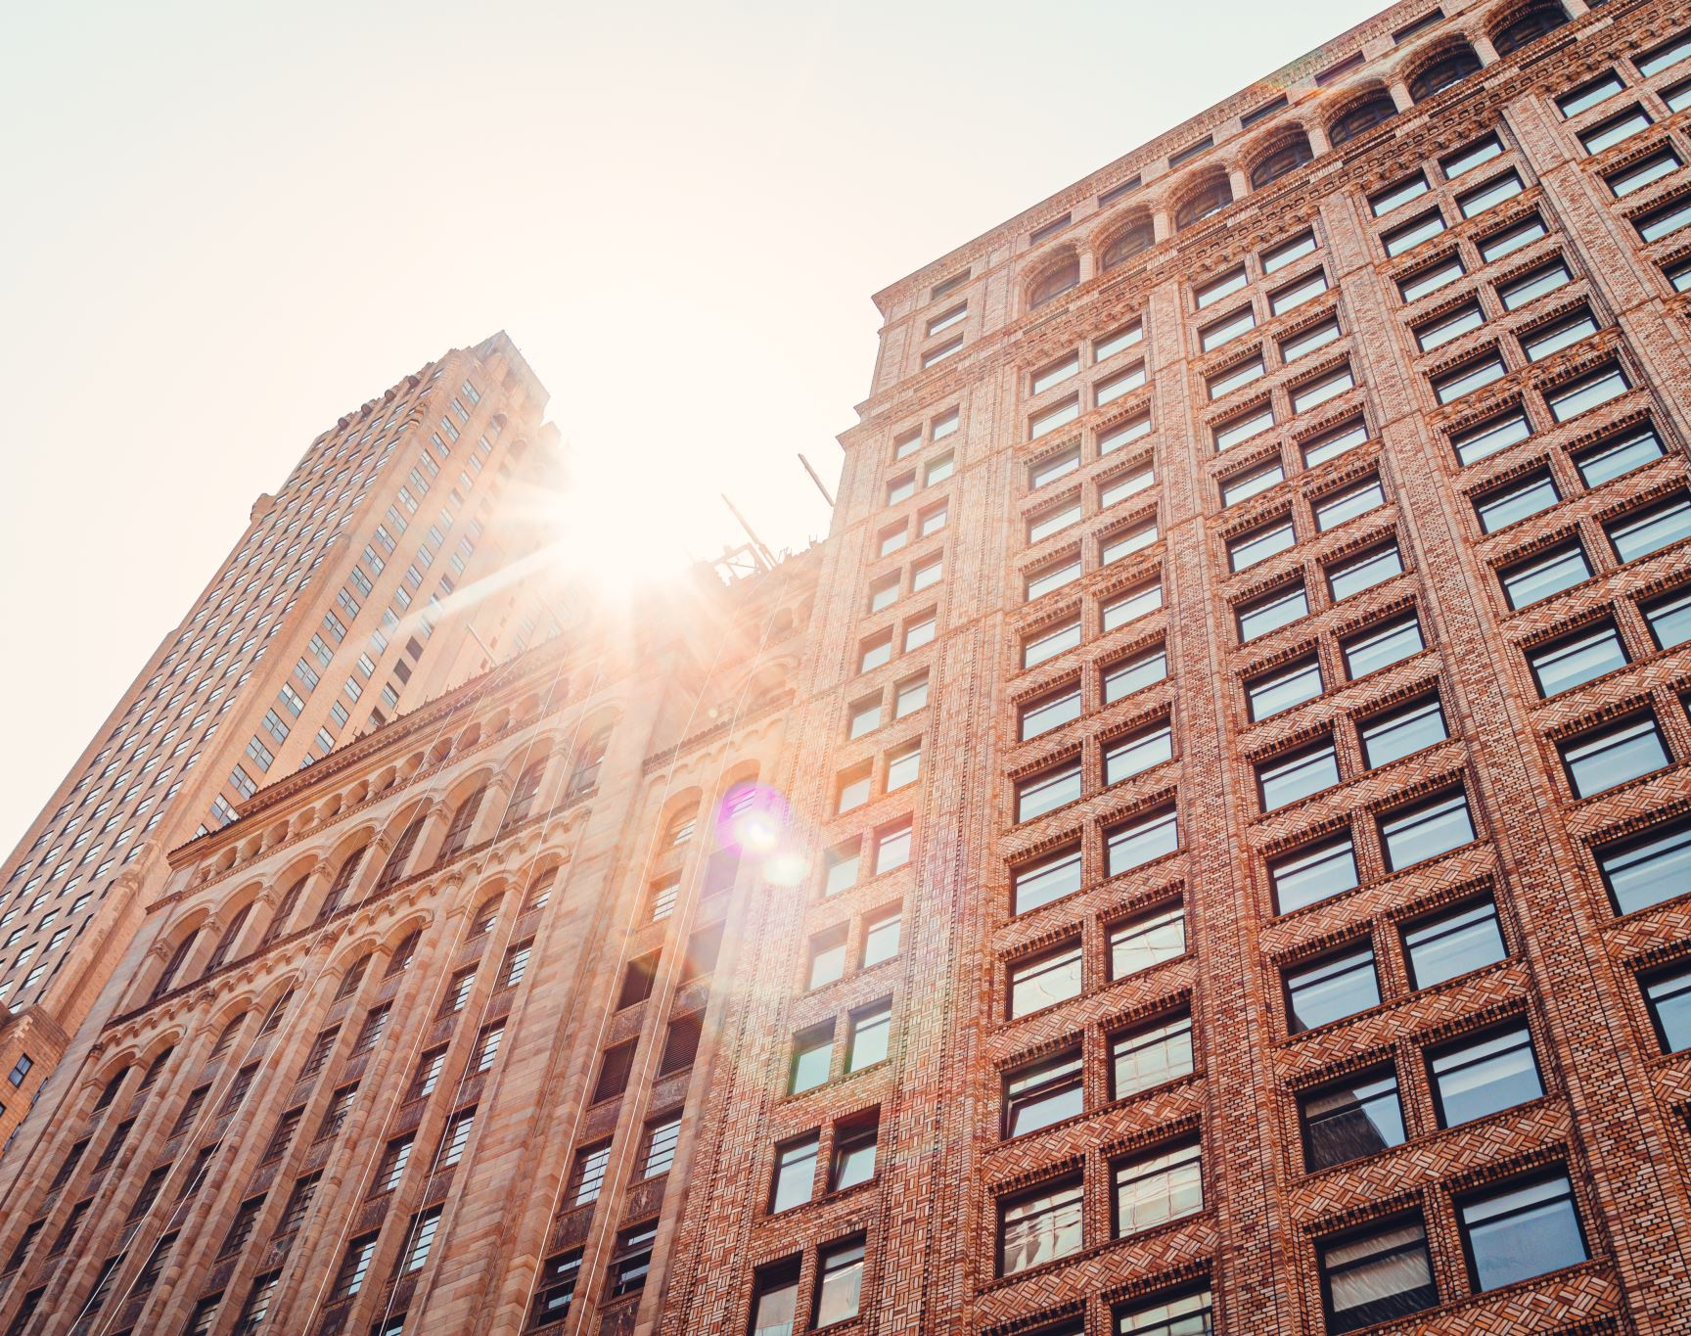




Thank You!
Please check out my other data science projects!

