Slide 1
Leave No Context Behind: Efficient Infinite Context Transformers with Infini-attention
Tsendsuren Munkhdalai, Manaal Faruqui and Siddharth Gopal
Google
Boo Minseong

Slide 2
Problem Statement
Scaling LLMs to longer sequences (i.e. 1M tokens) is challenging with the standard Transformer architectures
Compressive memory systems promise to be more scalable and efficient than the attention mechanism for extremely long sequences

Slide 3
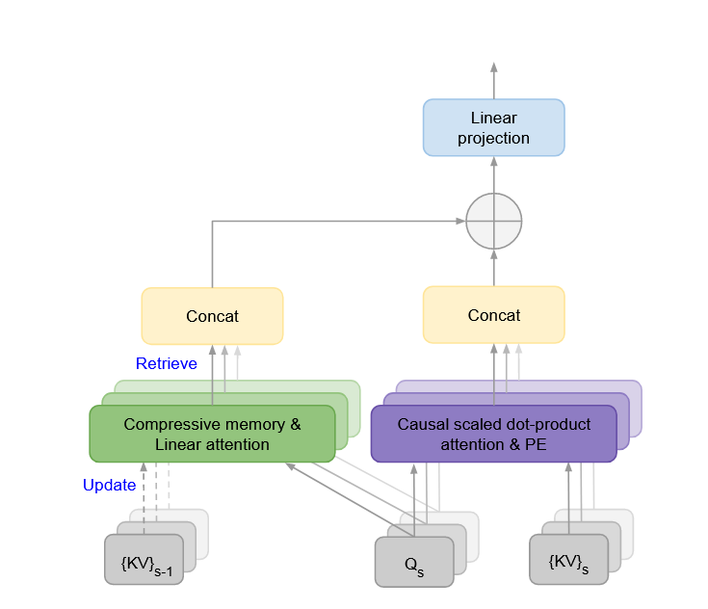
Contribution
Infini-attention with long-term compressive memory for modeling long contextual dependencies.
Enables Transformer LLMs to scale to infinitely long context by processing extremely long inputs in a streaming fashion.

Slide 4
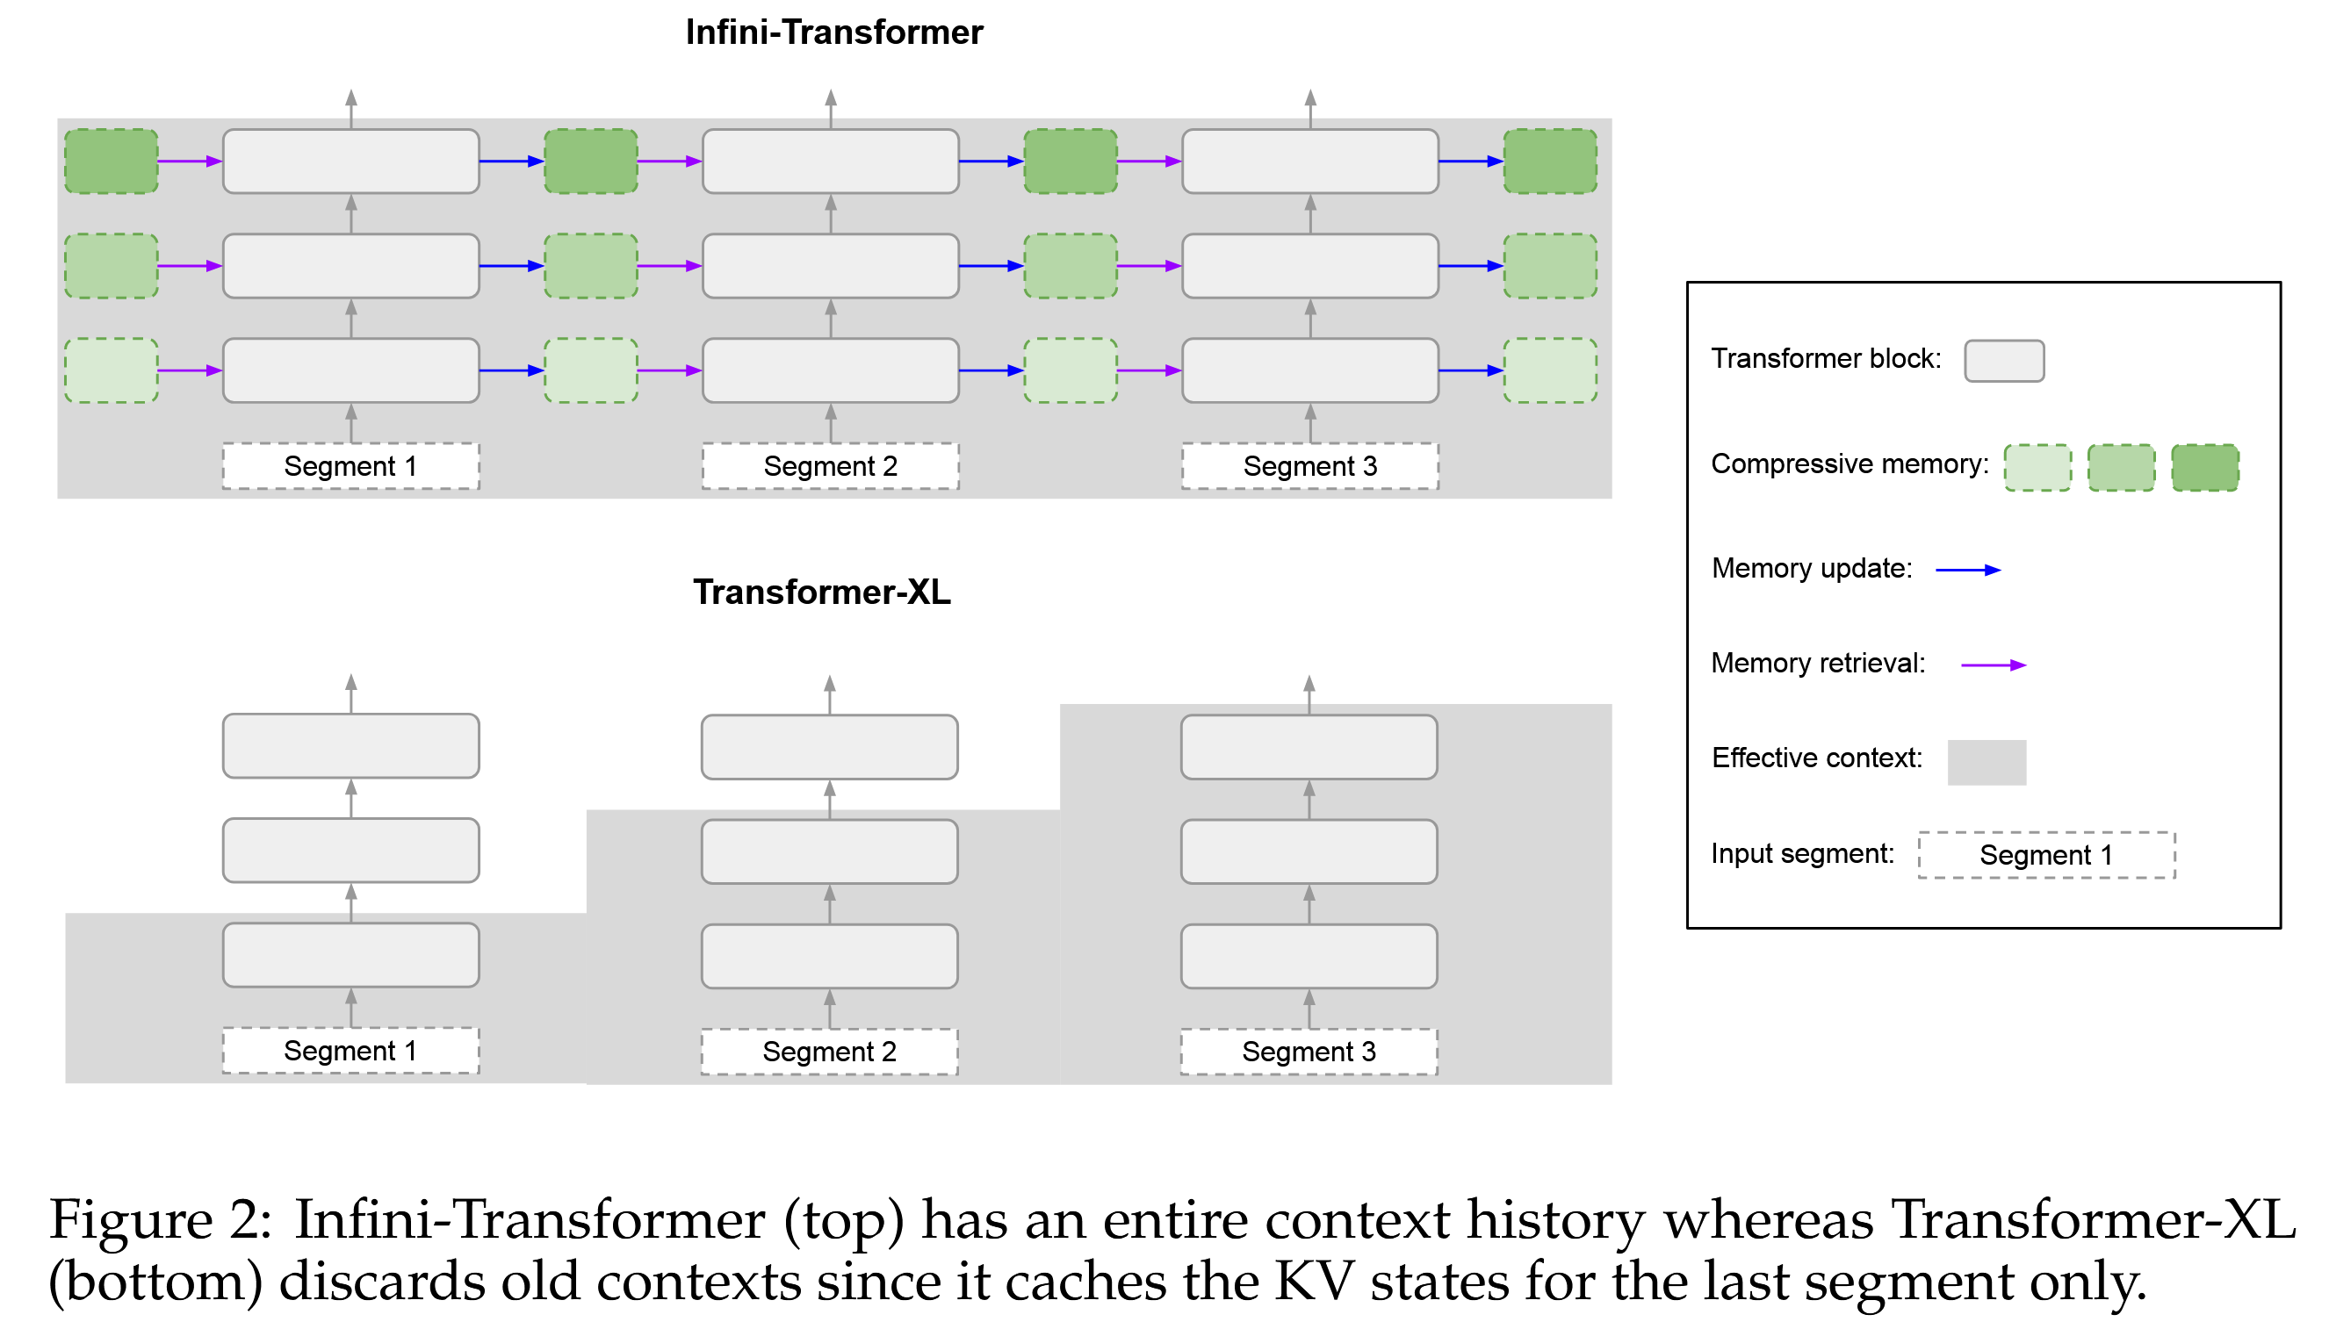
Contribution
Unlike prior segment methods, Infini-attention maintains fixed memory incrementally.

Slide 5
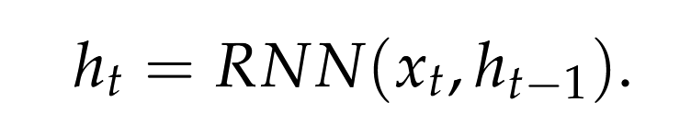
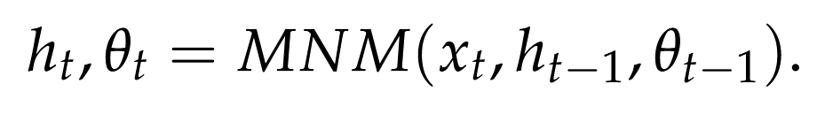
Background
Recurrent Neural Networks (RNNs)
Fixed Size, Efficient Computation
Metalearned Neural Memory (MNM)
learns an additional memory state,

Slide 6
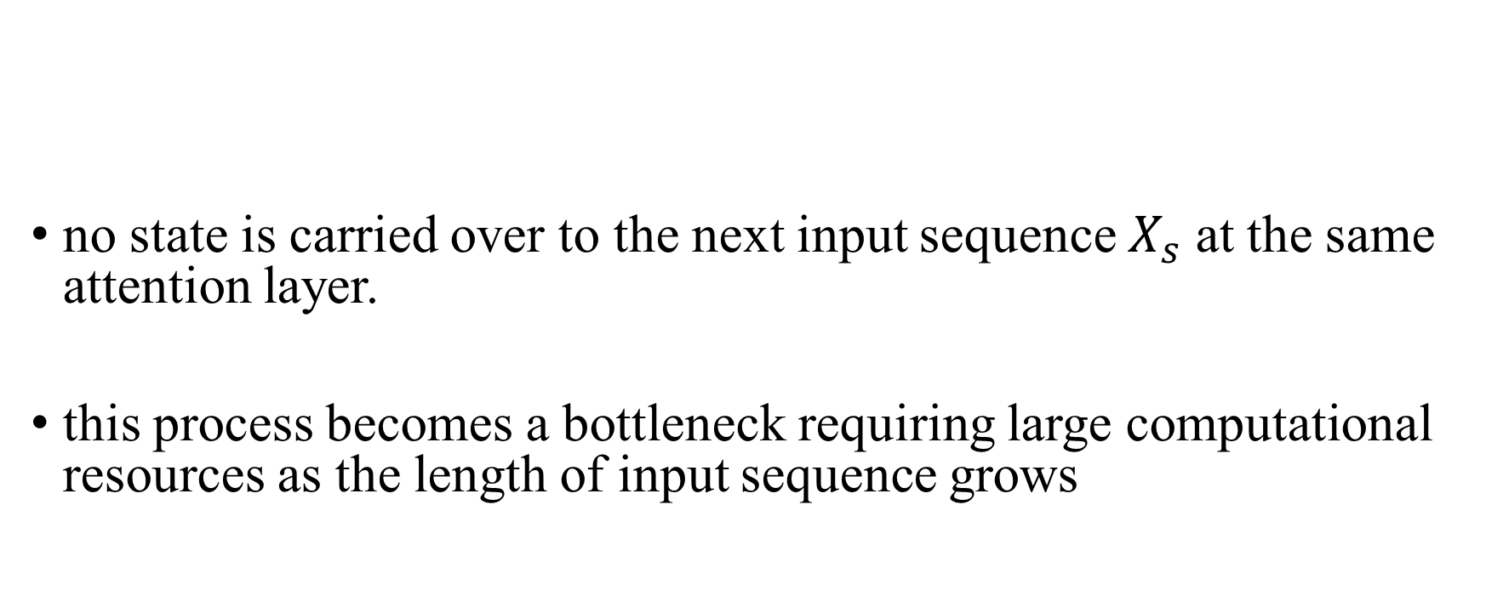
Background
no state is carried over to the next input sequence $X_{s}$ at the same attention layer.
this process becomes a bottleneck requiring large computational resources as the length of input sequence grows
$$O_{s} = attention(X_{s})$$

Slide 7
Method
Similar to previous research like Transformer-XL, the input context is divided into fixed-size 'Segments’
After processing each segment, a fixed-size 'Compressive Memory' is stored and updated.
$$O_{s}, M_{s}= infini_attention(X_{s}, M_{s−1})$$

Slide 8
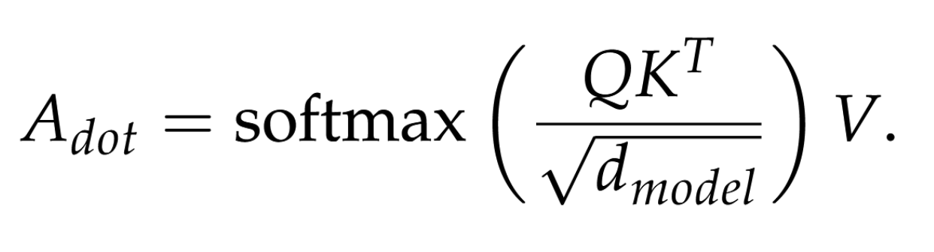
Method
Infini-attention
Scaled Dot Product Attention
Fixed Size Memory Attention
Scaled Dot-product Attention

Slide 9
Method
Compressive Memory
store bindings of key and value states in the compressive memory and retrieve by using the query vectors.
parameterize the memory with an associative matrix
memory update and retrieval process as linear attention mechanism
Notes:
associative 이것도 본인논문이네 그리고 이것도 단순화한 가정임. 수학적으로 선형 어텐션의 형태가 자연스럽게 도출되어, 선형 어텐션의 효율적인 계산 및 학습 기법들을 활용할 수 있게 되었다.

Slide 10
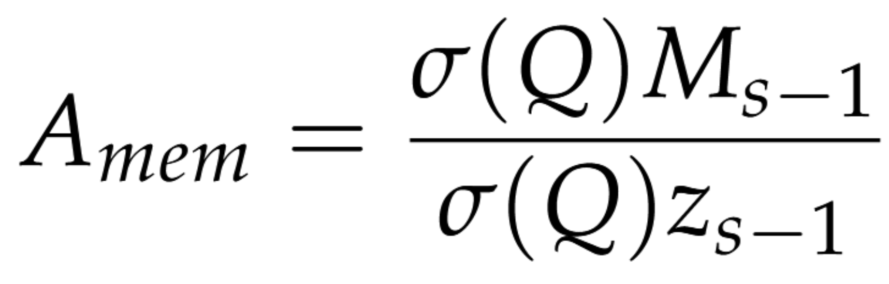
Method
Memory retrieval
Q : query, $σ$: non linear activation(elu+1) , M : memory , z : normalization term

Slide 11
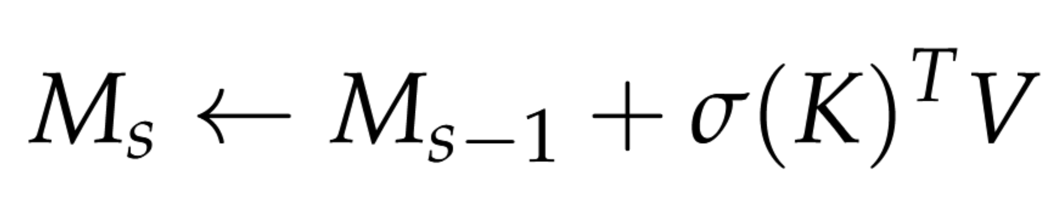
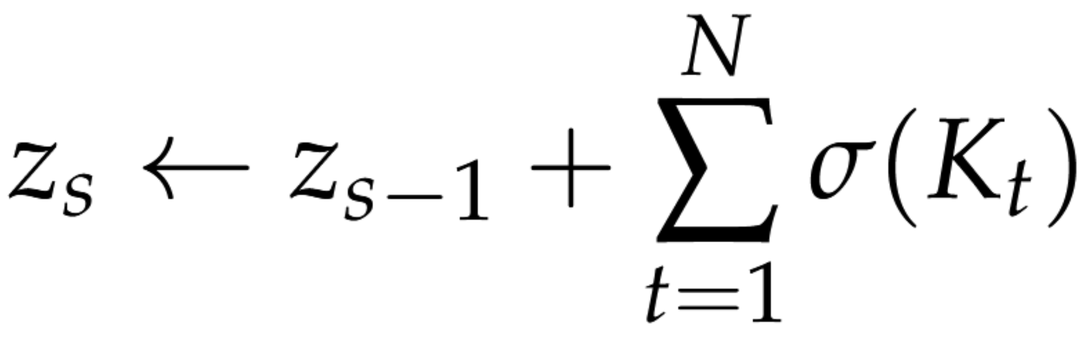
Method
Memory update(Linear)
Notes:
associative 이것도 본인논문이네 그리고 이것도 단순화한 가정임. 외적을 사용해서 모든 데이터들간의 관계를 계산하게 되었고, 이를 바탕으로 쿼리를 내적하면, 어텐션처럼 보일 수 있다.
수학적으로 선형 어텐션의 형태가 자연스럽게 도출되어, 선형 어텐션의 효율적인 계산 및 학습 기법들을 활용할 수 있게 되었다. 근데 실제론 반대일듯

Slide 12
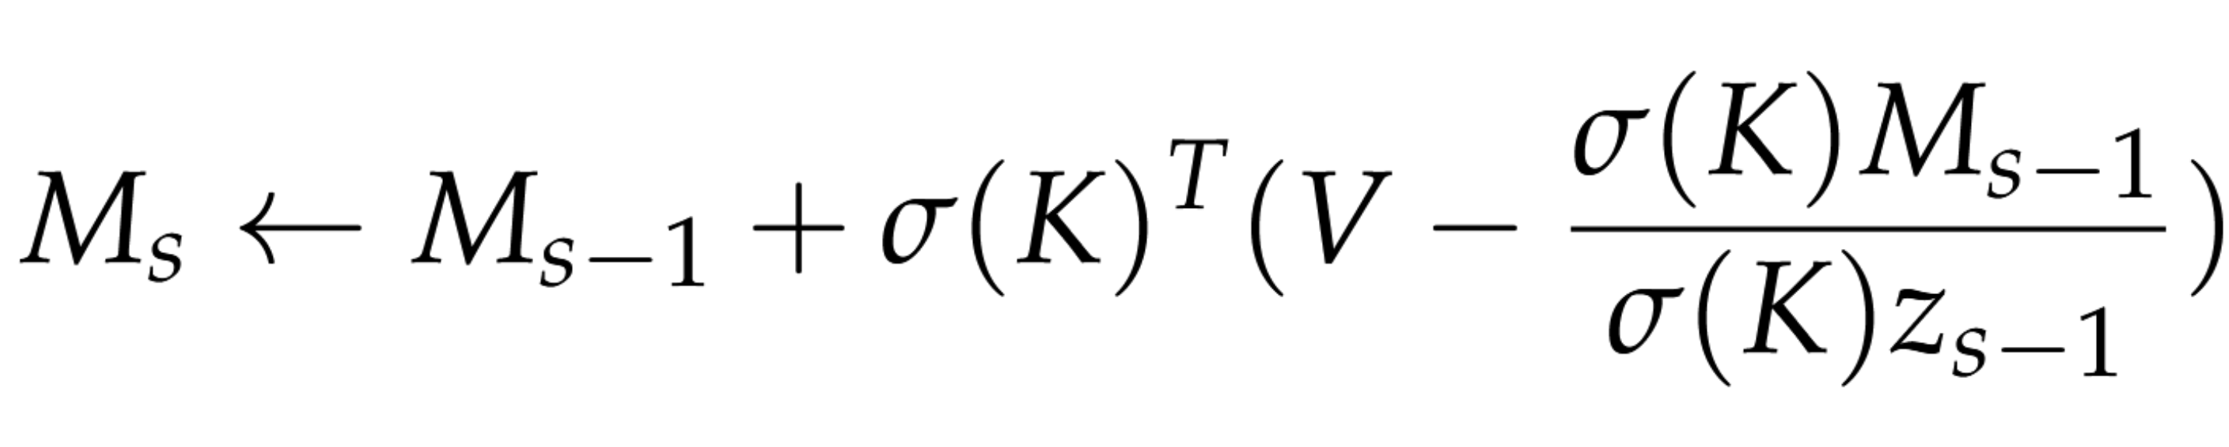
Method
Memory update(Linear +Delta)
Notes:
“The delta rule attempts a slightly improved memory update by first retrieving existing value entries and subtracting them from the new values before applying the associative bindings as new update.” (Munkhdalai 등, 2024, p. 5)

Slide 13
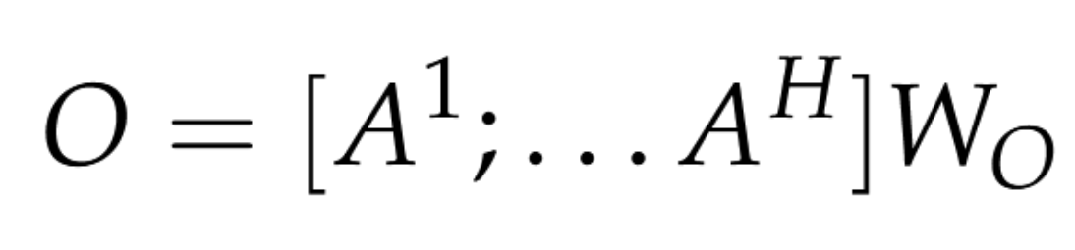
Method
Long-term context injection
Notes:
“single scalar value as training parameter per head” (Munkhdalai 등, 2024, p. 5)

Slide 14
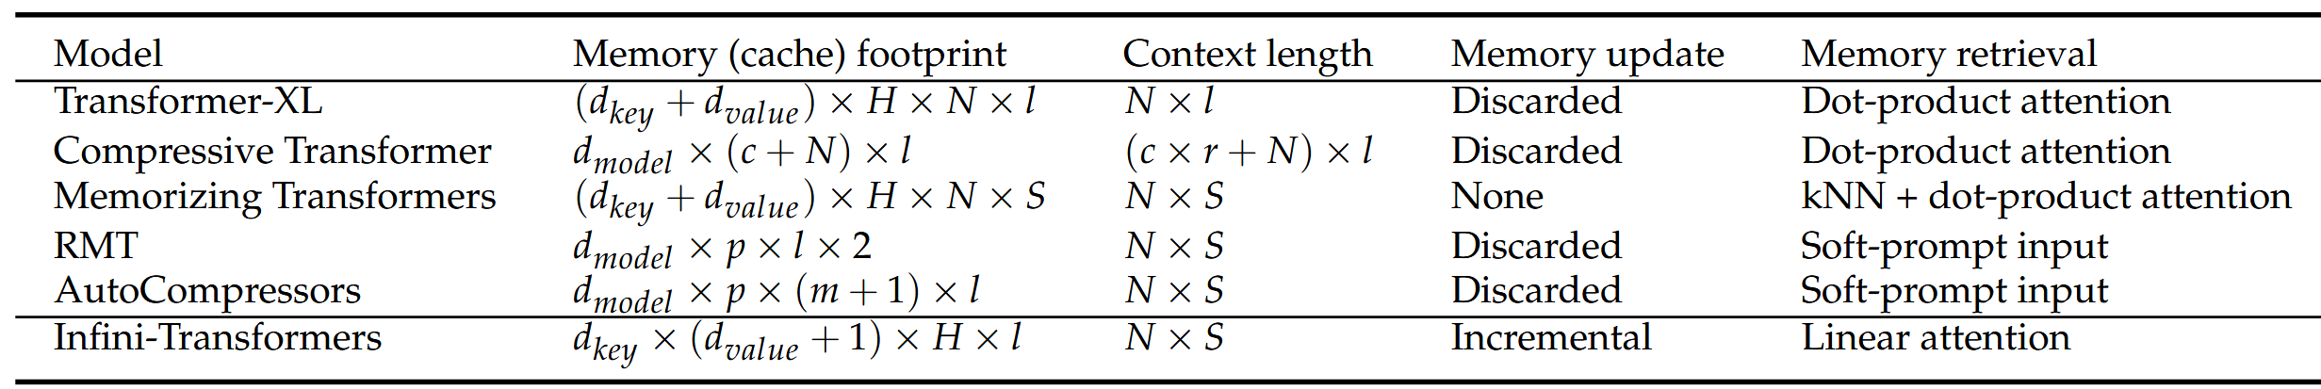
Method
Memory and Effective Context Window
dkey × dvalue + dkey : M_s + z_s
N : segment length, S : segment
Notes:
“single scalar value as training parameter per head” (Munkhdalai 등, 2024, p. 5)

Slide 15
Experiments
Implementation details
Segment chunking.
Chunk the input at each Infini-attention layer, process segments, and reassemble for the next layer.
Back-propagation through time (BPTT) with compressive memory states
Position Embeddings (PE)
Don’t use PE on compressive memory states to store only global contextual information
Notes:
to store only global contextual information in the long-term memory. Don’t use PE

Slide 16
Experiments
long-context language modeling
1M length passkey context block retrieval
500K length book summarization tasks
Notes:
정보를 효과적으로 검색할 수 있는가?
정말 잘 읽고 처리할 수 있는가?

Slide 17
Experiments
long-context language modeling
Dataset
PG19
Arxiv-math
Architect
12 layers
8 attention heads of dimension 128
FFN with hidden layer 4096
Input Seq len : 32768 = 16(segment number) x 2048(segment length)
Notes:
“single scalar value as training parameter per head” (Munkhdalai 등, 2024, p. 5)

Slide 18
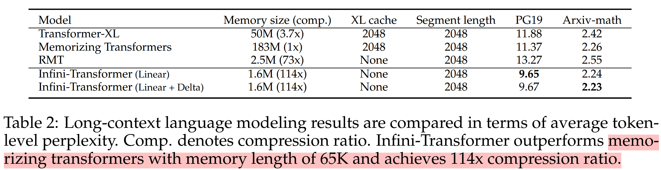
Experiments
long-context language modeling
100K length training decreased the perplexity score to 2.21(Linear) and 2.20(Linear+Delta)
Notes:
“single scalar value as training parameter per head” (Munkhdalai 등, 2024, p. 5)

Slide 19
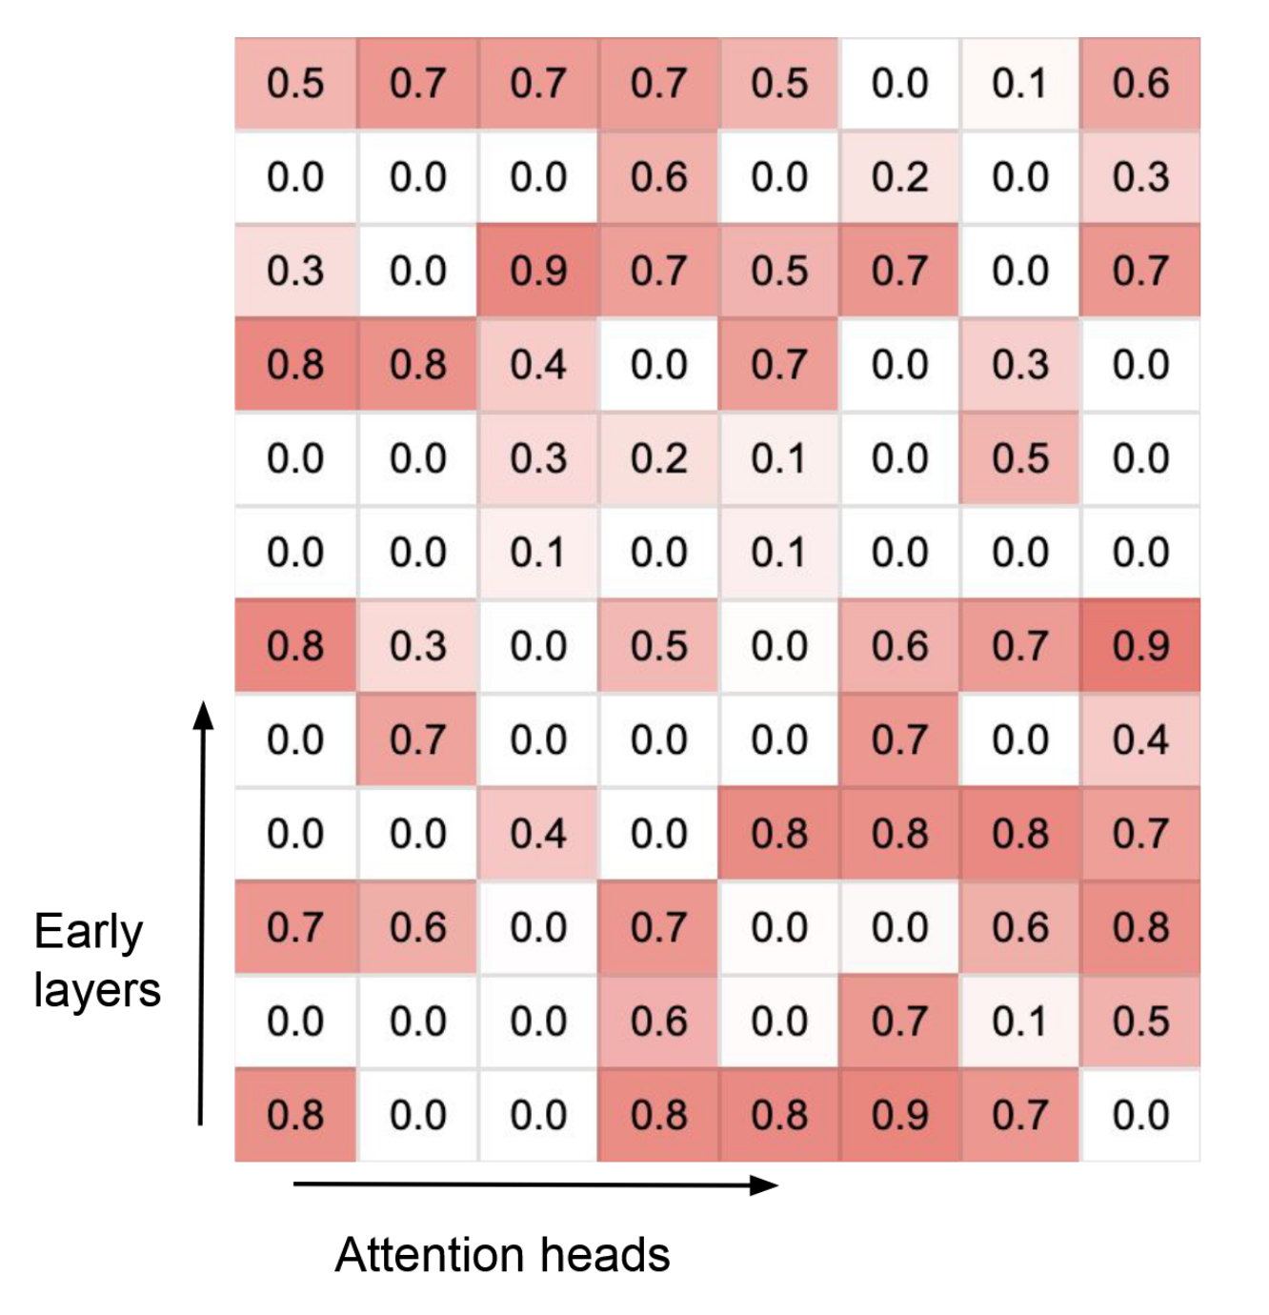
Experiments
long-context language modeling
Gating score visualization
Specialized Head : 0,1
Mixed head: 0.5
Notes:
0인 헤드가 무조건 하나씩 있어서 local attention 값이 끝까지 전달됨

Slide 20
Experiments
long-context language modeling
Gating score visualization
Specialized Head : 0,1
Mixed head: 0.5
Interleaving
Notes:
0인 헤드가 무조건 하나씩 있어서 local attention 값이 끝까지 전달됨

Slide 21
Experiments
1M passkey retrieval benchmark
LLM Continual Pre-training
Dataset : PG19, Arxiv-math, C4( longer than 4k tokens)
Segment length N : 2k
Train
1B LLM, 30k steps, 64 batchs, 4k input length
Finetune
5k input length, 400 steps, 1M input length for eval
Notes:
아마도 llama로 추측된다
Gemma는 9B라서

Slide 22
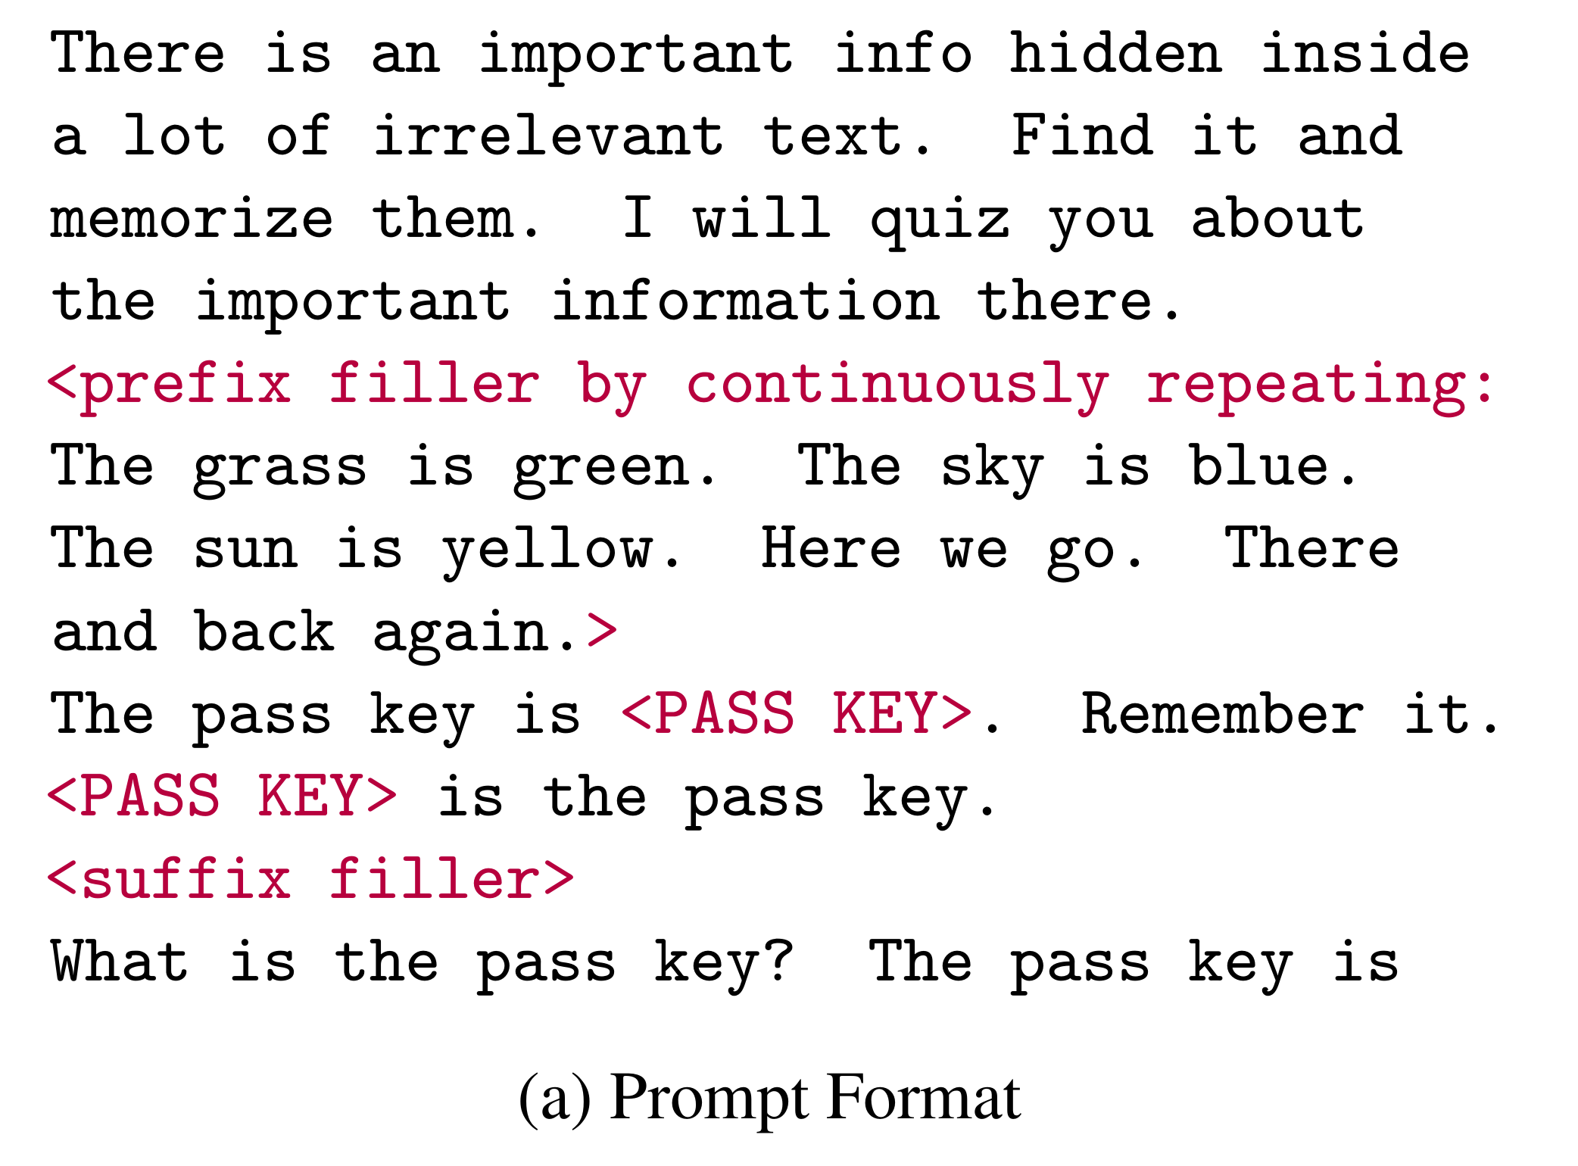
Experiments
1M passkey retrieval benchmark
LLM Continual Pre-training
Dataset : PG19, Arxiv-math, C4( longer than 4k tokens)
Segment length N : 2k
Train
1B LLM, 30k steps, 64 batchs, 4k input length
Finetune
5k input length
Notes:
아마도 llama로 추측된다
Gemma는 9B라서

Slide 23
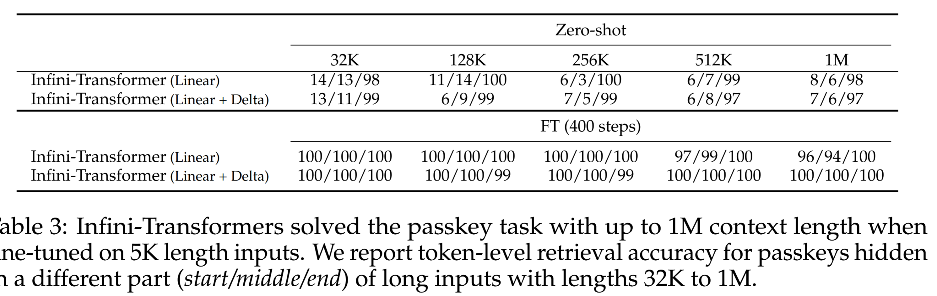
Experiments
1M passkey retrieval benchmark
Notes:
보면 전 중 후 인데, 후에 있는걸 잘한다는거는 로컬 어텐션 하는건 다 찾는다는거다
훈련 후에는 메모리에 있는것도 잘 찾더라

Slide 24
Experiments
500K length book summarization (BookSum)
LLM Continual Pre-training
Dataset : PG19, Arxiv-math, C4( longer than 4k tokens)
Segment length N : 2k
Train
8B LLM, 30k steps, 64 batchs, 8k input length
Finetune
32k input length, 400 steps, 500K input length for eval
Notes:
아마도 llama로 추측된다
Gemma는 9B라서

Slide 25
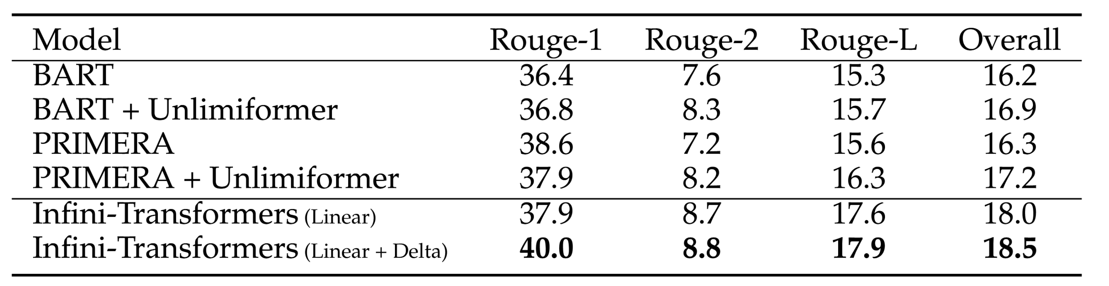
Experiments
500K length book summarization (BookSum)
Notes:
아마도 llama로 추측된다
Gemma는 9B라서
achieves a new SOTA on BookSum

Slide 26
Conclusion
An effective memory system is crucial
Modification to the attention layer enables LLMs to process infinitely long contexts with bounded memory and computation resources.
Demonstrate a promising length generalization capability of our approach
Notes:
메모리 시스템은 중요하고 attention 관점에서 통합이 필요할 수 있다.
이러한 긴 컨텍스트 시스템은 일반화 능력에 대한 증명 또한 필요하다.

Slide 27
Limitation
Hard to say Linear Attention is achieving great success these days.
Memory store method is not learned during training
In human perspective, memorize is not a linear process
Need learnable of Important memory
Evaluation metrics are limited
Potential Downsides of Lacking Positional Encoding in Memory
Limitation of Fixed Compressive Memory Size
Cost of Continual Pre-training
Notes:
리니어 어텐션은 여전히 증명 중이다. 저 비선형성이 커널을 사용해서 선형화 될 수있는게 맞는가? 실제 상황에 쓰일 수 있는가?
이러한 정보 압축이 멀티모달에도 사용될 수 있는가?
기억 저장이 선형적인 것이 단점이 될 수도 있다.

