Slide 1
Published at ICLR 2025 Workshop on Reasoning and Planning for LLMs
Thinking Slow, Fast: Scaling Inference Compute with Distilled Reasoners
Daniele Paliotta, Junxiong Wang, Metteo Pagliardini, Kevin Y. Li, Aviv Bick, J. Zico Kolter, Albert Gu, Francois Fleuret, Tri Dao
Chanhee Lee1, Yongjun Kim2, Jiwoo Kim1
1 Department of Electrical Engineering
2 Department of Computer Science
Notes:
Okay, let’s get started with our presentation.
Hello everyone. We are Chanhee Lee and Jiwoo Kim from the Department of Electrical Engineering, and Yongjun Kim from the Department of Computer Science. Today, we’ll be presenting the paper, "Thinking Slow, Fast: Scaling Inference Compute with Distilled Reasoners.“
This paper is published at ICLR 2025 Workshop on Reasoning and Planning for LLMs

Slide 2
Contents
Introduction
Background
Method
Experimental Result
Conclusion
Notes:
First, I’ll cover the introduction and background.
Then Yongjun will explain the method.
Finally, Jiwoo will go over the experiments and conclusion.

Slide 3
Introduction

Slide 4
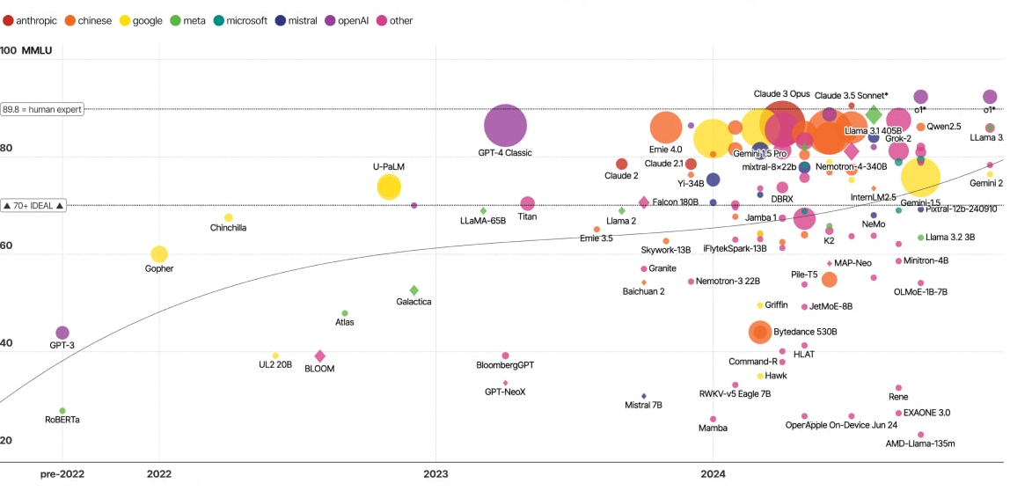
Improvement of recent LLMs inference performance
Problem of LLM
Large Language model (LLM) gains outstanding performance in recent studies, but it has clear limitation on complex inference.
Simply scaling up the model size is inefficient from latency, memory, computational complexity perspective.
Notes:
Let’s begin with something you might already be familiar with.
After the introduction of Transformers, the era of large language models truly began.
Thanks to tools like ChatGPT, LLMs became widely accessible and incredibly popular.
They are now one of the most rapidly growing areas in AI.
In recent years, researchers have boosted LLM performance mainly by increasing model size.
But scaling up parameters comes at a cost.
Latency increases, memory usage grows,
and overall efficiency drops—especially under resource constraints.

Slide 5
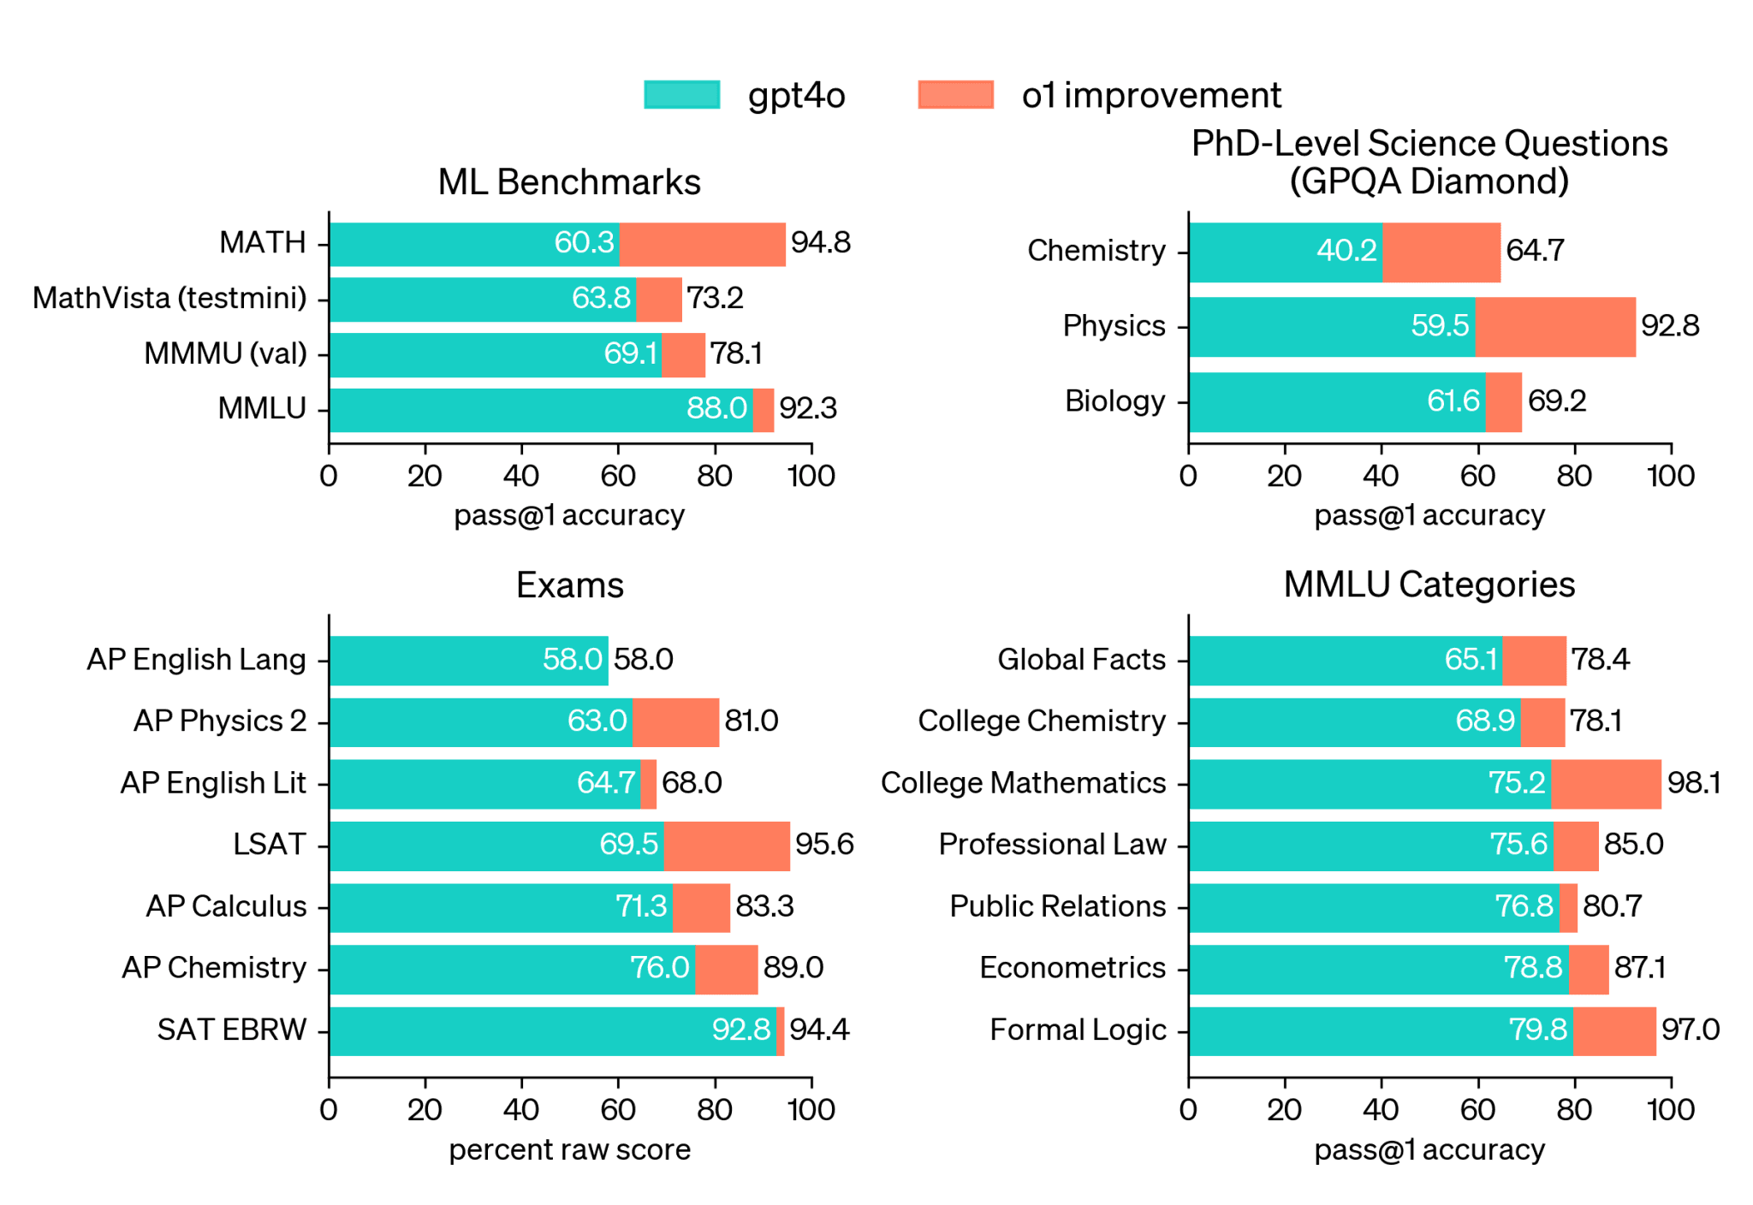
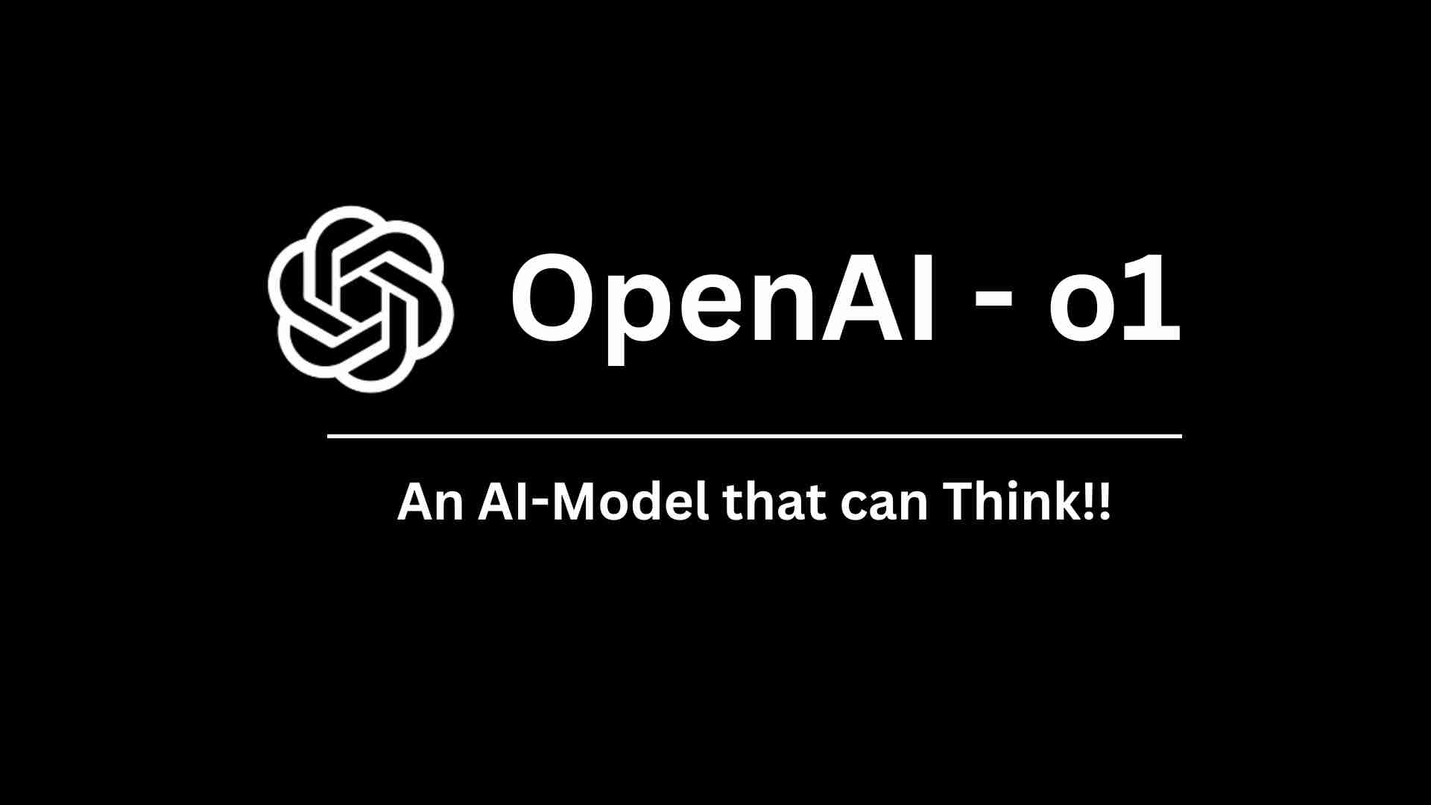
Improvement of recent LLM inference performance
Overcome the limitation
Test-time compute is one of the solution of these problems.
o1 model of OpenAI has proven usefulness of test-time compute
It gives outstanding performance than original models.
[R1] GPT-o1, OpenAI, 2024
Notes:
To address this, a new idea called test-time compute has emerged.
It focuses on improving reasoning ability during inference.
A good example is OpenAI’s GPT-o1.
This model applied test-time compute and achieved better performance than GPT-4o.

Slide 6
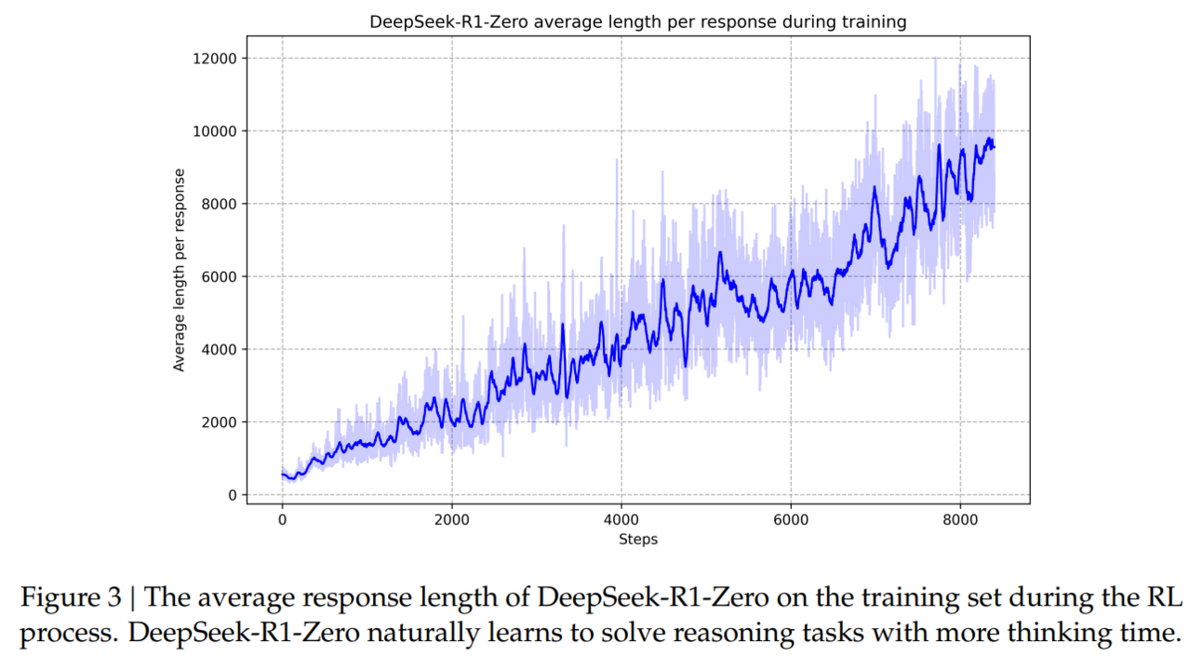
Optimal architecture for test-time compute
Disadvantage of test-time compute
In transformer architecture, High memory usage and slow inference, Due to their long sequence length.
This is especially noticeable in transformer structures where a lot of cost is required in the inference step.
Notes:
But test-time compute has a clear disadvantage.
It leads to longer contexts, which means more memory usage and slower inference speed.
Some of you may have noticed this when using models like GPT-o1.
This issue is especially severe in Transformer-based LLMs.

Slide 7
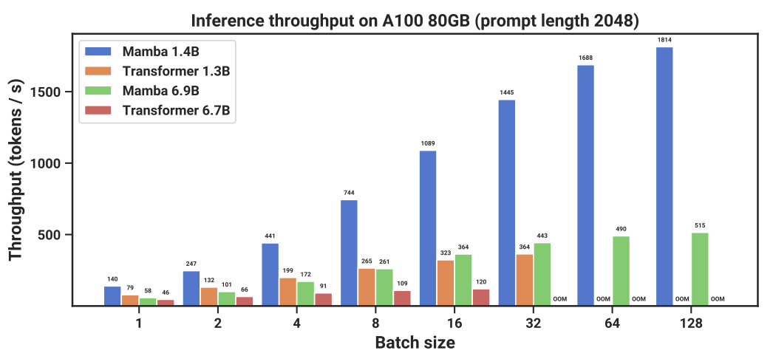
Optimal architecture for test-time compute
Subquadratic models
Faster, less memory usage than transformer, which is foundation model of LLMs
Inefficient well-trained subquadratic models. → distillation
Mamba is well-known subquadratic model.
Notes:
That’s where subquadratic architectures come in.
These models are faster than Transformers when handling long sequences.
A popular example is Mamba.
But subquadratic models are quite new, and well-trained versions are still rare.
The author said that it can solve this using distillation from existing Transformer models.

Slide 8
What the author do?
Problems and solutions summary
Test time compute needs long context → Use subquadratic model
Lack of well-trained subquadratic model → Distill transformer to subquadratic model
Notes:
In short, this paper combines both ideas.
It uses a subquadratic model to reduce the cost of long-context inference.
And it applies distillation to transfer knowledge to subquadratic models
from a pre-trained Transformer.

Slide 9
Background
Notes:
And here’s background

Slide 10
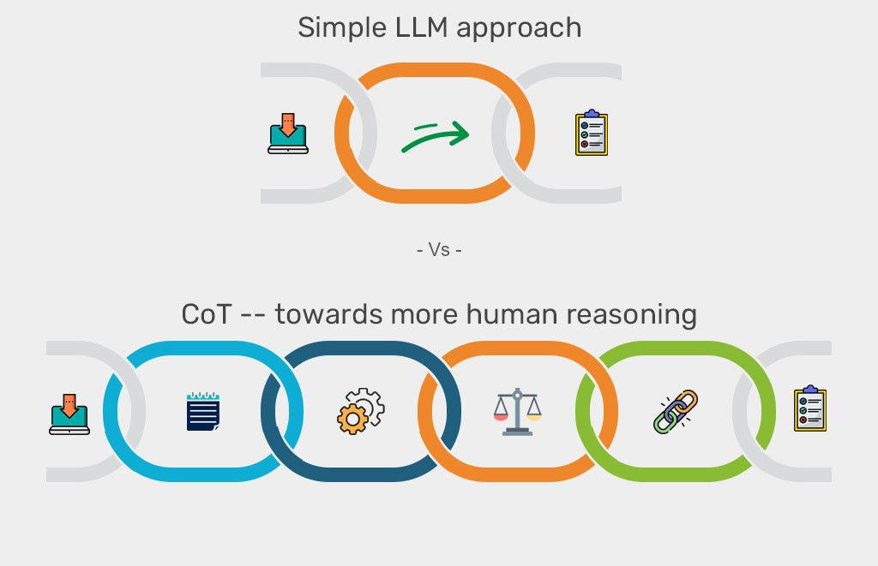
Chain of Thought (CoT)
II. Background
Step-by-step inference
Not compute the result directly, but implement the flow of thought
Show good performance some specific tasks
Mathematical problem
Logical determination
Analysis of complex sentence
Notes:
Let’s talk about Chain-of-Thought, as known as CoT.
This is a key concept in test-time compute.
Instead of giving the answer directly, the model is prompted to follow a reasoning path.
It breaks the problem into steps, making it useful for tasks like math problems, logical reasoning, and complex sentence analysis.

Slide 11
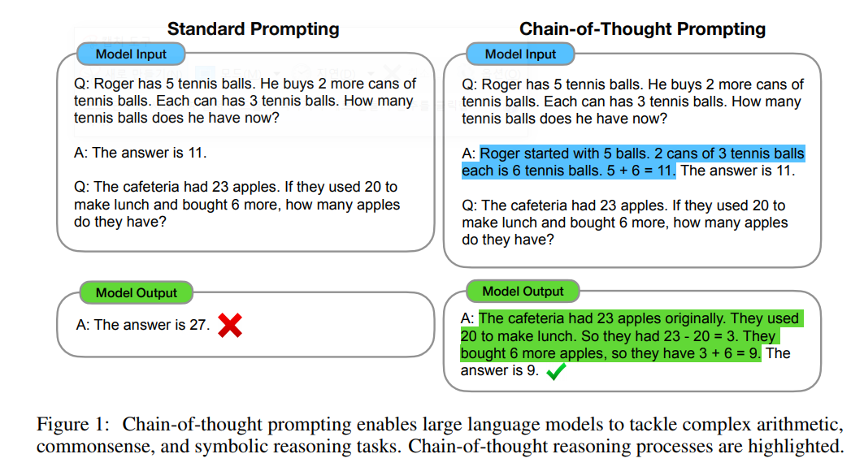
Chain of Thought (CoT)
II. Background
[R1] Wei, Jason, et al. "Chain-of-thought prompting elicits reasoning in large language models." Advances in neural information processing systems 35 (2022): 24824-24837.
Notes:
For example, consider a math problem.
In the left side,
If we just say “The answer is…”, the model often gets it wrong.
But in the right siede,
if we provide a full CoT prompt, the model explains each reasoning step.
This improves accuracy and helps the model think more like a human.

Slide 12
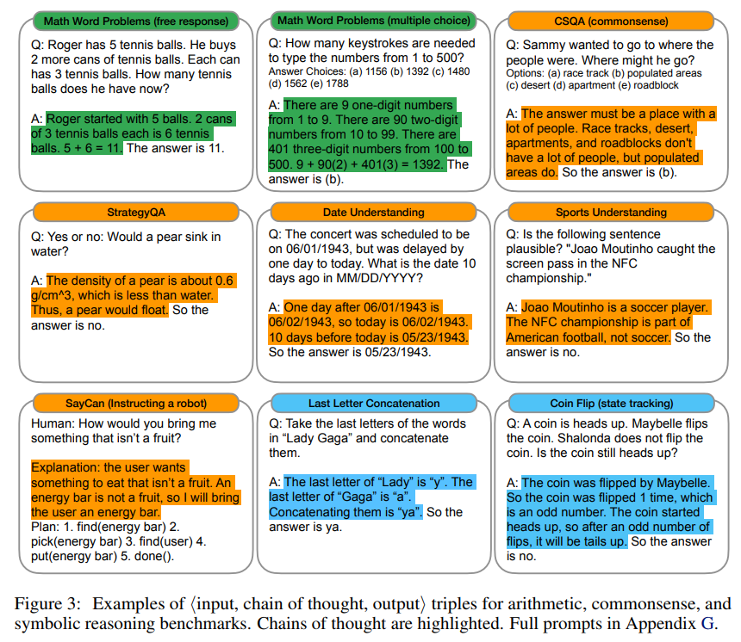
Chain of Thought (CoT)
II. Background
Various prompt example
Arithmetic (green)
Common sense (orange)
Symbolic reasoning (blue)
Features
Step-by-steps response
Generates longer sequence than original cases
[R1] Wei, Jason, et al. "Chain-of-thought prompting elicits reasoning in large language models." Advances in neural information processing systems 35 (2022): 24824-24837.
Notes:
Here you can see CoT applied in various domains: arithmetic, common sense, symbolic reasoning.
CoT improves answer quality in each case.
However, because it explains step-by-step, the output becomes longer.
And that increases inference cost.

Slide 13
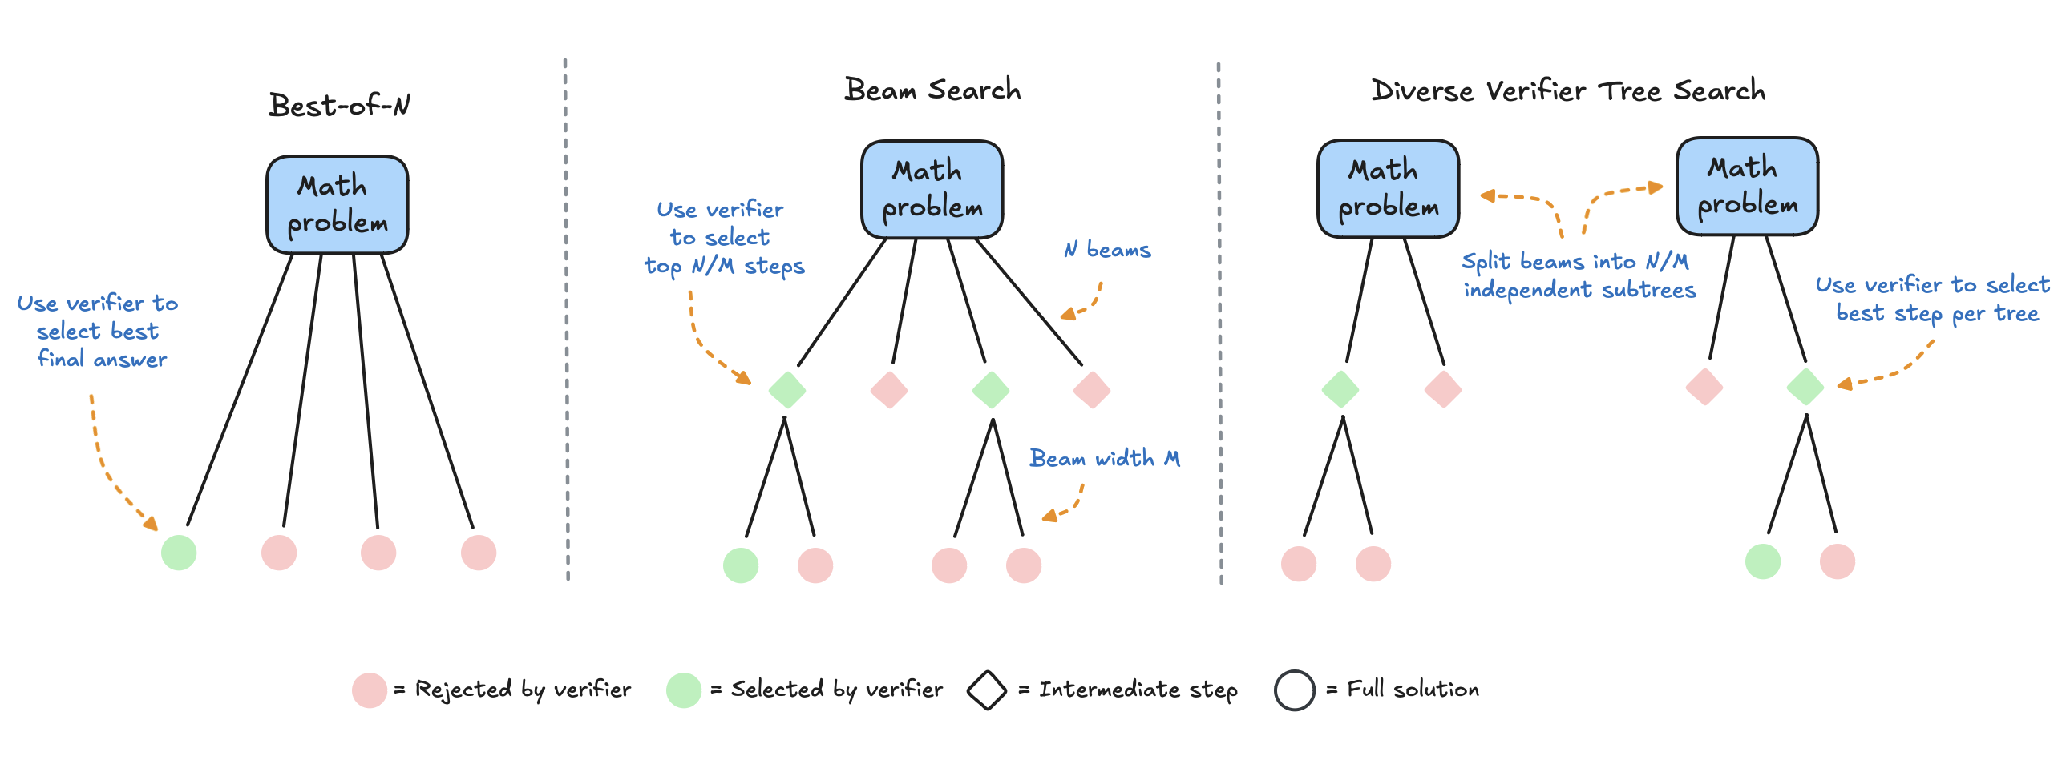
Test time compute with CoT
II. Background
Using more resource in inference step
Generate different result of CoTs
Select proper response various stratage
majority voting
Using learnable reward models for each CoTs
Disadvantage
Generate longer CoT sequences than normal cases → Require high cost and memory usage
Notes:
In test-time compute, we usually generate multiple CoT answers.
Then we choose the best one.
One simple method is majority voting.
It’s easy to apply and still works well.
Another approach uses a reward model to select the best response.
This paper discusses both options.
There’s also new research using tree search to find correct reasoning paths.
Still, long context remains a challenge due to high cost and memory usage.

Slide 14

Subquadratic model
II. Background
Transformer
Self-attention mechanism, which is main reason of performance of Transformer architecture, refer all tokens in each steps.
Its computational complexity is $O(L^{2})$ for input sequence of length L.
Subquadratic computational complexity
Less than $O(L^{2})$ computational complexity for input sequence of length L
→ Better than transformer to adopt Test-time compute
Notes:
This problem is worse in Transformers.
They use self-attention, which compares every token to all others.
As a result, the time complexity is L square, where L is the sequence length.
In contrast, subquadratic models have lower-than-quadratic complexity.
That makes them a good match for test-time compute.

Slide 15
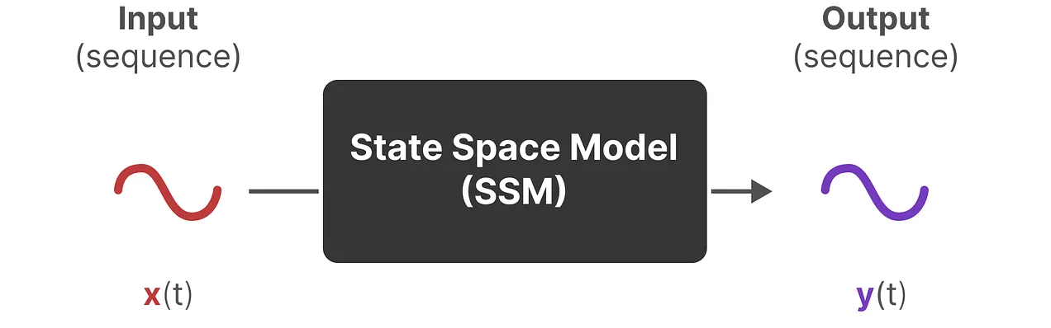
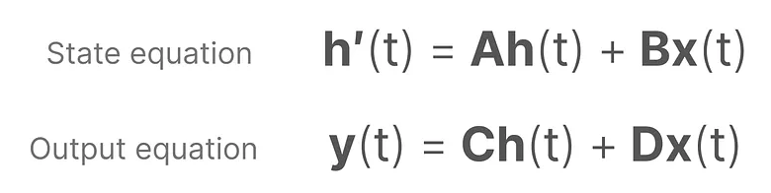
Subquadratic model
II. Background
Mamba [R2]
One of the highlighted subquadratic architecture of LLM
State Space Model (SSM) based recurrence model
[R2] Gu, Albert, and Tri Dao. "Mamba: Linear-time sequence modeling with selective state spaces." arXiv preprint arXiv:2312.00752 (2023).
Notes:
This paper uses Mamba-, a subquadratic model that’s gained recent attention.
Mamba is based on a State Space Model, or SSM.
The key advantage is that it runs in linear time.

Slide 16
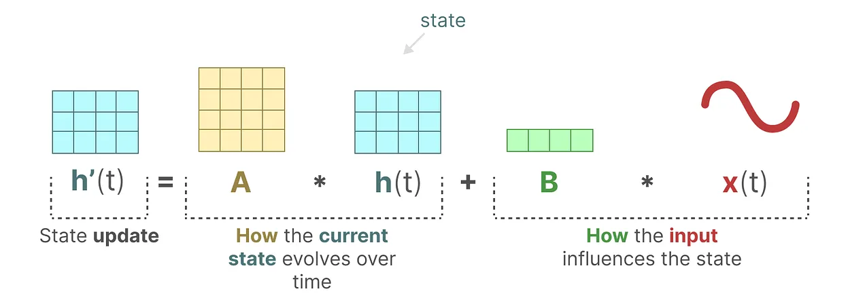
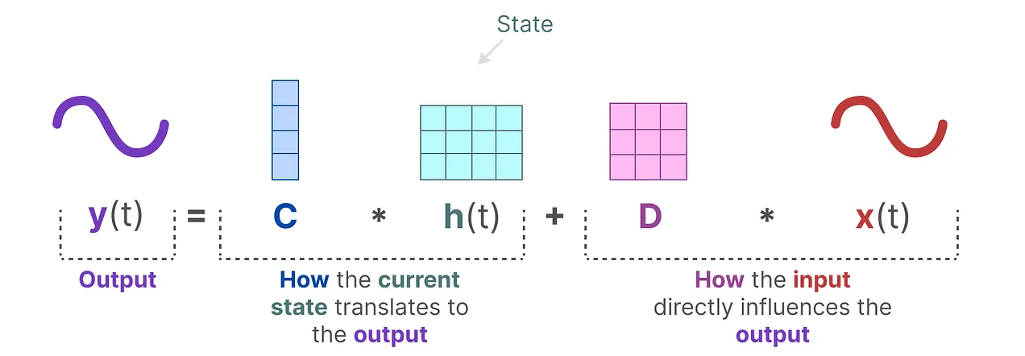
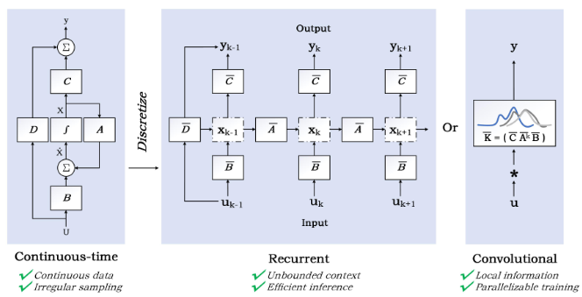
SSM block of Mamba
II. Background
Update state vector and discretize
[R2] Gu, Albert, and Tri Dao. "Mamba: Linear-time sequence modeling with selective state spaces." arXiv preprint arXiv:2312.00752 (2023).
Notes:
In an SSM, the model keeps an internal state.
This state updates at each time step, based on the current input and the previous state.
Unlike to traditional SSM, matrix B and C is different according to every different token.
Then the output is computed from that state.
Originally, SSMs work in continuous time.
So we need to discretize them to use in practice.
Once discretized, we can apply 1D convolution per token.
This makes training parallelizable, unlike traditional RNNs.
At inference time, SSMs behave like RNNs, processing one step at a time.
But they’re more efficient than Transformers.

Slide 17
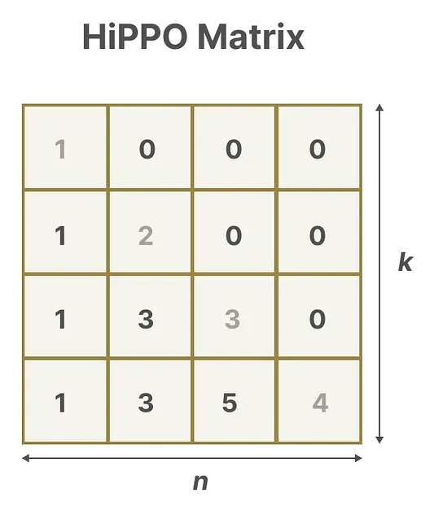
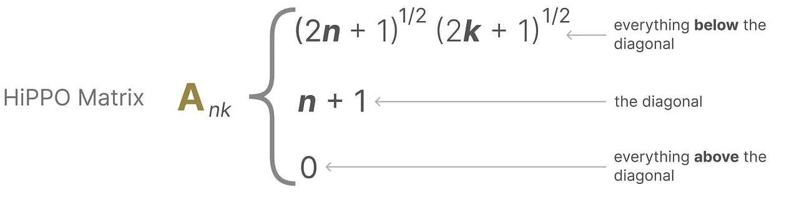
SSM block of Mamba
II. Background
Remove Linear Time-Invariant (LTI) constraint to SSM
Matrix A contributes major performance of SSM, but it has LTI constraints.
Using High-order Polynomial Projection Operators (HiPPO)
Construct recent token more precisely than first token.
[R2] Gu, Albert, and Tri Dao. "Mamba: Linear-time sequence modeling with selective state spaces." arXiv preprint arXiv:2312.00752 (2023).
Notes:
Additionally, However, recurrence alone can weaken long-range dependency.
To fix this, Mamba uses a special initialization called Hi-Order Polynomial Projection Operators.
This helps encode token positions more accurately.

Slide 18
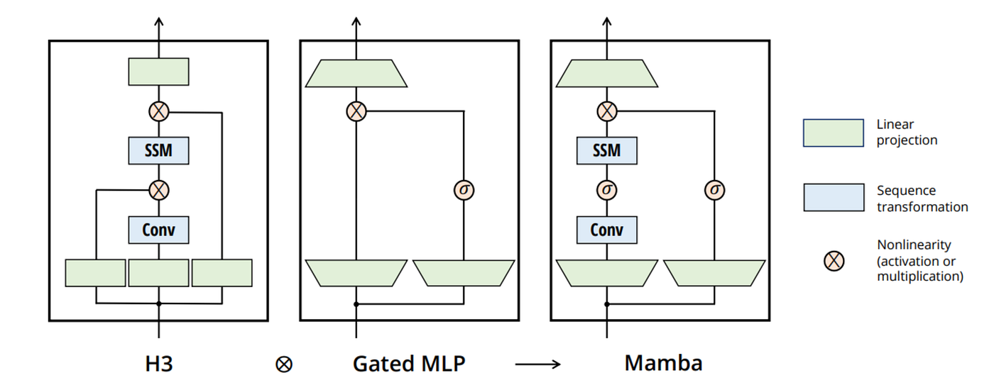
SSM block of Mamba
II. Background
Selectiveness
Fusion of H3 and Gated MLP
[R2] Gu, Albert, and Tri Dao. "Mamba: Linear-time sequence modeling with selective state spaces." arXiv preprint arXiv:2312.00752 (2023).
Notes:
The final structure of a Mamba block looks like this.
They made by fusion of H3 and gated MLP block
They gave sequence selectiveness to Mamba architecture.
With all the techniques we’ve discussed, Mamba achieves subquadratic complexity.
That makes it well-suited for test-time compute.

Slide 19
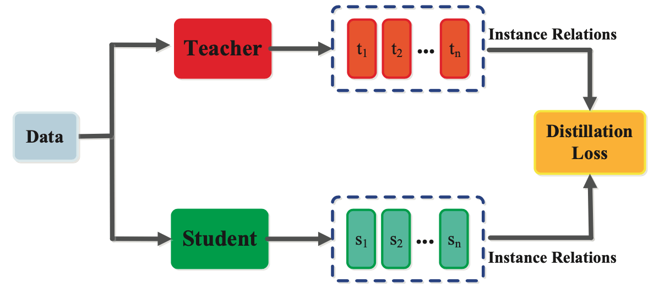
Distillation
II. Background
Definition
Transfer the knowledge large model to small model.
Efficient compression of LLMs
Cross-architecture distillation
Transformer to RNN[R3], Linear Attention[R4], SSM[R5] etc.
In this paper, the author distill the knowledge transformer to mamba.
[R3] Kasai, Jungo, et al. "Finetuning pretrained transformers into rnns." arXiv preprint arXiv:2103.13076 (2021).
[R4] Zhang, Michael, et al. "The Hedgehog & the Porcupine: Expressive Linear Attentions with Softmax Mimicry." ICLR, 2024
[R5] Wang, J., Paliotta, D., May, A., Rush, A., and Dao, T. “The mamba in the llama: Distilling and accelerating hybrid models.” NeurIPS, 2025
Notes:
To train Mamba, the authors used distillation.
We’ve covered this concept in class, so we’ll skip the details here.
But one key point is that this paper uses cross-architecture distillation.
That means transferring knowledge from a Transformer to a Mamba model.
This technique has also been used to distill into RNNs, linear attention models, and SSMs.

Slide 20
Method
Notes:
Youngjun Kim is going to present the Method part.

Slide 21
MOHAWK: Distill Llama to Mamba
III. Method
MOHAWK is composed of three stages:
Matrix orientation
Hidden state alignment
Weight transfer
&
Knowledge distillation
Notes:
From this slide, I’ll introduce the method part of this paper, which is to distill transformer-based models to state space models.
First of all, this paper suggested to use MOHAWK from previous paper, which introduce to distill transformer models to Mamba, with three stages.
MOHAWK is composed of three stages.
Matrix orientation, hidden state alignment, and weight transfer and knowledge distillation

Slide 22
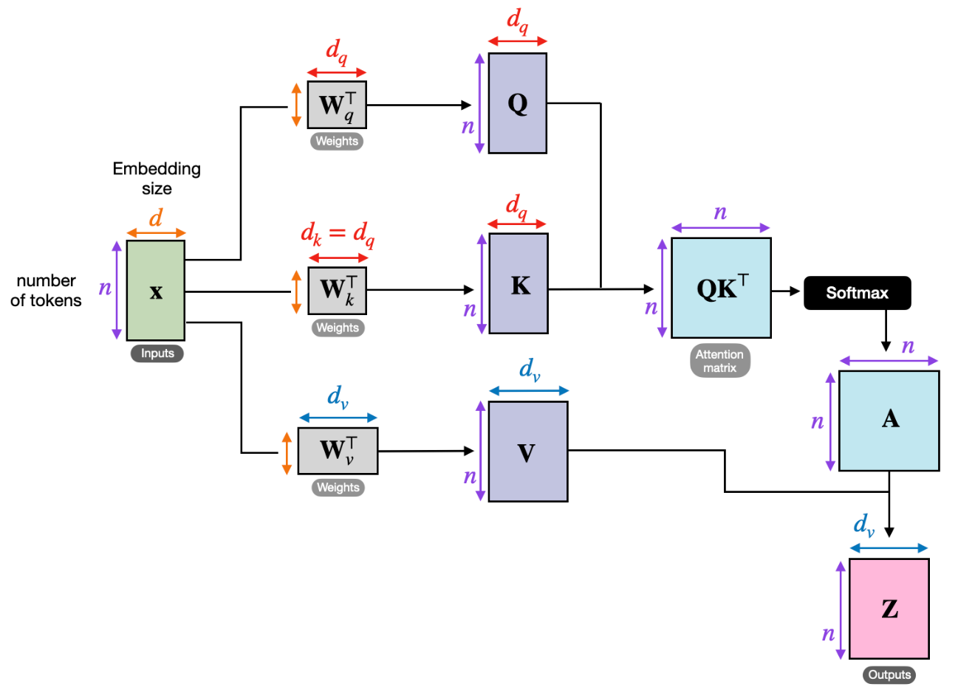
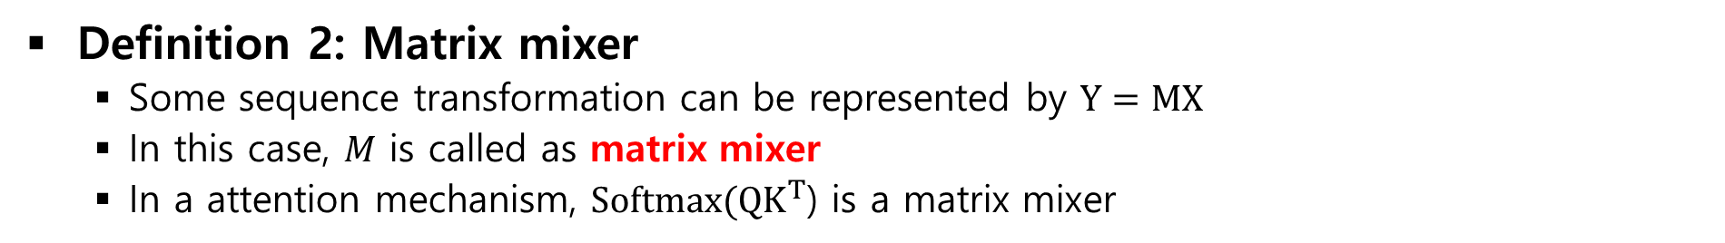
Sequence transformation & matrix mixer
III. Method
Definition 1: Sequence transformation
Sequence transformation refers to parameterized map on some sequence
i.e. sequence transformation combine tokens at various time steps
Definition 2: Matrix mixer
Some sequence transformation can be represented by $Y=MX$
In this case, $M$ is called as matrix mixer
In a attention mechanism, $Softmax(QK^{T}$) is a matrix mixer
Matrix mixer
Notes:
Before I explain details of the method, I’d like to introduce some of preliminaries.
Firstly, I want to define the sequence transformation.
Sequence transformation refers to any parameterized mappping function on some sequence.
In the aspect of model, sequence transformation combine tokens at various time steps, facilitating the model’s comprehension of temporal information and interactions.
Matrix mixer refers to matrix which can represent the sequence transformation.
Some sequence transformation can be represented as Y = MX, and in this case, M is called as a matrix mixer.
In a attention mechanism, output matrix of softmax is a matrix mixer, as it results in a sequence multiplied with value matrix.

Slide 23
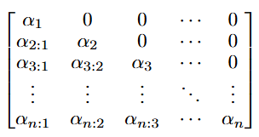

Causal variants of sequence transformation
III. Method
Definition 3: Causal variants of sequence transformation
By multiplying a lower triangular matrix filled with 1s (L), we can get casual variants of sequence transformation. That is, if we multiply L to the attention matrix, we can get causal variants of attention matrix.
Notes:
From previous definitions, we can define causal variants of sequence transformation.
By multiplying a lower triangular matrix filled with 1s, we can get causal variants of sequence transformation.
For example, if we multiply L to the attention matrix, we can get causal variants of attention matrix, which we use in decoder based transformer models.

Slide 24

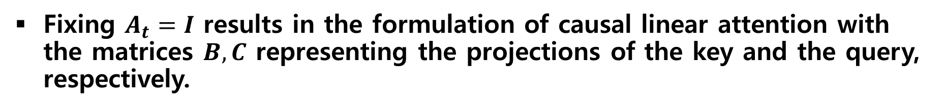
Relation between Mamba-2 & causal linear attention
III. Method
Mamba-2 is a time-varying state-space model, and defined as follow:
Fixing $A_{t}=I$ results in the formulation of causal linear attention with the matrices $B, C$ representing the projections of the key and the query, respectively.
Notes:
As we mentioned earlier, Mamba-2 is a time-varying state-space model, and defined as follow.
Here, B and C are input-dependent projections of the system, as in Mamba-1, and A_t is the identity matrix I multiplied by a time dependent scalar value alpha_t.
Fixing A_t as identity matrix results in the formulation of causal linear attention.
In this formulation, B, C representing the kernelized matrices of the key and the query matrices, respectively.

Slide 25



Why Mamba-2 can be the causal linear attention?
III. Method
Mamba-2 is a time-varying state-space model, and defined as follow:
If we unroll the state update with $h_{0}=0$, we can get ...
Same function with causal masking
Notes:
As the A_t in the previous slide is identity matrix, we can formulate the Mamba-2 as follow.
If we unroll the state update, we can get following equation.
In this equation, we can see that a_j act as a decaying factor of past informations.
This means that a_j has same functionality with casual masking.

Slide 26


Why Mamba-2 can be the causal linear attention?
III. Method
In linear attention, by using kernel-mapping, the output is calculated as follow :
By computing $y_{t}=C_{t}^{\text{T}}h_{t}$ with previously unrolled results, we can get
Notes:
Before we jump into the conclusion, let’s take a look at the linear attention mechanism.
In linear attention, by using kernel-mapping, the output is calculated as follow, and it is same with attention mechanism without normalization term in softmax.
In Mamba-2 equation again, By computing y_t with previously unrolled results, we can get following result.
We can see equation of linear attention and calculated result of Mamba-2 have same form.
Here, kernelized query matrices is equal to C_t, and kernlized key matrix multiplied by value matrix equal to rest part of equation
Therefore, C_t corresponds to the kernelized query matrix, and B_i x_i corresponds to the key-value multiplied matrix with kernelized key matrix

Slide 27
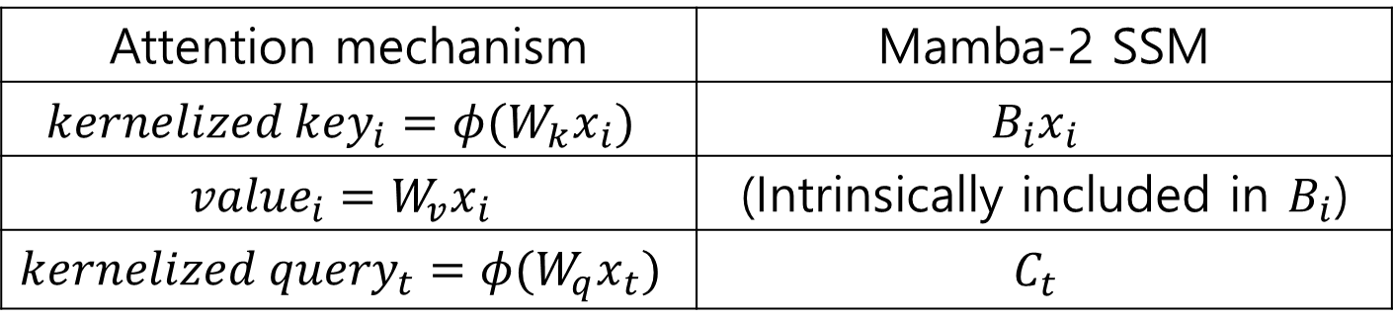
Why Mamba-2 can be the causal linear attention?
III. Method
In summarize, attention mechanism’s query, key, value matrices can be mapped into Mamba-2 SSM as below:
Please refer to Katharopoulos et al. & Bick et al. for more detailed explanation
Attention mechanism | Mamba-2 SSM
$$kernelized {key}_{i}={φ(W}_{k}x_{i})$$ | $$B_{i}x_{i}$$
$${value}_{i}=W_{v}x_{i}$$ | (Intrinsically included in $B_{i}$)
$$kernelized {query}_{t}={φ(W}_{q}x_{t})$$ | $$C_{t}$$
Notes:
In summarize, B_i x_i corresponds to product of kernelized key matrix and value matrix, and C_t is the kernelized query matrix.
We can make following table to compare attention mechanism with Mamba-2 SSM.
Please refer to linear attention paper and MOHAWK paper for more detailed explanation.

Slide 28
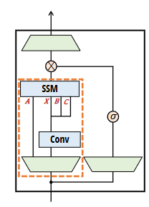
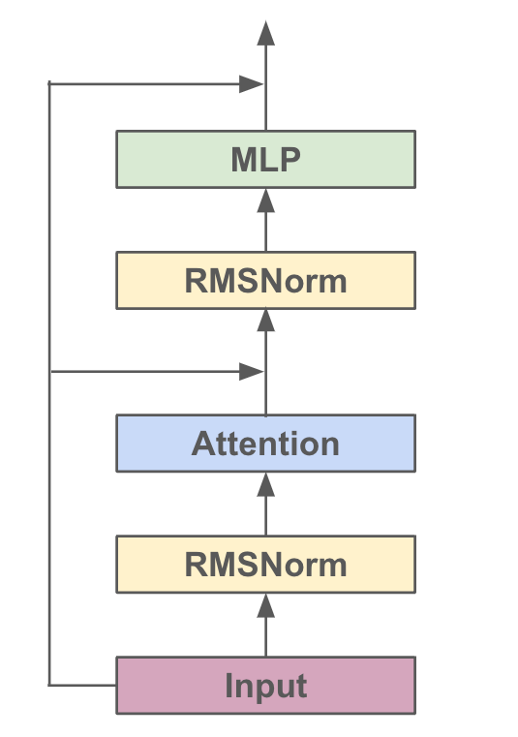
Distillation Llama into Llamba
III. Method
Goal: Distillation Llama to Llamba, which means Llama model replacing its attention to Mamba-2 SSMs.
Mamba-2 SSM
Mamba-2
Student: Llamba
Teacher: Llama
Notes:
Now, let’s dive into the actual method of distillation.
The goal is to distill knowledge of llama to Llamba, which is consisted with same model architecture with Llama except for the attention matrix.
In llamba, we replace attention matrix with Mamba-2 SSMs.
Unlike other distillation methods, we are actually building a almost same sized model.

Slide 29
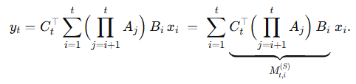


MOHAWK Stage 1: Matrix Orientation
III. Method
Goal: Align each student SSM block’s SSM to its teacher’s attention matrix.
Key insight: Matching mixing matrices first, to ensure the student mirrors the teacher’s long-range range information flow before any hidden-state alignment
Loss of stage 1:
Notes:
For the first stage, matrix orientation, we aligns each student SSM block’s sequence transformation matrix to its teacher transformer counter part, independent of all other parameters.
The equivalence of causal linear attention mechanism and mixing matrix of Mamba-2 model, which we previously discussed is used in here.
Because of this precise one-to-one correspondence, we can meaningfully extract prior knowledges from transformer attention matrix for Mamba-2 SSM matrix mixer.
Only because we know that Mamba-2 = causal linear attention at the matrix level we can minimize following loss with confidence that we are truly distilling the teacher’s quadratic mixing patterns into Mamba subquadratic student model.
When we minimize the loss, each layers are minimized independently, and output of previous layer of teacher model is used as a input for this loss, which is u_l in this case, so that the error doesn’t propagate through the layers.
The key insight is that by matching these mixing matrices first, we can ensure that the student’s long-range routing information mirrors the teacher’s one, before touching any hidden activation

Slide 30
Distillation Llama into Llamba
III. Method
Goal: Align each student SSM block’s SSM to its teacher’s attention matrix.
Loss of stage 1:
Mamba-2 SSM
Mamba-2
Student: Llamba
Teacher: Llama
Notes:
In the model aspective, we are trying to decrease the distance of Mamba-2 SSMs output with attention output.
To do this, we train Llamba model with following loss in this stage.

Slide 31

MOHAWK Stage 2: Hidden-State Alignment
III. Method
Goal: Bring the student’s internal representations in each mixer block into close agreement with the teacher’s output of attention block.
Copy & Train
Mamba-2 SSM
Notes:
For stage 2, the goal is to bring the student’s internal representations in each block into close aggrement with the teacher’s internal representations
In this stage, students copy over teacher’s MLP weight and layer norms into each student block.
For example, Student block copies MLP weight and RMSNorms.
After copying, the student model is trained to minimize the L2 norm of hidden state, so that the student model can learn the inner representations of teacher model.
Also like previous stage, the input is the output of teacher model’s previous block output, so that the error doesn’t propagate through the layers.

Slide 32
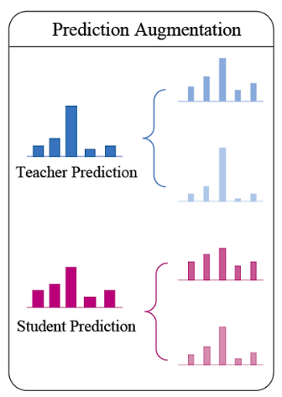

MOHAWK Stage 3: Weight transfer & End-to-End KD
III. Method
Goal: Finalize the student by
(a) inheriting compatible teacher weights
(b) training on final outputs so that its predictions match the teacher’s over a small corpus.
LLaMA
Logit
Lamba
Logit
Notes:
Having aligned mixing matrices in Stage 1 and matched hidden representations in Stage 2, the initialization process is now done and we need to teach it to produce the same outputs as the teacher.
It is done in two parts.
First, we need to transfer remaining teacher’s weight such as Embeddings & Positional Encodings, output head, and other components.
After that, the student model is trained on final outputs so that its predictions match the teacher’s one over a small corpus. In this procedure, student model aims to minimize the cross-entropy loss of logits with teacher model’s logit.
It is a kind of standard method done by other distillation methods.
As a result, we can get a Llamba model which is consisted of SSM matrix, distilled from transformer based model, llama.

Slide 33
Experimental Results

Slide 34
Experimental Results Overview
IV. Experimental Results
Authors tried to show..
Inference speedup of distilled models is better!
(2) This speedup can result in better scaling for a given inference time budget!

Slide 35
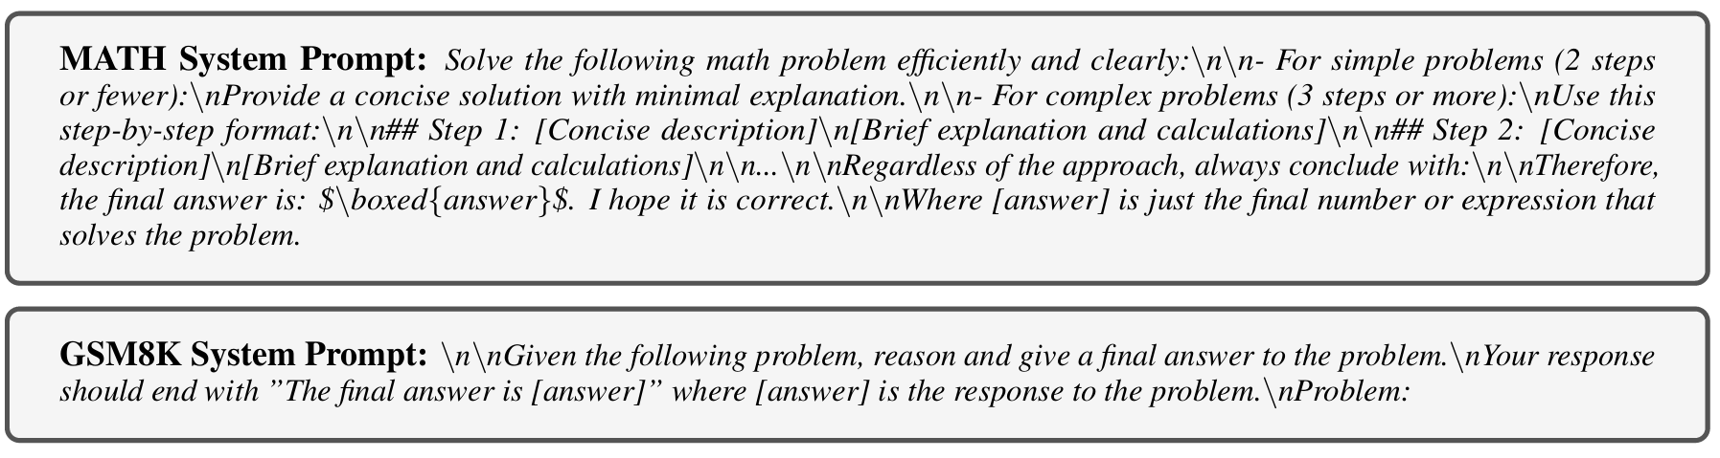
Inference Time Results
IV. Experimental Results
Experiment protocols
Dataset: MATH and GSM8K
Realistic setup that matches the prompt and CoTs length
Varying batch size, tasks of generating 512 tokens from a prompt with 512 tokens
Prefilling time is not included.
It depends on the given prompt
Only interested in the time to generate multiple completions given one prompt
Done on a single NVIDIA H100 GPU

Slide 36
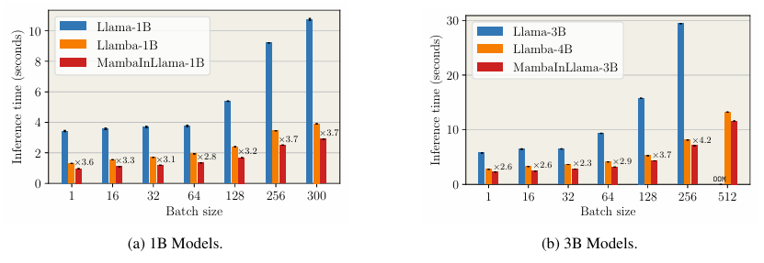
Inference Time Results
IV. Experimental Results
Faster generation of distilled models
Distilled models were faster than Llama baselines.
MambaInLlama models are slightly faster than Llamba
Smaller SSM state size: MambaInLlama(16) < Llamba(64)
Up to ×3.7 faster
Up to ×4.2 faster
Out-of-memory error on baseline

Slide 37
Results on Reasoning Tasks
IV. Experimental Results
Experiment Protocol
Teacher models: Llama-3.2-1B-Instruct & 3B-Instruct
Distilled Mamba Students: MambaInLlama-1B & 3B, Llamaba-1B & 4B
500 sample subset of MATH and GSM8K
Evaluated coverage and accuracy

Slide 38
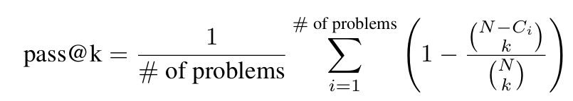
Results on Reasoning Tasks
IV. Experimental Results
Experiment Protocol
Coverage vs Accuracy
Coverage: Probability that the generated set contains the correct answer(upper bound)
Accuracy: Probability that the selected answer is correct (final output quality)
Generated Set
Selection
e.g. log-likelihood, reward model, etc.
Cannot derive a correct answer
Wrong
Can derive a correct answer!
Correct
Good Coverage
Poor Coverage
Coverage:

Slide 39
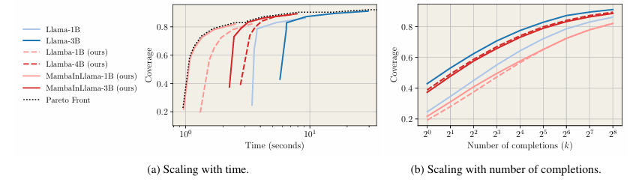
Results on Reasoning Tasks
IV. Experimental Results
Distilled Models can Cover like Teachers
“Does distilled model can generate meaningful results?”
Previous distilled models: could not achieve similar coverage with teachers…
Observed scaling of coverage as:
(a) a function of time budget, (b) the number of generation k increases
* Time budget: faster models can generate more candidates
Generate correct answer fast
∴ Overall Pareto front for coverage is dominated by distilled models
Similar coverage with teachers
∴ Distilled model has an ability to generate remarkable candidates

Slide 40
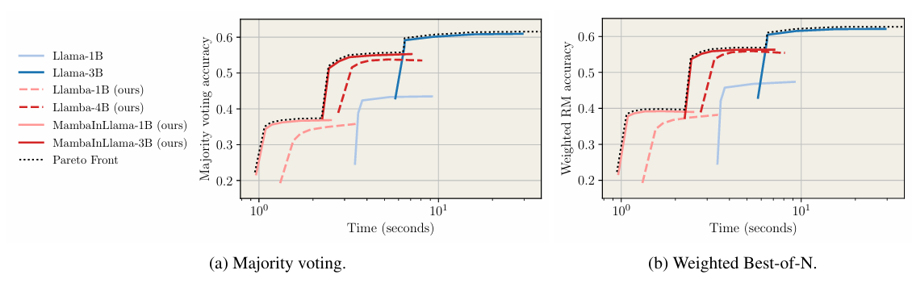
Results on Reasoning Tasks
IV. Experimental Results
Distilled Models Achieve Competitive Accuracy Under Fixed Time
Selection methods
Majority voting: Selects the most frequently occurring final answer
Weighted Best-of-N: Selects the answer with the highest score based on a reward model or evaluation function. (In this paper, Llama-3.1-8B-based reward model)
Small time budget:
Distilled models dominate
Large time budget:
Teacher models dominate
Larger distilled model(still being faster!) can provide better accuracy

Slide 41
Result Analysis
IV. Experimental Results
Larger Students are Better than Smaller Teachers
3B Subquadratic models are faster than 1B Transformer models
Proposed MambaInLlama-3B and Llamba-4B model outperforms Llama-1B baseline, in terms of coverage and accuracy while being faster

Slide 42
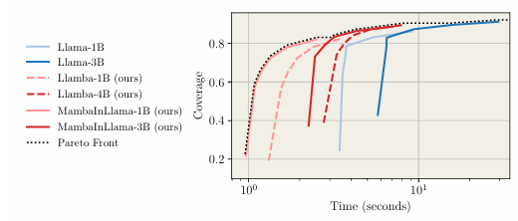
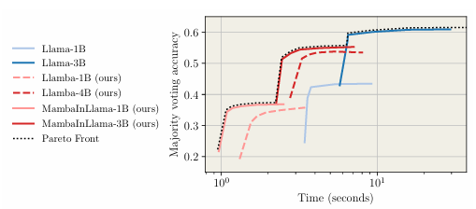
Result Analysis
IV. Experimental Results
Smaller Models have possibility to achieve better accuracy
Smaller models have great coverage, but gap between larger in accuracy test.
Smaller models have the ability to generate the correct answer → Developing better reward model can be helpful
For the tasks that coverage matters most(e.g. easily verifiable coding, mathematical proofs), smaller models can be preferred
MambaInLlama 1B vs 3B
Small Gap
MambaInLlama 1B vs 3B
Large Gap
MATH coverage
MATH accuracy

Slide 43
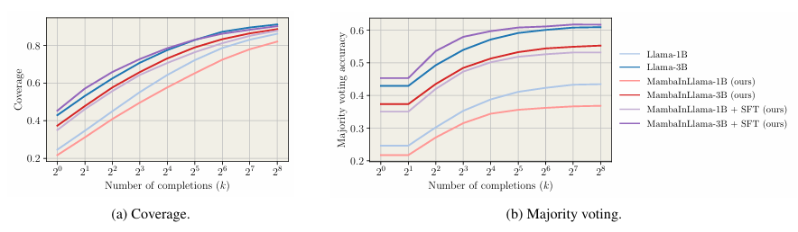
Supervised Fine-Tuning
IV. Experimental Results
SFT improves the models significantly
While distillation effectively transfers knowledge from the teacher model, SFT further refines and aligns the model’s capabilities
With SFT, subquadratic architectures can surpass teachers!
High improvement in accuracy!

Slide 44
Conclusion

Slide 45
Conclusion
V. Conclusion
Investigated whether lower-complexity models can leverage their superior generation throughput to outperform similarly sized Transformers
Focused on reasoning tasks to scale test-time computation
In fixed memory and computation source, proposed models achieve better coverage and accuracy for most time budgets compared to Transformers
The paper highlights the potential of Mamba and other attention alternatives

Slide 46
Limitation and Future Research
V. Conclusion
Lack of proposed method
Propose new distilling method, Develop better reward model, …
Need to compare with existing KD models
What is the exact limitation of existing models?
What is the difference between the existing models and proposed models?
Need to analyze the reason of improvement
Why the Mamba model is superior?
Why was the proposed model able to achieve this performance?

Slide 47
Thank You!
Chanhee Lee, Yongjun Kim, Jiwoo Kim

