Slide 1
Not All Tokens Are What You Need
Lin et al., NeurIPS 2024*
Kwanhee Lee, Wonjun Jo, Wonseok Choi
* this paper was selected as an oral presentation, and runner-up for the best paper award

Slide 2
Contents
Preliminaries
Introduction
Method
Experiments
Discussion & Limitations
Reference

Slide 3
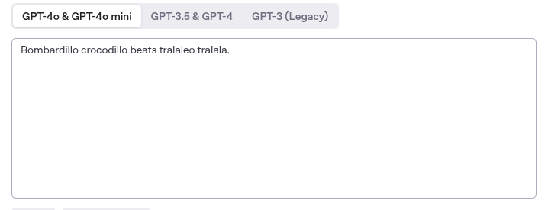
Tokenization
https://platform.openai.com/tokenizer

Slide 4
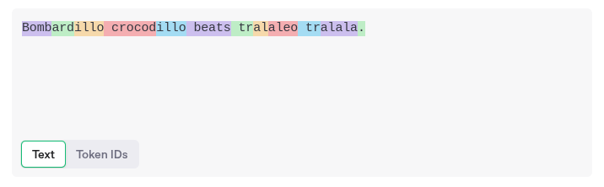
Tokenization

Slide 5
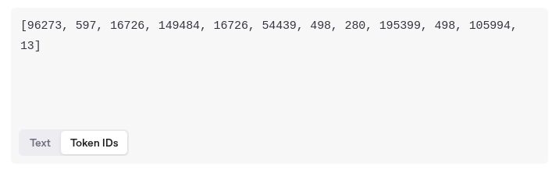
Tokenization

Slide 6
Causal Language Modeling
Given a language model M parameterized by θ, and a tokenized input sequence X = {x₁, x₂, ..., xₙ}, CLM aims to minimize the next-token prediction loss:

Slide 7

Causal Language Modeling
Given a language model M parameterized by θ, and a tokenized input sequence X = {x₁, x₂, ..., xₙ}, CLM aims to minimize the next-token prediction loss:

Slide 8
Causal Language Modeling
Given a language model M parameterized by θ, and a tokenized input sequence X = {x₁, x₂, ..., xₙ}, CLM aims to minimize the next-token prediction loss:
This objective encourages the model to assign high likelihood to the (probably) correct next token, given the preceding context (left-to-right)
* Perplexity = exp(L)

Slide 9
Introduction
Large Language Models are trained on vast amount of corpus via casual language modeling, using up to billions and trillions of tokens collected from the internet [1,2]

Slide 10
Training Large Language Models
Large Language Models are trained on vast amount of corpus via casual language modeling, using up to billions and trillions of tokens collected from the internet [1,2]
e.g.) GPT-3 used 300B tokens [1], Chinchilla used 1.4T tokens [2]

Slide 11
Training Large Language Models
Large Language Models are trained on vast amount of corpus via casual language modeling, using up to billions and trillions of tokens collected from the internet [1,2]
e.g.) GPT-3 used 300B tokens [1], Chinchilla used 1.4T tokens [2]
> extremely large corpus are noisy

Slide 12
Training Large Language Models
Large Language Models are trained on vast amount of corpus via casual language modeling, using up to billions and trillions of tokens collected from the internet [1,2]
e.g.) GPT-3 used 300B tokens [1], Chinchilla used 1.4T tokens [2]
> extremely large corpus are noisy
e.g. low-information, redundancy, mixed language, random words, etc.
"asdfasdfasdfasdfasdfasdf..."(e.g., keyboard mashing, filler content)
This article is about deep learning. Deep learning is a type of machine learning. Deep learning is…
오늘은 good day for learning! TensorFlowを使って..
i want hefawef ew><<3 to fjweoifajwemn eat banana.

Slide 13
Data Filtering
Removing noisy data - also known as data filtering - is crucial for improving LLM training performance/efficiency.

Slide 14
Data Filtering
Removing noisy data - also known as data filtering - is crucial for improving LLM training performance/efficiency.
document level filtering : removes entire low-quality documents based on repetition, content safety, etc. [3,4]

Slide 15
Data Filtering
Removing noisy data - also known as data filtering - is crucial for improving LLM training performance/efficiency.
document level filtering : removes entire low-quality documents based on repetition, content safety, etc. [3,4]
My name is kwanhee
Hi this is kwanhee speaking
Deep learning is fun!
This article is about deep learning. Deep learning is a type of machine learning. Dee
오늘은 good day for learning! TensorFlowを使って..
i want hefawef ew><<3 to fjweoifajwemn eat banana.
"asdfasdfasdfasdfasdfasdf..."(e.g., keyboard mashing, filler content)
This article is about deep learning. Deep learning is a type of machine learning. Deep learning is…
오늘은 good day for learning! TensorFlowを使って..
i want hefawef ew><<3 to fjweoifajwemn eat banana.
"asdfasdfasdfasdfasdfasdf..."(e.g., keyboard mashing, filler content)
This article is about deep learning. Deep learning is a type of machine learning. Deep learning is…
오늘은 good day for learning! TensorFlowを使って..
i want hefawef ew><<3 to fjweoifajwemn eat banana.
"asdfasdfasdfasdfasdfasdf..."(e.g., keyboard mashing, filler content)
This article is about deep learning. Deep learning is a type of machine learning. Deep learning is…
오늘은 good day for learning! TensorFlowを使って..
i want hefawef ew><<3 to fjweoifajwemn eat banana.
It was constructed in 1889 as the entrance arch to the World’s Fair.
Today, it attracts millions of tourists each year and offers a stunning view of the city.
The tower stands approximately 300 meters tall and was the tallest structure in the world when it was built
Its design, by Gustave Eiffel, has become an iconic symbol of French architecture and engineering.

Slide 16
Data Filtering
Removing noisy data - also known as data filtering - is crucial for improving LLM training performance/efficiency.
document level filtering : removes entire low-quality documents based on repetition, content safety, etc. [3,4]
My name is kwanhee
Hi this is kwanhee speaking
Deep learning is fun!
This article is about deep learning. Deep learning is a type of machine learning. Dee
오늘은 good day for learning! TensorFlowを使って..
i want hefawef ew><<3 to fjweoifajwemn eat banana.
My name is kwanhee
Hi this is kwanhee speaking
Deep learning is fun!
오늘은 good day for learning! TensorFlowを使って..
i want hefawef ew><<3 to fjweoifajwemn eat banana.
"asdfasdfasdfasdfasdfasdf..."(e.g., keyboard mashing, filler content)
This article is about deep learning. Deep learning is a type of machine learning. Deep learning is…
오늘은 good day for learning! TensorFlowを使って..
i want hefawef ew><<3 to fjweoifajwemn eat banana.
"asdfasdfasdfasdfasdfasdf..."(e.g., keyboard mashing, filler content)
This article is about deep learning. Deep learning is a type of machine learning. Deep learning is…
오늘은 good day for learning! TensorFlowを使って..
i want hefawef ew><<3 to fjweoifajwemn eat banana.
"asdfasdfasdfasdfasdfasdf..."(e.g., keyboard mashing, filler content)
This article is about deep learning. Deep learning is a type of machine learning. Deep learning is…
오늘은 good day for learning! TensorFlowを使って..
i want hefawef ew><<3 to fjweoifajwemn eat banana.
It was constructed in 1889 as the entrance arch to the World’s Fair.
Today, it attracts millions of tourists each year and offers a stunning view of the city.
The tower stands approximately 300 meters tall and was the tallest structure in the world when it was built
Its design, by Gustave Eiffel, has become an iconic symbol of French architecture and engineering.
It was constructed in 1889 as the entrance arch to the World’s Fair.
Today, it attracts millions of tourists each year and offers a stunning view of the city.
The tower stands approximately 300 meters tall and was the tallest structure in the world when it was built
Its design, by Gustave Eiffel, has become an iconic symbol of French architecture and engineering.

Slide 17
Data Filtering
Removing noisy data - also known as data filtering - is crucial for improving LLM training performance/efficiency.
line level filtering : removes individual data points (e.g., sentences) [5]

Slide 18
Data Filtering
Removing noisy data - also known as data filtering - is crucial for improving LLM training performance/efficiency.
line level filtering : removes individual data points (e.g., sentences) [5]
My name is kwanhee
Hi this is kwanhee speaking
Deep learning is fun!
오늘은 good day for learning! TensorFlowを使って..
i want hefawef ew><<3 to fjweoifajwemn eat banana.

Slide 19
Data Filtering
Removing noisy data - also known as data filtering - is crucial for improving LLM training performance/efficiency.
line level filtering : removes individual data points (e.g., sentences) [5]
My name is kwanhee
Hi this is kwanhee speaking
Deep learning is fun!
오늘은 good day for learning! TensorFlowを使って..
i want hefawef ew><<3 to fjweoifajwemn eat banana.
My name is kwanhee
Hi this is kwanhee speaking
Deep learning is fun!
오늘은 good day for learning! TensorFlowを使って..
i want hefawef ew><<3 to fjweoifajwemn eat banana.

Slide 20
Rho-loss
Removing noisy data - also known as data filtering - is crucial for improving LLM training performance/efficiency.
line level filtering : removes individual data points (e.g., sentences) [5]
Rho-loss
robust data selection method that filters data points based on reducible holdout loss

Slide 21
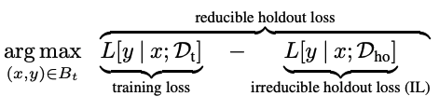
Rho-loss
Removing noisy data - also known as data filtering - is crucial for improving LLM training performance/efficiency.
line level filtering : removes individual data points (e.g., sentences) [5]
Rho-loss
robust data selection method that filters data points based on reducible holdout loss

Slide 22
More Fine-grained Filtering?
Removing noisy data - also known as data filtering - is crucial for improving LLM training performance/efficiency.
> is there more fine-grained approach?

Slide 23
Nature of Causal Language Modeling
e.g. i want hefawef ew><<3 to fjweoifajwemn eat banana.

Slide 24
Nature of Causal Language Modeling
e.g. i want hefawef ew><<3 to fjweoifajwemn eat banana.
Humans can focus on important tokens to process the sentence
> I want to eat banana

Slide 25
Nature of Causal Language Modeling
e.g. i want hefawef ew><<3 to fjweoifajwemn eat banana.
Humans can focus on important tokens to process the sentence
> I want to eat banana
Language models can’t do this!
> i want hefawef ew><<3 to fjweoifajwemn eat banana.

Slide 26
Research Question
Given that data filtering can improve performance and considering the nature of causal language modeling,
Q) Are all tokens necessary for pretraining?

Slide 27
Research Question
Given that data filtering can improve performance and considering the nature of causal language modeling,
Q) Are all tokens necessary for pretraining?
A) No!

Slide 28
Research Question
Given that data filtering can improve performance and considering the nature of causal language modeling,
Q) Are all tokens necessary for pretraining?
A) No!
Q)Then, how can we select tokens?

Slide 29
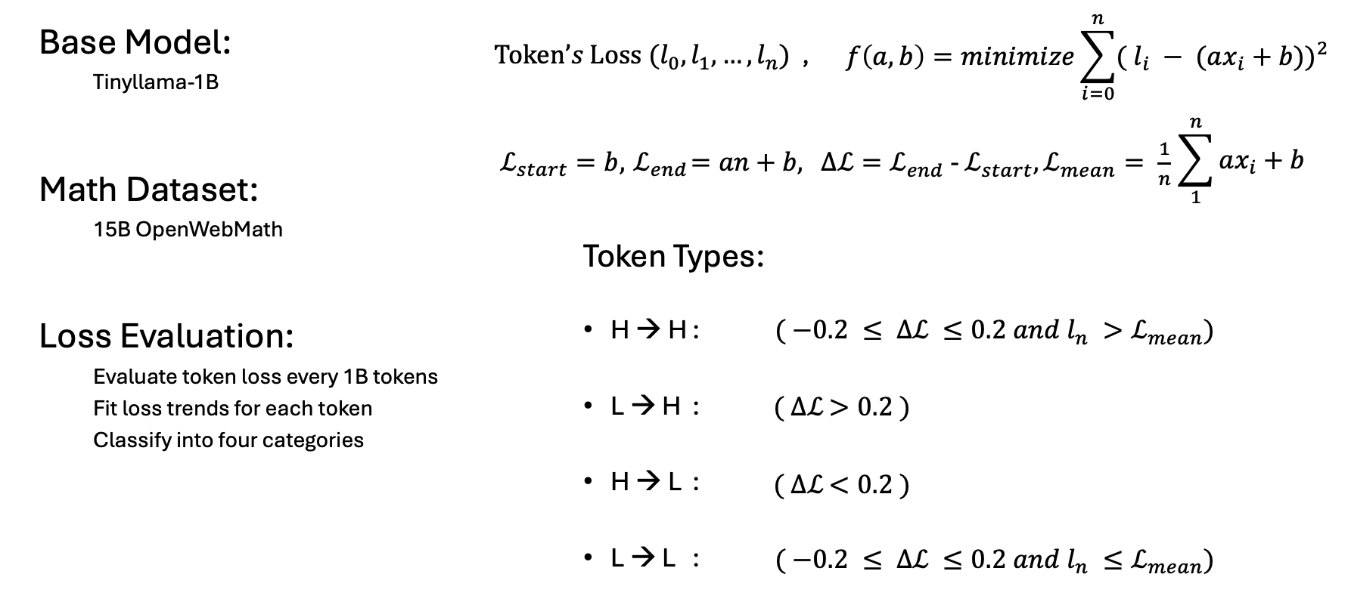
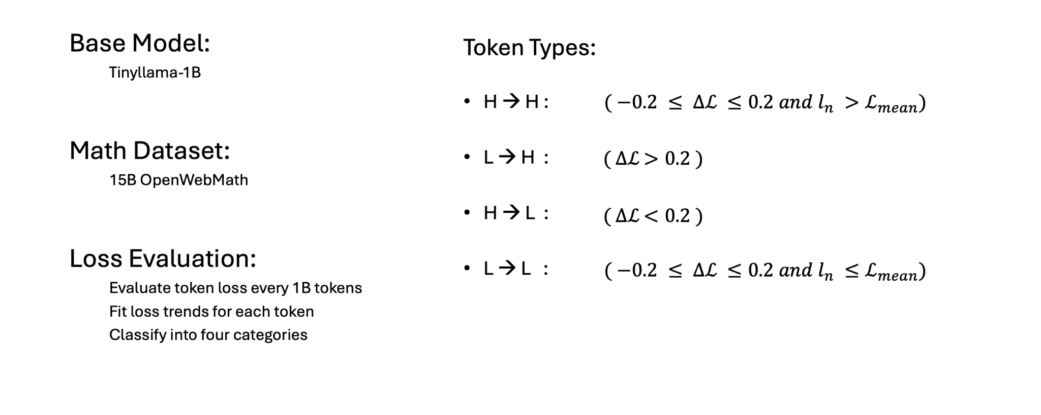
Training Dynamics of Token Loss

Slide 30
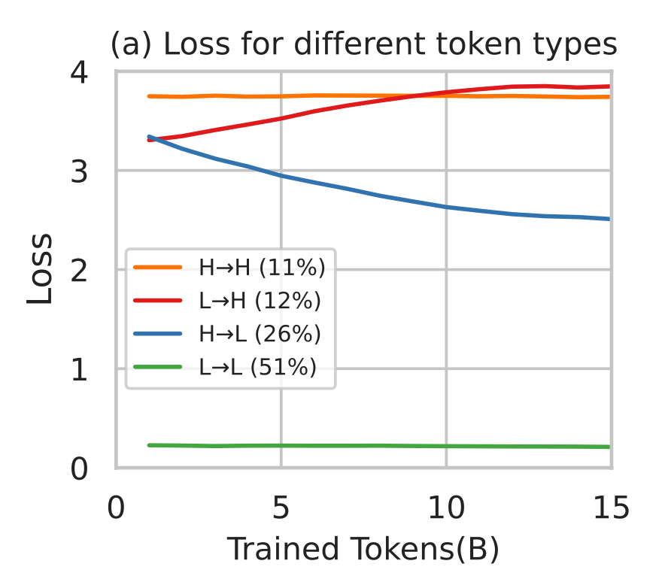
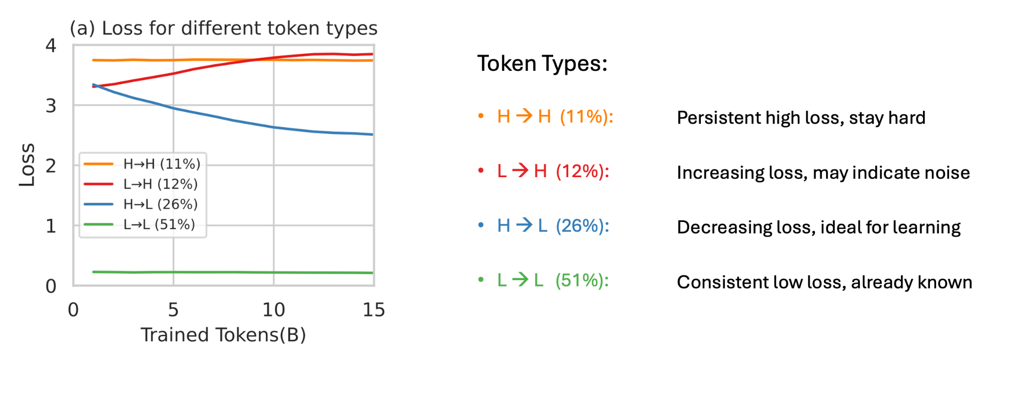
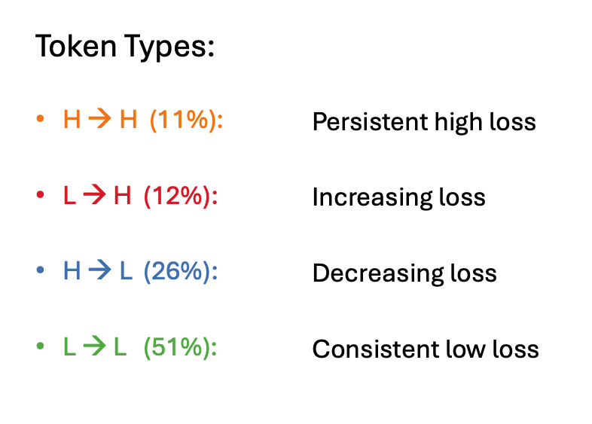
Not All Tokens Are Equal

Slide 31
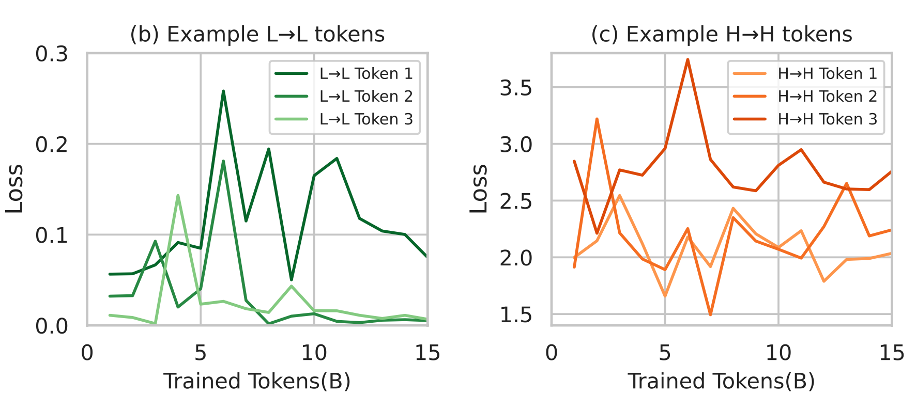

Not All Tokens Are Equal

Slide 32
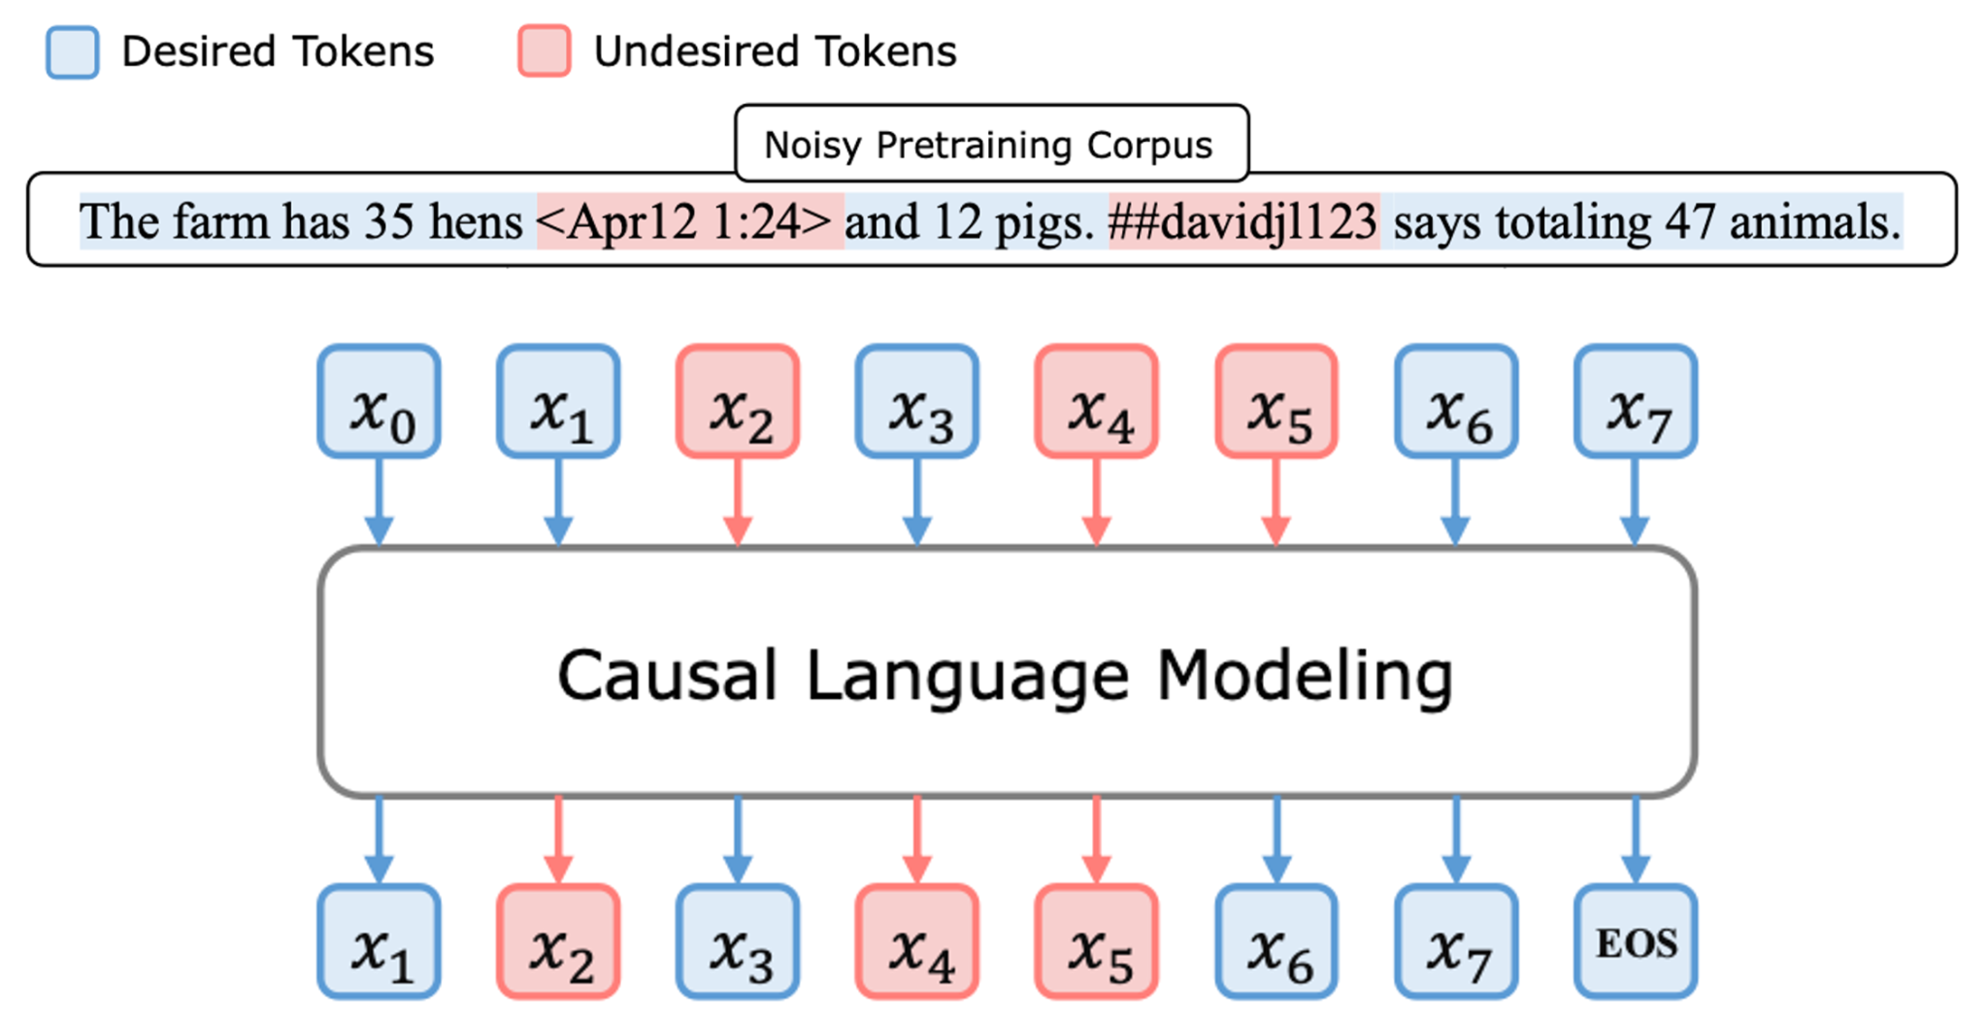
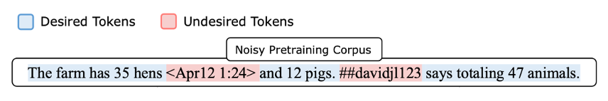
Can We Select Useful Tokens?

Slide 33
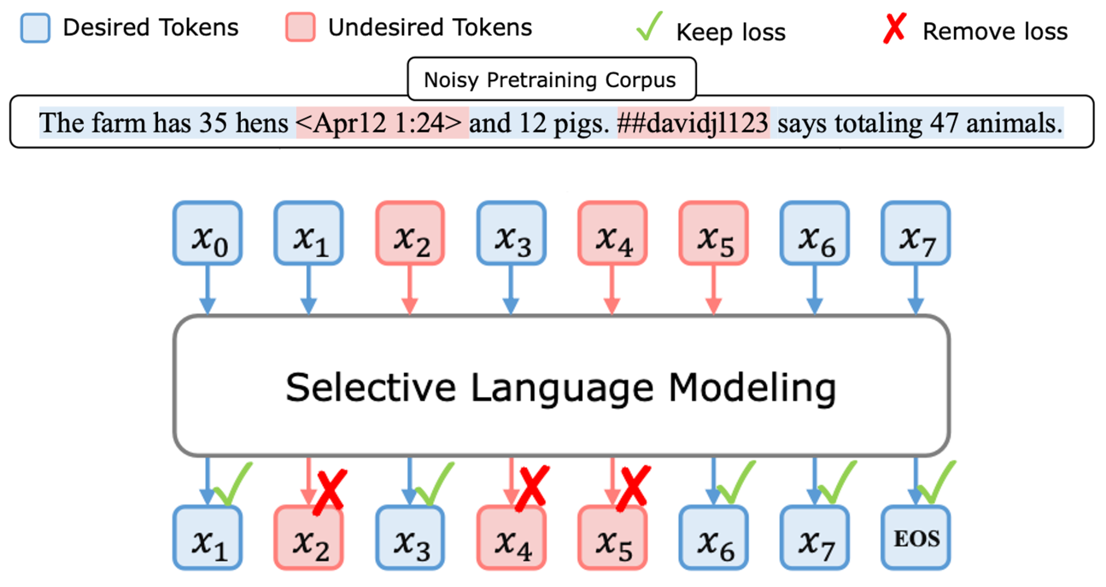
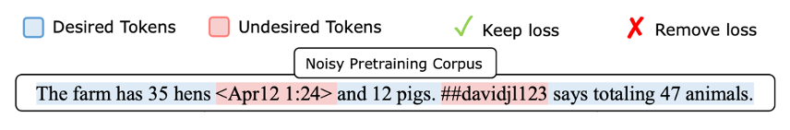
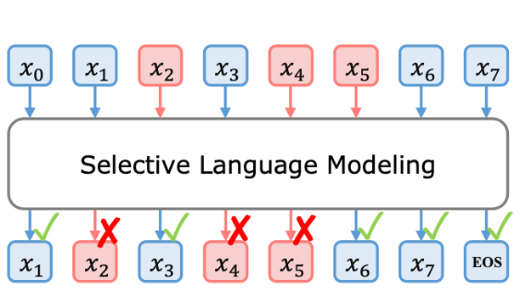
Can We Select Useful Tokens?

Slide 34

Selective Language Modeling (SLM)

Slide 35
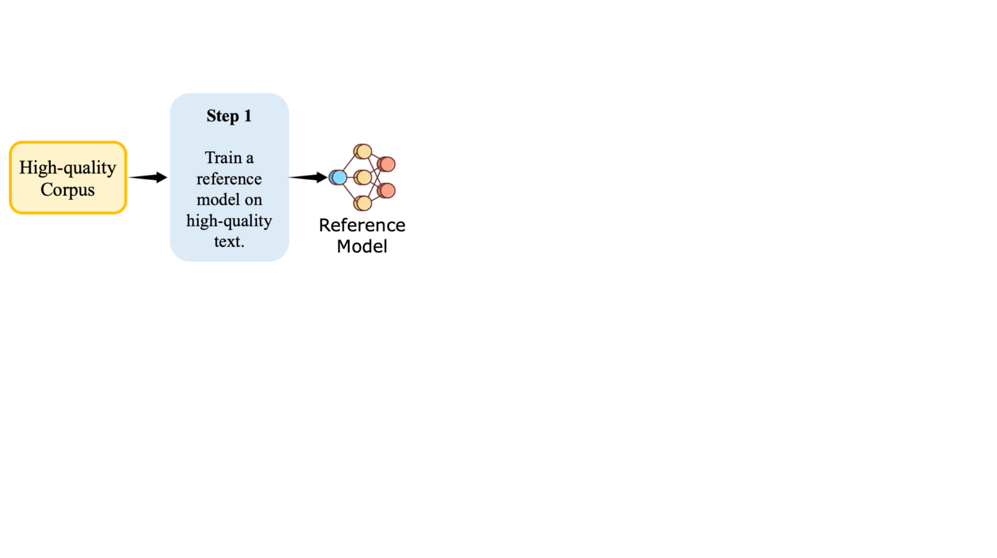
Selective Language Modeling (SLM)

Slide 36
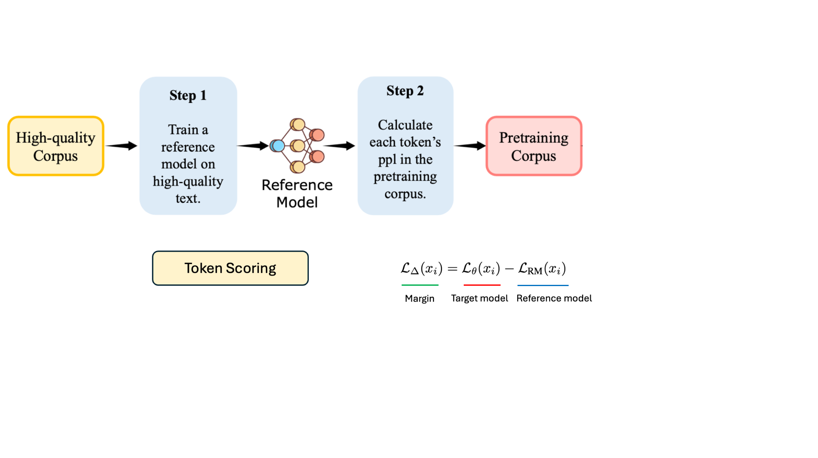
Selective Language Modeling (SLM)

Slide 37
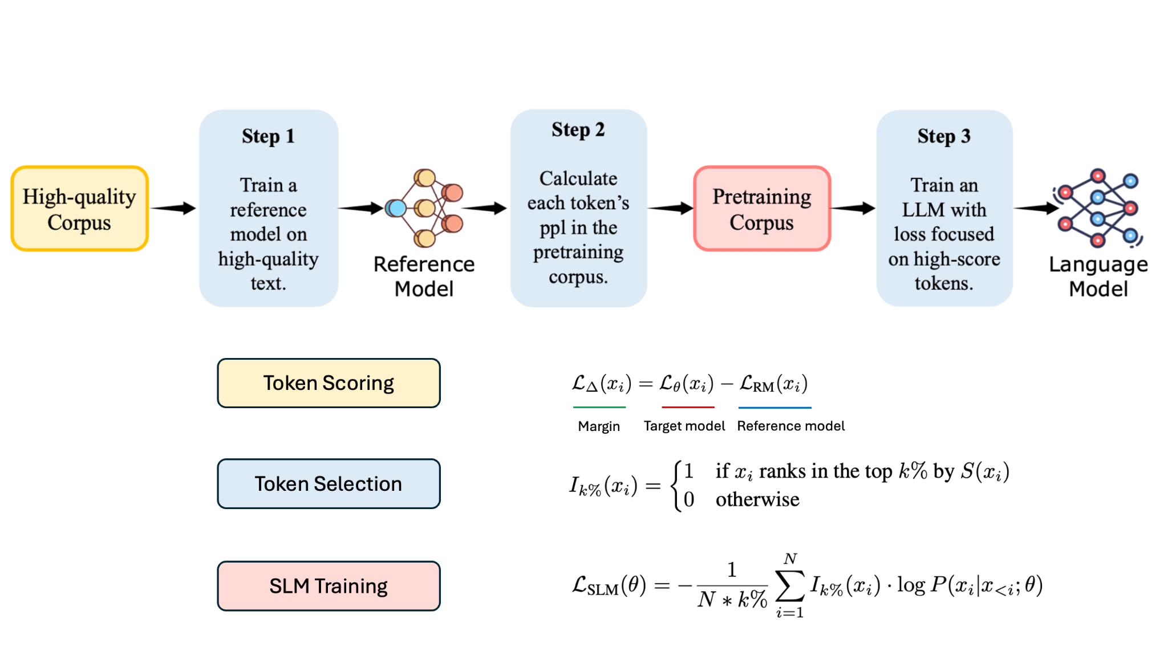
Selective Language Modeling (SLM)

Slide 38
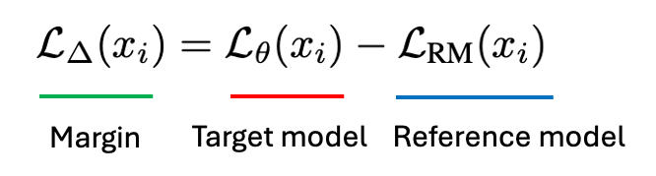





Token Selection Example
“Tom had 4 apples. He ate 2. How many are left?”
 |  |  |  | Selected
4 | 1.85 | 0.90 | 0.95
apples | 0.75 | 0.55 | 0.20
2 | 1.95 | 0.88 | 1.07
How | 1.10 | 0.70 | 0.40
left | 1.00 | 0.60 | 0.40
Tom | 0.35 | 0.25 | 0.10
ate | 0.65 | 0.55 | 0.10
Notes:
Math 언급

Slide 39
Experimental Setup
Reference Model (RM) Training
Dataset
Math domain
0.5B data from GPT and manually curated data
General domain
1.9B tokens from open-source datasets
Model
Tinyllama-1.1B (Pre-trained)
Mistral-7B (Pre-trained)
Language Model (LM) Training
Dataset
Math domain
14B OpenWebMath (OWM) dataset
General domain
80B tokens from open-source datasets
Model
Tinyllama-1.1B (Pre-trained)
Mistral-7B (Pre-trained)

Slide 40
Experimental Setup
Reference Model (RM) Training
Dataset
Math domain
0.5B data from GPT and manually curated data
General domain
1.9B tokens from open-source datasets
Model
Tinyllama-1.1B (Pre-trained)
Mistral-7B (Pre-trained)
Language Model (LM) Training
Dataset
Math domain
14B OpenWebMath (OWM) dataset
General domain
80B tokens from open-source datasets
Model
Tinyllama-1.1B (Pre-trained)
Mistral-7B (Pre-trained)

Slide 41
Experimental Setup
Reference Model (RM) Training
Dataset
Math domain
0.5B data from GPT and manually curated data
General domain
1.9B tokens from open-source datasets
Model
Tinyllama-1.1B (Pre-trained)
Mistral-7B (Pre-trained)
Language Model (LM) Training
Dataset
Math domain
14B OpenWebMath (OWM) dataset
General domain
80B tokens from open-source datasets
Model
Tinyllama-1.1B (Pre-trained)
Mistral-7B (Pre-trained)
Baseline (-CT)
Without token selection
RHO-1
With token selection

Slide 42
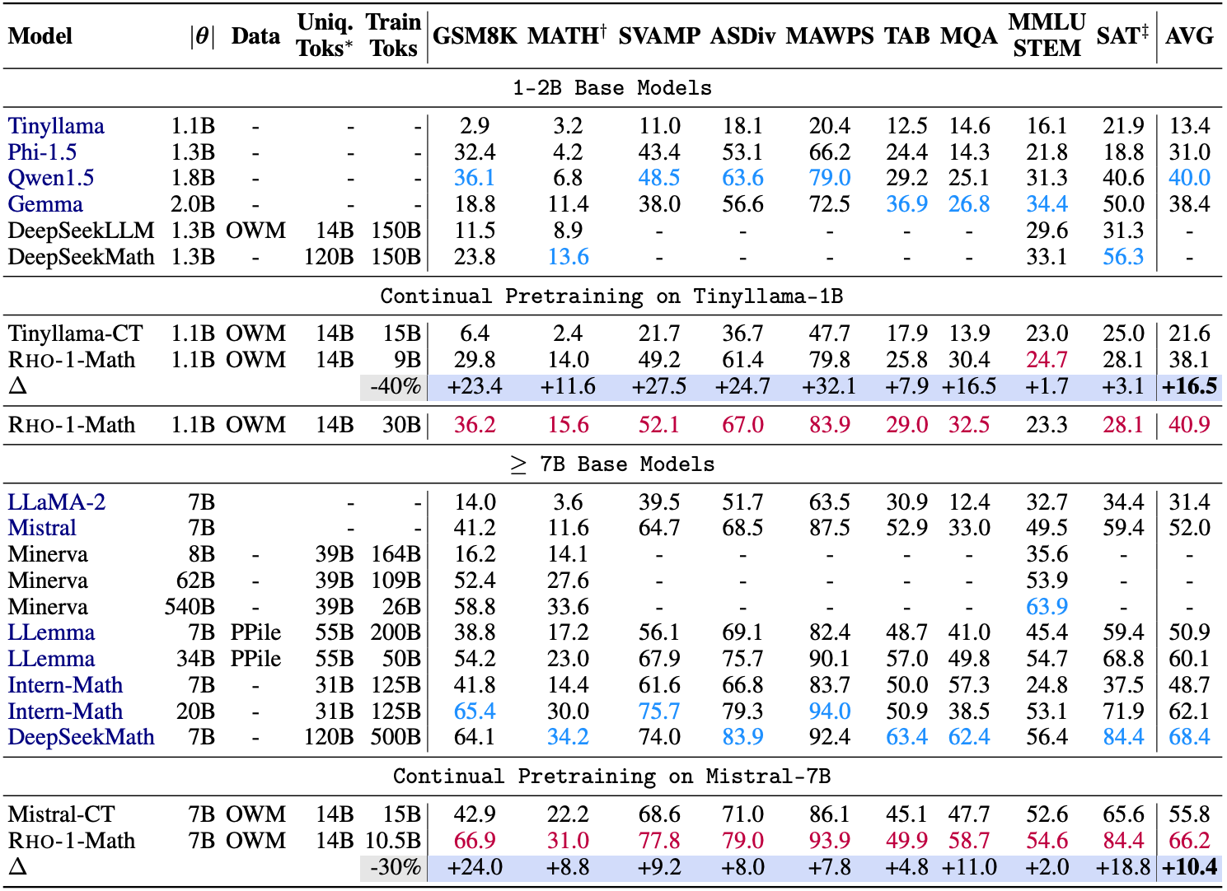
Pre-training Results on Math Domain
Experimental Setup
Dataset
14B OpenWebMath
Model
Tinyllama-1.1B
Mistral-7B
Task
Few-shot CoT Reasoning

Slide 43
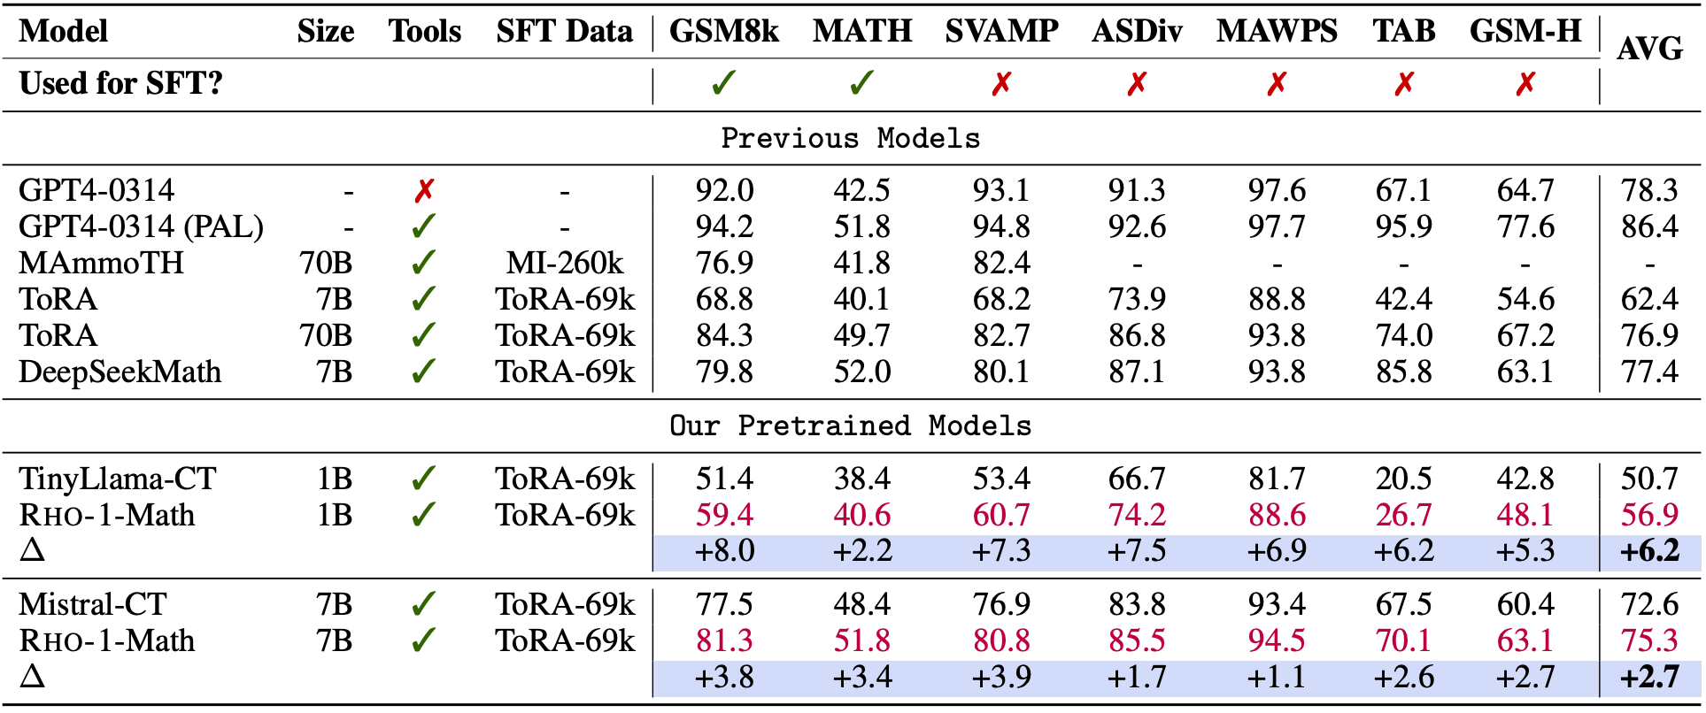
Supervised Fine-Tuning Results on Math Domain
Experimental Setup
Dataset
ToRA-69k
Model
Rho-1-Math-1B
Rho-1-Math-7B
Task
Tool-Integrated Reasoning

Slide 44
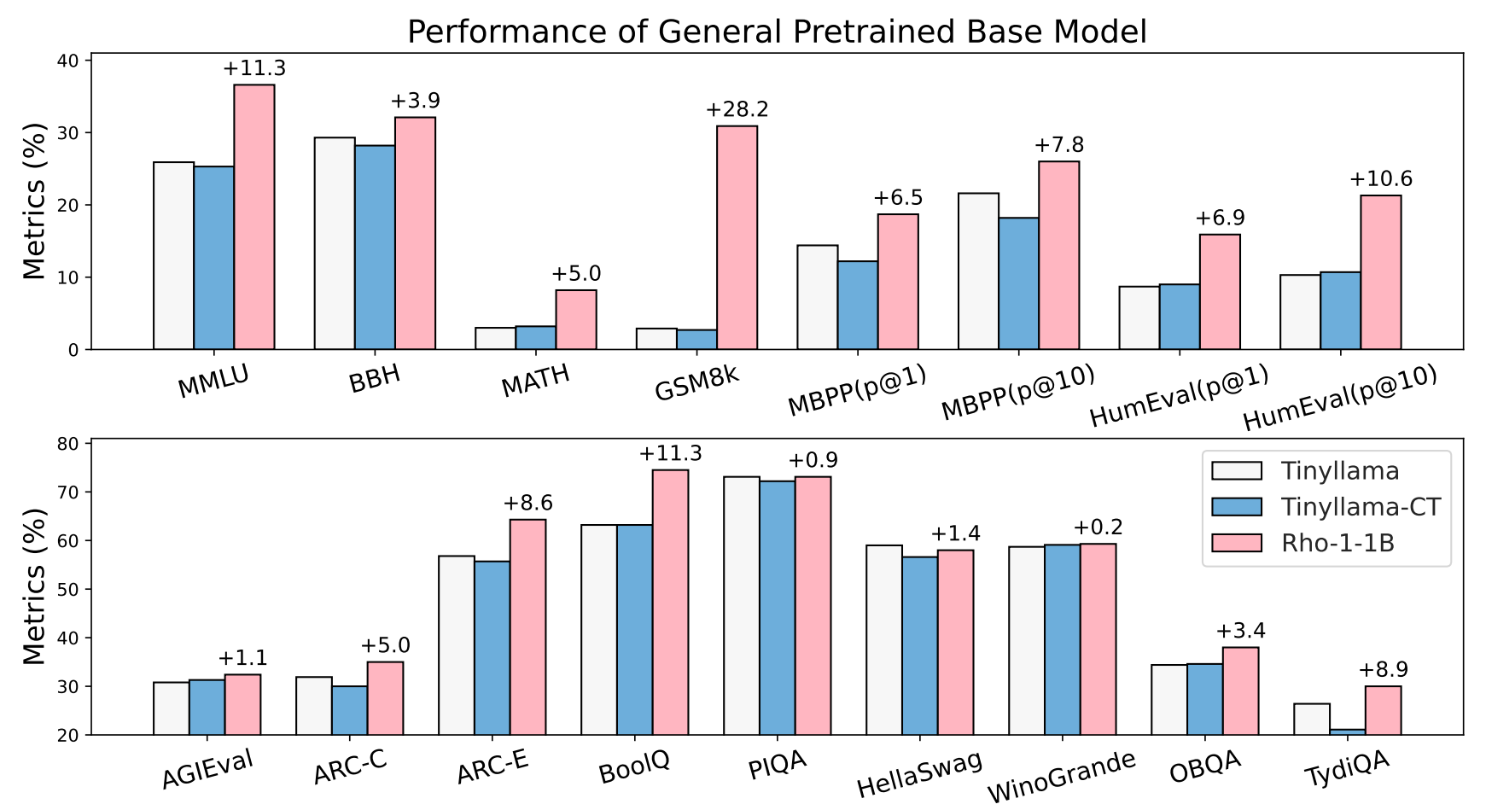
Results on General Domain
Around 6% average boost in performance in general domain
Improvement is significant on math-related benchmarks
Likely due to clear structure and explicit attention targets such as formulas.

Slide 45
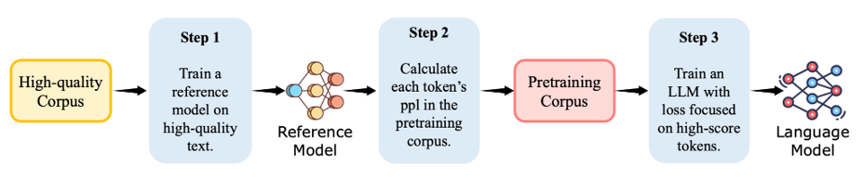
Can SLM Works w/o High-Quality Corpus?
We can’t always assume there is a high-quality corpus
What if there is no high-quality data?
We cannot do step 1 and 2

Slide 46
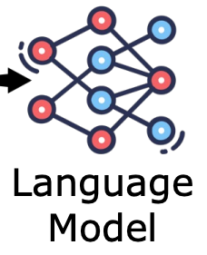
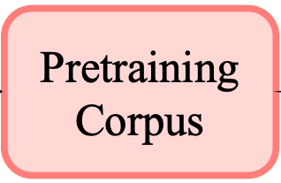
Can SLM Works w/o High-Quality Corpus?
Self-reference scenario
Case1: Train a model with full data to the end first, and use it as the reference model
Case2: Use different previous checkpoints as reference model
Scoring
Self-Reference
SLM Pre-training

Slide 47
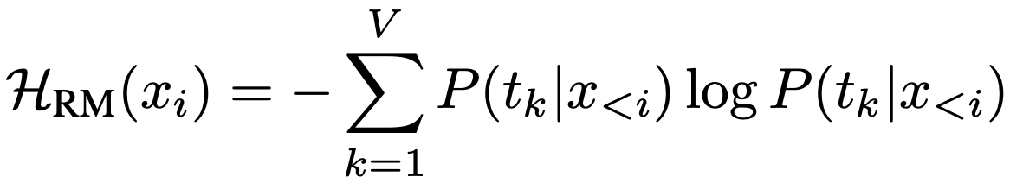
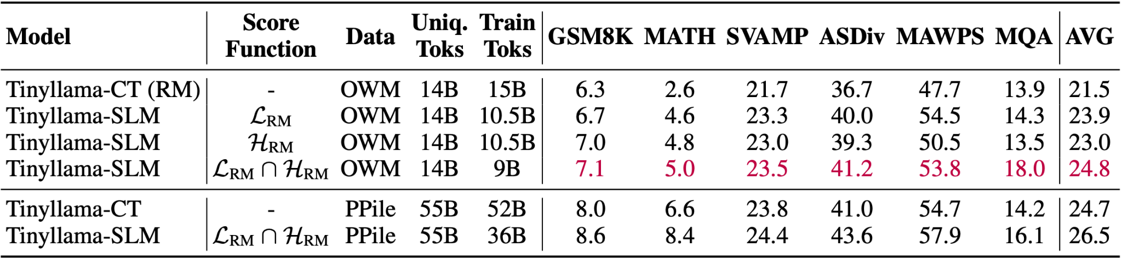
Can SLM Works w/o High-Quality Corpus?
SLM also performs well in self-reference scenarios
With information entropy scoring function, SLM achieves better results
Higher information entropy indicates greater uncertainty of a token in its context

Slide 48
Take-Home Message
Not all tokens are useful during language model (LM) pretraining
Some tokens are already learned or noisy, and training on them is a waste
SLM enhances data efficiency in LM training through token selection
It selects tokens based on how much they help the model improve
SLM is more efficient and works better
It needs fewer tokens but gives higher or comparable performance

Slide 49
Limitation & Discussion
SLM has only been validated on 1B and 7B models with <100B tokens
Scalability to larger models and corpora remains an open question
SLM needs many steps like reference model training and scoring
Real training efficiency may not always improve
Instead of training a LM after scoring, why not just use the RM directly?
The RM is only used for scoring, but its performance is not shown in the result tables.
Including RM’s result and analysis would help clarify whether SLM truly improves over it.
SLM does not work for specific downstream tasks
Token selection is not directly based on downstream task performance

Slide 50
Reference
Brown, T. et al., Language Models are Few-shot Learners, NeurIPS 2020
Training Compute-Optimal Large Language Models, NeurIPS 2022
Raffel, C. et al., Exploring the Limits of Transfer Learning with a Unified Text-to-Text Transformer, JMLR 2020
Penedo et al., The RefinedWeb Dataset for Falcon LLM: Outperforming Curated Corpora with Web Data, and Web Data Only, NeurIPS 2023
Mindermann et al., Prioritized Training on Points that are Learnable, Worth Learning, and Not Yet Learnt, ICML 2022

Slide 51
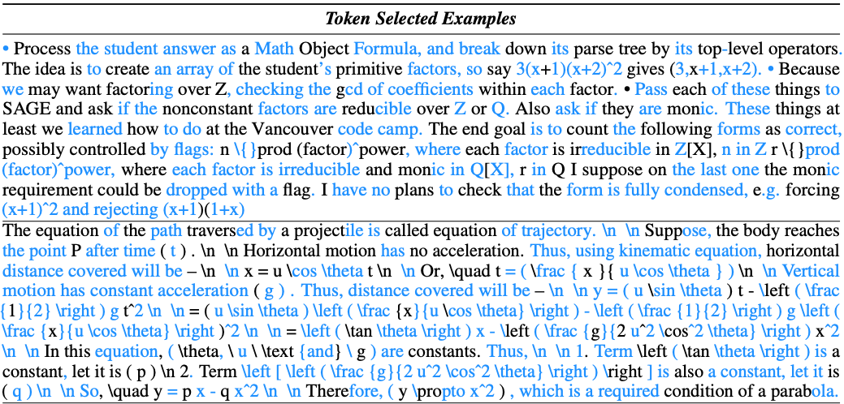
Appendix: What Tokens are Selected with SLM?
Visualization of token selection during the training on OpenWebMath
Blue tokens are retained during actual pretraining
The majority of tokens chosen by the SLM method are closely related to math

