Slide 1
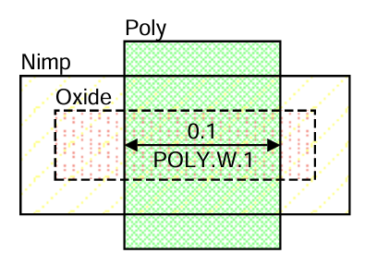
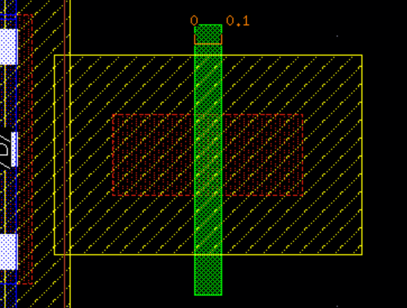
Rule Name | Value | Description
POLY.W.1 | 0.1um | Minimum 1.2V N-channel gate length..
Schematic in Design Rule Manual
Cadence Reproducing and vertical structure
✄
“Short Channel Effect와 누설전류 증가를 방지하기 위해 NMOS의 최소 Gate Length를 제한”
0.1um
STI
OXIDE
STI
Substrate
N+
N+
0.1um

Slide 2
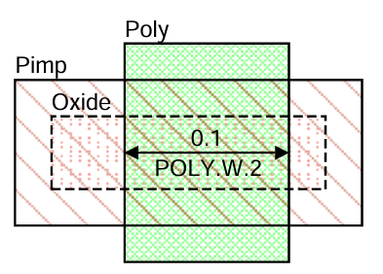
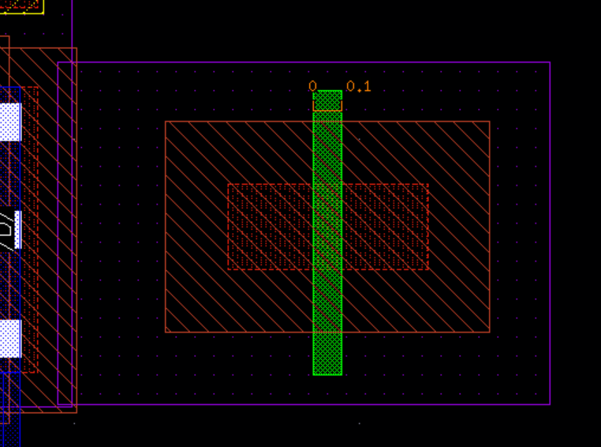
Rule Name | Value | Description
POLY.W.2 | 0.1um | Minimum 1.2V P-channel gate length.
Schematic in Design Rule Manual
Cadence Reproducing and vertical structure
✄
“PMOS의 전기적 특성과 신뢰성을 유지하기 위해 최소 Gate Length를 제한”
0.1um
STI
OXIDE
STI
P+
Nwell
P+
Substrate
0.1um

Slide 3
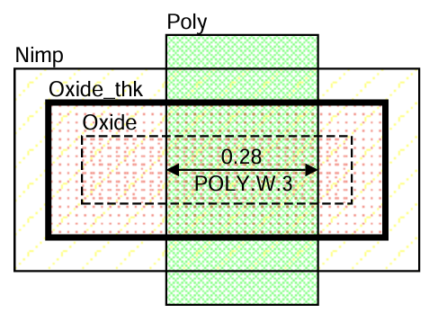
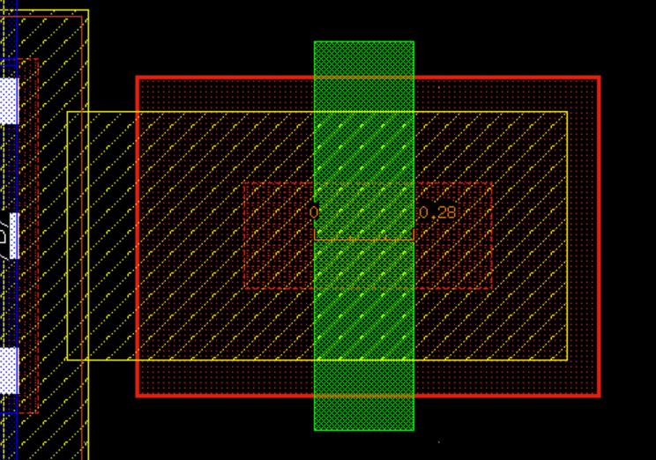
Rule Name | Value | Description
POLY.W.3 | 0.28um | Minimum 2.5V N-channel gate length.
Schematic in Design Rule Manual
Cadence Reproducing and vertical structure
✄
“고전압 동작 시 Hot Carrier Injection과 Gate Oxide 열화를
방지하기 위해 최소 Gate Length를 제한”
0.28um
STI
Thick OXIDE
STI
Substrate
N+
N+
0.28um

Slide 4
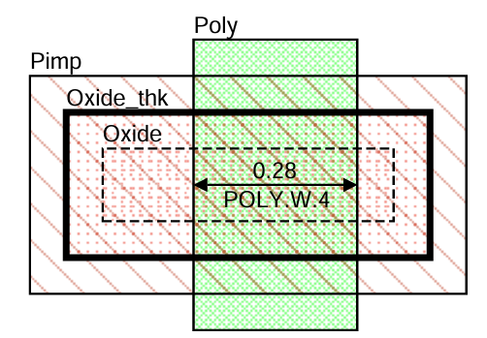
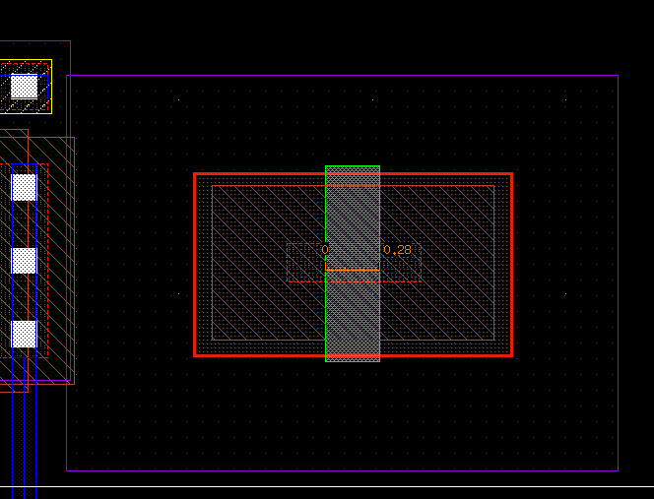
Rule Name | Value | Description
POLY.W.4 | 0.28um | Minimum 2.5V P-channel gate length.
Schematic in Design Rule Manual
Cadence Reproducing and vertical structure
✄
“고전압 동작 시 Hot Carrier Injection과 Gate Oxide 열화를
방지하기 위해 최소 Gate Length를 제한”
0.28um
Thick OXIDE
STI
P+
STI
Nwell
P+
Substrate
0.28um

Slide 5
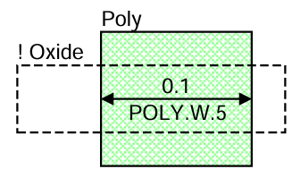
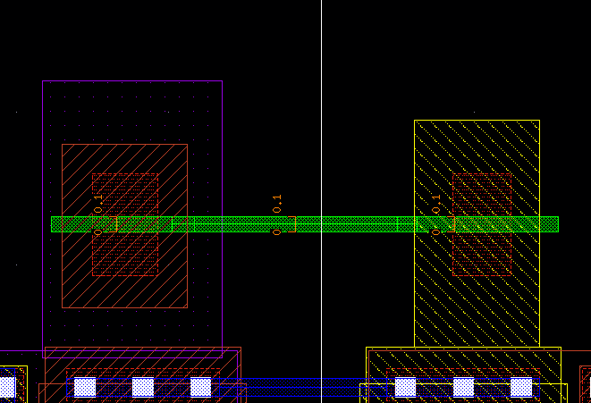
Rule Name | Value | Description
POLY.W.5 | 0.1um | Minimum Poly interconnect width.
Schematic in Design Rule Manual
Cadence Reproducing and vertical structure
q
“Poly 배선의 단선과 저항 증가를 방지하기 위해 최소 Poly 폭을 규정”
0.1um
0.1um

Slide 6
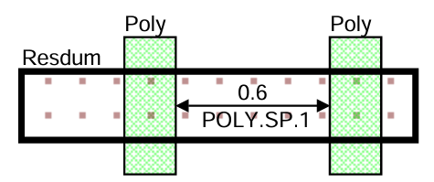
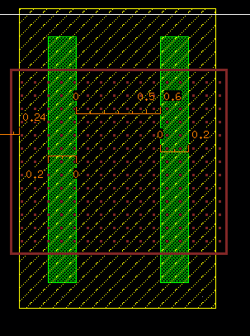
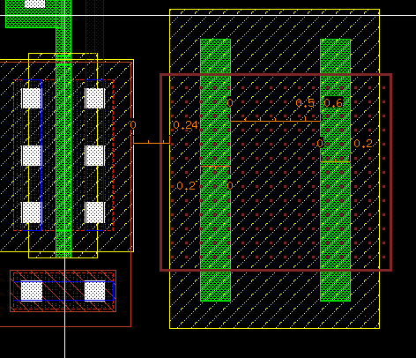
Rule Name | Value | Description
POLY.SP.1 | 0.6um | Minimum Poly resistor space.
Cadence Reproducing and vertical structure
Schematic in Design Rule Manual
“Poly 저항의 저항값 오차와 공정 간섭을 줄이기 위해 최소 간격을 확보”
0.6um
0.6um
STI
Substrate

Slide 7
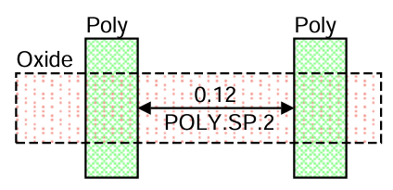
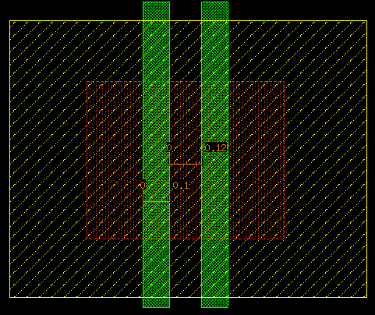
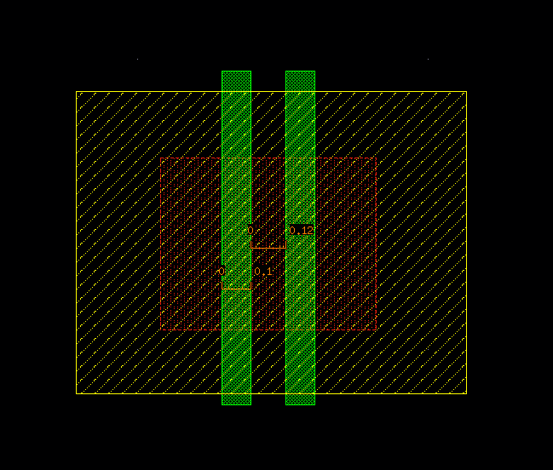
Rule Name | Value | Description
POLY.SP.2 | 0.12um | Minimum gate space.
Cadence Reproducing and vertical structure
Schematic in Design Rule Manual
✄
“인접한 Gate의 브리징과 기생 capacitor 증가를 방지하기 위해 최소 Gate 간격을 유지.”
0.12um
0.12um
STI
OXIDE
STI
N+
N+
Substrate

Slide 8
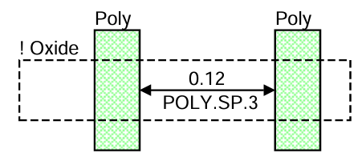
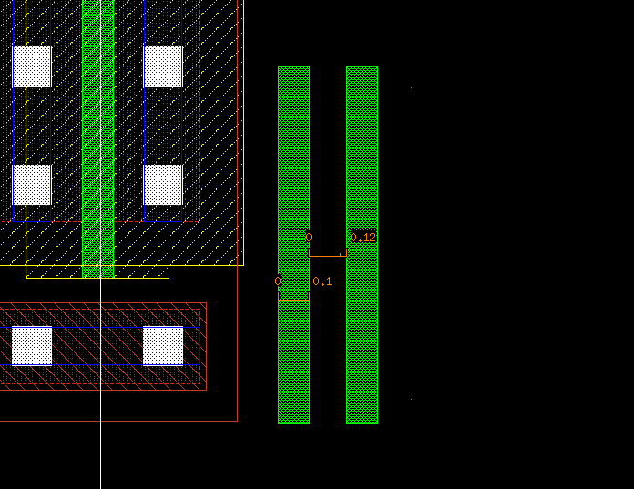
Rule Name | Value | Description
POLY.SP.3 | 0.12um | Minimum Poly interconnect space.
Schematic in Design Rule Manual
Cadence Reproducing and vertical structure
“Poly 배선 간 브리징과 signal 간섭을 방지하기 위해 최소 배선 간격을 유지”
0.12um
0.12um
STI
Substrate

Slide 9
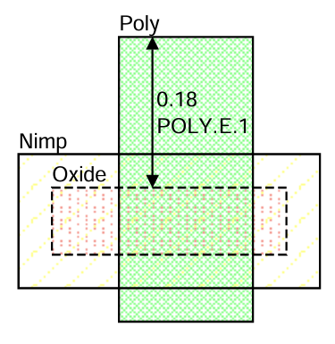
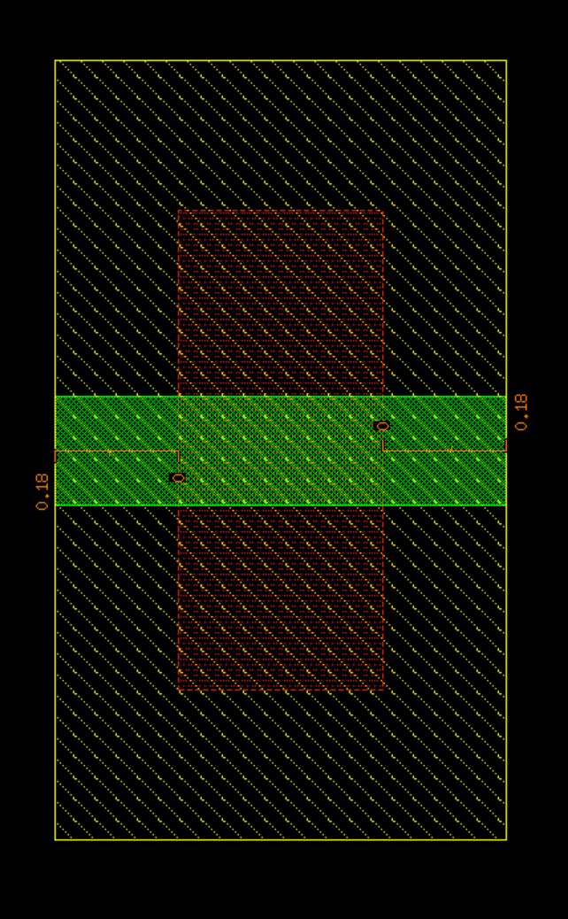
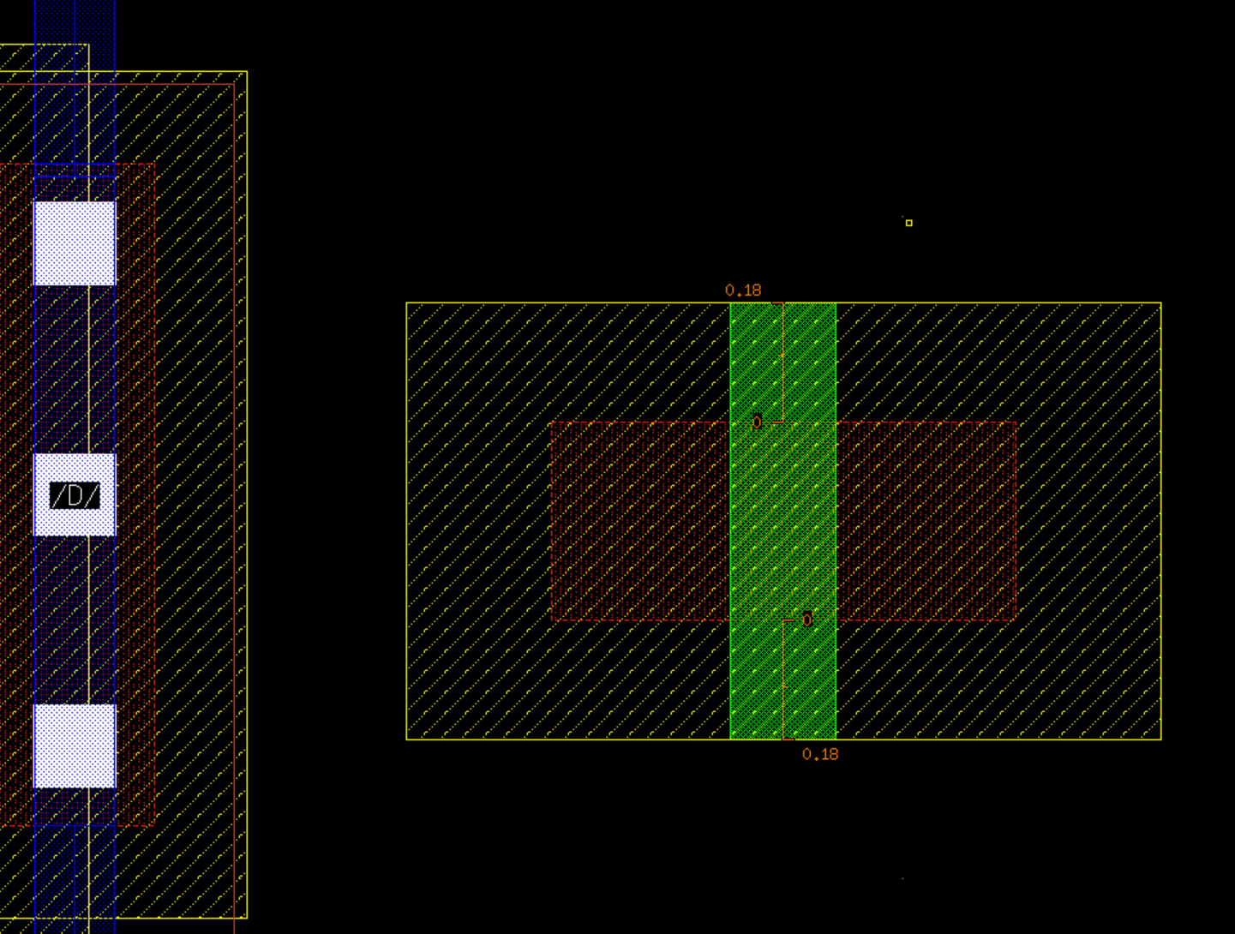
Rule Name | Value | Description
POLY.E.1 | 0.18um | Minimum N-channel gate extension beyond Active Area.
Schematic in Design Rule Manual
Cadence Reproducing and vertical structure
✄
“Gate Contact 배치 공간을 확보하고 Overlay 오차를 보상하기 위해 Gate Poly를 Active 밖으로 충분히 연장”
0.18um
0.18um
STI
OXIDE
STI
Substrate

Slide 10
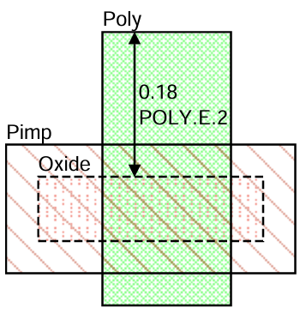
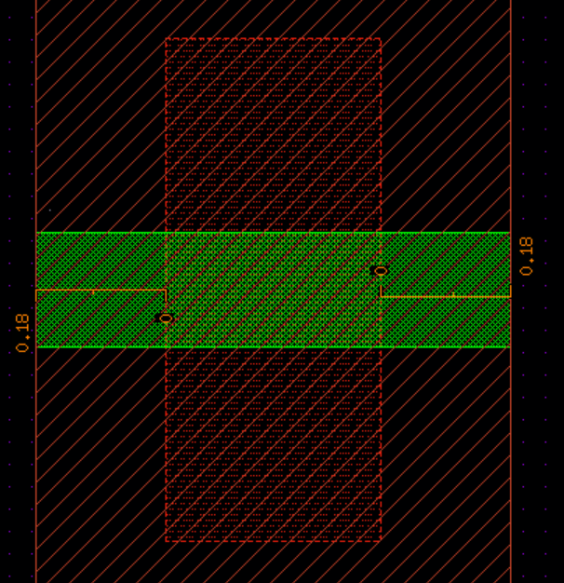
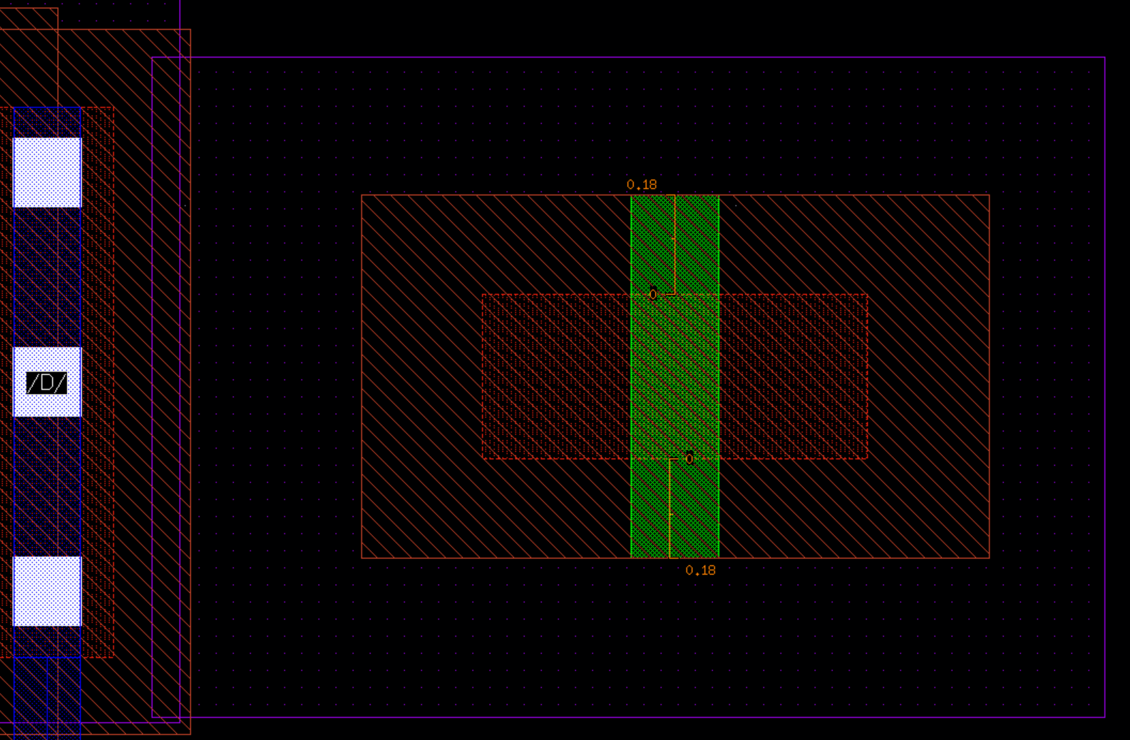
Rule Name | Value | Description
POLY.E.2 | 0.18um | Minimum P-channel gate extension beyond Active Area.
Schematic in Design Rule Manual
Cadence Reproducing and vertical structure
✄
“Gate Contact 배치 공간을 확보하고 Overlay 오차를 보상하기 위해 Gate Poly를 Active 밖으로 충분히 연장”
0.18um
0.18um
STI
OXIDE
STI
Substrate
Nwell

Slide 11
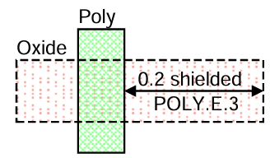
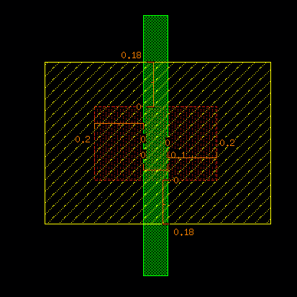
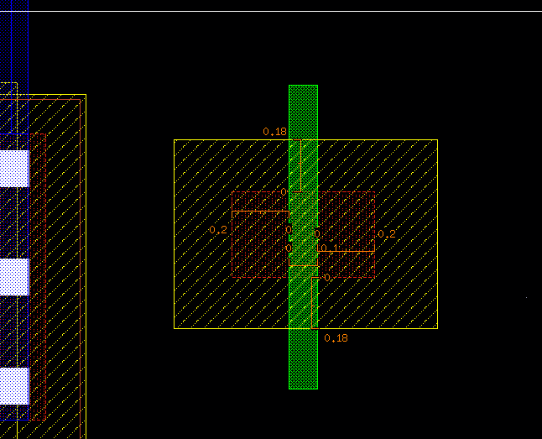
Rule Name | Value | Description
POLY.E.3 | 0.2um | Minimum Active Area (source/drain) to gate enclosure.
Schematic in Design Rule Manual
Cadence Reproducing and vertical structure
✄
“Source/Drain과 Gate의 정렬 오차를 보상하고 안정적인 채널 형성을 위해 충분한 Active Enclosure를 확보”
0.2um
0.2um
STI
OXIDE
STI
Substrate
N+
N+

Slide 12
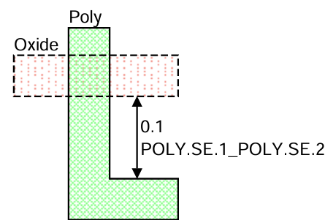
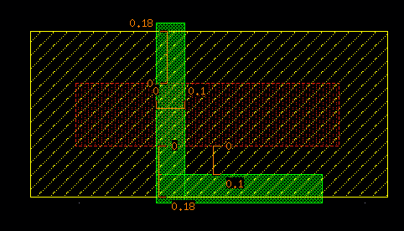
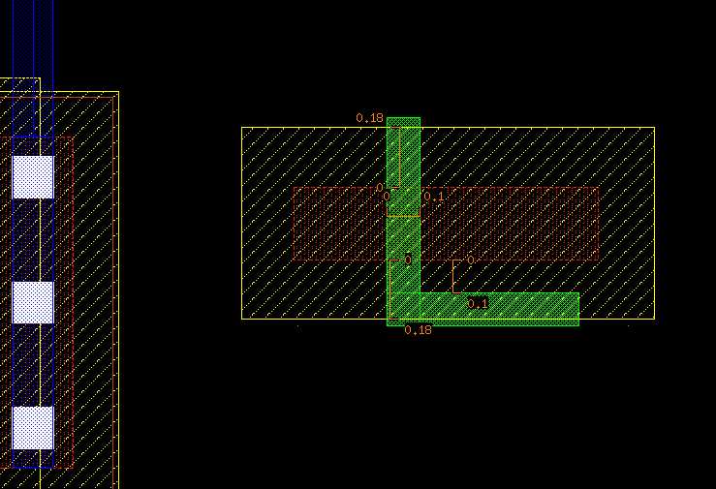
Rule Name | Value | Description
POLY.SE.1_2 | 0.1um | Minimum Poly interconnect to unrelated/related Active Area space.
Schematic in Design Rule Manual
Cadence Reproducing and vertical structure
“의도하지 않은 MOS 채널 형성과 단락을 방지하기 위해 Poly와 Active 사이의 최소 간격을 유지”
✄
0.1um
0.1um
POLY / Gate
OXIDE
STI
STI
N+
Substrate

Slide 13
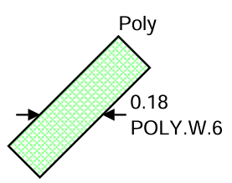
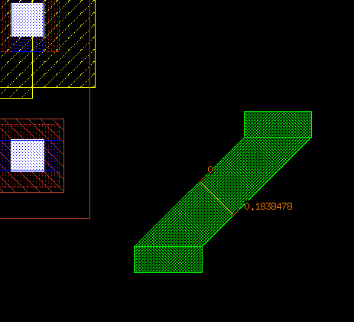
Rule Name | Value | Description
POLY.W.6 | 0.18um | Minimum bent Poly width.
Schematic in Design Rule Manual
Cadence Reproducing and vertical structure
“Corner Rounding으로 인한 폭 감소와 단선을 방지하기 위해 Bent Poly의 최소 폭을 규정”
0.18um
POLY / Gate
Substrate
STI
0.18um

Slide 14
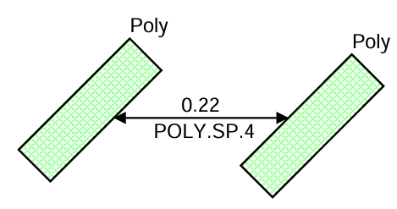
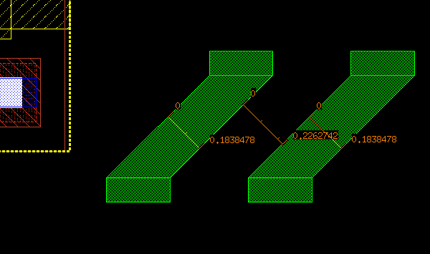
Rule Name | Value | Description
POLY.SP.4 | 0.22um | Minimum bent Poly space.
Schematic in Design Rule Manual
Cadence Reproducing and vertical structure
“Bent Poly에서 발생하는 패턴 왜곡과 브리징을 방지하기 위해 최소 간격을 적용”
0.18um
0.18um
0.22um
POLY / Gate
POLY / Gate
Substrate
STI
0.22um

Slide 15
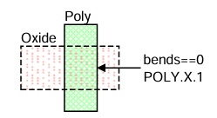
Rule Name | Value | Description
POLY.X.1 | - | Bent gate is not allowed.
Schematic in Design Rule Manual
Cadence Reproducing and vertical structure
✄
“균일한 채널 형성과 안정적인 소자 특성을 위해 Bent Gate를 금지. 직선 구조만 사용”
Bends==0
STI
OXIDE
STI
Substrate
N+
N+

Slide 16
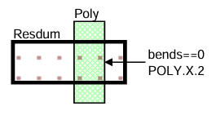
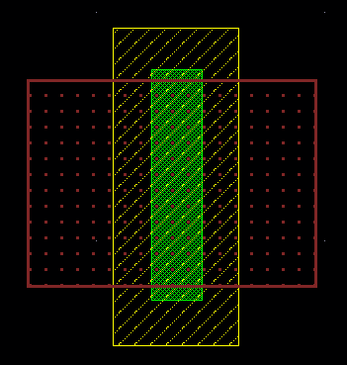
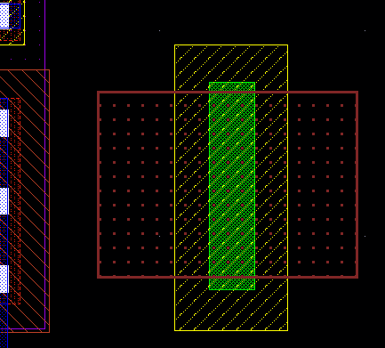
Rule Name | Value | Description
POLY.X.2 | - | Bent Poly resistor is not allowed.
Schematic in Design Rule Manual
Cadence Reproducing and vertical structure
“Current Crowding과 저항값 오차를 방지하기 위해 Bent Poly Resistor를 금지”
✄
Bends==0
STI
Substrate

Slide 17
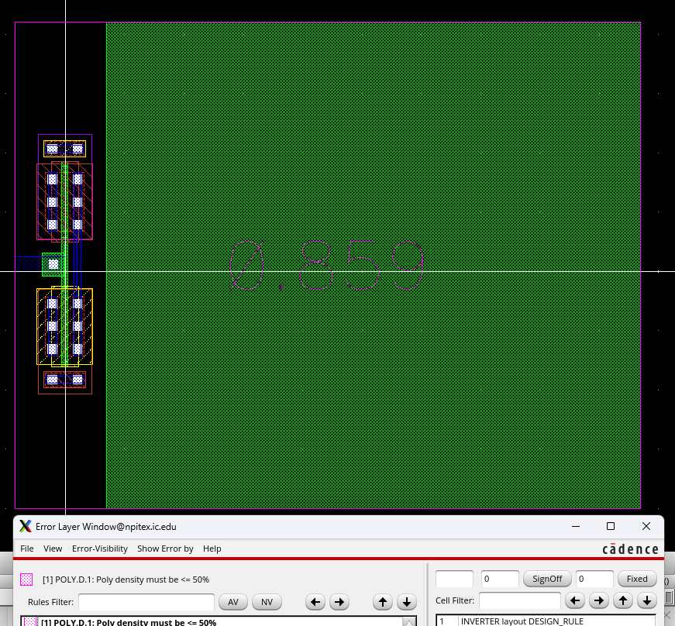
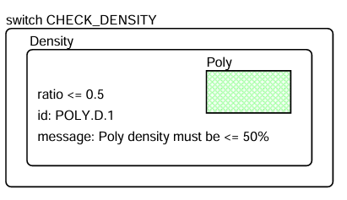
Rule Name | Value | Description
POLY.D.1 | 50% | Maximum Poly density across full chip.
Schematic in Design Rule Manual
“Poly Density Ratio를 제한하여 CMP와 식각 공정의 균일성을 확보”

Slide 18
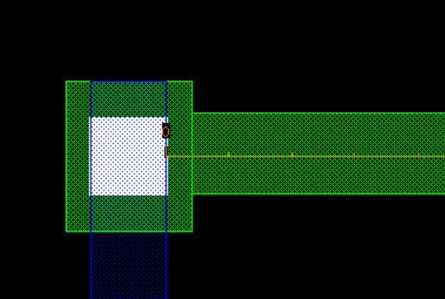
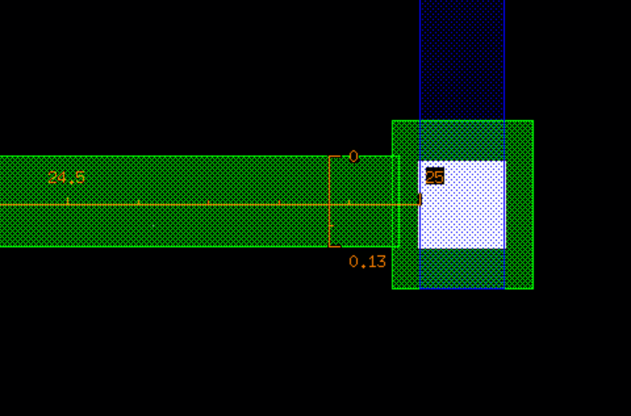
Rule Name | Value | Description
POLY.SE.3 | 25.0 | Minimum Poly segment length (width < 0.14) between two contacts.
Schematic in Design Rule Manual
“좁고 긴 Poly의 높은 저항과 IR Drop을 방지하기 위해 최대 Poly Segment Length를 제한”

Slide 19
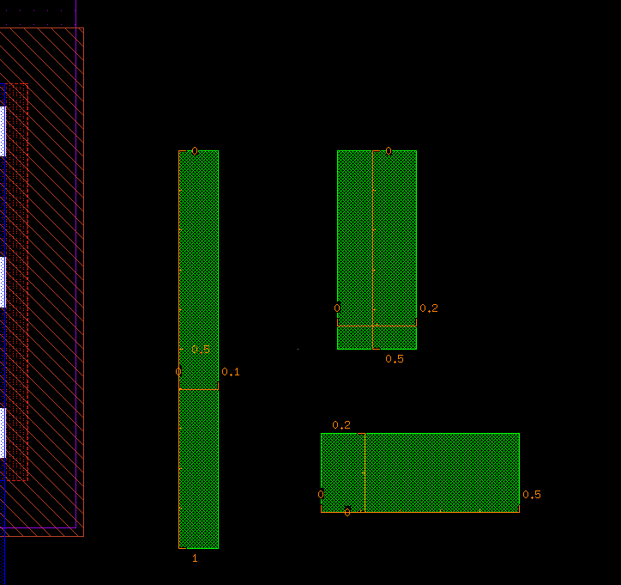
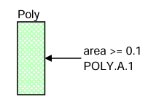
Rule Name | Value | Description
POLY.A.1 | 0.1 | Minimum area for Poly interconnect.
Schematic in Design Rule Manual
“공정에서 안정적으로 패턴을 형성하기 위해 Poly의 최소 면적을 확보”

