Slide 1
3조
조장 | 유경환
곽대현 | 전제현
김규민 | 박재호
전민석 | 이준민

Slide 2
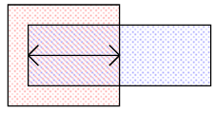

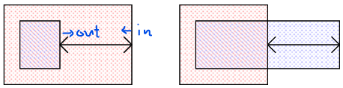
Definition
Spacing
Overlap
한 도형의 외곽경계에서 다른 도형의 외곽까지의 거리
한 도형이 다른 도형을 얼마나 감싸고 있는지를 나타내는 거리
Enclosure
Parallel length
두 도형의 서로 마주보는 가장자리가 겹쳐 있는 길이
두 도형이 서로 겹쳐 있는 영역의 거리

Slide 3
Layer colors
STI
Substrate
Nwell
POLY / Gate
METAL
VIA
IMD
ILD
Sillicide
P+
N+
CONTACTt
OXIDE
Thick OXIDE

Slide 4
Design Rule 이면의 공통 배경 : 공정상의 한계
1
LITHOGRAPHY 한계
2
ETCHING 한계
노광 해상도의 한계
식각 공정의 한계
너무 작은 패턴은 노광 과정에서 의도한 모양대로 만들어지지 않음
좁고 깊은 Hole·Line은 식각이 끝까지 진행되지 않거나 형상이 변형됨
관련: 대부분의 최소 Width / Length 규정
관련: Width, Enclosure 규정
3
SHORT CIRCUIT 방지
4
OVERLAY 정렬 오차
인접 패턴 간 단락 방지
마스크 정렬 오차 보정
공정 오차로 인접한 두 패턴이 붙어(Bridge) 전기적으로 단락되는 것을 방지
포토마스크 정렬 시 발생하는 오차를 흡수할 여유 마진 확보
관련: 대부분의 Spacing 규정
관련: 대부분의 Enclosure 규정

Slide 5
Why METAL and CONTACT?
Type-Ⅰ Heterojunction (schematic)
Heterojunction : An interface formed between two dissimilar semiconductor materials with unequal band gaps.
Interface physics — not bulk physics — is what makes heterojunctions interesting
E
Ec
Ec
ΔEc
Ev
ΔEv
Ev
Semiconductor A
(narrow gap)
Semiconductor B
(wide gap)
* 이상적인 straddling-gap (Type-Ⅰ) 배치를 나타낸 개념도

Slide 6
To Interface Physics
Heterojunction
Metal – Semiconductor Junction
M
EF
φB
ΔEc, ΔEv
전자 친화도 / work function 차이 → band offset 결정
Metal / Semiconductor work function 차이 → Schottky barrier 결정 (Schottky–Mott rule)
A
B
S
Heterogeneous interfaces host a range of fascinating physical phenomena that don't emerge in either bulk material alone.
Heterogeneous interfaces host physics found nowhere else — this is why I chose to explore how these effects shape Contact / Metal1 Design Rule.

Slide 7
Contact

Slide 8
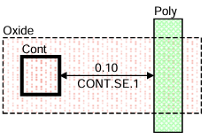
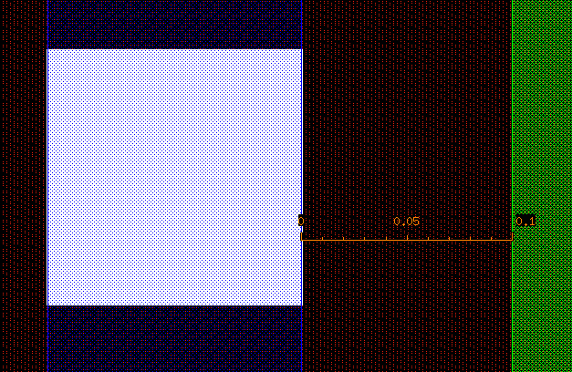
Rule Name | Value | Description
CONT.SE.1 | 0.10um | Minimum Contact on Active Area to gate spacing
Schematic in Design Rule Manual
Cadence Reproducing and vertical structure
Cadence
Gate 손상·Short 방지를 위한 최소 Contact-Gate 간격
✄
0.10um
METAL 1
0.10um
CONTACTt
ILD
Silicide
OXIDE
Substrate
N+

Slide 9
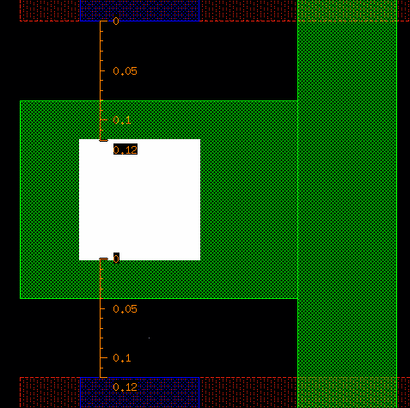
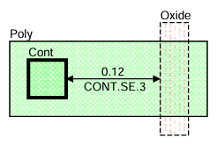
Rule Name | Value | Description
CONT.SE.3 | 0.12um | Minimum gate Contact to Active Area spacing
Schematic in Design Rule Manual
Cadence Reproducing and vertical structure
Cadence
Gate-Active Short 방지를 위한 최소 Gate Contact 간격
✄
0.12um
0.12um
ILD
CONTACTt
ILD
POLY / Gate
STI
Substrate

Slide 10
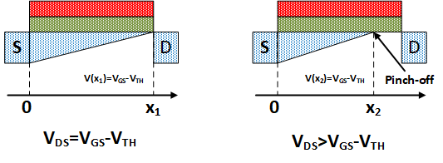
Why Contact-to-Gate Spacing Matters
Hot Carrier Injection Reliability
Pinch-off

Slide 11
HCI(Hot Carrier Injection)
Impact ionization rate : $α_{ii}\left(E\right)=a ∙\exp\left(−\frac{b}{E}\right)$
Charge trap formation
Device Degradation
Reliability Issue

Slide 12
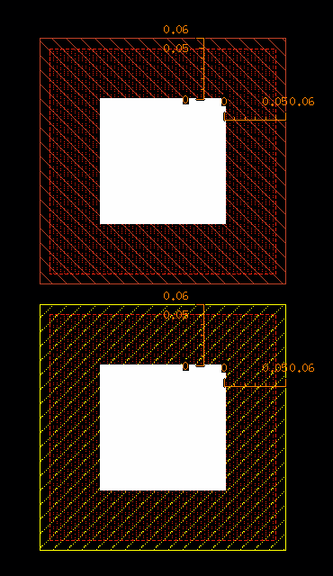
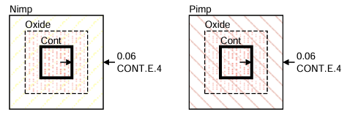
Rule Name | Value | Description
CONT.E.4 | 0.06um | Minimum N+/P+ Implant on Active Area to Contact enclosure
Schematic in Design Rule Manual
Cadence Reproducing and vertical structure
Cadence
✄
안정적인 Ohmic Contact 형성 및 Contact 저항 감소를 위한 Implant Enclosure 규정
0.06um
0.06um
0.06um
0.06um
CONTACT
CONTACT
0.06um
0.06um
OXIDE
Sillicide
OXIDE
OXIDE
Sillicide
OXIDE
P+
Substrate
Substrate
N+

Slide 13
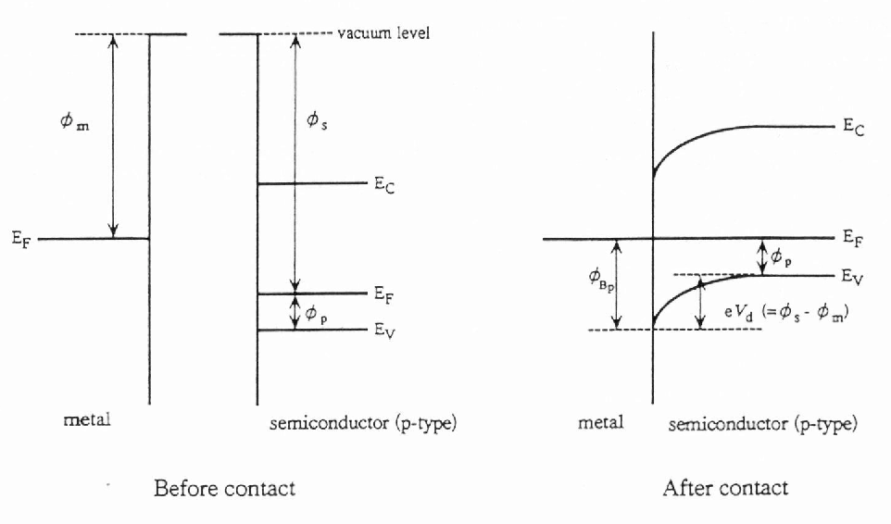
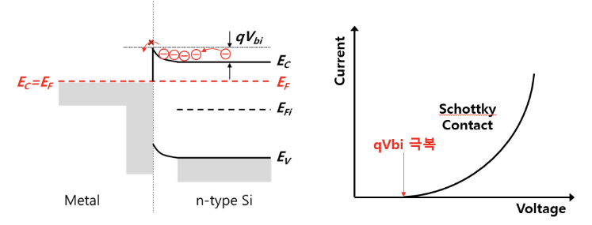


Schottky contact (p, n type)
Metal과 semiconductor는 각각 다른 work function을 가짐. (서로 다른 Fermi level)
접촉 후 Fermi level을 일치시키기 위해 전자가 이동, semiconductor의 Band가 휘어지며(Band Bending) Schottky Barrier가 형성.
(NMOS)
이상적인 경우, 형성되는 barrier height는 Schottky-Mott Rule에 의해 금속의 Work Function과 반도체의 Electron Affinity로 결정

Slide 14
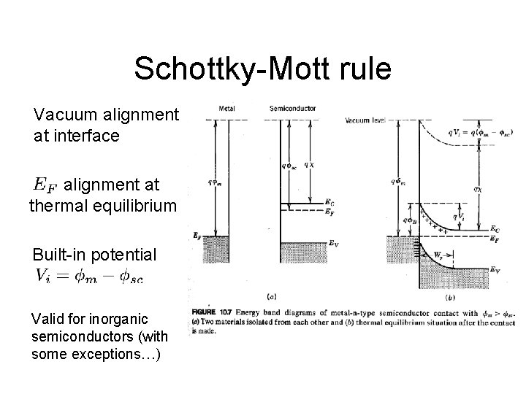
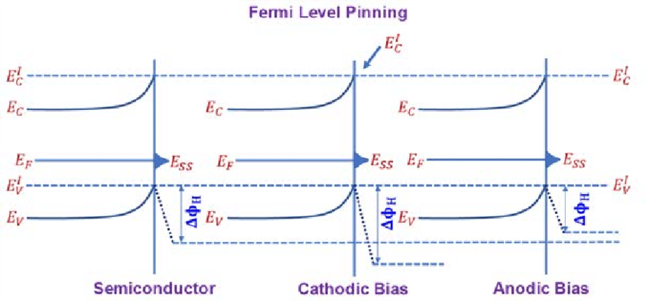
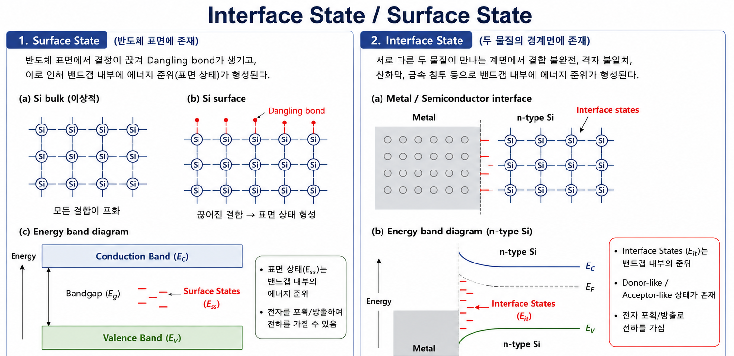
Ideal
Reality
실제 CMOS에서는 Bardeen model에 의해 Fermi level이 pinning되어 work function 조합만으로 contact 특성이 결정되지 않음.

Slide 15
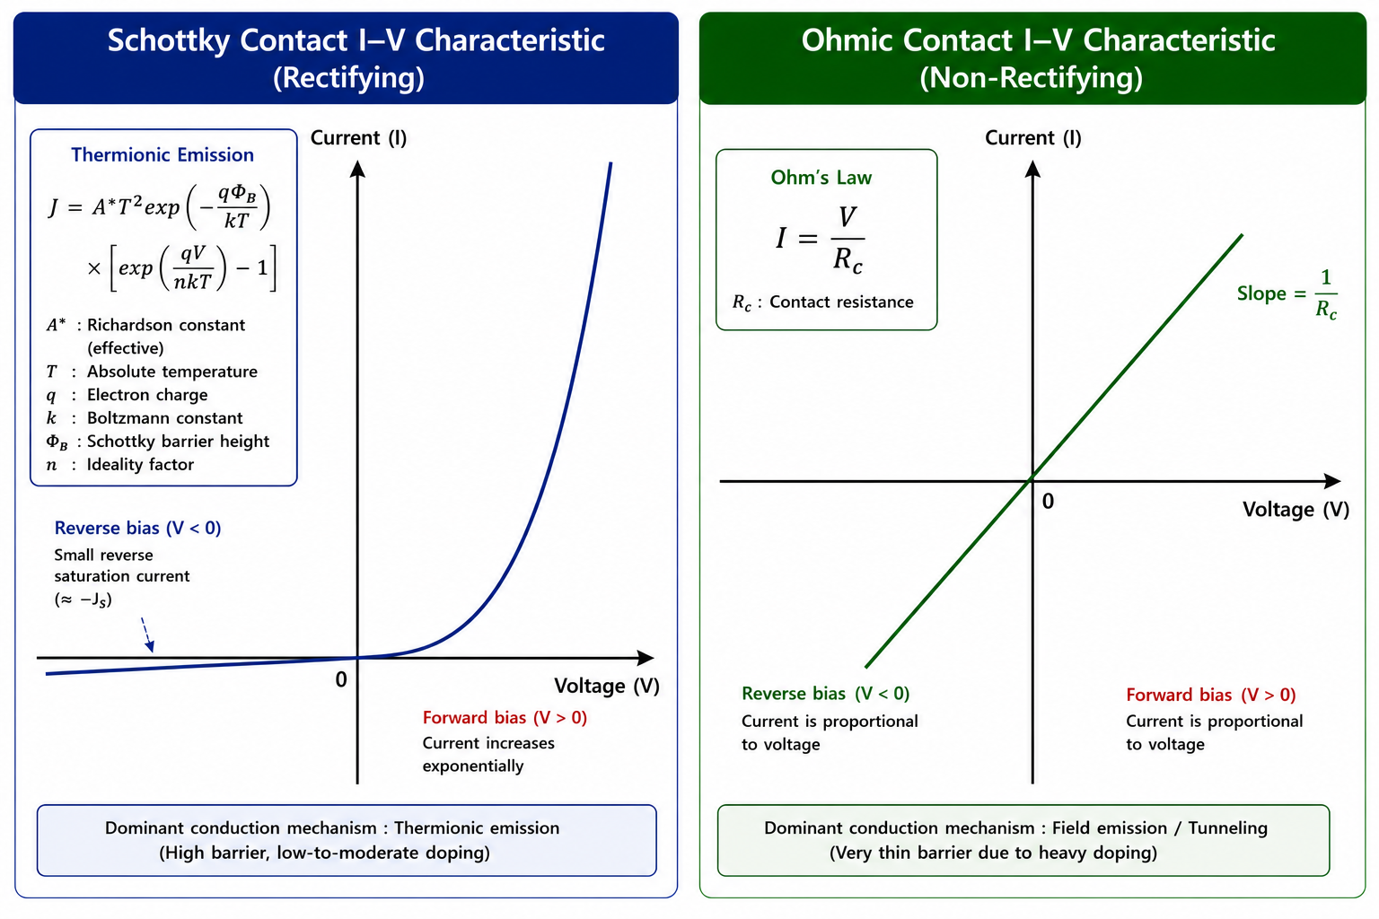

Slide 16
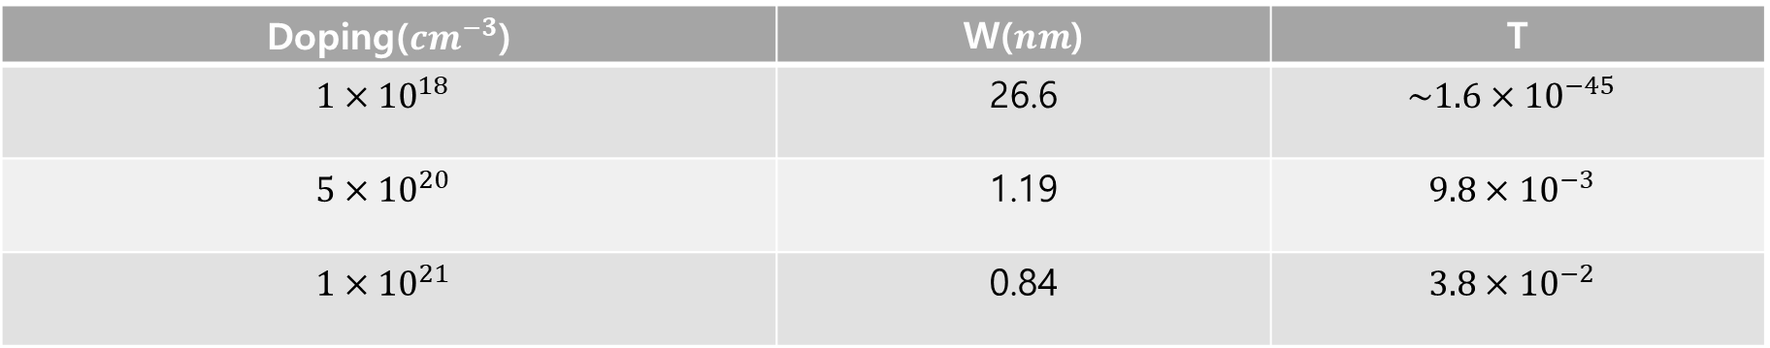
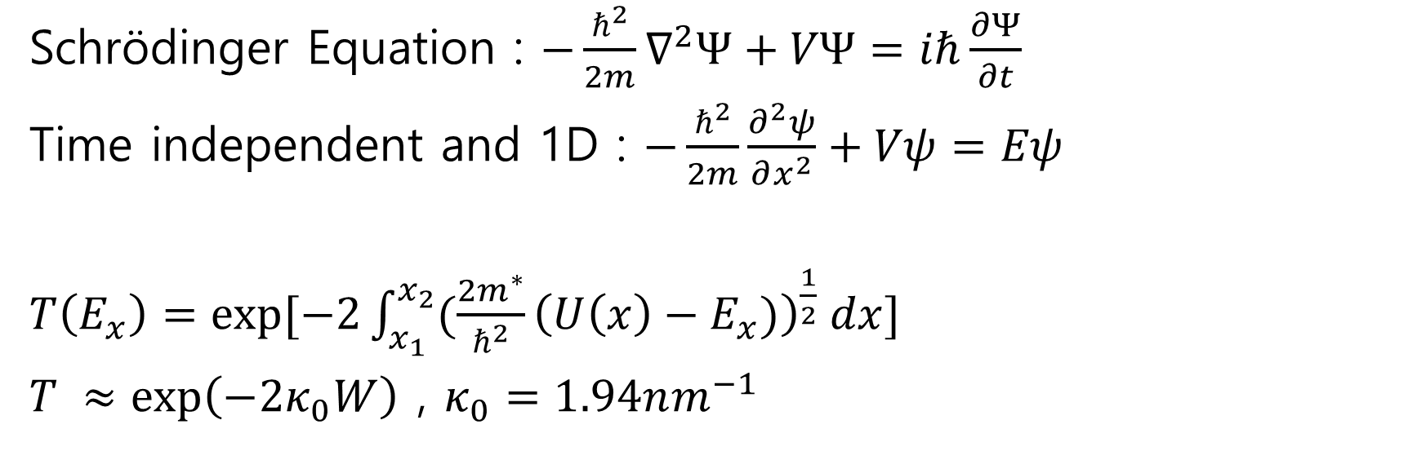
Schrödinger Equation : $−\frac{ℏ^{2}}{2m}∇^{2}Ψ+VΨ=iℏ\frac{∂Ψ}{∂t}$
Time independent and 1D : $−\frac{ℏ^{2}}{2m}\frac{∂^{2}ψ}{∂x^{2}}+Vψ=Eψ$
$T\left(E_{x}\right)=exp⁡[−2\int_{x_{1}}^{x_{2}}{(\frac{2m^{∗}}{ℏ^{2}}{\left(U\left(x\right)−E_{x})\right)}^{\frac{1}{2}} dx}]$
$T ≈\exp\left(−2κ_{0}W\right)$ , $κ_{0}=1.94nm^{−1}$
Doping($cm^{−3}$) | W($nm$) | T
$$1×{10}^{18}$$ | 26.6 | $$\sim 1.6×{10}^{−45}$$
$$5×{10}^{20}$$ | 1.19 | $$9.8×{10}^{−3}$$
$$1×{10}^{21}$$ | 0.84 | $$3.8×{10}^{−2}$$

Slide 17
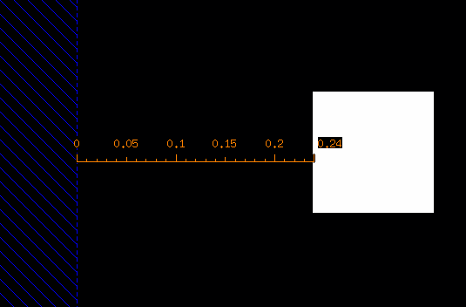
Rule Name | Value | Description
CONT.SE.5 | 0.24um | Minimum Poly Contact to non-salacided Poly resistor or Active Contact to non-salacided Active resistor spacing
Schematic in Design Rule Manual
Cadence Reproducing and vertical structure
Cadence
저항 특성 유지 및 Salicide 침범 방지를 위한 최소 Contact-Resistor 간격 규정
✄
0.24um
0.24um
CONTACTt
Silicide
POLY / Gate
Substrate
STI

Slide 18
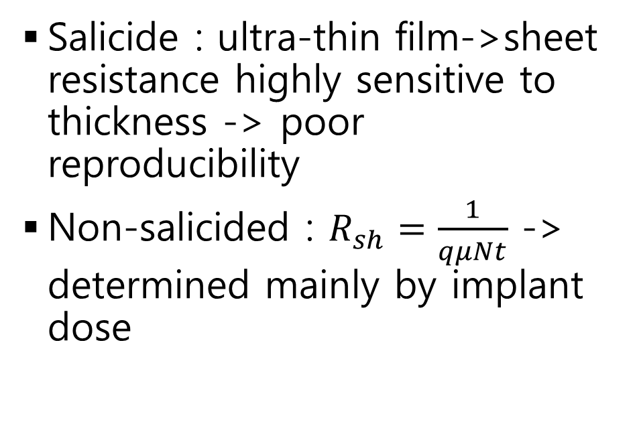
Why Non-salicided Resistor
Salicide : ultra-thin film->sheet resistance highly sensitive to thickness -> poor reproducibility
Non-salicided : $R_{sh}=\frac{1}{qμNt}$ -> determined mainly by implant dose
Salicide (junction)
thin, sensitive → low reproducibility
Salicide (junction)
thin, sensitive → low reproducibility
Salicide block mask
Poly / active (implant)
Non-salicided resistor body
R_sh set by implant dose → precise

Slide 19


Non-salicide Boundary
Transfer length : $L_{T}=\sqrt{ρ_{c}/R_{sh}}$
즉, Contact이 너무 가까우면 유효 폭 확보가 불가해 길이가 왜곡된다.
Contact
Salicide (low R)
Non-salicide resistor (high R)
$$L_{T}$$

Slide 20
Salicide encroachment risk
Salicide block mask overlay error
Effective non-silicide resistor length becomes shorter than designed
Designed non-salicide length
Encroachment

Slide 21
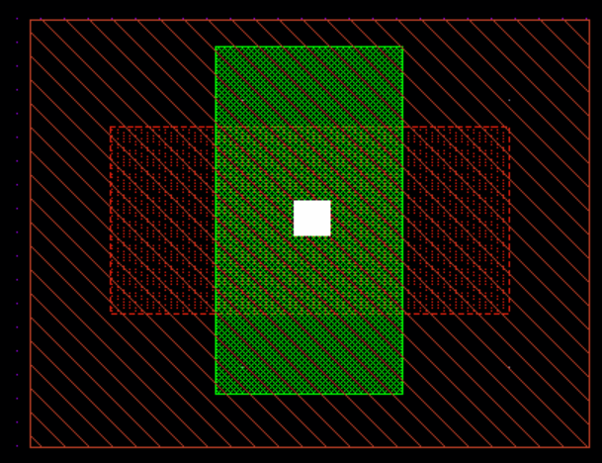
Rule Name | Value | Description
CONT.X.1 | - | Contact on gate is NOT allowed
Schematic in Design Rule Manual
Cadence Reproducing and vertical structure
Active 위에 있는 Gate Poly(채널 영역) 위에는 Contact를 놓으면 안 된다
Cadence
✄
Active area
POLY / Gate
Substrate
STI
P+

Slide 22
Contact causes field crowding at the edge
Contact behaves as an equipotential body
Contact close to / overlapping the gate edge → vertical E-field locally enhanced at that point
Contact (equipotential)
Gate
Active area
Gate edge
Field lines crowd toward the gate edge

Slide 23
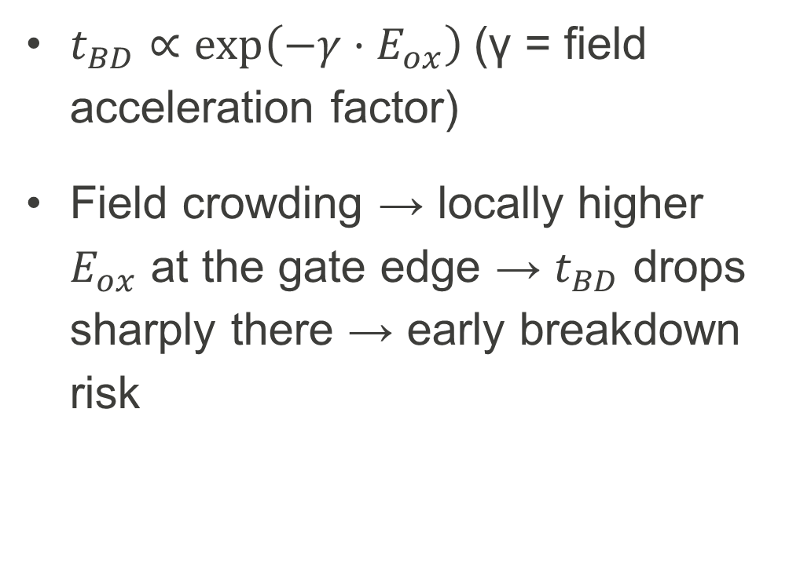
Reliability risk ① : TDDB acceleration
$t_{BD}∝\exp\left(−γ·E_{ox}\right)$(γ = field acceleration factor)
Field crowding → locally higher $E_{ox}$ at the gate edge → $t_{BD}$ drops sharply there → early breakdown risk
Local hotspot under contact → shifted to high-E_ox, low-t_BD region

Slide 24
Reliability risk ② : direct tunneling leakage
Thin gate oxide (≲ 3 nm): electrons tunnel through the full barrier thickness (direct tunneling)
Local field enhancement → tunneling probability spikes → excess gate leakage at that spot
Barrier (gate oxide)
Si substrate
Locally thinner barrier under the gate edge → tunneling probability T ↑ sharply

Slide 25
Metal

Slide 26
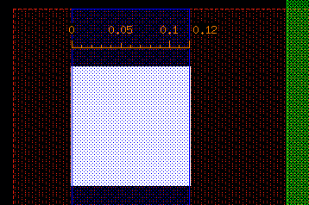
Rule Name | Value | Description
METAL1.W.1 | 0.12um | Minimum Metal 1 width
Schematic in Design Rule Manual
Cadence Reproducing and vertical structure
Cadence
공정 안정성 및 배선 신뢰성 확보를 위한 최소 Metal1 폭 규정
✄
0.12um
0.12um
METAL 1
CONTACTt
ILD
Silicide
OXIDE
Substrate
N+

Slide 27
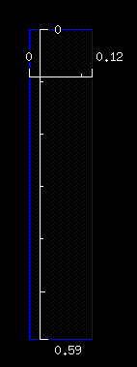

Rule Name | Value | Description
METAL1.A.1 | 0.07$um^{2}$ | Minimun bent Metal1 area
Schematic in Design Rule Manual
Cadence Reproducing and vertical structure
공정 안정성 및 배선 신뢰성 확보를 위한 최소 Metal1 면적 규정
Cadence
✄
0.07$um^{2}$
0.12um
0.59um
ILD
STI
Substrate

Slide 28
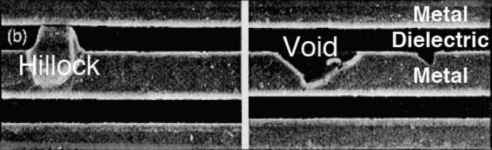
Electromigration

Slide 29
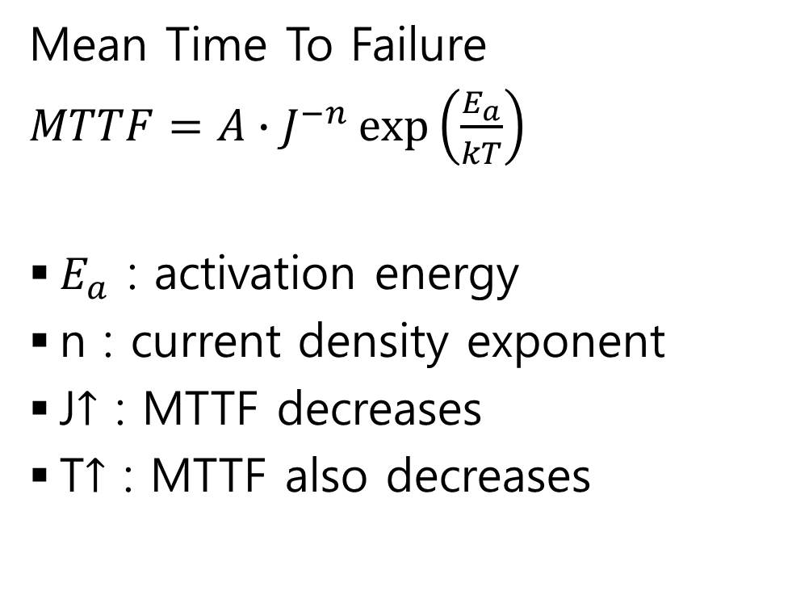
Quantifying Lifetime
Mean Time To Failure
$MTTF=A∙J^{−n}\exp\left(\frac{E_{a}}{kT}\right)$
$E_{a}$ : activation energy
n : current density exponent
J$↑$ : MTTF decreases
T$↑$ : MTTF also decreases
Narrower Metal1 → higher J → shifted to the low-MTTF region

Slide 30
감사합니다

