Slide 1
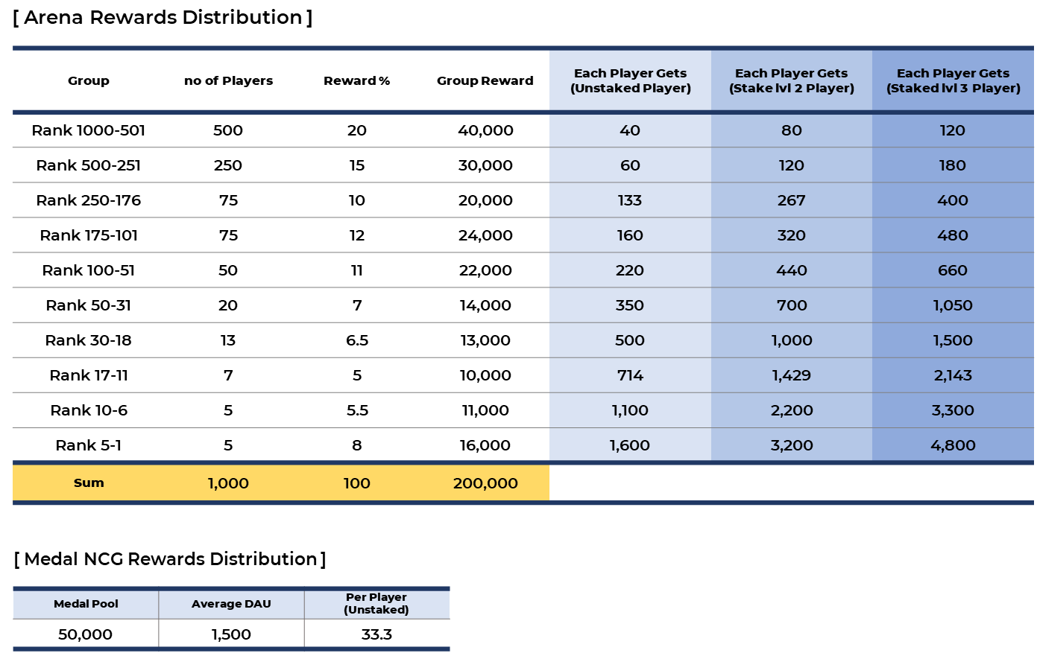
[ Arena Rewards Distribution ]
Group | no of Players | Reward % | Group Reward | Each Player Gets (Unstaked Player) | Each Player Gets (Stake lvl 2 Player) | Each Player Gets (Staked lvl 3 Player)
Rank 1000-501 | 500 | 20 | 40,000 | 40 | 80 | 120
Rank 500-251 | 250 | 15 | 30,000 | 60 | 120 | 180
Rank 250-176 | 75 | 10 | 20,000 | 133 | 267 | 400
Rank 175-101 | 75 | 12 | 24,000 | 160 | 320 | 480
Rank 100-51 | 50 | 11 | 22,000 | 220 | 440 | 660
Rank 50-31 | 20 | 7 | 14,000 | 350 | 700 | 1,050
Rank 30-18 | 13 | 6.5 | 13,000 | 500 | 1,000 | 1,500
Rank 17-11 | 7 | 5 | 10,000 | 714 | 1,429 | 2,143
Rank 10-6 | 5 | 5.5 | 11,000 | 1,100 | 2,200 | 3,300
Rank 5-1 | 5 | 8 | 16,000 | 1,600 | 3,200 | 4,800
Sum | 1,000 | 100 | 200,000
[ Medal NCG Rewards Distribution ]
Medal Pool | Average DAU | Per Player (Unstaked)
50,000 | 1,500 | 33.3

Slide 2
Live

Slide 3

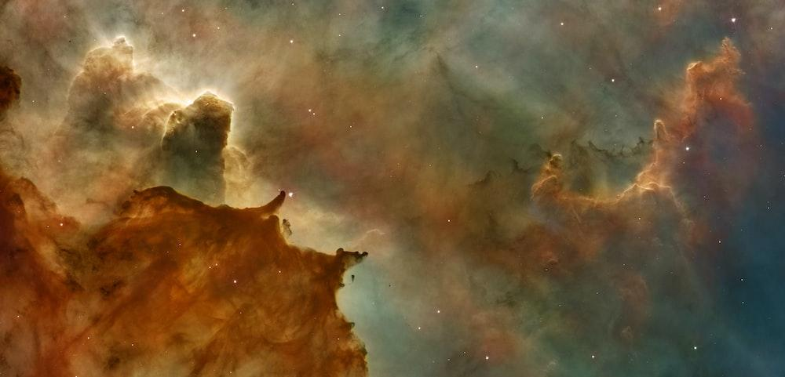

[ Odin ] Arena Season 36 Rewards
Group | No of Players | Reward % | Group Reward | Basic | Staking lvl 02 | Staking lvl 03 | Courage Pass | Courage Pass & Staking lvl 2 | Courage Pass & Staking lvl 3
Rank 1 – 2 | 2 | 8 | 32,000 | 5000 | 7,500 | 10,000 | 11,000 | 13,500 | 16,000
Rank 3 –5 | 3 | 9 | 36,000 | 3750 | 5,625 | 7,500 | 8,250 | 10,125 | 12,000
Rank 6 – 9 | 4 | 8 | 32,000 | 2500 | 3,750 | 5,000 | 5,500 | 6,750 | 8,000
Rank 10 – 15 | 16 | 10 | 40,000 | 2083 | 3,125 | 4,167 | 4,583 | 5,625 | 6,667
Rank 16 – 25 | 10 | 12 | 48,000 | 1500 | 2,250 | 3,000 | 3,300 | 4,050 | 4,800
Rank 26 – 50 | 25 | 18 | 72,000 | 900 | 1,350 | 1,800 | 1,980 | 2,430 | 2,880
Rank 51 – 87 | 37 | 16 | 64,000 | 541 | 811 | 1,081 | 1,189 | 1,459 | 1,730
Rank 88 – 125 | 38 | 11 | 44,000 | 362 | 543 | 724 | 796 | 977 | 1,158
Rank 126 – 250 | 125 | 5 | 20,000 | 50 | 75 | 100 | 110 | 135 | 160
Rank 251 – 500 | 250 | 3 | 12,000 | 15 | 23 | 30 | 33 | 41 | 48
Sum | 500 | 100 | 400,000
Block Information
Start Block : 17,543,624 (Est. March 2nd) End Block : 17,694,823 (Est. March 16th)
Ticket Information
You can buy up to 24 tickets during the entire Season
You can buy up to 4 extra tickets during each session (each refresh, or about 24 hours).

Slide 4
[ Odin ] Arena Championship 14 Rewards
Group | No of Players | Reward % | Group Reward | Basic | Staking lvl 02 | Staking lvl 03 | Courage Pass | Courage Pass & Staking lvl 2 | Courage Pass & Staking lvl 3
Rank 1 – 5 | 5 | 10 | 40,000 | 2,667 | 4,000 | 5,333 | 5,333 | 6,667 | 8,000
Rank 6 – 10 | 5 | 8 | 32,000 | 2,133 | 3,200 | 4,267 | 4,267 | 5,333 | 6,400
Rank 11 – 17 | 7 | 9 | 36,000 | 1,714 | 2,571 | 3,429 | 3,429 | 4,286 | 5,143
Rank 18 – 30 | 13 | 12 | 48,000 | 1,231 | 1,846 | 2,462 | 2,462 | 3,077 | 3,692
Rank 31 – 50 | 20 | 12 | 48,000 | 800 | 1,200 | 1,600 | 1,600 | 2,000 | 2,400
Rank 51 – 100 | 50 | 15 | 60,000 | 400 | 600 | 800 | 800 | 1,000 | 1,200
Rank 101 – 175 | 75 | 15 | 60,000 | 267 | 400 | 533 | 533 | 667 | 800
Rank 176 – 250 | 75 | 13 | 52,000 | 231 | 347 | 462 | 462 | 578 | 693
Rank 251 – 500 | 250 | 4 | 16,000 | 21 | 32 | 43 | 43 | 53 | 64
Rank 501 – 1000 | 500 | 2 | 8,000 | 5 | 8 | 11 | 11 | 13 | 16
Sum | 1,000 | 100 | 400,000
Block Information
Start Block : 15,923,624 (Est. October 3rd) End Block : 16,074,823 (Est. October 17th)
Ticket Information
You can buy up to 24 tickets during the entire Season
You can buy up to 4 extra tickets during each session (each refresh, or about 24 hours).

Slide 5
[ Heimdall ] Arena Season 20 Rewards
Group | No of Players | Reward % | Group Reward | Basic | Staking lvl 02 | Staking lvl 03 | Courage Pass | Courage Pass & Staking lvl 2 | Courage Pass & Staking lvl 3
Rank 1 – 2 | 2 | 8 | 32,000 | 5000 | 7,500 | 10,000 | 11,000 | 13,500 | 16,000
Rank 3 –5 | 3 | 9 | 36,000 | 3750 | 5,625 | 7,500 | 8,250 | 10,125 | 12,000
Rank 6 – 9 | 4 | 8 | 32,000 | 2500 | 3,750 | 5,000 | 5,500 | 6,750 | 8,000
Rank 10 – 15 | 16 | 10 | 40,000 | 2083 | 3,125 | 4,167 | 4,583 | 5,625 | 6,667
Rank 16 – 25 | 10 | 12 | 48,000 | 1500 | 2,250 | 3,000 | 3,300 | 4,050 | 4,800
Rank 26 – 50 | 25 | 18 | 72,000 | 900 | 1,350 | 1,800 | 1,980 | 2,430 | 2,880
Rank 51 – 87 | 37 | 16 | 64,000 | 541 | 811 | 1,081 | 1,189 | 1,459 | 1,730
Rank 88 – 125 | 38 | 11 | 44,000 | 362 | 543 | 724 | 796 | 977 | 1,158
Rank 126 – 250 | 125 | 5 | 20,000 | 50 | 75 | 100 | 110 | 135 | 160
Rank 251 – 500 | 250 | 3 | 12,000 | 15 | 23 | 30 | 33 | 41 | 48
Sum | 500 | 100 | 400,000
Block Information
Start Block : 9,067,181 (Est. March 4th) End Block : 9,218,380 (Est. March 18th)
Ticket Information
You can buy up to 24 tickets during the entire Season
You can buy up to 4 extra tickets during each session (each refresh, or about 24 hours).

Slide 6
[ Heimdall ] Arena Championship 7 Rewards
Group | No of Players | Reward % | Group Reward | Basic | Staking lvl 02 | Staking lvl 03 | Courage Pass | Courage Pass & Staking lvl 2 | Courage Pass & Staking lvl 3
Rank 1 – 5 | 5 | 10 | 40,000 | 2,667 | 4,000 | 5,333 | 5,333 | 6,667 | 8,000
Rank 6 – 10 | 5 | 8 | 32,000 | 2,133 | 3,200 | 4,267 | 4,267 | 5,333 | 6,400
Rank 11 – 17 | 7 | 9 | 36,000 | 1,714 | 2,571 | 3,429 | 3,429 | 4,286 | 5,143
Rank 18 – 30 | 13 | 12 | 48,000 | 1,231 | 1,846 | 2,462 | 2,462 | 3,077 | 3,692
Rank 31 – 50 | 20 | 12 | 48,000 | 800 | 1,200 | 1,600 | 1,600 | 2,000 | 2,400
Rank 51 – 100 | 50 | 15 | 60,000 | 400 | 600 | 800 | 800 | 1,000 | 1,200
Rank 101 – 175 | 75 | 15 | 60,000 | 267 | 400 | 533 | 533 | 667 | 800
Rank 176 – 250 | 75 | 13 | 52,000 | 231 | 347 | 462 | 462 | 578 | 693
Rank 251 – 500 | 250 | 4 | 16,000 | 21 | 32 | 43 | 43 | 53 | 64
Rank 501 – 1000 | 500 | 2 | 8,000 | 5 | 8 | 11 | 11 | 13 | 16
Sum | 1,000 | 100 | 400,000
Block Information
Start Block : 8,743,181 (Est. February 1st) End Block : 8,894,380 (Est. February 15th)
Ticket Information
You can buy up to 24 tickets during the entire Season
You can buy up to 4 extra tickets during each session (each refresh, or about 24 hours).

Slide 7
Old

Slide 8
[ Odin ] Arena Championship 15 Rewards
Group | No of Players | Reward % | Group Reward | Basic | Staking lvl 02 | Staking lvl 03 | Courage Pass | Courage Pass & Staking lvl 2 | Courage Pass & Staking lvl 3
Rank 1 – 2 | 2 | 7 | 35,000 | 5,833 | 8,750 | 11,667 | 11,667 | 14,583 | 17,500
Rank 3 – 5 | 3 | 8 | 40,000 | 4,444 | 6,667 | 8,889 | 8,889 | 11,111 | 13,333
Rank 6 – 9 | 4 | 7 | 35,000 | 2,917 | 4,375 | 5,833 | 5,833 | 7,292 | 8,750
Rank 10 – 15 | 6 | 9 | 45,000 | 2,500 | 3,750 | 5,000 | 5,000 | 6,250 | 7,500
Rank 16 – 25 | 10 | 12 | 60,000 | 2,000 | 3,000 | 4,000 | 4,000 | 5,000 | 6,000
Rank 26 – 50 | 25 | 18 | 90,000 | 1,200 | 1,800 | 2,400 | 2,400 | 3,000 | 3,600
Rank 51 – 87 | 37 | 18 | 90,000 | 811 | 1,216 | 1,622 | 1,622 | 2,027 | 2,432
Rank 88 – 125 | 38 | 12 | 60,000 | 526 | 789 | 1,053 | 1,053 | 1,316 | 1,579
Rank 126 – 250 | 125 | 6 | 30,000 | 80 | 120 | 160 | 160 | 200 | 240
Rank 251 – 500 | 250 | 3 | 15,000 | 20 | 30 | 40 | 40 | 50 | 60
Sum | 500 | 100 | 500,000
Block Information
Start Block : 16,895,624 (Est. January 1st) End Block : 17,046,823 (Est. January 15th)
Ticket Information
You can buy up to 24 tickets during the entire Season
You can buy up to 4 extra tickets during each session (each refresh, or about 24 hours).

Slide 9
[ Heimdall ] Arena Season 19 Rewards
Group | No of Players | Reward % | Group Reward | Basic | Staking lvl 02 | Staking lvl 03 | Courage Pass | Courage Pass & Staking lvl 2 | Courage Pass & Staking lvl 3
Rank 1 – 2 | 2 | 7 | 35,000 | 5,833 | 8,750 | 11,667 | 11,667 | 14,583 | 17,500
Rank 3 – 5 | 3 | 8 | 40,000 | 4,444 | 6,667 | 8,889 | 8,889 | 11,111 | 13,333
Rank 6 – 9 | 4 | 7 | 35,000 | 2,917 | 4,375 | 5,833 | 5,833 | 7,292 | 8,750
Rank 10 – 15 | 6 | 9 | 45,000 | 2,500 | 3,750 | 5,000 | 5,000 | 6,250 | 7,500
Rank 16 – 25 | 10 | 12 | 60,000 | 2,000 | 3,000 | 4,000 | 4,000 | 5,000 | 6,000
Rank 26 – 50 | 25 | 18 | 90,000 | 1,200 | 1,800 | 2,400 | 2,400 | 3,000 | 3,600
Rank 51 – 87 | 37 | 18 | 90,000 | 811 | 1,216 | 1,622 | 1,622 | 2,027 | 2,432
Rank 88 – 125 | 38 | 12 | 60,000 | 526 | 789 | 1,053 | 1,053 | 1,316 | 1,579
Rank 126 – 250 | 125 | 6 | 30,000 | 80 | 120 | 160 | 160 | 200 | 240
Rank 251 – 500 | 250 | 3 | 15,000 | 20 | 30 | 40 | 40 | 50 | 60
Sum | 500 | 100 | 500,000
Block Information
Start Block : 8,419,181 (Est. January 2nd) End Block : 8,570,380 (Est. January 16th)
Ticket Information
You can buy up to 24 tickets during the entire Season
You can buy up to 4 extra tickets during each session (each refresh, or about 24 hours).

Slide 10
[ Thor ] Arena Season 2 Rewards
Group | No of Players | Reward % | Group Reward | Basic | Staking lvl 02 | Staking lvl 03 | Courage Pass | Courage Pass & Staking lvl 2 | Courage Pass & Staking lvl 3
Rank 1 – 2 | 2 | 7 | 42,000 | 7,000 | 10,500 | 14,000 | 14,000 | 17,500 | 21,000
Rank 3 – 5 | 3 | 8 | 48,000 | 5,333 | 8,000 | 10,667 | 10,667 | 13,333 | 16,000
Rank 6 – 9 | 4 | 7 | 42,000 | 3,500 | 5,250 | 7,000 | 7,000 | 8,750 | 10,500
Rank 10 – 15 | 6 | 9 | 54,000 | 3,000 | 4,500 | 6,000 | 6,000 | 7,500 | 9,000
Rank 16 – 25 | 10 | 12 | 72,000 | 2,400 | 3,600 | 4,800 | 4,800 | 6,000 | 7,200
Rank 26 – 50 | 25 | 18 | 108,000 | 1,440 | 2,160 | 2,880 | 2,880 | 3,600 | 4,320
Rank 51 – 87 | 37 | 18 | 108,000 | 973 | 1,459 | 1,946 | 1,946 | 2,432 | 2,919
Rank 88 – 125 | 38 | 12 | 72,000 | 632 | 947 | 1,263 | 1,263 | 1,579 | 1,895
Rank 126 – 250 | 125 | 6 | 36,000 | 96 | 144 | 192 | 192 | 240 | 288
Rank 251 – 500 | 250 | 3 | 18,000 | 24 | 36 | 48 | 48 | 60 | 72
Sum | 500 | 100 | 600,000
Block Information
Start Block : 158,003 (Est. January 8th) End Block : 309,202 (Est. January 22th)
Ticket Information
You can buy up to 24 tickets during the entire Season
You can buy up to 4 extra tickets during each session (each refresh, or about 24 hours).

Slide 11

[ Odin ] Arena Season 31 Rewards
Group | No of Players | Reward % | Group Reward | No Pass | Adventure Boss Pass | Courage Pass
Rank 1-5 | 5 | 10 | 30,000 | 4,000 | 8,000 | 12,000
Rank 6 – 10 | 5 | 8 | 24,000 | 3,200 | 6,400 | 9,600
Rank 11 – 17 | 7 | 9 | 27,000 | 2,571 | 5,143 | 7,714
Rank 18 – 30 | 13 | 12 | 36,000 | 1,846 | 3,692 | 5,538
Rank 31 – 50 | 20 | 12 | 36,000 | 1,200 | 2,400 | 3,600
Rank 51 – 100 | 50 | 15 | 45,000 | 600 | 1,200 | 1,800
Rank 101 – 175 | 75 | 15 | 45,000 | 400 | 800 | 1,200
Rank 176 – 250 | 75 | 13 | 39,000 | 347 | 693 | 1,040
Rank 251 – 500 | 250 | 4 | 12,000 | 32 | 64 | 96
Rank 501 – 1000 | 500 | 2 | 6,000 | 8 | 16 | 24
Sum | 1,000 | 100 | 300,000
Block Information
Ticket Information
Start Block : 14,283,104 (Est. May 4th)
End Block : 14,434,303 (Est. May 18th)
You can buy up to 24 tickets during the entire Season
You can buy up to 4 extra tickets during each session (each refresh, or about 16 hours).

Slide 12
[ Odin ] Arena Championship 31 Rewards
Group | No of Players | Reward % | Group Reward | No Pass | Adventure Boss Pass | Courage Pass
Rank 1-5 | 5 | 10 | 30,000 | 4,000 | 8,000 | 12,000
Rank 6 – 10 | 5 | 8 | 24,000 | 3,200 | 6,400 | 9,600
Rank 11 – 17 | 7 | 9 | 27,000 | 2,571 | 5,143 | 7,714
Rank 18 – 30 | 13 | 12 | 36,000 | 1,846 | 3,692 | 5,538
Rank 31 – 50 | 20 | 12 | 36,000 | 1,200 | 2,400 | 3,600
Rank 51 – 100 | 50 | 15 | 45,000 | 600 | 1,200 | 1,800
Rank 101 – 175 | 75 | 15 | 45,000 | 400 | 800 | 1,200
Rank 176 – 250 | 75 | 13 | 39,000 | 347 | 693 | 1,040
Rank 251 – 500 | 250 | 4 | 12,000 | 32 | 64 | 96
Rank 501 – 1000 | 500 | 2 | 6,000 | 8 | 16 | 24
Sum | 1,000 | 100 | 300,000
Block Information
Ticket Information
Start Block : 14,283,104 (Est. May 4th)
End Block : 14,434,303 (Est. May 18th)
You can buy up to 24 tickets during the entire Season
You can buy up to 4 extra tickets during each session (each refresh, or about 16 hours).

Slide 13

[ Heimdall ] Arena Season 13 Rewards
Group | No of Players | Reward % | Group Reward | No Pass | Staking Level 02 | Staking Level 03
Rank 1-5 | 5 | 14 | 28,000 | 1,867 | 3,733 | 5,600
Rank 6 – 10 | 5 | 11 | 22,000 | 1,467 | 2,933 | 4,400
Rank 11 – 17 | 7 | 11 | 22,000 | 1,048 | 2,095 | 3,143
Rank 18 – 30 | 13 | 10 | 20,000 | 513 | 1,026 | 1,538
Rank 31 – 50 | 20 | 10 | 20,000 | 333 | 667 | 1,000
Rank 51 – 100 | 50 | 14 | 28,000 | 187 | 373 | 560
Rank 101 – 175 | 75 | 12 | 24,000 | 107 | 213 | 320
Rank 176 – 250 | 75 | 11 | 22,000 | 98 | 196 | 293
Rank 251 – 500 | 250 | 4 | 8,000 | 11 | 21 | 32
Rank 501 – 1000 | 500 | 3 | 6,000 | 4 | 8 | 12
Sum | 1,000 | 100 | 200,000
Block Information
Ticket Information
Start Block : 5,511,821 (Est. Apr 7th)
End Block : 5,663,020 (Est. Apr 21st)
You can buy up to 24 tickets during the entire Season
You can buy up to 4 extra tickets during each session (each refresh, or about 16 hours).

Slide 14
[ Heimdall ] Arena Championship 13 Rewards
Group | No of Players | Reward % | Group Reward | No Pass | Staking Level 02 | Staking Level 03
Rank 1-5 | 5 | 14 | 28,000 | 1,867 | 3,733 | 5,600
Rank 6 – 10 | 5 | 11 | 22,000 | 1,467 | 2,933 | 4,400
Rank 11 – 17 | 7 | 11 | 22,000 | 1,048 | 2,095 | 3,143
Rank 18 – 30 | 13 | 10 | 20,000 | 513 | 1,026 | 1,538
Rank 31 – 50 | 20 | 10 | 20,000 | 333 | 667 | 1,000
Rank 51 – 100 | 50 | 14 | 28,000 | 187 | 373 | 560
Rank 101 – 175 | 75 | 12 | 24,000 | 107 | 213 | 320
Rank 176 – 250 | 75 | 11 | 22,000 | 98 | 196 | 293
Rank 251 – 500 | 250 | 4 | 8,000 | 11 | 21 | 32
Rank 501 – 1000 | 500 | 3 | 6,000 | 4 | 8 | 12
Sum | 1,000 | 100 | 200,000
Block Information
Ticket Information
Start Block : 5,511,821 (Est. Apr 7th)
End Block : 5,663,020 (Est. Apr 21st)
You can buy up to 24 tickets during the entire Season
You can buy up to 4 extra tickets during each session (each refresh, or about 16 hours).

Slide 15

[ Thor ] Arena Season 03 Rewards
Group | No of Players | Reward % | Group Reward | No Staking | Staking Level 02 | Staking Level 03
Rank 1-5 | 5 | 14 | 70,000 | 4,667 | 9,333 | 14,000
Rank 6 – 10 | 5 | 11 | 55,000 | 3,667 | 7,333 | 11,000
Rank 11 – 17 | 7 | 11 | 55,000 | 2,619 | 5,238 | 7,857
Rank 18 – 30 | 13 | 10 | 50,000 | 1,282 | 2,564 | 3,846
Rank 31 – 50 | 20 | 10 | 50,000 | 833 | 1,667 | 2,500
Rank 51 – 100 | 50 | 14 | 70,000 | 467 | 933 | 1,400
Rank 101 – 175 | 75 | 12 | 60,000 | 267 | 533 | 800
Rank 176 – 250 | 75 | 11 | 55,000 | 244 | 489 | 733
Rank 251 – 500 | 250 | 4 | 20,000 | 27 | 53 | 80
Rank 501 – 1000 | 500 | 3 | 15,000 | 10 | 20 | 30
Sum | 1,000 | 100 | 500,000
Block Information
Ticket Information
Start Block : 872,758 (Est. Feb 17th)
End Block : 1,023,958 (Est. Mar 3rd)
You can buy up to 24 tickets during the entire Season
You can buy up to 4 extra tickets during each session (each refresh, or about 16 hours).

Slide 16
[ Heimdall ] Arena Season 10 Rewards
Group | No of Players | Reward % | Group Reward | No Staking | Staking Level 02 | Staking Level 03
Rank 1-5 | 5 | 14 | 56,000 | 3,733 | 7,467 | 11,200
Rank 6 – 10 | 5 | 11 | 44,000 | 2,933 | 5,867 | 8,800
Rank 11 – 17 | 7 | 11 | 44,000 | 2,095 | 4,190 | 6,286
Rank 18 – 30 | 13 | 10 | 40,000 | 1,026 | 2,051 | 3,077
Rank 31 – 50 | 20 | 10 | 40,000 | 667 | 1,333 | 2,000
Rank 51 – 100 | 50 | 14 | 56,000 | 373 | 747 | 1,120
Rank 101 – 175 | 75 | 12 | 48,000 | 213 | 427 | 640
Rank 176 – 250 | 75 | 11 | 44,000 | 196 | 391 | 587
Rank 251 – 500 | 250 | 4 | 16,000 | 21 | 43 | 64
Rank 501 – 1000 | 500 | 3 | 12,000 | 8 | 16 | 24
Sum | 1,000 | 100 | 400,000
Block Information
Ticket Information
Start Block : 4,187,516 (Est. Dec 5th)
End Block : 4,338,715 (Est. Dec 19th)
You can buy up to 40 tickets during the entire Season
You can buy up to 8 extra tickets during each session (each refresh, or about 16 hours).

Slide 17
[ Odin ] Arena Championship 10 Rewards
Group | No of Players | Reward % | Group Reward | No Staking | Staking Level 02 | Staking Level 03
Rank 1-5 | 5 | 14 | 35,000 | 2,333 | 4,667 | 7,000
Rank 6-10 | 5 | 11 | 27,500 | 1,833 | 3,667 | 5,500
Rank 11-17 | 7 | 11 | 27,500 | 1,310 | 2,619 | 3,929
Rank 18-30 | 13 | 10 | 25,000 | 641 | 1,282 | 1,923
Rank 31-50 | 20 | 10 | 25,000 | 417 | 833 | 1,250
Rank 51-100 | 50 | 14 | 35,000 | 233 | 467 | 700
Rank 101-175 | 75 | 12 | 30,000 | 133 | 267 | 400
Rank 176-250 | 75 | 11 | 27,500 | 122 | 244 | 367
Rank 251-500 | 250 | 4 | 10,000 | 13 | 27 | 40
Rank 501-1000 | 500 | 3 | 7,500 | 5 | 10 | 15
Sum | 1,000 | 100 | 250,000
Block Information
Ticket Information
Start Block : 12,038,501 (Est. Oct 6th)
End Block : 12,189,700 (Est. Oct 20th)
You can buy up to 40 tickets during the entire Season
You can buy up to 8 extra tickets during each session (each refresh, or about 16 hours).

Slide 18
[ Thor ] Arena Season 01 Rewards
Group | No of Players | Reward % | Group Reward | No Staking | Staking Level 02 | Staking Level 03
Rank 1-5 | 5 | 14 | 56,000 | 3,733 | 7,467 | 11,200
Rank 6 – 10 | 5 | 11 | 44,000 | 2,933 | 5,867 | 8,800
Rank 11 – 17 | 7 | 11 | 44,000 | 2,095 | 4,190 | 6,286
Rank 18 – 30 | 13 | 10 | 40,000 | 1,026 | 2,051 | 3,077
Rank 31 – 50 | 20 | 10 | 40,000 | 667 | 1,333 | 2,000
Rank 51 – 100 | 50 | 14 | 56,000 | 373 | 747 | 1,120
Rank 101 – 175 | 75 | 12 | 48,000 | 213 | 427 | 640
Rank 176 – 250 | 75 | 11 | 44,000 | 196 | 391 | 587
Rank 251 – 500 | 250 | 4 | 16,000 | 21 | 43 | 64
Rank 501 – 1000 | 500 | 3 | 12,000 | 8 | 16 | 24
Sum | 1,000 | 100 | 400,000
Block Information
Ticket Information
Start Block : 77,630 (Est. Dec 5th)
End Block : 228,829 (Est. Dec 19th)
You can buy up to 40 tickets during the entire Season
You can buy up to 8 extra tickets during each session (each refresh, or about 16 hours).

Slide 19
[ Odin ] Arena Championship 10 Rewards
Group | No of Players | Reward % | Group Reward | No Staking | Staking Level 02 | Staking Level 03
Rank 1-5 | 5 | 14 | 35,000 | 2,333 | 4,667 | 7,000
Rank 6-10 | 5 | 11 | 27,500 | 1,833 | 3,667 | 5,500
Rank 11-17 | 7 | 11 | 27,500 | 1,310 | 2,619 | 3,929
Rank 18-30 | 13 | 10 | 25,000 | 641 | 1,282 | 1,923
Rank 31-50 | 20 | 10 | 25,000 | 417 | 833 | 1,250
Rank 51-100 | 50 | 14 | 35,000 | 233 | 467 | 700
Rank 101-175 | 75 | 12 | 30,000 | 133 | 267 | 400
Rank 176-250 | 75 | 11 | 27,500 | 122 | 244 | 367
Rank 251-500 | 250 | 4 | 10,000 | 13 | 27 | 40
Rank 501-1000 | 500 | 3 | 7,500 | 5 | 10 | 15
Sum | 1,000 | 100 | 250,000
Block Information
Ticket Information
Start Block : 12,038,501 (Est. Oct 6th)
End Block : 12,189,700 (Est. Oct 20th)
You can buy up to 40 tickets during the entire Season
You can buy up to 8 extra tickets during each session (each refresh, or about 16 hours).

Slide 20
[ Odin ] Arena Championship 9 Rewards
Group | No of Players | Reward % | Group Reward | No Staking | Staking Level 02 | Staking Level 03
Rank 1-5 | 5 | 14 | 35,000 | 2,333 | 4,667 | 7,000
Rank 6-10 | 5 | 11 | 27,500 | 1,833 | 3,667 | 5,500
Rank 11-17 | 7 | 11 | 27,500 | 1,310 | 2,619 | 3,929
Rank 18-30 | 13 | 10 | 25,000 | 641 | 1,282 | 1,923
Rank 31-50 | 20 | 10 | 25,000 | 417 | 833 | 1,250
Rank 51-100 | 50 | 14 | 35,000 | 233 | 467 | 700
Rank 101-175 | 75 | 12 | 30,000 | 133 | 267 | 400
Rank 176-250 | 75 | 11 | 27,500 | 122 | 244 | 367
Rank 251-500 | 250 | 4 | 10,000 | 13 | 27 | 40
Rank 501-1000 | 500 | 3 | 7,500 | 5 | 10 | 15
Sum | 1,000 | 100 | 250,000
Block Information
Ticket Information
Start Block : 11,131,301 (Est. July 11th)
End Block : 11,282,500 (Est. July 23rd)
You can buy up to 40 tickets during the entire Season
You can buy up to 8 extra tickets during each session (each refresh, or about 16 hours)

