Slide 1
IPMON: IPv6 Mobile Object Networking - Problem Statement and Use Cases
IETF 117 in San Francisco
draft-jeong-6man-ipmon-problem-statement-01
July 25, 2023
Jaehoon (Paul) Jeong
Sungkyunkwan University (SKKU)
Email: pauljeong@skku.edu

Slide 2
Motivation of IPMON
IPMON aims at the provisioning of IPv6 networking over 5G V2X (Vehicle-to-Everything) for mobile objects such as terrestrial, aerial, and marine vehicles.
Those vehicles are mentioned as vehicles in draft-jeong-6man-ipmon-problem-statement-01
IPMON fills in the gap of IPv6-related standards in 3GPP V2X to provide those vehicles with the communication among them or with 5G infrastructure nodes for the Internet connectivity.
IPMON Communication Types in 5G Networks: Vehicle-to-Everything (V2X), Vehicle-to-Vehicle (V2V), and Vehicle-to-Infrastructure (V2I)
IPMON considers (1) multihop IPv6 address autoconfiguration, (2) proactive mobility management, (3) light-weight routing, and (4) security and privacy in 5G V2X:
IPMON aims at developing protocols for IPv6 networking over 5G V2X:
e.g., draft-jeong-6man-ipv6-over-5g-v2x-01

Slide 3
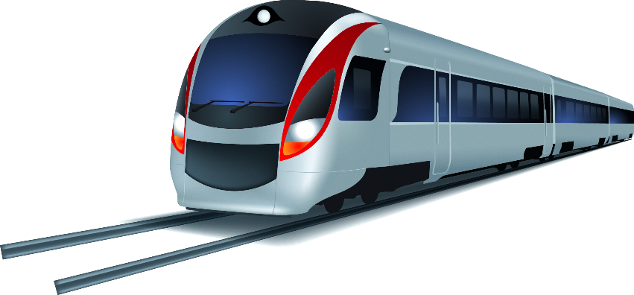
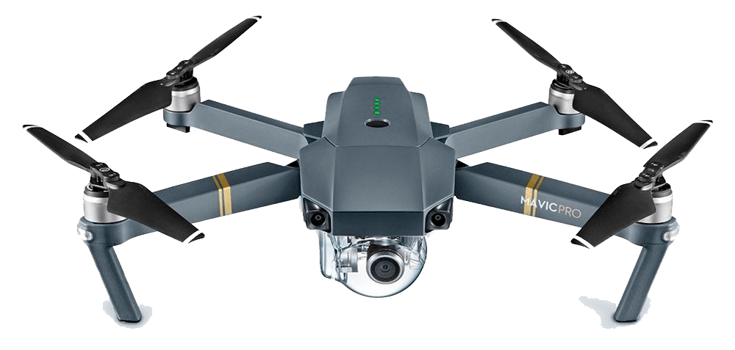
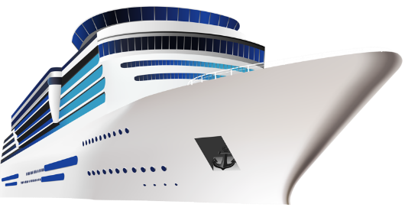

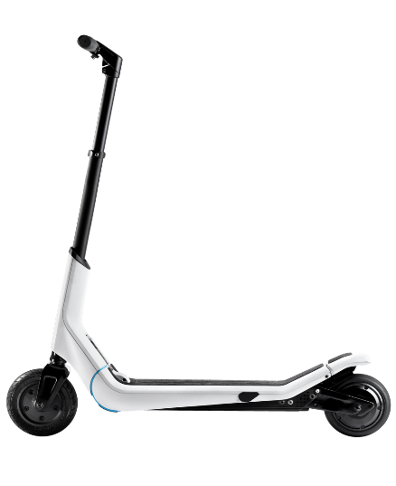

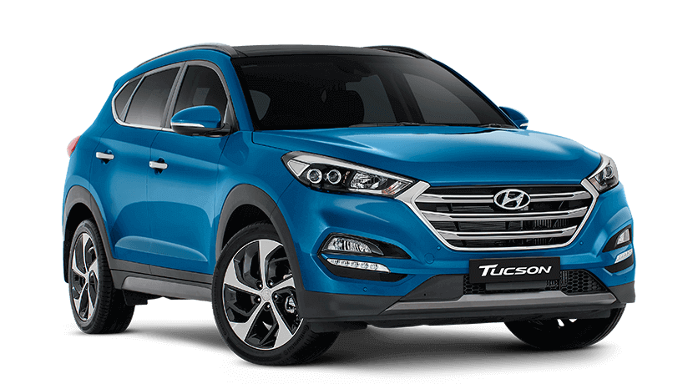
Mobile Objects (MO) in IPMON
Vehicle, Motorcycle, Scooter, Pedestrian, Unmanned Aerial Vehicle (UAV), Drone, Urban Air Mobility (UAM), Train & Ship.
Drone
Ship
Train
Motorcycle
Vehicle
Pedestrian
Scooter

Slide 4
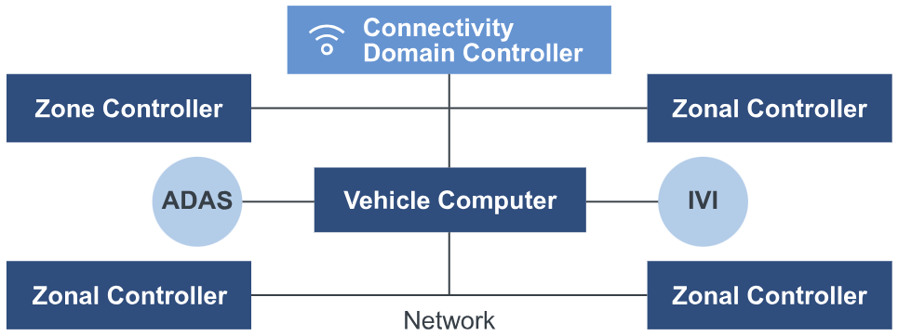

Software-Defined Vehicle (SDV) defined as MO
Vehicle Computer
Safety, security, real-time and application processing with in-vehicle and vehicular cloud
Connectivity Domain Controller
Secure car access, 5G V2X, Wi-Fi, and UWB with other cars and infrastructure nodes
In-Vehicle Networking
Safe and secure flexible backbone of Ethernet, CAN, LIN and FlexRay
Zonal Controller
Hub for power distribution and data connection to actuators and sensors
[Source] https://www.nxp.com/applications/automotive/software-defined-vehicle-infrastructure

Slide 5
IPMON Network Architecture (1/2)
An IPMON Network consists of Vehicular Ad Hoc Networks (VANET) and Radio Access Networks (RAN) for Internet connectivity.
Wireless Communications supports 3GPP 5G V2X.
(i) V2V over PC5 Interface (i.e., Sidelink) and (ii) V2I2V over Uu and Uu Interfaces
Wireless Communication is based on 3GPP 5G V2X.

Slide 6
IPMON Network Architecture (2/2)
Traffic Control Center
A Control Entity that makes decisions for various services for mobile objects with information from the mobile objects.
Vehicular Cloud
A cloud infrastructure for vehicular networks, having compute nodes, storage nodes, and network forwarding elements (e.g., switch and router).
Infrastructure Nodes
Infrastructure nodes (e.g., gNodeB and IP-RSU) enable mobile objects on the road being connected to the networks.
Mobile Objects
The objects that are running on the road or sidewalks while connected to networks. Those objects share mobility information and communicate with each other and TCC.

Slide 7
Target Scenarios of IPMON
IPMON is used in various environments such as Highway, Urban Road Networks, Streets, Parking Lots, and Drone Networks.
IPMON VANET is intermittently connected to the Internet infrastructure.
IPMON MOs need to effectively configure their IPv6 addresses for both VANET and RAN.
Packets of MOs need to be routed to destinations efficiently.

Slide 8
Use Cases of IPMON: V2V (1/2)
Context-aware navigation for safe driving and collision avoidance
Collision avoidance service of end systems of Urban Air Mobility (UAM)
Cooperative adaptive cruise control in a roadway
Platooning in a highway
Cooperative environment sensing

Slide 9
Use Cases of IPMON: V2V (2/2)
Safe Driving in Road Networks
Safe Flying in Drone Networks
Platooning for Efficient Driving
9

Slide 10
Use Cases of IPMON: V2I (1/2)
Navigation service
Energy-efficient speed recommendation service
Accident notification service
Electric vehicle (EV) charging service
UAM navigation service with efficient battery charging

Slide 11
Use Cases of IPMON: V2I (2/2)
Effective Navigation for Emergency
Efficient Navigation for Road Networks
Speed Recommendation for Energy Efficiency
11

Slide 12
Use Cases of IPMON: V2X (1/2)
Protection service for vulnerable road user (VRU)
e.g., pedestrian and cyclist
Human sensing-based protection service for VRUs without smart devices

Slide 13
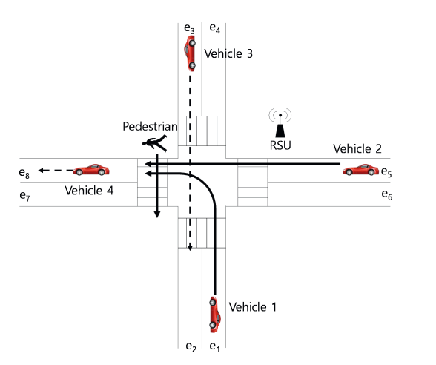
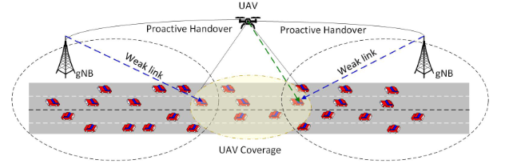
Use Cases of IPMON: V2X (2/2)
Mobile gNB
Pedestrian Protection
Blind Spot Coverage in Road Networks with Drones

Slide 14
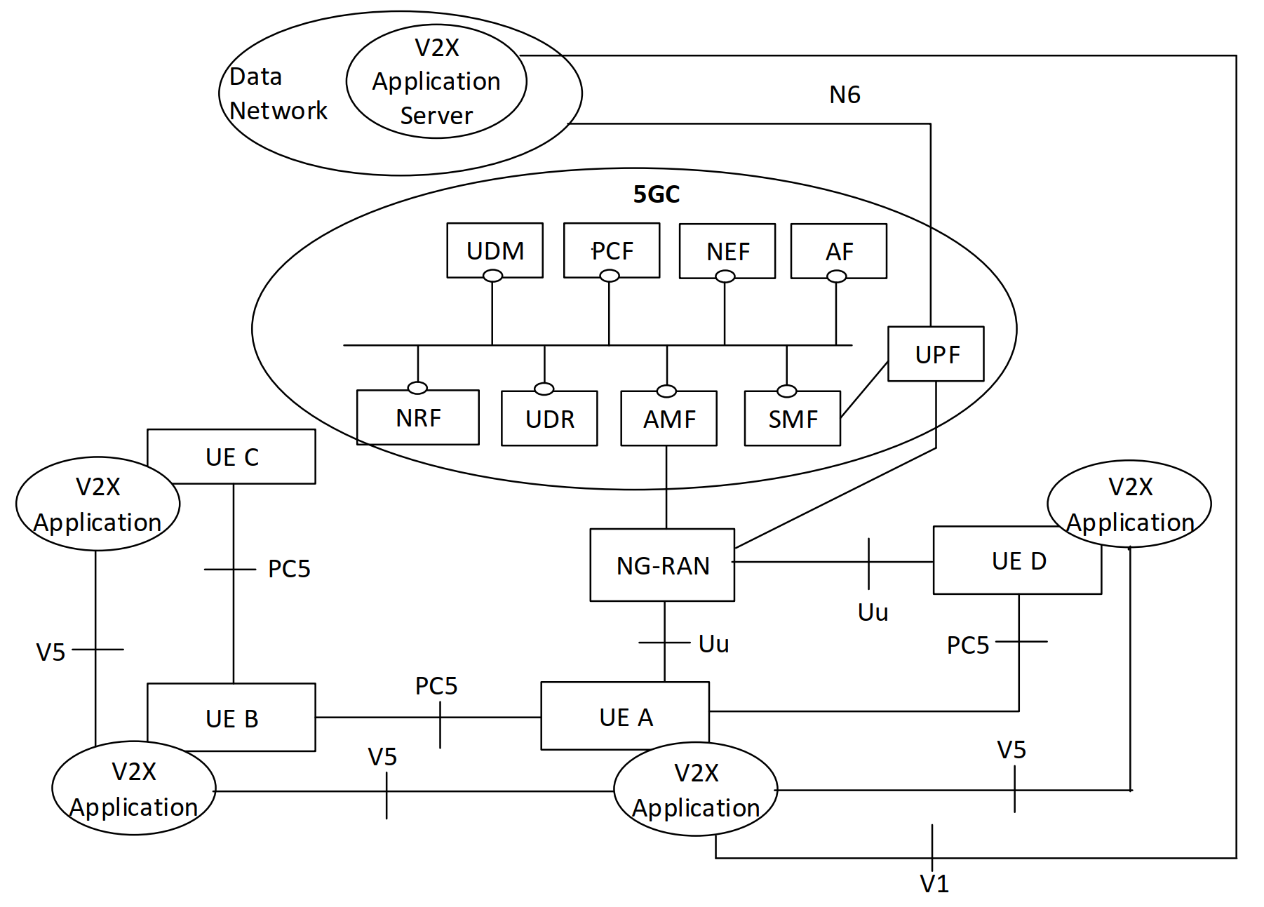
5G System Architecture for V2X in TS 23.287: Architecture enhancements for 5G System (5GS) to support Vehicle-to-Everything (V2X) services
V2V by PC5 reference point
V2I by Uu reference point
UEs can be ground vehicles, drones, pedestrian devices, scooters, etc.

Slide 15
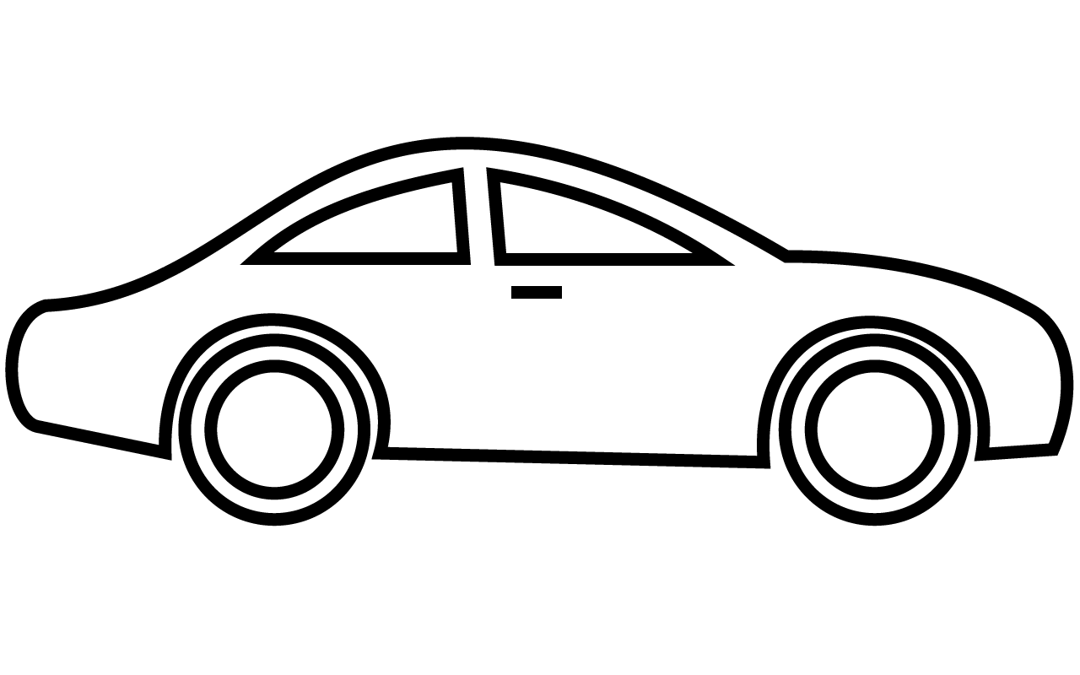
Observation 1
For 5G V2V by PC5 in unicast mode, one vehicle UE (VehUE) needs to be an IPv6 router for SLAAC.
SLAAC
IPv6 Router
IPv6 Host
SLAAC
SLAAC
SLAAC
Which one shall be the IPv6 router for SLAAC?
How many IPv6 addresses/prefixes will a vehicle have in this case?

Slide 16
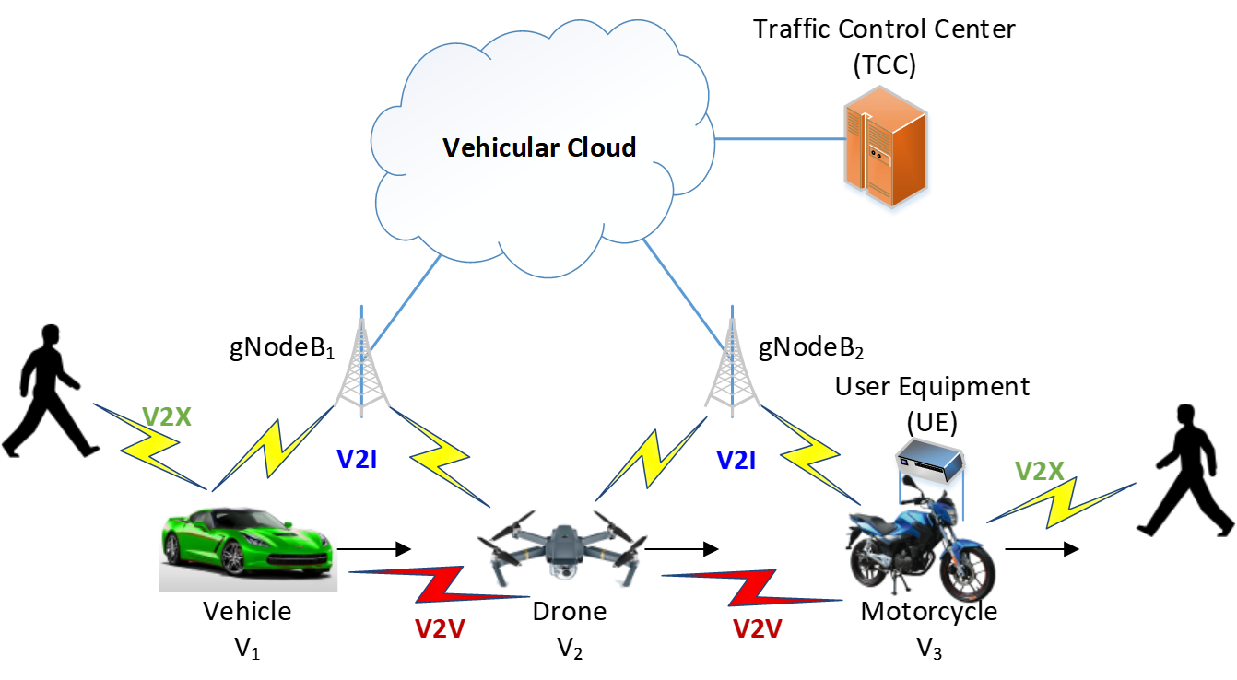
Observation 2
For V2V and V2I communications in general, will they use the same IPv6 configuration?
Using the same prefix?
Using the different prefixes?

Slide 17
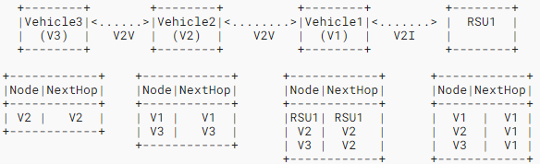
Observation 3
For multihop V2V and V2I, existing routing protocols are costly to maintain routing table.
How to minimize control traffic overhead for both routing and IPv6 ND?
(gNodeB)

Slide 18
Observation 4
Mobility Management in 5G V2X is required for the communications between a VehUE and a server in a Data Network (i.e., Internet).
How to manage mobility of vehicles that have connections with a server while they are moving along their moving paths?

Slide 19
Problem Statement in IPMON (1/2)
IPv6 Slateless Address Autoconfiguration (SLAAC)
in Unicast Mode by PC5 Interface of 5G V2V

Slide 20
Problem Statement in IPMON (2/2)
Which VehUE shall be the IPv6 router for the role to assign IPv6 addresses/prefixes if multiple VehUEs can be or want to be an IPv6 router?
For a VehUE acting as an IPv6 router, how many IPv6 addresses/prefixes will it assign?
How much will the role of an IPv6 router burden the IPv6 router VehUE?
For a VehUE receiving IPv6 addresses/prefixes from an IPv6 router VehUE, how many IPv6 addresses/prefixes will it have on the movement?
If a VehUE does not have any connection with an IPv6 router VehUE, it will only use an IPv6 link local address for communications. In this case, multihop routing is triggered to forward IPv6 packets.
How will this scenario affect the IPv6 networking among VehUEs?

Slide 21
Work Items for IPMON
IPv6 Mobile Objects (IPMON): Problem Statement and Use Cases
Basic Support for IPv6 Networks Operating over 5G Vehicle-to-Everything (V2X) Communications
Vehicular Neighbor Discovery (VND) for Multihop IPv6 Address Autoconfiguration
Vehicular Mobility Management (VMM) for Proactive Mobility Support
Vehicular Packet Routing (VPR) with Light-Weight Routing Overhead
Vehicular Security and Privacy (VSP) for Mobile Objects
Context-Aware Navigation Protocol (CNP) for Safe Maneuver of Mobile Objects
Identifier and Locator Management for Mobile Objects

Slide 22
Next Step of IPMON
IPMON BoF in the IETF-118 Prague Meeting
The Clarification of IPMON Charter
Forming of Interested Group from Automotive Vendors, Network Vendors, and Operators
Request for Non-WG Forming IPMON BoF
IPMON Hackathon Project: IPv6 Drone Networking over 5G V2X

