Slide 1

IETF-117 IPMON Context-Aware Navigator
(draft-jeong-ipwave-context-aware-navigator-08)
Presenter: Junhee Kwon
Department of Computer Science and Engineering at SKKU
Email: juun9714@skku.edu
Notes:
Hello every one my name is junhee kwon and I’ll present about our hackathon project for this ietf 116. IPMON is the next team of the IPWAVE Working group. By the way, IPWAVE problem statement has been published as RFC this month.
For this hackathon, we implemented the Network and mobility communication on OMNET simulation.

Slide 2
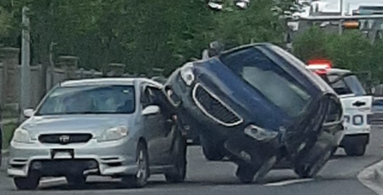
Motivation
Road injury is one of top 10 causes of death,
More than 1.2 million people are killed.
Up to 50 million are injured every year.
94% crashes are caused by human.
Environment, vehicles and unknown reasons share 6%.
Autonomous vehicles can eradicate human errors.
Emergency Scenario
Abrupt vehicle stop
Safety preserving handling mechanisms are needed.
CNP’s Aims
Collision Avoidance mechanism
Collision mitigation
[Source] Bien Aime Mugabarigira et al., "Context-Aware Navigation Protocol for Safe Driving in Vehicular Cyber-Physical Systems", IEEE Transactions on Intelligent Transportation Systems, Vol. 24, No. 1, January 2023.

Slide 3
Cooperative Collision Avoidance (1/2)
Sensing:
Local: Onboard sensors for self track
Remote: Share with other its kinematics
Risk Assessment
Cluster Head (CH) analyzes sensed data to detect risks.
Maneuver:
Lateral maneuver: when doable
Turn right or left
Longitudinal : Slow down, allow collision
Tracking Mechanism
Maneuver of vehicles which are in danger
Exit from emergence : Safely drive through
Motion planning for the Emergence vehicles
Collaborative vehicle trajectory planning via msg exchange
based on neighboring vehicles in Clusters

Slide 4
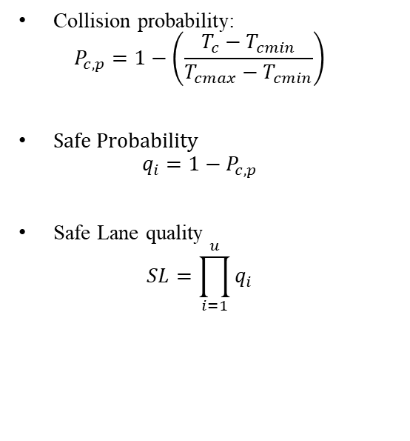
Cooperative Collision Avoidance (2/2)
Coordinated Maneuvers
Kinematics information are shared in real time.
Cluster Heads assess risks associated with sensed data.
Plan Maneuver Path & tracking
To centralize the computation : minimize computation burden
Collision probability:
$$P_{c,p}=1−\left(\frac{T_{c}−T_{cmin}}{T_{cmax}−T_{cmin}}\right)$$
Safe Probability
$$q_{i}=1−P_{c,p}$$
Safe Lane quality
$$SL=\prod_{i=1}^{u}{q_{i}}$$

Slide 5


Emergency Maneuver
Front Vehicles
Rear Vehicles
$$L_{x}^{∗}=\max_{L_{x}∈\left\{L,E,R\right\}}{(S_{L},S_{E},S_{R})}$$
The decision of the lane for maneuvering emergency vehicles in adjacent lanes
$$u={\left[\begin{matrix}ρ & a\end{matrix}\right]}^{T}$$
trajectory control input
The directly affected vehicles are the first to be maneuvered.
The rear vehicles affected by maneuvers are also maneuvered.

Slide 6
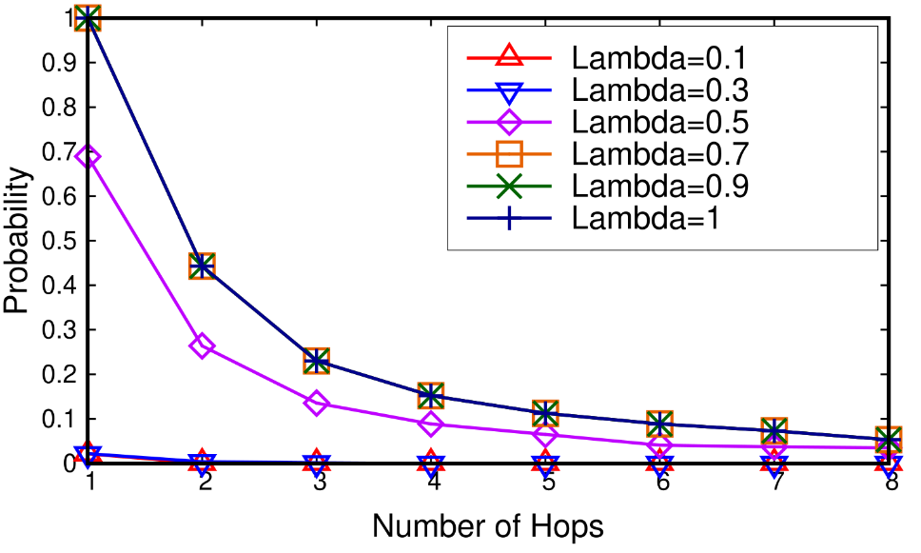
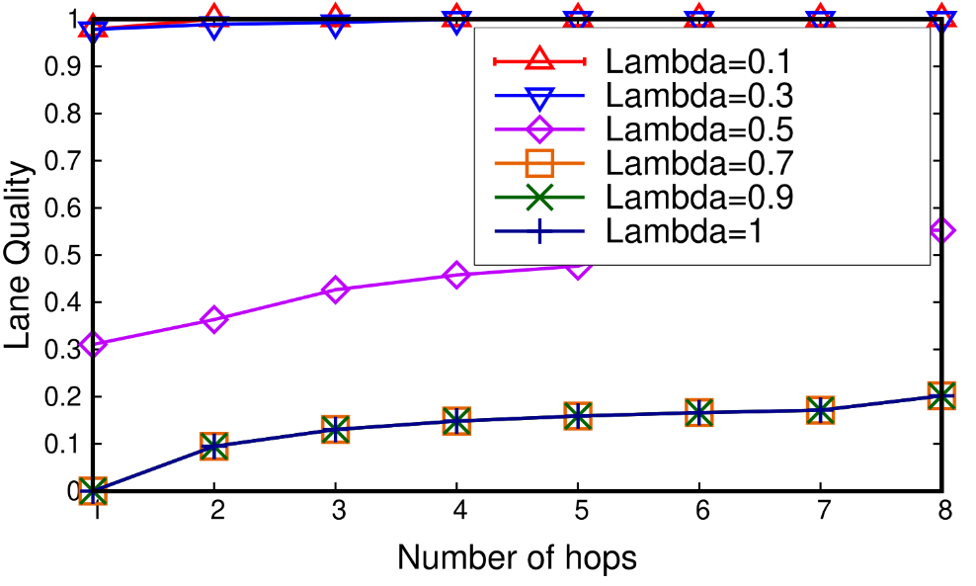
Simulation Results (1/4)
Lane quality validation
The risk of collision is high if the CNP assesses the risk only to its neighbors.
The greater the number of vehicles in the lane that are considered by the risk assessment is, the lower the risk of collision is.
A small number of vehicles in the CNP risk assessment will result in poor safe lane quality.

Slide 7
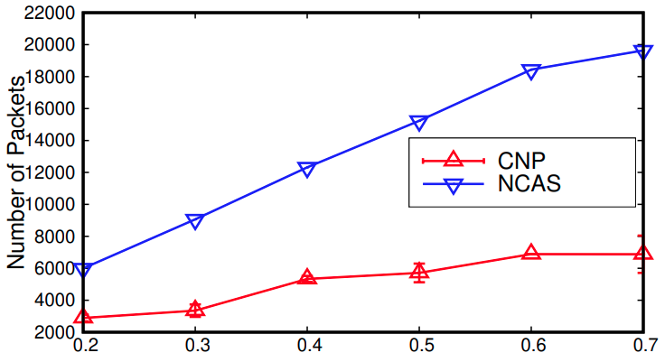
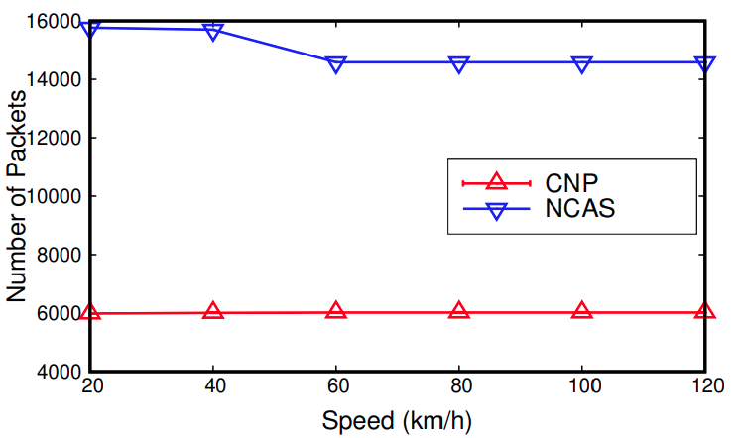
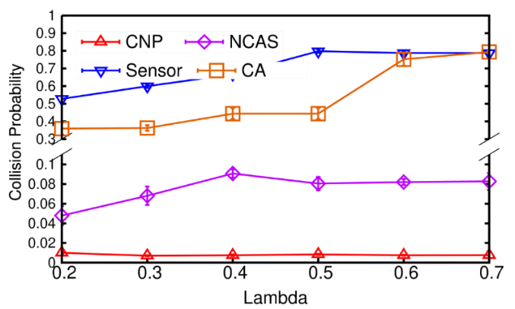
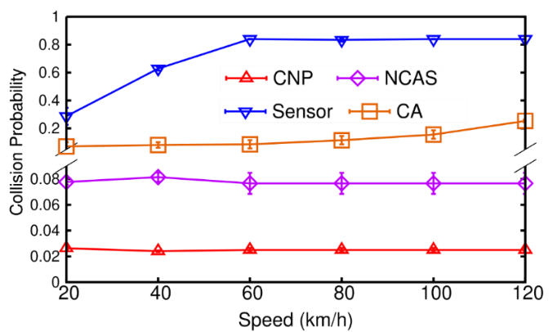
Simulation Results (2/4)
Overhead & Collision Probability of CAP, NCAS and Sensors
Overhead
CNP reduces 15-60% of communication overhead caused by NCAS (Average Speed =80km/h)
It also reduces up to 60% of communication overhead (Lambda = 0.6)
Collision Probability
CNP has the minimal collision risk on average either considering road arrival rates or speeds
Notes:
Both CNP and NCAS are communication-based mechanisms to avoid crashes in vehicular networks. Unlike NCAS, CNP uses a coordinated communication protocol and CH is the orchestrator of the remaining CMs’ maneuvers. Fig. 8(a) shows the evaluation of communication overhead in a vehicular networks wherein vehicles drive at 80km/h and are injected at injection rate λ ∈ [0.2 0.8]. The results show that CNP reduces the communication overhead caused by NCAS from 15% to 60%.
Fig. 8(b) shows an overhead comparison figure where vehicles drive with maximum speeds varying from 20 to 140km/h while maintaining an injection rate of 0.6. The results shows that CNP reduces the overhead caused by the NCAS communication control by up to 60%.

Slide 8
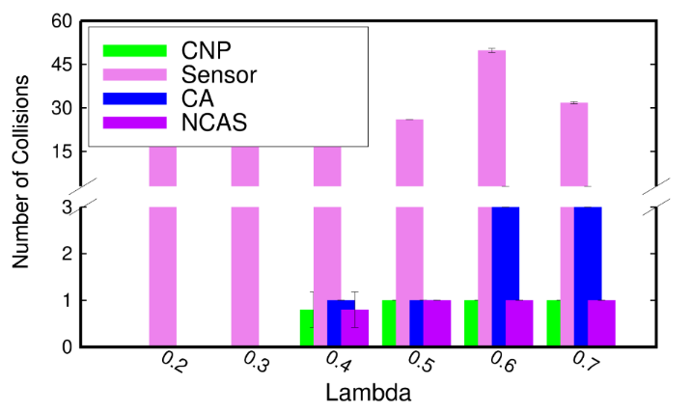
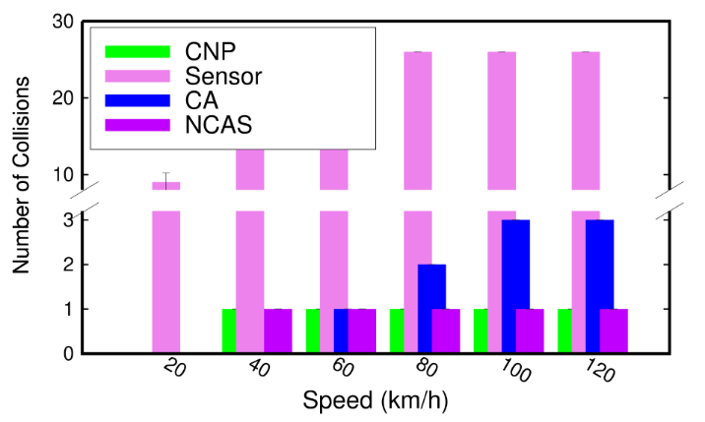
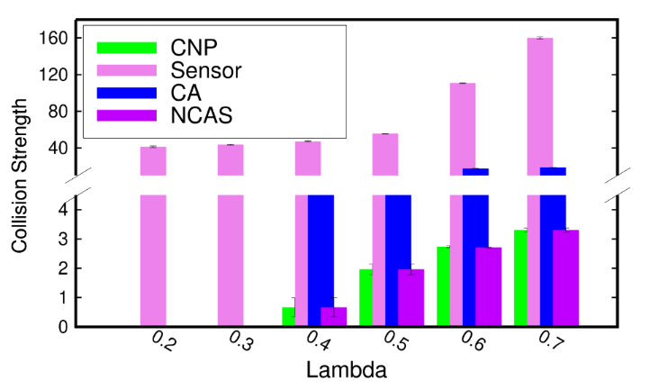
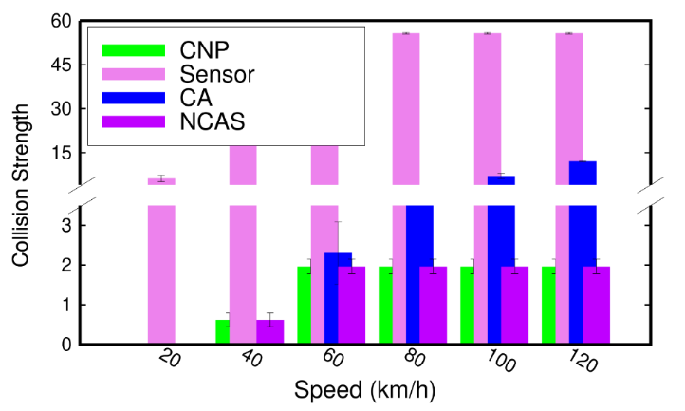
Simulation Results (3/4)
Number and strength of collisions for CAP, NCAS and Sensors
Number of Collisions
CNP has the smallest number of collisions either when we considering road arrival rates or speeds
Collision Strength
The collision strength is the smallest in CNP, resulting in small damage of colliding vehicles for both road arrival rates and speeds.

Slide 9
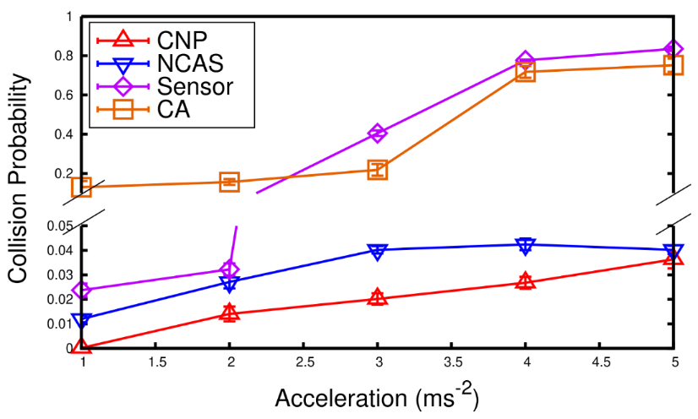
Simulation Results (4/4)
Impact of Acceleration
Collision Probability
CNP has the minimal collision risk on average for all the accelerations tested.

