Slide 1

IETF-117 IPMON Hackathon Project
IPMON Side Meeting
July 22~23, 2023
Champion: Jaehoon (Paul) Jeong
Presenter: Hyeonah Jung
Members: Junhee Kwon and Bien Aime Mugabarigira
Department of Computer Science and Engineering at SKKU
Email: {pauljeong, hyeonah214, juun9714, bienaime}@skku.edu
Notes:
Hello every one my name is junhee kwon and I’ll present about our hackathon project for this ietf 116. IPMON is the next team of the IPWAVE Working group. By the way, IPWAVE problem statement has been published as RFC this month.
For this hackathon, we implemented the Network and mobility communication on OMNET simulation.

Slide 2
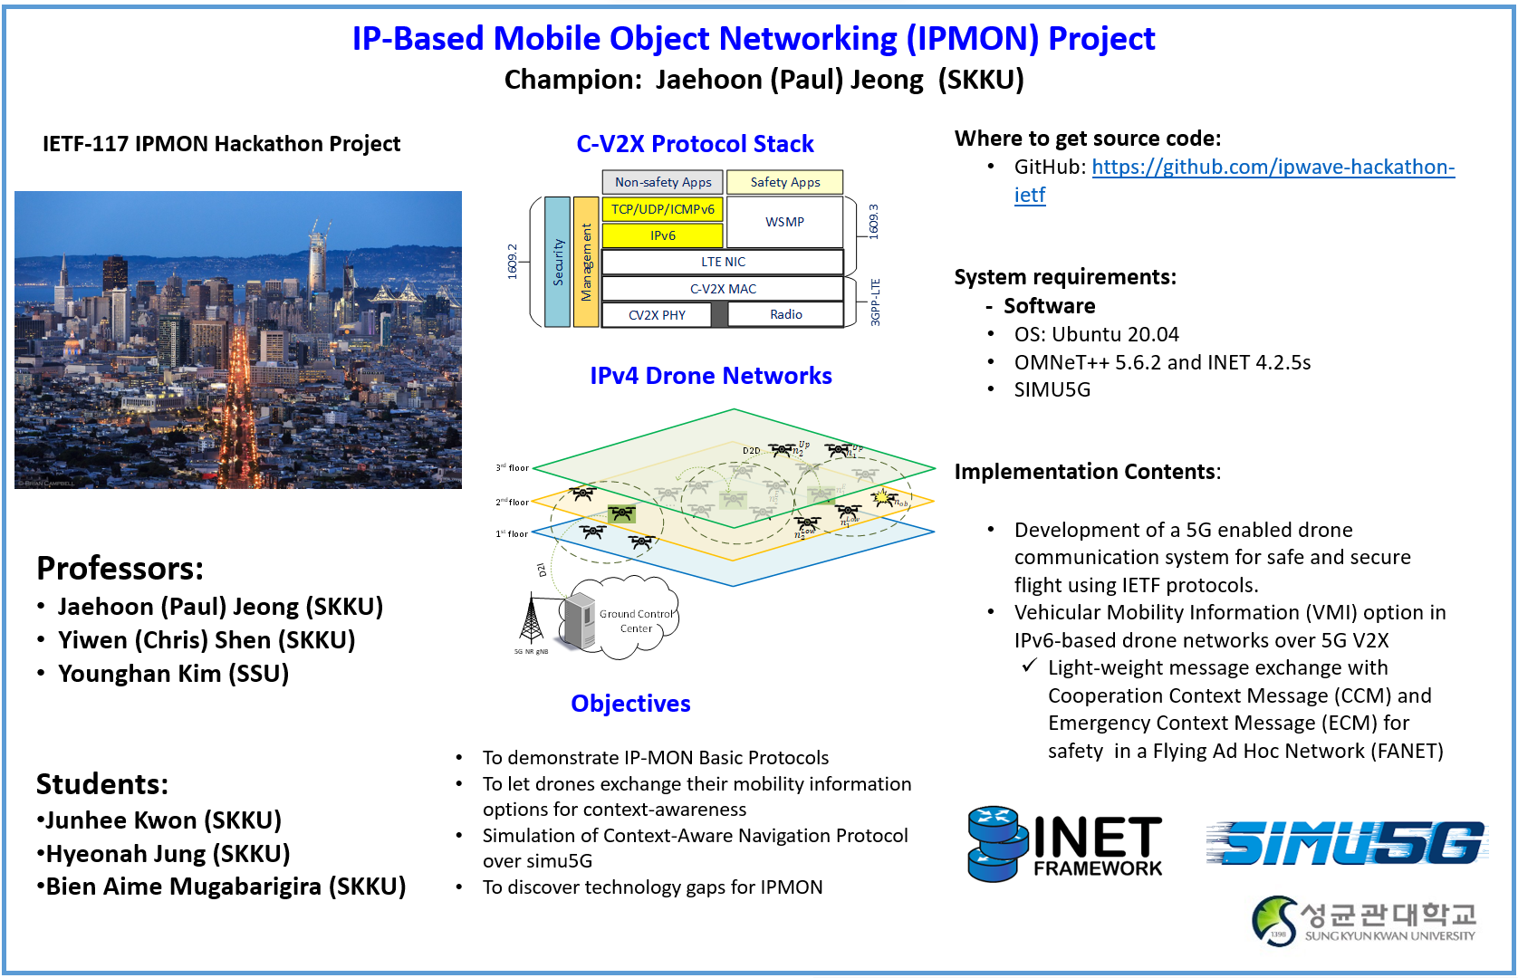
Notes:
This is our poster

Slide 3
Hackathon Plan
Drafts for the IP-Based Mobile Object Networking (IPMON) Project
https://datatracker.ietf.org/doc/draft-jeong-6man-ipmon-problem-statement/
https://datatracker.ietf.org/doc/draft-jeong-6man-ipv6-over-5g-v2x/
https://datatracker.ietf.org/doc/draft-jeong-ipwave-context-aware-navigator/
Simulation
To simulate an efficient 5G-based drone networks suitable for safety drone flight.
To extend the Simu5G infrastructure by deploying the gNodeBs along with a Ground Control System (GCS).
Support of Drone to Drone (D2D) and Drone to Infrastructure (D2I) Communications.
Simulation of a Lightweight Vehicle Mobility Information (VMI) Exchange for Safe Drone Flight:
Cooperation Context Message (CCM) for mobility information exchange.
Emergency Context Message (ECM) for rapid hazardous information sharing.

Slide 4
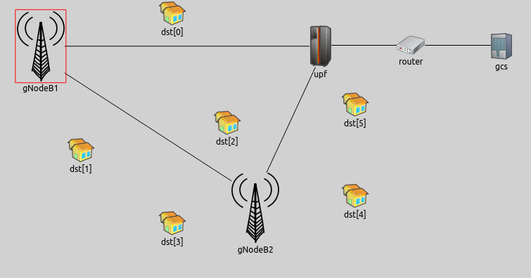
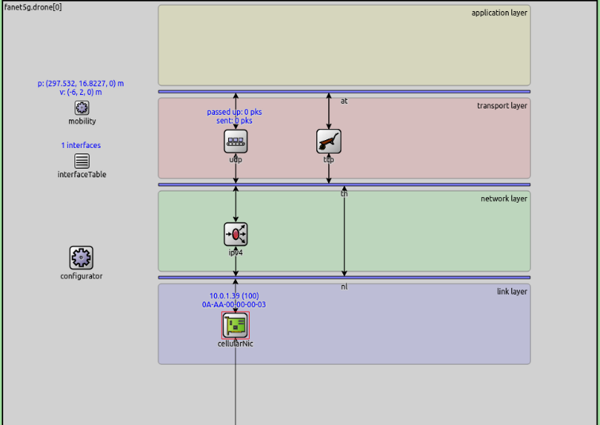



What got done (1/2)
VMI Options: CCM & ECM
exchange built in application layer
OMNeT++
A 5G drone protocol stack structure

Slide 5
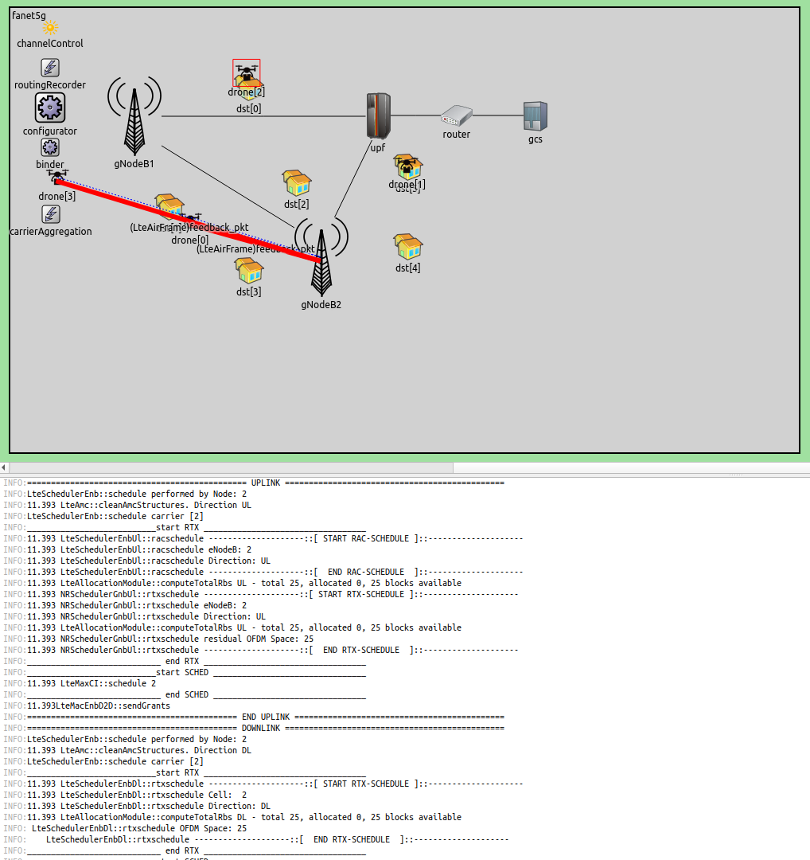
What got done (2/2)
Simulation implementation of 5G-based safe drone networks through:
Exchange of Cooperation Context Message (CCM) via D2X.
Exchange of Emergency Context Message (ECM) via D2X.

Slide 6
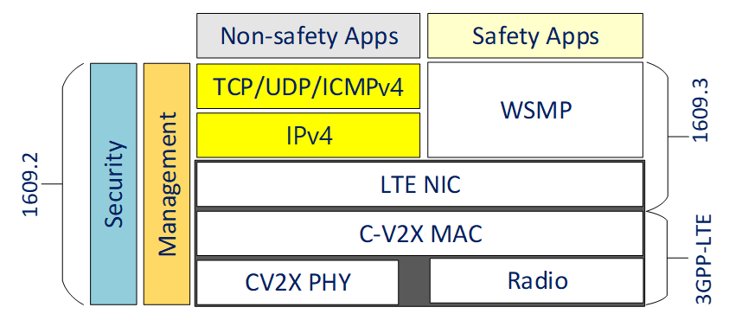
What we learned
Through safety App on top of UDP in a 5G protocol stack, safe messages like CCM can be shared among drones in drone networks with IPv4 over 5G V2X.
A 5G Cellular Infrastructure can be used to handle safety message communication in a complex drone networks.
CCM messages can be used for sharing drone mobility information through application layer over UDP/IPv4/5G-V2X.

Slide 7
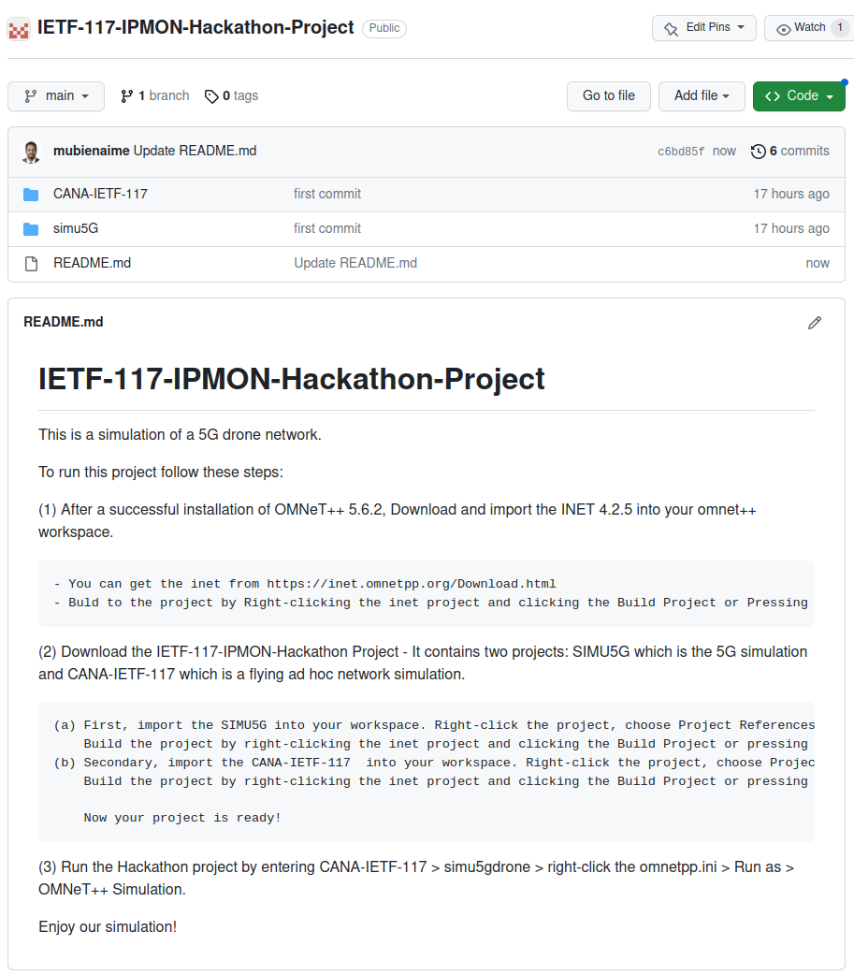
Open Source Project at Github
URL: https://github.com/ipwave-hackathon-ietf/IETF-117-IPMON-Hackathon-Project

Slide 8
Demonstration Video Clip at YouTube
URL:https://youtu.be/wJrh3LsIF44

Slide 9
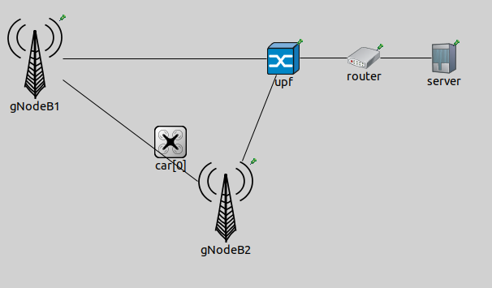
Next Step
We will implement an IPv6-based 5G drone networking in IETF-118.
We will implement the CCM and ECM as ICMPv6 Neighbor Discovery options with IPv6 over 5G V2X.

Slide 10
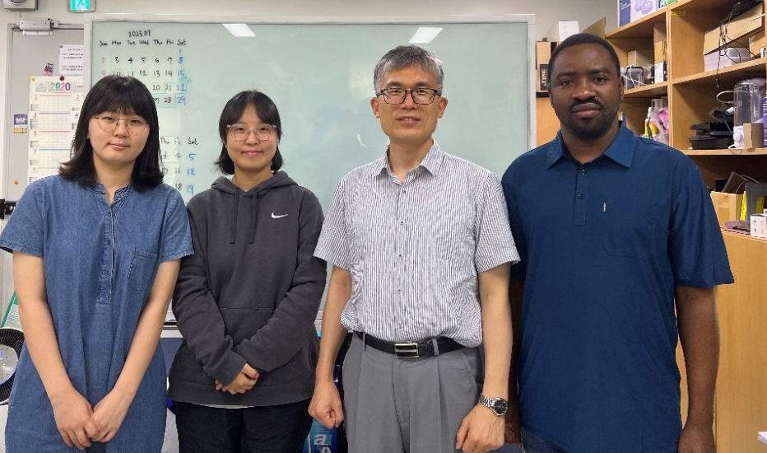
Wrap Up
Hackathon Team
Champion:
Jaehoon (Paul) Jeong (SKKU)
Professors:
Yiwen (Chris) Shen (SKKU)
Younghan Kim (SSU)
Students:
Junhee Kwon (SKKU)
Hyeonah Jung (SKKU)
Bien Aime Mugabarigira (SKKU)
Hackathon Team Photo

Slide 11
Appendix
Simulation Environment
Configuration
Running Simulation

Slide 12
Simulation Environment
OS: Ubuntu 16.04
Simulators:
OMNeT++ 6.0
GNU GCC 5.4
Open Sources:
https:https://github.com/ipwave-hackathon-ietf/IETF-117-IPMON-Hackathon-Project

Slide 13
Configuration
Install OMNeT++ following the procedure in the installation manual: https://doc.omnetpp.org/omnetpp/InstallGuide.pdf
Import projects in OMNeT++ workspace
Import SIMU5G into your workspace.
Right click the project, choose Project References, tick the inet, and click apply and close.
Build the project by Right clicking the inet project and clicking the Build Project or Pressing the Ctrl + B.
Import the CANA-IETF-117 into your workspace.
Right click the project, choose Project References, tick the inet and simu5G, and click apply and close.
Build the project by Right clicking the inet project Band clicking the Build Project or Pressing the Ctrl + B.

Slide 14
Running Simulation
Run the Hackathon Project by entering the following:
CANA-IETF-117 > simu5gdrone
right click the omnetpp.ini > Run as > OMNeT++ Simulation

