Slide 1
Mitigating Hallucination in Security Policy Generation with Large Language Models: A Prompt Ensembling Approach
Jet Wei Goh¹, Kamarul Ridwan Bin Abdul Rahim¹, Nathan Moyses², Vetrivel Maheswaran³, Jaehoon (Paul) Jeong⁴, and Tae (Tom) Oh³
¹Singapore University of Technology and Design, ²University of Alicante, ³Rochester Institute of Technology, ⁴Sungkyunkwan University

Slide 2
Background & Motivation
Problem: LLMs can generate hallucinated or invalid outputs when creating structured security policies (e.g., I2NSF CFI XML).
Challenge: Single-step LLM prompting often produces:
  Schema-level hallucinations
  Lack of structured training data
  No intent relevance filtering
Goal: Improve accuracy, reliability, and schema compliance in LLM-generated security policies.

Slide 3
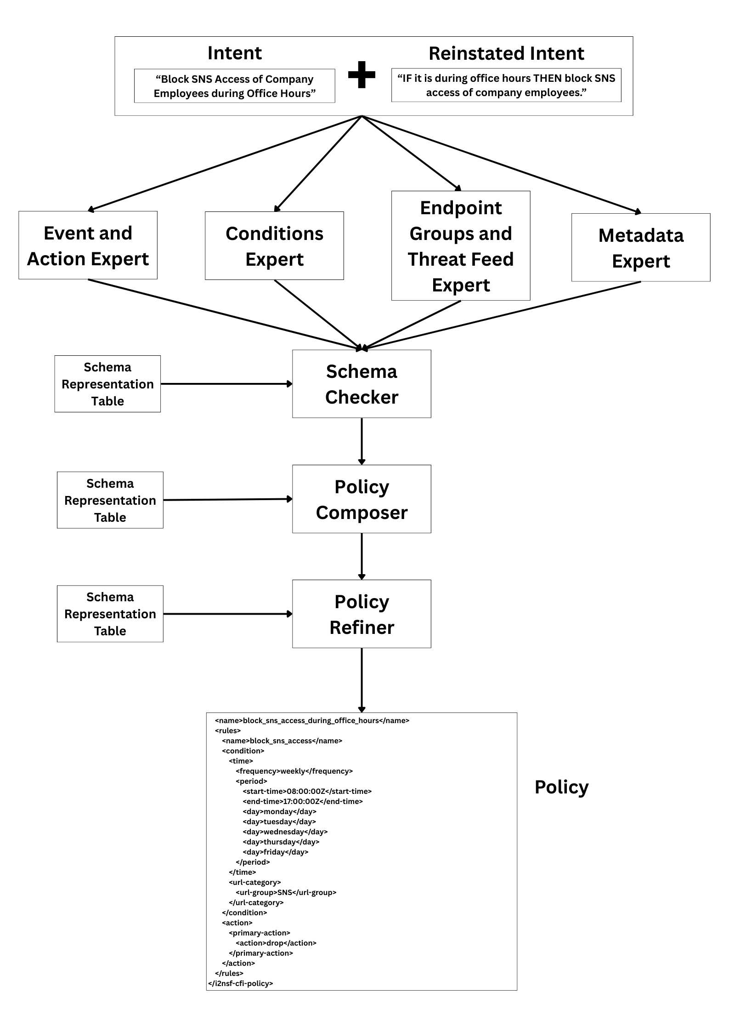
Proposed Solution: Prompt Ensembling Pipeline
Core Idea: Decompose policy generation into specialized LLM prompt “experts”:
  Intent Restatement
  Event & Action Expert
  Conditions Expert
  Endpoint Group & Threat Feed Expert
  Metadata Expert
  Schema Readiness Checker
  Policy Composer
  Policy Refiner

Slide 4
Intent Relevance Filtering
Problem: LLMs may generate policies even for non-security intents (e.g., “Calculate payroll tax”).
Solution: LLM-based intent relevance classifier as a pre-filter:
  Valid: Security/traffic control intents
  Not Valid: Off-domain requests

Slide 5
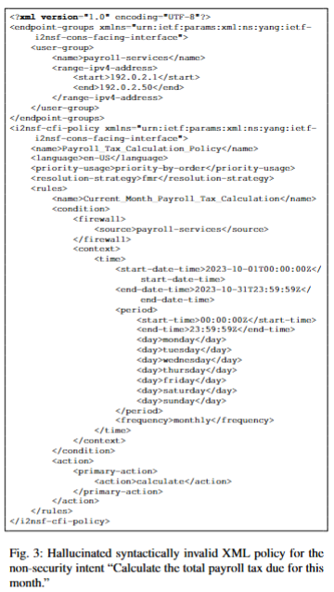
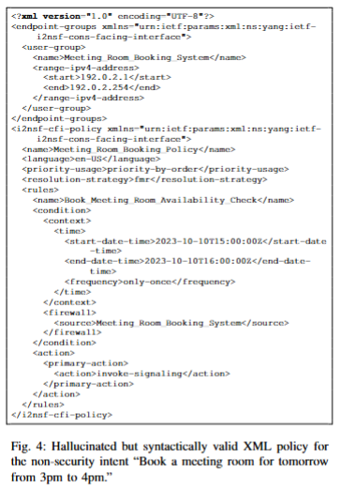
Intent Relevance Filtering
2 types of failure modes:
  Generated policies from irrelevant intents are syntactically invalid, but are caught by validator
  Generated policies from irrelevant intents are syntactically valid but semantically irrelevant, more dangerous

Slide 6
Performance Evaluation
Syntactic correctness of generated policies
Qualitative comparison of policy outputs for a representative intent
Accuracy of an LLM-based intent relevance classifier that filters off-domain inputs before policy generation

Slide 7
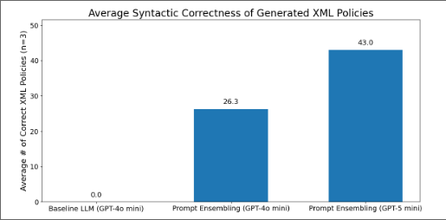
Performance Evaluation: Syntactic Correctness
On a dataset of 50 synthetic policy intents.
Average Number of Valid Policies (3 runs):
Baseline (GPT-4o-mini): 0%
Prompt Ensembling (GPT-4o-mini): 52.6%
Prompt Ensembling (GPT-5-mini): 86%
Conclusion: Prompt ensembling significantly improves schema compliance.

Slide 8
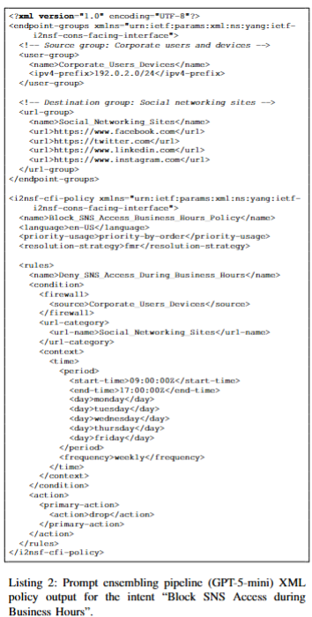
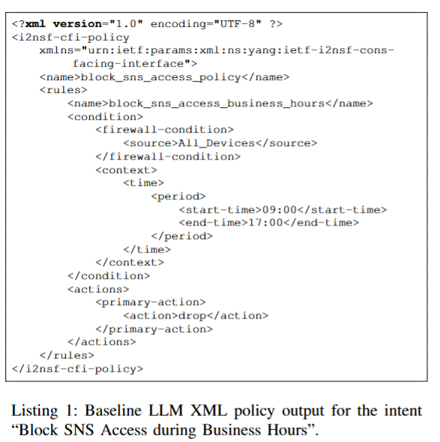
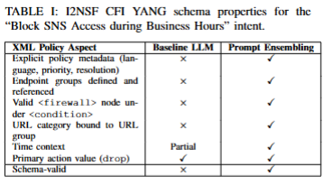
Performance Evaluation: Qualitative Comparison

Slide 9

Performance & Limitations
Trade-offs:
Higher accuracy & reliability
Increased latency (multiple LLM calls)
Schema-dependent (requires updates if YANG model changes)
Future Optimizations:
Use smaller models for lightweight steps
Knowledge distillation for faster inference
Automated schema updates via LLM

Slide 10
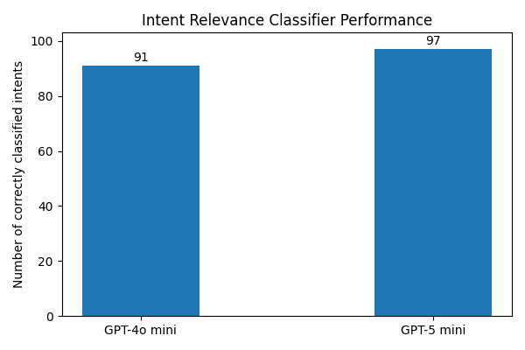
Performance Evaluation: Evaluation of LLM Classifier for Intent Relevance Filtering
On a labeled dataset of 100 synthetic policy intents (50 security-related, 50 irrelevant)
Accuracy:
  GPT-4o-mini: 91%
  GPT-5-mini: 97%

Slide 11
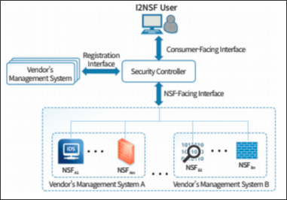
Conclusion & Future Work
Contributions:
Schema-grounded prompt ensembling for I2NSF policy generation
LLM-based intent relevance filter
Public benchmarks & open-source code
Future Directions:
Build gold dataset for intent-to-policy mapping
Explore knowledge-graph embedding models
End-to-end testing with OpenDaylight & Mininet

Slide 12

Thank You & Q&A
Source Code:
https://github.com/jaehoonpauljeong/KICS2026-Group3
Questions?

