Slide 1
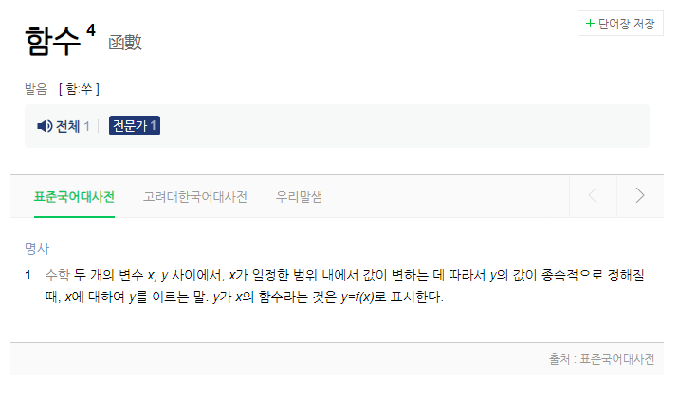

Slide 2
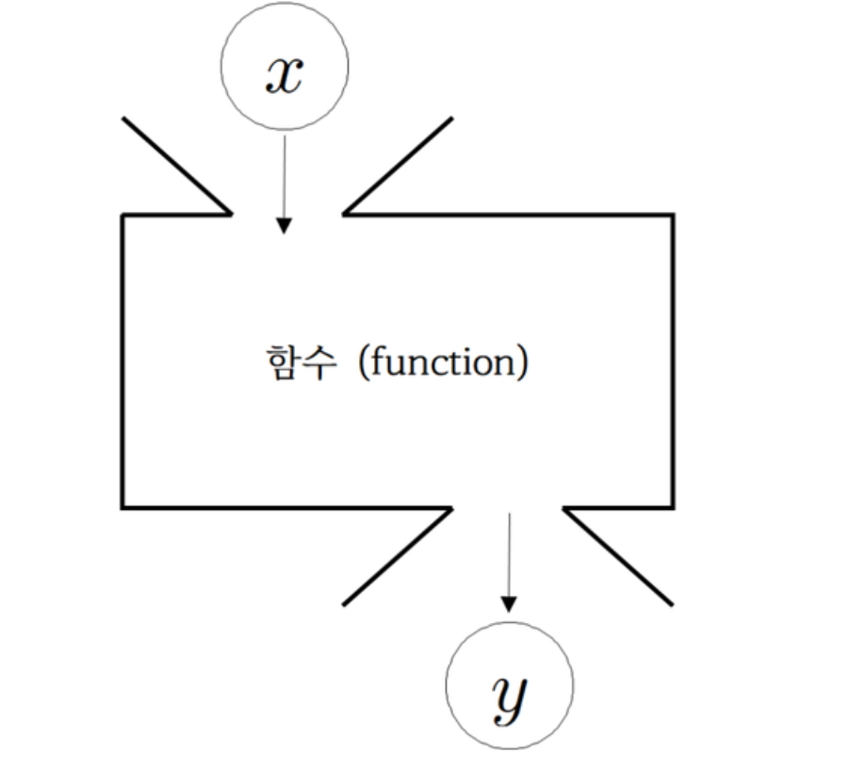
y = f(x)

Slide 3
x = 2, y = 4
x = 3, y = 9
x = 4, y = 16
x = 5, y = 25

Slide 4
x = [1, 2, 3, 4, 5, 6, 7, 8, 9, 10]
y = 55

Slide 5




Slide 6
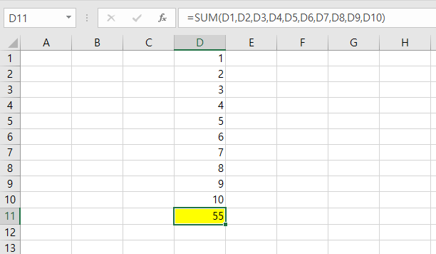

Slide 7
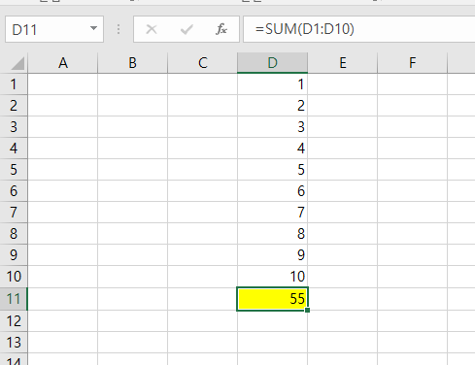

Slide 8
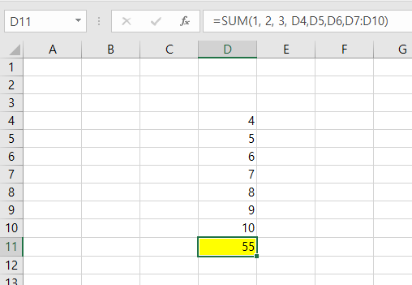

Slide 9

1, 2, 3 15 34

Slide 10
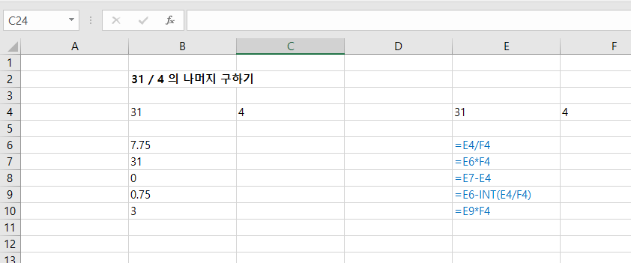

Slide 11
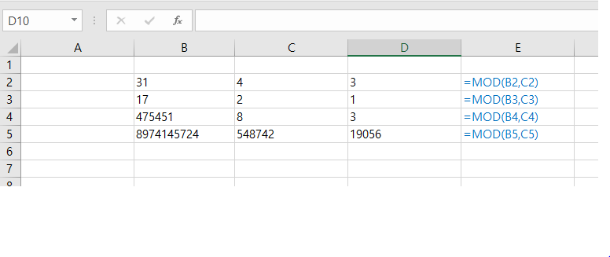

Slide 12
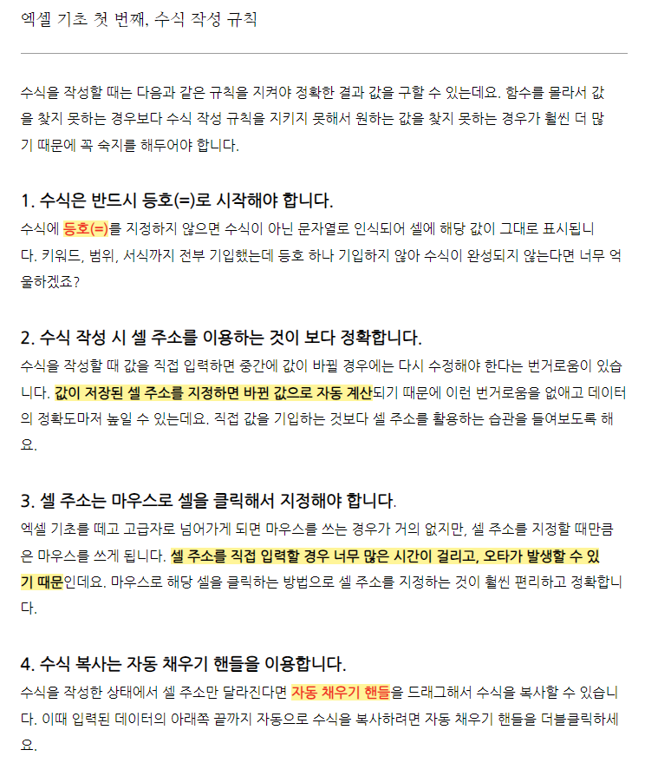

Slide 13
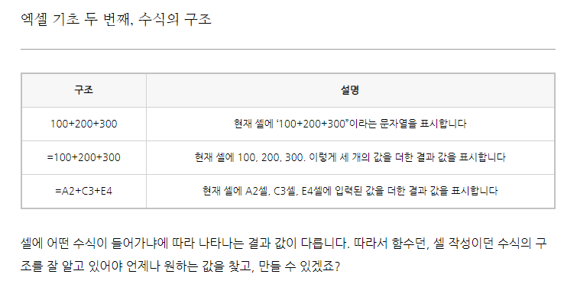

Slide 14
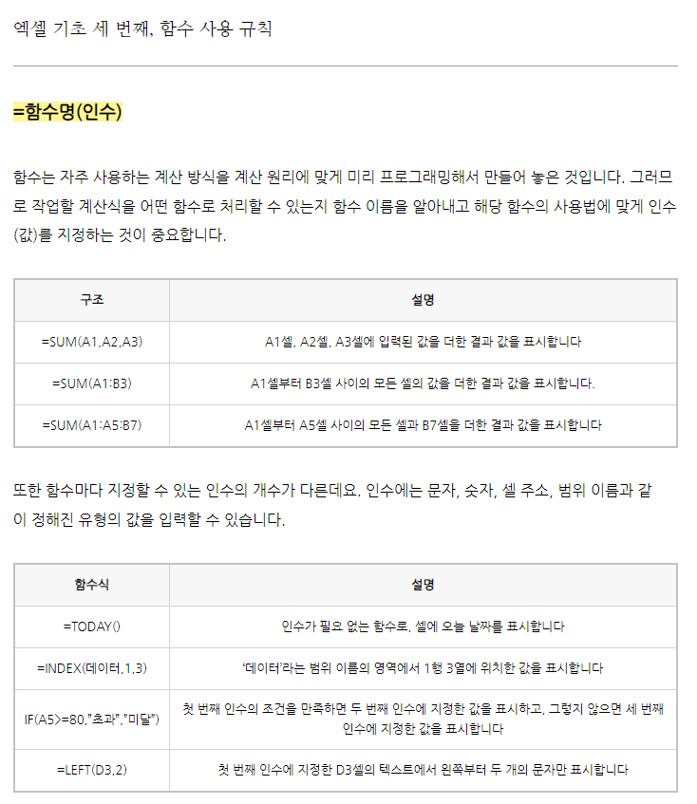

Slide 15
