Slide 1
Generative Adversarial Nets
2017.12.17.

Slide 2
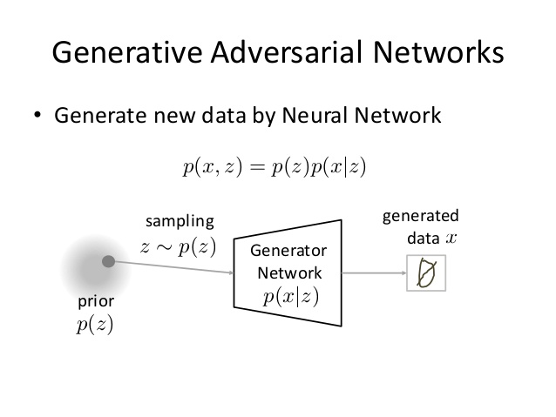
https://www.slideshare.net/ckmarkohchang/generative-adversarial-networks

Slide 3


Slide 4
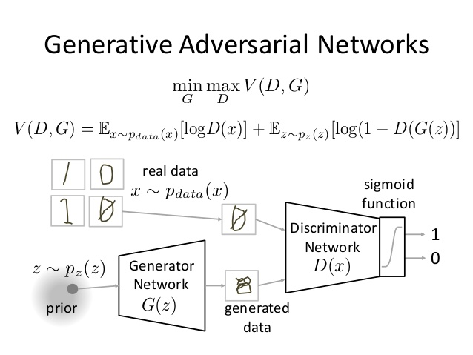

Slide 5
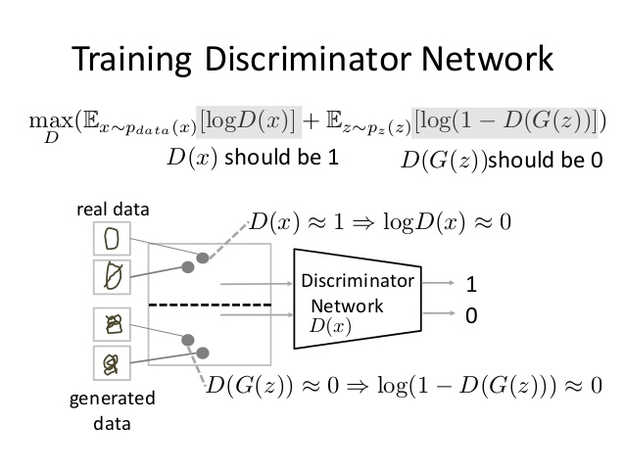

Slide 6
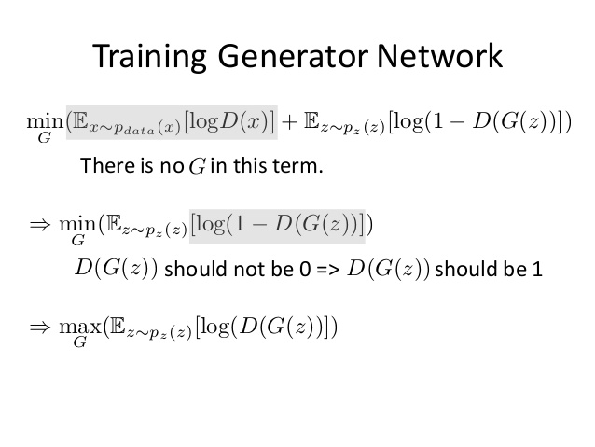

Slide 7
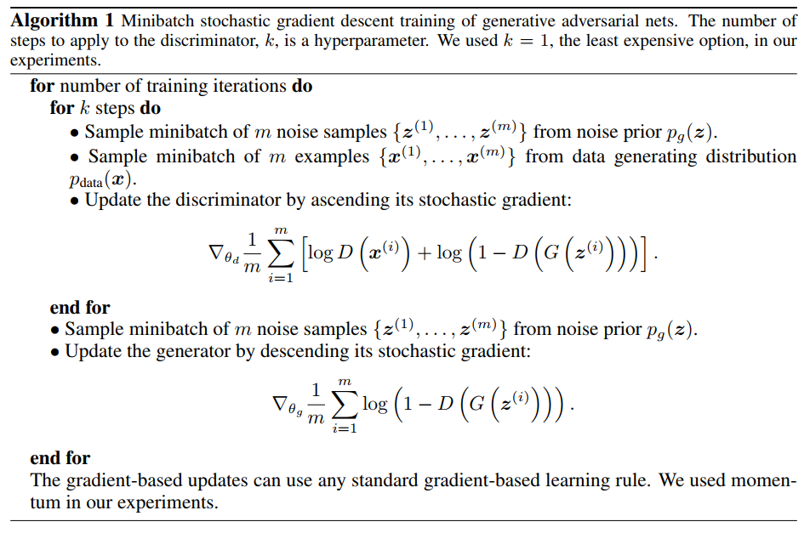

Slide 8
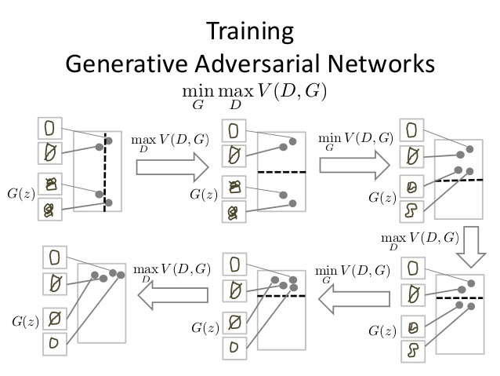

Slide 9
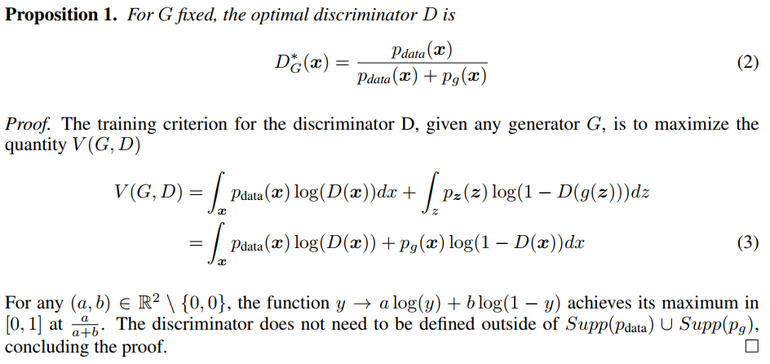

Slide 10
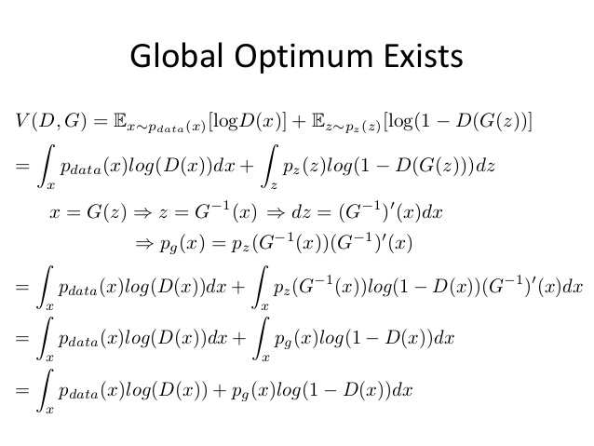

Slide 11


Slide 12
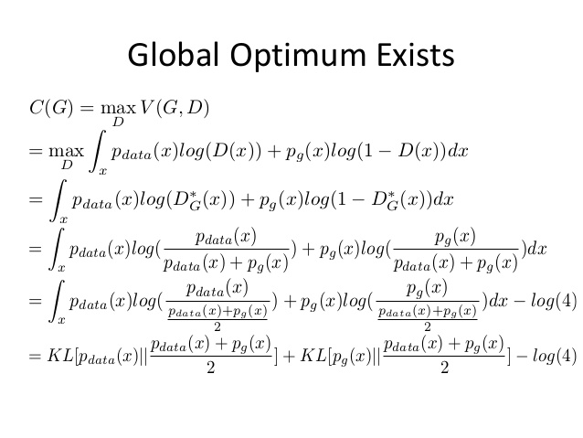

Slide 13
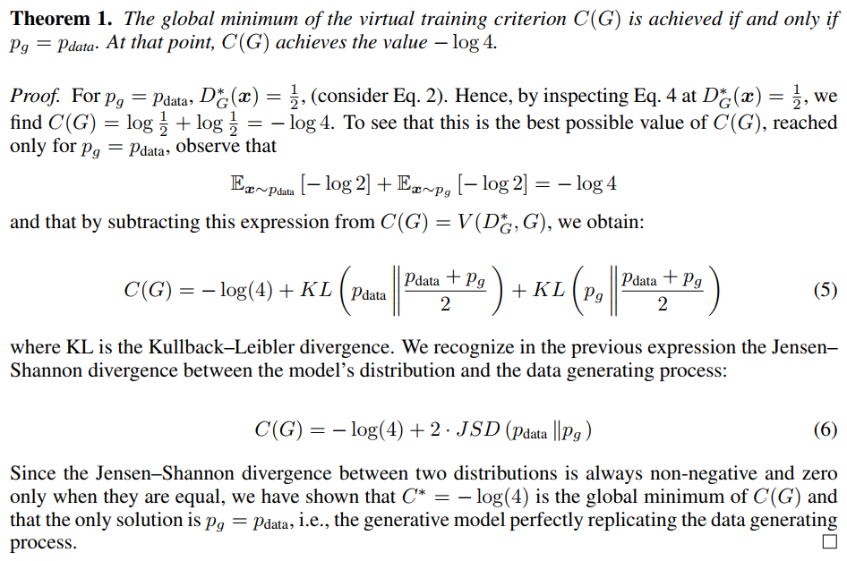

Slide 15

http://blog.aylien.com/introduction-generative-adversarial-networks-code-tensorflow/

