Slide 1
LSTMP
2018.01.21.

Slide 2
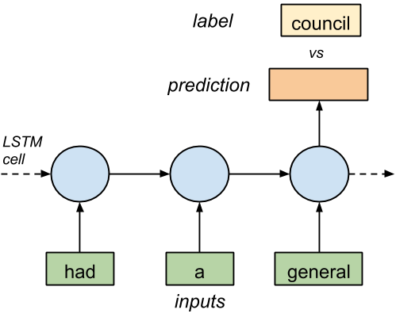

Slide 3


Slide 4
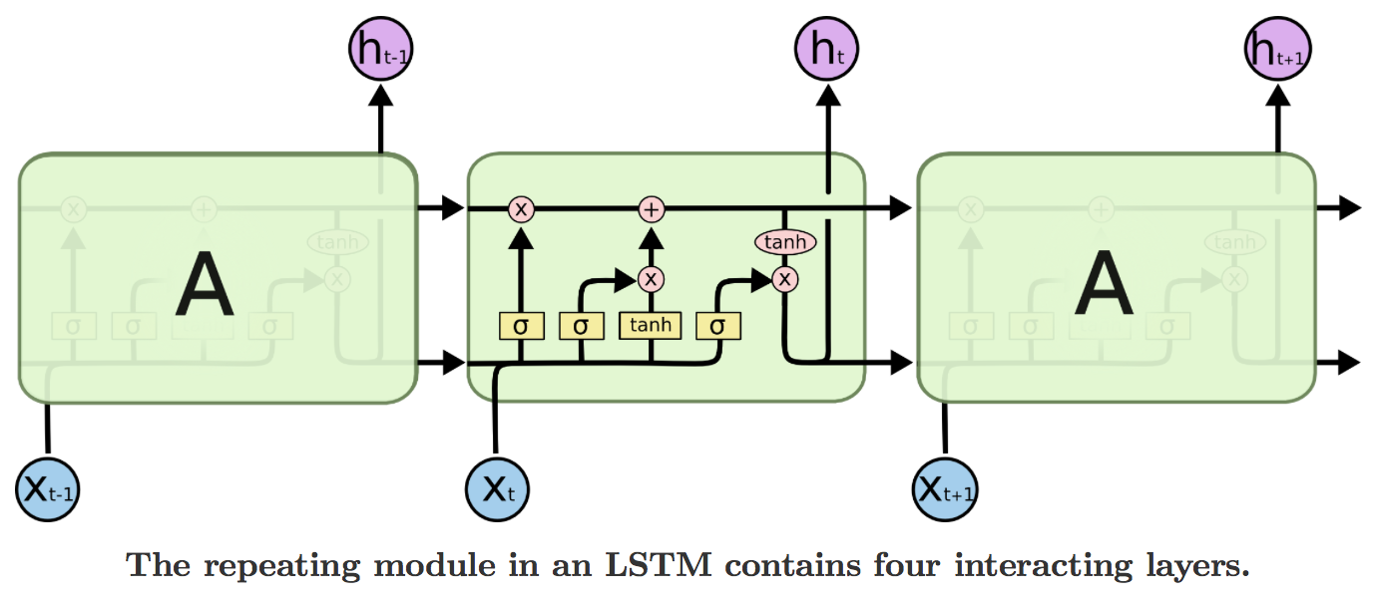

Slide 5
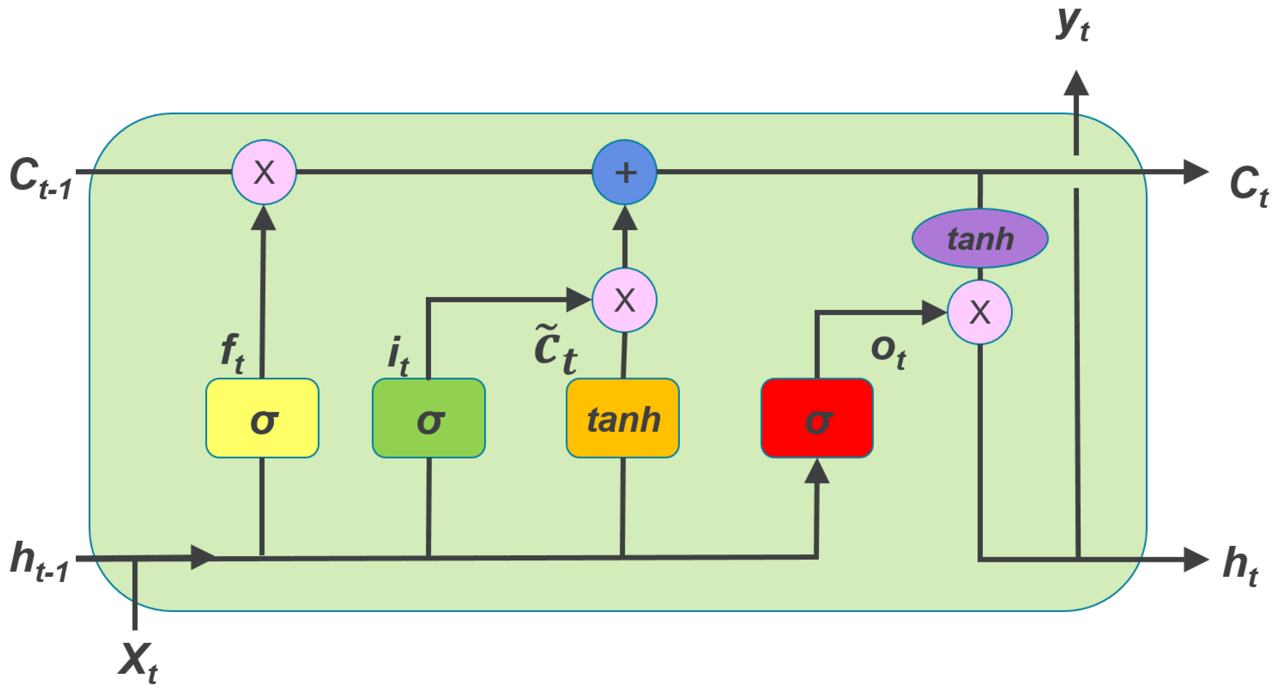
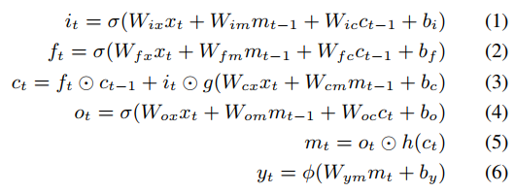

Slide 6
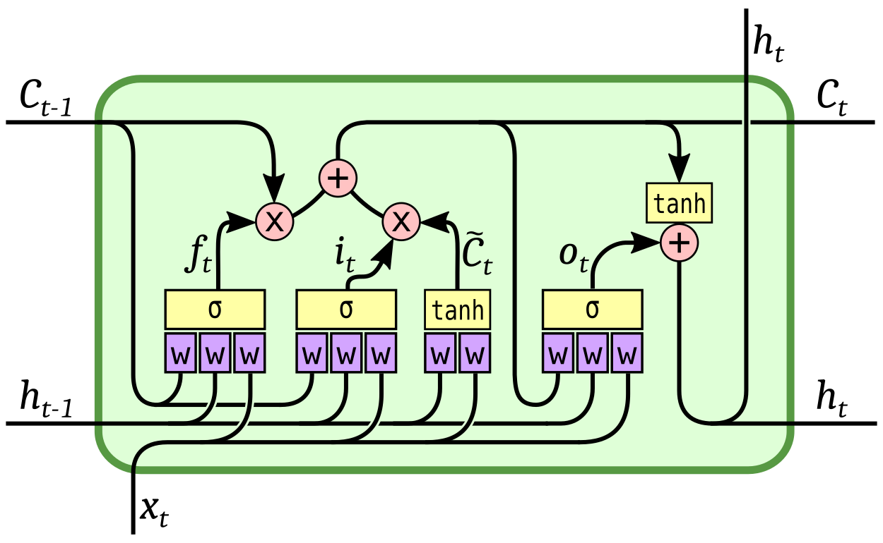
Mt
Mt-1
Mt

Slide 7
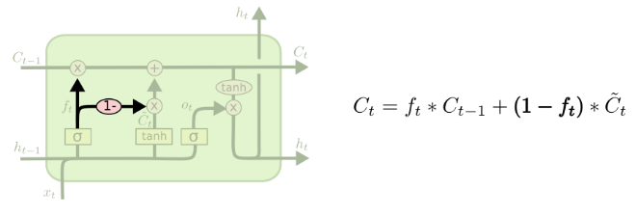

Slide 8
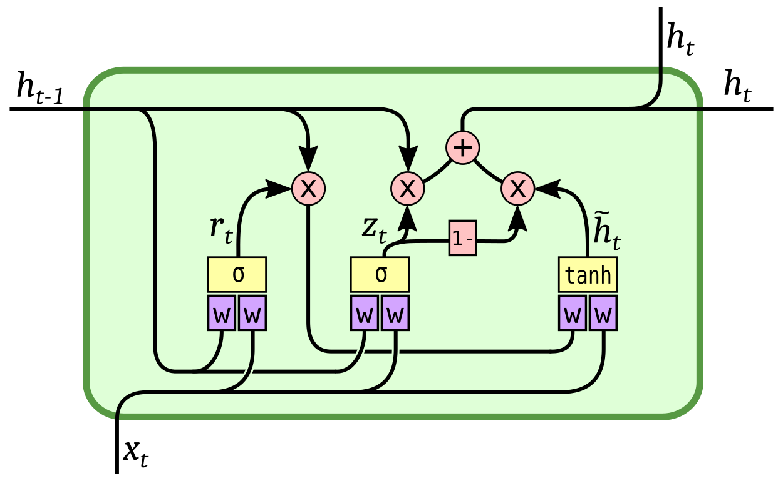

Slide 9
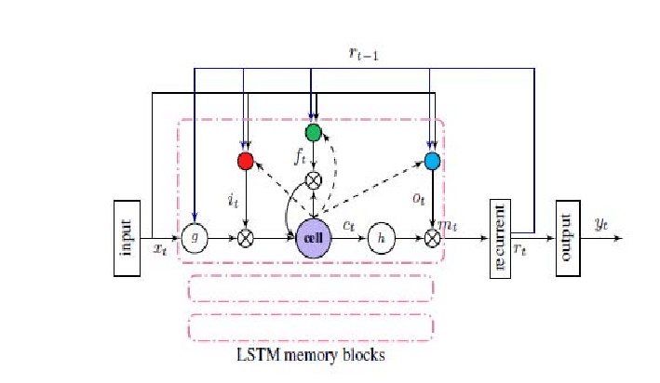

Slide 10
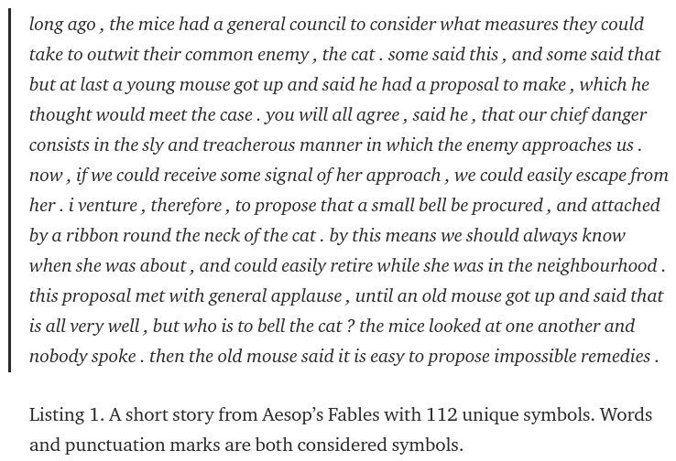
https://towardsdatascience.com/lstm-by-example-using-tensorflow-feb0c1968537
https://github.com/aymericdamien/TensorFlow-Examples/blob/master/examples/3_NeuralNetworks/recurrent_network.py

Slide 11
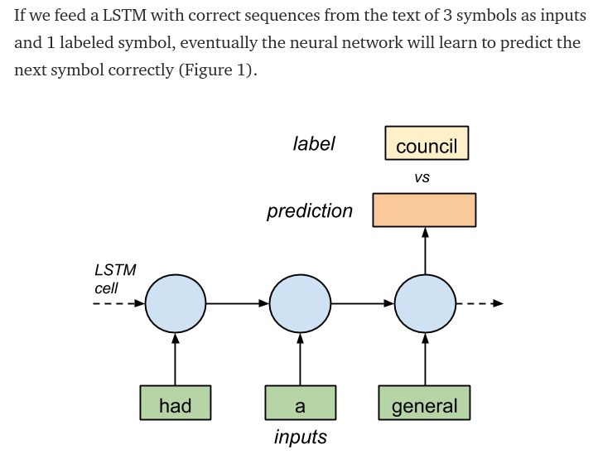

Slide 12
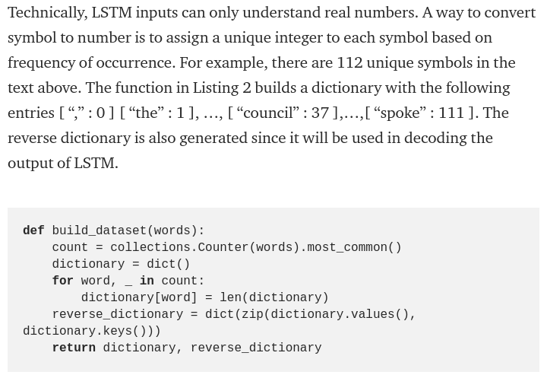

Slide 13
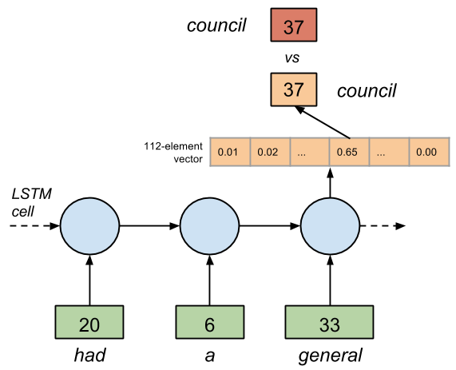

Slide 14
