Slide 1
MS-UCG #2: Concepts, algorithms, and force checking by hands
January 22, 2016
Jaehyeok Jin

Slide 2
Brief review: MS-UCG #2
1. Parameter & Variable
2. Technical notes
- Full-neighbor list implementation & double-checking
- No newton-pair for the system
3. Current MS-UCG #2 algorithm
4. Force component checking
- System description
- MATLAB codes (by hands)
- LAMMPS simulations
- Changes in LAMMPS code & reasoning

Slide 3
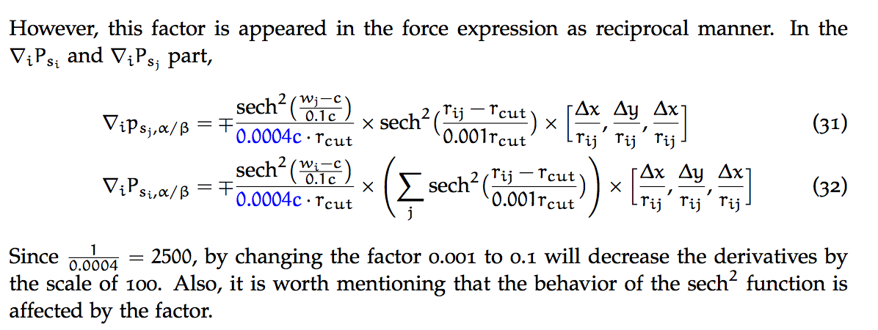
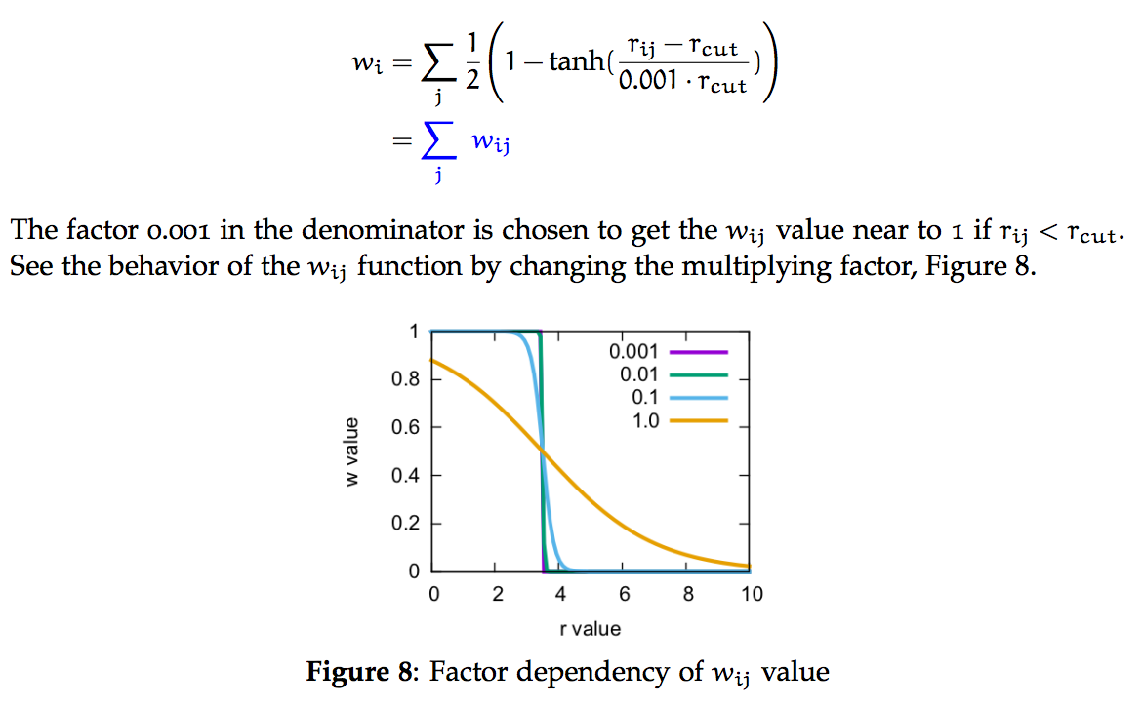
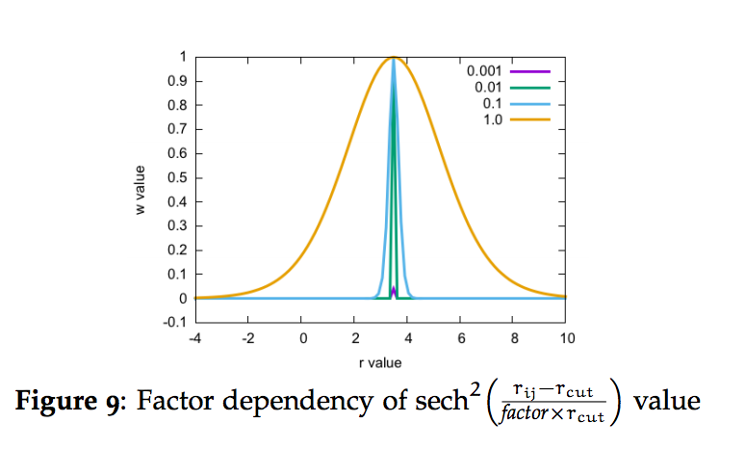
Changes in parameters
Parameters & Variables
Why 0.001 to 0.1?
Previous version
Current version

Slide 4
Parameters & Variables
Number function
Pre-determined value
Probability Value
Defined probability
Derivatives of probability: we need two different derivatives of probability
← Condition: j ∈ N(i,lj_{cut}), which means j is i’s neighbor.

Slide 5
Changes from MS-UCG #1 code
1. Enabling the full neighbor-list (default in LAMMPS is half neighbor-list)
→ We cannot use half neighbor-list because we have to consider all of neighbor’s neighbors and we need to turn off newton pair.
2. Turning off the newton pair (default in LAMMPS is turned on)
→ Since we have to consider the interactions among all possible i-j-k pairs, turning off newton pair gives feasible way to implement/check each force component.
Note) MS-UCG #1 and #2 codes are based on pair_lj_cut.cpp & .h files already in LAMMPS

Slide 6
Technical note: Full neighbor-list implementation
Newton pairs are messy in I, j, k three particle interactions – change from half list to full list is needed despite of its cost.
Changes are followed by in init_style routine.
Since we don’t use the RESPA command, it follows the end of the else loop.
else{ irequest = neighbor->request(this,instance_me); neighbor->requests[irequest]->half=0; neighbor->requests[irequest]->full=1; }

Slide 7
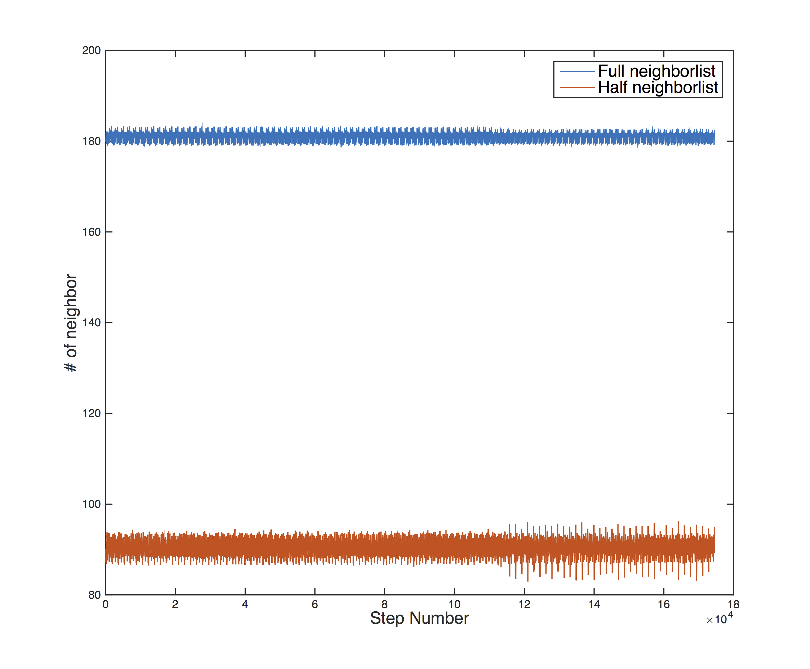
Validation: Full neighbor-list implementation
System description
A system with 1728 LJ particles, with position mixed UCG code(pair_msucg_mix1d.cpp / h)
Calculation detail
Conducted at 300 K with 100 run steps(time_step=1.0) with dumping for each timestep
The data analysis is followed by a moving average treatment: every 100 data set

Slide 8
Force-checking
Modifying previous theory: subforce terms
Considering a double-counting problem
Current Algorithm
Two neighbor loops and routine to calculate probability, and its derivatives
System description
MATLAB implementation (as checking by hands)
LAMMPS calculations with force-checking by MATLAB
Conclusion

Slide 9
Subforce terms
4-(1)
4-(2)
4-(3)

Slide 10
Fourth subforce term: double-counting
Double-counting in 4-(2) & 4-(3) term
Same term (only different order)
Thus one term is vanished because we only consider either j>k or j<k
Thus, let’s only consider 4-(3) term and get rid of 4-(2) term.
(This is efficient because then we can couple this term with the third subforece term)

Slide 11
Current code double-counts i-j1-j2 interactions for following cases
Fourth subforce term: double-counting
Double-counting in 4-(1) term
j2
j1
j1
i
j2
i
has to be changed with

Slide 12
Fourth subforce term: Conclusion
Overall fourth subforce term in changed LAMMPS code
4-(1) term, f₄⁽¹⁾
4-(3) term, f₄⁽³⁾

Slide 13
Current code algorithm
Second neighbor loop (Force Routine)
for i
for j ∈ N(i;ljcut)
Calculating 2 subforce(averaged lj force)
-> Updating energy(ev_tally)
Calculating 3 subforce
for k ∈ N(i;2.0 X ljcut)
if r(j-k) < ljcut(i.e. k ∈ N(j;ljcut))
if ik < ljcut
Calculating 4-(1) subforce
else(ik > ljcut)
Calculating 4-(3) subforce
Probability Routine
P(state, *x[i], ff[0], W[i], *dW[i], single)
First neighbor loop
Get P
for i
for j ∈ N(i;ljcut)
W value
dW value
Reverse/forward communication
Get P, ∇_{i} p_{i} , ∇_{i} p_{j}
Get P, ∇_{i} p_{i} , ∇_{i} p_{j}
Get P, ∇_{i} p_{i}
Get
W, dW values
Store
W, dW value

Slide 14
Current code algorithm
W value is simply calculated by following equation. Therefore, the probability for each state follows simply too.
First neighbor loop
However, the derivative of probability cannot be calculated simply because it depends on p_{i} or p_{j}
for i
for j ∈ N(i;ljcut)
W value
dW value
Reverse/forward communication
dW[i] value
Different
Thus, P routine (to calculate probability and derivative) in the cpp code has a flag (called int single) to check if it’s a particle i^{th} derivative over p_{i} or p_{j}.
If Single == 1: (∇_{i} p_{i} term)
Return following term (using dW value)
Probability Routine
If Single == 0: (∇_{i} p_{j} term)
Return only following term. Remaining term will be directly calculated in Force routine.
P(state, *x[i], ff[0], W[i], *dW[i], single)

Slide 15
Force checking – System construction
The cell is (32, 32, 32) – cubic
X value: 0 < x < 32
Y value: 0 < y < 32
Z value: 0 < z < 32
This cell size is important to consider the Periodic Boundary Condition (later)
LJ_cutoff : 6.0
<-> LAMMPS cutoff : 12.0 (< 32 * 0.5)
P constant = sigma cutoff = 3.0
i
2.5

Slide 16
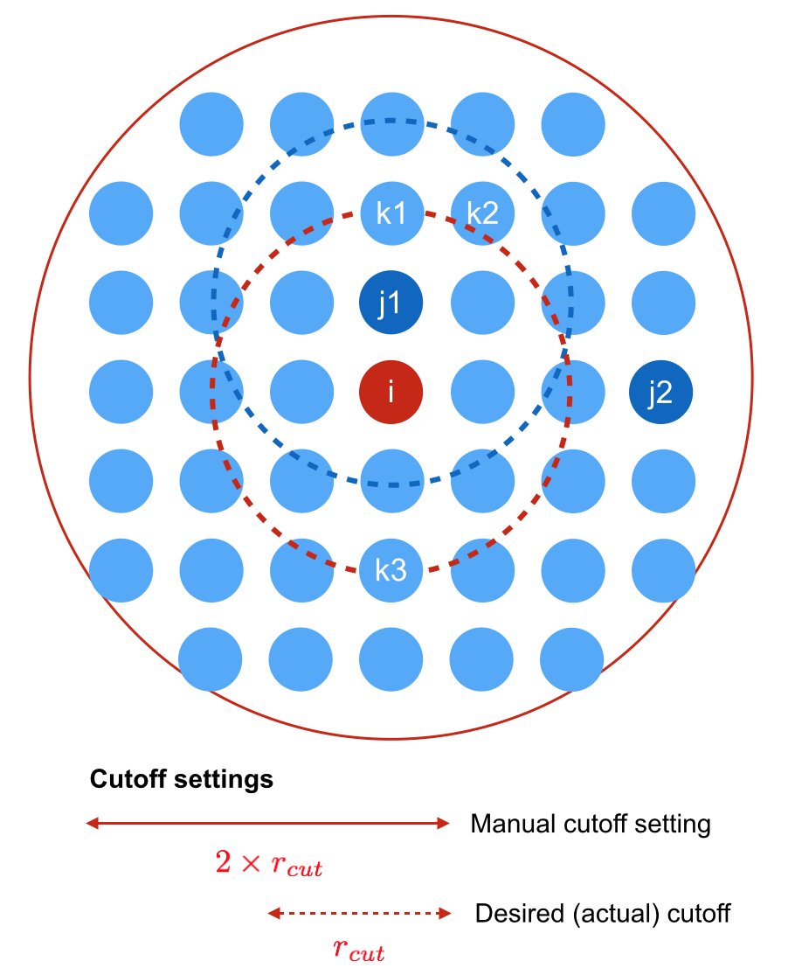
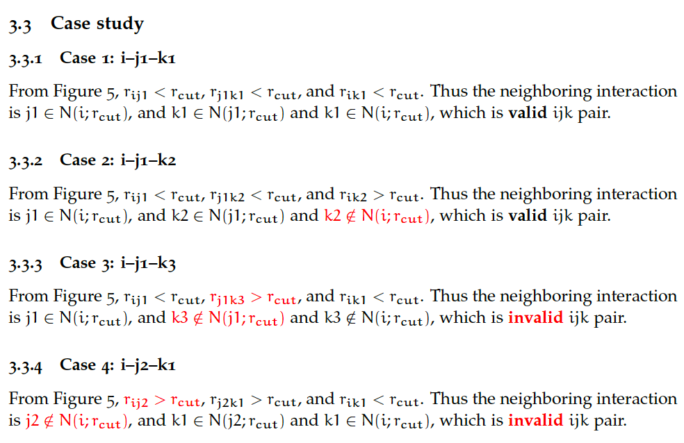
Force checking – Case setting

Slide 17
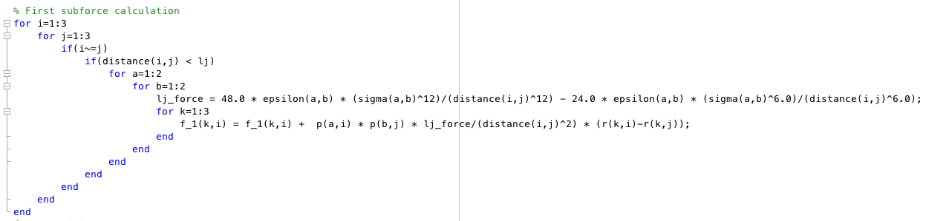
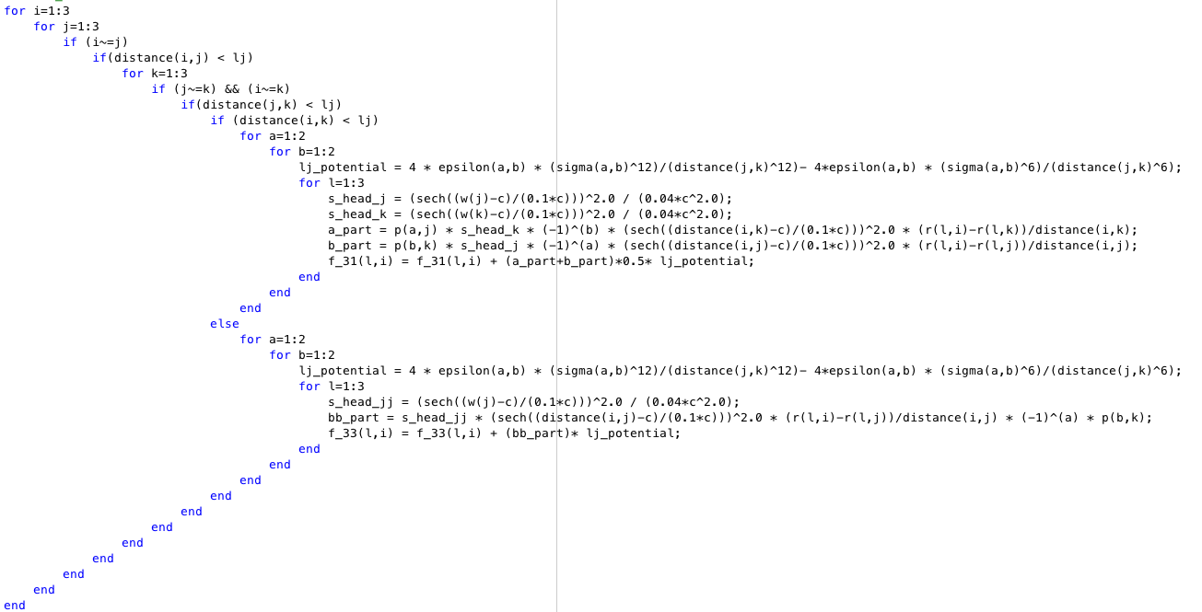
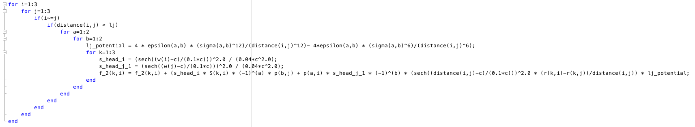
MATLAB code
To check the force components obtained from LAMMPS, I wrote down the MATLAB code to get the force component. (uploaded on Github)
Each subforce term is calculated by separate loops
Also, I checked the probability & its derivative terms with LAMMPS and it matched perfectly.
Second subforce term
Fourth subforce term (4-(1) at first and 4-(3) at last)
Third subforce term

Slide 18
System 1 : Case 1
Positions:
I (0.0, 0.0, 0.0)
J (5.0, 0.0, 0.0)
K (10.0, 0.0, 0.0)
LJ_cut : 6.0
C_value, p_sigma : 3.0
k
j
i
Y
X

Slide 19
Table 1. Force components of System 1 from LAMMPS and MATLAB
(a) Particle i | Force | f₂ | f₃ | f₄
 | component |  |  | f₄⁽¹⁾ | f₄⁽³⁾
 | LAMMPS | (6.3479 X 10⁻³, 0, 0) | (-9.8299 X 10⁻¹⁵, 0, 0) | (-4.9150 X 10⁻¹⁵, 0, 0)
 | MATLAB | (6.3479 X 10⁻³, 0, 0) | (-9.8299 X 10⁻¹⁵, 0, 0) | (0, 0, 0) | (-4.9150 X 10⁻¹⁵, 0, 0)
(b) Particle j | Force | f₂ | f₃ | f₄
 | component |  |  | f₄⁽¹⁾ | f₄⁽³⁾
 | LAMMPS | (-8.6736 X 10⁻¹⁹, 0, 0) | (-7.8886 X 10⁻³¹, 0, 0) | (0, 0, 0)
 | MATLAB | (-867.3617 X 10⁻²¹, 0, 0) | (-788.8609 X 10⁻³³, 0, 0) | (0, 0, 0) | (0, 0, 0)
(c) Particle k | Force | f₂ | f₃ | f₄
 | component |  |  | f₄⁽¹⁾ | f₄⁽³⁾
 | LAMMPS | (-6.3479 X 10⁻³, 0, 0) | (9.8299 X 10⁻¹⁵, 0, 0) | (4.9150 X 10⁻¹⁵, 0, 0)
 | MATLAB | (-6.3479 X 10⁻³, 0, 0) | (9.8299 X 10⁻¹⁵, 0, 0) | (0, 0, 0) | (4.9150 X 10⁻¹⁵, 0, 0)

Slide 20
System 2 : System 1 with rotation
Positions:
I (0.0, 0.0, 0.0)
J (2.5√2, 2.5√2, 0.0)
K (5.0√2, 5.0√2, 0.0)
LJ_cut : 6.0
C_value, p_sigma : 3.0
Y
k
j
i
X

Slide 21
Table 2. Force components of System 2 from LAMMPS and MATLAB
(a) Particle i | Force | f₂ | f₃ | f₄
 | component |  |  | f₄⁽¹⁾ | f₄⁽³⁾
 | LAMMPS | (4.4886 X 10⁻³,4.4886 X 10⁻³, 0) | (-6.9508 X 10-¹⁵, -6.9508 X 10⁻¹⁵, 0) | (-3.4754 X 10⁻¹⁵, -3.4754 X 10⁻¹⁵, 0)
 | MATLAB | (4.4886 X 10⁻³, 4.4886 X 10⁻³, 0) | (-6.9508 X 10⁻¹⁵, -6.9508 X 10⁻¹⁵, 0) | (0, 0, 0) | (-3.4754 X 10⁻¹⁵, -3.4754 X 10⁻¹⁵, 0)
(b) Particle j | Force | f₂ | f₃ | f₄
 | component |  |  | f₄⁽¹⁾ | f₄⁽³⁾
 | LAMMPS | (-9.0494 X 10⁻¹⁰, -9.0494 X 10⁻¹⁰, 0) | (-1.0332 X 10⁻²¹, -1.0332 X 10⁻²¹, 0) | (0, 0, 0)
 | MATLAB | (-904.9426 X 10⁻¹², -904.9426 X 10-¹², 0) | (-1.0331 X 10⁻²¹, -1.0331 X 10⁻²¹, 0) | (0, 0, 0) | (0, 0, 0)
(c) Particle k | Force | f₂ | f₃ | f₄
 | component |  |  | f₄⁽¹⁾ | f₄⁽³⁾
 | LAMMPS | (-4.4886 X 10⁻³, -4.4886 X 10⁻³, 0) | (6.9508 X 10⁻¹⁵, 6.9508 X 10⁻¹⁵, 0) | (3.4754 X 10⁻¹⁵, 3.4754 X 10⁻¹⁵, 0)
 | MATLAB | (-4.4886 X 10⁻³, -4.4886 X 10⁻³, 0) | (6.9508 X 10⁻¹⁵, 6.9508 X 10⁻¹⁵, 0) | (0, 0, 0) | (3.4754 X 10⁻¹⁵, 3.4754 X 10⁻¹⁵, 0)

Slide 22
System 3 : Case 1
k
Positions:
I (0.0, 0.0, 0.0)
J (5.0, 0.0, 0.0)
K (5.0, 5.0, 0.0)
LJ_cut : 6.0
C_value, p_sigma : 3.0
j
i
Y
X

Slide 23
Table 3. Force components of System 3 from LAMMPS and MATLAB
(a) Particle i | Force | f₂ | f₃ | f₄
 | component |  |  | f₄⁽¹⁾ | f₄⁽³⁾
 | LAMMPS | (6.3479 X 10⁻³, 0, 0) | (-9.8299 X 10⁻¹⁵, 0, 0) | (-4.9150 X10⁻¹⁵, 0, 0)
 | MATLAB | (6.3479 X 10⁻³ , 0, 0) | (-9.8299 X 10⁻¹⁵, -3.5047 X 10⁻²¹, 0) | (0, 0, 0) | (-4.9150 X 10⁻¹⁵, 0, 0)
(b) Particle j | Force | f₂ | f₃ | f₄
 | component |  |  | f₄⁽¹⁾ | f₄⁽³⁾
 | LAMMPS | (-6.3479 X 10⁻³, 6.3479 X 10⁻³, 0) | (1.4745 X 10⁻¹⁴, -1.4745 X 10⁻¹⁴, 0) | (0, 0, 0)
 | MATLAB | (-6.3479 X 10⁻³, 6.3479 X 10⁻³, 0) | (14.7449 X 10⁻¹⁵, -14.7449 X 10⁻¹⁵, 0) | (0, 0, 0) | (0, 0, 0)
(c) Particle k | Force | f₂ | f₃ | f₄
 | component |  |  | f₄⁽¹⁾ | f₄⁽³⁾
 | LAMMPS | (0, -6.3479 X 10⁻³, 0) | (0, 9.8299 X 10⁻¹⁵, 0) | (0, 4.9150 X 10⁻¹⁵, 0)
 | MATLAB | (0, -6.3479 X 10⁻³, 0) | (3.5047 X 10⁻²¹, 9.8299 X 10⁻¹⁵, 0) | (0, 0, 0) | (0, 4.9150 X 10⁻¹⁵, 0)

Slide 24
System 4 : Case 2
Positions:
I (0.0, 0.0, 0.0)
J (2.5, 0.0, 0.0)
K (5.0, 0.0, 0.0)
LJ_cut : 6.0
C_value, p_sigma : 3.0
k
j
i
Y
X

Slide 25
Table 4. Force components of System 4 from LAMMPS and MATLAB
(a) Particle i | Force | f₂ | f₃ | f₄
 | component |  |  | f₄⁽¹⁾ | f₄⁽³⁾
 | LAMMPS | (-6.6710 X 10⁺², 0, 0) | (2.1362 X 10⁻², 0, 0) | (2.1327 X 10⁻², 0, 0)
 | MATLAB | (-667.0974 X 10⁺⁰, 0, 0) | (21.3616 X 10⁻³, 0, 0) | (21.3275 X 10⁻³, 0, 0) | (0, 0, 0)
(b) Particle j | Force | f₂ | f₃ | f₄
 | component |  |  | f₄⁽¹⁾ | f₄⁽³⁾
 | LAMMPS | (0, 0, 0) | (0, 0, 0) | (0, 0, 0)
 | MATLAB | (0, 0, 0) | (0, 0, 0) | (0, 0, 0) | (0, 0, 0)
(c) Particle k | Force | f₂ | f₃ | f₄
 | component |  |  | f₄⁽¹⁾ | f₄⁽³⁾
 | LAMMPS | (6.6710 X 10⁺², 0, 0) | (-2.1362 X 10⁻², 0, 0) | (-2.1327 X 10⁻², 0, 0)
 | MATLAB | (667.0974 X 10⁺⁰, 0, 0) | (-21.3616 X 10⁻³, 0, 0) | (-21.3275 X 10⁻³, 0, 0) | (0, 0, 0)

Slide 26
System 5 : Case 4 with rotation
Positions:
I (0.0, 0.0, 0.0)
J (1.25√2, 1.25√2, 0.0)
K (2.5√2, 2.5√2, 0.0)
LJ_cut : 6.0
C_value, p_sigma : 3.0
Y
k
j
i
X

Slide 27
Table 5. Force components of System 5 from LAMMPS and MATLAB
(a) Particle i | Force | f₂ | f₃ | f₄
 | component |  |  | f₄⁽¹⁾ | f₄⁽³⁾
 | LAMMPS | (-4.7171 X 10⁺², -4.7171 X 10⁺², 0) | (1.5105 X 10⁻²,1.5105 X 10⁻², 0) | (1.5081 X 10⁻²,1.5081 X 10⁻², 0)
 | MATLAB | (-471.7091 X 10⁺⁰, -471.7091 X 10⁺⁰, 0) | (15.1050 X 10⁻³, 15.1050 X 10⁻³, 0) | (15.0808 X 10⁻³, 15.0808 X 10⁻³, 0) | (0, 0, 0)
(b) Particle j | Force | f₂ | f₃ | f₄
 | component |  |  | f₄⁽¹⁾ | f₄⁽³⁾
 | LAMMPS | (3.4963 X 10⁻⁵,3.4963 X 10⁻⁵, 0) | (2.6476 X 10⁻⁹, 2.6476 X 10⁻⁹, 0) | (-2.9807 X 10⁻¹⁵, -2.9807 X 10⁻¹⁵, 0)
 | MATLAB | (34.9634 X 10⁻⁶, 34.9634 X 10⁻⁶, 0) | (2.6476 X 10⁻⁹, 2.6476 X 10⁻⁹, 0) | (-2.9811 X 10⁻¹⁵, -2.9811 X 10⁻¹⁵, 0) | (0, 0, 0)
(c) Particle k | Force | f₂ | f₃ | f₄
 | component |  |  | f₄⁽¹⁾ | f₄⁽³⁾
 | LAMMPS | (4.7171 X 10⁺², 4.7171 X 10⁺², 0) | (-1.5105 X 10⁻², -1.5105 X 10⁻², 0) | (-1.5081 X 10⁻², -1.5081 X 10⁻², 0)
 | MATLAB | (471.7091 X 10⁺⁰, 471.7091 X 10⁺⁰, 0) | (-15.1050 X 10⁻³, -15.1050 X 10⁻³, 0) | (-15.0808 X 10⁻³, -15.0808 X 10⁻³, 0) | (0, 0, 0)

Slide 28
System 6 : Case 4
Positions:
I (0.0, 0.0, 0.0)
J (5.0, 0.0, 0.0)
K (-5.0, 0.0, 0.0)
LJ_cut : 6.0
C_value, p_sigma : 3.0
j
i
k
Y
X

Slide 29
Table 6. Force components of System 6 from LAMMPS and MATLAB
(a) Particle i | Force | f₂ | f₃ | f₄
 | component |  |  | f₄⁽¹⁾ | f₄⁽³⁾
 | LAMMPS | (7.5114 X 10⁻¹⁶, 0, 0) | (-5.3080 X 10⁻²⁰, 0, 0) | (0, 0, 0)
 | MATLAB | (867.3617 X 10⁻²¹, 0, 0) | (788.8609 X 10⁻³³, 0, 0) | (0, 0, 0) | (0, 0, 0)
(b) Particle j | Force | f₂ | f₃ | f₄
 | component |  |  | f₄⁽¹⁾ | f₄⁽³⁾
 | LAMMPS | (-6.3479 X 10⁻³, 0, 0) | (9.8299 X 10⁻¹⁵, 0, 0) | (4.9150 X 10⁻¹⁵, 0, 0)
 | MATLAB | (-6.3479 X 10⁻³, 0, 0) | (9.8299 X 10⁻¹⁵, 0, 0) | (0, 0, 0) | (4.9150 X 10⁻¹⁵, 0, 0)
(c) Particle k | Force | f₂ | f₃ | f₄
 | component |  |  | f₄⁽¹⁾ | f₄⁽³⁾
 | LAMMPS | (6.3479 X 10⁻³, 0, 0) | (-9.8298 X 10⁻¹⁵, 0, 0) | (-4.9149 X 10⁻¹⁵, 0, 0)
 | MATLAB | (6.3479 X 10⁻³, 0, 0) | (-9.8298 X 10⁻¹⁵, 0, 0) | (0, 0, 0) | (-4.9150 X 10⁻¹⁵, 0, 0)
Note) Inconsistent part is marked as orange color

Slide 30
The inconsistency in System 6
Originally, I thought that the problem happened because of the floating point error
Because, it only happened at the particle i with force component ~ 10⁻²¹ or 10⁻³³, which is really small value
However, same errors are also observed at System 7 with much larger magnitudes.

Slide 31
System 7 : Case 4
Positions:
I (0.0, 0.0, 0.0)
J (5.0, 0.0, 0.0)
K (-2.5, 0.0, 0.0)
LJ_cut : 6.0
C_value, p_sigma : 3.0
j
i
k
Y
X

Slide 32
Table 7. Force components of System 7 from LAMMPS and MATLAB
(a) Particle i | Force | f₂ | f₃ | f₄
 | component |  |  | f₄⁽¹⁾ | f₄⁽³⁾
 | LAMMPS | (6.6704 X 10⁺², 0, 0) | (-3.4194 X10⁻⁵, 0, 0) | (0, 0, 0)
 | MATLAB | (667.0362, 0, 0) | (-68.3425 X 10⁻⁶, 0, 0) | (0, 0, 0) | (0, 0, 0)
(b) Particle j | Force | f₂ | f₃ | f₄
 | component |  |  | f₄⁽¹⁾ | f₄⁽³⁾
 | LAMMPS | (-6.3479 X 10⁻³, 0, 0) | (3.0745 X 10⁻¹², 0, 0) | (-1.6656 X 10⁻⁹, 0, 0)
 | MATLAB | (-6.3479 X 10⁻³, 0, 0) | (3.0745 X 10⁻¹², 0, 0) | (0, 0, 0) | (-1.6656 X 10⁻⁹, 0, 0)
(c) Particle k | Force | f₂ | f₃ | f₄
 | component |  |  | f₄⁽¹⁾ | f₄⁽³⁾
 | LAMMPS | (-6.6703 X 10⁺², 0, 0) | (3.4258 X 10⁻⁵, 0, 0) | (-1.0093 X 10⁻¹⁰, 0, 0)
 | MATLAB | (-667.0298 X 10⁺⁰, 0, 0) | (68.4072 X 10⁻⁶, 0, 0) | (0, 0, 0) | (-63.0353 X 10⁻⁹, 0, 0)

Slide 33
The inconsistency in System 6 & 7
For the System 7, the error was about 10⁻⁵ to 10⁻⁶, which is not negligible.
Therefore, this error is not from the floating point error.
The problem was occurred from the Periodic Boundary Condition
Input file is followed as
0.000000 32.000000 xlo xhi 0.000000 32.000000 ylo yhi 0.000000 32.000000 zlo zhi
Atoms
1 1 0.000000 0.000000 0.000000 2 1 5.000000 0.000000 0.000000 3 1 -5.000000 0.000000 0.000000

Slide 34
The inconsistency in System 6 & 7
(b) System in LAMMPS
(a) System in MATLAB
PBC
32.0
k
i
j
j
j’
k
i
j
Additional interactions
Y
X

Slide 35
The inconsistency in System 6 & 7
System in MATLAB & LAMMPS
Therefore, constructing the system cell with following parameter can get rid of the additional interaction
-32.000000 32.000000 xlo xhi
-32.000000 32.000000 ylo yhi
-32.000000 32.000000 zlo zhi
k
i
j
Y
X

Slide 36
Still inconsistent. Same magnitude, but different sign
Table 8. Force components of System 6 from LAMMPS and MATLAB (PBC corrected)
(a) Particle i | Force | f₂ | f₃ | f₄
 | component |  |  | f₄⁽¹⁾ | f₄⁽³⁾
 | LAMMPS | (-8.6736 X 10⁻¹⁹, 0, 0) | (-7.8886X 10⁻³¹, 0, 0) | (0, 0, 0)
 | MATLAB | (867.3617 X 10⁻²¹, 0, 0) | (788.8609 X 10⁻³³, 0, 0) | (0, 0, 0) | (0, 0, 0)
(b) Particle j | Force | f₂ | f₃ | f₄
 | component |  |  | f₄⁽¹⁾ | f₄⁽³⁾
 | LAMMPS | (-6.3479 X 10⁻³, 0, 0) | (9.8299 X 10⁻¹⁵, 0, 0) | (4.9150 X 10⁻¹⁵, 0, 0)
 | MATLAB | (-6.3479 X 10⁻³, 0, 0) | (9.8299 X 10⁻¹⁵, 0, 0) | (0, 0, 0) | (4.9150 X 10⁻¹⁵, 0, 0)
(c) Particle k | Force | f₂ | f₃ | f₄
 | component |  |  | f₄⁽¹⁾ | f₄⁽³⁾
 | LAMMPS | (6.3479 X 10⁻³, 0, 0) | (-9.8298 X 10⁻¹⁵, 0, 0) | (-4.9149 X 10⁻¹⁵, 0, 0)
 | MATLAB | (6.3479 X 10⁻³, 0, 0) | (-9.8298 X 10⁻¹⁵, 0, 0) | (0, 0, 0) | (-4.9150 X 10⁻¹⁵, 0, 0)
Note) Inconsistent part is marked as green color

Slide 37
The inconsistency in System 6: Pair orders
The pair order is changed for 3-1 1-3 interactions.
Initial input in LAMMPS
I (0.0, 0.0, 0.0): #1 particle
J (5.0, 0.0, 0.0): #2 particle
K (-5.0, 0.0, 0.0): #3 particle
Actual input considered in LAMMPS
K (-5.0, 0.0, 0.0): #1 particle
I (0.0, 0.0, 0.0): #2 particle
J (5.0, 0.0, 0.0): #3 particle
This gives different sign in 1~3 pair considerations because force term has
(if i=#1, j=#3) in MATLAB
Δx = xi – xj = x1 – x3
Δy = yi – yj = y1 – y3
Δz = zi – zj = z1 – z3
But, acutally, in LAMMPS
Δx = xi – xj = x3 – x1
Δy = yi – yj = y3 – y1
Δz = zi – zj = z3 – z1
Thus, the resultant force has different sign (-, +)
k
i
j
Y
X

Slide 38
Sorting the position in MATLAB can resolve this problem!
Table 9. Force components of System 6 from LAMMPS and MATLAB (PBC/order corrected)
(a) Particle i | Force | f₂ | f₃ | f₄
 | component |  |  | f₄⁽¹⁾ | f₄⁽³⁾
 | LAMMPS | (-8.6736 X 10⁻¹⁹, 0, 0) | (-7.8886X 10⁻³¹, 0, 0) | (0, 0, 0)
 | MATLAB | (-867.3617 X 10⁻²¹, 0, 0) | (-788.8609 X 10⁻³³, 0, 0) | (0, 0, 0) | (0, 0, 0)
(b) Particle j | Force | f₂ | f₃ | f₄
 | component |  |  | f₄⁽¹⁾ | f₄⁽³⁾
 | LAMMPS | (-6.3479 X 10⁻³, 0, 0) | (9.8299 X 10⁻¹⁵, 0, 0) | (4.9150 X 10⁻¹⁵, 0, 0)
 | MATLAB | (-6.3479 X 10⁻³, 0, 0) | (9.8299 X 10⁻¹⁵, 0, 0) | (0, 0, 0) | (4.9150 X 10⁻¹⁵, 0, 0)
(c) Particle k | Force | f₂ | f₃ | f₄
 | component |  |  | f₄⁽¹⁾ | f₄⁽³⁾
 | LAMMPS | (6.3479 X 10⁻³, 0, 0) | (-9.8298 X 10⁻¹⁵, 0, 0) | (-4.9149 X 10⁻¹⁵, 0, 0)
 | MATLAB | (6.3479 X 10⁻³, 0, 0) | (-9.8298 X 10⁻¹⁵, 0, 0) | (0, 0, 0) | (-4.9150 X 10⁻¹⁵, 0, 0)

Slide 39
Table 10. Force components of System 7 from LAMMPS and MATLAB (PBC/order corrected)
(a) Particle i | Force | f₂ | f₃ | f₄
 | component |  |  | f₄⁽¹⁾ | f₄⁽³⁾
 | LAMMPS | (6.6704 X 10⁺², 0, 0) | (-6.8342 X10⁻⁵, 0, 0) | (0, 0, 0)
 | MATLAB | (667.0362, 0, 0) | (-68.3425 X 10-6, 0, 0) | (0, 0, 0) | (0, 0, 0)
(b) Particle j | Force | f₂ | f₃ | f₄
 | component |  |  | f₄⁽¹⁾ | f₄⁽³⁾
 | LAMMPS | (-6.3479 X 10⁻³, 0, 0) | (3.0745 X 10⁻¹², 0, 0) | (-1.6656 X 10⁻⁹, 0, 0)
 | MATLAB | (-6.3479 X 10⁻³, 0, 0) | (3.0745 X 10⁻¹², 0, 0) | (0, 0, 0) | (-1.6656 X 10⁻⁹, 0, 0)
(c) Particle k | Force | f₂ | f₃ | f₄
 | component |  |  | f₄⁽¹⁾ | f₄⁽³⁾
 | LAMMPS | (-6.6703 X 10⁺², 0, 0) | (6.8407 X 10⁻⁵, 0, 0) | (-6.3035 X 10⁻⁸, 0, 0)
 | MATLAB | (-667.0298 X 10⁺⁰, 0, 0) | (68.4072 X 10⁻⁶, 0, 0) | (0, 0, 0) | (-63.0353 X 10⁻⁹, 0, 0)

Slide 40
System 8 : Case 4 with rotation
Positions:
I (0.0, 0.0, 0.0)
J (2.5√2, 2.5√2, 0.0)
K (-2.5√2, -2.5√2, 0.0)
LJ_cut : 6.0
C_value, p_sigma : 3.0
Y
k
i
j
X

Slide 41
Table 11. Force components of System 8 from LAMMPS and MATLAB (Before corrected)
(a) Particle i | Force | f₂ | f₃ | f₄
 | component |  |  | f₄⁽¹⁾ |  | f₄⁽³⁾
 | LAMMPS | (6.8782 X 10⁻¹⁶, 6.8782 X 10⁻¹⁶, 0) | (-3.7533 X 10⁻²⁰, -3.7533 X 10⁻²⁰, 0) | (0, 0, 0)
 | MATLAB | (867.3617 X 10⁻²¹, 867.3617 X 10⁻²¹, 0) | (0, 0, 0) | (0, 0, 0) | (0, 0, 0)
(b) Particle j | Force | f₂ | f₃ | f₄
 | component |  |  | f₄⁽¹⁾ |  | f₄⁽³⁾
 | LAMMPS | (-4.4886 X 10⁻³,- 4.4886 X 10⁻³, 0) | (6.9508 X 10⁻¹⁵,6.9508 X 10⁻¹⁵, 0) | (3.4753 X 10⁻¹⁵, 3.4753 X 10⁻¹⁵, 0)
 | MATLAB | (-4.4886 X 10⁻³, -4.4886 X 10⁻³, 0) | (6.9508 X 10⁻¹⁵, 6.9508 X 10⁻¹⁵, 0) | (0, 0, 0) | (3.4754 X 10⁻¹⁵, 3.4754 X 10⁻¹⁵, 0)
(c) Particle k | Force | f₂ | f₃ | f₄
 | component |  |  | f₄⁽¹⁾ |  | f₄⁽³⁾
 | LAMMPS | (4.4886 X 10⁻³, 4.4886 X 10⁻³, 0) | (-6.9507 X 10⁻¹⁵, -6.9507 X 10⁻¹⁵, 0) | (-3.4753 X 10⁻¹⁵, -3.4753 X 10⁻¹⁵, 0)
 | MATLAB | (4.4886 X 10⁻³, 4.4886 X 10⁻³, 0) | (-6.9508 X 10⁻¹⁵, -6.9508 X 10⁻¹⁵, 0) | (0, 0, 0) | (-3.4754 X 10⁻¹⁵, -3.4754 X 10⁻¹⁵, 0)

Slide 42
Table 12. Force components of System 8 from LAMMPS and MATLAB (PBC/order corrected)
(a) Particle i | Force | f₂ | f₃ | f₄
 | component |  |  | f₄⁽¹⁾ |  | f₄⁽³⁾
 | LAMMPS | (-8.6736 X 10⁻¹⁹, -8.6736 X 10⁻¹⁹, 0) | (0, 0, 0) | (0, 0, 0)
 | MATLAB | (-867.3617 X 10⁻²¹, -867.3617 X 10⁻²¹, 0) | (0, 0, 0) | (0, 0, 0) | (0, 0, 0)
(b) Particle j | Force | f₂ | f₃ | f₄
 | component |  |  | f₄⁽¹⁾ |  | f₄⁽³⁾
 | LAMMPS | (-4.4886 X 10⁻³,- 4.4886 X 10⁻³, 0) | (6.9508 X 10⁻¹⁵,6.9508 X 10⁻¹⁵, 0) | (3.4754 X 10⁻¹⁵, 3.4754 X 10⁻¹⁵, 0)
 | MATLAB | (-4.4886 X 10⁻³, -4.4886 X 10⁻³, 0) | (6.9508 X 10⁻¹⁵, 6.9508 X 10⁻¹⁵, 0) | (0, 0, 0) | (3.4754 X 10⁻¹⁵, 3.4754 X 10⁻¹⁵, 0)
(c) Particle k | Force | f₂ | f₃ | f₄
 | component |  |  | f₄⁽¹⁾ |  | f₄⁽³⁾
 | LAMMPS | (4.4886 X 10⁻³, 4.4886 X 10⁻³, 0) | (-6.9507 X 10⁻¹⁵, -6.9507 X 10⁻¹⁵, 0) | (-3.4754 X 10⁻¹⁵, -3.4754 X 10⁻¹⁵, 0)
 | MATLAB | (4.4886 X 10⁻³, 4.4886 X 10⁻³, 0) | (-6.9508 X 10⁻¹⁵, -6.9508 X 10⁻¹⁵, 0) | (0, 0, 0) | (-3.4754 X 10⁻¹⁵, -3.4754 X 10⁻¹⁵, 0)

Slide 43
System 9 : System 6 with different distance
Positions:
I (0.0, 0.0, 0.0)
J (5.0, 0.0, 0.0)
K (-4.0, 0.0, 0.0)
LJ_cut : 6.0
C_value, p_sigma : 3.0
k
i
j
Y
X

Slide 44
Table 13. Force components of System 9 from LAMMPS and MATLAB (PBC/order corrected)
(a) Particle i | Force | f₂ | f₃ | f₄
 | component |  |  | f₄⁽¹⁾ | f₄⁽³⁾
 | LAMMPS | (1.0876 X 10⁺⁰, 0, 0) | (2.0953 X10⁻¹¹, 0, 0) | (0, 0, 0)
 | MATLAB | (1.0876, 0, 0) | (20.9526X 10⁻¹², 0, 0) | (0, 0, 0) | (0, 0, 0)
(b) Particle j | Force | f₂ | f₃ | f₄
 | component |  |  | f₄⁽¹⁾ | f₄⁽³⁾
 | LAMMPS | (-6.3479 X 10⁻³, 0, 0) | (9.8717 X 10⁻¹⁵, 0, 0) | (1.0901X 10⁻¹⁴, 0, 0)
 | MATLAB | (-6.3479 X 10⁻³, 0, 0) | (9.8717 X 10⁻¹⁵, 0, 0) | (0, 0, 0) | (10.9013 X 10⁻¹⁴, 0, 0)
(c) Particle k | Force | f₂ | f₃ | f₄
 | component |  |  | f₄⁽¹⁾ | f₄⁽³⁾
 | LAMMPS | (-1.0813 X 10⁺⁰, 0, 0) | (-1.7088 X 10⁻¹¹, 0, 0) | (-3.8850X 10⁻¹², 0, 0)
 | MATLAB | (-1.0813 X 10⁺⁰, 0, 0) | (-17.0884 X 10⁻¹², 0, 0) | (0, 0, 0) | (-3.8850X 10⁻¹², 0, 0)

Slide 45
Conclusion
Our newly modified MS-UCG successfully reproduces the force term for nine different systems, which corresponds to important examples of i-j-k neighboring loop.
The algorithm and the force terms are modified to compute the force term correctly, and current neighbor-loop is much concise and faster than previous MS-UCG #2 code.

