Slide 1

Electronics Reviews Analysis
Drashti Shah, Cenrara Widi, Jaejae Zhang
Notes:
Jaejae

Slide 2

Agenda
Background and Purposes
Exploratory Analysis
Predictive Modeling
Conclusion and Future Outlook
1
3
5
7
2
4
6
Analytical Techniques
Sentiment Analysis
Topic Modeling
Notes:
Jaejae

Slide 3
Background
Purposes
Amazon Reviews – One big metric to determine quality and authenticity of the product
Second largest share (61%) fake product reviews belong to Amazon Electronics Products category
(Statista, Dec 2018)
In 2016, Amazon changed its policy to ban incentivised reviews and started the “Verified Purchase” system
However, sellers are still abusing the review system
Identify any particular trends in the review score from 2016 - 2018 depicting Amazon’s efforts in tackling the fake reviews
Understand the reviews by sentiment analysis
Build a predictive model to predict ratings based on customer reviews
Notes:
Jaejae

Slide 4
Analytical Techniques
Predictive Modeling
Tokenization
CART Model
Regression Model
Exploratory Analysis
Distribution of Review Scores in Verified vs Unverified Purchases
Review Trend from 2016 – 2018
Sentiment Analysis
Bing Lexicon
NRC Emotion Lexicon
Afinn Sentiment Score
Word Clouds – Top 100, (+) & (-) words
Topic Modeling
Latent Dirichlet Allocation (LDA)
Latent Semantic Analysis (LSA)
Notes:
Jaejae

Slide 5
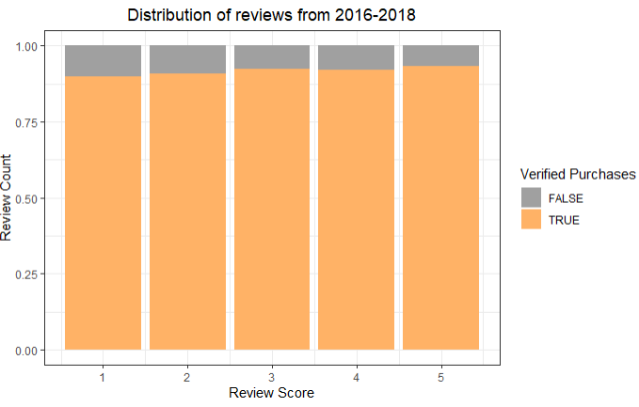
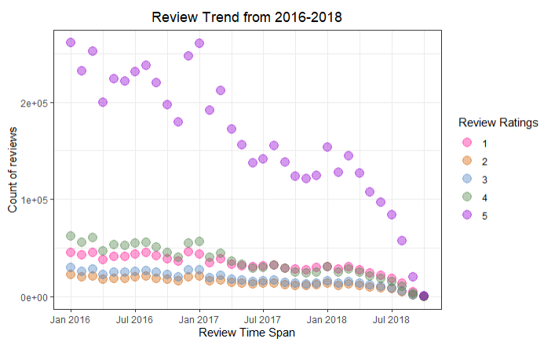
Results – Exploratory Analysis
Almost 90% of purchases across the review scores are verified
The length of the review does not impact the review score
Despite 90% of reviews being verified, the 5-star reviews have been consistently high, which seems a bit unusual
Are people generally optimistic or are there still fraudulent reviews?
Notes:
Drashti
Our dataset had over 20 million reviews so we had to narrow it down to only 3 years which still contains 9 millions reviews for all analysis
From the exploratory analysis on the left we can see that almost 90% of purchases in all review scores are verified and the length of the review does not impact the review score.
In the right graph, we can see that despite 90% reviews being verified the 5 star reviews are consistently high have that trend is starting to decline from early 2017
This is shortly after Amazon changes its policy to stop incentivised reviews. This makes us wonder whether people are generally optimistic or there are still some inflated fraudulent reviews

Slide 6
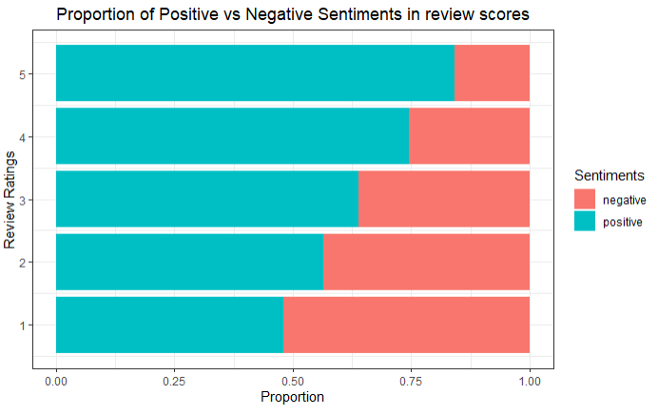
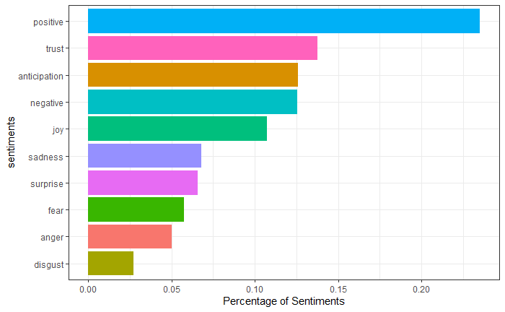
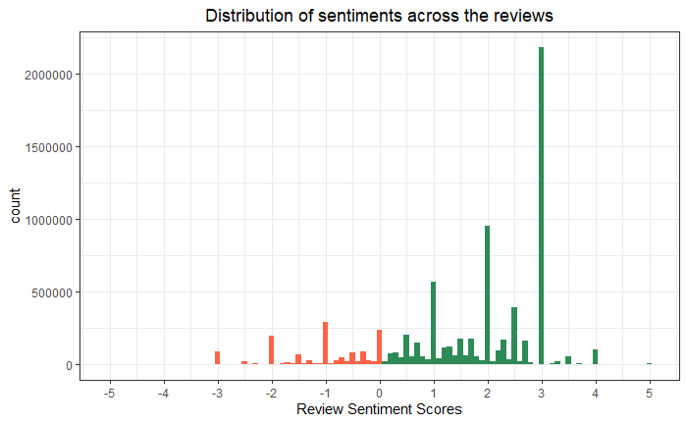
Results – Sentiment Analysis
Bing Lexicon
The ratio of positive to negative is higher
Almost 52% reviews with positive words are rated favorably
NRC Lexicon
50% of words are associated with positive emotions
33% words are associated with negative emotions
Affin Lexicon
The average sentiment is trending positive
More than 2 million reviews have a sentiment score of +3
Notes:
Drashti
This slide shows the results of sentiment analysis. From the bing lexicon , we can see that ratio of positive to negative words is higher and almost 52% of reviews with positive words are rated favorably
The NRC lexicon shows that positive and trust emotions have the highest proportion. But overall 50% of words are associated with clear positive emotions like trust, joy
33% of words are associated with clear negative emotions such as sadness, fear, disgust .The review ratings are not tied to any frequency of emotions expressed. So, review ratings are mostly random in nature. The affin lexicon confirms that the average sentiment in reviews is trending positive and more than 2 million reviews have a sentiment score of +3

Slide 7
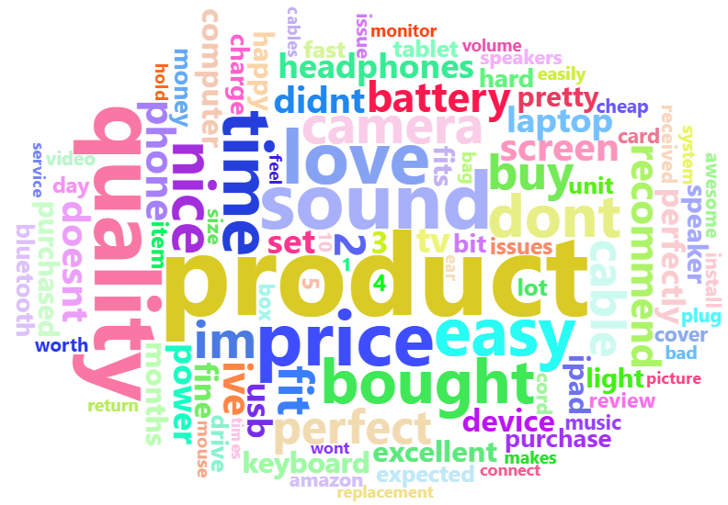
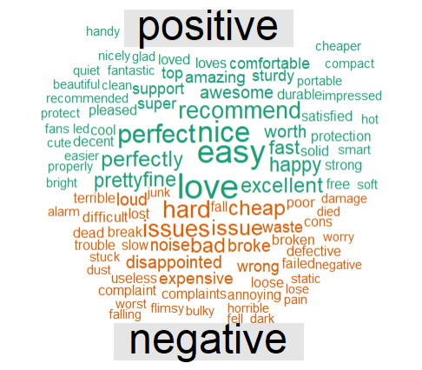
Sentiment Analysis Word Clouds
Most Frequent 100 Words
product, quality, sound, price, love, battery
Positive vs. Negative
Positive terms: love, easy, nice, perfect
Negative terms: hard, issues, cheap, broke, bad
Notes:
Drashti
After removing meaningless words, the most frequent 100 words in review text mostly highlight the characteristics of the product like “product”,” quality”, “sound”, “price”
On the right after splitting the same word cloud into positive and negative sentiments, we get a clear picture of what complaints and praises people have regarding the products bought. A few negative terms that stand out are “hard”, “issues”, “cheap”, “bad”, “broke”, etc. A few praises that stand out are “love”, “easy”, “nice”, “perfect”, “recommend”.

Slide 8
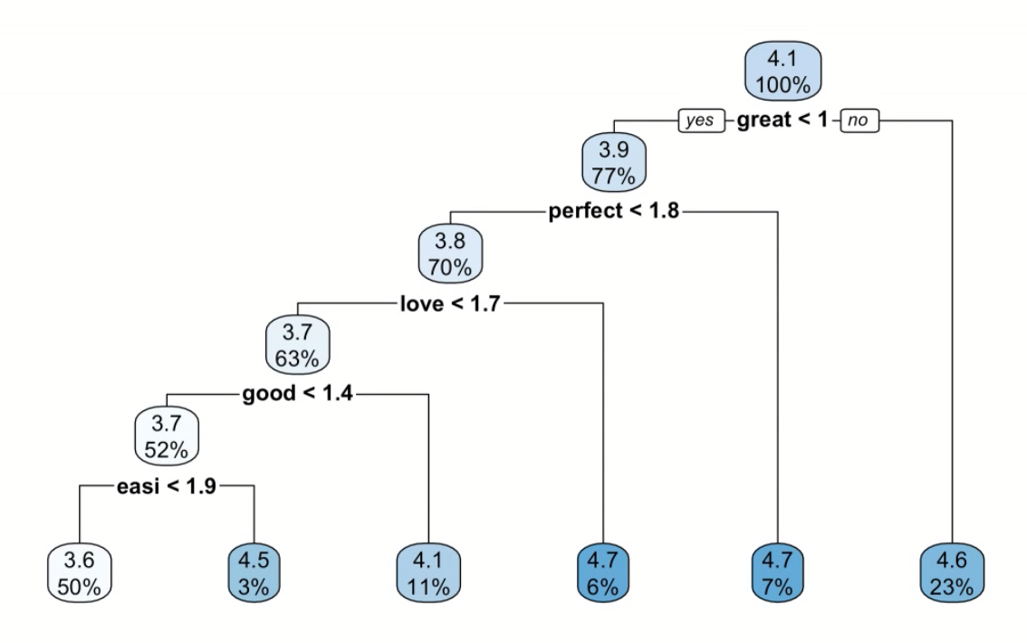
Results – Predictive Modeling
Regression
Most frequently occurring term ‘work’ is predictive
All the terms the model included are statistically significant
CART
Reviews that contains the terms ‘great’, ‘perfect’, ‘love’, ‘good’, ‘easy’ are rated higher
 | CART | Regression
RMSE | 1.329 | 1.307
Notes:
Cenra
Now we are looking at the results of our predictive analysis. We implemented the regression model and CART model. Based on the regression model, the most frequently occurring term, work, is predictive as well as all the terms the model included as they are statistically significant. From the CART model, we can visualize all the terms. Review that contains the terms great, perfect, good are rated higher. We can also compare the RMSEs, seems like regression produces the lowest.

Slide 9
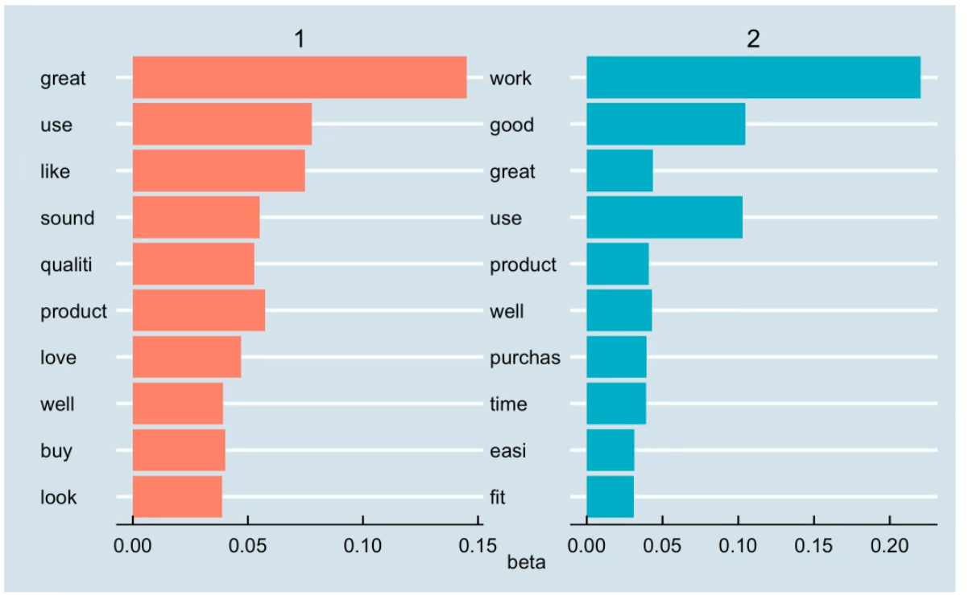
Result – Topic Modeling
Probabilities of the Top 10 Terms within Each Topic
LDA solves topic modeling by focusing on term-topic and document-topic distributions
LSA focuses on reducing matrix dimension
 | RMSE
LDA | 1.349
LSA | 1.358
Notes:
Cenra
We also included topic modeling in our analysis to uncover some hidden or latent variables (topics) that shape the meaning of our document and corpus. On the left side, we can see the graphs that visualizes the probabilities of the top 10 terms within each topic. The LDA model classified the words that are highly associated with each topic. And we can also compare their RMSEs
LSA decomposes our document term matrix (TF-IDF) into a separate document-topic matrix and a term-topic matrix. Meanwhile, with LDA, the assumption is that each document consists of a mixture of topics and each topic consists of a collection of words.

Slide 10
Conclusion and Future Outlook
There is an alarming number of 5-star reviews that may indicate signs of the abuse of the Verified Purchase system
The declining 5-star reviews after the end of 2016 suggests success in combating fake reviews to some extent by Amazon
There is no correlation between review score and review length
Reviews with positive words are predicted to receive higher rating
Regression model produces the lowest RMSE
Future outlook:
Build a predictive model to predict the helpfulness rating of the review
Combine social network modeling techniques and deep learning to understand the drivers for helpfulness ratings and review scores
Notes:
Cenra

Slide 11
Thank you

