Slide 1
Goal
Goal
To maximize QoE in video streaming over multiple WiFi networks with SDN
Adjusting Bitrate
To ensure total QoE
AP Load Balancing
To ensure minimum QoE for each user
Notes:
질문 사항
Bitrate 조절

Slide 2




Basic Idea
Basic Idea
Media Server
SDN Controller
AP
Client

Slide 3
Basic Idea
Basic Idea
Media Server
SDN Controller
AP
Client
Notes:
Controller가 정보 수집한 뒤 Load Balancing한 후 bitrate 조절까지(Jain Fairness Index 값에 따라 Load balancing 안할 수도)

Slide 4
Basic Idea
Basic Idea
Media Server
SDN Controller
AP
Client
Notes:
Load Balancing 명령과 동시에 Bitrate 한계치 정보 제공

Slide 5
Basic Idea
Basic Idea
Media Server
SDN Controller
AP

Slide 6
Basic Idea
Basic Idea
SDN collects information from clients
List of connectable Aps and current AP
Using load balancing
Bandwidth
Using bitrate adjustment, load balancing
Packet Error Rate
Using load balancing

Slide 7
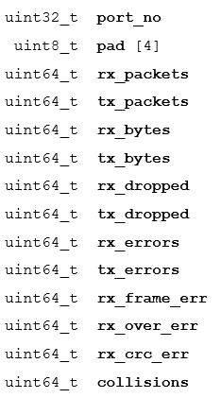
Basic Idea
Basic Idea
SDN collects information using Open Flow protocol
Using OFPMP_PORT_STATS message
Clients respond to it with ofp_port_stats message
< ofp_port_stats structure >

Slide 8
Basic Idea
Basic Idea
SDN collects information using Open Flow protocol
Using OFPMP_PORT_STATS message
Calculate bandwidth and packet error rate
< ofp_port_stats structure >

Slide 9
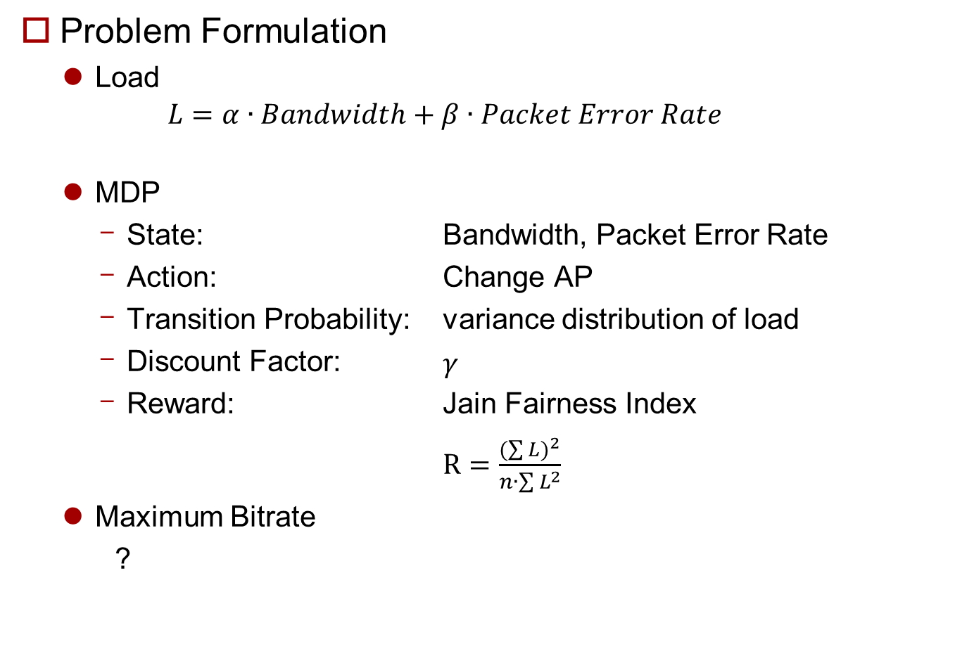
Problem Formulation
Problem Formulation
Load
$$L=α∙Bandwidth+β∙Packet Error Rate$$
MDP
State: Bandwidth, Packet Error Rate
Action: Change AP
Transition Probability: variance distribution of load
Discount Factor: $γ$
Reward: Jain Fairness Index
$R=\frac{{(\sum{L})}^{2}}{n∙\sum{L^{2}}}$
Maximum Bitrate
?

