Slide 1
Research Jae Jun Ha Media Computing and Networking Laboratory POSTECH 2018-12-07
Notes:
세미나 발표를 시작하겠습니다.

Slide 2
Contents
Contents
Fairness
Bandwidth Estimation
Determine AP
Future Work

Slide 3
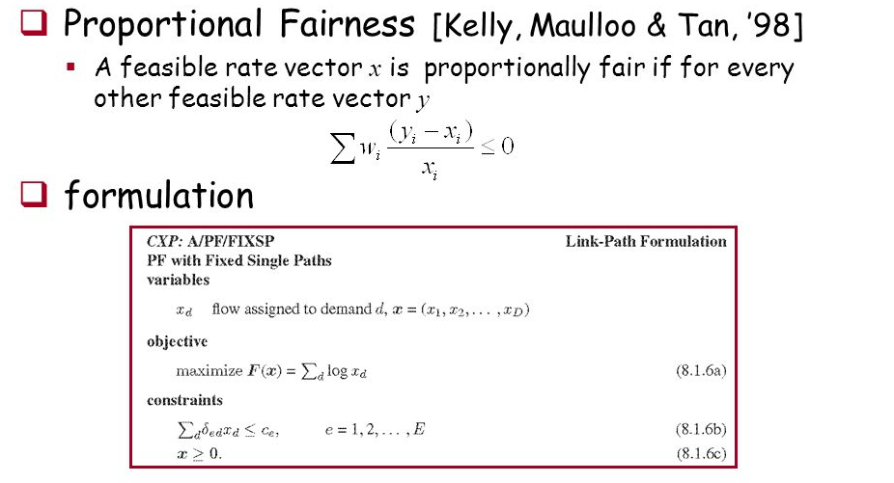
Fairness
Proportional fairness
< https://slideplayer.com/slide/9817360/32/images/18/Proportional+Fairness.jpg >

Slide 4
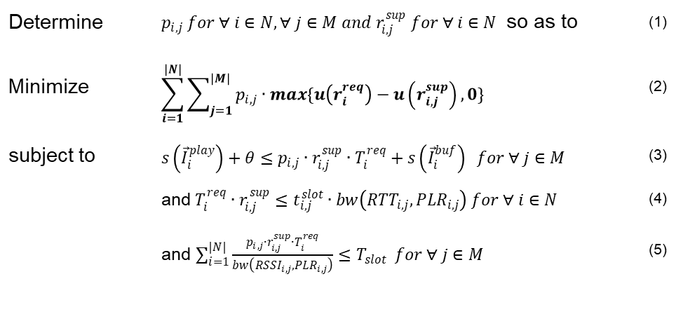
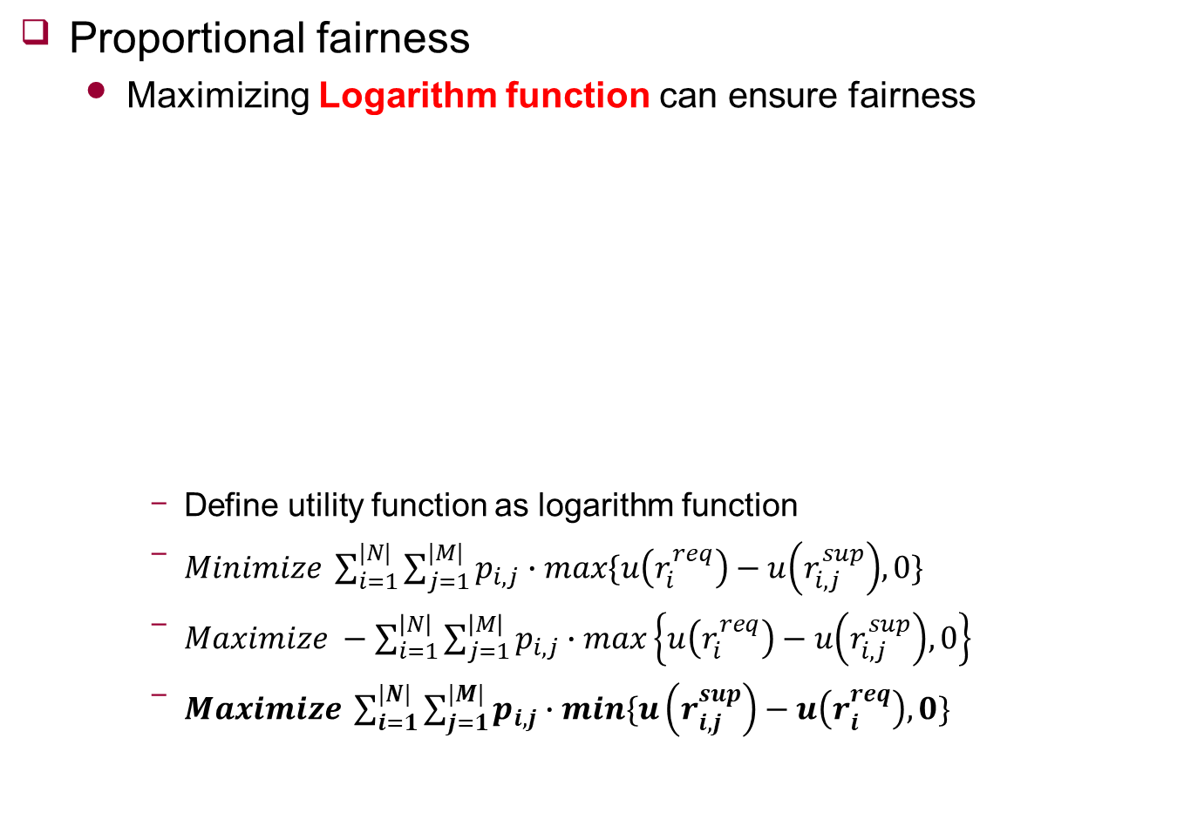
Fairness
Proportional fairness
Maximizing Logarithm function can ensure fairness
Define utility function as logarithm function
$Minimize \sum_{i=1}^{|N|}{\sum_{j=1}^{|M|}{p_{i,j}∙max\{u\left(r_{i}^{req}\right)−u\left(r_{i,j}^{sup}\right),0\}}}$
$Maximize −\sum_{i=1}^{\left|N\right|}{\sum_{j=1}^{\left|M\right|}{p_{i,j}∙max\left\{u\left(r_{i}^{req}\right)−u\left(r_{i,j}^{sup}\right),0\right\}}}$
$Maximize \sum_{i=1}^{|N|}{\sum_{j=1}^{|M|}{p_{i,j}∙min\{u\left(r_{i,j}^{sup}\right)−u\left(r_{i}^{req}\right),0\}}}$
Determine | $p_{i,j} for ∀ i∈N, ∀ j∈M and r_{i,j}^{sup} for ∀ i∈N$ so as to | (1)
Minimize | $$\sum_{i=1}^{|N|}{\sum_{j=1}^{|M|}{p_{i,j}∙max\{u\left(r_{i}^{req}\right)−u\left(r_{i,j}^{sup}\right),0\}}}$$ | (2)
subject to | $s\left({\vec{I}}_{i}^{play}\right)+θ≤p_{i,j}∙r_{i,j}^{sup}∙T_{i}^{req}+s\left({\vec{I}}_{i}^{buf}\right) for ∀ j∈M$ | (3)
 | and $T_{i}^{req}∙r_{i,j}^{sup}≤t_{i,j}^{slot}∙bw\left({RTT}_{i,j},{PLR}_{i,j}\right) for ∀ i∈N$ | (4)
 | and $\sum_{i=1}^{|N|}{\frac{p_{i,j}∙r_{i,j}^{sup}∙T_{i}^{req}}{bw\left({RSSI}_{i,j},{PLR}_{i,j}\right)}≤T_{slot}} for ∀ j∈M$ | (5)

Slide 5
Bandwidth Estimation
Consider only RSSI
RSSI can not consider load of AP
Physical layer
Only considered information between two antennas
Can’t consider upper layer situation
Upper layer
Need to consider “share”
Real throughput is not decided by RSSI
Consider Round Trip Time and PLR

Slide 6
Bandwidth Estimation
Round Trip Time
Theoretical, bandwidth is inversely related
Hypothesis: there is inverse relationship between Bandwidth and RTT
Two devices: Galaxy A7, Raspberry PI
Tools: iperf(Bandwidth), ICMP ping(RTT)

Slide 7
Bandwidth Estimation
Round Trip Time
Compare between K/RTT (K = 800) and Bandwidth

Slide 8



Bandwidth Estimation
Round Trip Time
At server, collect RTT information periodically like OpenFlow protocol
In addition, will estimate current RTT using previous RTT information and ARIMA model
PLR
TX: xxx
RX: xxx
Packet Loss Rate
$$=\frac{RX}{\sum{TX}}$$
TX: xxx
RX: xxx
TX: xxx
RX: xxx

Slide 9





Determine AP
How to determine the AP using statistical properties
Assume estimated bandwidth follows Gaussian distribution
Statistical data will be made by collected RTT and PLR
${UE}_{i}$ wants to connect ideal AP
Using probability
$${AP}_{1}\sim N(μ_{i1}\text{,}σ_{i1}^{2})$$
$${AP}_{2}\sim N(μ_{i2}\text{,}σ_{i2}^{2})$$
$$r_{i}^{req}$$
$$r_{i}^{req}$$

Slide 10
Future work
Bandwidth modeling
Find relationship between Bandwidth and PLR
Modify Algorithm detail

