Slide 1











Situation
When network can not support enough bandwidth
Consider $r_{i}^{service}≤{bw}_{i,j} for r_{i}^{service}∈MPD, ∀ i∈N, ∀ j∈M$
Therefore, iterate $r_{i}^{service}$ from min($r_{i}^{req},{bw}_{i,j}$) to $r_{i}^{min}$
$$T_{unit}$$
$$T_{unit}$$
$$r_{2}^{service}≤{bw}_{2,1}$$
$$r_{2}^{service}≤{bw}_{2,2}$$
$${bw}_{2,1}$$
$$x_{2,1}$$
$$x_{2,2}$$
$${bw}_{2,2}$$
$$r_{2}^{service}$$
Notes:
문제는 앞에서 말한대로 한 UE가 최대 2개의 AP에 연결하고 각 AP 마다 chunk를 받는 비율, amount of bit를 정하는 것입니다.

Slide 2
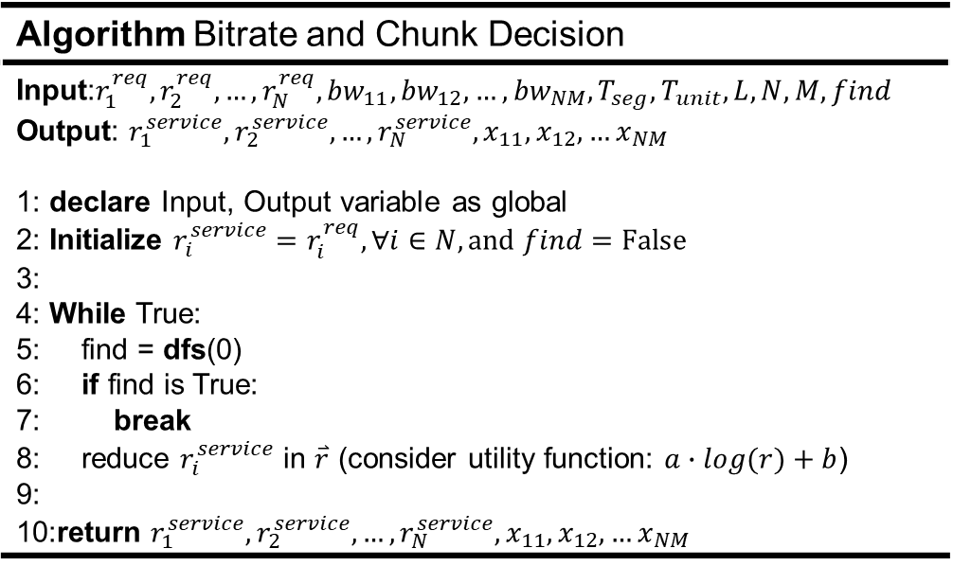


Algorithm
Based on Depth First Search (DFS)
To find chunk ratio, divide segment size with L
If L → ∞, it is optimal solution
DFS is based on full search
Algorithm Bitrate and Chunk Decision
Input:$r_{1}^{req},r_{2}^{req},…,r_{N}^{req},{bw}_{11},{bw}_{12},…,{bw}_{NM},T_{seg},T_{unit},L,N,M,find$ Output: $r_{1}^{service},r_{2}^{service},…,r_{N}^{service},x_{11},x_{12},…x_{NM}$ 1: declare Input, Output variable as global 2: Initialize $r_{i}^{service}=r_{i}^{req},∀i∈N, and find=False$ 3: 4: While True: 5: find = dfs(0) 6: if find is True: 7: break 8: reduce $r_{i}^{service}$ in $\overset{⃑}{r}$ (consider utility function: $a∙log(r)+b$) 9: 10:return $r_{1}^{service},r_{2}^{service},…,r_{N}^{service},x_{11},x_{12},…x_{NM}$
Iterate $r_{i}^{service}$
Iterate $x_{ij}$
How?

Slide 3
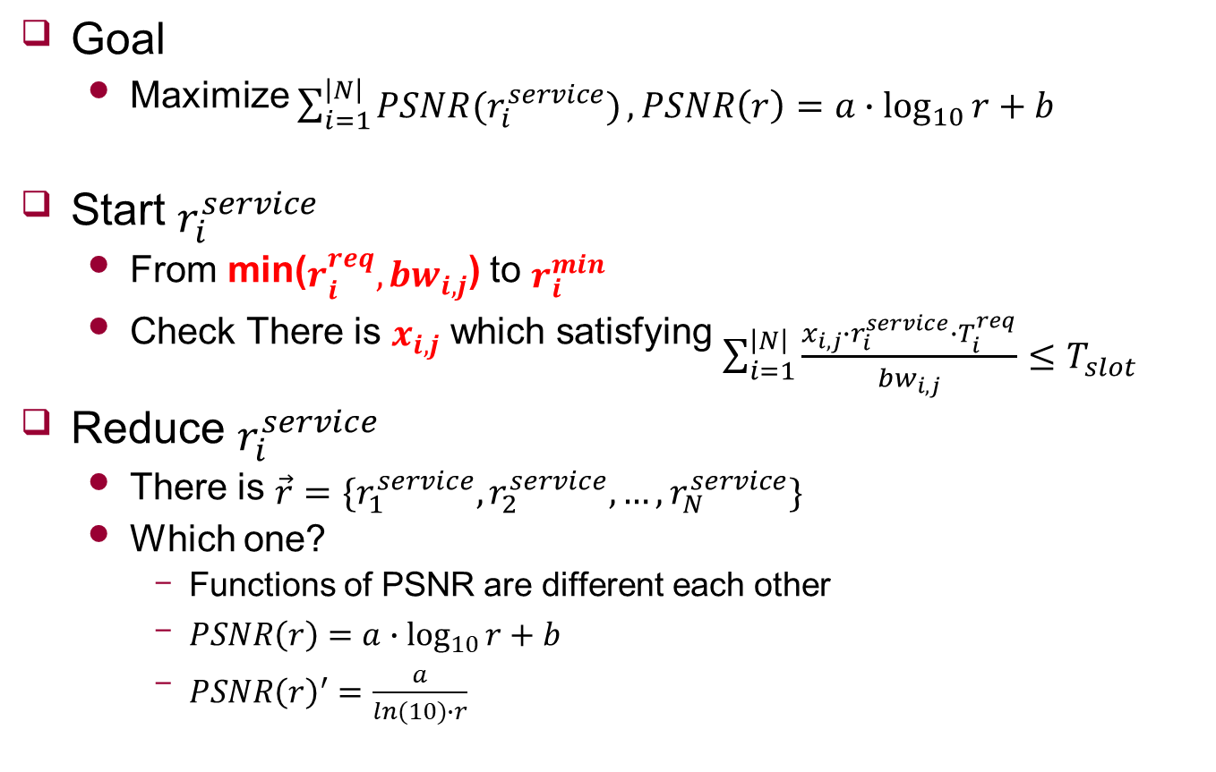
Maximize PSNR
Goal
Maximize $\sum_{i=1}^{\left|N\right|}{PSNR(r_{i}^{service})}, PSNR\left(r\right)=a∙\log_{10}{r}+b$
Start $r_{i}^{service}$
From min($r_{i}^{req},{bw}_{i,j}$) to $r_{i}^{min}$
Check There is $x_{i,j}$ which satisfying $\sum_{i=1}^{\left|N\right|}{\frac{x_{i,j}∙r_{i}^{service}∙T_{i}^{req}}{{bw}_{i,j}}≤T_{slot}}$
Reduce $r_{i}^{service}$
There is $\vec{r}=\{r_{1}^{service},r_{2}^{service},…,r_{N}^{service}\}$
Which one?
Functions of PSNR are different each other
$PSNR\left(r\right)=a∙\log_{10}{r}+b$
${PSNR\left(r\right)}^{′}=\frac{a}{ln⁡(10)∙r}$
Notes:
문제는 앞에서 말한대로 한 UE가 최대 2개의 AP에 연결하고 각 AP 마다 chunk를 받는 비율, amount of bit를 정하는 것입니다.

