Slide 1
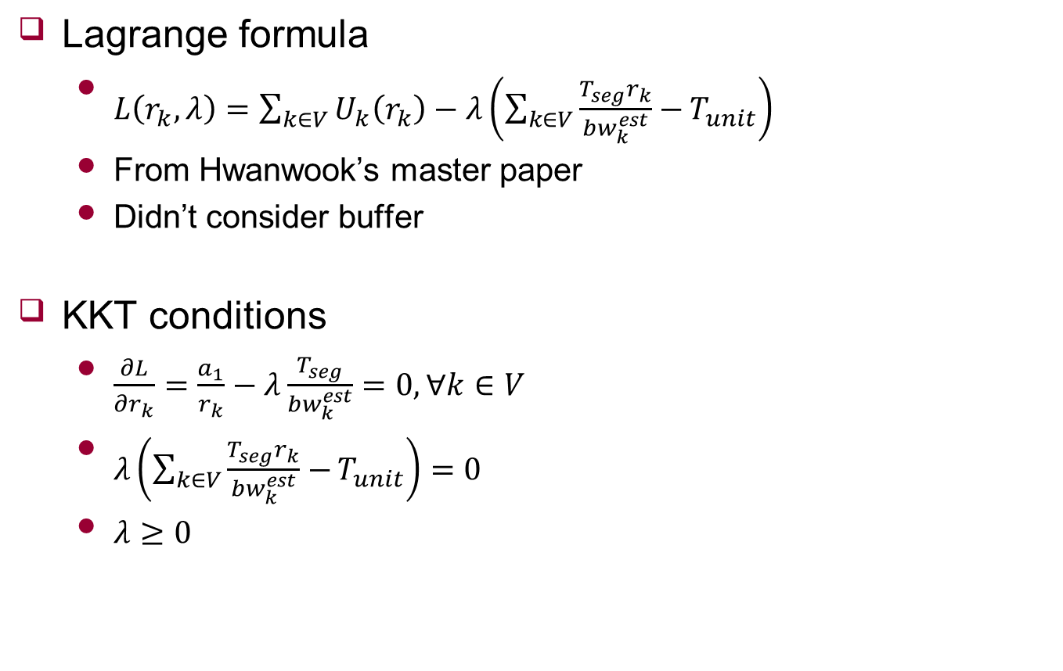
Algorithm Design
Lagrange formula
$L\left(r_{k},λ\right)=\sum_{k∈V}{U_{k}\left(r_{k}\right)−λ\left(\sum_{k∈V}{\frac{T_{seg}r_{k}}{{bw}_{k}^{est}}−}T_{unit}\right)}$
From Hwanwook’s master paper
Didn’t consider buffer
KKT conditions
$\frac{∂L}{∂r_{k}}=\frac{a_{1}}{r_{k}}−λ\frac{T_{seg}}{{bw}_{k}^{est}}=0,∀k∈V$
$λ\left(\sum_{k∈V}{\frac{T_{seg}r_{k}}{{bw}_{k}^{est}}−}T_{unit}\right)=0$
$λ≥0$

Slide 2

Algorithm Design
KKT conditions
$\frac{∂L}{∂r_{k}}=\frac{a_{1}}{r_{k}}−λ\frac{T_{seg}}{{bw}_{k}^{est}}=0,∀k∈V$
$λ\left(\sum_{k∈V}{\frac{T_{seg}r_{k}}{{bw}_{k}^{est}}−}T_{unit}\right)=0$
$λ≥0$
To reduce $r_{k}$, must increase $λ$
$λ=\frac{a_{1}{bw}_{k}^{est}}{r_{k}T_{seg}}$
$r_{k}=\frac{a_{1}{bw}_{k}^{est}}{{λT}_{seg}}$

Slide 3

Algorithm Design
Relation between x and $λ$
How to adjust $λ$?
$λ$ is decided by Levenberg-marquardt algorithm
Need to increase $λ$
Unit must be decided using mpd bitrate information

