Slide 1
Wireless Networks Jae Jun Ha Media Computing and Networking Laboratory POSTECH 2018-09-01
Notes:
세미나 발표를 시작하겠습니다.

Slide 2
Contents
MAC layer
Some backgrounds on Wireless channel
Wireless versus Wired
Fading
Model
Modulation
Analog modulation
Digital modulation
Adaptive modulation
Multi-carrier modulation

Slide 3
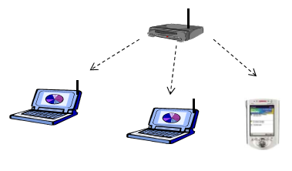
Broadcast Channel
From access point to stations
Downlink (DL) or Forward link (FL)
Multiplexing schemes
FDM (Frequency Division Multiplexing)
TDM (Time Division Multiplexing)
CDM (Code Division Multiplexing)
OFDM (Orthogonal Frequency Division Multiplexing)
Complexity and power at the transmitter is less limited than at the receiver
Notes:
DL: 위성에서 지상국 방향으로의 링크
FL: 고정된 지점(즉, 기지국)에서 이동하는 사용자 방향의 링크
AP의 제약이 덜함

Slide 4
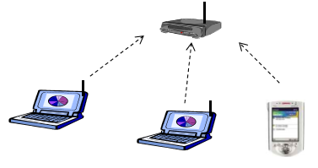
Multiple Access Channel
From stations point to access point
Uplink (UL) or Reverse link (RL)
Multiple access schemes
FDMA (Frequency Division Multiplexing Access)
TDMA (Time Division Multiplexing Access)
CDMA (Code Division Multiplexing Access)
OFDMA (Orthogonal Frequency Division Multiplexing Access)
Complexity and power at the receiver is less limited than at the transmitter

Slide 5
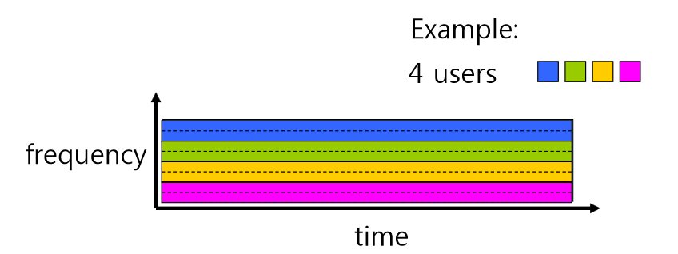
FDM / FDMA
Each user modulates his/her data with the assigned carrier frequency
Notes:
각 사용자는 지정된 캐리어 주파수로 데이터를 변조합니다.
FDM은 통신 매체에서 이용 가능한 총 대역폭을 겹치지 않는 일련의 주파수 하부 대역으로 분리시킨 뒤, 분리된 대역을 각각 개별 신호를 전달하는데 사용하도록 하는 기술
주파수 분할 다중화를 통해 여러 사용자들이 하나의 물리적인 통신 채널을 공유하는 경우에는 이를 주파수 분할 다중 접속(FDMA)으로 부른다.
https://ko.wikipedia.org/wiki/주파수_분할_다중화

Slide 6
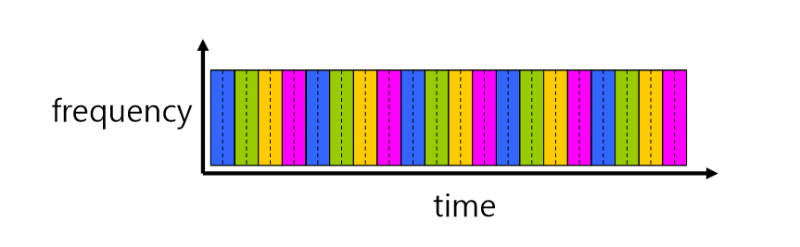
TDM / TDMA
Notes:
이동통신 서비스를 실현하기 위해서는 하나의 주파수 대역을 여러 사용자가 동시에 이용하기 위한 방식의 개발이 필요하다
https://ko.wikipedia.org/wiki/시분할다중접속
시간축을 여러 시간구간으로 나누어서, 각 사용자가 자기에게 할당된 시간구간을 다른 사용자의 시간구간과 겹치지 않게 사용하는 방식 - 이때, 주파수영역에서는 하나의 동일한 반송 대역폭을 여럿이 공유 사용
http://www.ktword.co.kr/abbr_view.php?nav=2&id=911&m_temp1=348

Slide 7
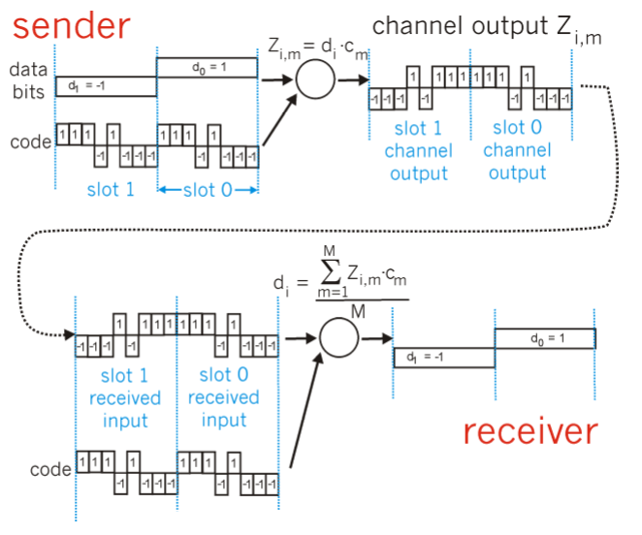
CDM / CDMA
Unique “code” assigned to each user
All user share same frequency, but each user has own “chipping” sequence to encode data
Encoding signal = (original data) x (chipping sequence)
Decoding: inner-product of encoded signal and chipping sequence
Allows multiple users to “coexist” and transmit simultaneously when minimal interference (if codes are “orthogonal”)

Slide 8
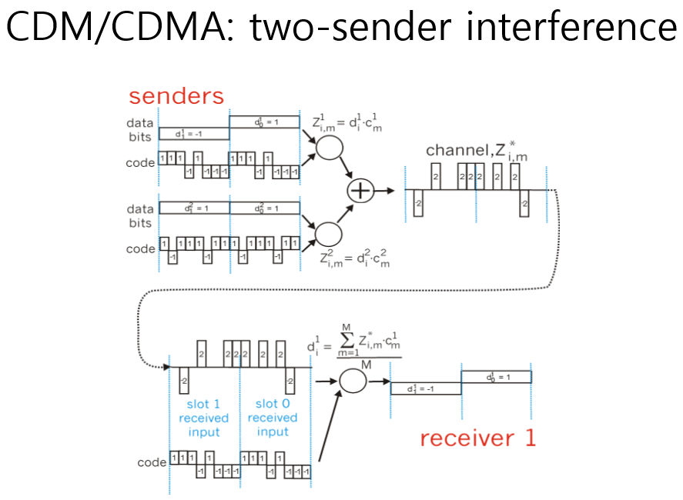
CDM / CDMA

Slide 9
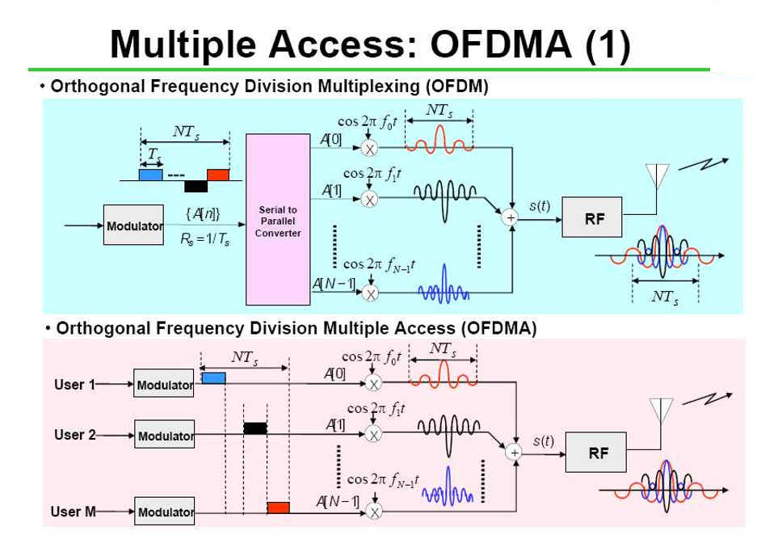
OFDM / OFDMA

Slide 10
Duplexing Schemes
FDD (Frequency Division Duplexing)
UL/DL in separate frequency bands
Can use different modem schemes for UL and DL easily
No synchronization issue
Used for most commercial cellular systems
TDD (Time Division Duplexing)
UL/DL shares the same frequency band in different time slots
Need a guard time between UL and DL boundary
Flexible UL/DL time sharing
Easy channel estimation due to channel repository
Notes:
Duplex는 full-duplex(동시에 송수신), half-duplex(한번에 한쪽만 송수신)등이 있음
Wireless network에는 FDD, TDD등의 Duplexing 방법이 있음

Slide 11
Duplexing Schemes
FDD (Frequency Division Duplexing)
UL/DL in separate frequency bands
Can use different modem schemes for UL and DL easily
No synchronization issue
Used for most commercial cellular systems
TDD (Time Division Duplexing)
UL/DL shares the same frequency band in different time slots
Need a guard time between UL and DL boundary
Flexible UL/DL time sharing
Easy channel estimation due to channel repository
Notes:
Duplex는 full-duplex(동시에 송수신), half-duplex(한번에 한쪽만 송수신)등이 있음
Wireless network에는 FDD, TDD등의 Duplexing 방법이 있음
시분할 이중통신 (TDD, Time Division Duplex): 정보를 시간축으로 압축하여 송수신 방향을 변경한다. 시간 배분을 바꾸는 것으로 송수신 데이터 양의 비율이 동적으로 변경될 수 있다. TCM-ISDN, PHS, TD-CDMA 등에 쓰인다.
주파수 분할 이중통신 (FDD, Frequency Division Duplex): 주파수 대역을 분할한다. 송수신 분리에 대역 필터 회로가 필요하다. 휴대 전화, 통신 위성에 쓰인다.
https://ko.wikipedia.org/wiki/이중통신

Slide 12
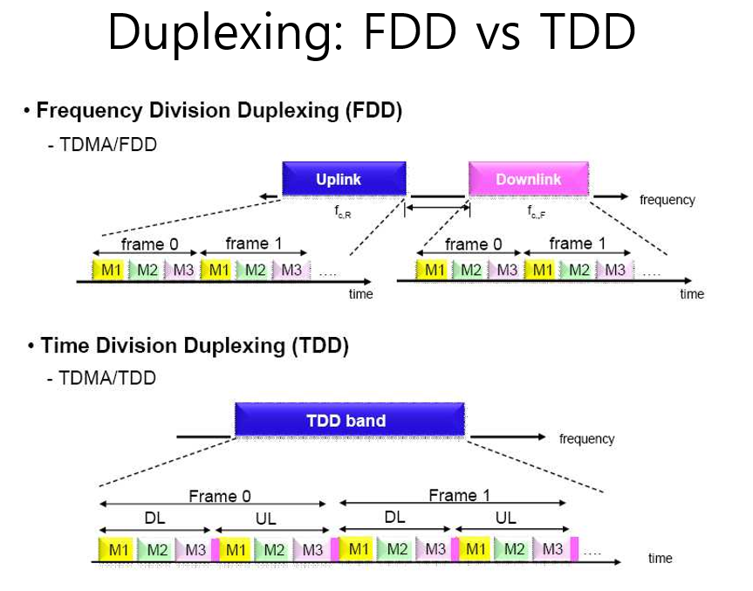
Duplexing Schemes

Slide 13
MAC
Medium Access Control
Determines who/when to transmit a packet through channel
Provides MAC-specific framing
Fragmentation, splitting into slots
Provides error control mechanism
How to detect the errors
How to correct the errors (ex ARQ, FEC, etc.)
Performs management functions
QoShttp://boncns.com/index.cgi?page_code=otherpage&code=online
Handover
Power saving, etc.

Slide 14
Distributed vs Centralized
Distributed and contention-based
Random Access
Robust to a single point failure
Good for bursty traffic in light load
Centralized and controlled
Controlled by BS
More controllable
Could be more efficient, esp. with many users in heavy load

Slide 15
Random Access MAC
When node has packets to send
Transmit without a priori coordination among nodes
Two or more transmitting nodes → collision
Random access MAC protocol specifies
How to detect collisions
How to recover from collisions
Examples
Slotted ALOHA, ALOHA
CSMA, CSMA/CD, CSMA/CA

Slide 16
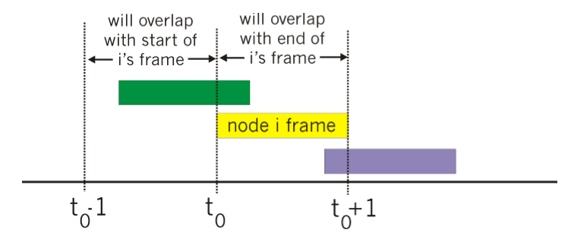
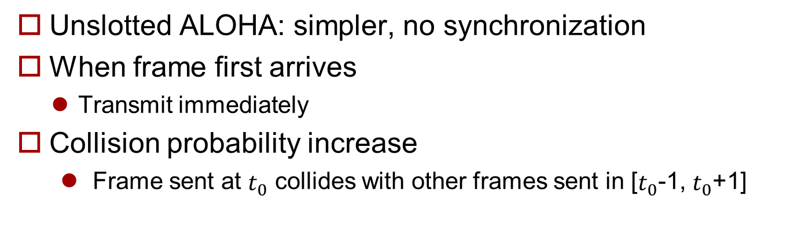
Pure (unslotted) ALOHA
Unslotted ALOHA: simpler, no synchronization
When frame first arrives
Transmit immediately
Collision probability increase
Frame sent at $t_{0}$ collides with other frames sent in [$t_{0}$-1, $t_{0}$+1]

Slide 17
Slotted ALOHA
Assumptions
All frames same size
Time is divided into equal size slots, time to transmit 1 frame
Nodes start to transmit frames only at beginning of slots
Nodes are synchronized
If 2 or more nodes transmit in slot, all nodes detect collision
Operation
When node obtain fresh frame, it transmits in next slot
No collision, node can send new frame in next slot
If collision, node retransmits frame in each subsequent slot with prob. P until success

Slide 18
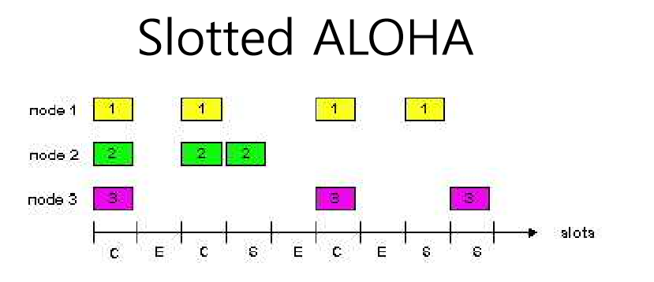
Slotted ALOHA
Pros
Single active node can continuously transmit at full rate of channel
Highly decentralized: only slots in nodes need to be in sync
simple
Cons
Collisions, wasting slots
Idle slots
Nodes may be able to detect collision in less than time to transmit packet

Slide 19
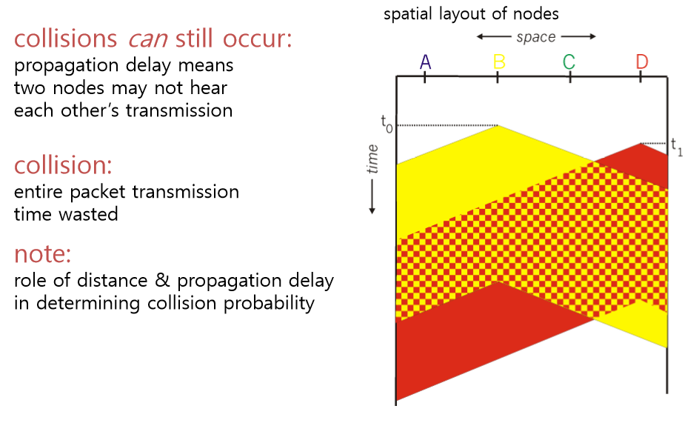
CSMA
Carrier Sense Multiple Access
Listen before transmit
If channel sensed idle: transmit entire frame
If channel sensed busy, defer transmission

Slide 20
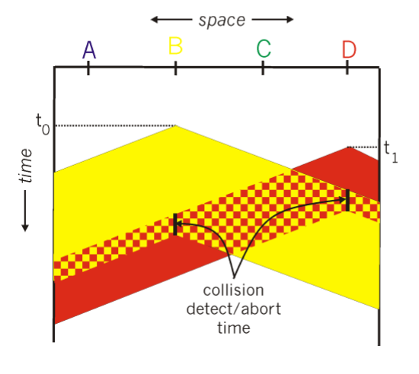
CSMA/CD
Carrier Sense Multiple Access / Collision Detection
Carrier sensing, deferral as in CSMA
Collisions detected within short time
Colliding transmissions aborted, reducing channel wastage
Collision detection
Easy in wired LANs: measure signal strengths, compare transmitted, received signals
Difficult in wireless LANs: receiver shut off while transmitting

Slide 21
???
메모 참조
메모 참조
Notes:
숨겨진 노드 문제 (Hidden Terminal Problem)
무선 LAN에서 3개의 노드가 있을 때, 중간 1개 노드는 양 노드가 보여 통신이 가능하나, 2개 사이에는 통신이 불가 그래서 둘다 가운데 노드에게 신호를 보낼 때 서로 보낸 지를 모르기 때문에 충돌이 일어날 수 있음
http://www.ktword.co.kr/abbr_view.php?m_temp1=3262 + 첨언

Slide 22
???
메모 참조
메모 참조
Notes:
Exposed Terminal Problem 이 먼지

