Slide 1
Research Jae Jun Ha Media Computing and Networking Laboratory POSTCH 2020-04-03
Notes:
발표 시작하겠습니다.
오늘 발표 드릴 내용은 알고리즘에 관한 내용을 정리했습니다.

Slide 2

Contents
Flow Chart (Modified)
$x_{ij}$ Adjustment
Simple Comparison

Slide 3
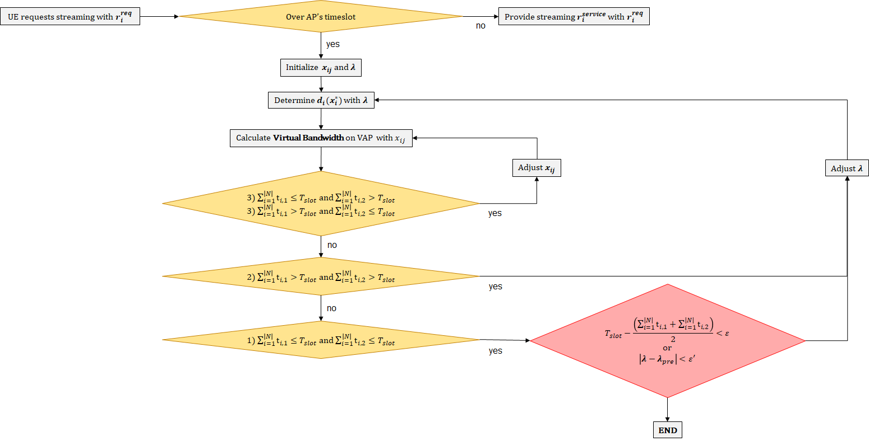
Flow Chart
Scenario
Notes:
지난 세미나에서 교수님 말 반영해서 ~ 넣었다.

Slide 4
Flow Chart
Scenario

Slide 5
Flow Chart
Scenario

Slide 6
Flow Chart
Scenario

Slide 7
Flow Chart
Scenario
Notes:
이 과정을 Fast하게 찾는 알고리즘

Slide 8

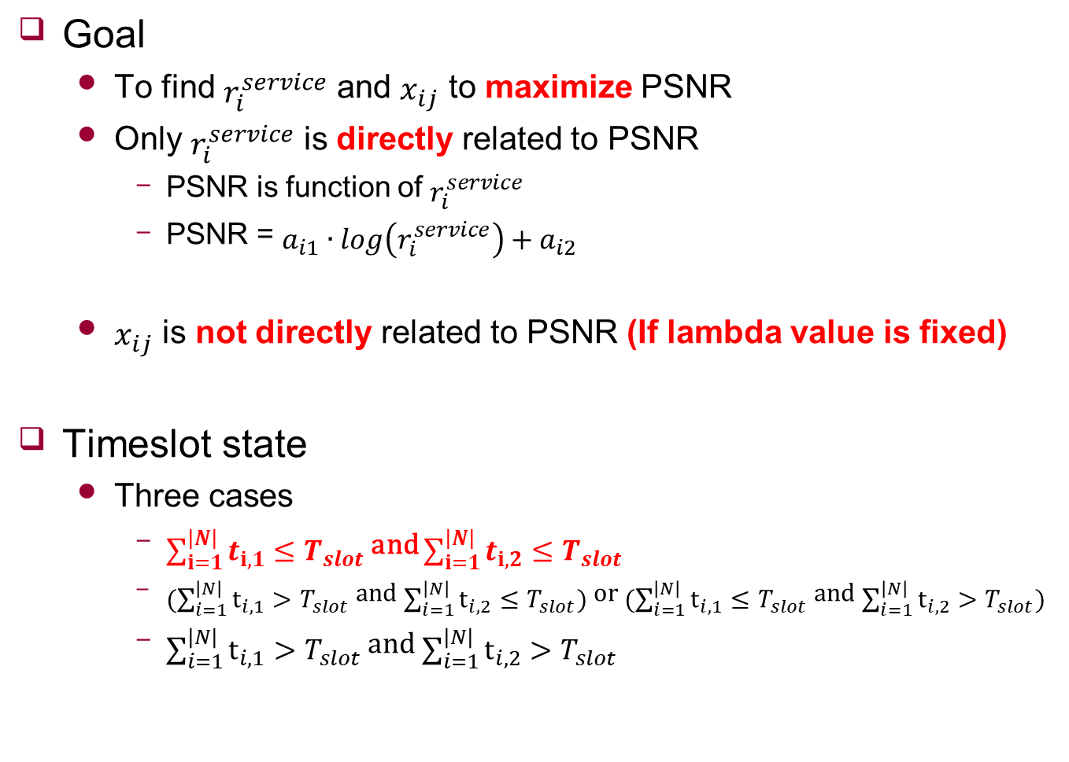
$x_{ij}$ Adjustment
Goal
To find $r_{i}^{service}$ and $x_{ij}$ to maximize PSNR
Only $r_{i}^{service}$ is directly related to PSNR
PSNR is function of $r_{i}^{service}$
PSNR = $a_{i1}∙\log\left(r_{i}^{service}\right)+a_{i2}$
$x_{ij}$ is not directly related to PSNR (If lambda value is fixed)
Timeslot state
Three cases
$\sum_{i=1}^{\left|N\right|}{t_{i,1}}≤T_{slot}$ and $\sum_{i=1}^{\left|N\right|}{t_{i,2}}≤T_{slot}$
$(\sum_{i=1}^{\left|N\right|}{t_{i,1}}>T_{slot}$ and $\sum_{i=1}^{\left|N\right|}{t_{i,2}}≤T_{slot})$ or $(\sum_{i=1}^{\left|N\right|}{t_{i,1}}≤T_{slot}$ and $\sum_{i=1}^{\left|N\right|}{t_{i,2}}>T_{slot})$
$\sum_{i=1}^{\left|N\right|}{t_{i,1}}>T_{slot}$ and $\sum_{i=1}^{\left|N\right|}{t_{i,2}}>T_{slot}$

Slide 9

$x_{ij}$ Adjustment
How to find group of $x_{ij}$
Which makes $\sum_{i=1}^{\left|N\right|}{t_{i,1}}≤T_{slot}$ and $\sum_{i=1}^{\left|N\right|}{t_{i,2}}≤T_{slot}$
Which makes $\sum_{i=1}^{\left|N\right|}{\sum_{j=1}^{\left|M\right|}{t_{i,j}}}$ min
➔ Consider bandwidth ratio

Slide 10

$x_{ij}$ Adjustment
How to find group of $x_{ij}$
Which makes $\sum_{i=1}^{\left|N\right|}{t_{i,1}}≤T_{slot}$ and $\sum_{i=1}^{\left|N\right|}{t_{i,2}}≤T_{slot}$
Which makes $\sum_{i=1}^{\left|N\right|}{\sum_{j=1}^{\left|M\right|}{t_{i,j}}}$ min
➔ Consider bandwidth ratio
Initial value
High RSSI

Slide 11

$x_{ij}$ Adjustment
Initial value
High RSSI
Example
Each bitrate is 2000 kbps
Find AP which has over timeslot
AP 1
Calculate $BW_{1}/BW_{2}$
 | AP 1 |  |  | AP 2
 | BW | x | timeslot | BW | x | timeslot
UE 1 | 1852 | 0 | 0.00 | 1915 | 1 | 1.04
UE 2 | 1614 | 1 | 1.24 | 1146 | 0 | 0.00
UE 3 | 1702 | 1 | 1.18 | 1614 | 0 | 0.00
 |  |  | 2.41 |  |  | 1.04
0.967102 | 1.408377 | 1.054523

Slide 12
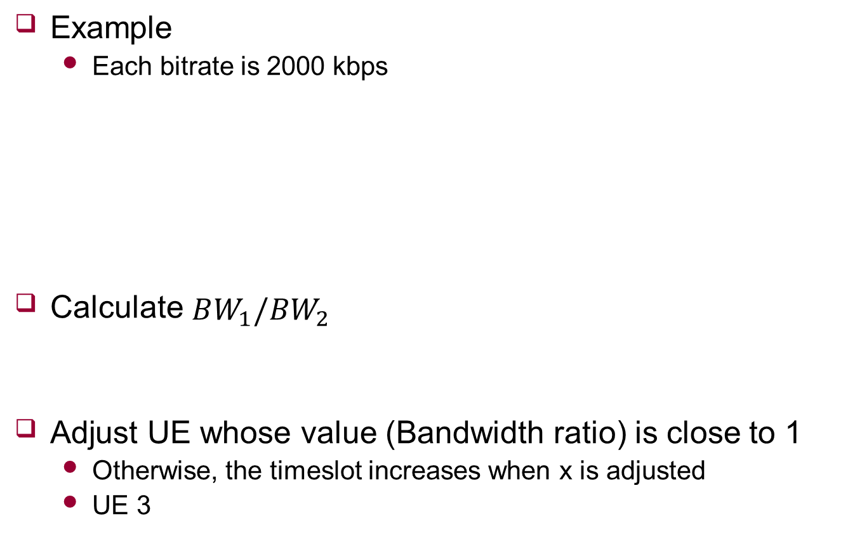
$x_{ij}$ Adjustment
Example
Each bitrate is 2000 kbps
Calculate $BW_{1}/BW_{2}$
Adjust UE whose value (Bandwidth ratio) is close to 1
Otherwise, the timeslot increases when x is adjusted
UE 3
 | AP 1 |  |  | AP 2
 | BW | x | timeslot | BW | x | timeslot
UE 1 | 1852 | 0 | 0.00 | 1915 | 1 | 1.04
UE 2 | 1614 | 1 | 1.24 | 1146 | 0 | 0.00
UE 3 | 1702 | 1 | 1.18 | 1614 | 0 | 0.00
 |  |  | 2.41 |  |  | 1.04
Over AP
0.967102 | 1.408377 | 1.054523

Slide 13
$x_{ij}$ Adjustment
If adjust UE 2
Sum of timeslot = 3.71
If adjust UE 3 (Recommended)
Sum of timeslot = 3.49
 | AP 1 |  |  | AP 2
 | BW | x | timeslot | BW | x | timeslot
UE 1 | 1852 | 0 | 0.00 | 1915 | 1 | 1.04
UE 2 | 1614 | 0.5 | 0.62 | 1146 | 0.5 | 0.87
UE 3 | 1702 | 1 | 1.18 | 1614 | 0 | 0.00
 |  |  | 1.79 |  |  | 1.92
 | AP 1 |  |  | AP 2
 | BW | x | timeslot | BW | x | timeslot
UE 1 | 1852 | 0 | 0.00 | 1915 | 1 | 1.04
UE 2 | 1614 | 1 | 1.24 | 1146 | 0 | 0.00
UE 3 | 1702 | 0.5 | 0.59 | 1614 | 0.5 | 0.62
 |  |  | 1.83 |  |  | 1.66

Slide 14

$x_{ij}$ Adjustment
Minimize adjust $x_{ij}$ (UE 3 is adjusted)
-0.35
Sum of timeslot = 3.48
-0.5
Sum of timeslot = 3.49
 | AP 1 |  |  | AP 2
 | BW | x | timeslot | BW | x | timeslot
UE 1 | 1852 | 0 | 0.00 | 1915 | 1 | 1.04
UE 2 | 1614 | 1 | 1.24 | 1146 | 0 | 0.00
UE 3 | 1702 | 0.65 | 0.76 | 1614 | 0.35 | 0.43
 |  |  | 2.00 |  |  | 1.48
 | AP 1 |  |  | AP 2
 | BW | x | timeslot | BW | x | timeslot
UE 1 | 1852 | 0 | 0.00 | 1915 | 1 | 1.04
UE 2 | 1614 | 1 | 1.24 | 1146 | 0 | 0.00
UE 3 | 1702 | 0.5 | 0.59 | 1614 | 0.5 | 0.62
 |  |  | 1.83 |  |  | 1.66

Slide 15
Simple Comparison
Case #1
Video
Bandwidth
Single
39.66dB
Multi
40.12dB
UE 1 | UE 2 | UE 3
Elephants dream | Tears of steel | Big buck bunny
 | UE 1 | UE 2 | UE 3
AP 1 | 1852 | 1915 | 2023
AP 2 | 2109 | 1405 | 1972
UE 1 |  | UE 2 |  | UE 3
2000 | AP 2 | 900 | AP 1 | 900 | AP 1
 | UE 1 |  | UE 2 |  | UE 3
AP 1 | 1500 | 0 | 1200 | 0.995 | 1200 | 0.625
AP 2 |  | 1 |  | 0.005 |  | 0.375

Slide 16
Simple Comparison
Case #2
Video
Bandwidth
Single
35.61dB
Multi
38.94dB
UE 1 | UE 2 | UE 3
Big buck bunny | Tears of steel | Big buck bunny
 | UE 1 | UE 2 | UE 3
AP 1 | 1702 | 1781 | 1915
AP 2 | 1515 | 1515 | 1614
UE 1 |  | UE 2 |  | UE 3
600 | AP 1 | 500 | AP 1 | 600 | AP 1
 | UE 1 |  | UE 2 |  | UE 3
AP 1 | 900 | 0.005 | 1200 | 0.56 | 1200 | 0.98
AP 2 |  | 0.995 |  | 0.44 |  | 0.02

Slide 17
Future Work
Improve algorithm

Slide 18





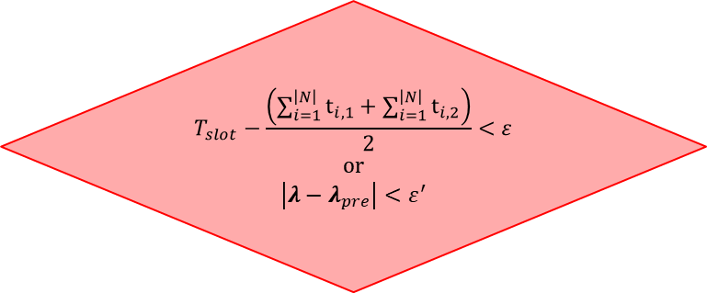
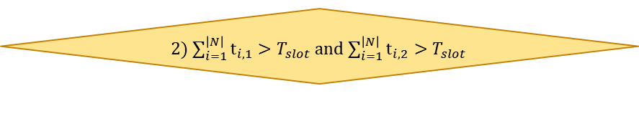
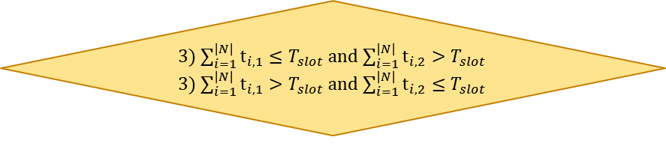

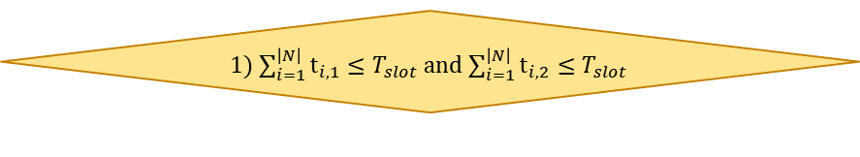

Appendix
UE requests streaming with $r_{i}^{req}$
Over AP’s timeslot
Provide streaming $r_{i}^{service}$ with $r_{i}^{req}$
no
yes
Initialize $x_{ij}$ and $λ$
Determine $d_{i}(x_{i}^{∗})$ with $λ$
Calculate Virtual Bandwidth on VAP with $x_{ij}$
Adjust $x_{ij}$
Adjust $λ$
3) $\sum_{i=1}^{\left|N\right|}{t_{i,1}}≤T_{slot}$ and $\sum_{i=1}^{\left|N\right|}{t_{i,2}}>T_{slot}$
3) $\sum_{i=1}^{\left|N\right|}{t_{i,1}}>T_{slot}$ and $\sum_{i=1}^{\left|N\right|}{t_{i,2}}≤T_{slot}$
yes
no
2) $\sum_{i=1}^{\left|N\right|}{t_{i,1}}>T_{slot}$ and $\sum_{i=1}^{\left|N\right|}{t_{i,2}}>T_{slot}$
yes
$$T_{slot}−\frac{\left(\sum_{i=1}^{\left|N\right|}{t_{i,1}}+\sum_{i=1}^{\left|N\right|}{t_{i,2}}\right)}{2}<ε$$
or
$$\left|λ−λ_{pre}\right|<ε^{′}$$
no
1) $\sum_{i=1}^{\left|N\right|}{t_{i,1}}≤T_{slot}$ and $\sum_{i=1}^{\left|N\right|}{t_{i,2}}≤T_{slot}$
yes
END

