Slide 1
Research Jae Jun Ha Media Computing and Networking Laboratory POSTECH 2019-02-23
Notes:
세미나 발표를 시작하겠습니다.

Slide 2
Contents
Previous Seminar
Multiple Knapsack Problem
Future Work

Slide 3

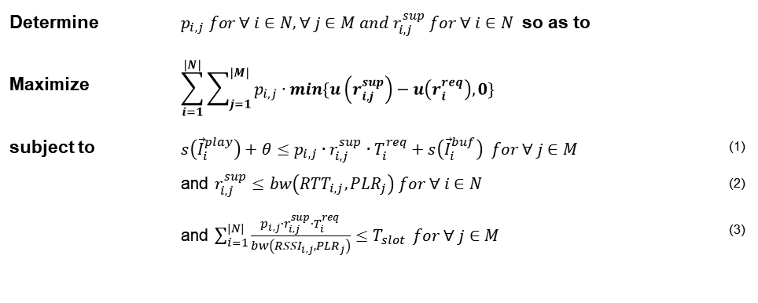

Previous Seminar
Formulation
If there are APs which can fulfill UE's request [$bw\left({RTT}_{i,j},{PLR}_{j}\right)≥r_{i}^{req}$]
Select possible AP [constraint 3] and
Select bitrate [constraint 1, 2 and $r_{i,j}^{sup}≅r_{i}^{req}$]
Others [$bw\left({RTT}_{i,j},{PLR}_{j}\right)<r_{i}^{req}$]
Check each APs(m)
Sort UE by requested bitrate ($O(n∙\log{n})$ )
Choose K UEs which have high requested bitrate
Decrease K UE’s bitrate one step until total QoE is maximized ($O(L^{K})$, $L$ is the number of bitrate level )
Estimate available bitrate [using constraint 3] and
Select bitrate [using constraint 1, 2 and $r_{i,j}^{sup}≅r_{i}^{req}$]
Change other APs (K UE) ($O(m^{K})$)
Estimate possible AP [using constraint 3] and
Select bitrate [using constraint 1, 2 and $r_{i,j}^{sup}≅r_{i}^{req}$]
Choose best case which maximizes total QoE
Consider two cases ($O(n∙m∙{(L∙m)}^{K}∙\log{n}))$
Determine | $p_{i,j} for ∀ i∈N, ∀ j∈M and r_{i,j}^{sup} for ∀ i∈N$ so as to
Maximize | $$\sum_{i=1}^{|N|}{\sum_{j=1}^{|M|}{p_{i,j}∙min\{u\left(r_{i,j}^{sup}\right)−u\left(r_{i}^{req}\right),0\}}}$$
subject to | $s\left({\vec{I}}_{i}^{play}\right)+θ≤p_{i,j}∙r_{i,j}^{sup}∙T_{i}^{req}+s\left({\vec{I}}_{i}^{buf}\right) for ∀ j∈M$ | (1)
 | and $r_{i,j}^{sup}≤bw\left({RTT}_{i,j},{PLR}_{j}\right) for ∀ i∈N$ | (2)
 | and $\sum_{i=1}^{|N|}{\frac{p_{i,j}∙r_{i,j}^{sup}∙T_{i}^{req}}{bw\left({RSSI}_{i,j},{PLR}_{j}\right)}≤T_{slot}} for ∀ j∈M$ | (3)
K
↓

Slide 4

Simulation Setting
Utility function
$ln⁡(r_{req}−r_{sup})$
If $r_{req}==r_{sup}$:
Utility function is 1
RSSI
Range(-30dB ~ -99dB)
Bandwidth
Exponential model according to RSSI
AP time slot
1.0
MPD bitrates
900kbps, 1200kbps, 1500kbps, 2000kbps
Segment duration
1 sec

Slide 5
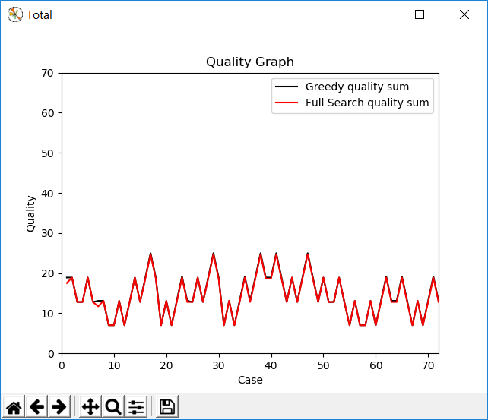
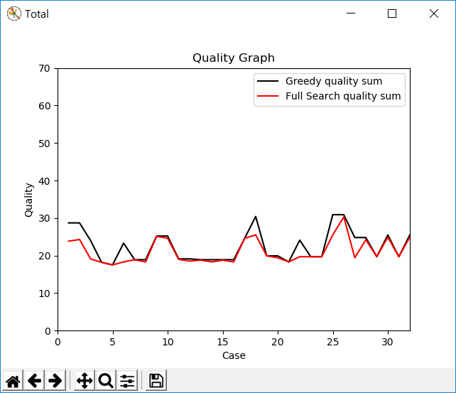
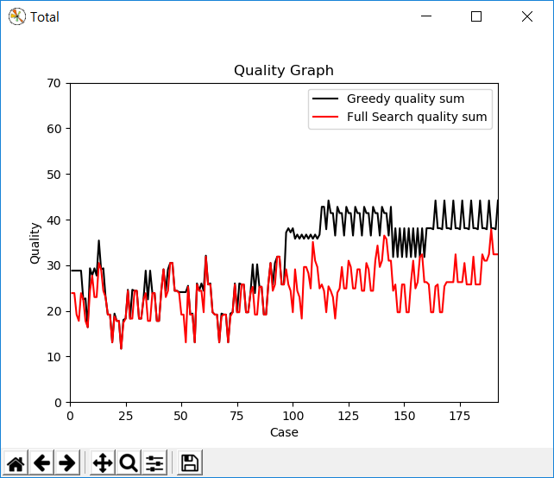
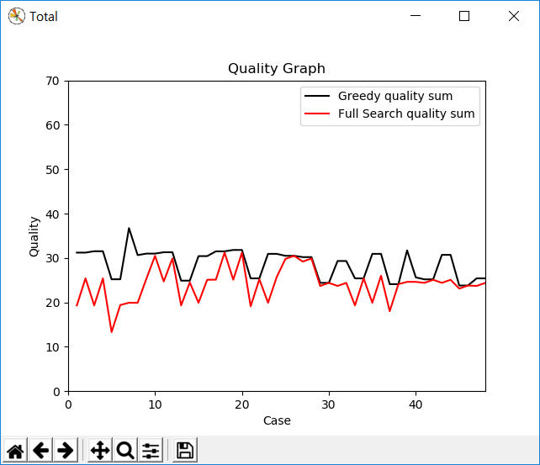
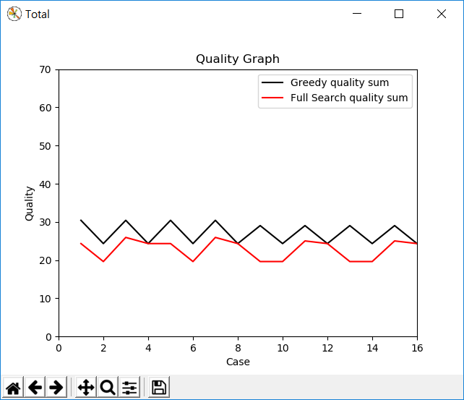
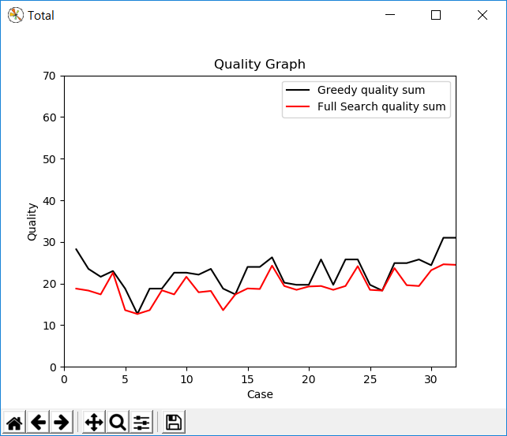
Simulation Result
7UEs and 3APs

Slide 6

Simulation Result
7UEs and 3APs
Time complexity
Greedy
$O\left({(M)}^{N}∗NM\right)$
Not working when the number of UEs > 20
Full Search
$O\left({(M)}^{N}∗{(LM)}^{N}\right)$
Not working when the number of UEs > 8

Slide 7


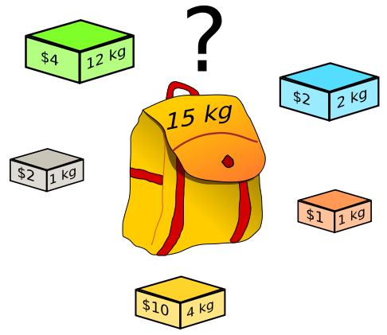




Multiple Knapsack Problem
Compare with 0/1 Multiple Knapsack Problem
Common
Item = UE
Knapsack = AP
Time slot = Weight
Price = Utility function(Quality)
<https://ko.wikipedia.org/wiki/배낭_문제>
Notes:
공통점 짧게 하기
Formulation 짧게 보여주기(AP load 설명)

Slide 8
Multiple Knapsack Problem
Compare with 0/1 Multiple Knapsack Problem
Difference (because of bandwidth)
Not unique weight (time slot)
MKP: each item has unique weight value
This: time slot value depends on AP
Not unique price (quality)
MKP: each item has unique price
This: quality depends on AP or network condition
➔It is difficult to use MKP solution without modification
1200kbps
2000kbps
900kbps

Slide 9
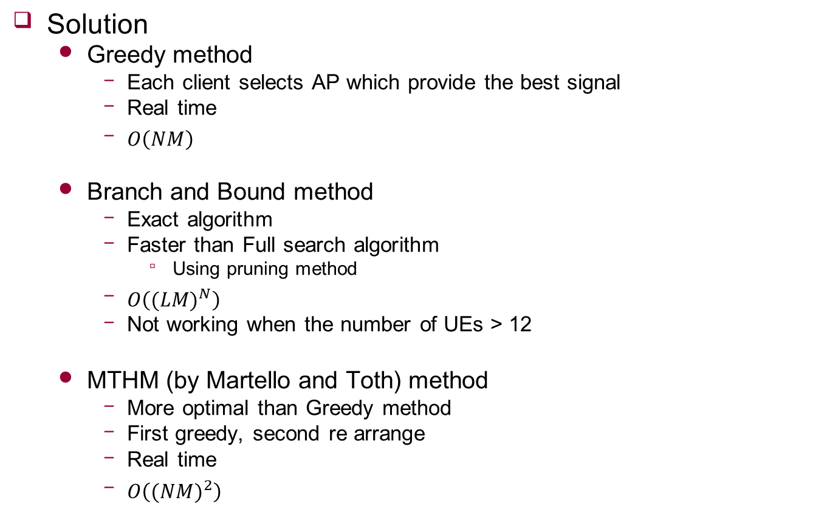
Multiple Knapsack Problem
Solution
Greedy method
Each client selects AP which provide the best signal
Real time
$O\left(NM\right)$
Branch and Bound method
Exact algorithm
Faster than Full search algorithm
Using pruning method
$O\left({(LM)}^{N}\right)$
Not working when the number of UEs > 12
MTHM (by Martello and Toth) method
More optimal than Greedy method
First greedy, second re arrange
Real time
$O\left({(NM)}^{2}\right)$

Slide 10
Multiple Knapsack Problem
Compare Branch and Bound with Full Search
7UEs and 3APs
Full Search: 0.2081 sec (53 times)
Branch and Bound: 0.0039 sec
 |  | 1 | 2 | 3 | 4 | 5 | 6 | 7 | 8 | 9 | 10
Full Search | Quality | 11.70 | 18.81 | 18.40 | 17.79 | 7 | 24.78 | 7 | 12.80 | 24.31 | 18.89
 | Time | 0.0342 | 0.0270 | 0.0871 | 0.0428 | 0.5582 | 0.3586 | 0.1167 | 0.6196 | 0.2233 | 0.0873
Branch and Bound | Quality | 11.70 | 18.81 | 18.40 | 17.79 | 7 | 24.78 | 7 | 12.80 | 24.31 | 18.89
 | Time | 0.0034 | 0.0036 | 0.0056 | 0.0017 | 0.0023 | 0.0092 | 0.0003 | 0.0147 | 0.0071 | 0.0044
 |  | 11 | 12 | 13 | 14 | 15 | 16 | 17 | 18 | 19 | 20
Full Search | Quality | 7 | 13.60 | 18.02 | 18.71 | 19.63 | 12.40 | 26.00 | 7 | 7 | 13.60
 | Time | 0.1057 | 0.2191 | 0.0686 | 0.1144 | 0.0351 | 0.0826 | 0.0217 | 1.1052 | 0.2345 | 0.0200
Branch and Bound | Quality | 7 | 13.60 | 18.02 | 18.71 | 19.63 | 12.40 | 26.00 | 7 | 7 | 13.60
 | Time | 0.0016 | 0.0071 | 0.0050 | 0.0035 | 0.0017 | 0.0021 | 0.0015 | 0.0006 | 0.0003 | 0.0031

Slide 11
Multiple Knapsack Problem
Compare MKP Solutions
12UEs and 5APs
Greedy: 26.62, 0.00141 sec
MTHM: 25.27, 0.00531 sec (3.8 times)
Branch and Bound: 20.59, 0.68131sec (483 times)
 |  | 1 | 2 | 3 | 4 | 5 | 6 | 7 | 8 | 9 | 10
Greedy | Quality | 41.73 | 29.11 | 24.32 | 22.39 | 12 | 23.77 | 28.92 | 18.00 | 36.58 | 29.33
 | Time | 0.00173 | 0.00171 | 0.00157 | 0.00113 | 0.00171 | 0.00108 | 0.00107 | 0.00133 | 0.00138 | 0.00143
MTHM | Quality | 35.93 | 27.72 | 24.32 | 22.39 | 12 | 23.77 | 28.92 | 18.00 | 36.58 | 23.02
 | Time | 0.00470 | 0.00683 | 0.00401 | 0.00638 | 0.00457 | 0.00304 | 0.00609 | 0.00443 | 0.00766 | 0.00538
Branch and Bound | Quality | 23.71 | 24.40 | 23.02 | 17.68 | 12 | 16.70 | 23.02 | 17.68 | 35.71 | 12
 | Time | 0.58185 | 0.42379 | 0.26578 | 0.03243 | 0.00098 | 0.07479 | 4.27024 | 0.83596 | 0.26223 | 0.06502

Slide 12
Future work
Algorithm
Modify algorithm
Bandwidth Estimation
Use PLR and RTT

