Slide 1
Research Jae Jun Ha Media Computing and Networking Laboratory POSTCH 2019-12-27
Notes:
발표 시작하겠습니다

Slide 2
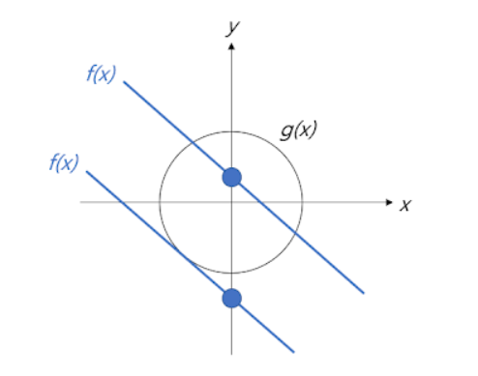
Lagrange Multiplier
Meaning of Lagrange Multiplier
Idea
Make one function combing cost function and constraint to derive variables which make maximizing cost function
Geometric meaning
Min or max value may exist at the junction of f(x) and g(x)
f(x): cost function
g(x): constraint
< http://arkainoh.blogspot.com/2017/10/lagrange.multiplier.method.html >

Slide 3

Lagrange Multiplier
Meaning of Lagrange Multiplier
Geometric meaning
The Lagrange multiplier uses the concept of gradient to describe this relationship
At the point where f(x) and g(x) meet, the gradients of the two functions are constant multiples of each other
$∇f=λ∇g$
f(x): cost function
g(x): constraint
< http://arkainoh.blogspot.com/2017/10/lagrange.multiplier.method.html >

Slide 4

Lagrange Multiplier
Example
$f\left(x,y\right):x^{2}+y^{2}, g\left(x,y\right):3x−y−4=0$
$∇f\left(x,y\right)=<2x,2y>,∇g\left(x,y\right)=<3,−1>$
From $∇f\left(x,y\right)=λ∇g\left(x,y\right)$
$<2x,2y>=λ<3,−1>$
$2x=3λ, 2y=−λ$ ①
Insert ① into $g\left(x,y\right)$
$10y=−4$
point is $∴(\frac{6}{5},−\frac{2}{5})$
< https://m.blog.naver.com/dydrogud22/220249087798 >
…

Slide 5
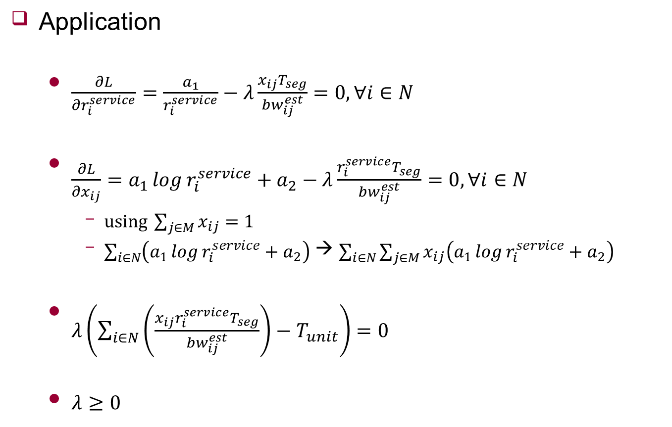
Design
Application
$\frac{∂L}{∂r_{i}^{service}}=\frac{a_{1}}{r_{i}^{service}}−λ\frac{x_{ij}T_{seg}}{{bw}_{ij}^{est}}=0,∀i∈N$
$\frac{∂L}{∂x_{ij}}=a_{1}\log{r_{i}^{service}}+a_{2}−λ\frac{r_{i}^{service}T_{seg}}{{bw}_{ij}^{est}}=0,∀i∈N$
$using \sum_{j∈M}{x_{ij}}=1$
$\sum_{i∈N}{\left(a_{1}\log{r_{i}^{service}}+a_{2}\right)}$ → $\sum_{i∈N}{\sum_{j∈M}{x_{ij}\left(a_{1}\log{r_{i}^{service}}+a_{2}\right)}}$
$λ\left(\sum_{i∈N}{\left(\frac{x_{ij}r_{i}^{service}T_{seg}}{{bw}_{ij}^{est}}\right)}−T_{unit}\right)=0$
$λ≥0$

Slide 6
Design
Hwanwook Lee’s algorithm
Make matrix from Lagrange Multiplier method
Using Levenberg-marquardt algorithm and derive r, x
Using candidate r using MPD representation set
Find r, x which maximizing utility function
Notes:
하지만 제 문제의 경우 multipath를 고려하기 때문에 방정식에 비해 미지수가 너무 많습니다.
그렇기 때문에 lambda값과 chunk ratio를 나타내는 x값을 각각 iteration 후 bitrate와 chunk ratio를 결정하는 방식으로 진행하려 합니다.

Slide 7
Future Work
Complement algorithm

