Slide 1
Research Jae Jun Ha Media Computing and Networking Laboratory POSTECH 2019-02-01
Notes:
세미나 발표를 시작하겠습니다.

Slide 2
Contents
Structure
Previous structure, Problem of OVS
Modified structure
Problem
Simulation
Future Work

Slide 3
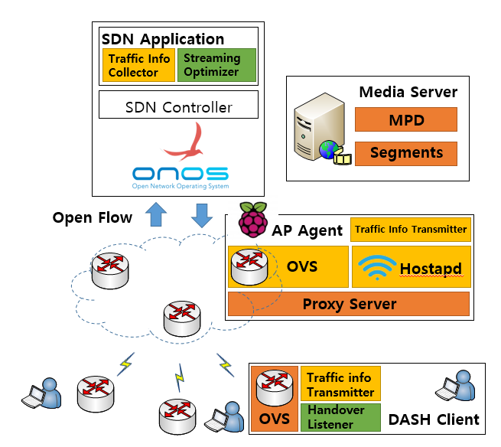
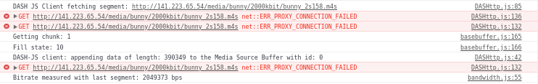
Structure
Previous structure
Because of OVS, when client changes other AP
there is some delay
Notes:
기존에 클라이언트에 OVS를 설치 하여 Open Flow 메시지를 통해 ONOS controller에게 해당 정보 제공할 예정
하지만 AP 바꿀 때마다 리눅스의 dhclient 명령어를 통해 arp 경로 설정, 이 때문에 delay 발생

Slide 4
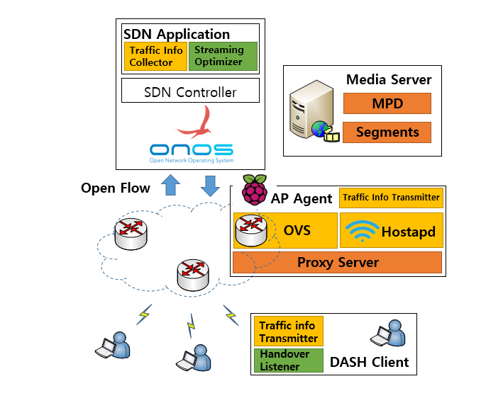
Structure
Modified structure
Clients request segment using HTTP
Because of DASH property
So, The client and the proxy server
communicate using the HTTP protocol.
The client will send the status information
to the Proxy via an HTTP Post
message.
The proxy will collect the AP and Client
information at one time and send it to
the SDN Controller.

Slide 5
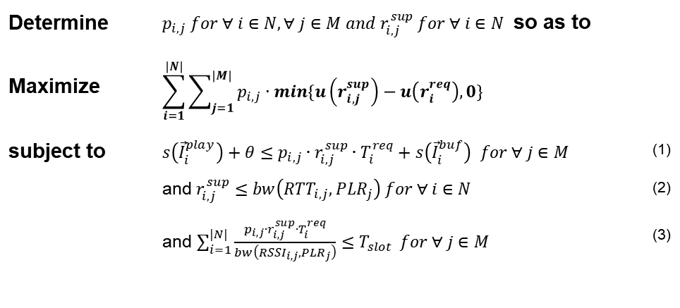
Problem
Formulation
Determine | $p_{i,j} for ∀ i∈N, ∀ j∈M and r_{i,j}^{sup} for ∀ i∈N$ so as to
Maximize | $$\sum_{i=1}^{|N|}{\sum_{j=1}^{|M|}{p_{i,j}∙min\{u\left(r_{i,j}^{sup}\right)−u\left(r_{i}^{req}\right),0\}}}$$
subject to | $s\left({\vec{I}}_{i}^{play}\right)+θ≤p_{i,j}∙r_{i,j}^{sup}∙T_{i}^{req}+s\left({\vec{I}}_{i}^{buf}\right) for ∀ j∈M$ | (1)
 | and $r_{i,j}^{sup}≤bw\left({RTT}_{i,j},{PLR}_{j}\right) for ∀ i∈N$ | (2)
 | and $\sum_{i=1}^{|N|}{\frac{p_{i,j}∙r_{i,j}^{sup}∙T_{i}^{req}}{bw\left({RSSI}_{i,j},{PLR}_{j}\right)}≤T_{slot}} for ∀ j∈M$ | (3)
Notes:
(1)은 버퍼에 따라 bitrate 조절(일시적)
(2)는 클라이언트가 받는 bandwidth로 판단
(3)은 AP의 로드

Slide 6

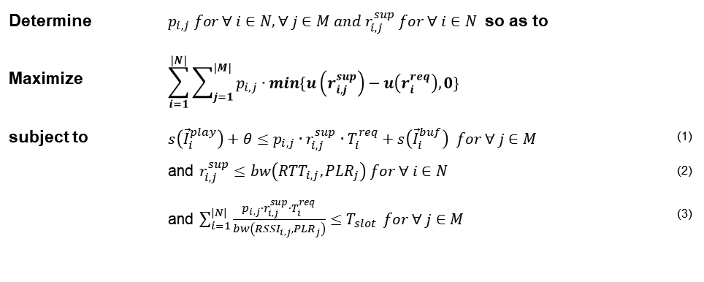

Problem
Formulation
If there are APs which can fulfill UE's request [$bw\left({RTT}_{i,j},{PLR}_{j}\right)≥r_{i}^{req}$]
Select possible AP [constraint 3] and
Select bitrate [constraint 1, 2 and $r_{i,j}^{sup}≅r_{i}^{req}$]
Others [$bw\left({RTT}_{i,j},{PLR}_{j}\right)<r_{i}^{req}$]
Check each APs(m)
Sort UE by requested bitrate ($O(n∙\log{n})$ )
Choose K UEs which have high requested bitrate
Decrease K UE’s bitrate one step until total QoE is maximized ($O(L^{K})$, $L$ is the number of bitrate level )
Estimate available bitrate [using constraint 3] and
Select bitrate [using constraint 1, 2 and $r_{i,j}^{sup}≅r_{i}^{req}$]
Change other APs (K UE) ($O(m^{K})$)
Estimate possible AP [using constraint 3] and
Select bitrate [using constraint 1, 2 and $r_{i,j}^{sup}≅r_{i}^{req}$]
Choose best case which maximizes total QoE
Consider two cases ($O(n∙m∙{(L∙m)}^{K}∙\log{n}))$
Determine | $p_{i,j} for ∀ i∈N, ∀ j∈M and r_{i,j}^{sup} for ∀ i∈N$ so as to
Maximize | $$\sum_{i=1}^{|N|}{\sum_{j=1}^{|M|}{p_{i,j}∙min\{u\left(r_{i,j}^{sup}\right)−u\left(r_{i}^{req}\right),0\}}}$$
subject to | $s\left({\vec{I}}_{i}^{play}\right)+θ≤p_{i,j}∙r_{i,j}^{sup}∙T_{i}^{req}+s\left({\vec{I}}_{i}^{buf}\right) for ∀ j∈M$ | (1)
 | and $r_{i,j}^{sup}≤bw\left({RTT}_{i,j},{PLR}_{j}\right) for ∀ i∈N$ | (2)
 | and $\sum_{i=1}^{|N|}{\frac{p_{i,j}∙r_{i,j}^{sup}∙T_{i}^{req}}{bw\left({RSSI}_{i,j},{PLR}_{j}\right)}≤T_{slot}} for ∀ j∈M$ | (3)
K
↓
Notes:
(1)은 버퍼에 따라 bitrate 조절(일시적)
(2)는 클라이언트가 받는 bandwidth로 판단
(3)은 AP의 로드
연결 안된 것의 RTT와 PLR은 어떻게?
이전 연결된 것의 통계적 정보를 활용한다.

Slide 7
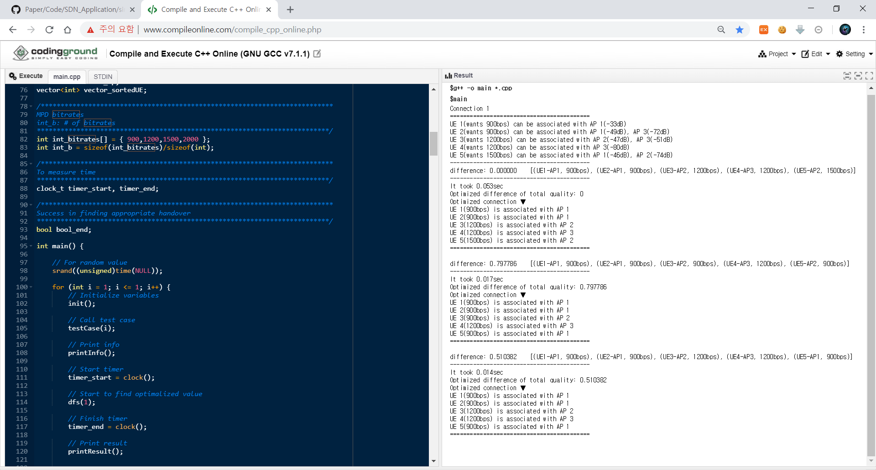


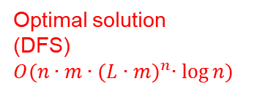
Simulation
Compares three cases
Optimal solution
(DFS)
$$O(n∙m∙{(L∙m)}^{n}∙\log{n})$$
Proposal algorithm
$$O(n∙m∙{(L∙m)}^{K}∙\log{n})$$
Greedy algorithm
$$O(n∙m∙L)$$

Slide 8
Future work
Make Simulation
Evaluates utility function
Whether optimal solution or not
Compares three case
Optimal solution (Using DFS)
Proposal algorithm
Greedy algorithm

