Slide 1
Case
Video
Big Buck Bunny: UE 1, UE 2, UE 5
Elephants Dream: UE 3, UE 4
-71dB
-73dB
-70dB
-73dB
-72dB
-61dB
-59dB
-74dB
-70dB
-72dB

Slide 2
Case
Lambda
25, (Min: 0, Max: 50)
Bitrate
Bitrate : [1500, 2000, 1500, 1500, 2000]
Timeslot
AP 1: 0.84
AP 2: 3.56
1702
1515
1781
1515
1614
2208
2258
1405
1614
1781
(0/1)
(0/1)
(1/0)
(0/1)
(0/1)

Slide 3
Case
Lambda
25, (Min: 0, Max: 50)
Bitrate
Bitrate : [1500, 2000, 1500, 1500, 2000]
Timeslot
AP 1: 2.26
AP 2: 2.26
1702
1515
1781
1515
1614
2208
2258
1405
1614
1781
(0/1)
(0/1)
(0.5/0.5)
(0/1)
(0/1)

Slide 4
Case
Lambda
37.5, (Min: 25, Max: 50)
Bitrate
Bitrate : [1200, 1500, 1200, 900, 1500]
Timeslot
AP 1: 1.70
AP 2: 1.62
1702
1515
1781
1515
1614
2208
2258
1405
1614
1781
(0/1)
(0/1)
(0.5/0.5)
(0/1)
(0/1)

Slide 5
Case
Lambda
31.25, (Min: 25, Max: 37.5)
Bitrate
Bitrate : [1200, 1500, 1500, 1200, 1500]
Timeslot
AP 1: 1.97
AP 2: 1.72
1702
1515
1781
1515
1614
2208
2258
1405
1614
1781
(0/1)
(0/1)
(0.5/0.5)
(0/1)
(0/1)

Slide 6
Case
Lambda
28.125, (Min: 25, Max: 31.25)
Bitrate
Bitrate : [1500, 2000, 1500, 1200, 2000]
Timeslot
AP 1: 2.15
AP 2: 2.16
1702
1515
1781
1515
1614
2208
2258
1405
1614
1781
(0/1)
(0/1)
(0.5/0.5)
(0/1)
(0/1)

Slide 7
Case
Lambda
29.6875, (Min: 28.125, Max: 31.25)
Bitrate
Bitrate : [1500, 2000, 1500, 1200, 2000]
Timeslot
AP 1: 2.15
AP 2: 2.16
1702
1515
1781
1515
1614
2208
2258
1405
1614
1781
(0/1)
(0/1)
(0.5/0.5)
(0/1)
(0/1)

Slide 8
Case
Lambda
30.46875, (Min: 29.6875, Max: 31.25)
Bitrate
Bitrate : [1200, 2000, 1500, 1200, 1500]
Timeslot
AP 1: 1.97
AP 2: 1.94
1702
1515
1781
1515
1614
2208
2258
1405
1614
1781
(0/1)
(0/1)
(0.5/0.5)
(0/1)
(0/1)

Slide 9


$x_{ij}$ Adjustment
Case
$\sum_{i=1}^{\left|N\right|}{t_{i,1}}<T_{slot}$ and $\sum_{i=1}^{\left|N\right|}{t_{i,2}}>T_{slot}$
$\sum_{i=1}^{\left|N\right|}{t_{i,1}}>T_{slot}$ and $\sum_{i=1}^{\left|N\right|}{t_{i,2}}<T_{slot}$
Need to make below condition
$\sum_{i=1}^{\left|N\right|}{t_{i,1}}>T_{slot}$ and $\sum_{i=1}^{\left|N\right|}{t_{i,2}}>T_{slot}$
$\sum_{i=1}^{\left|N\right|}{t_{i,1}}<T_{slot}$ and $\sum_{i=1}^{\left|N\right|}{t_{i,2}}<T_{slot}$

Slide 10
Memo for seminar

Slide 11
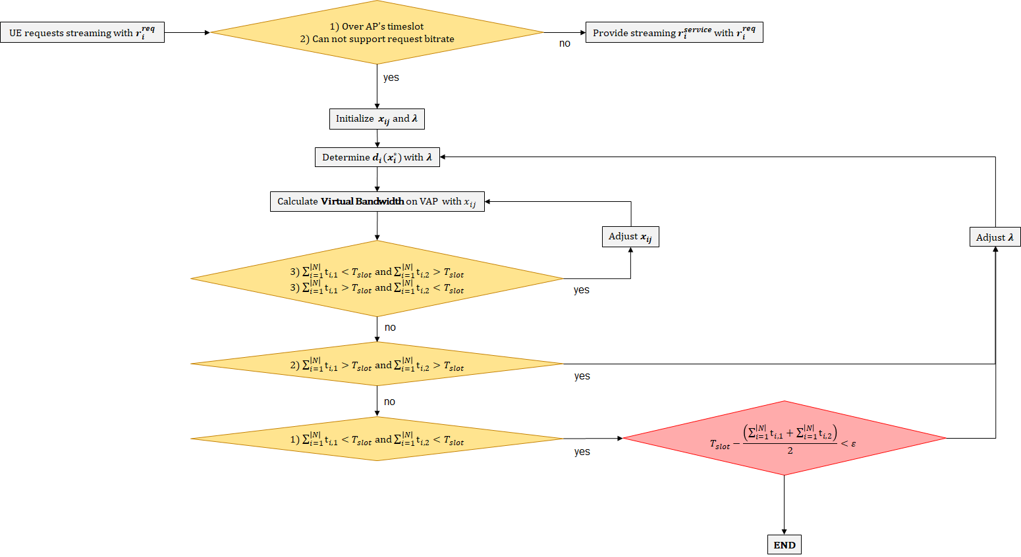
Consider Congestion
Congestion

Slide 12





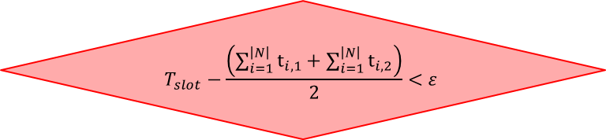
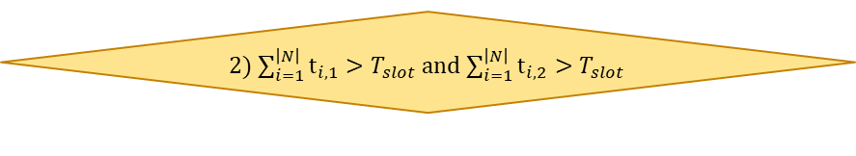
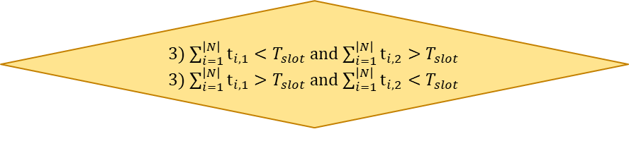

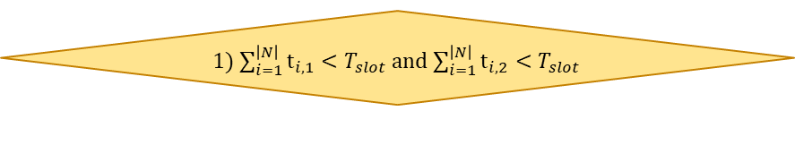

Appendix
Loop
1) Over AP’s timeslot
2) Can not support request bitrate
UE requests streaming with $r_{i}^{req}$
Provide streaming $r_{i}^{service}$ with $r_{i}^{req}$
no
yes
Initialize $x_{ij}$ and $λ$
Determine $d_{i}(x_{i}^{∗})$ with $λ$
Calculate Virtual Bandwidth on VAP with $x_{ij}$
Adjust $x_{ij}$
Adjust $λ$
3) $\sum_{i=1}^{\left|N\right|}{t_{i,1}}<T_{slot}$ and $\sum_{i=1}^{\left|N\right|}{t_{i,2}}>T_{slot}$
3) $\sum_{i=1}^{\left|N\right|}{t_{i,1}}>T_{slot}$ and $\sum_{i=1}^{\left|N\right|}{t_{i,2}}<T_{slot}$
yes
no
2) $\sum_{i=1}^{\left|N\right|}{t_{i,1}}>T_{slot}$ and $\sum_{i=1}^{\left|N\right|}{t_{i,2}}>T_{slot}$
yes
no
$$T_{slot}−\frac{\left(\sum_{i=1}^{\left|N\right|}{t_{i,1}}+\sum_{i=1}^{\left|N\right|}{t_{i,2}}\right)}{2}<ε$$
1) $\sum_{i=1}^{\left|N\right|}{t_{i,1}}<T_{slot}$ and $\sum_{i=1}^{\left|N\right|}{t_{i,2}}<T_{slot}$
yes
END

