Slide 1
Research Jae Jun Ha Media Computing and Networking Laboratory POSTCH 2020-05-01
Notes:
발표 시작하겠습니다.
오늘 발표 드릴 내용은 알고리즘에 관한 내용을 정리했습니다.

Slide 2
Contents
Introduction
Proposed Video Streaming Services
System Architecture
Problem Description
Proposed Algorithm
Experimental Results
Experiment Environments
Performance Comparison with Existing Algorithms
Conclusion
Notes:
30초

Slide 3
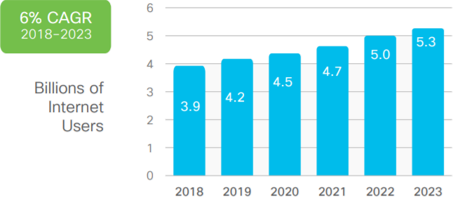
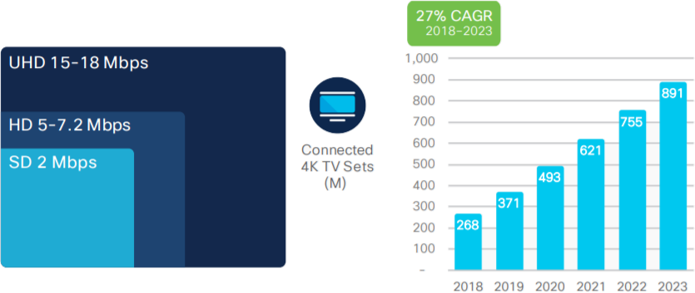
Introduction
Trend of traffic
The total number of Internet users is expected to increase from 3.9 billion in 2018 to 5.3 billion in 2023.
Video streaming had heavy effect on traffic
Over time, clients want higher quality video streaming.
< https://www.cisco.com/c/en/us/solutions/collateral/executive-perspectives/annual-internet-report/white-paper-c11-741490.html >
Notes:
30초
인터넷 사용자 증가 → traffic 증가 → bandwidth 관리 필요
특히 고품질의 비디오 스트링 서비스 요청 증가 (더 많은 대역폭이 필요)

Slide 4
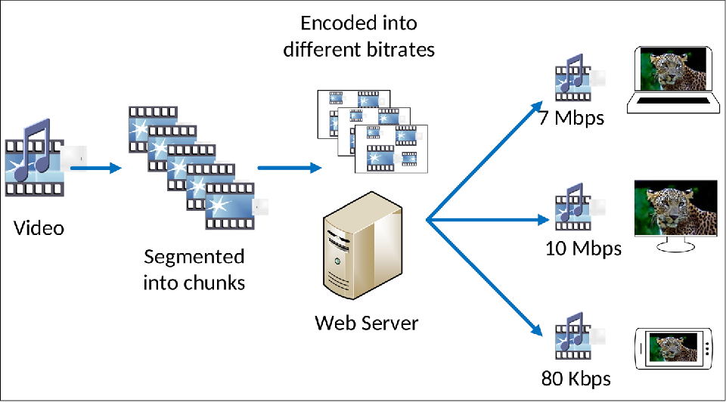
Introduction
DASH (Dynamic Adaptive Streaming over HTTP)
It is one of the adaptive bitrate streaming technologies that enables high quality streaming of media over the Internet, delivered from a traditional HTTP web server.
< https://www.semanticscholar.org/paper/Toward-a-full-peer-to-peer-MPEG-DASH-compliant-Gazdar-Alkwai/f64cc400bda95dc6b471c622378e3a7e2c853eb1 >
Notes:
1분
이러한 video traffic을 다루기 위한 기술로써 DASH가 있습니다.
세그먼트 잘게 쪼개 저장하는 것 설명

Slide 5
Introduction
Problem of DASH
However, DASH streaming has big issue.
Because this streaming technology considers each client situation, not the overall client, it causes unfairness of the overall resource usage.
480p
480p
1080p
144p
< Ideal case >
< A specific client preempts resource >
Notes:
1분
전체가 아닌 각 클라이언트 상황만 고려 → 자원 사용의 불공정성

Slide 6
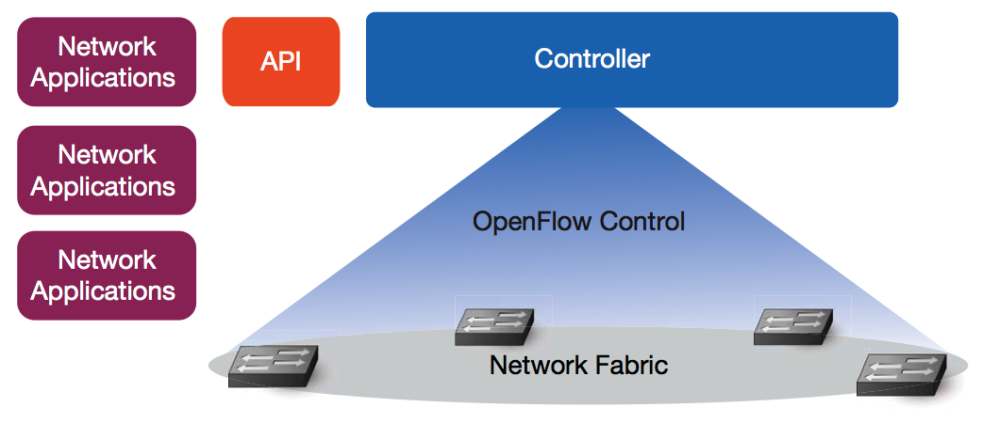
Introduction
SDN (Software Defined Networking)
SDN is composed of a structure that separates data planes and control planes of network equipment. It connects controllers and network equipment using Open Flow API.
Through the centralized structure on the controller, overall network is controlled. It enables efficient use of the network.
< http://www.spkr.co.kr/sdn-solution-guide/ >
Notes:
1분

Slide 7

Introduction
Multiple Wi-Fi connection
The wireless network situation is changing rapidly. So, it is necessary to use the resource according to the situation.
Through multiple interfaces, chunks can be received differently depending on the unstable wireless network situation.
< https://speedify.com/wp-content/uploads/combine-two-wifi.png >
Notes:
30초

Slide 8
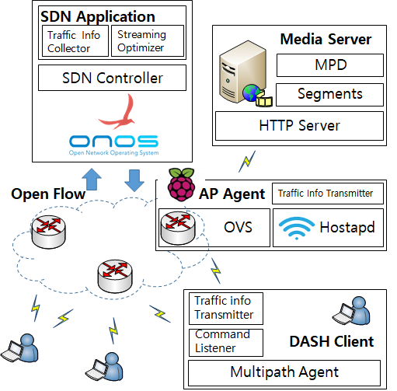
System Architecture
The system consists of four elements.
Notes:
3분

Slide 9
System Architecture
SDN Application periodically collects resource information.
Based on the collected resources, the bitrate and delivery ratio of the client are determined.
Notes:
3분

Slide 10
System Architecture
Media Server keeps MPD (Media Presentation Description) and videos.
it keeps the videos in segment units according to the encoding rate.
Notes:
3분

Slide 11
System Architecture
AP agent periodically provides resource information to SDN application.
Notes:
3분

Slide 12
System Architecture
DASH Client is a client that receives video streaming.
DASH Client connects to multiple APs using multiple interfaces.
Bitrate and delivery ratio are controlled by SDN Application.
Notes:
3분

Slide 13
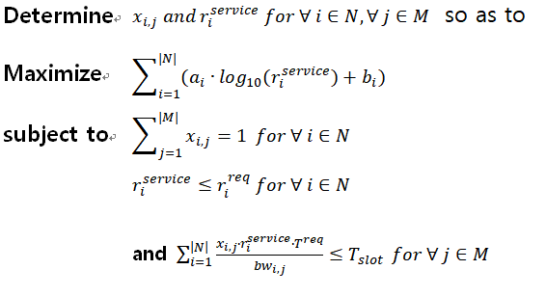
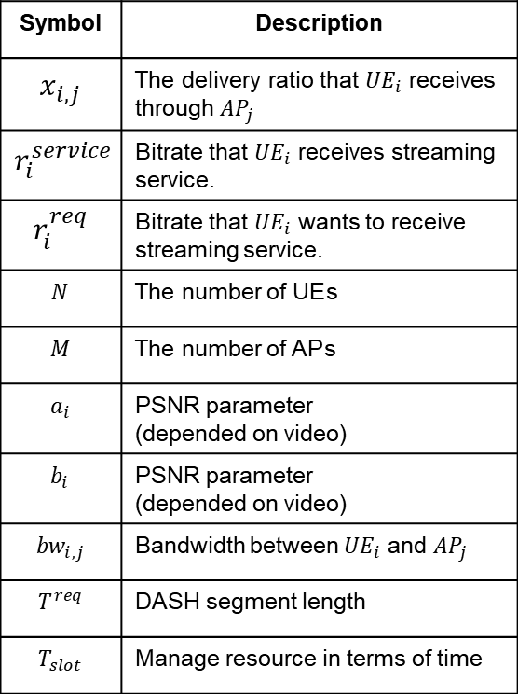
Problem Description
Problem Formulation
Symbol | Description
$$x_{i,j}$$ | The delivery ratio that ${UE}_{i}$ receives through ${AP}_{j}$
$$r_{i}^{service}$$ | Bitrate that ${UE}_{i}$ receives streaming service.
$$r_{i}^{req}$$ | Bitrate that ${UE}_{i}$ wants to receive streaming service.
$$N$$ | The number of UE s
$$M$$ | The number of AP s
$$a_{i}$$ | PSNR parameter (depended on video)
$$b_{i}$$ | PSNR parameter (depended on video)
$${bw}_{i,j}$$ | Bandwidth between ${UE}_{i}$ and ${AP}_{j}$
$$T_{}^{req}$$ | DASH segment length
$$T_{slot}$$ | Manage resource in terms of time
Notes:
3분
Proportional Fairness 보장하기 위해 Log 함수 사용

Slide 14






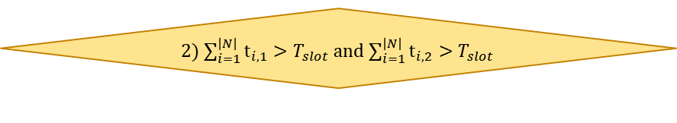


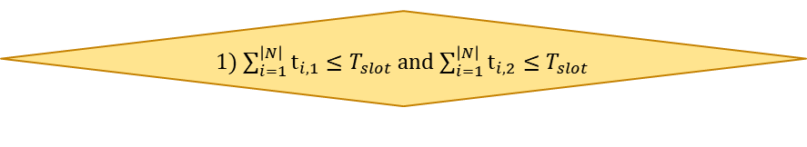

Algorithm
Request with $r_{i}^{req}$
Over AP’s timeslot
Provide streaming $r_{i}^{service}$ with $r_{i}^{req}$
no
yes
Initialize $x_{i,j}$ and $λ$
Determine $d_{i}(x_{i}^{∗})$ with $λ$
Calculate Virtual Bandwidth on VAP with $x_{i,j}$
Adjust $x_{i,j}$
Adjust $λ$
3) $\sum_{i=1}^{\left|N\right|}{t_{i,1}}≤T_{slot}$ and $\sum_{i=1}^{\left|N\right|}{t_{i,2}}>T_{slot}$
3) $\sum_{i=1}^{\left|N\right|}{t_{i,1}}>T_{slot}$ and $\sum_{i=1}^{\left|N\right|}{t_{i,2}}≤T_{slot}$
yes
no
2) $\sum_{i=1}^{\left|N\right|}{t_{i,1}}>T_{slot}$ and $\sum_{i=1}^{\left|N\right|}{t_{i,2}}>T_{slot}$
yes
no
1) $\sum_{i=1}^{\left|N\right|}{t_{i,1}}≤T_{slot}$ and $\sum_{i=1}^{\left|N\right|}{t_{i,2}}≤T_{slot}$
$$\left|λ−λ_{pre}\right|<ε^{′}$$
yes
END
Notes:
2분

Slide 15
Algorithm
Request with $r_{i}^{req}$
Over AP’s timeslot
Provide streaming $r_{i}^{service}$ with $r_{i}^{req}$
no
yes
Normal
Initialize $x_{i,j}$ and $λ$
Determine $d_{i}(x_{i}^{∗})$ with $λ$
Calculate Virtual Bandwidth on VAP with $x_{i,j}$
Adjust $x_{i,j}$
Adjust $λ$
3) $\sum_{i=1}^{\left|N\right|}{t_{i,1}}≤T_{slot}$ and $\sum_{i=1}^{\left|N\right|}{t_{i,2}}>T_{slot}$
3) $\sum_{i=1}^{\left|N\right|}{t_{i,1}}>T_{slot}$ and $\sum_{i=1}^{\left|N\right|}{t_{i,2}}≤T_{slot}$
yes
no
2) $\sum_{i=1}^{\left|N\right|}{t_{i,1}}>T_{slot}$ and $\sum_{i=1}^{\left|N\right|}{t_{i,2}}>T_{slot}$
yes
no
1) $\sum_{i=1}^{\left|N\right|}{t_{i,1}}≤T_{slot}$ and $\sum_{i=1}^{\left|N\right|}{t_{i,2}}≤T_{slot}$
$$\left|λ−λ_{pre}\right|<ε^{′}$$
yes
END
Notes:
2분

Slide 16
Algorithm
Request with $r_{i}^{req}$
Over AP’s timeslot
Provide streaming $r_{i}^{service}$ with $r_{i}^{req}$
no
yes
Initialize $x_{i,j}$ and $λ$
Congestion
Determine $d_{i}(x_{i}^{∗})$ with $λ$
Calculate Virtual Bandwidth on VAP with $x_{i,j}$
Adjust $x_{i,j}$
Adjust $λ$
3) $\sum_{i=1}^{\left|N\right|}{t_{i,1}}≤T_{slot}$ and $\sum_{i=1}^{\left|N\right|}{t_{i,2}}>T_{slot}$
3) $\sum_{i=1}^{\left|N\right|}{t_{i,1}}>T_{slot}$ and $\sum_{i=1}^{\left|N\right|}{t_{i,2}}≤T_{slot}$
yes
no
2) $\sum_{i=1}^{\left|N\right|}{t_{i,1}}>T_{slot}$ and $\sum_{i=1}^{\left|N\right|}{t_{i,2}}>T_{slot}$
yes
no
1) $\sum_{i=1}^{\left|N\right|}{t_{i,1}}≤T_{slot}$ and $\sum_{i=1}^{\left|N\right|}{t_{i,2}}≤T_{slot}$
$$\left|λ−λ_{pre}\right|<ε^{′}$$
yes
END
Notes:
2분

Slide 17
Algorithm
Request with $r_{i}^{req}$
Over AP’s timeslot
Provide streaming $r_{i}^{service}$ with $r_{i}^{req}$
no
yes
Initialize $x_{i,j}$ and $λ$
Congestion
Determine $d_{i}(x_{i}^{∗})$ with $λ$
Calculate Virtual Bandwidth on VAP with $x_{i,j}$
Adjust $x_{i,j}$
Adjust $λ$
3) $\sum_{i=1}^{\left|N\right|}{t_{i,1}}≤T_{slot}$ and $\sum_{i=1}^{\left|N\right|}{t_{i,2}}>T_{slot}$
3) $\sum_{i=1}^{\left|N\right|}{t_{i,1}}>T_{slot}$ and $\sum_{i=1}^{\left|N\right|}{t_{i,2}}≤T_{slot}$
yes
no
2) $\sum_{i=1}^{\left|N\right|}{t_{i,1}}>T_{slot}$ and $\sum_{i=1}^{\left|N\right|}{t_{i,2}}>T_{slot}$
yes
no
1) $\sum_{i=1}^{\left|N\right|}{t_{i,1}}≤T_{slot}$ and $\sum_{i=1}^{\left|N\right|}{t_{i,2}}≤T_{slot}$
$$\left|λ−λ_{pre}\right|<ε^{′}$$
yes
END
Notes:
2분
람다와 x에 관해 설명

Slide 18
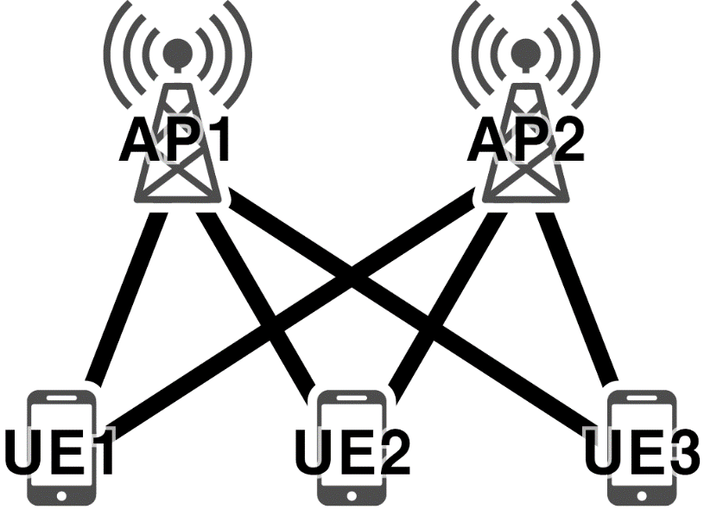
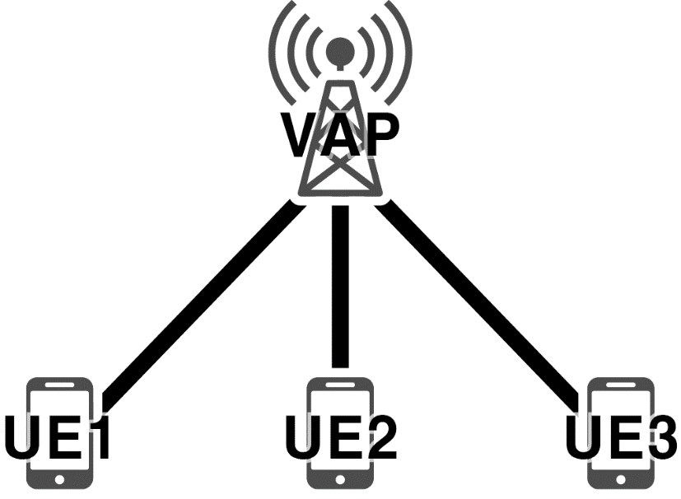
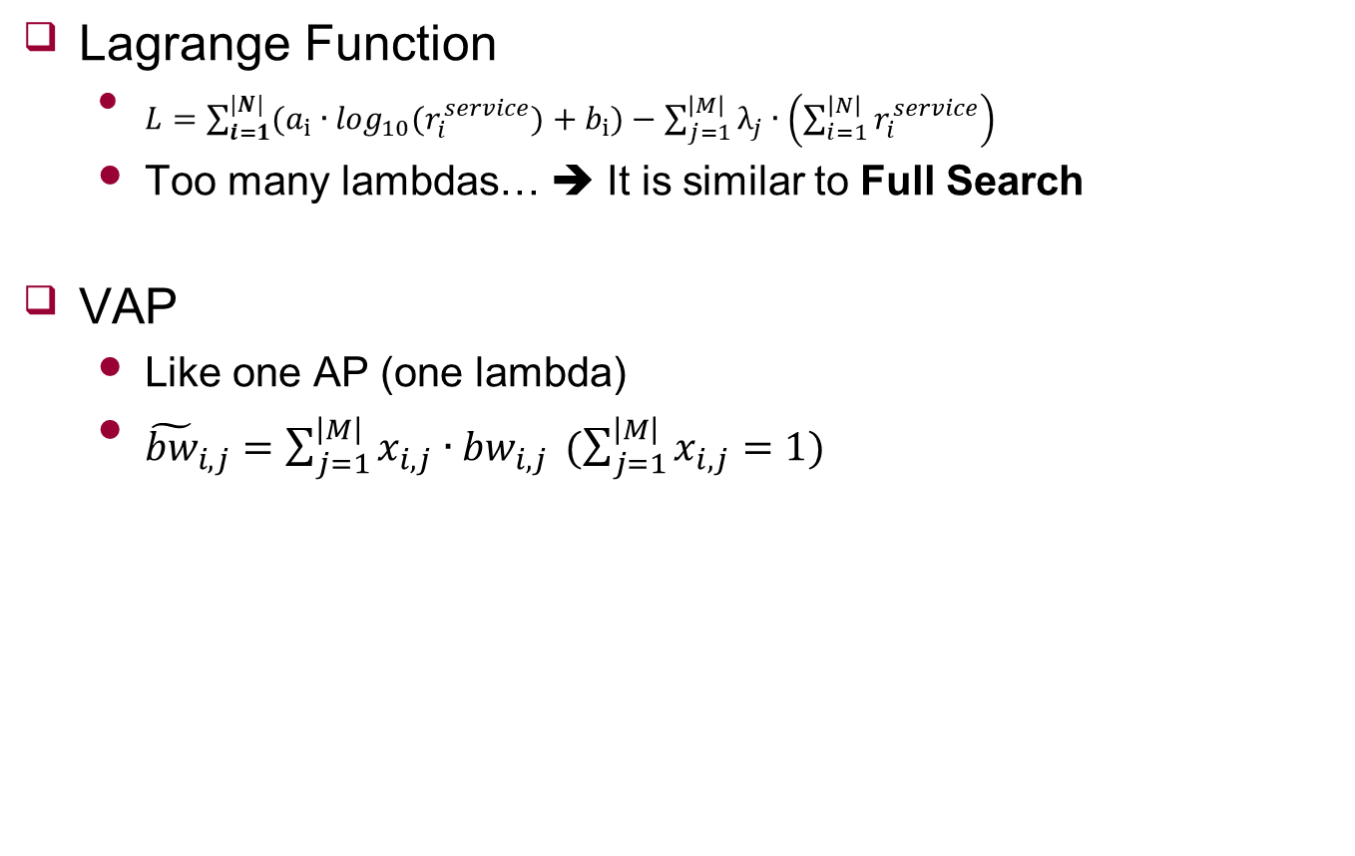
Algorithm
Lagrange Function
$L=\sum_{i=1}^{|N|}{(a_{i}∙\log_{10}(r_{i}^{service})+b_{i})}−\sum_{j=1}^{\left|M\right|}{λ_{j}∙\left(\sum_{i=1}^{\left|N\right|}{r_{i}^{service}}\right)}$
Too many lambdas… ➔ It is similar to Full Search
VAP
Like one AP (one lambda)
${\tilde{bw}}_{i,j}=\sum_{j=1}^{\left|M\right|}{x_{i,j}∙{bw}_{i,j}} (\sum_{j=1}^{\left|M\right|}{x_{i,j}}=1)$
Notes:
2분
Optimal solution 풀기 위해 Lagrange Multiplier 사용 한다는 것 설명
Lagrange Multiplier를 사용할 경우 AP 하나당 람다가 생기게 때문에 여러 개의 람다를 조절할 경우 Full Search 와 다를 바가 없음

Slide 19


Algorithm
Request with $r_{i}^{req}$
Over AP’s timeslot
Provide streaming $r_{i}^{service}$ with $r_{i}^{req}$
no
yes
Initialize $x_{i,j}$ and $λ$
$λ$ Adjustment
Determine $d_{i}(x_{i}^{∗})$ with $λ$
$x_{i,j}$ Adjustment
Calculate Virtual Bandwidth on VAP with $x_{i,j}$
Adjust $x_{i,j}$
Adjust $λ$
3) $\sum_{i=1}^{\left|N\right|}{t_{i,1}}≤T_{slot}$ and $\sum_{i=1}^{\left|N\right|}{t_{i,2}}>T_{slot}$
3) $\sum_{i=1}^{\left|N\right|}{t_{i,1}}>T_{slot}$ and $\sum_{i=1}^{\left|N\right|}{t_{i,2}}≤T_{slot}$
yes
no
2) $\sum_{i=1}^{\left|N\right|}{t_{i,1}}>T_{slot}$ and $\sum_{i=1}^{\left|N\right|}{t_{i,2}}>T_{slot}$
yes
no
1) $\sum_{i=1}^{\left|N\right|}{t_{i,1}}≤T_{slot}$ and $\sum_{i=1}^{\left|N\right|}{t_{i,2}}≤T_{slot}$
$$\left|λ−λ_{pre}\right|<ε^{′}$$
yes
END
Notes:
2분
Inner loop
Out loop

Slide 20
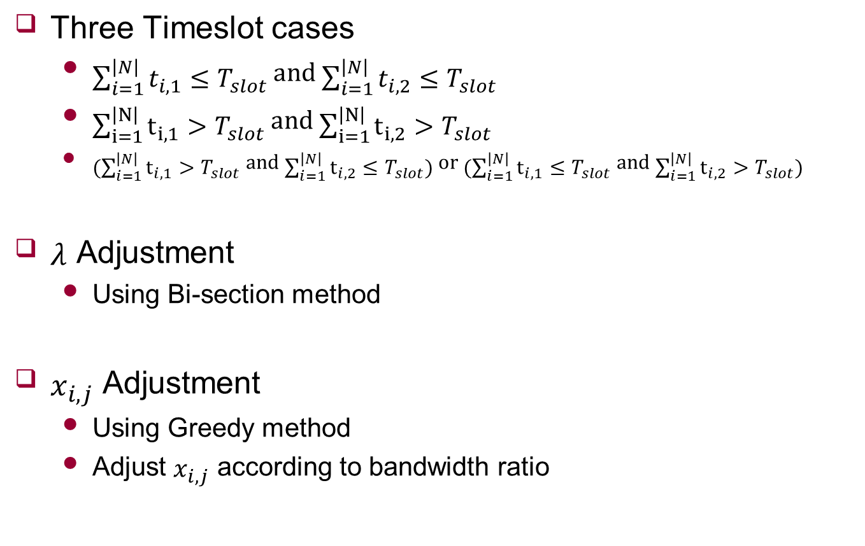


Algorithm
Three Timeslot cases
$\sum_{i=1}^{\left|N\right|}{t_{i,1}}≤T_{slot}$ and $\sum_{i=1}^{\left|N\right|}{t_{i,2}}≤T_{slot}$
$\sum_{i=1}^{\left|N\right|}{t_{i,1}}>T_{slot}$ and $\sum_{i=1}^{\left|N\right|}{t_{i,2}}>T_{slot}$
$(\sum_{i=1}^{\left|N\right|}{t_{i,1}}>T_{slot}$ and $\sum_{i=1}^{\left|N\right|}{t_{i,2}}≤T_{slot})$ or $(\sum_{i=1}^{\left|N\right|}{t_{i,1}}≤T_{slot}$ and $\sum_{i=1}^{\left|N\right|}{t_{i,2}}>T_{slot})$
$λ$ Adjustment
Using Bi-section method
$x_{i,j}$ Adjustment
Using Greedy method
Adjust $x_{i,j}$ according to bandwidth ratio
$λ$ Adjustment
$x_{i,j}$ Adjustment
Notes:
1분
Timeslot 설명하고

Slide 21
Future Work
Experiment
Conclusion

Slide 22
Appendix
Request with $r_{i}^{req}$
Over AP’s timeslot
Provide streaming $r_{i}^{service}$ with $r_{i}^{req}$
no
yes
Initialize $x_{i,j}$ and $λ$
Determine $d_{i}(x_{i}^{∗})$ with $λ$
Calculate Virtual Bandwidth on VAP with $x_{i,j}$
Adjust $x_{i,j}$
Adjust $λ$
3) $\sum_{i=1}^{\left|N\right|}{t_{i,1}}≤T_{slot}$ and $\sum_{i=1}^{\left|N\right|}{t_{i,2}}>T_{slot}$
3) $\sum_{i=1}^{\left|N\right|}{t_{i,1}}>T_{slot}$ and $\sum_{i=1}^{\left|N\right|}{t_{i,2}}≤T_{slot}$
yes
no
2) $\sum_{i=1}^{\left|N\right|}{t_{i,1}}>T_{slot}$ and $\sum_{i=1}^{\left|N\right|}{t_{i,2}}>T_{slot}$
yes
no
1) $\sum_{i=1}^{\left|N\right|}{t_{i,1}}≤T_{slot}$ and $\sum_{i=1}^{\left|N\right|}{t_{i,2}}≤T_{slot}$
$$\left|λ−λ_{pre}\right|<ε^{′}$$
yes
END

