Slide 1
Research Jae Jun Ha Media Computing and Networking Laboratory POSTCH 2020-01-23
Notes:
발표 시작하겠습니다

Slide 2
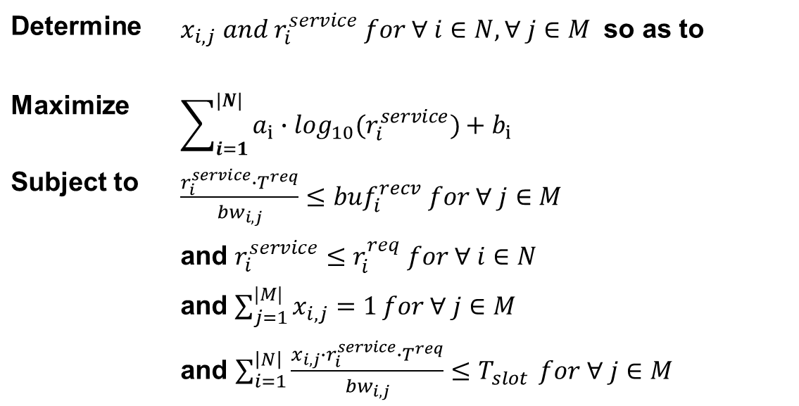
Formulation
Determine | $x_{i,j} and r_{i}^{service} for ∀ i∈N, ∀ j∈M$ so as to
Maximize | $$\sum_{i=1}^{|N|}{a_{i}∙\log_{10}(r_{i}^{service})+b_{i}}$$
Subject to | $\frac{r_{i}^{service}∙T^{req}}{{bw}_{i,j}}≤{buf}_{i}^{recv}$ $for ∀ j∈M$
 | and $r_{i}^{service}≤r_{i}^{req} for ∀ i∈N$
 | and $\sum_{j=1}^{|M|}{x_{i,j}=1}for ∀ j∈M$
 | and $\sum_{i=1}^{\left|N\right|}{\frac{x_{i,j}∙r_{i}^{service}∙T^{req}}{{bw}_{i,j}}≤T_{slot}} for ∀ j∈M$
Notes:
문제 풀기 어렵다.

Slide 3
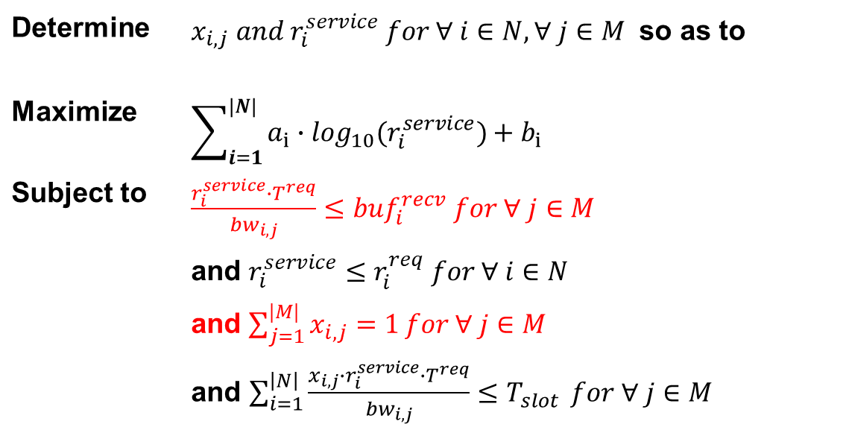
Formulation
Determine | $x_{i,j} and r_{i}^{service} for ∀ i∈N, ∀ j∈M$ so as to
Maximize | $$\sum_{i=1}^{|N|}{a_{i}∙\log_{10}(r_{i}^{service})+b_{i}}$$
Subject to | $\frac{r_{i}^{service}∙T^{req}}{{bw}_{i,j}}≤{buf}_{i}^{recv}$ $for ∀ j∈M$
 | and $r_{i}^{service}≤r_{i}^{req} for ∀ i∈N$
 | and $\sum_{j=1}^{|M|}{x_{i,j}=1}for ∀ j∈M$
 | and $\sum_{i=1}^{\left|N\right|}{\frac{x_{i,j}∙r_{i}^{service}∙T^{req}}{{bw}_{i,j}}≤T_{slot}} for ∀ j∈M$

Slide 4
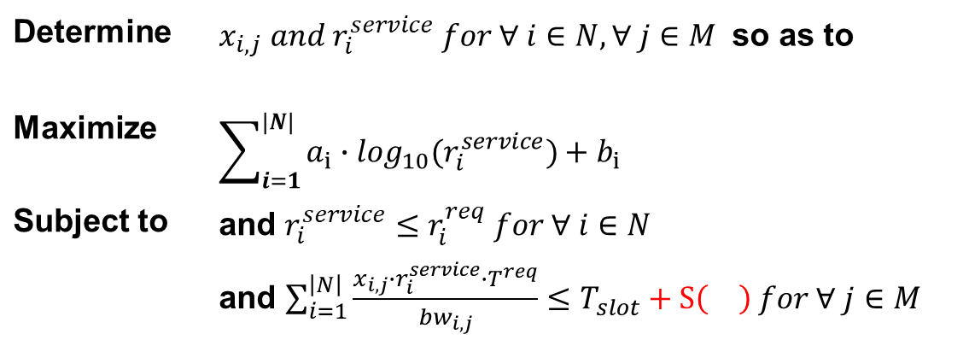
Formulation
Determine | $x_{i,j} and r_{i}^{service} for ∀ i∈N, ∀ j∈M$ so as to
Maximize | $$\sum_{i=1}^{|N|}{a_{i}∙\log_{10}(r_{i}^{service})+b_{i}}$$
Subject to | and $r_{i}^{service}≤r_{i}^{req} for ∀ i∈N$
 | and $\sum_{i=1}^{\left|N\right|}{\frac{x_{i,j}∙r_{i}^{service}∙T^{req}}{{bw}_{i,j}}}≤T_{slot}+S\left(\right) for ∀ j∈M$

Slide 5
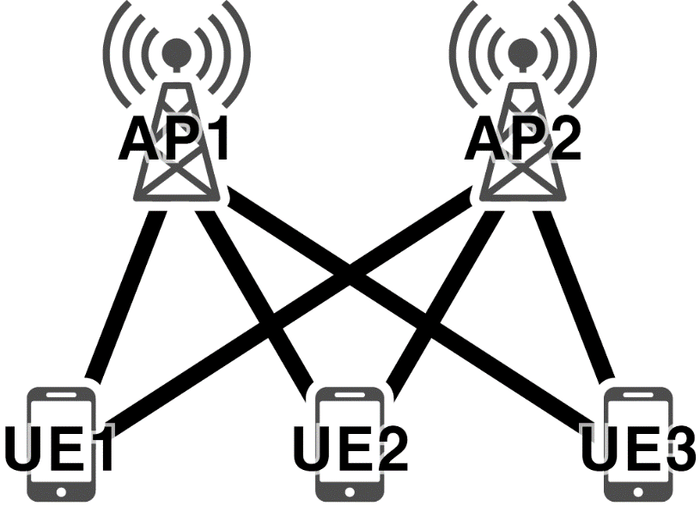
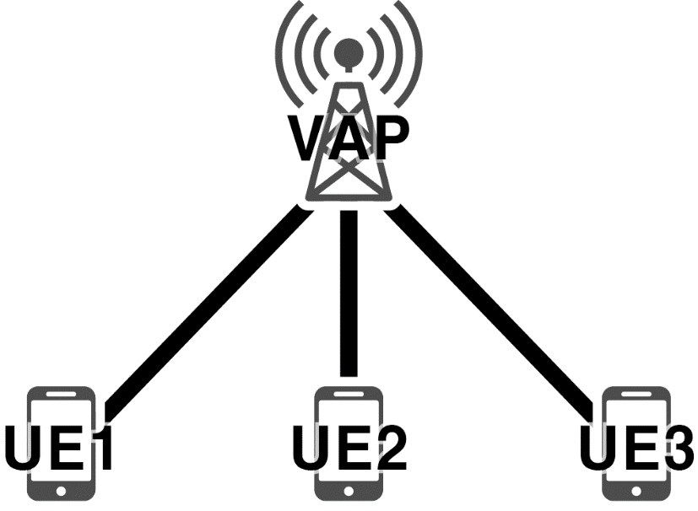

Lagrange Multiplier
Function
$L=\sum_{i=1}^{|N|}{(a_{i}∙\log_{10}(r_{i}^{service})+b_{i})}−\sum_{j=1}^{|M|}{λ_{j}∙(\sum_{i=1}^{\left|N\right|}{\frac{x_{i,j}∙r_{i}^{service}∙T^{req}}{{bw}_{i,j}}−T_{slot}−S\left(\right)})}$
VAP
Like one AP
Consider merged bandwidth
Each pair (UE – AP connection) has a different RSSI value
Notes:
마지막 제약조건만 고려한다고 해도 람다를 여러 개 사용해야합니다.
람다가 여러 개면 문제를 풀 수 없기 때문에 여러 AP를 하나로 뭉치는 방법

Slide 6

Lagrange Multiplier
Function
$L=\sum_{i=1}^{|N|}{(a_{i}∙\log_{10}(r_{i}^{service})+b_{i})}−\sum_{j=1}^{|M|}{λ_{j}∙(\sum_{i=1}^{\left|N\right|}{\frac{x_{i,j}∙r_{i}^{service}∙T^{req}}{{bw}_{i,j}}−T_{slot}−S\left(\right)})}$
$L=\sum_{i=1}^{|N|}{(a_{i}∙\log_{10}(r_{i}^{service})+b_{i})}−λ∙(\sum_{i=1}^{\left|N\right|}{\frac{r_{i}^{service}∙T^{req}}{{bw}_{i}}−T_{slot}}−S\left(\right))$

Slide 7

Lagrange Multiplier
Function
$L=\sum_{i=1}^{|N|}{(a_{i}∙\log_{10}(r_{i}^{service})+b_{i})}−λ∙(\sum_{i=1}^{\left|N\right|}{\frac{r_{i}^{service}∙T^{req}}{{bw}_{i}}}−T_{slot}−S\left(\right))$
$\frac{∂L}{∂r_{i}^{service}}=\frac{a_{i}}{r_{i}^{service}}−λ∙\frac{T^{req}}{{bw}_{i}}=0$
$\frac{a_{i}}{λ}=\frac{r_{i}^{service}∙T^{req}}{{bw}_{i}}$
$From \sum_{i=1}^{\left|N\right|}{\frac{r_{i}^{service}∙T^{req}}{{bw}_{i,j}}}≤T_{slot}+S\left(\right)$
$\sum_{i=1}^{\left|N\right|}{\frac{a_{i}}{λ}}≤T_{slot}+S\left(\right)$
$\frac{\sum_{i=1}^{\left|N\right|}{a_{i}}}{λ}≤T_{slot}+S\left(\right)$
$λ≥\frac{\sum_{i=1}^{\left|N\right|}{a_{i}}}{T_{slot}+S\left(\right)}$
Notes:
굳이 bi-section이나 gradient method 사용할 필요 없음
실제 bi-section을 통해 람다 값을 컴퓨터 써서 구하면 소수 3자리 부터 오차 있고 별 차이 없음

Slide 8
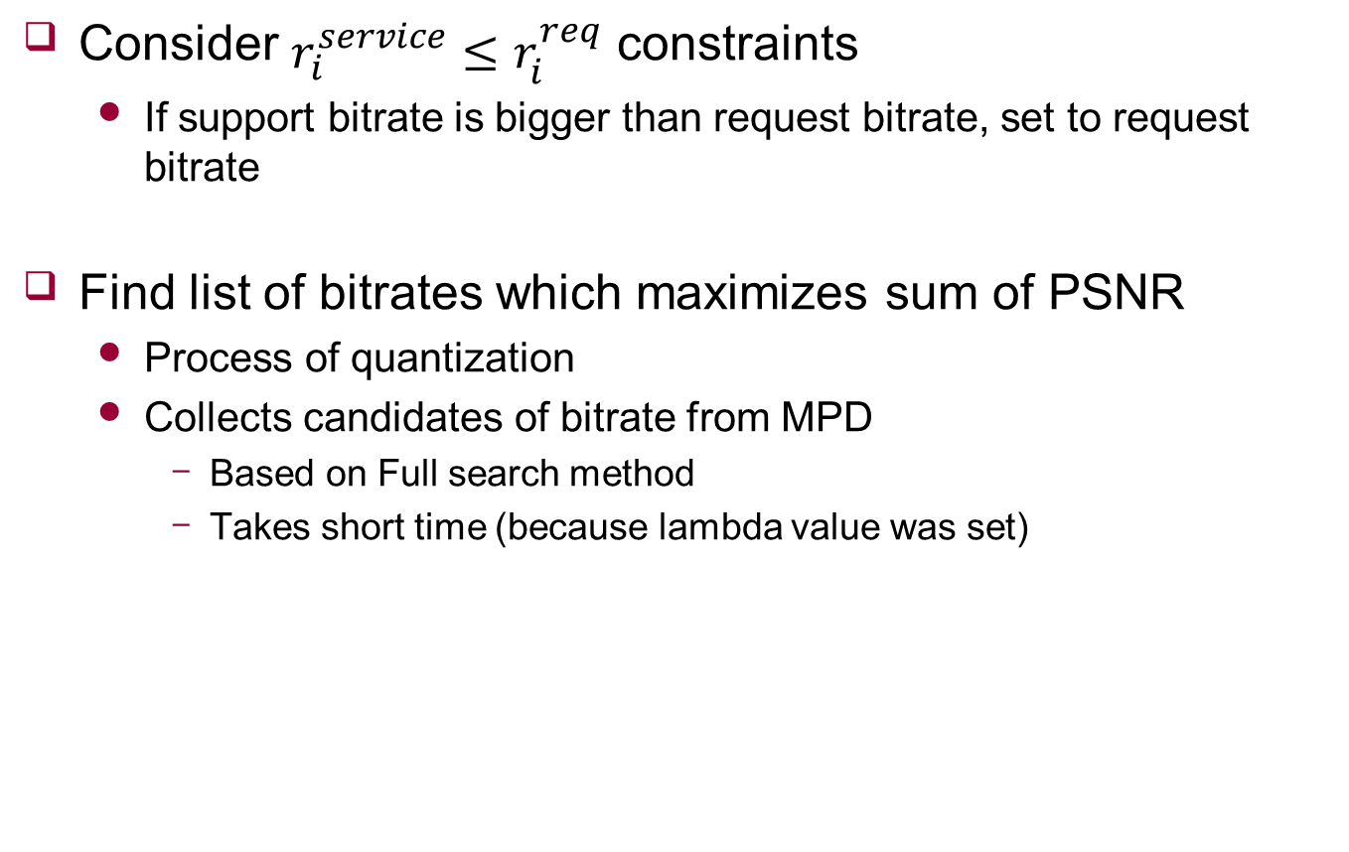
Algorithm
Consider $r_{i}^{service}≤r_{i}^{req}$ constraints
If support bitrate is bigger than request bitrate, set to request bitrate
Find list of bitrates which maximizes sum of PSNR
Process of quantization
Collects candidates of bitrate from MPD
Based on Full search method
Takes short time (because lambda value was set)

Slide 9
Algorithm
Function
List of bitrate was set

Slide 10
Algorithm
Function
List of bitrate was set
It means that each timeslot can be derived

Slide 11

Algorithm
Calculate $x$
Consider fairness

Slide 12

Algorithm
Calculate $x$
Consider fairness
Can calculate chunk ratio using
$\sum_{j=1}^{|M|}{x_{i,j}=1}for ∀ j∈M$
${bw}_{i,j}$ $for ∀ i∈N, ∀ j∈M$

