Slide 1
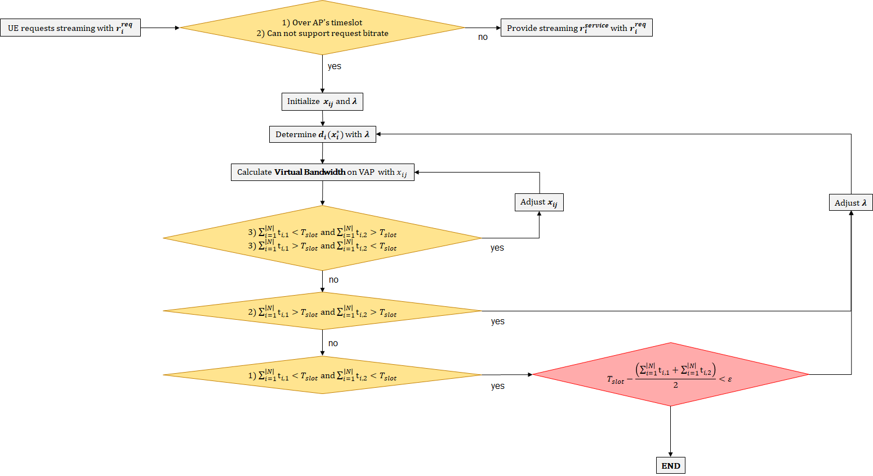
Algorithm
Outer loop
Inner loop

Slide 2
Algorithm
Outer loop
Inner loop

Slide 3
Algorithm
Outer loop
Inner loop

Slide 4
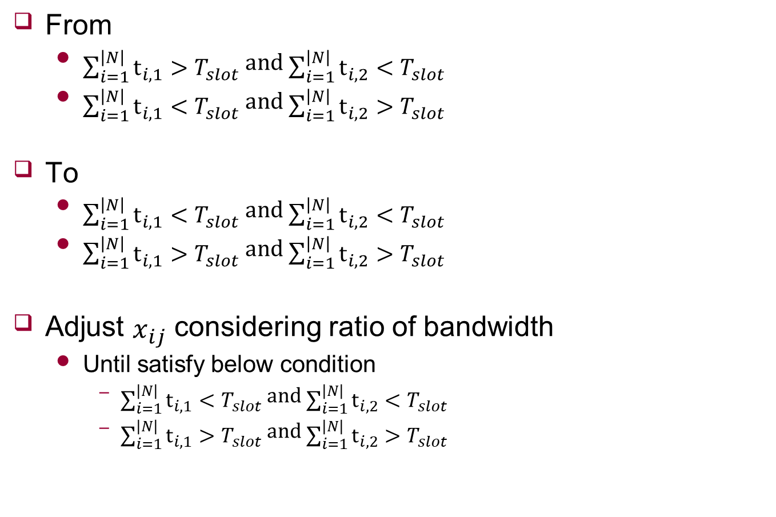

$x_{ij}$ Adjustment
From
$\sum_{i=1}^{\left|N\right|}{t_{i,1}}>T_{slot}$ and $\sum_{i=1}^{\left|N\right|}{t_{i,2}}<T_{slot}$
$\sum_{i=1}^{\left|N\right|}{t_{i,1}}<T_{slot}$ and $\sum_{i=1}^{\left|N\right|}{t_{i,2}}>T_{slot}$
To
$\sum_{i=1}^{\left|N\right|}{t_{i,1}}<T_{slot}$ and $\sum_{i=1}^{\left|N\right|}{t_{i,2}}<T_{slot}$
$\sum_{i=1}^{\left|N\right|}{t_{i,1}}>T_{slot}$ and $\sum_{i=1}^{\left|N\right|}{t_{i,2}}>T_{slot}$
Adjust $x_{ij}$ considering ratio of bandwidth
Until satisfy below condition
$\sum_{i=1}^{\left|N\right|}{t_{i,1}}<T_{slot}$ and $\sum_{i=1}^{\left|N\right|}{t_{i,2}}<T_{slot}$
$\sum_{i=1}^{\left|N\right|}{t_{i,1}}>T_{slot}$ and $\sum_{i=1}^{\left|N\right|}{t_{i,2}}>T_{slot}$

