Slide 1
Bandwidth
저번 세미나 Bandwidth 관련
Bandwidth를 random하게 생성한 것이 아니라 RSSI를 랜덤하게 생성하고 bandwidth는 아래 reference를 통해 mapping함
A. Y. Ding et al., “Vision: Augmenting WiFi offloading with an opensource collaborative platform,” in Proc. MCS, 2015, pp. 44–48.
-71dB
-69dB
-70dB
-70dB
-67dB
-67dB
-76dB
-64dB
-60dB
-67dB

Slide 2


$x_{ij}$ Adjustment
Case
$\sum_{i=1}^{\left|N\right|}{t_{i,1}}<T_{slot}$ and $\sum_{i=1}^{\left|N\right|}{t_{i,2}}>T_{slot}$
$\sum_{i=1}^{\left|N\right|}{t_{i,1}}>T_{slot}$ and $\sum_{i=1}^{\left|N\right|}{t_{i,2}}<T_{slot}$
Need to make below condition
$\sum_{i=1}^{\left|N\right|}{t_{i,1}}>T_{slot}$ and $\sum_{i=1}^{\left|N\right|}{t_{i,2}}>T_{slot}$
$\sum_{i=1}^{\left|N\right|}{t_{i,1}}<T_{slot}$ and $\sum_{i=1}^{\left|N\right|}{t_{i,2}}<T_{slot}$

Slide 3
Comparison
Consider only congestion situation
Over AP’s timeslot
Can not support request bitrate
Each case (random RSSI, videos)
UE 3 & AP 2 - 20 cases
UE 4 & AP 2 - 20 cases
UE 5 & AP 2 - 20 cases
 | UE 3 | UE 4 | UE 5
Multi | 43.21 | 42.02 | 40.69
Single | 41.99 | 40.82 | 39.95
Notes:
그냥 이 정도 gain이 나온다 정도 말하기

Slide 4
Memo for seminar

Slide 5
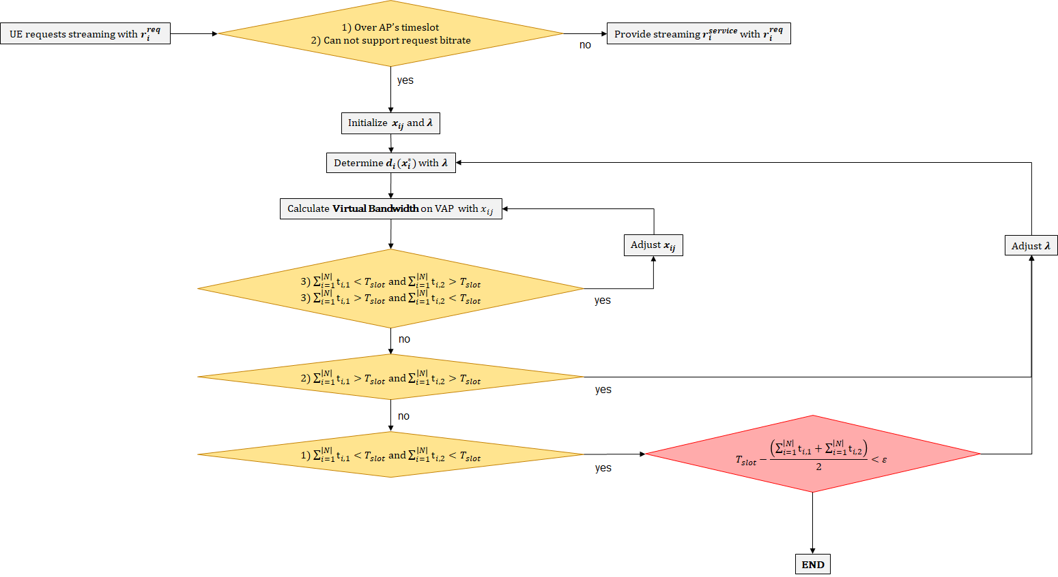
Consider Congestion
Congestion

Slide 6





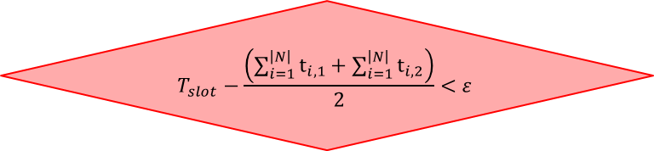





Appendix
Loop
1) Over AP’s timeslot
2) Can not support request bitrate
UE requests streaming with $r_{i}^{req}$
Provide streaming $r_{i}^{service}$ with $r_{i}^{req}$
no
yes
Initialize $x_{ij}$ and $λ$
Determine $d_{i}(x_{i}^{∗})$ with $λ$
Calculate Virtual Bandwidth on VAP with $x_{ij}$
Adjust $x_{ij}$
Adjust $λ$
3) $\sum_{i=1}^{\left|N\right|}{t_{i,1}}<T_{slot}$ and $\sum_{i=1}^{\left|N\right|}{t_{i,2}}>T_{slot}$
3) $\sum_{i=1}^{\left|N\right|}{t_{i,1}}>T_{slot}$ and $\sum_{i=1}^{\left|N\right|}{t_{i,2}}<T_{slot}$
yes
no
2) $\sum_{i=1}^{\left|N\right|}{t_{i,1}}>T_{slot}$ and $\sum_{i=1}^{\left|N\right|}{t_{i,2}}>T_{slot}$
yes
no
$$T_{slot}−\frac{\left(\sum_{i=1}^{\left|N\right|}{t_{i,1}}+\sum_{i=1}^{\left|N\right|}{t_{i,2}}\right)}{2}<ε$$
1) $\sum_{i=1}^{\left|N\right|}{t_{i,1}}<T_{slot}$ and $\sum_{i=1}^{\left|N\right|}{t_{i,2}}<T_{slot}$
yes
END

