Slide 1
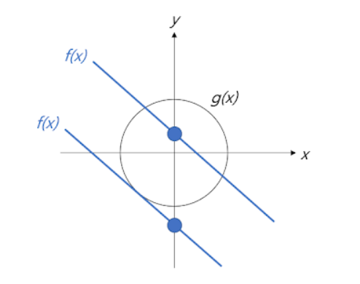
Lagrange Multiplier
Meaning of Lagrange Multiplier
Idea
Cost function과 constraint를 하나로 합쳐서 min, max를 구함
Geometric meaning
Min or max value may exist at the junction of f(x) and g(x)
f(x): cost function
g(x): constraint
< http://arkainoh.blogspot.com/2017/10/lagrange.multiplier.method.html >

Slide 2

Lagrange Multiplier
Meaning of Lagrange Multiplier
Geometric meaning
The Lagrange multiplier uses the concept of gradient to describe this relationship
At the point where f(x) and g(x) meet, the gradients of the two functions are constant multiples of each other
$∇f=λ∇g$
f(x): cost function
g(x): constraint
< http://arkainoh.blogspot.com/2017/10/lagrange.multiplier.method.html >

Slide 3
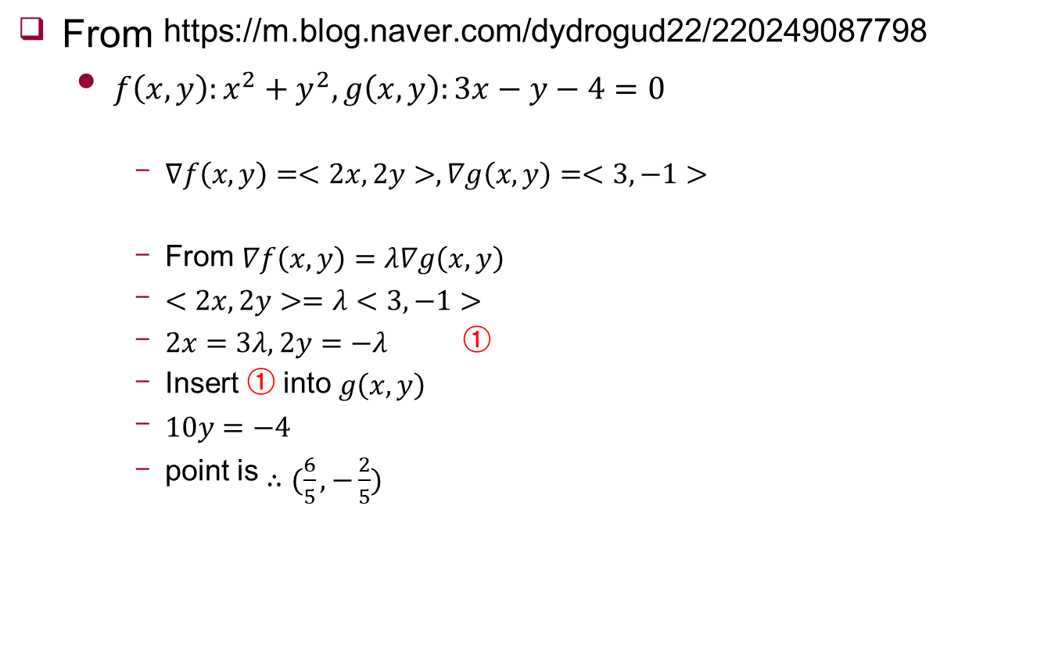
Example
From https://m.blog.naver.com/dydrogud22/220249087798
$f\left(x,y\right):x^{2}+y^{2}, g\left(x,y\right):3x−y−4=0$
$∇f\left(x,y\right)=<2x,2y>,∇g\left(x,y\right)=<3,−1>$
From $∇f\left(x,y\right)=λ∇g\left(x,y\right)$
$<2x,2y>=λ<3,−1>$
$2x=3λ, 2y=−λ$ ①
Insert ① into $g\left(x,y\right)$
$10y=−4$
point is $∴(\frac{6}{5},−\frac{2}{5})$

