Slide 1

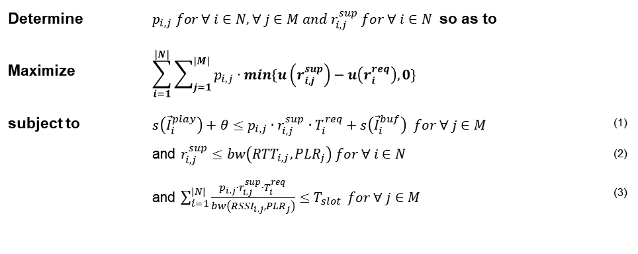

Problem
Formulation
If there are APs which can fulfill UE's request [$bw\left({RTT}_{i,j},{PLR}_{j}\right)≥r_{i}^{req}$]
Select possible AP [constraint 3] and
Select bitrate [constraint 1, 2 and $r_{i,j}^{sup}≅r_{i}^{req}$]
Others [$bw\left({RTT}_{i,j},{PLR}_{j}\right)<r_{i}^{req}$]
Check each APs(m)
Sort UE by requested bitrate ($O(n∙\log{n})$ )
Choose K UEs which have high requested bitrate
Decrease K UE’s bitrate one step until total QoE is maximized ($O(L^{K})$, $L$ is the number of bitrate level )
Estimate available bitrate [using constraint 3] and
Select bitrate [using constraint 1, 2 and $r_{i,j}^{sup}≅r_{i}^{req}$]
Change other APs (K UE) ($O(m^{K})$)
Estimate possible AP [using constraint 3] and
Select bitrate [using constraint 1, 2 and $r_{i,j}^{sup}≅r_{i}^{req}$]
Choose best case which maximizes total QoE
Consider two cases ($O(n∙m∙{(L∙m)}^{K}∙\log{n}))$
Determine | $p_{i,j} for ∀ i∈N, ∀ j∈M and r_{i,j}^{sup} for ∀ i∈N$ so as to
Maximize | $$\sum_{i=1}^{|N|}{\sum_{j=1}^{|M|}{p_{i,j}∙min\{u\left(r_{i,j}^{sup}\right)−u\left(r_{i}^{req}\right),0\}}}$$
subject to | $s\left({\vec{I}}_{i}^{play}\right)+θ≤p_{i,j}∙r_{i,j}^{sup}∙T_{i}^{req}+s\left({\vec{I}}_{i}^{buf}\right) for ∀ j∈M$ | (1)
 | and $r_{i,j}^{sup}≤bw\left({RTT}_{i,j},{PLR}_{j}\right) for ∀ i∈N$ | (2)
 | and $\sum_{i=1}^{|N|}{\frac{p_{i,j}∙r_{i,j}^{sup}∙T_{i}^{req}}{bw\left({RSSI}_{i,j},{PLR}_{j}\right)}≤T_{slot}} for ∀ j∈M$ | (3)
↓
↓
↓
↓

Slide 2
Setting
Utility function
1 * ln(request - support) + 0
Bandwidth
RSSI → PER, RTT
Random RSSI
5 UEs and 3 Aps
Random connection

Slide 3
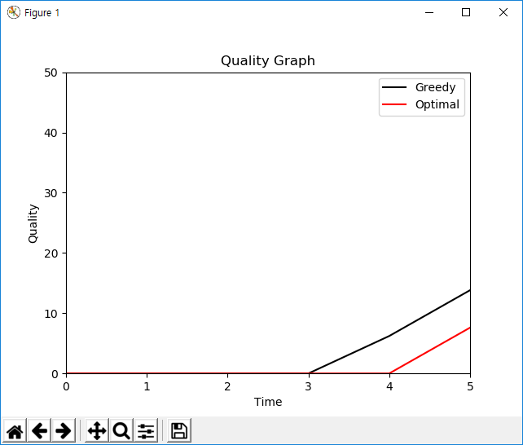
Result
5 UEs and 3 APs
G | 13.82 | 19.74 | 6.80 | 18.64 | 6.21
O | 7.60 | 13.30 | 0 | 13.21 | 6.21
T | 9.98배 | 56.06배 | 0.69배 | 8.30배 | 10.12배
G | 0 | 13.02 | 7.60 | 7.31 | 6.21
O | 0 | 7.00 | 7.60 | 7.31 | 6.21
T | 0.83배 | 9.16배 | 5.22배 | 13.67배 | 4.22배
G | 19.23 | 12.71 | 6.40 | 13.30 | 13.22
O | 20.40 | 12.71 | 0 | 6.21 | 13.22
T | 161.62배 | 50.72배 | 58.05배 | 12.58배 | 254.84배

Slide 4
Result
10 UEs and 6 Aps
Not working because of Time complexity

