Slide 1
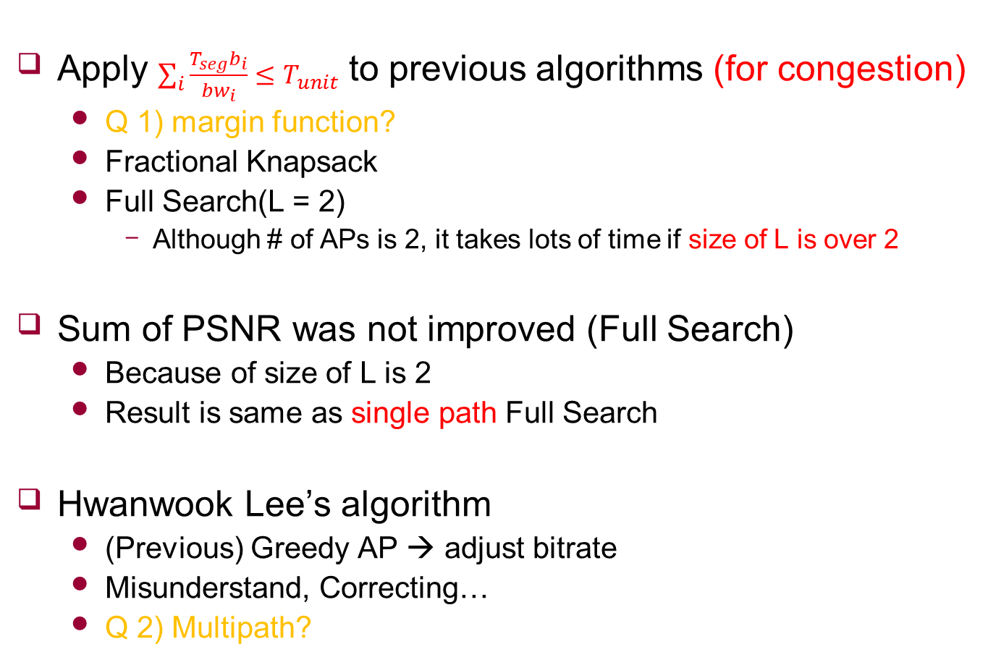
Work
Apply $\sum_{i}{\frac{T_{seg}b_{i}}{{bw}_{i}}}≤T_{unit}$ to previous algorithms (for congestion)
Q 1) margin function?
Fractional Knapsack
Full Search(L = 2)
Although # of APs is 2, it takes lots of time if size of L is over 2
Sum of PSNR was not improved (Full Search)
Because of size of L is 2
Result is same as single path Full Search
Hwanwook Lee’s algorithm
(Previous) Greedy AP → adjust bitrate
Misunderstand, Correcting…
Q 2) Multipath?

Slide 2
Feedback
C(x) function이 threshold 근처에 있어야함
MNTP 논문 참고, 무슨 문제점 있음

