Slide 1
Research Jae Jun Ha Media Computing and Networking Laboratory POSTECH 2019-07-26

Slide 2


Previous
DQN vs Random vs Optimal
Performance of DQN is not good
When check
ideal
real

Slide 3
Problem
State
State must represent simulation situation
Computer must be able to play the game only using this state
Example) bitrate, available bandwidth → timeslot
State must consist of timeslot
Too many actions
AP X Level of Bitrate

Slide 4

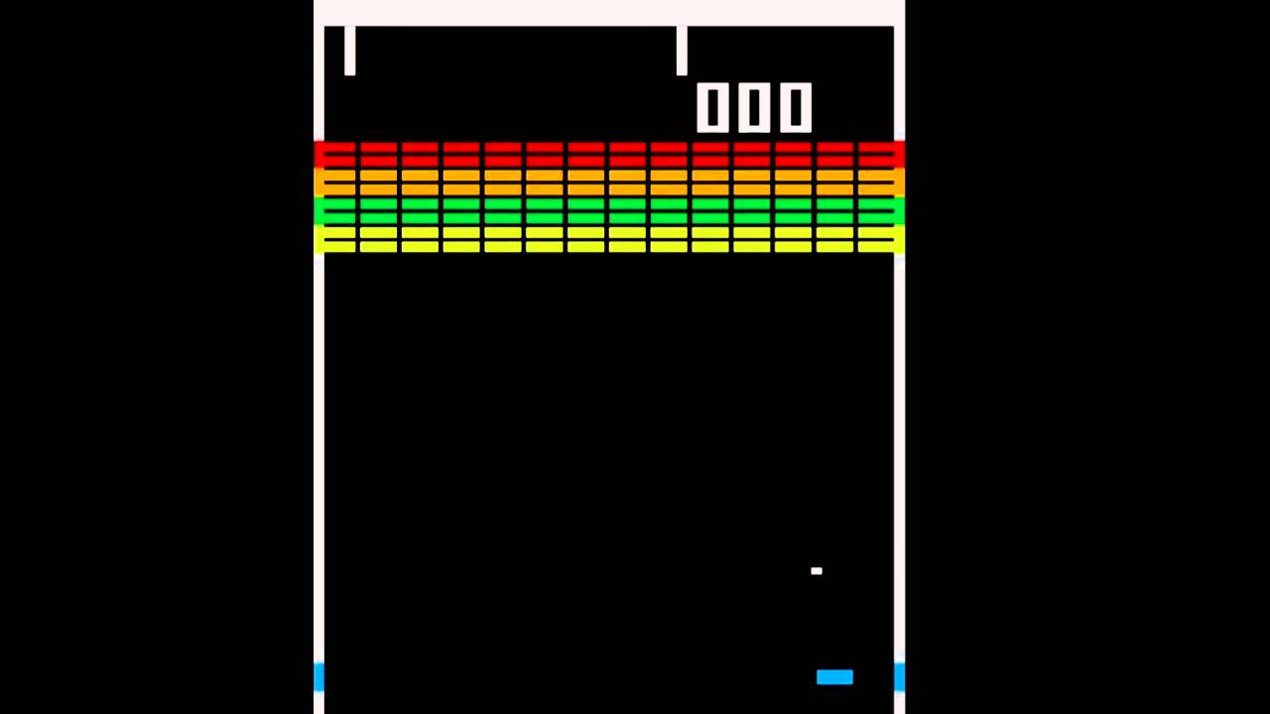
Examples
Alpha Go
여러 과정을 거쳐서 Action을 줄임
여러 프로 선수들이 플레이한 게임을 바탕으로 action을 한정
Alpha Run:
3가지: 숙이기, 가만히, 점프
Atari:
3가지: 왼쪽, 가만히, 오른쪽
< https://www.twipu.com/tag/알파런 >
< https://www.youtube.com/watch?v=AMUv8KvVt08 >
< https://www.slideshare.net/deview/ai-67608549 >

Slide 5
Process
Three stages
Stage1
Stage2
Stage3
Stage1
Best solution or not
Stage2
Grouping
Stage3
Bitrate adjustment

Slide 6
Stage1
State
Action
AP selection (assumption using request bitrate)
AP
Remain AP Timeslot
Timeslot
between UE and AP
UE

Slide 7
Stage1
Training
UE 10, AP 6, Timeslot = 1.5
bitrate = [50, 400, 800, 1200, 2000], bandwidth = N(2000, 500^2)
random action = up to 2000 episode
Episode
Random한 bandwidth와 request bitrate 생성
UE가 순차적으로 request bitrate를 가지고 action에서 얻어진 AP에 연결
Training reward
연결 성공: +1
연결 실패: -10 그리고 episode 종료
Case (per episode)
연결 실패: -10
UE 1개까지 성공: -9
UE 2개까지 성공: -8
UE 3개까지 성공: -7
UE 4개까지 성공: -6
UE 5개까지 성공: -5
UE 6개까지 성공: -4
UE 7개까지 성공: -3
UE 8개까지 성공: -2
UE 9개까지 성공: -1
UE 10개 모두 성공: +10

Slide 8
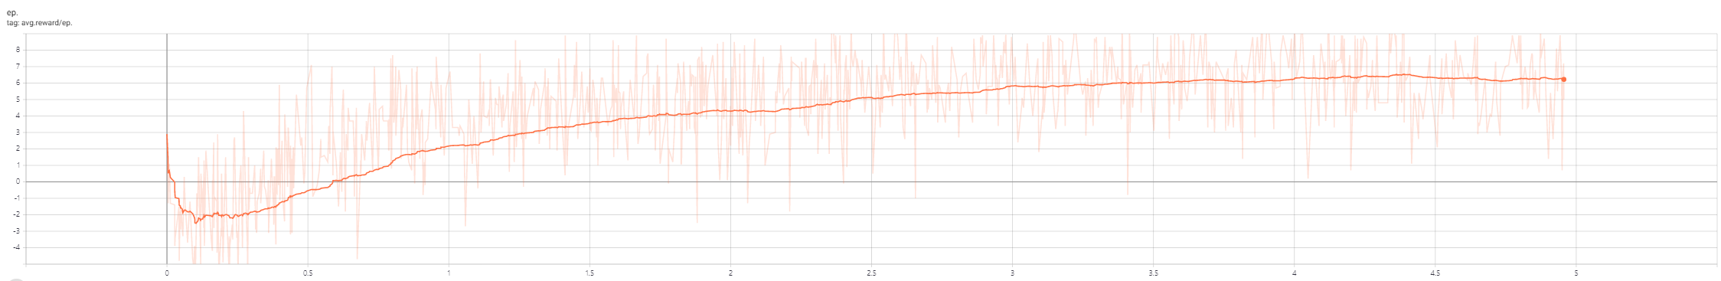
Stage1
Training
시간이 지날 수록 reward가 좋아짐
 |  |  |  |  |  |  |  |  |  | Training | 50K
Success | 0 | 1 | 2 | 3 | 4 | 5 | 6 | 7 | 8 | 9 | 10
Percent | 3% | 10% | 18% | 14% | 10% | 6% | 20% | 10% | 6% | 8% | 38%
 |  |  |  |  |  |  |  |  |  | Training | 1.742M
Success | 0 | 1 | 2 | 3 | 4 | 5 | 6 | 7 | 8 | 9 | 10
Percent | 0% | 0% | 1% | 2% | 3% | 2% | 1% | 3% | 8% | 5% | 76%

Slide 9
Summary
Three stages
Stage1
Stage2
Stage3
Stage2 ➔ DQN
Stage3 ➔ DQN or Greedy
 |  |  |  |  |  |  |  |  |  | Training | 1.742M
Success | 0 | 1 | 2 | 3 | 4 | 5 | 6 | 7 | 8 | 9 | 10
Percent | 0% | 0% | 1% | 2% | 3% | 2% | 1% | 3% | 8% | 5% | 76%

